Slide 1
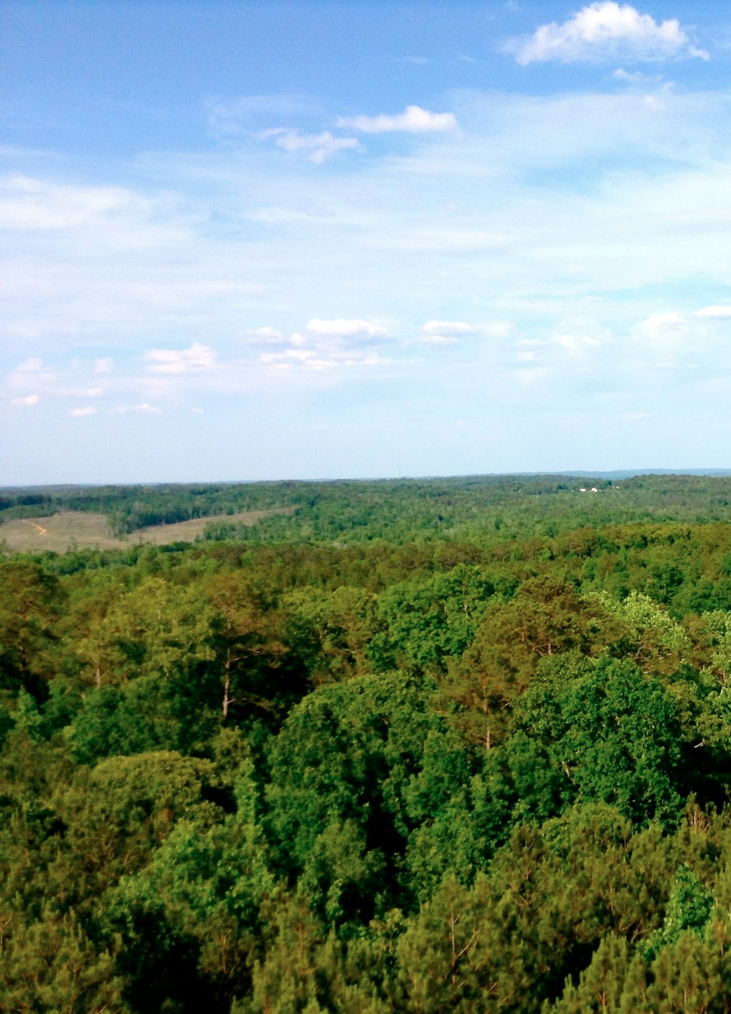




Regional and temporal trends in semi-empirical estimates of aerosol water concentration in the continental U.S.
Thien Khoi V. Nguyen¹
Annmarie G. Carlton¹
Shannon L. Capps²
¹ Rutgers University
² U.S. Environmental Protection Agency through Oak Ridge Institute for Science and Education
CMAS 2014 Annual Conference
R835041

Slide 2
Introduction & Motivation
Aerosol water
Condenses onto existing aerosol particles as f(RH, T, aerosol and gas phase concentration & composition)
Why is aerosol water important?
Atmospheric aqueous chemistry (partitioning medium)
Visibility impairment
Influences climate
What are the regional & temporal trends in aerosol water?

Slide 3
Model Description
Inorganic aerosol thermodynamics model ISORROPIA v2.1 (Nenes et al., 1998, Fountoukis and Nenes, 2007)
Assumes a NH₄-SO₄-NO₃ metastable system
Provides low boundary for water content

Slide 4
Southeastern U.S.
Southeastern Aerosol Research and Characterization (SEARCH)
Why Southeastern U.S.?
Recent Southern Oxidant and Aerosol Study (SOAS) & other SAS field campaigns
Biogenic carbon and anthropogenic pollutants combine to form a cooling haze over the southeastern United States (Goldstein et al., 2009)
Liquid water dominant aerosol constituent in the Eastern US (Carlton and Turpin, 2013)
SEARCH network monitored by the Atmospheric Research & Analysis, Inc. (ARA) (Hansen et al. 2003; Edgerton et al. 2005, 2006)
Years: 2001-2010

Slide 5
Trends
~70% decrease in overall water
Average water concentrations at CTR in 2013: 4 µg m⁻³
(Nguyen et al., 2014)

Slide 6
Urban vs. Rural
Temperature
RH
ºC
Sulfate
Nitrate
µg m⁻³
µg m⁻³

Slide 7
Monthly Trends by RH
  Water content decreases after ~2006
  Ultra-low S fuel introduced late 2006/early 2007
  May-Oct: most noticeable decrease in water concentrations
---
__
Data screened for forest fires:
[CO] > 700 ppb
Raw data

Slide 8
Trends

Slide 9
Trends
[Organic aerosol] ↓ in S.E. US (Blanchard et al., 2013)

Slide 10
Discussion
[Organic aerosol] ↓ in S.E. U.S. Why?

Slide 11
Discussion
[Organic aerosol] ↓ in S.E. U.S. Why?
Possible Reasons:
Anthropogenic [VOCs] ↓
Primary non-fossil [OC] ↓
Temperature ↑
Acidity effects
[Aerosol water] ↓
…

Slide 12
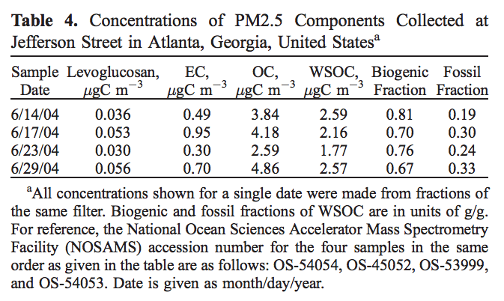
Modern vs. Fossil Carbon
[Organic aerosol] ↓ in S.E. U.S. Why?
Anthropogenic [VOCs] ↓?
Not main driving factor, SE SOA is primarily biogenic, even in urban areas (Weber et al., 2007; Lewis et al., 2004; Lemire et al., 2002)
Weber et al., 2007

Slide 13
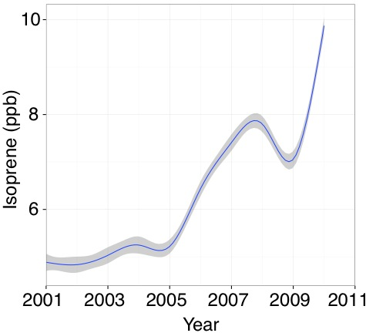
Biogenic OC
[Organic aerosol] ↓ in S.E. U.S. Why?
Primary non-fossil [OC] ↓?
No, forest fires have been increasing (NIFC, 2008) and presumably fire-related [OC] (Park et al., 2003)
No, ambient [isoprene] ↑ → index for primary biogenic OC emissions
Photochemical Assessment Monitoring Stations (PAMS) in SEARCH states

Slide 14
Temperature effects
[Organic aerosol] ↓ in S.E. U.S. Why?
Temperature ↑?
No, although compounds may vaporize at high temperatures, temperatures have been decreasing

Slide 15
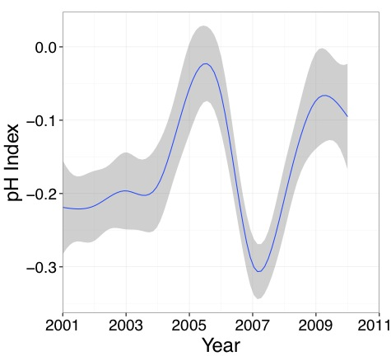
Acidity effects
[Organic aerosol] ↓ in S.E. U.S. Why?
Acidity effects? Unclear.
Isoprene epoxydiol (IEPOX) chemistry activated by H⁺ transfer from strong acid and nucleophilic addition; enhanced in the presence of acidified sulfate seed aerosol; chemical system is nucleophile-limited (Surratt et al., 2010, Nguyen et al., 2014)
Use ion-charge balance to calculate an index for acidity
pH index = - log ((1000 * H⁺)/(V_{w,i}+V_{w,o}))
H⁺ = (2*SO₄/96+NO₃/62-NH₄/18)
For V_{w,o}, κ_{org} ~ 0.1
Correlation with OC trends:
R²: 0.08, p-value: 0.44
Notes:
Nguyen et al., 2014: weak correlations between IEPOX-derived OA and particle acidity

Slide 16
Aerosol water
[Organic aerosol] ↓ in S.E. U.S. Why?
[Aerosol water] ↓? Yes. Medium to partition polar, water-soluble gas phase organic species (Asa-Awuku et al., 2010, Prisle et al., 2010, Carlton and Turpin, 2013)
Water vs. time: R² = 0.69, p-value = 0.0029
Water fraction vs. time: R² = 0.52, p-value = 0.0019
Water trend vs. Organic trend: R² = 0.70, p-value = 0.0026

Slide 17
Trends
[Organic aerosol] ↓ in S.E. U.S. Why?
Anthropogenic [VOCs] ↓ Not main driving factor
Primary non-fossil [OC] ↓ No
Temperature ↑ No
Acidity effects Uncertain
[Aerosol water] ↓ Yes
…

Slide 18
What about the rest of the world?

Slide 19
July 2003 average
July 2003 average, CMAQv4.7 using ISORROPIA
Adapted from Carlton and Turpin, 2013
Simulation details in Carlton et al., 2010
Notes:
OC EC classification same as NEI

Slide 20
Regional comparison for 2003
Meteorological & modeled inorganic ion data from Carlton et al., 2010
ISORROPIA v2.1

Slide 21
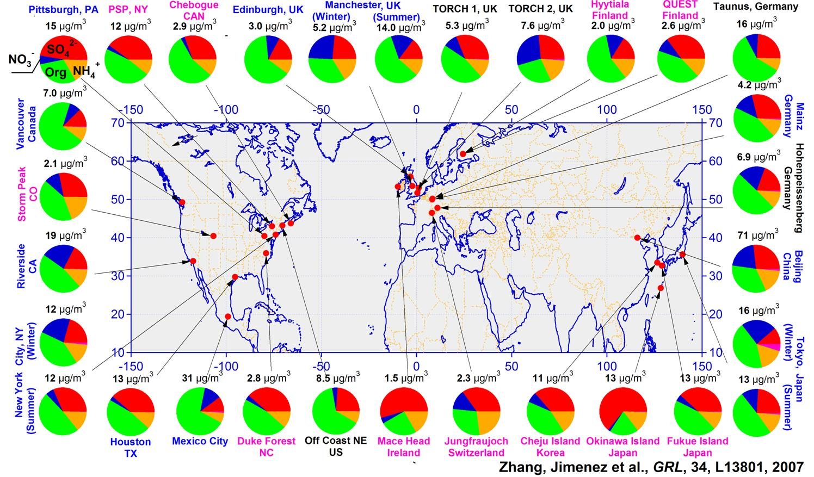
Zhang et al., 2007
Ubiquity and dominance of oxygenated species in organic aerosols in anthropogenically‐influenced Northern Hemisphere mid-latitudes
Notes:
Location of the AMS datasets analyzed here (data shown in Table S1 in the auxiliary material). Colors for the study labels indicate the type of sampling location: urban areas (blue), <100 miles downwind of major cites (black), and rural/remote areas >100 miles downwind (pink). Pie charts show the average mass concentration and chemical composition: organics (green), sulfate (red), nitrate (blue), ammonium (orange), and chloride (purple), of NR‐PM₁.

Slide 22
World comparison
Using avg T & RH data from 2014 summer solstice & AMS data (Zhang et al., 2007)
µg m⁻³
Water
1.4
0.2
6.4
2.3
1.5
0.9
5.8
3.6
37.5
3.1
9.1
16.8
1.7
0.7
8.0
0.3
1.0
7.2
ISORROPIA v2.1
Notes:
Lots of water in Pittsburgh
Mace Head – sulfate from US and DMS
Vancouver – humid but lots of organics
More aerosol water in Mexico City, i.e. than Mace Head despite fractions

Slide 23
Conclusions
  Aerosol water in the SE US
    Decreased by ~70% between 2001-2010, possibly due to improvements in emissions
    Most noticeable decrease in water concentrations: after 2006 and between May and October
    Rural water > urban water
  Organic aerosols in the SE US
    Decreasing organic aerosol trends are consistent with decreasing trends in aerosol water; acidity effects unclear
  Aerosol water elsewhere
    Lots of water in NE, SE, and Midwest, but not much in Central, West, or West Pacific
    High water concentrations in places with high levels of sulfate (e.g., Beijing, Pittsburgh)

Slide 24




Acknowledgements
Atmospheric Research and Analysis, Inc.
Environmental Protection Agency
National Science Foundation: AGS-1242155
U.S. Department of Education
Carlton group at Rutgers
Barbara Turpin & group
Eric Edgerton, ARA
R835041
Although this presentation has been reviewed by EPA and approved for presentation, it does not necessarily reflect official EPA agency views or policies.

Slide 25
EXTRA SLIDES

Slide 26
IMPROVE Sites
Notes:
OC EC classification same as NEI

Slide 27
Isoprene PAMS sites

Slide 28
Water uptake by organics
In laboratory studies, organic compounds ubiquitous in the troposphere (e.g., methylglyoxal and acetaldehyde) increase particle hygroscopicity (Sareen et al., 2013)
Adapted from
Petters and Kreidenweis, 2007
κ_{org} ~ 0.01-0.2

Slide 29
Model comparison for SOAS
ISORROPIA SMPS
Water (µg m⁻³)
RH < 99%
Hours past midnight
ISORROPIA ran with SEARCH
ion and met data
SMPS hygroscopicity data from Nguyen et al., 2014
adjusted to SEARCH RH using P&K eqn.

Slide 31
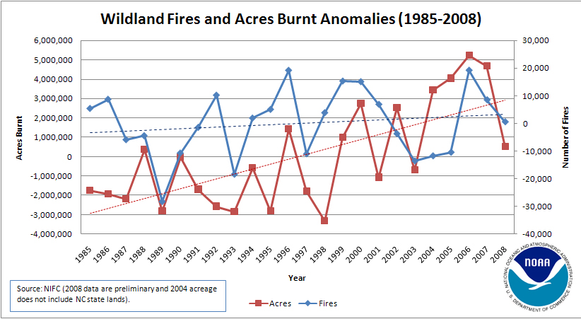
Notes:
http://www.ncdc.noaa.gov/img/climate/research/2008/dec/fire/fire-anom-annual-2008-pg.jpg

