Slide 1
A Web-based Community Approach to Model Evaluation using AMET
Saravanan Arunachalam¹, Nathan Rice² and Pradeepa Vennam¹
¹Institute for the Environment
²ITS Research Computing Services
The University of North Carolina at Chapel Hill
Presented at the
13th Annual CMAS Users Conference, Chapel Hill
October 27 – 29, 2014

Slide 2
Acknowledgements
U.S. EPA for providing AMET v1.2 and Observations from U.S. networks
FAA under PARTNER - a U.S. DOT Center of Excellence for partly sponsoring this work

Slide 3
Motivation
Confidence needed in model outputs before they can be used to make policy
Both models and ambient datasets have grown in complexity
CMAS user community has grown and we have 1000’s of users who can run the CMAQ model
Tools needed to assist user community to evaluate, assess and interpret model performance
Atmospheric Model Evaluation Tool (AMET) released by EPA/CMAS in Feb 2008
Since then, only ~13% of CMAQ users have downloaded AMET
Fairly steep learning curve to be able to install and use the tool

Slide 4
Objective
Enhance AMET with a web-based front-end to assist users
Provide common infrastructure for multiple users to perform model evaluation
Share “processed” ambient datasets
Easily switch between model scenarios
Compare performance across model iterations
Leverage expertise in community

Slide 5
Observational Datasets
AIRS (hourly) (~4000)
IMPROVE (every 3rd day) (~160)
CASTNET (hourly, weekly) (123)
NADP (weekly) (over 200)
EPA CSN (daily, every 6th day) (~225)
EPA Supersites (sub-hourly) (8)
EPA CSN (daily, every 6th day) (~225)
AERONET
Special field campaigns
e.g. AIRMAP, ASACA, BRAVO, CCOS, CRPAQS,, SEARCH, SOS, TXAQS, etc.
Aircraft Data
Remote Sensing Data
MODIS AOD from Aqua, Terra; O₃, NH₃ from Aqua’s TES; NO₂ from OMI, etc.

Slide 6
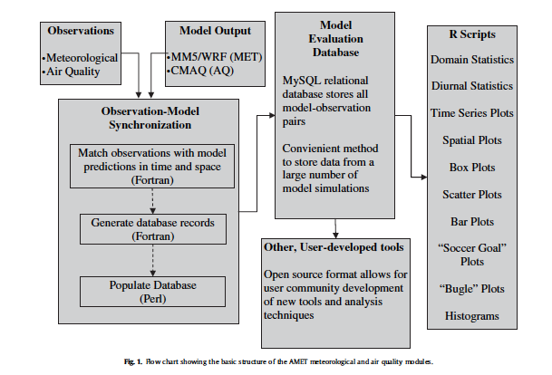
AMET Approach
Source: Appel et al, Env. Mod. Software, 2011

Slide 7
Software Tools: AMET on the Web
AMET v1.2 (Released via CMAS in July 2013)
Uses MySQL, R and perl
JavaScript, JQuery and Angular JS
Python and Flask (web application framework written in Python)
Google Maps

Slide 8
Approach 1: AMET Form

Slide 9
AMET Form
Interactive approach to evaluating CMAQ
Can perform custom analyses for user-defined set of networks, pollutants, time-periods, metrics
Uses canned AMET v1.2 scripts
Obs data stored on backend, but user needs to upload model-data, as “combine” outputs, via the web browser
Uses Forms to get user inputs to create AMET config files
AMET v1.2 scripts on back-end use the config files to perform analyses
Output files (plots, tables and logs) displayed on web browser

Slide 10
AMET Form
Pros
Relies on off-line AMET v1.2 scripts, hence consistent and full functionality
GUI to choose network/pollutant/type of analyses
Interface to review all analyses products and logs
Can obtain paired CSVs as outputs for use in other software (!)
Cons
Relies on off-line AMET v1.2 scripts
Software dependencies in current AMET structure still remain
Error messages not intuitive
Current design limits file sizes of model outputs to 2 GB
~10 days of “combine” outputs for ConUS domain
148 Cols x 112 Rows x 134 Species x 240 hours
After finishing one set of plots, for any revised of plots, project name needs to be changed

Slide 11
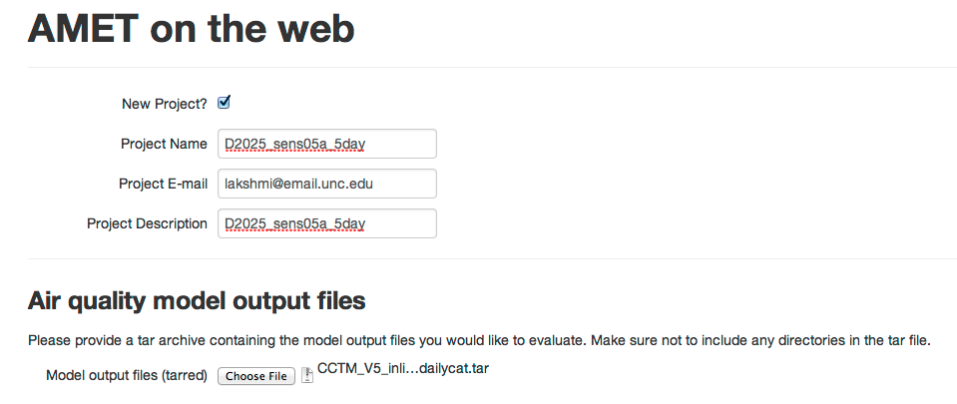

Slide 12
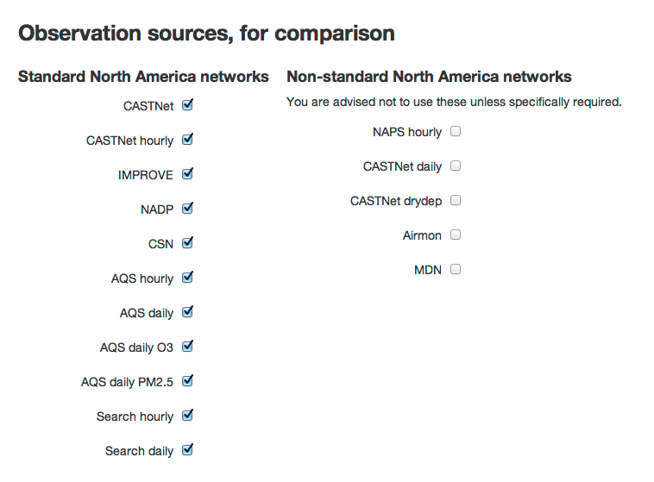

Slide 13
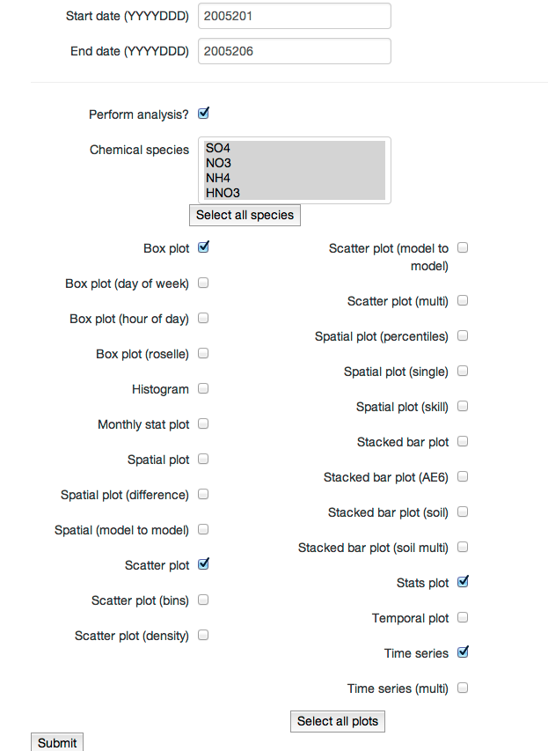

Slide 14
Approach 2: AMET Map

Slide 15
AMET Map
Interactive approach to evaluating CMAQ
Can perform custom analyses for user-defined set of networks, pollutants, time-periods, metrics
Uses pre-loaded obs-model data pairs based on “combine” outputs
Can easily repeat same analyses for multiple model iterations
Uses Map interface for user inputs
Does not use AMET v1.2 scripts for plots and analyses

Slide 16
AMET Map
Pros
Once obs-model pairs of multiple model iterations are paired and stored, AMET Map has immediate access to perform analyses
Paired data of observations and any AQM is supported
Map interface to select individual site(s) to assess model performance
After species is selected, only relevant networks are shown
Cons
Remote users need to have access to MySQL server on backend to be able to load obs-model pairs
Not all of current AMET v1.2 functionality is provided

Slide 17
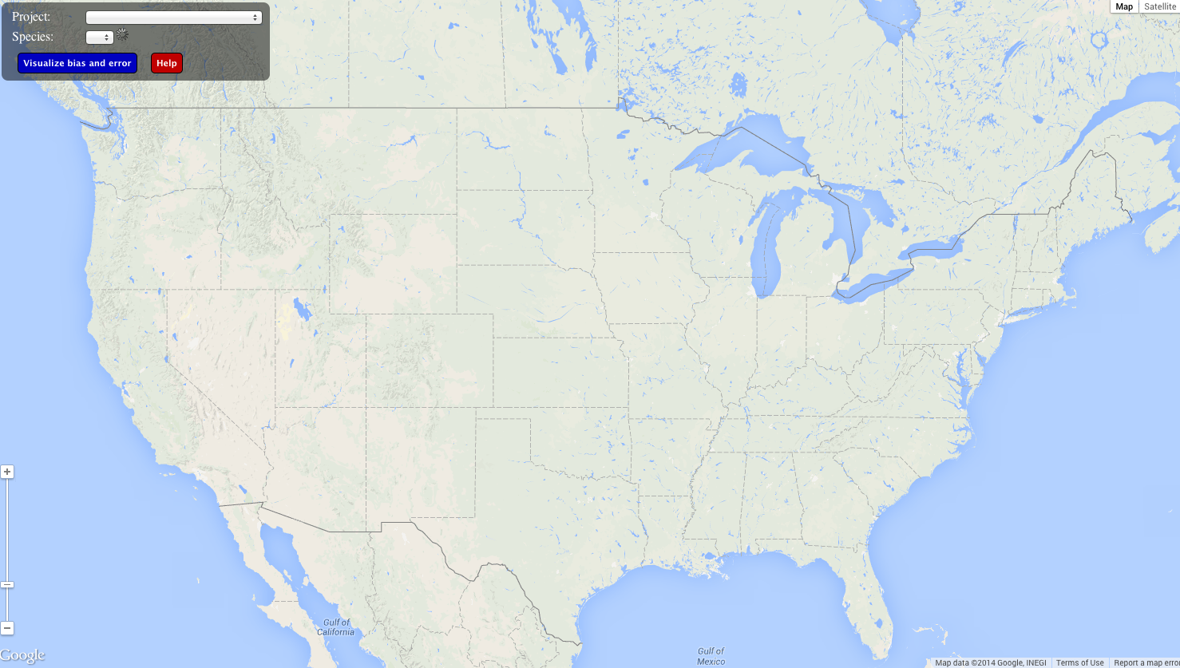

Slide 18
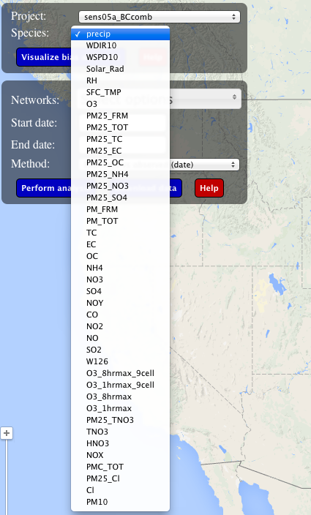
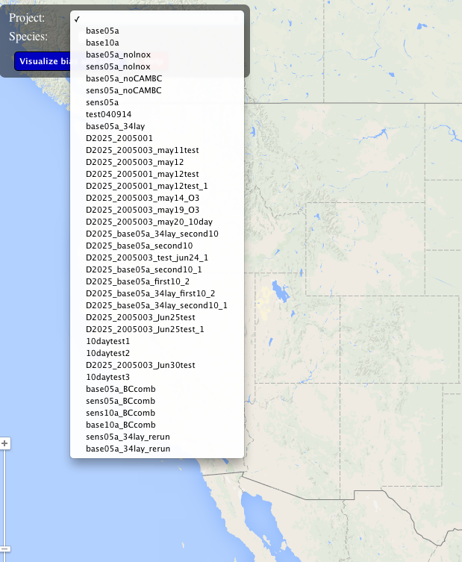

Slide 19
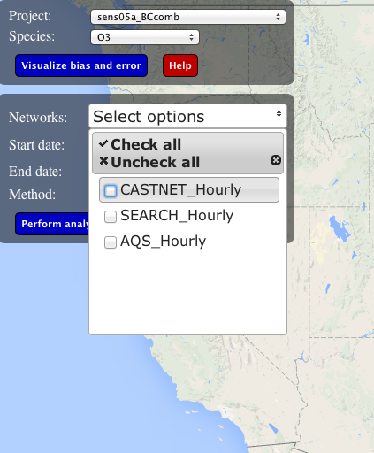
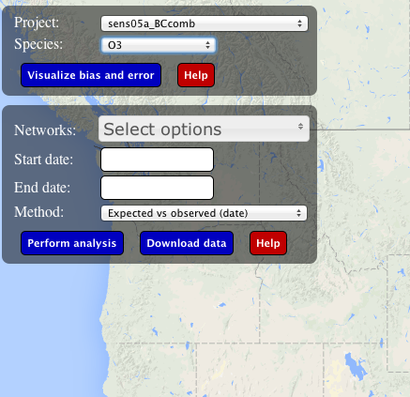
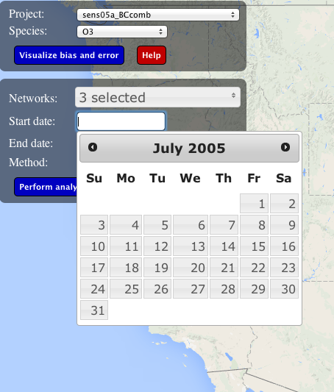

Slide 20
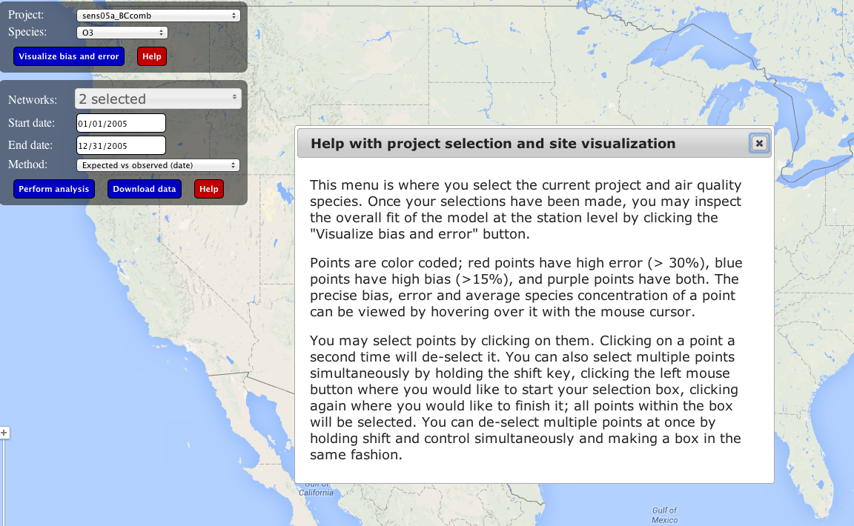
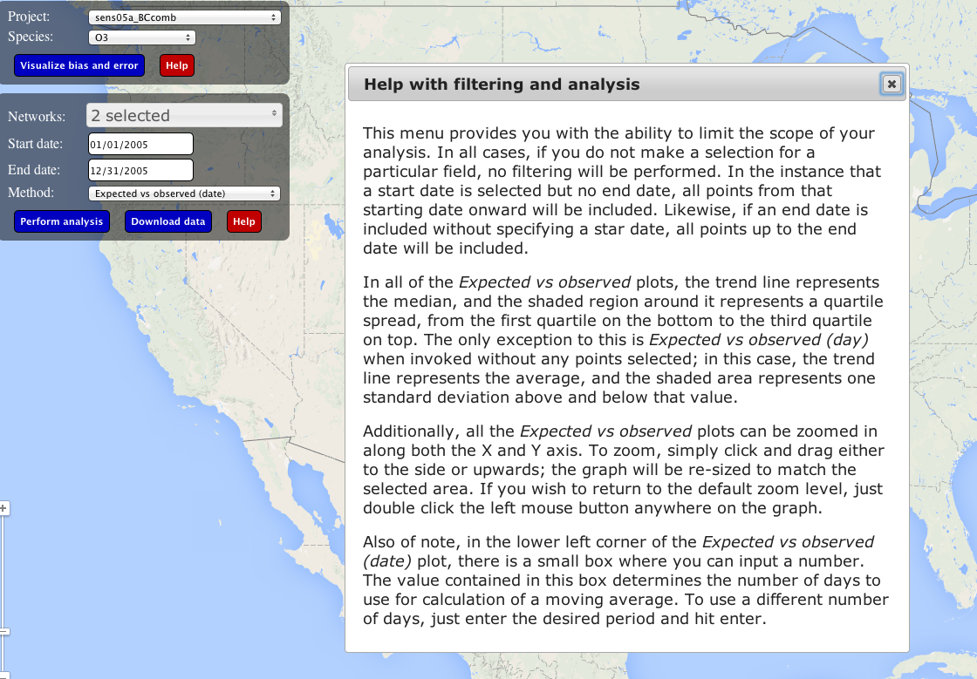

Slide 21
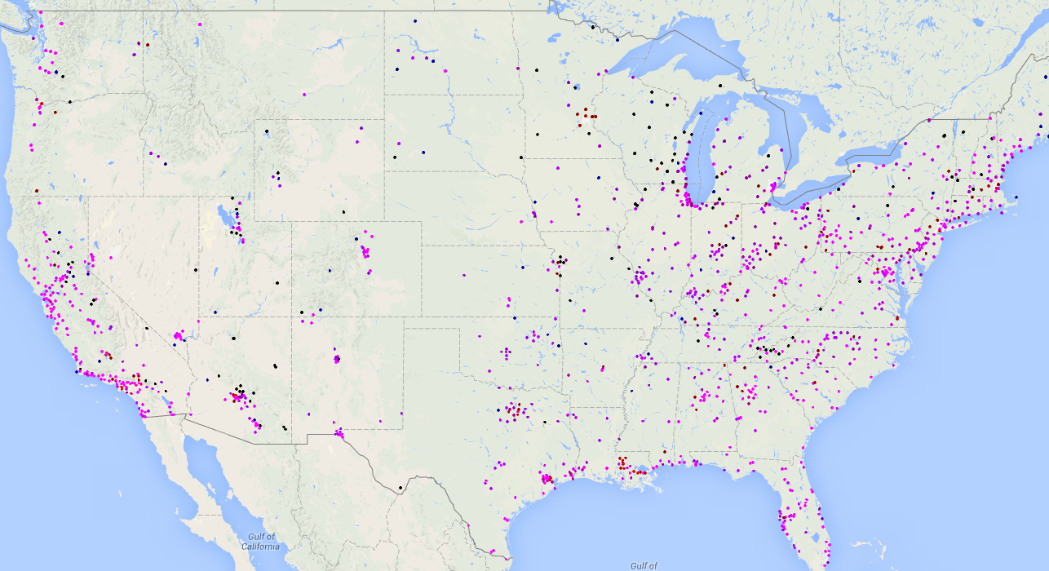
Visualize bias and error

Slide 22
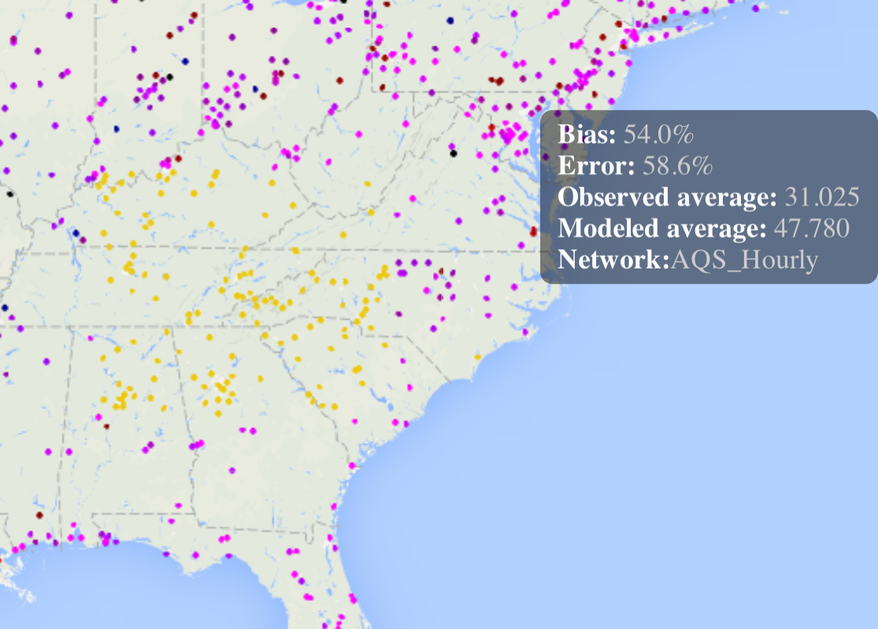
Explore performance at individual (or subset of) sites

Slide 23
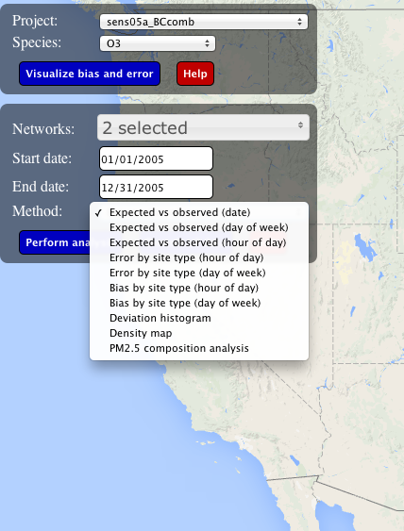

Slide 24
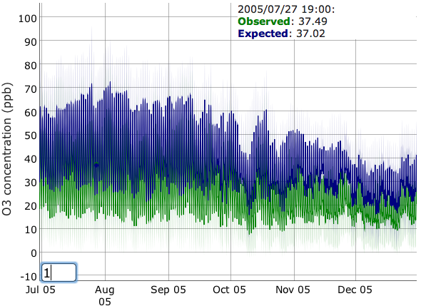
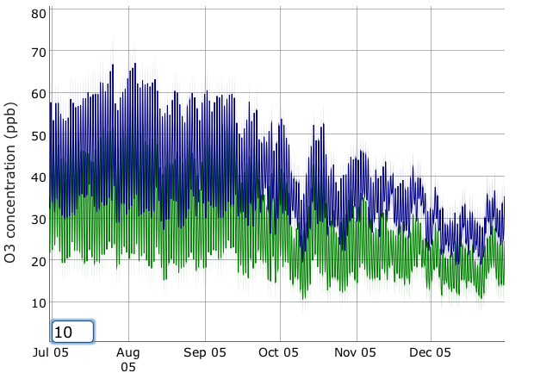
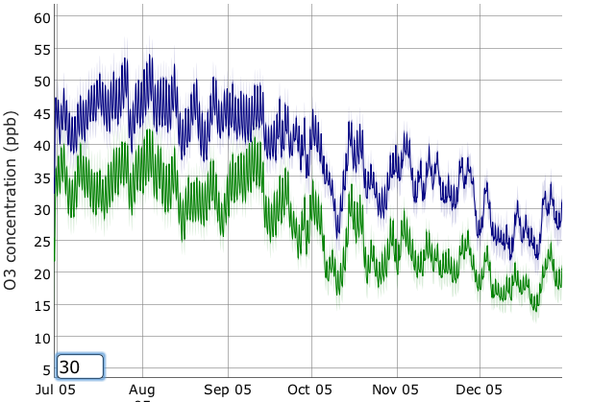
Expected vs. observed concentration by Date
Timestep for Moving average

Slide 25
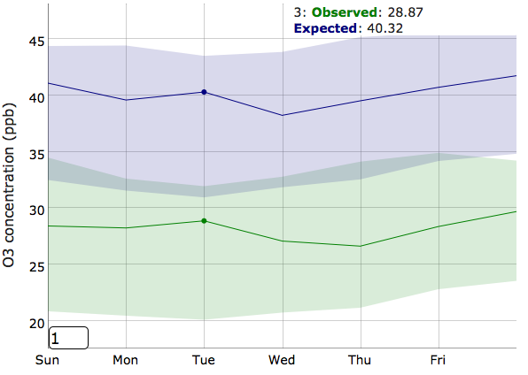
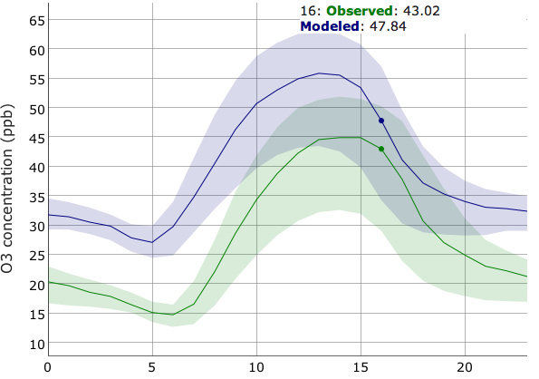
Expected vs. observed concentrations
By Day of the Week
By Hour of the Day

Slide 26
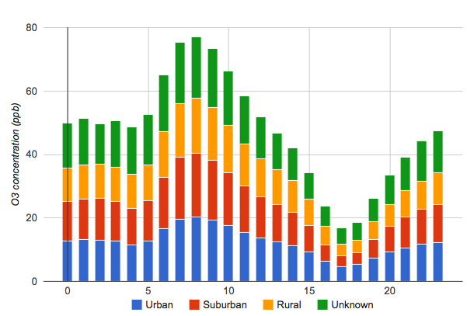
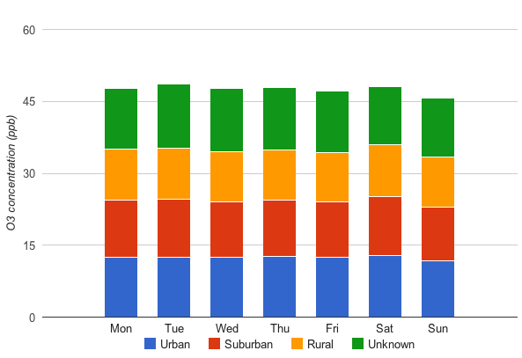
Bias by Site Type
and by Hour of the Day
and by Day of the Week
Site Type: Uses EPA’s Designations for “Location Settings” for AQS Sites

Slide 27
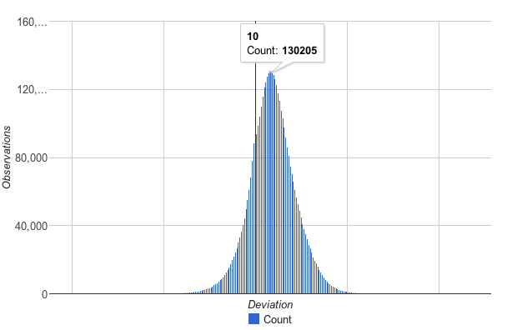
Histogram of deviations from expected value

Slide 28
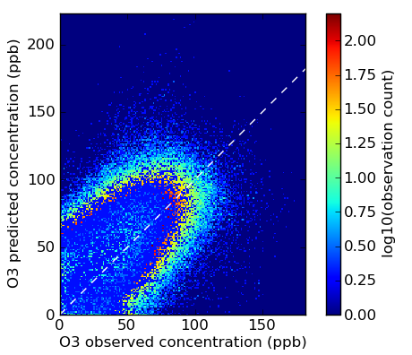
Density Map

Slide 29
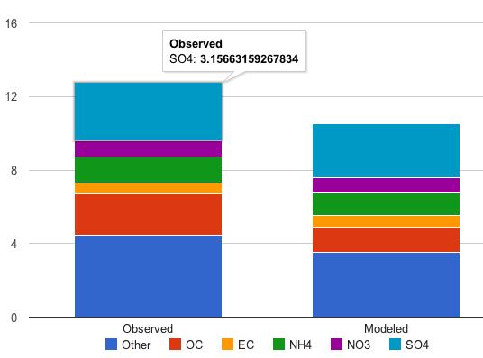
PM_{2.5} Composition Analysis

Slide 30
Next Steps
Complete “stress-testing” of both systems
Enable access to larger size datasets via AMET Form
Improve error reporting to make systems user-friendly
Expand scope to include
Meteorological model evaluation
Simultaneous analyses of emissions, meteorology and AQ

Slide 31
Challenges
Moving this from from prototype to production version will take additional work
Computing resource needs for AMET Form and AMET Map will grow very fast to support community needs
Creating acceptable use policy for AMET Map and AMET Form
Explore creating “packages” of these that can be distributed for users to install locally?

