Slide 1



Modeled Trends in Impacts of Landing and Takeoff Aircraft Emissions on Surface Air-Quality in U.S for 2005, 2010 and 2018
Lakshmi Pradeepa Vennam¹, Saravanan Arunachalam¹, Jared Bowden¹, B.H Baek¹, Mohammad Omary¹, William Vizuete¹, Seth Olsen²
¹University of North Carolina, Chapel Hill, NC
²formerly @ University of Illinois at Urbana-Champaign, IL

Slide 2
Background and Motivation
Aircraft emits CO, NO_{x}, SO₂, VOCs and Particulate Matter; aviation NOx can contribute about ~0.5% to overall US anthropogenic NO_{x} and 5-7% in some counties (Fulton county, Atlanta)
Landing and Takeoff (LTO) emissions comprise of emissions from idle, taxi, take-off, climb-out and landing activity phases. ~150 airports exists in non-attainment area in US (Ratliff et al., FAA-PARTNER report, 2009).
LTO emissions from large airports can have 28-35% of PM_{2.5} impacts occurring 300km away from the airports due to the secondary aerosol formation (Arunachalam et al., AE, 2011).
Aviation-attributable health impacts due to PM_{2.5} will be ~6x in 2025 compared to 2005 (Woody et al., AE, 2011; Levy et al, 2012).
Limited studies considered all US airports LTO emissions to study their impacts and prior studies stressed the need to study LTO impacts both in terms of health risks and policy.
Notes:
Like any other automobiles, aircraft emits suite of pollutants, if you are wondering how much these aircraft emissions can contribute to anthropogenic source, for example avi.NOx can contribute ……which is very less when we look at the whole domain but it can contribute even 5-7% in some counties that are closer to bigger airports. And landing and take off emissions are the major aircraft emissions that occur near surface and in vicinity of airports, which comprises…… There are few studies that looked at these emissions and their findings motivated us to look into this impact of LTO emissions on surface air quality topic a little bit further more. We went one step a ahead and considered all US airports.

Slide 3
Objective
FAA’s Aspirational Goal: Achieve an absolute reduction in aviation emissions induced “significant health impacts”
Develop comprehensive modeling framework to assess year-over-year AQ and health impacts of aviation emissions
  On National basis (This presentation) and
  Airport-by-Airport basis (See Boone et al, CMAS 2014 Poster)
Understand how the background emissions (non-aviation) change the aviation impacts on surface AQ
Notes:
To understand what mitigation strategies should be taken to reach FAA’s goal. Collaborating with BU for risk assessment. in order to attain that goal we developed.
Finally we are also trying to understand

Slide 4
Methodology
Notes:
The domain resolution used for this regional scale modeling is 36km. For background emissions we used NEI v2 inventory. AEDT- Aviation environmental design tool , a chorded emission inventory [Wilkerson et al., 2010, Olsen et al., 2012] that consists of fuel burn data and emission values for all individual flights throughout the world for different aircraft engines, so in our study we considered emissions from every flight that take off and land in US for 2005 and 2010 years.

Slide 5
Emission Analysis
NEI Emissions
AEDT aircraft Emissions
Lightning Emissions
Notes:
As we are conducting multiple year simulations we looked at all three emission inputs to understand how much they are varying among our modeling years and how much they are contributing

Slide 6
Emission comparison
Aircraft emissions domain totals for annual years
Both background and aircraft emissions decreased from 2005 to 2010, but the contribution of aviation to total emissions is still higher in 2010.
Notes:
Here in first left hand figure I am showing change in domain wide emissions from 2005 to 2010, which showed decrease in the case of both aviation and non-aviation, except in the case of NH3 where we are seeing increase of those emissions in 2010. In the case of CO, there was error in aviation emissions due to inconsistent fleet used in 2005 and 2010 which is being rectified for our next round of model runs.

Slide 7
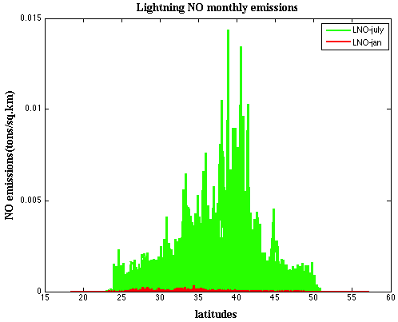
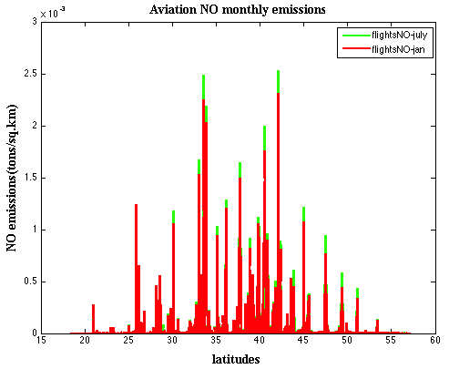
Lightning Emissions
Lightning emissions show strong seasonal trend and very high particularly during summer months.
Notes:
Lightning NOx as it is one other natural emission source that has emissions varying four dimensionally similar to aircraft emissions.
We are using the lightning NOx update in CMAQv5.0. The new inline LNOx approach takes National Lightning Detection Network (NLDN) [Cummins and Murphy, 2009] flash counts and convective precipitation variable from meteorology data to allocate lightning NO emissions spatially and vertically. We also modified the code such that the vertical allocation was done based on met layers instead of emission layers. Here at the bottom I am showing a latitude plot of lightning and aviation NOx.

Slide 8
CMAQ US-wide modeling
Model Evaluation (Surface & in-situ aircraft observations)
Aviation Impacts
Notes:
Before looking into aviation contributions we performed extensive model evaluation using both surface and in-situ aircraft observations.

Slide 9
Model Evaluation (Surface Observations)
2005
2010
O₃
PM_{2.5}
For both 2005 and 2010, O₃ normalized mean bias (NMB) -20 to +60 % (similar model performance). For PM_{2.5}, model underpredicts in 2005 and overpredicts in 2010 (differences in inorganic aerosols).
Notes:
Here I am showing O3 and PM2.5 spatial normalized mean bias plots. In the case of PM2.5, we are seeing underprediction in 2005 but overprediction in 2010 particularly near eastern US, to understand this we looked individual aerosol species model performance from other networks like CSN, Castnet and SEARCH and observed that both nitrate and sulfate aerosols are slightly overpredicted in 2010.

Slide 10
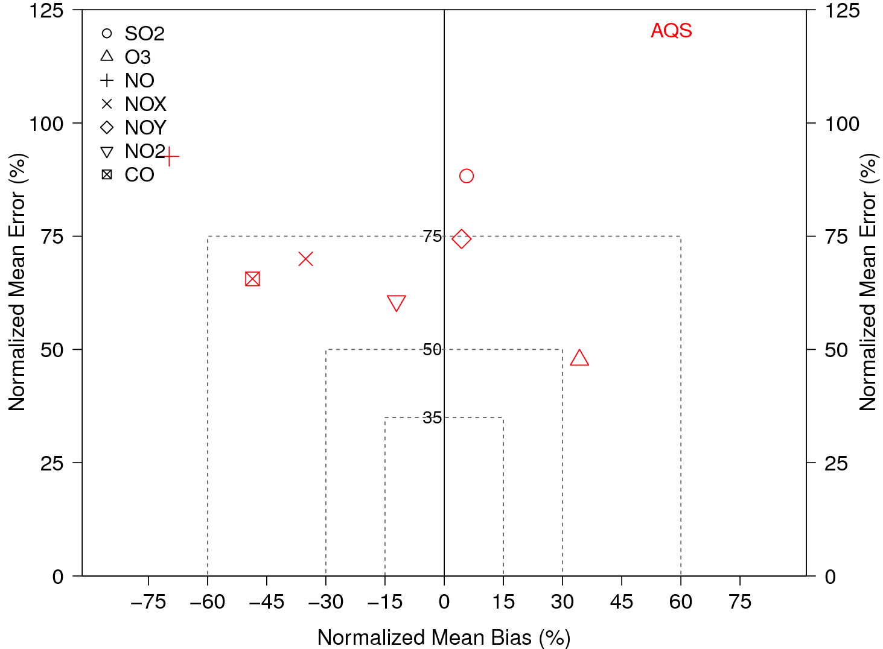
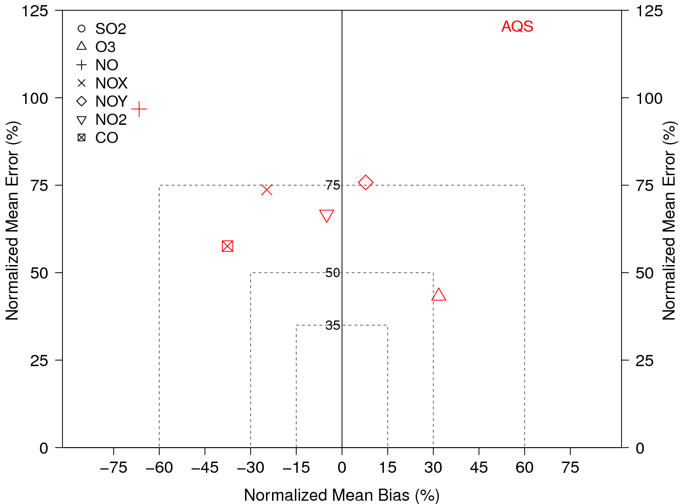
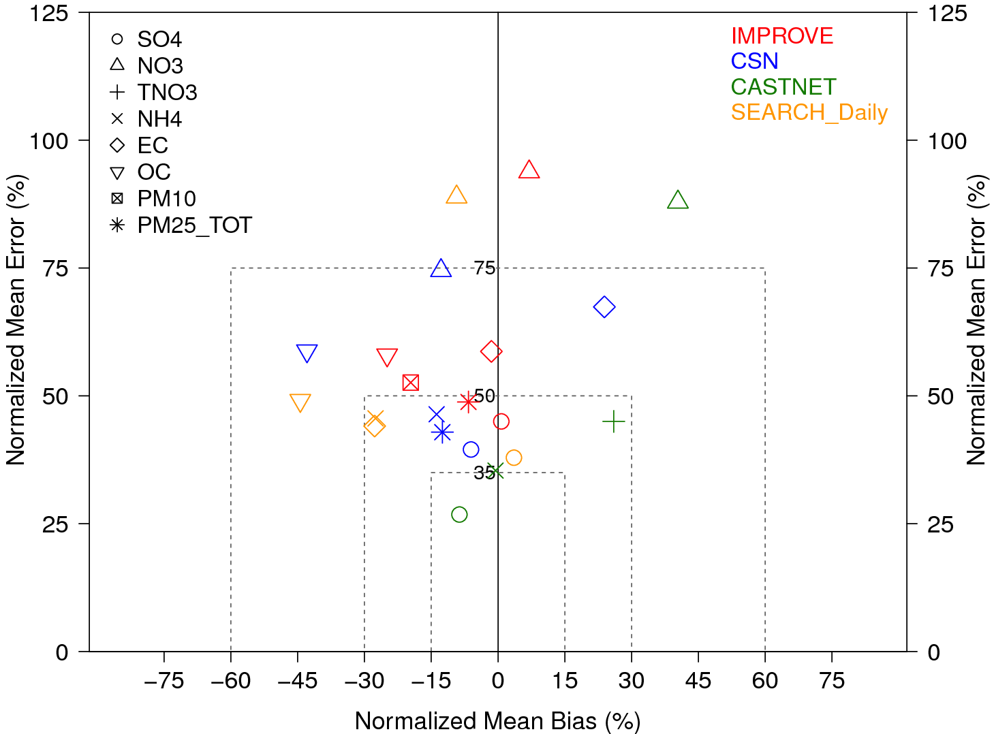
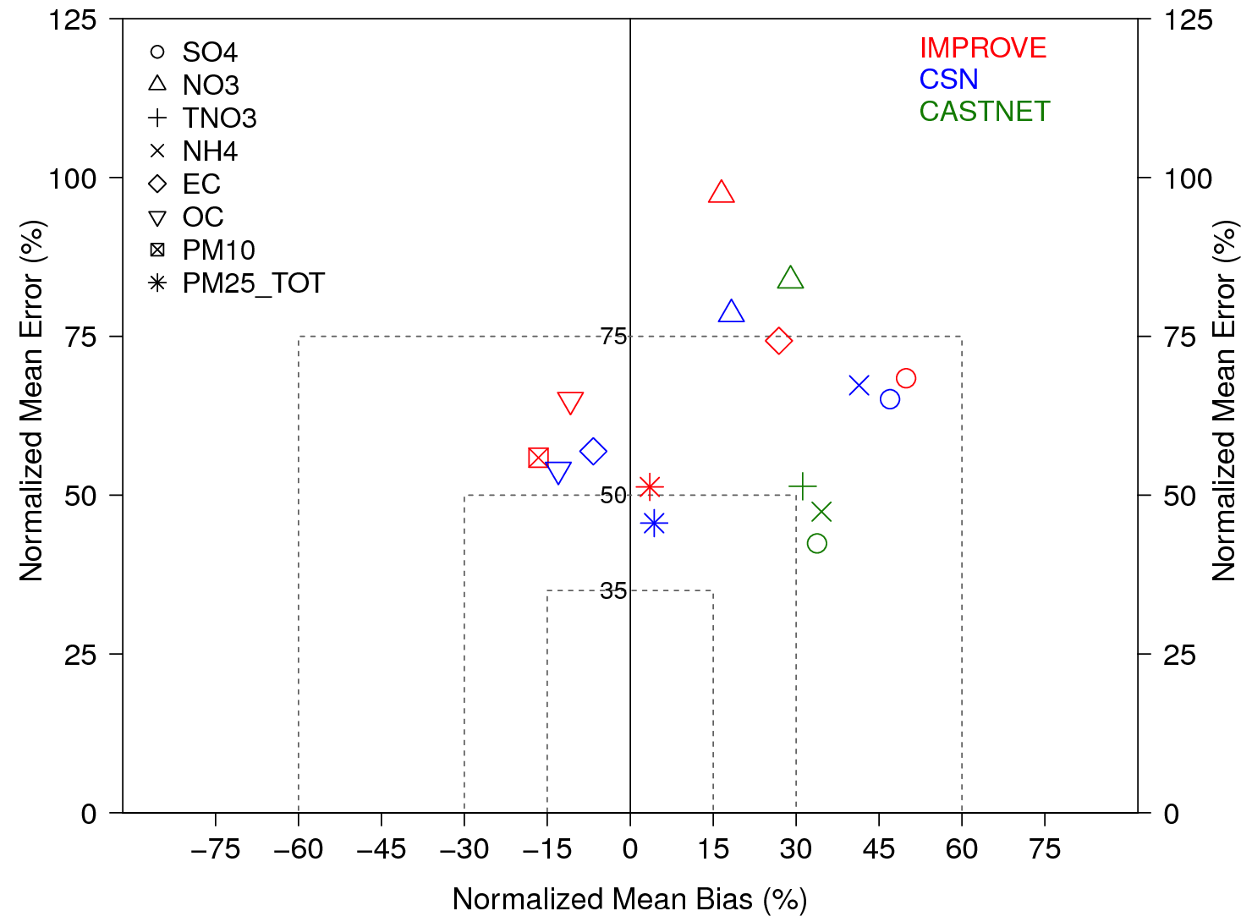
Model Evaluation (Surface Observations)
2005
2010
Gas
Aerosol
Between 2005 and 2010, overall similar model performance in case of gas species but differences exist in aerosol species.
Notes:
Here I am showing gas and aerosol species soccer plots for both 2005 and 2010. In the case of aerosol species in 2005 sulfate aerosols are

Slide 11
Aircraft observations (MOZAIC)
New York airport
Chicago airport
Vertical profile of model predictions are comparable with observations near airports.
Notes:
We also compared our model simulations with MOZAIC data obtained from IAGOS (inservice aircraft for global observing system). We developed a tool that can grid the in-situ aircraft observation data to our domain and does a spatial and vertical pairing. Here I am showing vertical profiles of Ozone and CO near JFK and Ohare airports.

Slide 12
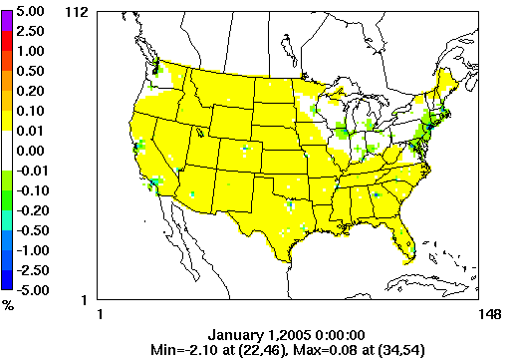
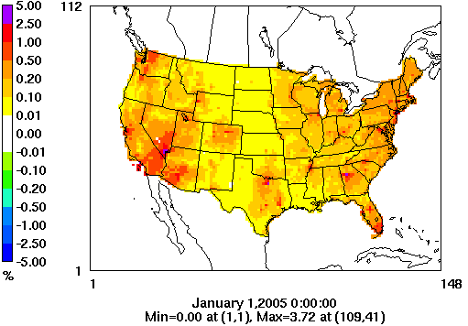
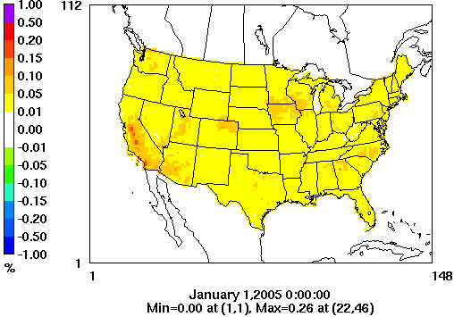
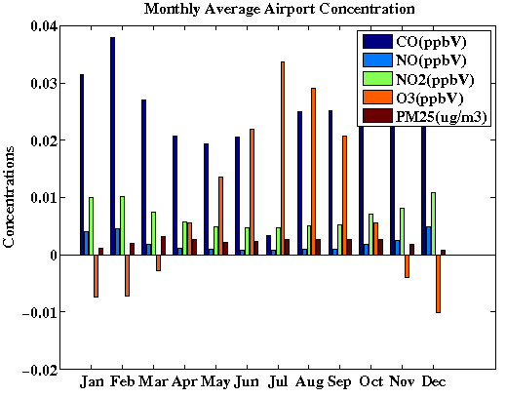
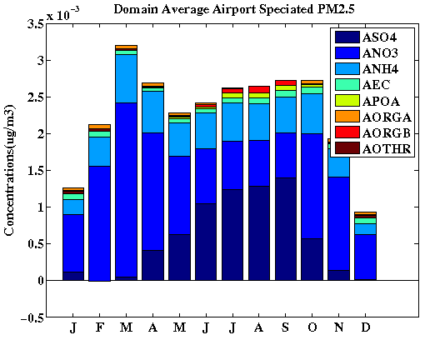
Aviation contributions in 2005
Annual aviation percent contributions
O₃
NO₂
PM_{2.5}
Observing decreases in O₃ near urban areas, annual US aviation perturbation is ~0.02% (max: 0.08%)
For NO₂ and PM_{2.5}, the US aviation perturbation is ~0.25% and ~0.035% (max: 3.72% and 0.26%).
Notes:
In the case of O3, we are seeing decreases near airport regions which could be due to the titration effect , i.e., reaction of available O3 with excess NO2 as most of the airports are near urban locations. In the case of NO2 and PM2.5 we are seeing near airports. Nitrate aerosol is contributing higher in winter months to the total PM2.5 and sulfate aerosol is contributing high during summer months. Therefore in order to take any policy relevant action one should remember the

Slide 13
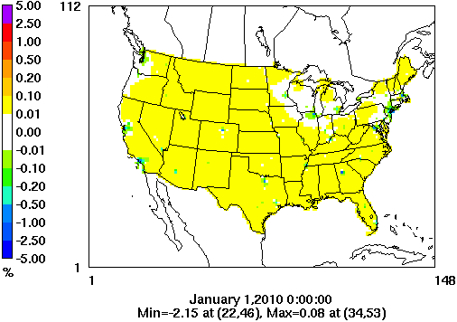
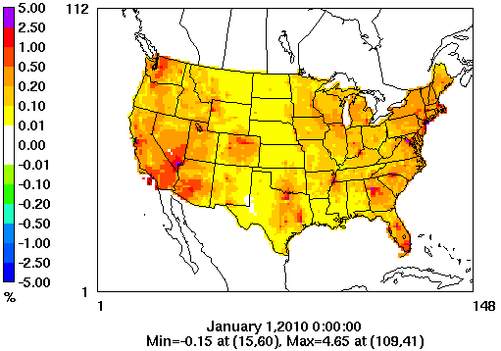
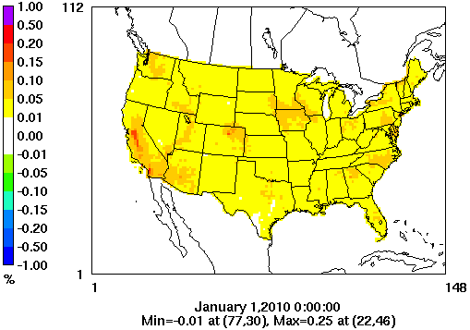
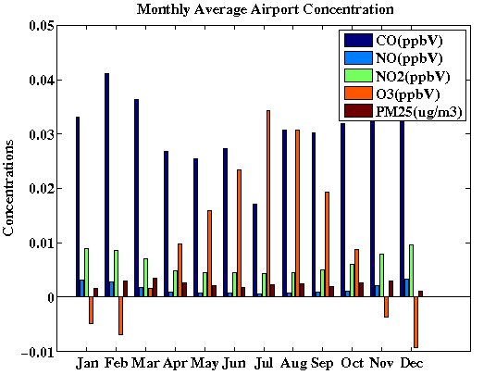
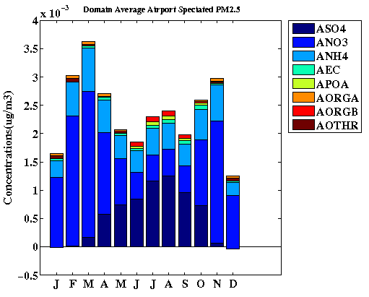
Aviation contributions in 2010
Annual aviation percent contributions
O₃
NO₂
PM_{2.5}
Spatially aviation contributions in 2010 appear similar to 2005, annual US averages are
O₃: ~0.025% (max: 0.08%), NO₂: ~0.28% (max: 4.65%), PM_{2.5}: ~0.037% (max: 0.25%)

Slide 14
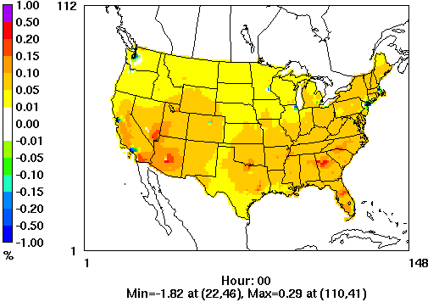
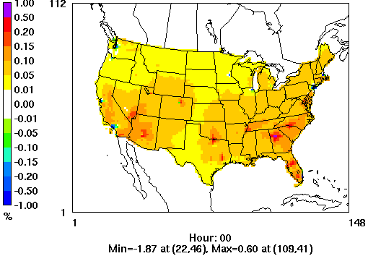
Ozone 8hr
Summer months (May-Sep) aviation percent contributions
2005
2010
Summer months 8hr.max O₃ shows 0.3% and 0.6% maximum increase due to aviation in 2005 and 2010 respectively.

Slide 15
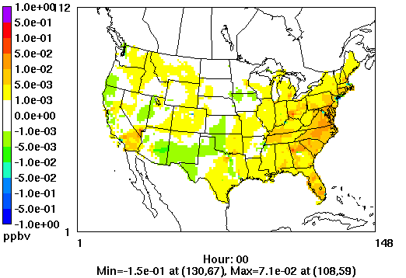
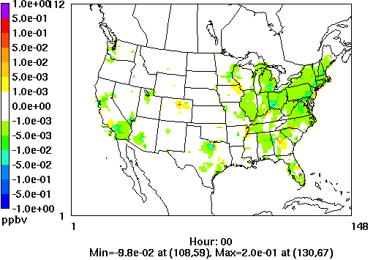
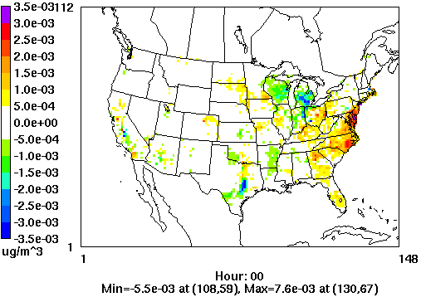
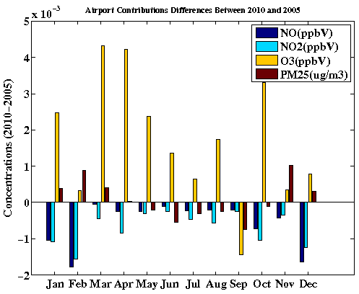
Differences between 2010 and 2005 aviation contributions
O₃
NO₂
PM_{2.5}
2010 shows slight increase in NO₂ (max: 0.02 ppbv) and PM_{2.5} (max: 7.6 ng/m³) concentrations near airports.

Slide 16
PRESENT and FUTURE TRENDS
FUTURE WORK:
We will apply similar modeling framework for future year (i.e., 2018) and study contributions from projected future year aviation emissions.
Explore emission reduction strategies and policy options to achieve FAA’s aspirational goal.
Notes:
With our first round of 2005 and 2010 modeling results, boston university collaborators calculated the mortality numbers for 2005 and 2010, and since we haven’t finished our future year modeling simulations we calculated future year mortality using prior studies 6X factor. So in order to decrease the impact of aviation in future years there is a need of huge effort.

Slide 17
CONCLUSIONS
Developed enhanced modeling framework to study aviation contributions of LTO emissions from all US airports.
Evaluated model predictions with both surface and in-situ aircraft observations.
Observed decreases in O₃ near airports, annual US aviation perturbation is ~0.02-0.025% in 2005 and 2010 (but maximum can be ~0.08%).
In case of NO₂ and PM_{2.5}, the US aviation contribution is ~0.02% (max ~3.5-4.5%) and ~0.035% (max ~0.25%) in 2005 and 2010.
Spatially, aviation contribution looks similar between 2005 and 2010, but observed slight increases near bigger airports in 2010.

Slide 18


ACKNOWLEDGEMENTS
Funding: Federal Aviation Administration (FAA)
Advisors : Sarav Arunachalam, Will Vizuete
& Committee Members (Rohit Mathur, Marc Serre, Jason West)
UNC – Institute for Environment, Labmates (Matt, Changsy, Scott)
THANK YOU

Slide 19
EXTRA SLIDES

Slide 21
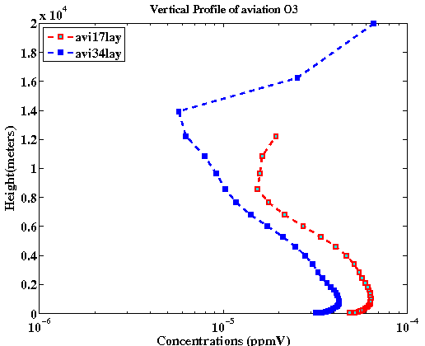
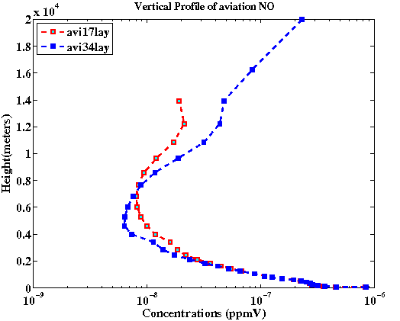
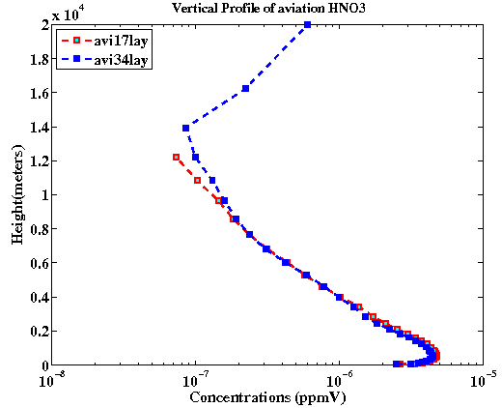
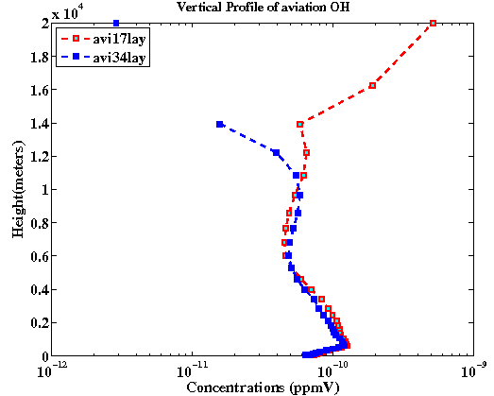

Slide 22
Major Improvements and tools
AEDT based aircraft emissions on a chorded flight-segment basis (LTO only)
  Developed AEDTProc tool for CMAQ
MERRA to WRF meteorology downscaling tool
CAMChem to CMAQ boundary conditions downscaling tool
- Species mapping
- Horizontal interpolation
- Vertical interpolation
NLDN based lightning emissions
- NLDN flash density observation data
- Vertical allocation based on meteorology layers
Online Photolysis
- Calculates photolysis rates incorporating radiative impacts of aerosol loading
Notes:
Discuss the LNOx fix in CMAQ and the vertical allocation

