Slide 1
Modeling the Role of Oil and Gas Emissions on Regional Ozone
in the Intermountain West: Using CAMx HDDM for W126 Ozone
Mike Barna, NPS-ARD
Tammy Thompson, CIRA-CSU
Tom Moore, WRAP/WESTAR
CMAS Annual Conference
Chapel Hill, NC
October 27-29, 2014

Slide 2
Introduction
Oil and gas development in the western US has rapidly accelerated due to fracking
Much of this development is upwind of sensitive high-elevation ecosystems
EPA has indicated that a strengthened primary standard for ozone will not adequately protect sensitive tree species in higher elevation Western ecosystems
Impacts to western forests include:
diminished growth
needle/leaf necrosis
changes in ecosystem form, structure

Slide 3
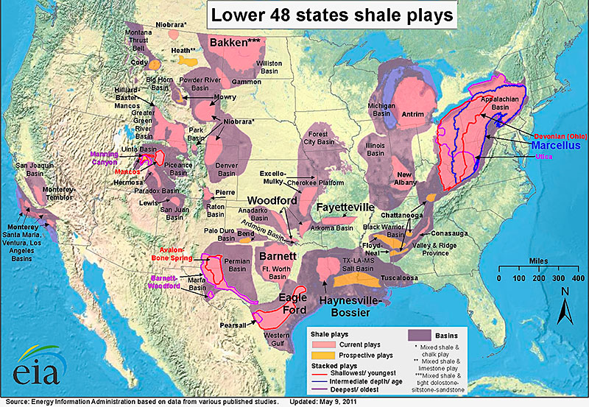
Current US oil and gas development
http://www.eia.gov/pub/oil_gas/natural_gas/analysis_publications/maps/maps.htm#field

Slide 4
W126 ozone and plant damage
Plants stressed from ozone injury are more vulnerable to drought, disease and insects
Primary ozone NAAQS does not protect sensitive tree species at western US high elevation forests.
W126 is a cumulative ozone exposure index that is biologically based
A sigmoidal-weighted function that focuses on higher ozone concentrations, but maintains lower- and mid-level concentrations

Slide 5
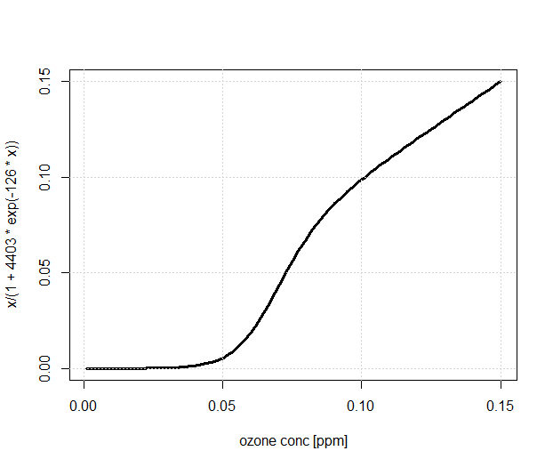
W126 ozone definition
Calculate W126 ozone from 8am to 8pm local time, and sum over three months (growing season)
Proposed range of 7 – 15 ppm-hrs
W_{i} = 1/[1 + M x e ^{– (A x Ci)}]
M = 4403 and A = 126 ppm⁻¹
W126 ozone [ppm-hr]
< 1:1
1:1

Slide 6
Decoupled direct method
High-order decoupled direct method (HDDM) is an efficient approach to evaluate ozone’s response to changes in precursor emissions
Develop 1st and 2nd order sensitivity coefficients from Taylor’s series approximation to estimate ozone at any location and time for varying NOx and/or VOC emissions
How does HDDM compare to a ‘brute force’ emissions sensitivity run, e.g., removing all emissions of interest and comparing to base case? (We hope they’re comparable.)

Slide 7
WestJumpAQMS
The WestJumpAQMS Air Quality Modeling Study: initiate the next generation of regional technical analysis and support for O3 and PM transport and attainment demonstrations across the West
Detailed EI updates for O&G, other sectors
SMOKE, WRF, CAMx
Modeling platform foundation of the ‘Three State Air Quality Study’ (3SAQS)
2008 (2011, 2014)
http://www.wrapair2.org/WestJumpAQMS.aspx

Slide 8
4km Intermountain West model domain
O&G basins in CO, WY, UT, NM
Denver-Julesburg
Upper Green River
Uintah
Piceance
San Juan
A mix of national parks and wilderness areas near O&G development, EGUs, and a large urban area (Denver)

Slide 9
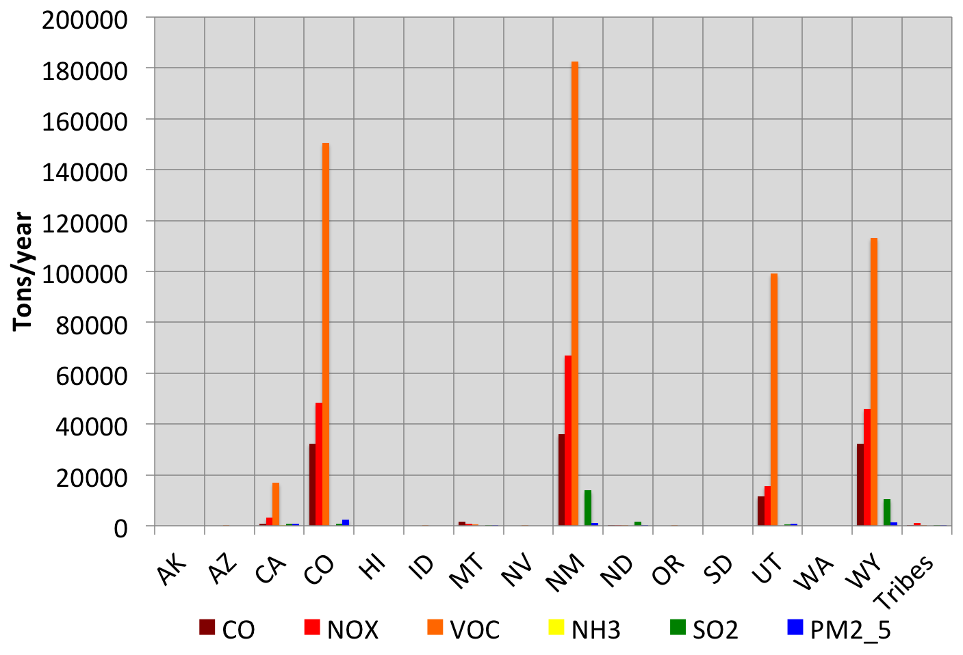
2008 WestJumpAQMS O&G emissions
CO, NM, UT, WY have largest O&G emissions
WRAP Phase III 2006 inventory projected to 2008, Permian Basin 2008 inventory, and NEI2008v2; includes both point and area inventories
http://www.wrapair2.org/calendar/viewitem.jsp?&cal_item_id=88

Slide 10
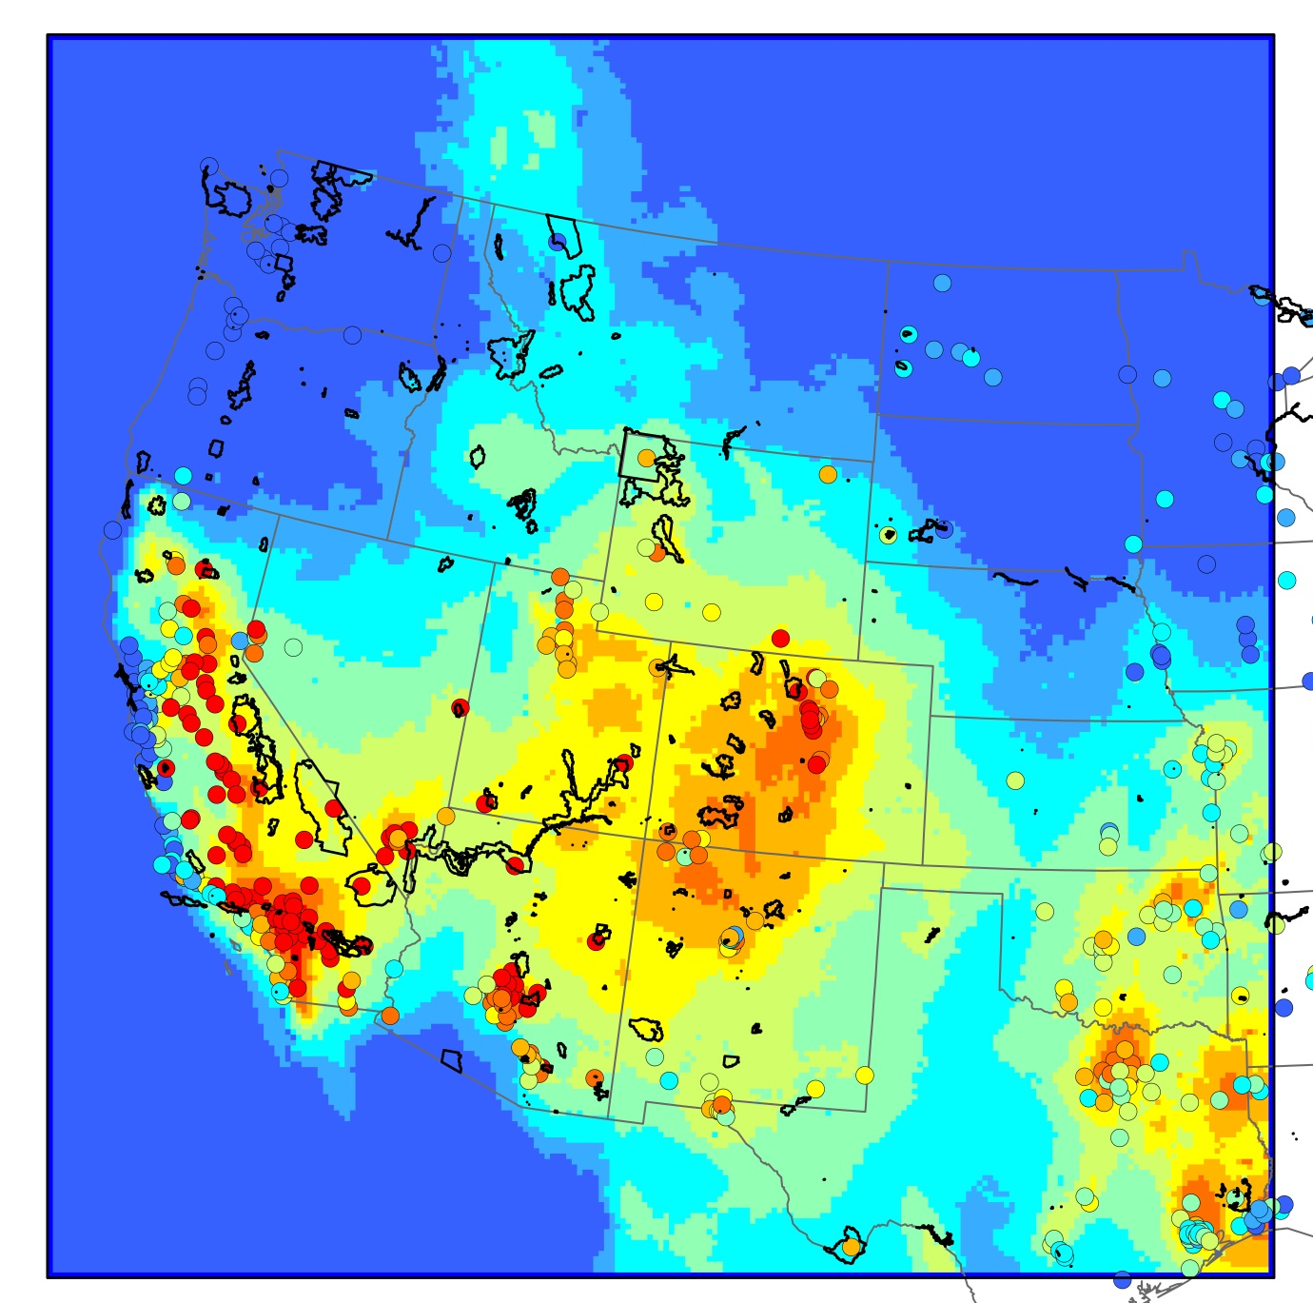
W126 estimates for western US
WestJumpAQMS 12km domain
High W126 values in the Four Corners states.

Slide 11
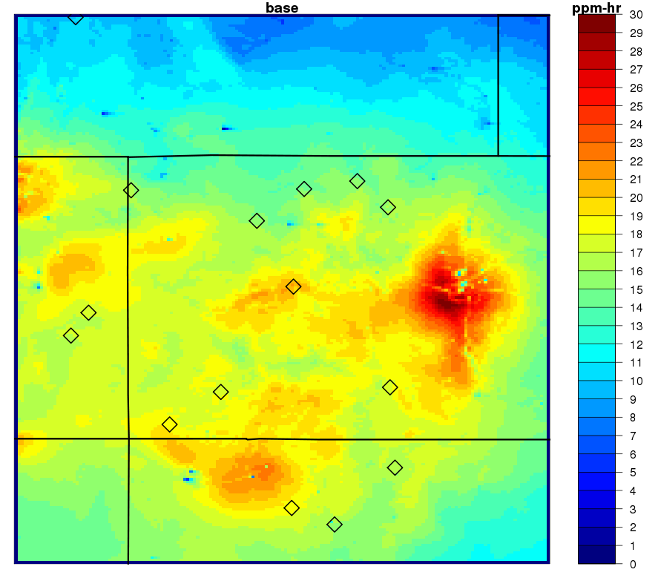
Base case W126 in 4km domain
Most national parks and wilderness area within 4km domain above 7-15 ppm-hr
June-Aug 2008 W126
[ppm – hr]
Mesa Verde NP: 18
Maroon Bells WA: 20
Arches NP: 17
Rocky Mountain NP: 16
Dinosaur NM: 16
San Pedro Parks WA: 18
Denver

Slide 12
HDDM results for W126 ozone
Two questions to consider:
How does HDDM compare to ‘brute force’?
BF: remove all O&G VOC and NOx, and subtract base case
HDDM: set ε_{i,j} = -1, and subtract from base case
How does ozone respond to changes in oil and gas emissions? Use HDDM to:
remove NOx+VOC, NOx, and VOC emis
double NOx+VOC, NOx, and VOC emis

Slide 13
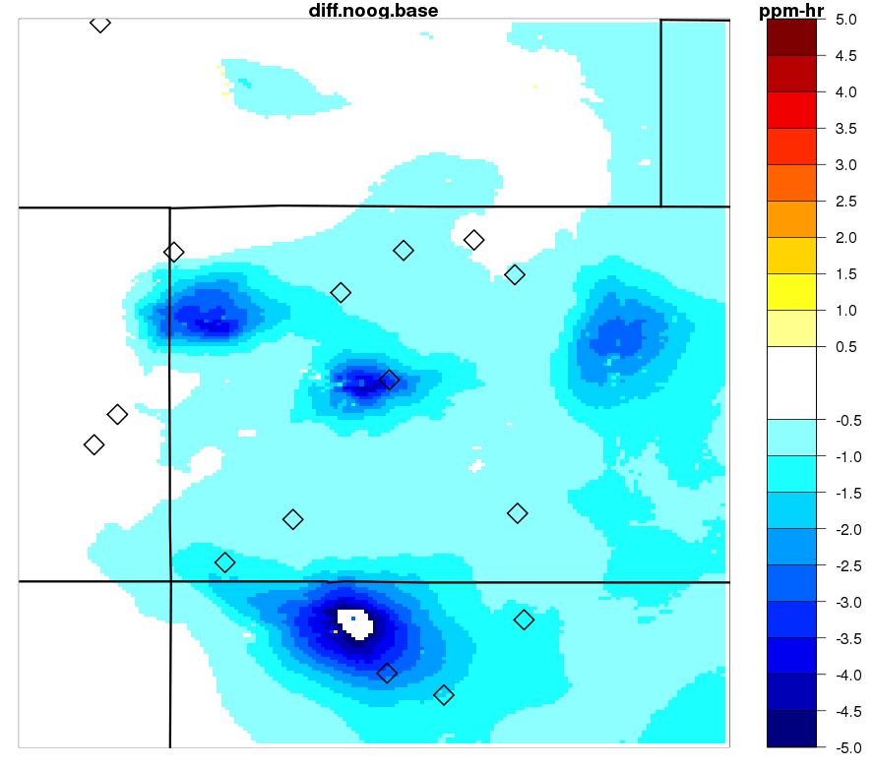
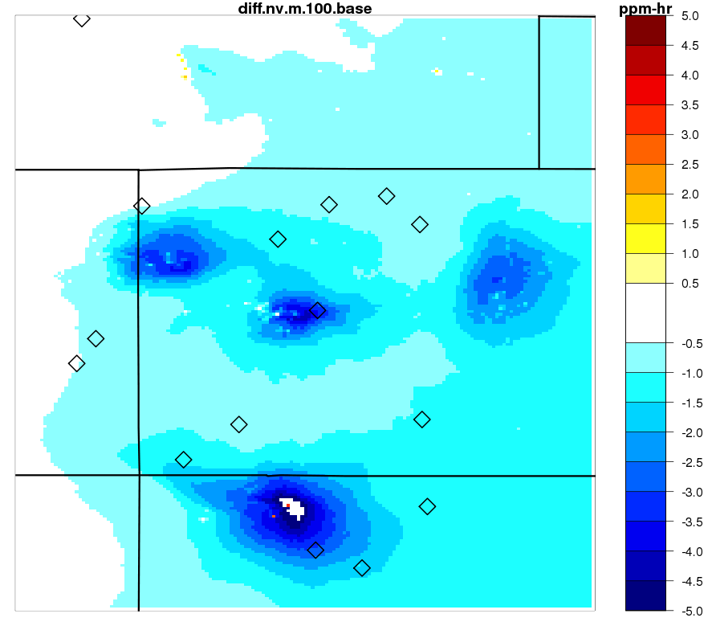
Regional ozone reductions: no O&G
“brute force” – base case
HDDM(ε_{i,j} = -1) – base case

Slide 14
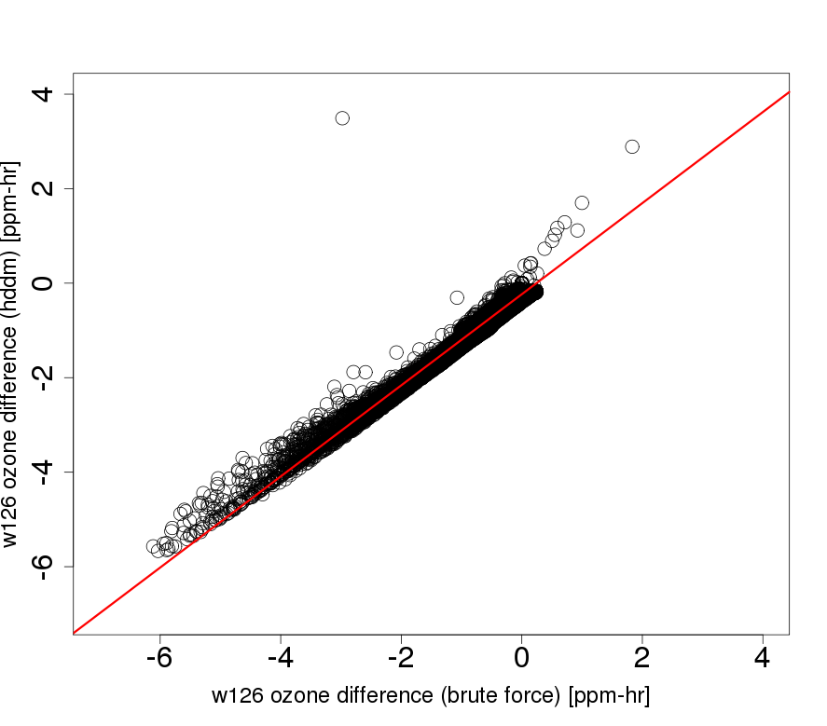
Compare O&G impacts from BF v. HDDM
y = 0.964x - 0.213
r^2 = 0.975
estimated change in W126 ozone: HDDM [ppm-hr]
estimated change in W126 ozone: “brute force” [ppm-hr]

Slide 15
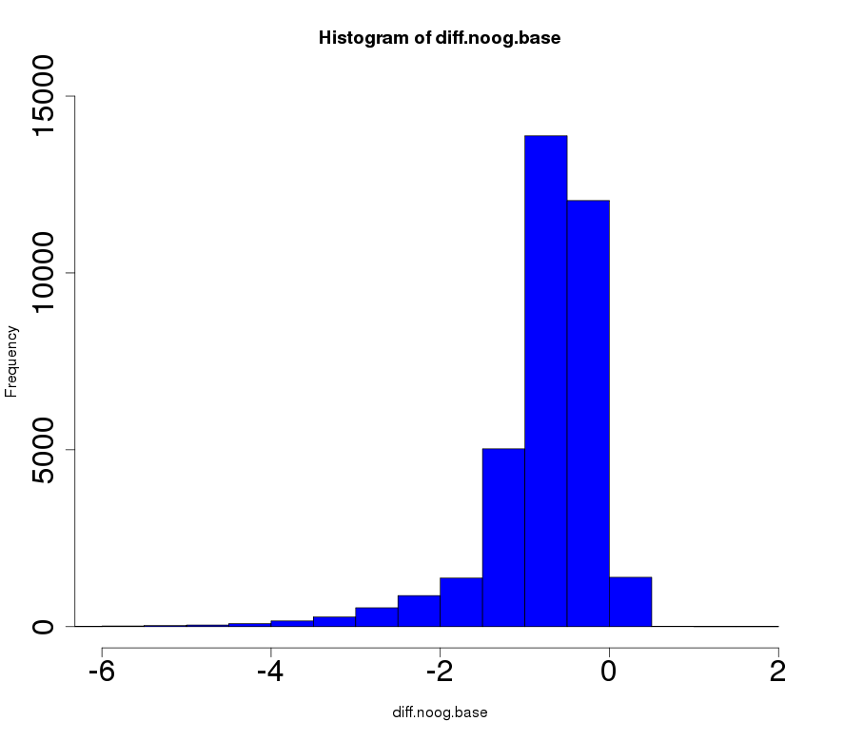
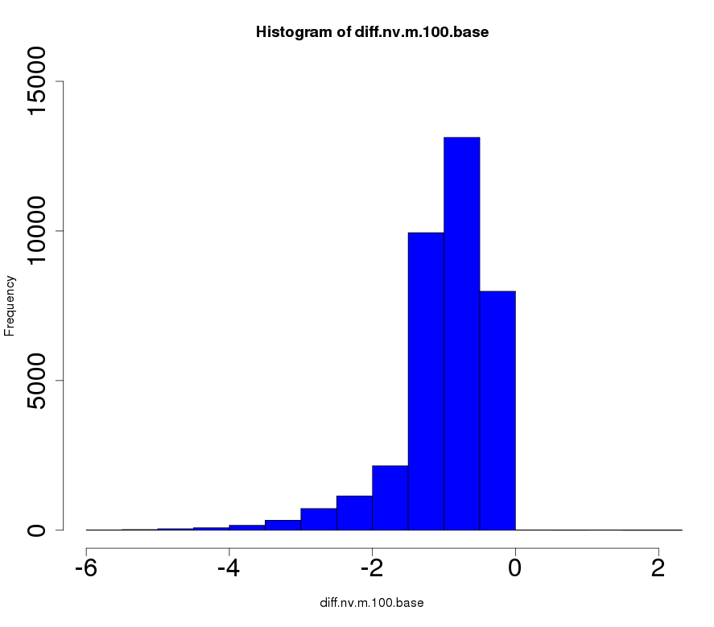
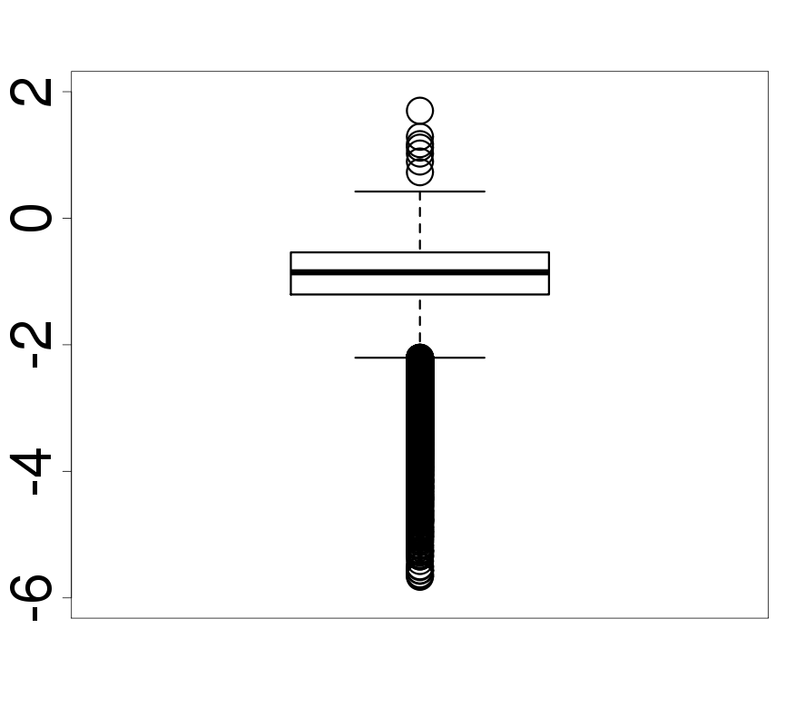
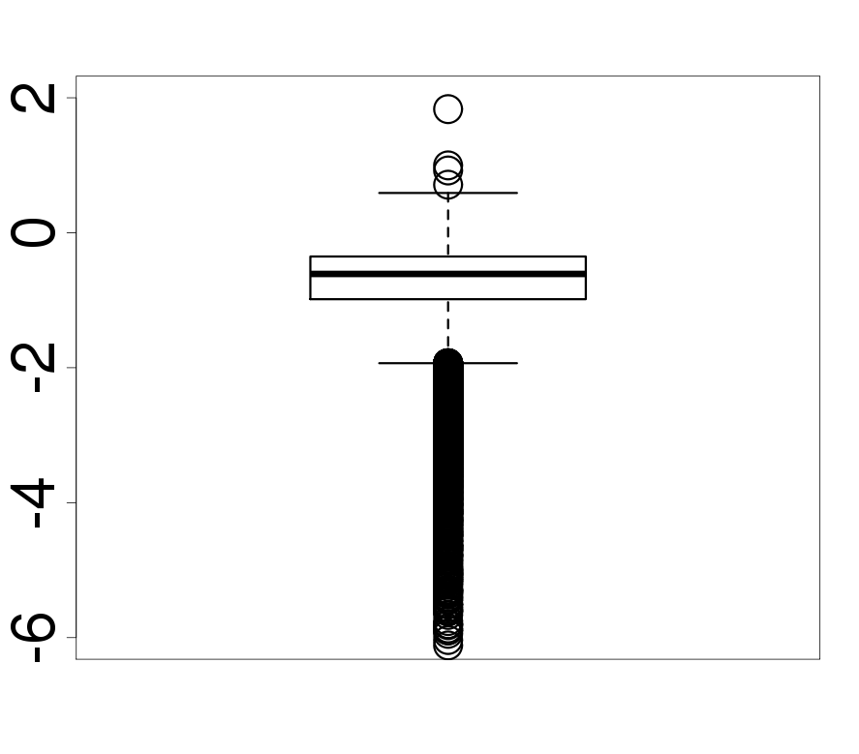
Compare O&G impacts from BF v. HDDM
“brute force” – base case
HDDM(ε_{i,j} = -1) – base case

Slide 16
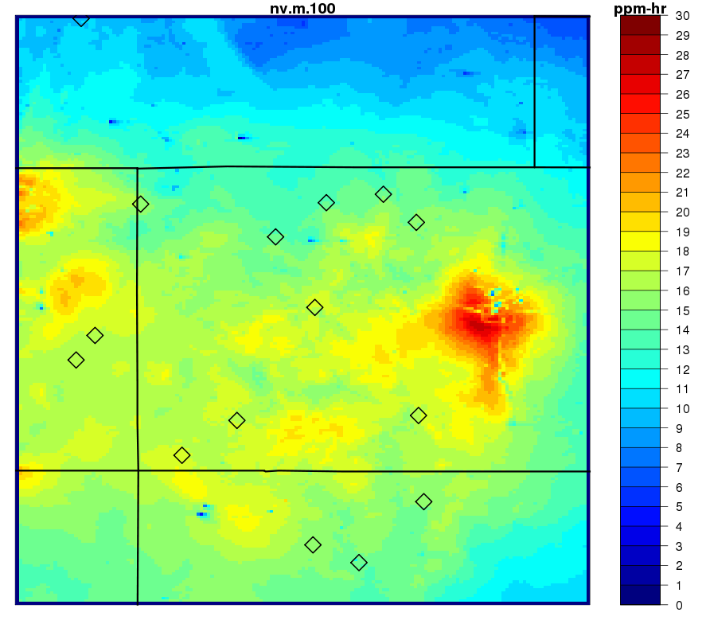
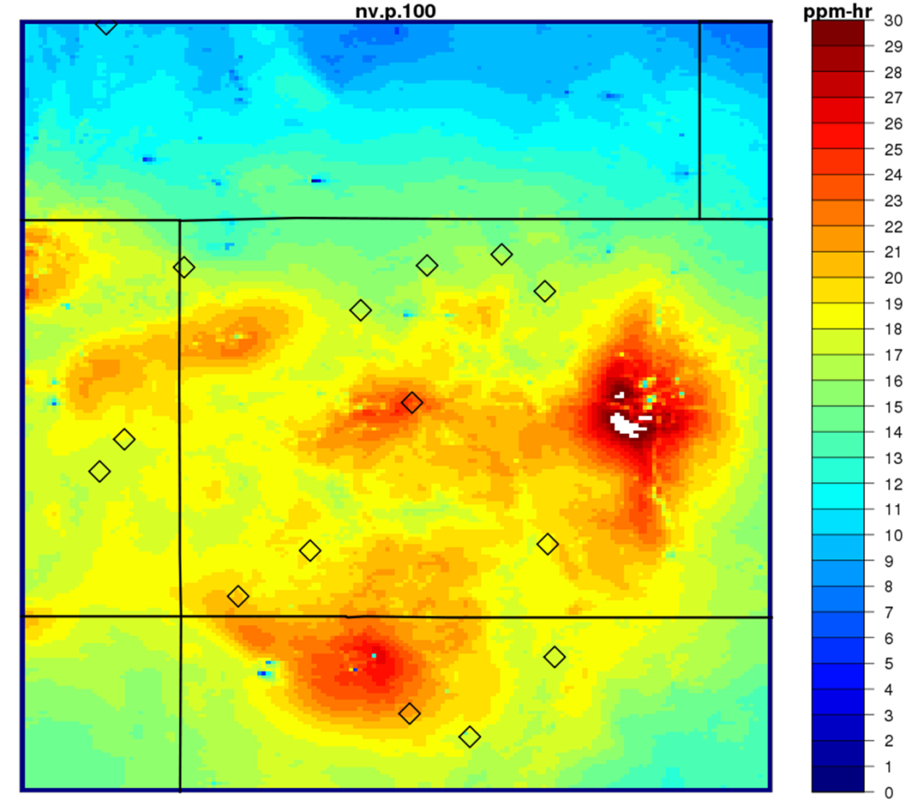
Regional W126 ozone response to O&G
HDDM(ε_{i,j} = -1) – base case
HDDM(ε_{i,j} = 1) – base case

Slide 17
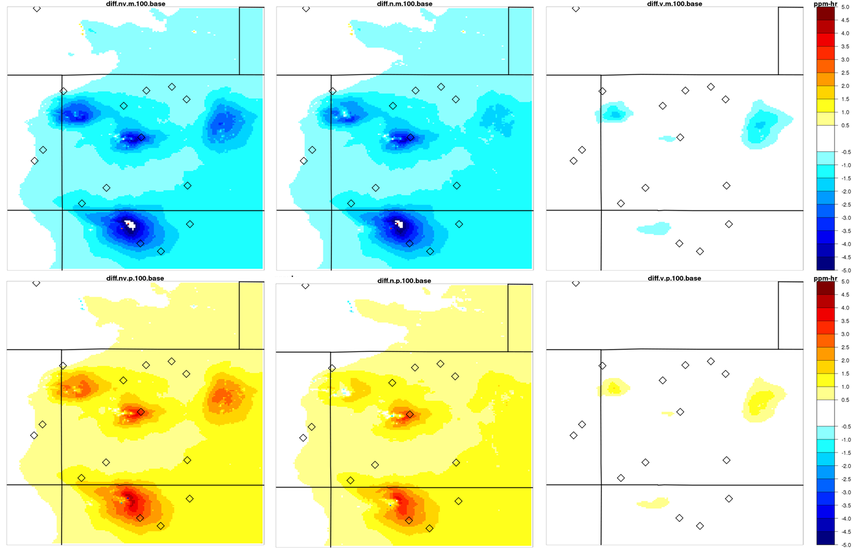
W126: no O&G (t) and 2x O&G (b) emis
ΔO&G NOx and VOC
ΔO&G NOx
ΔO&G VOC
HDDM(ε_{i,j} = -1) – base case
HDDM(ε_{i,j} = 1) – base case

Slide 18
Conclusions and recommendations
Simulated W126 ozone is often above the recommended range of 7 – 15 ppm-hr in the Intermountain West
Oil and gas emissions can contribute significantly to estimated W126 ozone, e.g.,
4 ppm-hr at Maroon Bells-Snowmass WA
2 ppm-hr at Mesa Verde NP
Good agreement between HDDM and ‘brute force’ W126 impacts from O&G emissions (within 0.2 ppm-hr)
HDDM impacts slightly larger

Slide 19
Conclusions and recommendations
A combination of both NOx and VOC controls was generally most effective for reducing regional W126 ozone
Unlike other basins, Denver-Julesberg had strongest response to VOC (not NOx) reductions
O&G VOC + Denver NOx -> O3?
NOx reductions also benefit
visibility
nitrogen deposition

Slide 20
Conclusions and recommendations
Oil and gas emissions in this region are rapidly evolving; significant emission inventory updates for 2011 (and 2014), developed by the Three State Air Quality Study, would be useful for extending this work
When considering plant damage from ozone, some other metrics might also be useful, e.g., N100, AOT40, SUM06

Slide 21
Acknowledgements
WestJumpAQMS and 3SAQS
Bonyoung Koo and Chris Emery for assistance with CAMx HDDM configuration (Environ Corp)

