Slide 1


Multiscale Predictions of Aircraft-Attributable PM_{2.5} Modeled Using CMAQ-APT enhanced with an Aircraft-Specific 1-D Model for U.S. Airports
Matthew Woody, Hsi-Wu Wong, J. Jason West, and
Saravanan Arunachalam
UNC Center for Environmental Modeling and Policy Development
Institute for the Environment
13th Annual CMAS Conference
October 27-29, 2014

Slide 2
Background
2013 U.S. Aircraft Usage (FAA, 2013):
  739 million passenger enplanements
  68 million tons of cargo
  18 million flights
Future Usage (FAA, 2013):
  Passenger growth of 2.3% per year over next 20 years
  1.15 billion passengers in 2034
PM_{2.5} Non-attainment areas (1997 standard) and Major U.S. Airports
Aircraft emit:
  CO SO₂
  VOCs NO_{x}
  PM (elemental carbon, primary organics, sulfate)
FAA, 2013
Notes:
aircraft engine certifications for NOx and EC (proposed), climate change (CO2), contrails, EC, and anthro cruise emissions

Slide 3
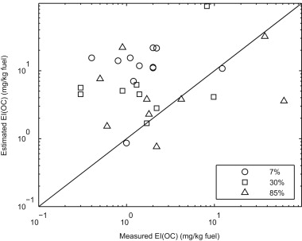
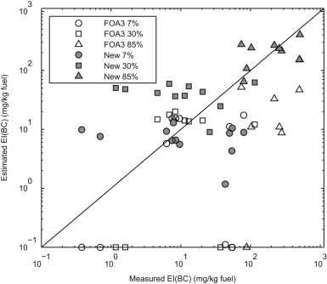
Aircraft PM Emissions
Estimated using the First Order Approximation v3 (FOA3) methodology (Wayson et al., 2009)
Organic carbon PM emission indices from 4 measurement studies varied from 0.2 to 83 mg per kg fuel (Timko et al., J. Eng. Gas Turbines Power, 2010; Yu et al., ES&T, 2010; Kinsey et al., ES&T 2011; Agrawal et al., Atmos. Env., 2008)
POA
EC
Notes:
High number of engines, each with unique emission profiles. Missing FOA BC EI (circled); Limitations in PM measurements (total PM, no protocol, at engine exit or downwind, handful of measurements available)

Slide 4
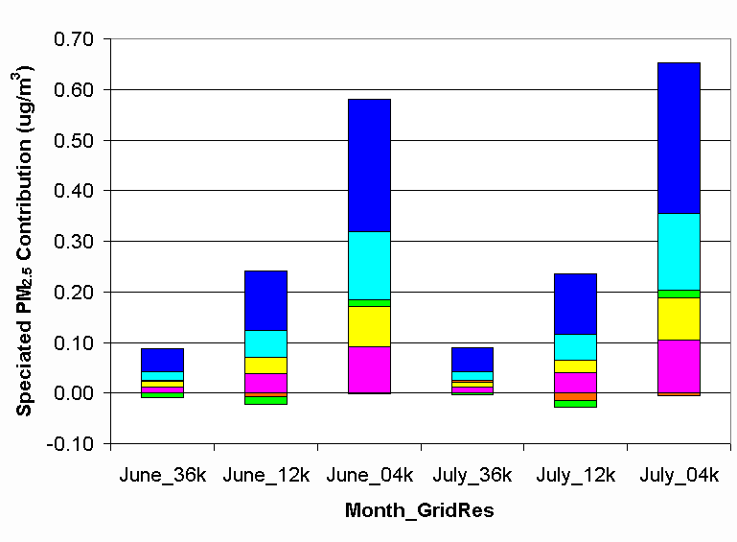
Objectives
Utilize plume-in-grid modeling techniques and updated emission estimates to remove potential non-linear responses to spatial scales and gaps in existing PM estimates
Simultaneously obtain fine-scale (sub-grid) and regional to Contiguous U.S. aviation-attributable PM_{2.5} impacts
Motivation and Goals
Motivation
Non-linear response to SOA produced from aircraft emissions at various model grid resolutions
-Smog chamber results indicate significant amounts of SOA formed from
aircraft emissions
Aircraft PM emission estimates vary by an order of magnitude for ~50% of engines compared to measurements (Stettler et al., Atmos. Env., 2011)
In grid-based models, quantification of fine-scale impacts limited to grid resolution
Arunachalam et al., Atmos. Env., 2011
Notes:
Gaps include missing BC EI, S/IVOCs, and ambient condition depended emissions

Slide 5
Aerosol Dynamics Simulation Code (ADSC)
One dimensional plume scale model
Provides aircraft emission factors for sulfate, elemental carbon, and organics (S/IVOCs)
  Sulfate emission factors shown to correspond well with measurements
  Organics grouped by volatilities and include NTSOA precursors
Wong et al., J. of Jet Prop., 2008

Slide 6
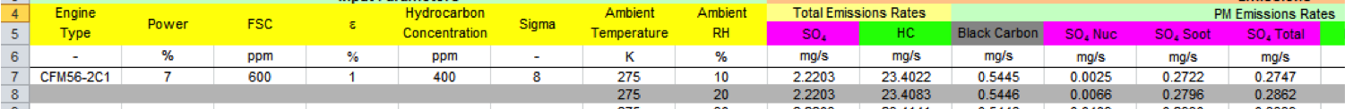
ADSC (Continued)
PM emission factors at a range of conditions
  6 Engines Types (61% of aircraft at ATL in 2006)
  6 engine power settings (4%, 7%, 30%, 65%, 85%, 100%)
  8 relative humidities (10%-90%)
  8 temperatures (275K – 310K)
2,304 total ADSC simulations formatted into lookup table
ADSC Look-up Table Excerpt

Slide 7
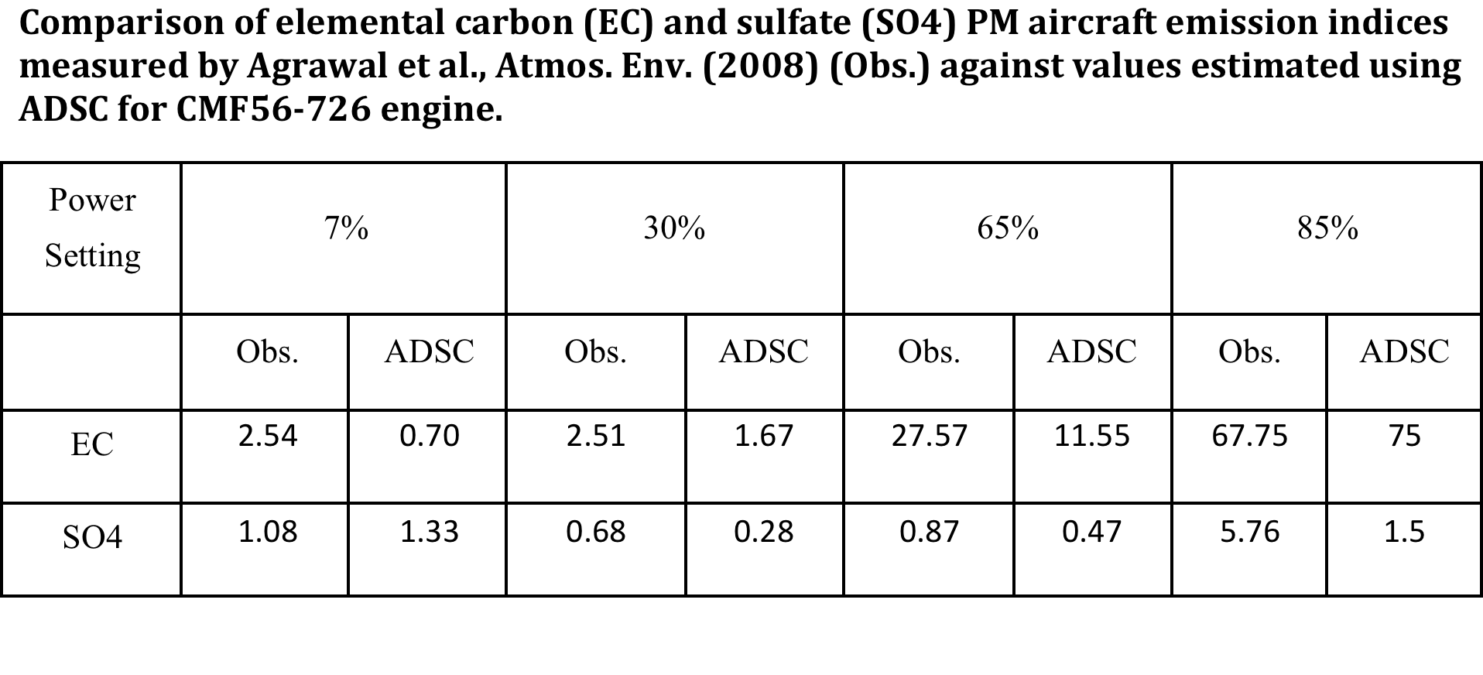
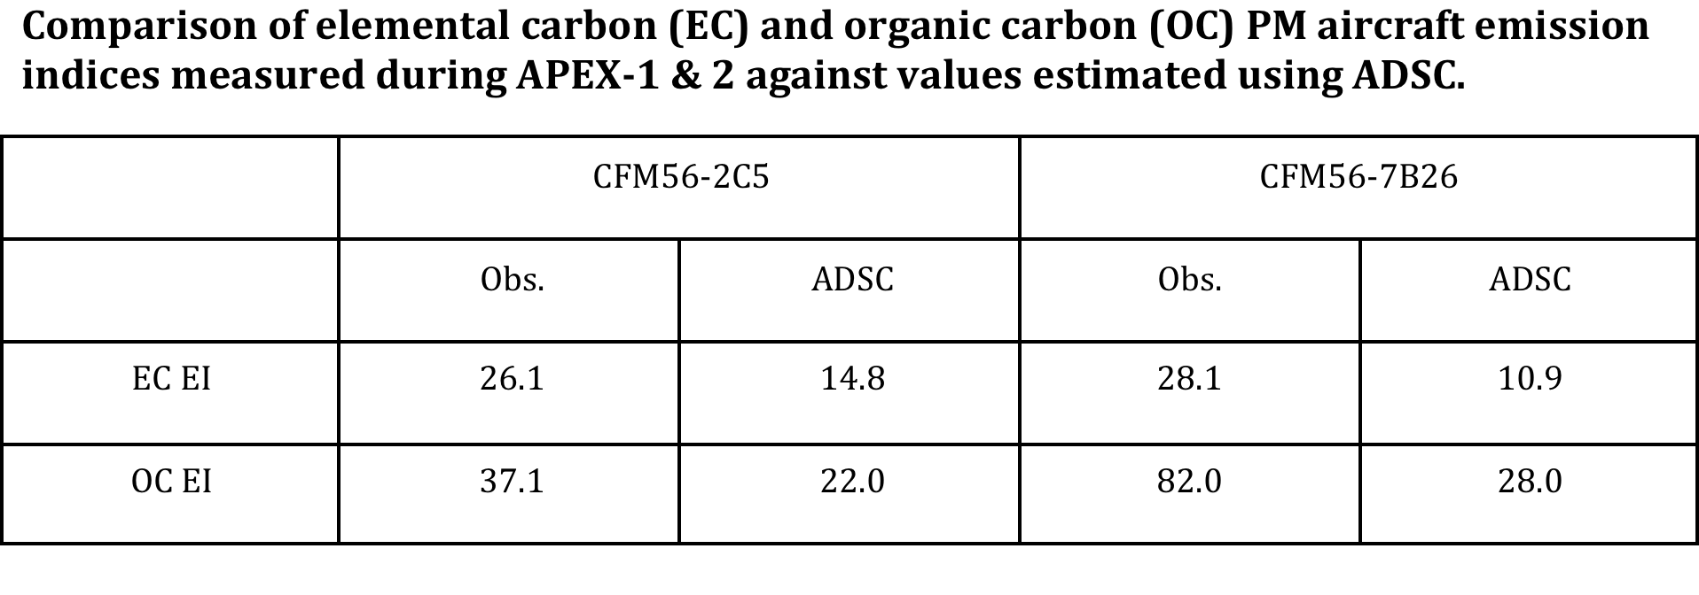
ADSC (Continued)
ADSC predictions generally comparable to observations for CFM56-726 and CFM56-2C5 engines. However, it tends to underpredict for these two engines.

Slide 8
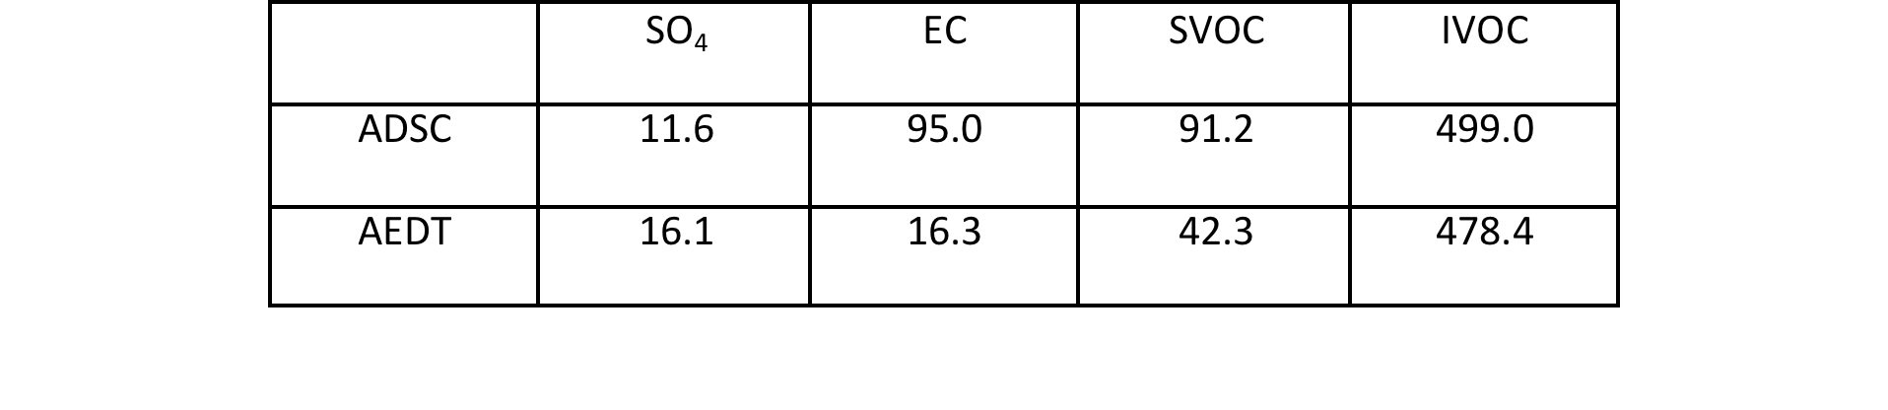
CMAQ-APT Configuration
CMAQ-APT with VBS for organics (and NTSOA parameterization for aircraft)
36-km Contiguous U.S. Domain
  Focusing on 99 major U.S. airports
~2,000 PinG emitters
AEDT and ADSC aircraft emission inventories
  AEDT IVOC emissions estimated by scaling AEDT POA emissions using measured IVOC/POA ratio reported by Jathar et al., ACP, 2013
AEDT and ADSC aircraft PM emission estimates (tons/month) for 99 airports

Slide 9
99 U.S. Airports
Airports categorized by size and activity: large (Tier I), medium (Tier II), small (Tier III). Tier classification used to determine number of emitters used at each airport (larger airports = more emitter locations)

Slide 10
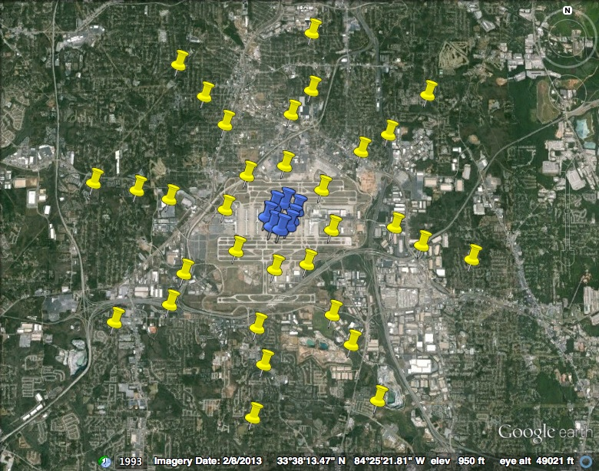
Example 3-D PinG Emitter Locations
ground level
elevated
Example of 3-D emitter locations at ATL. Hourly aircraft emissions allocated to points based on AEDT flight data.

Slide 11
Example 3-D PinG Emitter Locations
Snapshot of puff locations in CMAQ-APT. Puffs reach distances > 200 km downwind of airport.

Slide 12
Monthly and Contiguous U.S. Average Aviation-Attributable PM_{2.5}
APT increased aviation-attributed PM_{2.5} in January (from 1.9 ng m⁻³ to 2.5 ng m⁻³, 27% increase) and produced similar concentrations in July (from 2.3 to 2.4 ng m⁻³, 2% increase)
ADSC predicted higher PM_{2.5} in January (2.7 ng m⁻³) and similar contributions in July (2.6 ng m⁻³)

Slide 13
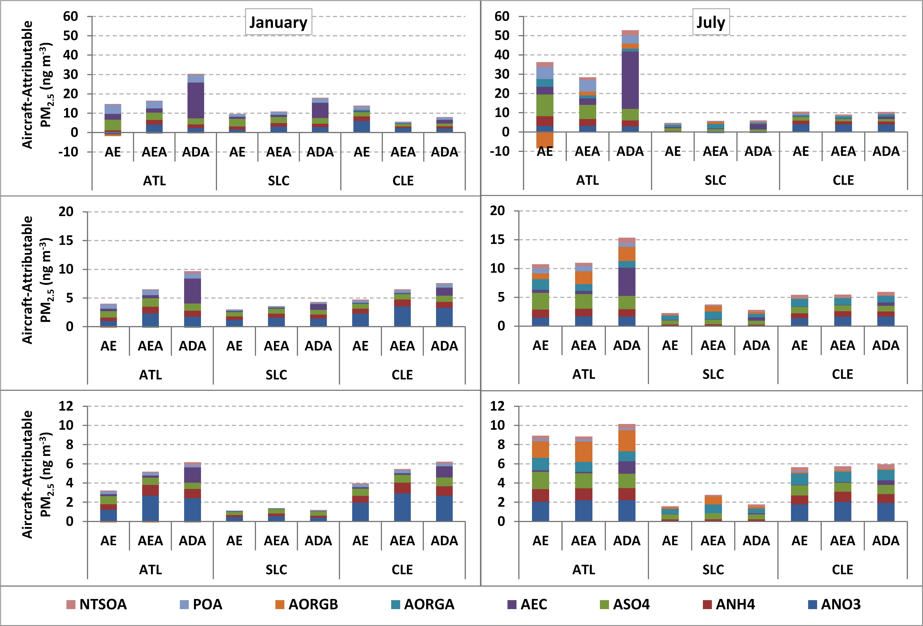
Monthly Average Aviation-Attributable PM_{2.5} at Three Select Airports
Use of APT removes the effect of reduced biogenic SOA due to aircraft emissions
  Aircraft NO_{x} emissions within puffs no longer available to interact with biogenic SOA precursors at gridcell containing ATL

Slide 14
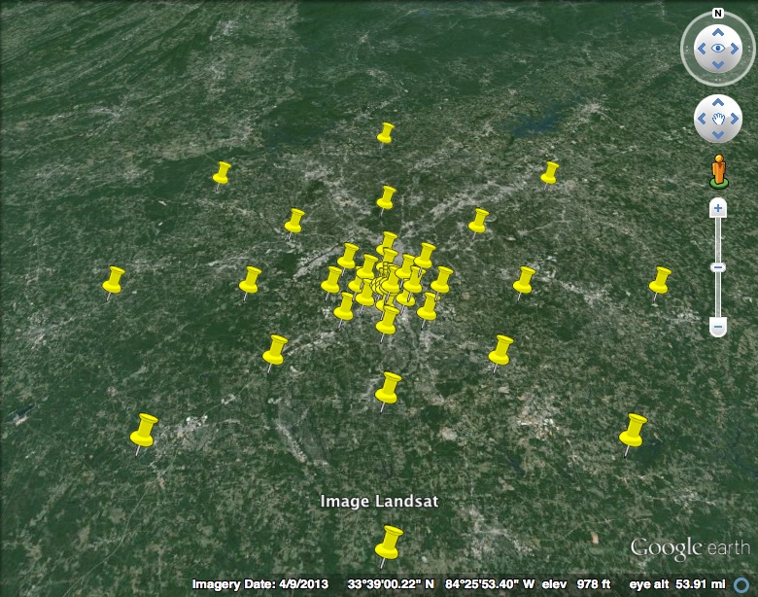
Hourly Grid-based and Subgrid/Fine Scale Impacts - January
Grid
Subgrid
Subgrid scale impacts higher than grid-based, more so with ADSC (~4x) than AEDT (~2x)
Notes:
Subgrid scale impacts near airport dominated by primary PM emissions (small puff volumes, high number of overlapping puffs)

Slide 15
Hourly Grid-based and Subgrid/Fine Scale Impacts - July
Grid
Subgrid
Maximum subgrid scale impact (ADSC) ~100x higher than grid-based impact in July (AEDT ~50x higher)
Notes:
Subgrid scale impacts near airport dominated by primary PM emissions (small puff volumes, high number of overlapping puffs)

Slide 16
Hourly Grid-based and Subgrid/Fine Scale Impacts – January (Outliers Removed)
Grid
Subgrid
Average subgrid scale impacts ~10x higher. Grid-based impacts appear comparable at SLC and CLE while sub-grid scale impacts vary between the two airports.
Notes:
Subgrid scale impacts near airport dominated by primary PM emissions (small puff volumes, high number of overlapping puffs)

Slide 17
Hourly Grid-based and Subgrid/Fine Scale Impacts – July (Outliers Removed)
Grid
Subgrid
Similar findings in July, average subgrid scale impacts ~10x higher than grid-based impacts
Notes:
Subgrid scale impacts near airport dominated by primary PM emissions (small puff volumes, high number of overlapping puffs)

Slide 18
Conclusions
CMAQ-APT successfully utilized to model aircraft emissions on Contiguous U.S. Scale
  Simultaneously provides regional and fine scale impacts
  Computationally expensive
APT increased PM_{2.5} contributions by 27% in January and 2% in July
  January increase primarily attributable to nitrate
ADSC (w/APT) increased PM_{2.5} contributions by 40% in January and 12% in July
  Increase in nitrate (January) and EC (January and July)
Subgrid/Fine scale impacts up to 100x higher than grid-based impacts

Slide 19
Acknowledgements
Environ
FAA Center for Excellence for Alternative Jet Fuels and Environment (ASCENT)
Partnership for AiR Transportation Noise and Emissions Reduction (PARTNER)
The emissions inventories used for this work were provided by US DOT Volpe Center and are based on data provided by the US Federal Aviation Administration and EUROCONTROL in support of the objectives of the International Civil Aviation Organization Committee on Aviation Environmental Projection CO2 Task Group. Any opinions, finding, and conclusions or recommendations expressed in this material are those of the author(s) and do not necessarily reflect the views of the US DOT, Volpe Center, the US FAA, EUROCONTROL or ICAO.

