Slide 1
Regional background ozone in the eastern half of Texas
Mark Estes, Jim Smith & Fernando Mercado
Texas Commission on Environmental Quality, Austin, TX
Presented at:
CMAS 2014
Chapel Hill, North Carolina
29 October 2014
Air Quality Division

Slide 2
Outline
For these analyses, “regional background ozone” is the ozone transported into the area such that local emissions have little influence upon the ozone concentrations.
Background ozone estimates for Houston and Dallas
Factors affecting background ozone: Wind run or ventilation index as a measure of stagnation
Local and regional ventilation, and the relationship to background and locally-formed ozone
Transport patterns and their relationship to background ozone

Slide 3
Method: Background ozone estimated at upwind sites
Select sites in/near the urban area that are capable of measuring background ozone, given the proper conditions. These sites are not located near large emission sources
Calculate Maximum Daily Average 8-hour (MDA8) ozone concentration for each site.
Select the lowest MDA8 ozone concentration from the subset of background sites.
Ozone season defined as April 1 – Oct 31.

Slide 4
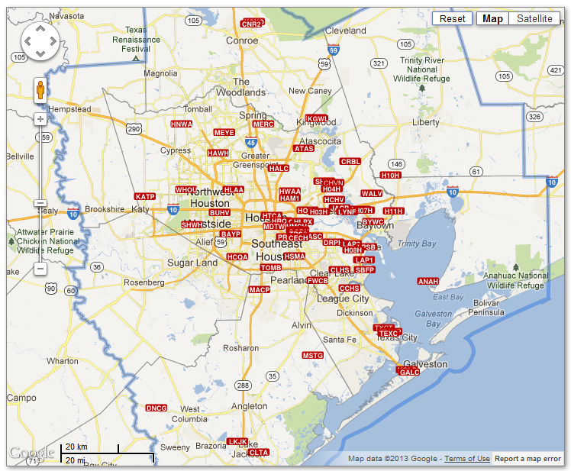
Sites outside the red boundary are able to measure background ozone reliably; sites inside often do not, due to influence from local sources.
Notes:
Sites used to estimate background ozone

Slide 5
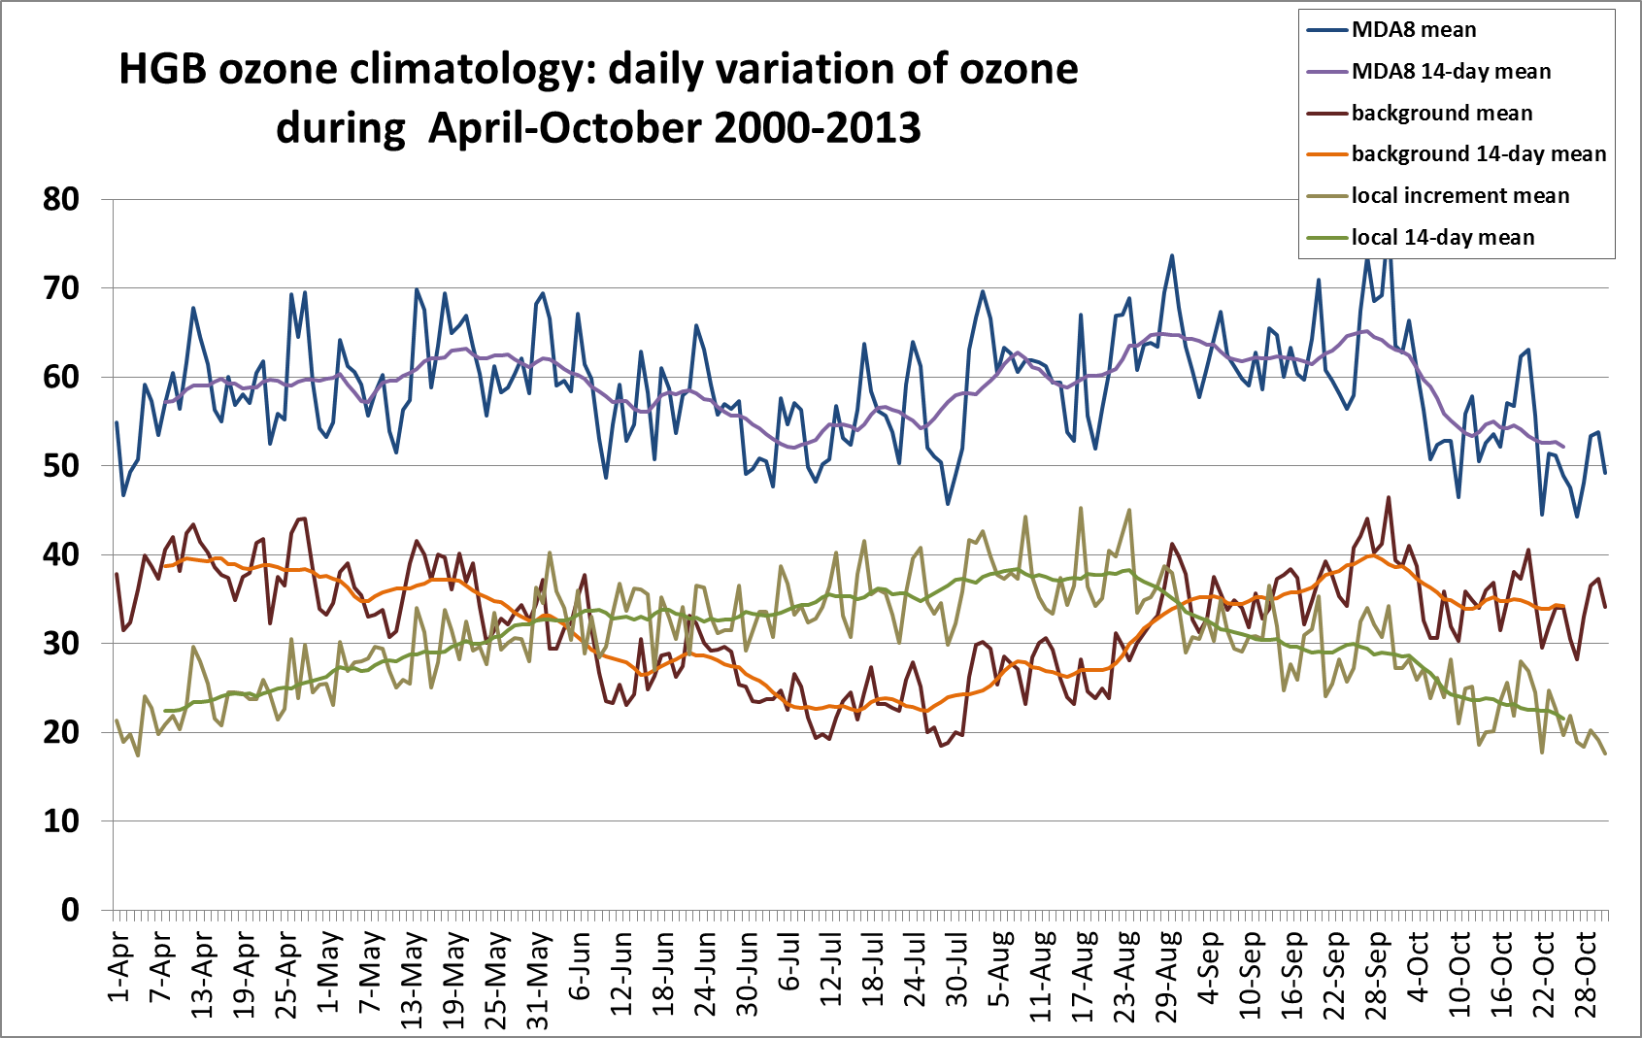
Mean background: 32.3 ppbv
Median: 30 ppbv
95th percentile: 58 ppbv

Slide 6
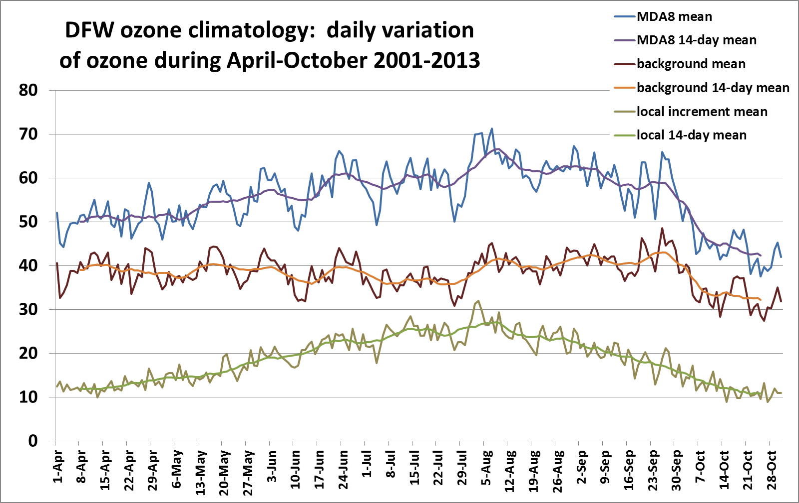
Mean background: 41.2 ppbv
Median: 40 ppbv
95th percentile: 63 ppbv

Slide 7
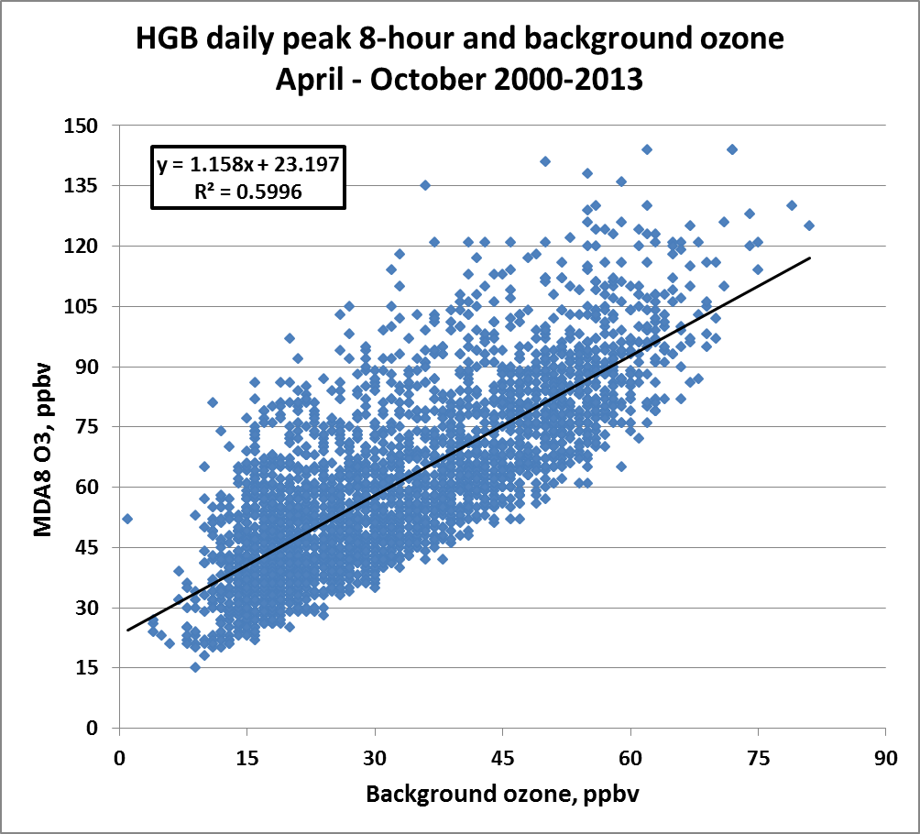

Slide 8
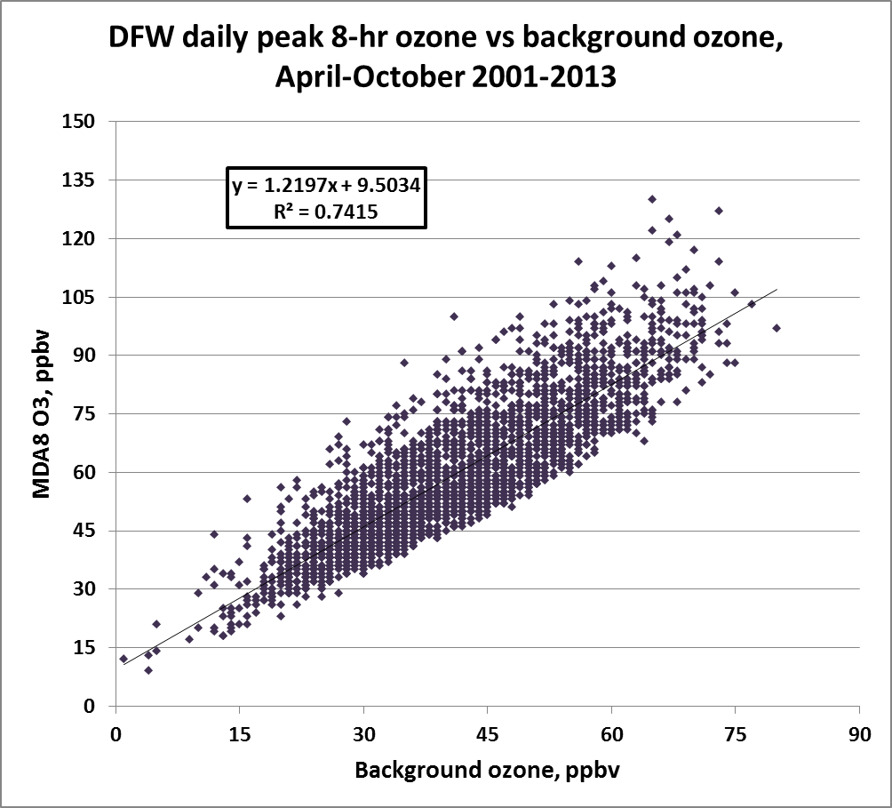

Slide 9
Questions
Is the upwind-downwind technique sufficient to isolate the background contribution from the local contribution of ozone? Are high background O3 values caused by local emissions?
Is the stagnation associated with high ozone local or regional?
Use ventilation index and trajectory analyses to address these questions for ozone seasons of 2011-2012.

Slide 10
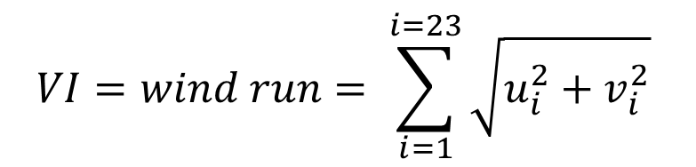
Ventilation index (i.e., wind run)
Simple technique follows Allwine and Whiteman (1994) method of estimating ventilation from wind speed and direction data. Vector addition of uv wind vectors to determine “wind run”, which is the distance that an air parcel could travel if it moved at the speed and direction indicated by the wind measurements at the site.
$$VI=wind run= \sum_{i=1}^{i=23}{\sqrt{u_{i}^{2}+v_{i}^{2}}}$$

Slide 11
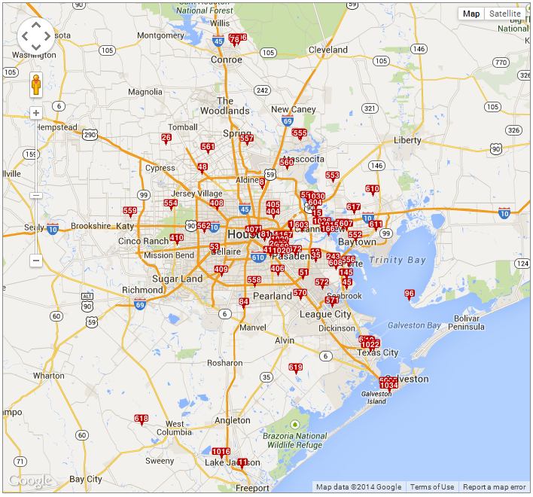
C8 Aldine
C11 Clute
C15 Channelview
C26 NW Harris
C35 Deer Park
C45 Seabrook
C53 Bayland Park
C78 Conroe
C84 Manvel Croix
C96 Smith Point
C145 Shore Acres
C148 Baytown
C169 Milby Park
C403 Clinton
C404 Houston Kirkpatrick
C409 Houston Croquet
C410 Houston Westhollow
C416 Park Place
C617 Wallisville Road
C618 Danciger
C619 Mustang Bayou
C620 Texas City 34th St
C1015 Lynchburg Ferry
C1016 Lake Jackson
C1020 Cesar Chavez
C1022 Texas City Ballpark
C1029 Manchester
C1034 Galveston 99th
Houston metro area monitoring sites used to calculate ventilation indices. Daily site indices were averaged to obtain a single area-wide average.
Notes:
Sites chosen for ventilation index were well distributed across the metro area. To obtain a single value for each day, daily ventilation indices for all sites were averaged together.

Slide 12
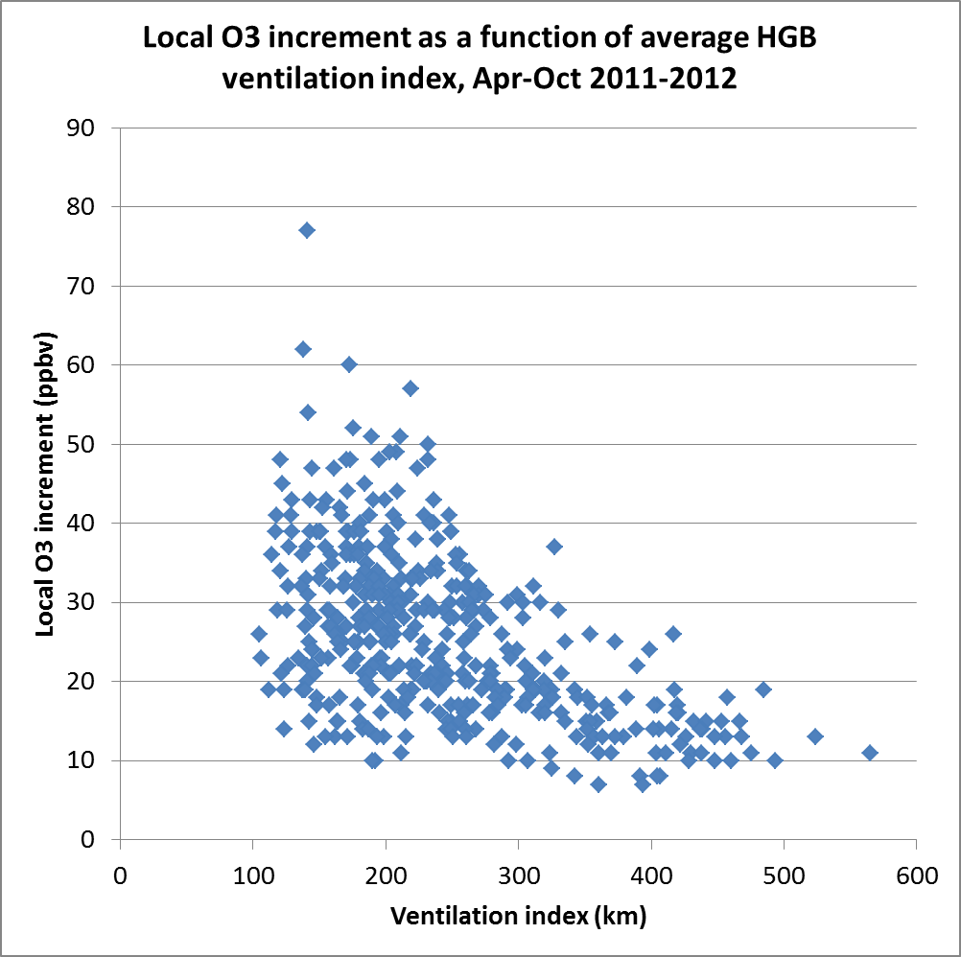
The relationship between local ozone increment varies clearly with local ventilation in a non-linear manner.
Stagnation is necessary but not sufficient for high local ozone production.
Notes:
Local ozone increment = MDA8 O3 – background ozone. Although background ozone isn’t closely related to ventilation, local increment varies strongly with ventilation.

Slide 13
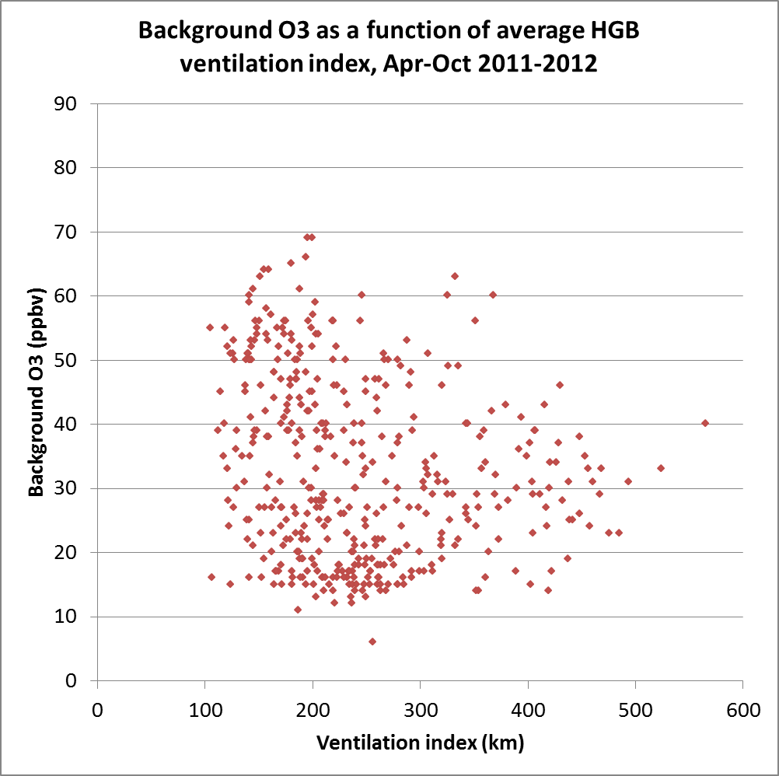
HGB background ozone is not clearly correlated with HGB areawide average ventilation index. But the highest background ozone does seem to occur with low ventilation…
Notes:
Although high background ozone tends to occur at low ventilation, the pattern indicates that the relationship is not simple. Is the ventilation poor regionally rather than just locally?

Slide 14
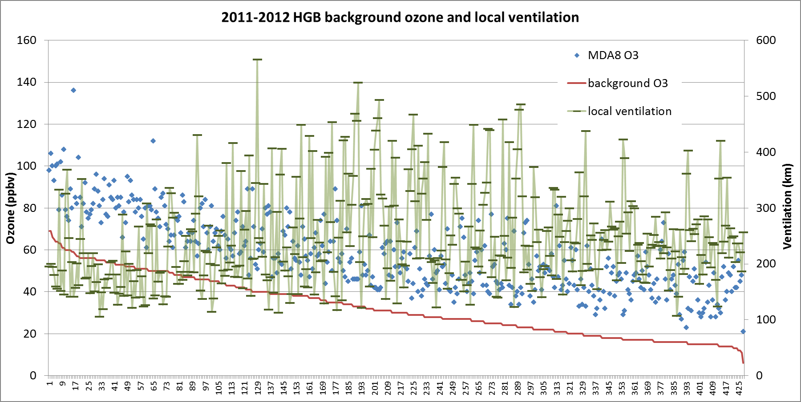
Ranked background ozone, MDA8 ozone, and ventilation index.
Highest background ozone apparently associated with low ventilation. Is the low ventilation local or regional? Is the high background only local, or also regional? Examine regional ventilation, DFW background ozone.

Slide 15
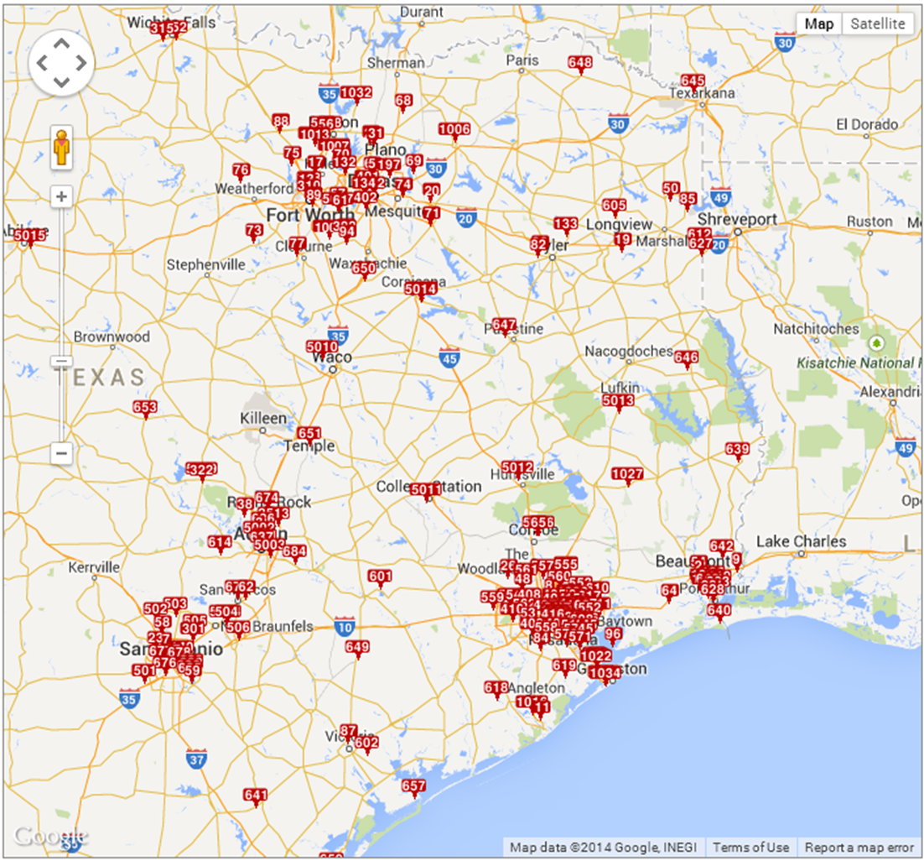
Regional ventilation index
Notes:
Sites listed in the table were used to calculate the regional ventilation index. These sites are well distributed around eastern Texas.

Slide 16
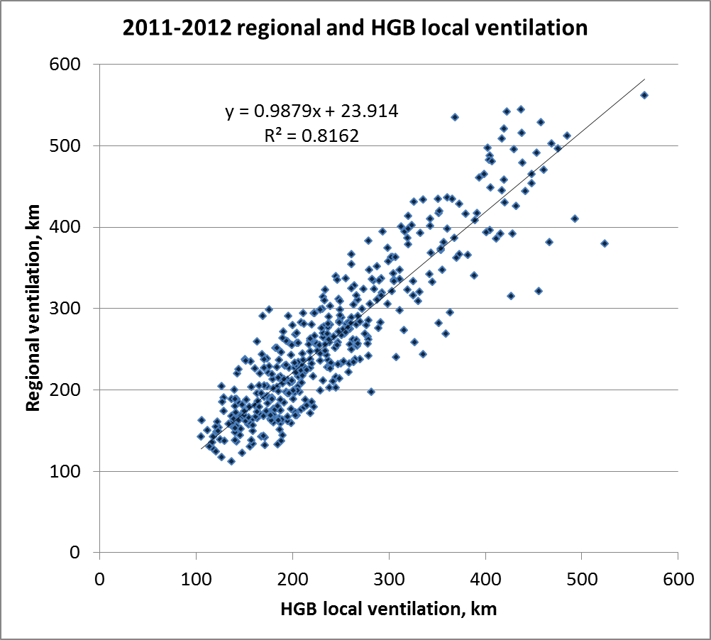
Notes:
Daily average regional and HGB local ventilation indices were closely correlated, suggesting that local stagnation tends to occur when meteorological conditions are stagnant regionally.

Slide 17
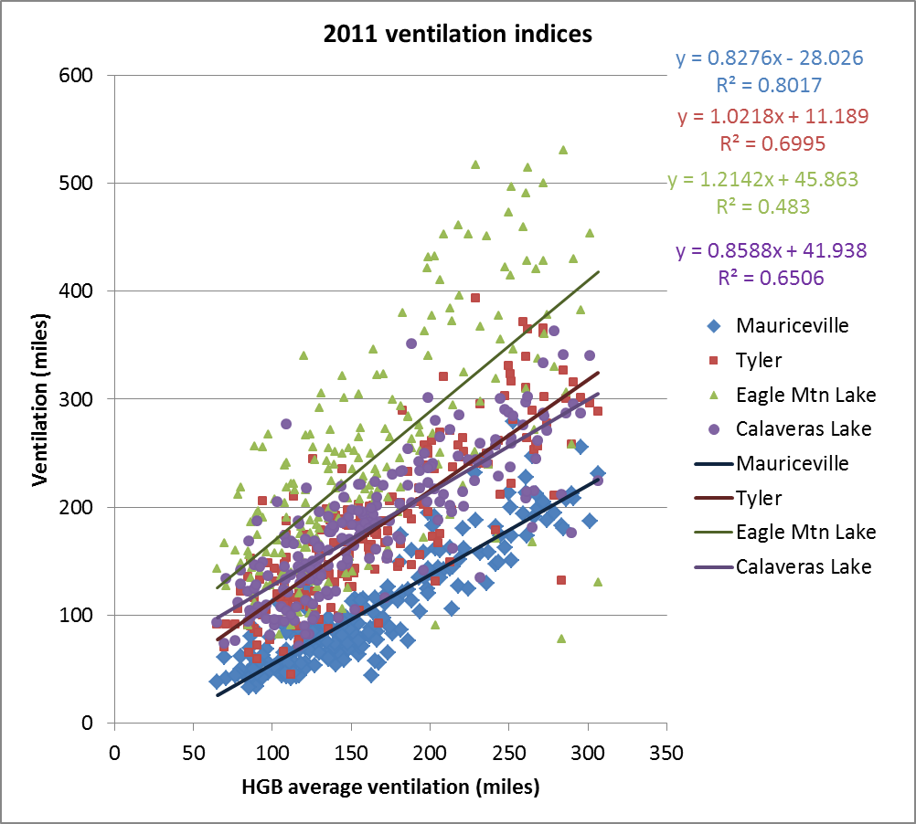
Notes:
In this graph, the HGB average daily ventilation index is compared to daily ventilation indices for four sites: Mauriceville, near Beaumont; Tyler; Eagle Mountain Lake, on the western edge of Fort Worth; and Calaveras Lake, just SE of San Antonio. The HGB average is correlated with all of these sites, though sites farther away have lower correlations, as one would expect.

Slide 18
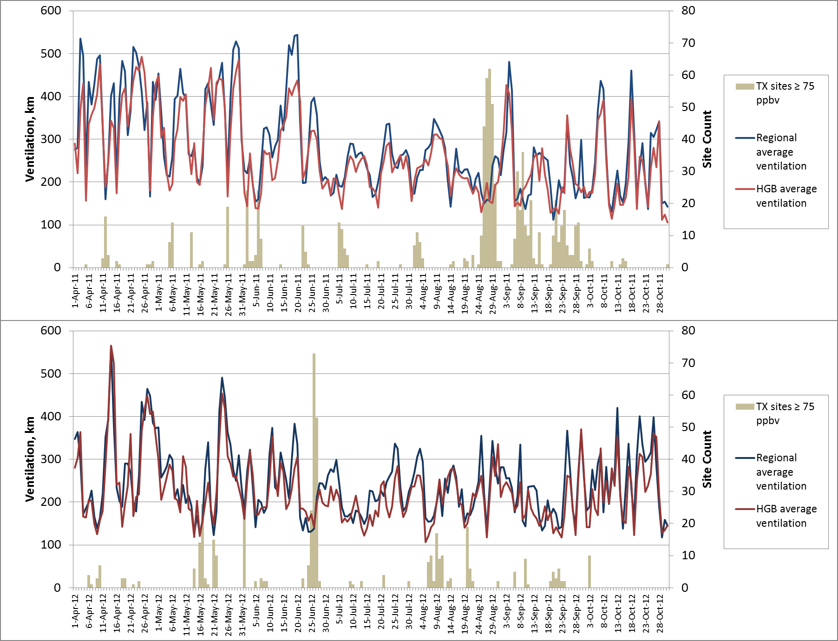
Notes:
Regional and HGB local ventilation track each other relatively well. Some periods of stagnation lead to high ozone (surpassing 75 ppbv). Long periods (5-10 days) of low ventilation are particularly conducive to high ozone across a widespread area. [Need to add Houston MDA8 ozone concentrations to these graphs]

Slide 19
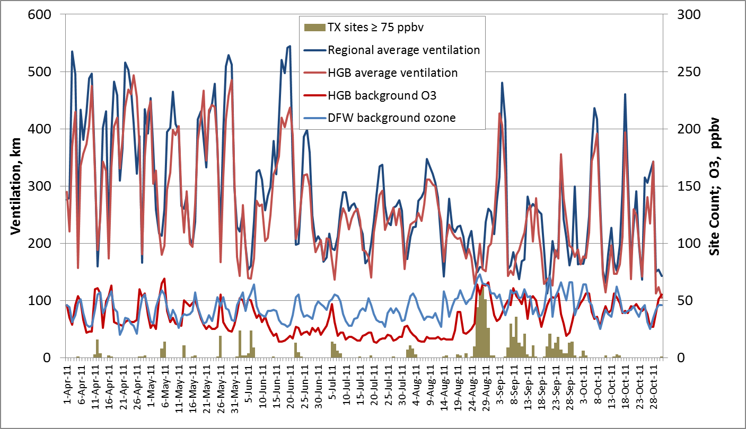
In 2011, spring frontal passages are punctuated by stagnant periods that lead to high background and peak ozone. Summer has lower ventilation, but also lower background, especially for HGB. Transition to fall leads to longer stagnant periods, widespread ozone.

Slide 20
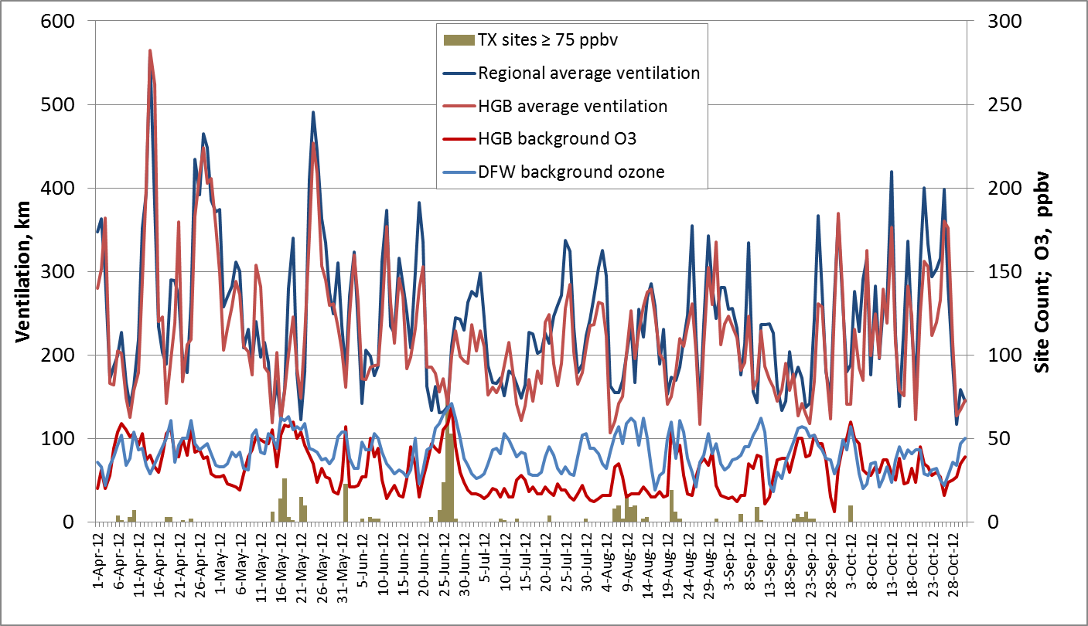
In 2012, spring frontal passages are less frequent than 2011. Mid-summer has an extended period of low ventilation and high background, leading to high MDA8 O3. Transition to fall has fewer stagnant periods, lower ozone.

Slide 21
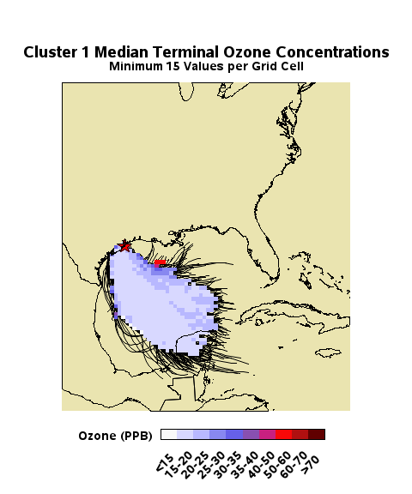
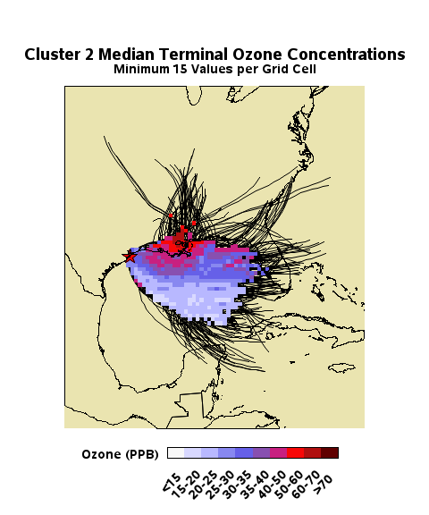
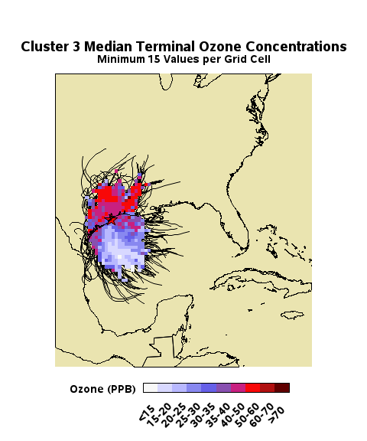
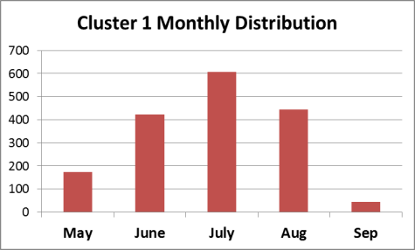
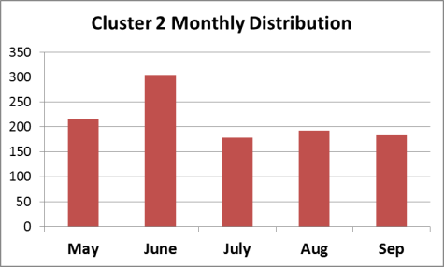
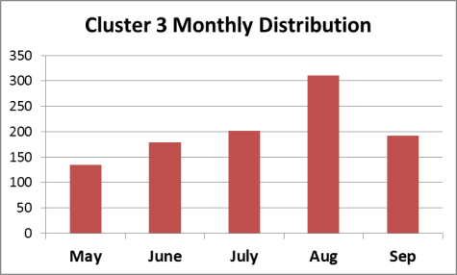
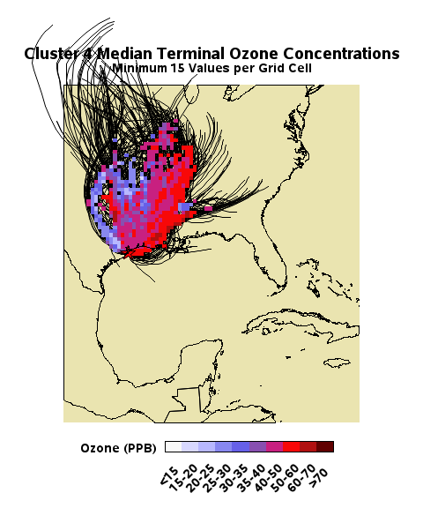
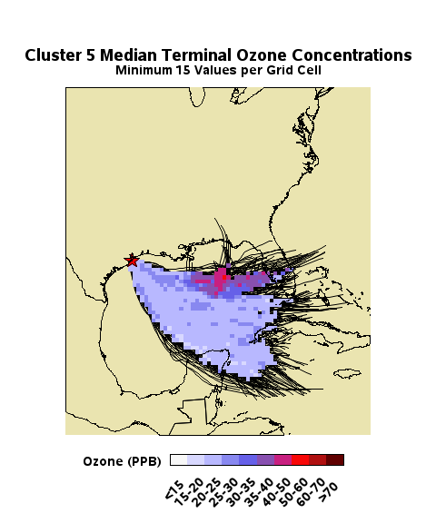
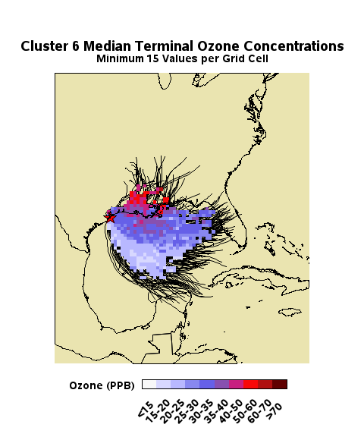
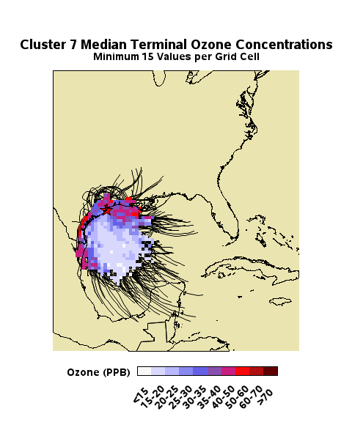
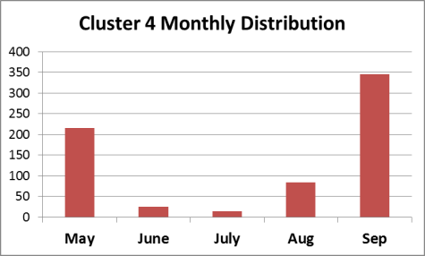
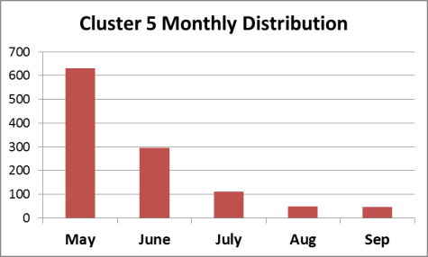
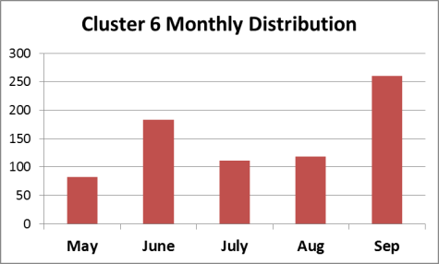
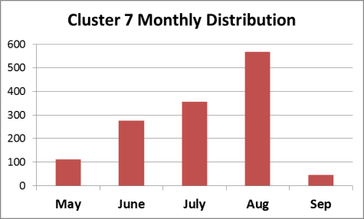
Monthly distribution of Galveston back trajectory clusters.
Notes:
The monthly distribution of Cluster 1 peaks in July, while that of Cluster 4 reaches its minimum then. July records relatively few high ozone concentrations, due to persistent southerly flow bring in clean Gulf air and flushing out local emissions. Continental flow in May and September often brings high ozone to Galveston, but much of that is from industrial areas in and around Houston to the north. Stagnant events (Cluster 3) peak in August and are often associated with flow reversals. Mid-August to Mid-September traditionally is the peak of the Houston ozone season.

Slide 22
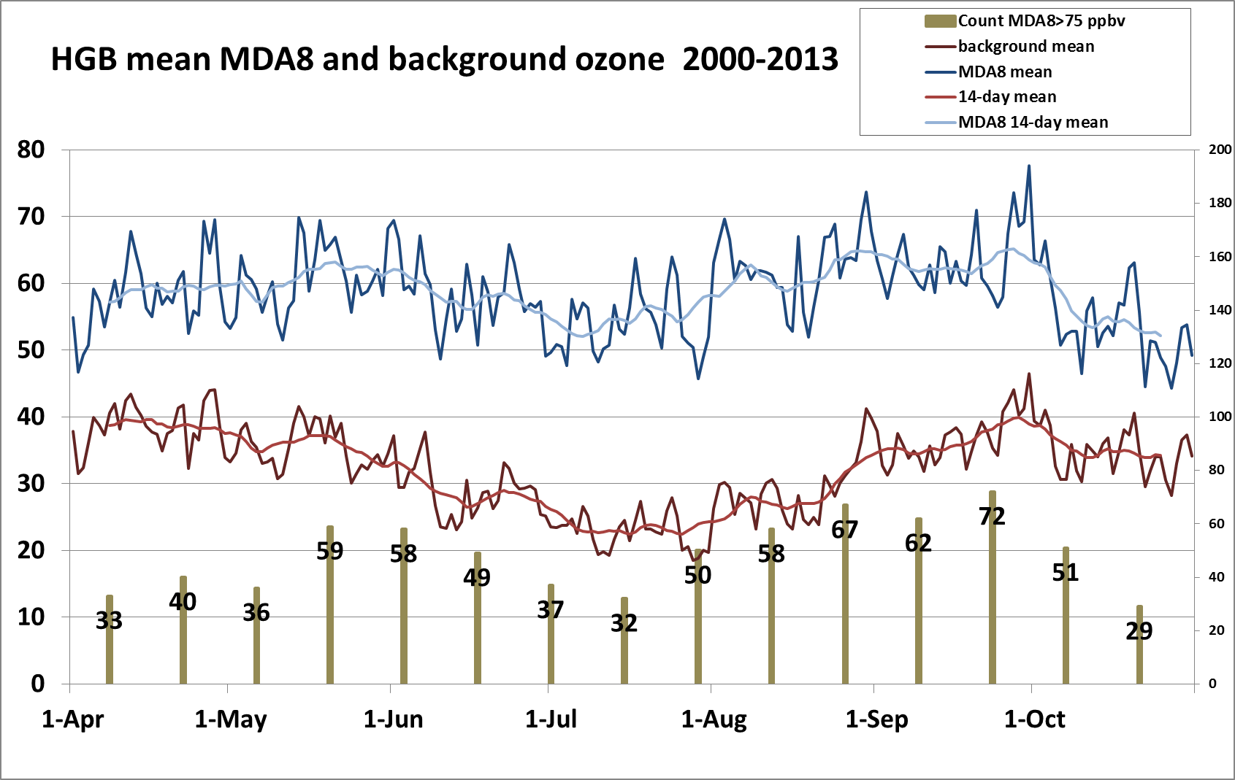
Notes:
Number of days from 2000-2013 above 75 ppbv peaks in late May-early June, and again in late August to late September. Coincides with higher background concentrations.

Slide 23
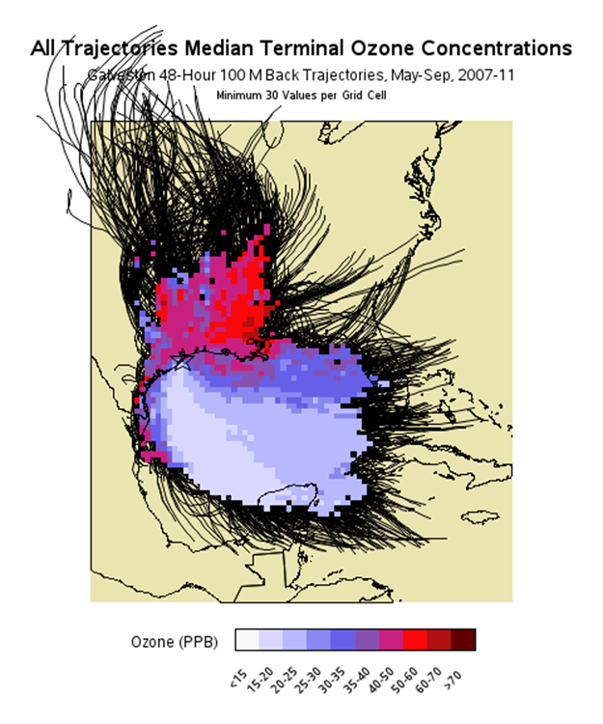
Highest concentrations linked to continental flow
Intermediate concentrations linked to coastal flow
Lowest concentrations linked to Gulf of Mexico flow
Notes:
Trajectories for every day, May-Sept 2007-2011 (odd hours 1-23). The 36 km CONUS grid was overlaid on trajectory map, and the observed ozone concentration at Galveston was associated with each trajectory passing through a grid cell (minimum of 30 trajectories per grid cell). The median concentration is calculated for all grid cells containing 30+ trajectory points. Warmer colors indicate higher concentrations; cooler colors indicate lower concentrations.
Note that warm colors in a grid cell do not necessarily indicate that it contains emission sources, only that when trajectories passed through that grid cell the ozone concentration at Galveston tended to be high.

Slide 24
Cluster 1 Median Terminal
Ozone Concentrations
Min 15 Values per Cell
Cluster 2 Median Terminal
Ozone Concentrations
Min 15 Values per Cell
Cluster 3 Median Terminal
Ozone Concentrations
Min 15 Values per Cell
Seven clusters of 3-D Galveston back trajectories produced by SAS FASCLUS procedure.
Cluster 4 Median Terminal
Ozone Concentrations
Min 15 Values per Cell
Cluster 5 Median Terminal
Ozone Concentrations
Min 15 Values per Cell
Cluster 6 Median Terminal
Ozone Concentrations
Min 15 Values per Cell
Cluster 7 Median Terminal
Ozone Concentrations
Min 15 Values per Cell
Notes:
The FASCLUS procedure did a nice job of separating different flow regimes into discernable groups. Clustering was based solely on trajectories (including altitude) and did not factor in ozone concentrations.
Note in particular Cluster 1 which represents very clean maritime air and Cluster 4 which represents continental flow with correspondingly higher concentrations. The other clusters include both maritime trajectories and those near or over land. The difference in ozone concentrations is obvious.

Slide 25
Findings
Regionally, background ozone varies with ventilation, but locally, background ozone is only weakly related to ventilation.
The local ozone increment has a strong, non-linear relationship to local stagnation. Stagnation is a necessary but not sufficient condition for high local ozone production.
Local and regional ventilation vary together, suggesting that larger scale weather patterns cause both.
DFW background is usually higher than HGB background, especially in mid-summer.
High background ozone is associated with post-frontal stagnation (in agreement with Rappenglueck 2009; Lefer 2010; Haman 2014; Davis 1997).
For these reasons, high ozone tends to occur in multiple eastern Texas cities simultaneously.

Slide 26
Findings
On average, background ozone in DFW varies little throughout the summer; in HGB, background ozone reaches a minimum during mid-summer (mid-June to mid-August).
Low HGB background ozone is due in part to transport from the Gulf of Mexico, which tends to occur in mid-summer in Houston.
Higher HGB background ozone occurs when transport is continental, and when transport occurs only over a short distance.

Slide 27
Findings3
June-July-August are not the only important months for high ozone; annual and multi-year modeling exercises must consider a longer period when studying the “ozone season.”

Slide 28
Contact information
Mark.Estes@tceq.texas.gov
  (512) 239-6049
Jim.Smith@tceq.texas.gov
  (512) 239-1941

