Slide 1
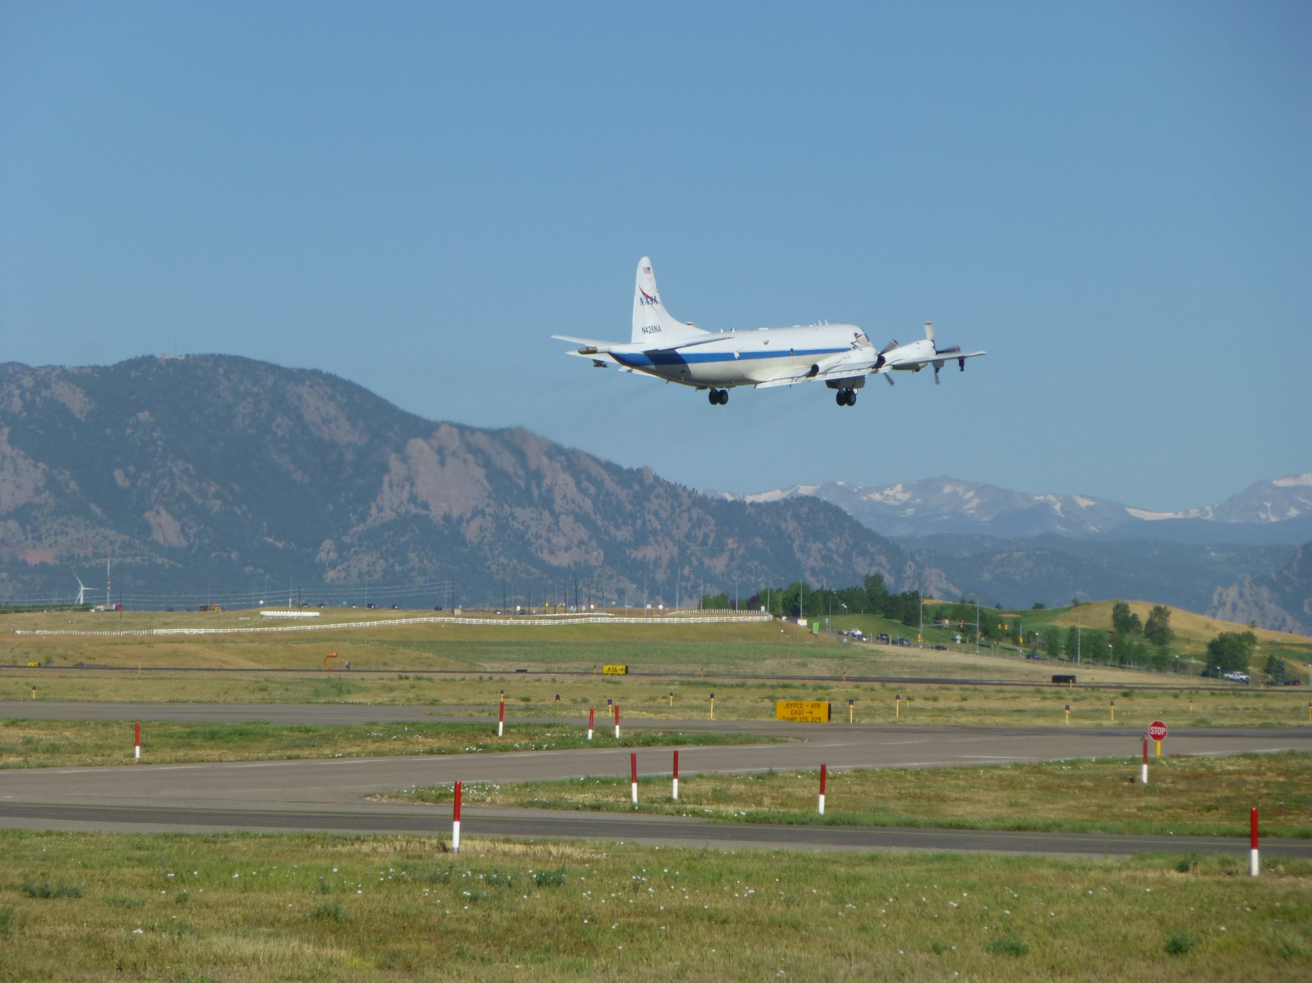
The July – August 2014 DISCOVER-AQ and FRAPPÉ Field Campaigns
in the Front Range Region of Colorado: Summary of Experiment
Design and Preliminary Findings
Ken Pickering, NASA Goddard
James Crawford, NASA Langley
Frank Flocke, NCAR
Gabriele Pfister, NCAR
Pius Lee, NOAA/ARL
Melanie Follette-Cook, GESTAR
The DISCOVER-AQ and FRAPPÉ
Observation Teams

Slide 2
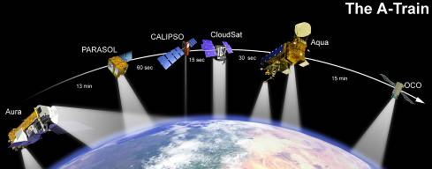
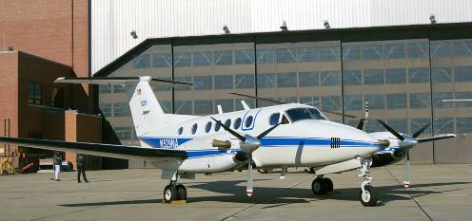
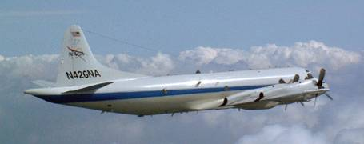
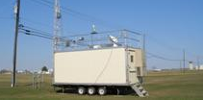
DISCOVER-AQ Overview
Deriving Information on Surface Conditions from Column
and VERtically Resolved Observations Relevant to Air Quality
A NASA Earth Venture campaign intended to improve the interpretation of satellite observations to diagnose near-surface conditions relating to air quality
Objectives:
1. Relate column observations to surface conditions for aerosols and key trace gases O₃, NO₂, and CH₂O
2. Characterize differences in diurnal variation of surface and column observations for key trace gases and aerosols
3. Examine horizontal scales of variability affecting satellites and model calculations
NASA King Air
NASA P-3B
Deployments and key collaborators
Maryland, July 2011 (EPA, MDE, UMd, and Howard U.)
SJV, California, January/February 2013 (EPA and CARB)
Houston, Texas, Sept. 2013 (EPA, TCEQ, and U. of Houston)
Front Range, Colorado, Summer 2014 (EPA, NCAR, CDPHE)
NATIVE, EPA AQS, and associated Ground sites
Notes:
DISCOVER-AQ is a 5-year, $30M airborne field study funded under NASA’s Earth Venture 1 program. The goals of the program are intended to shed light on challenges in observing air quality from space. Results are expected to be of direct benefit to GEO-CAPE planning and development.

Slide 3
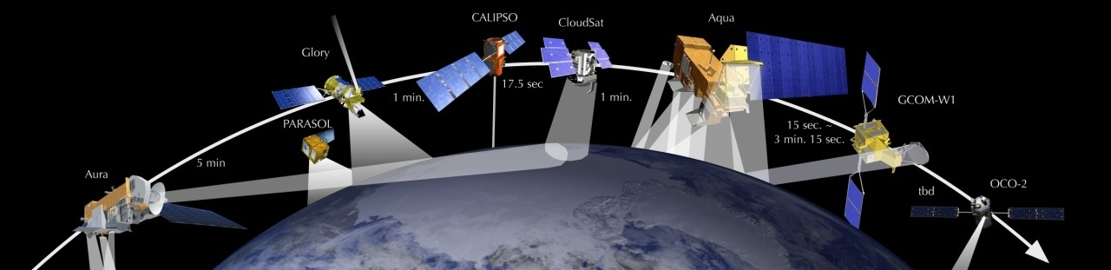
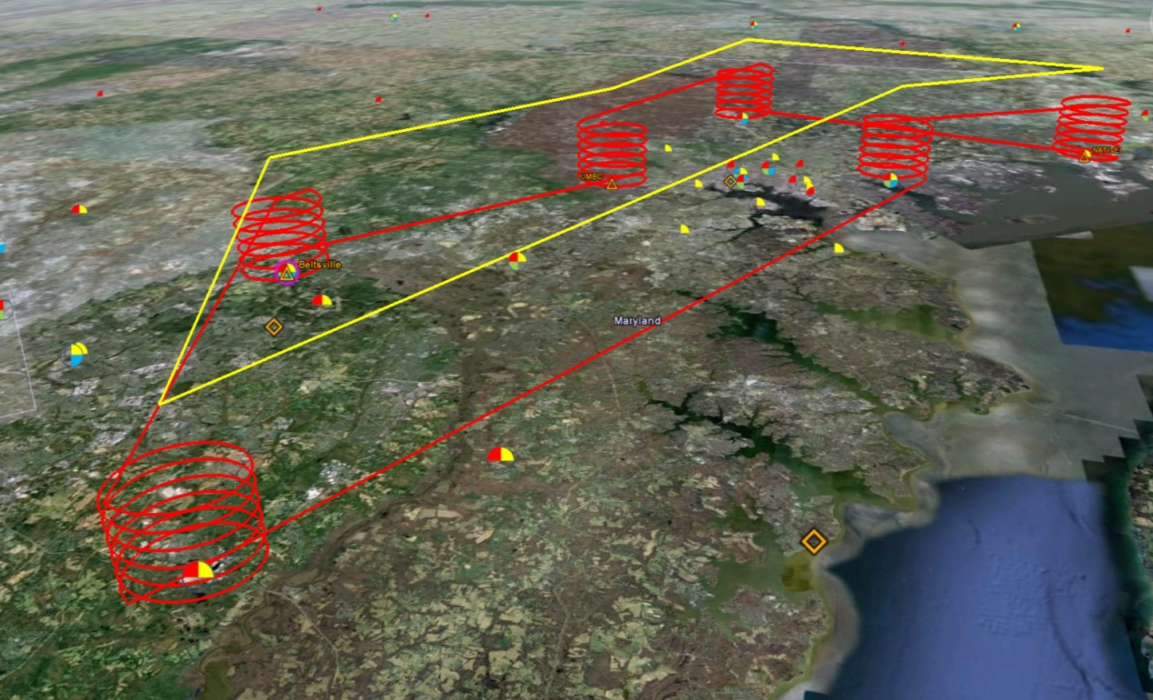
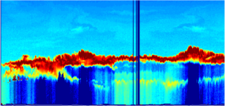

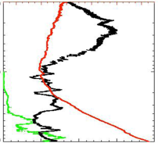
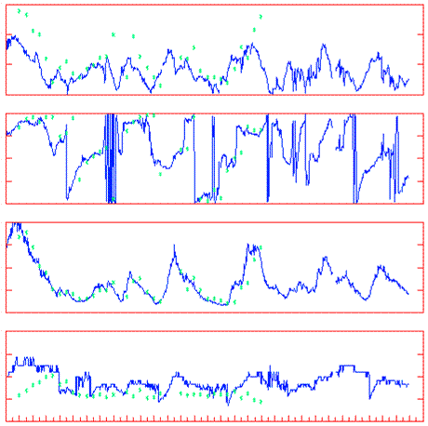
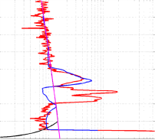
Deployment Strategy
Systematic and concurrent observation of column-integrated, surface, and vertically-resolved distributions of aerosols and trace gases relevant to air quality as they evolve throughout the day.
Three major observational components:
NASA B-200 (Remote sensing)
Continuous mapping of aerosols with HSRL and trace gas columns with ACAM
NASA P-3B (in situ meas.)
In situ profiling of aerosols and trace gases over surface measurement sites
Ground sites
In situ trace gases and aerosols
Remote sensing of trace gas and aerosol columns
Ozonesondes
Aerosol lidar observations
Notes:
The density and simultaneity of observations from different perspectives is a key aspect of DISCOVER-AQ in creating a dataset useful for linking remote sensing and in situ observations of air quality.

Slide 4
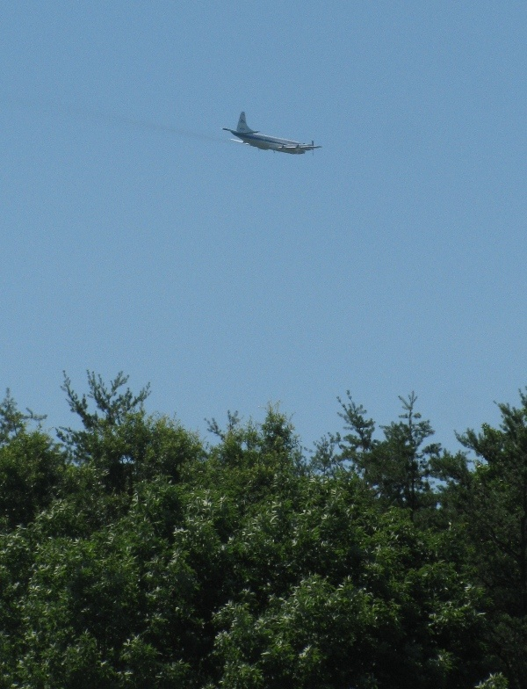
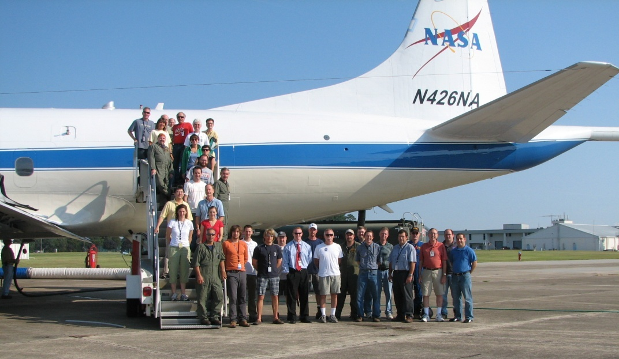
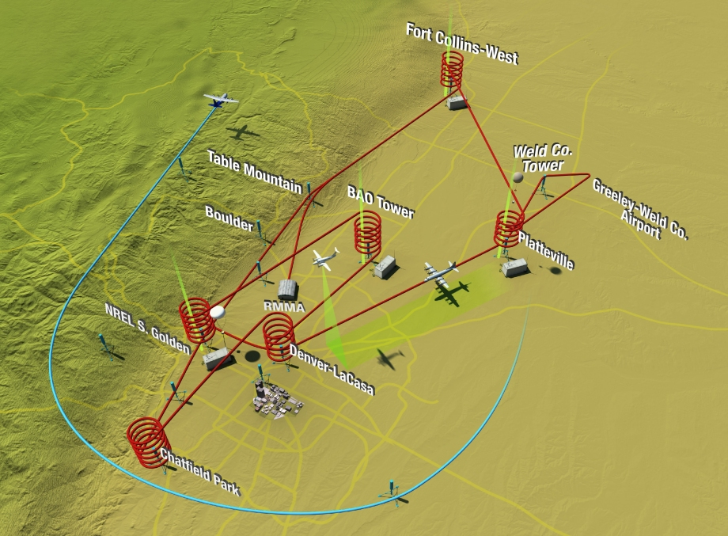
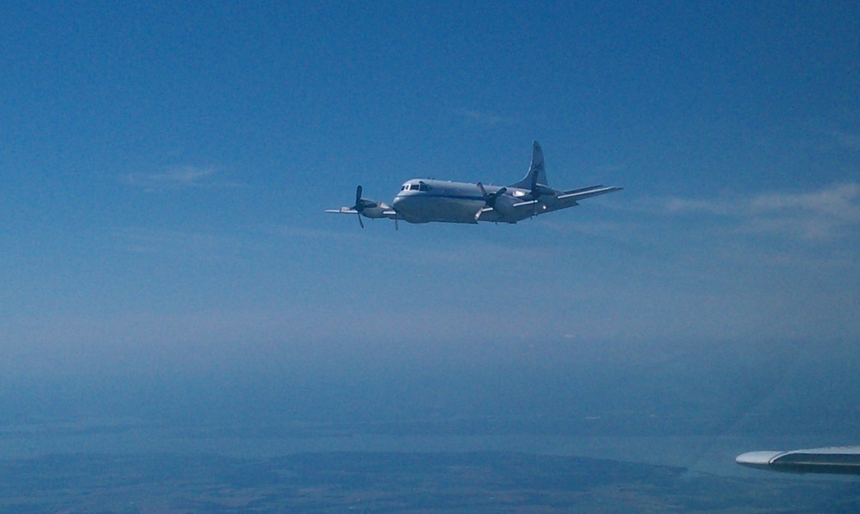
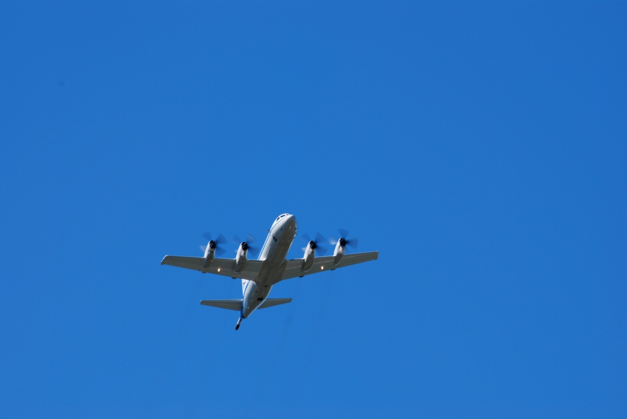
P-3B flights spiral over surface sites
(typically 3 times per day, 2 hours apart)
DISCOVER-AQ Colorado Front Range Campaign - July 17 – August 10, 2014
P-3B In Situ Airborne Measurements
Bruce Anderson, NASA LaRC | aerosol optical, microphysical, and chemical properties
Andrew Weinheimer, NCAR | O₃, NO₂, NO, NO_{y}
Ronald Cohen, UC Berkeley | NO₂, ANs, PNs, HNO₃
Alan Fried, NCAR | HCHO
Glenn Diskin, NASA LaRC | H₂O, CO, CH₄
Stephanie Vay, NASA LaRC | CO₂
Armin Wisthaler, Innsbruck | Non-methane hydrocarbons
Scott Herndon, Aerodyne | Fast ethane
GSFC O₃ lidar
MPL
Millersville U.
Tethersonde,
NO2 sonde, MPL
LaRC O₃ lidar
NOAA O₃
lidar
PSU Native Trailer,
Ozonesondes
16 Pandora UV/Vis spectrom.
16 AERONET sunphotometers
6 EPA NO2 sites
4 Aerosol lidars
2 Wind lidars
3 Instrumented trailers
3 missed approach airports

Slide 5
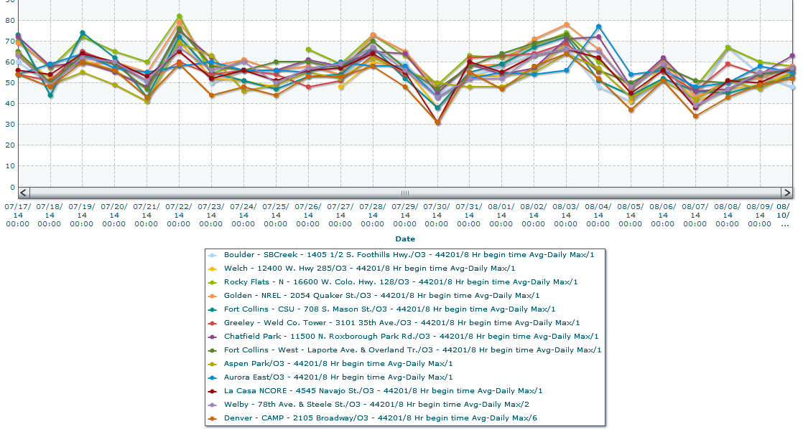
Daily 8-Hr Ozone Max (airnowtech.org)
July 17th – August 10th
82 Rocky Flats
79 Golden
76 Ft. Collins W.
75 Chatfield Pk.
75 Boulder
76 Golden
77 Aurora
78 Golden
80
60
40
8-Hour Ozone Max (ppb)
20
Notes:
Flight days

Slide 6
Ozone Summary for Colorado DISCOVER-AQ Flight Days
Surface Stations
Max 8-hr O₃ Max 1-hr O₃
50 – 59 ppbv 1 day 1 day
60 – 69 9 1
70 – 79 4 6
80 – 89 1 4
90 – 99 0 3
Only 2 out of 15 flight days exceeded 75 ppbv 8-hr NAAQS
Ozone production in Front Range limited by frequent and extensive cloudiness during July/August 2014:
Upper-level large-scale clouds from southwest monsoon
Upper-level outflow from convection over mountains
Local convection
Stratus resulting from low-level outflow from strong convection over Nebraska/Kansas
DISCOVER-AQ desired 8-hour duration flights; however P-3B averaged only
6.2 hours and B-200 averaged 5.4 hours due to cloudiness

Slide 7
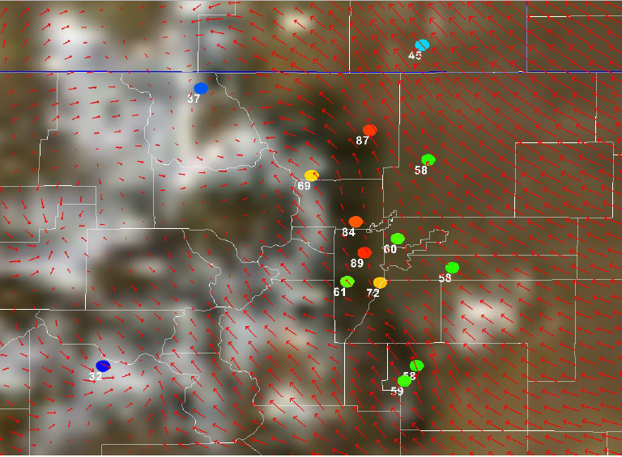
Mountain – Plains Solenoid Circulation may be important in driving high ozone in the
Front Range foothills in late afternoon
NAM 12-km Surface Winds 00Z 23 July
Surface Ozone (ppbv) 23Z (5 PM LT) 22 July
P. Reddy, CDPHE

Slide 8
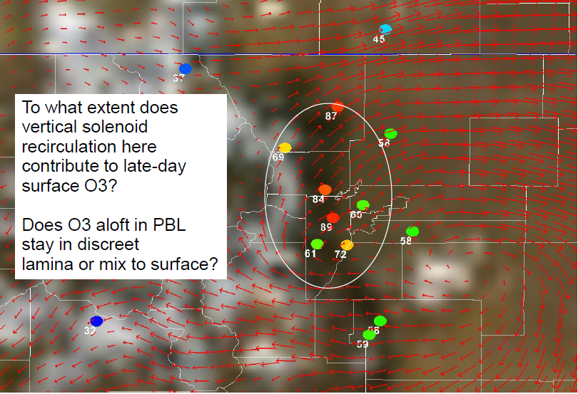
NAM 12-km 600 hPa Winds 00Z 23 July
Surface Ozone (ppbv) 23Z (5 PM LT) 22 July
P. Reddy, CDPHE

Slide 9
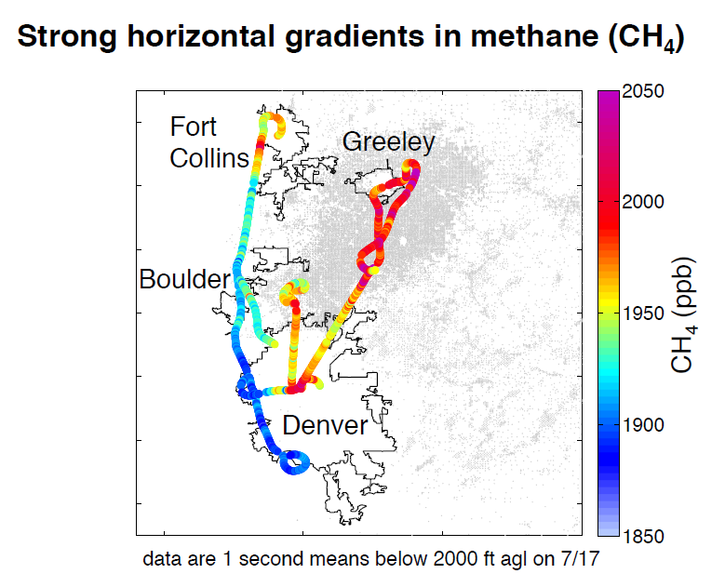
Preliminary data
from DACOM
instrument on
P-3B aircraft
Gray shading →
gas well locations
Platteville
Pusede and Diskin, LaRC

Slide 10


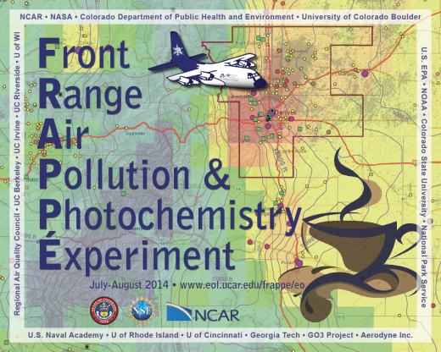
Front Range Air Pollution and Photochemistry Éxperiment
PIs: Gabriele Pfister and Frank Flocke
National Center for Atmospheric Research (NCAR)
Funded by State of Colorado & National Science Foundation
National Center for Atmospheric Research (NCAR), NASA Airborne Science Program
Colorado Department for Health and Environment (CDPHE), Colorado State University (CSU),
University of Colorado Boulder, Environmental Protection Agency (EPA) Region 8,
National Oceanic and Atmospheric Administration (NOAA), National Park Service (NPS),
Regional Air Quality Council (RAQC), UC Berkeley, UC Irvine, UC Riverside, US Naval Academy,
U of Wisconsin, U of Rhode Island, U of Cincinnati, Georgia Tech, GO3 Project, Aerodyne Inc., and others
Northern Front Range Metro Area (NFRMA)
July 17-August 18, 2014
http://www2.acd.ucar.edu/frappe

Slide 11
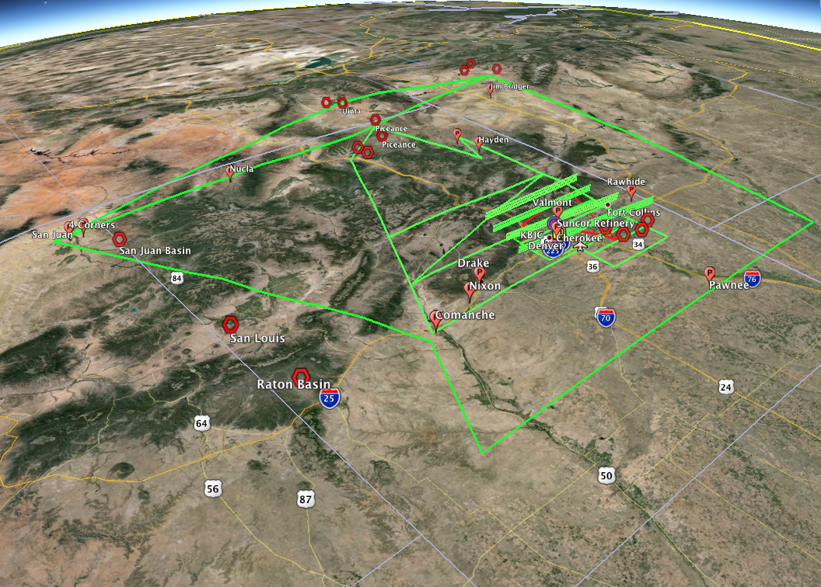
Regional Emissions
Large scale inflow
(CA, UT, Asia)
Local Emissions
and mountain-
valley circulation
Regional Emissions
Regional scale outflow
NCAR – C130
  88 Flight Hours
  Comprehensive AQ & Met sampling
Ground sites
  BAO Tower, Golden NREL
  6 Mobile labs – oil and gas facilities,
  CAFOs, urban areas
  Additional CDPHE surface monitors
  Tethered balloons – O₃ profiles
  O₃ and VOC E-W gradient sampling
C-130 flight tracks

Slide 12

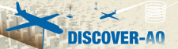

NAQFC-$β \text{f}$orecasting support: Initialized at 00 UTC with 60 hours forecast duration
WRF-ARW | Both North America (12 km) & CONUS (4 km)
Map projection & grid | Lambert Conformal & Arakawa C staggering
Vert. co-ordinate | 42 σ-p unevenly spaced levels
advection | RK3 (Skamarock and Weisman (2008))
SW & LW radiation | RRTMG (Iacono et al. 2008))
PBL Physics | Mellor-Yamada-Janjic (MYJ) level 2.5 closure
Surface layer scheme | Monin-Obukhov Similarity with viscous sub-layer
Land Surface Model | NCEP NOAH
Cloud Microphysics | Thompson et al. (2008)
Cloud convective mixing | Betts-Miller-Janjic Mass adjustment
AForecast: 12 km nested to 4 km
CMAQ4.7.1 | Both CONUS(12 km) & DISCOVER-AQ/FRAPPE (4 km)
Map projection & grid | Lambert Conformal & Arakawa C staggering
Vert. co-ordinate | 42 σ-p unevenly spaced levels
Gas chemistry | CB05 with 156 reactions
Aerosol chemistry | Aero5 with updated evaporation enthalpy
Anthropogenic emission | 2005 NEI as base year, mobile projected using AQS*, area and off-road used CSAPR, point source uses 2012 CEM data
 | WRAP oil and gas emissions data
Biogenic emission | BEIS-3.14
Lateral BC | RAQM (B. Pierce)
42 vertical layers
Air Resources Laboratory/NOAA
Notes:
^12 km domain is set a bit large to match National AQ Forecasting Capability for side-by-side verification.

Slide 13
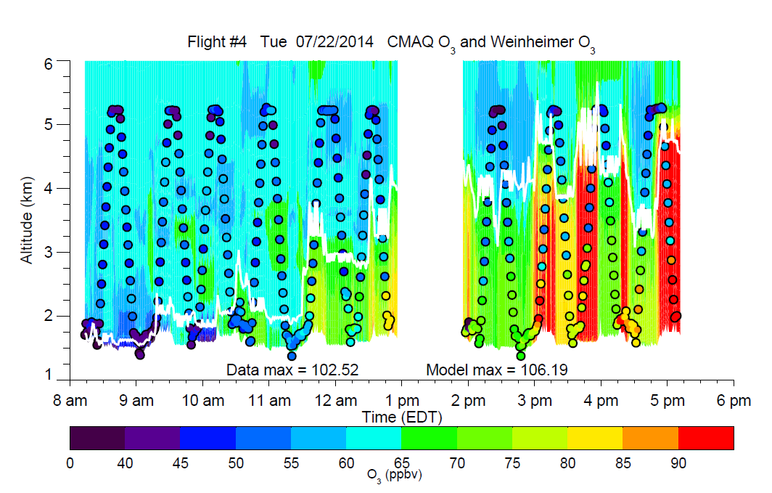
Preliminary Evaluation of NOAA CMAQ forecasts using DISCOVER-AQ P-3B In-situ Observations
One of two days exceeding the NAAQS for ozone
Preliminary P-3B data

Slide 14
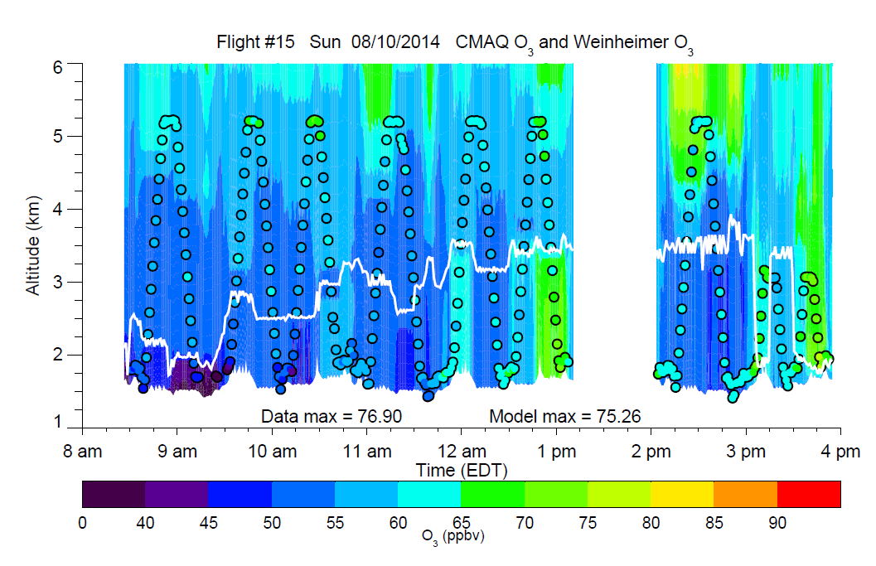
Model forecast did well on this relatively clean day
Preliminary P-3B data

Slide 15
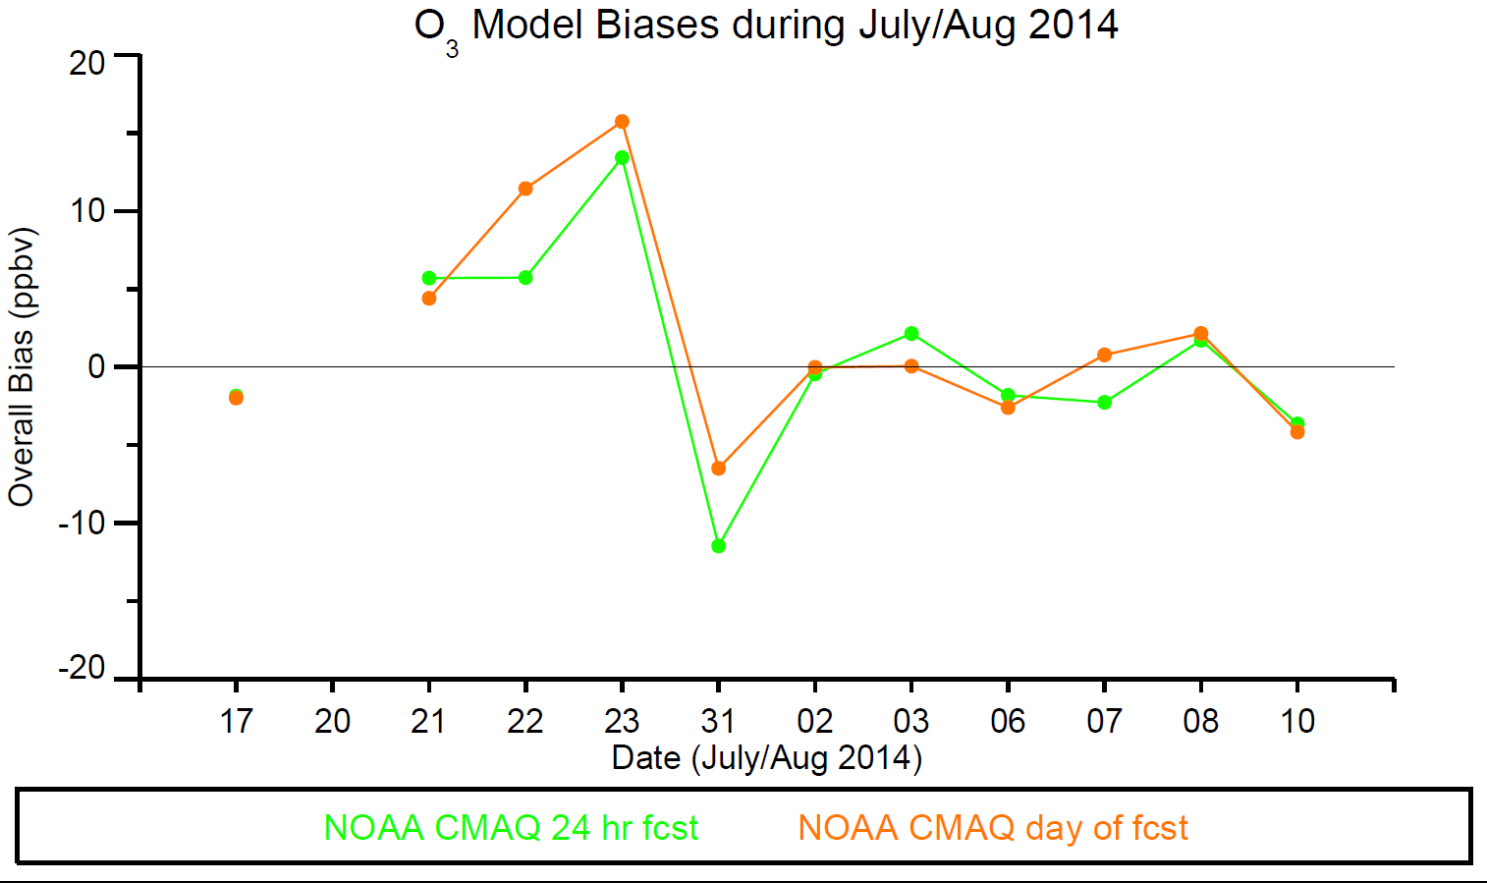
Mean
Low-level stratus cloud not forecast;
reduced ozone production
Mean percent biases:
Day before: 2.8%
Same day: 4.6%
Based on preliminary P-3B data

Slide 16
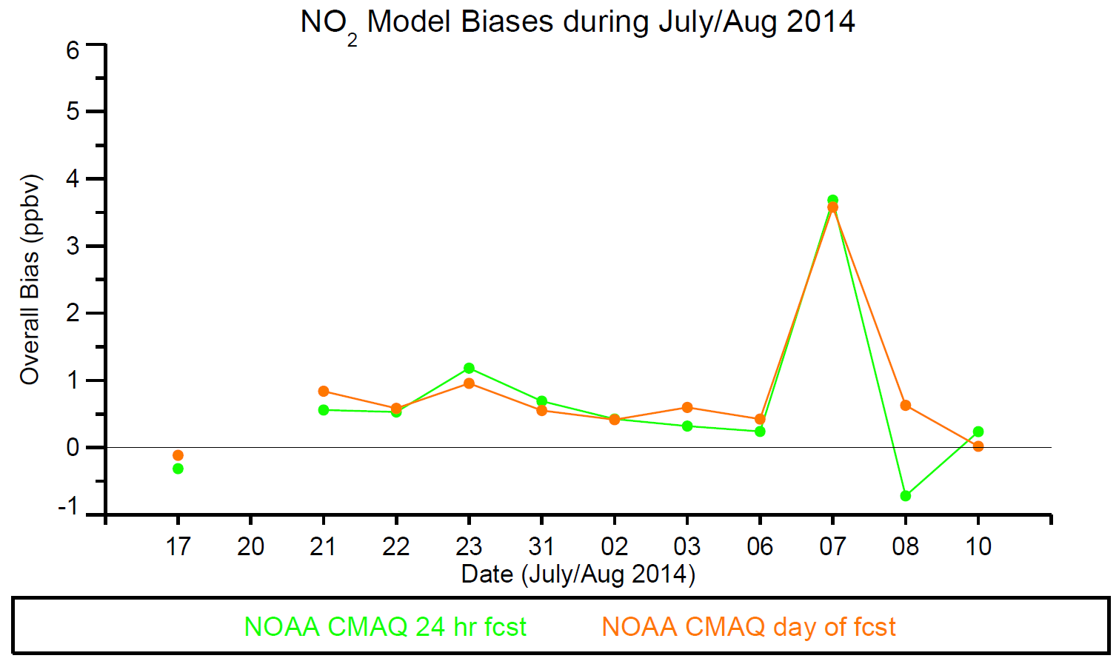
Mean
Based on preliminary P-3B data

Slide 17
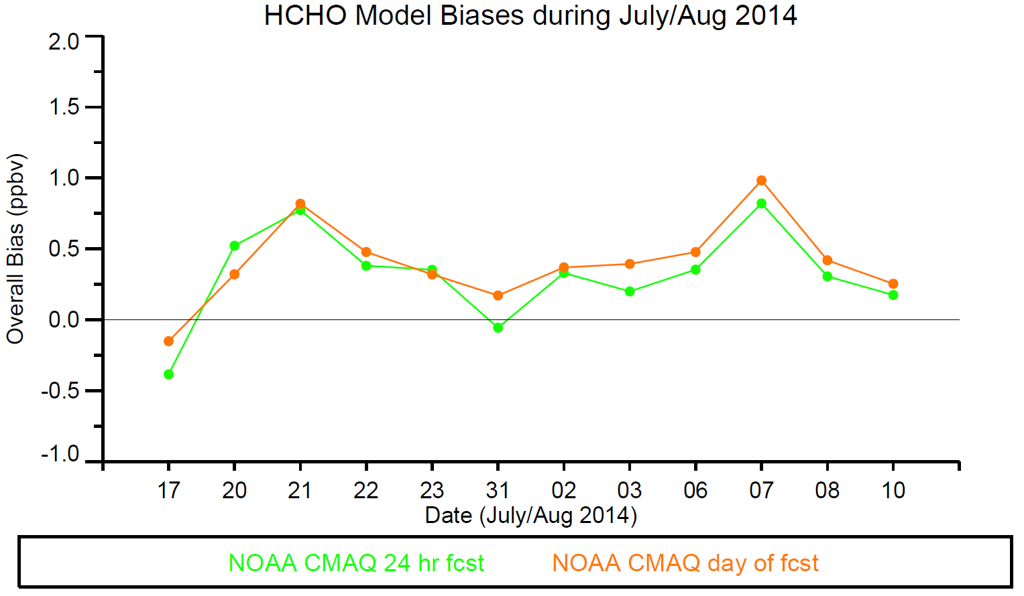
Mean
Mean Percent Biases:
Day before: 64%
Same day: 72%
Based on preliminary P-3B data

Slide 18
NOAA 4-km CMAQ Performance Based on Median Percent Bias
 | Overall | PBL | FT
O₃ | Day before -0.45% | Same Day 0.93% | - 1.72%
NO₂ | Same day -24.76% | Same day 0.86% | Same day -59.76%
CO | - 4.12% | - 7.49% | - 2.14%
HCHO | Day before 32.13% | Day before -14.44% | Day before 52.40%
- ← indicates that the difference between forecasts was less than 1%

Slide 19
DISCOVER-AQ Colorado Campaign Summary
15 flight days by the NASA WFF P-3B
17 flight days by the NASA LaRC B200
8 joint flight days with the NSF/NCAR C-130 -- FRAPPÉ
9 joint flight days with the NASA LaRC Falcon -- Geo-TASO
Routine overflight of three ozone lidars from NASA’s Tropospheric Ozone Lidar Network (TOLNet)
Routine overflight of NOAA’s instrumented 1000 ft BAO tower
Routine overflight of other ground assets: Pandora spectrometers, AERONET sunphotometers, aerosol lidars, tethered balloon observations, mobile labs
Two flight days documented conditions for ozone that exceeded federal air quality standards On many other days, ozone production was interrupted by afternoon storms, avoiding the potential for additional violations.
Clearly identifiable chemical signatures noted associated with urban emissions, oil and gas exploration, and feedlot operations.
NOAA NAQFC-β at 4-km resolution well predicted ozone in PBL and FT
Final data available – mid-December 2014
http://www-air.larc.nasa.gov/missions/discover-aq/discover-aq.html

Slide 20
FRAPPÉ Very Preliminary Findings
Clearly identified and characterized all emission sources in the Front Range (FR) and W slope
Northern FR region / Greeley / DJ Basin dominated by oil and gas extraction / processing and agricultural emission signatures
Urban center usually dominated by traffic and industrial emissions
Oil/gas and urban emissions can sometimes stay regionally separated, even into foothills with some mixing in/downwind of northern Denver suburbs
In the absence of wildfires, this summer’s Front Range air quality was controlled by local emissions, not large scale inflow
Air quality / ozone production and transport in(to) eastern foothills and to the continental divide dominated by FR emissions, not inflow from the west
Outflow from FR into eastern plains can be significant
Extremely rich data set, surface not even scratched yet

