Slide 1
Comprehensive comparisons of NAQFC surface and column NO₂ with satellites, surface, and field campaign measurements during 2009-2014
Hyun Cheol Kim ^{1,2}, Pius Lee ¹, Li Pan ^{1,2}, Laura Judd ³, Daniel Tong ^{1,2}, Youhua Tang ^{1,2}, Tianfeong Chai ^{1,2}, Barry Lefer³, and Ivanka Stajner ⁴
¹ NOAA/Air Resources Laboratory, College Park, MD
² UMD/Cooperative Institute for Climate and Satellites, College Park, MD
³ University of Houston, Dept. of Earth and Atmospheric Sciences, Houston, TX
⁴ NOAA/National Weather Service, Silver Spring, MD

Slide 2
General goals & focuses of today’s talk
This study is to provide comprehensive comparisons of NAQFC simulated NO₂ with observations over CONUS
To evaluate and understand NAQFC system’s performance
To understand long-term changes of observed NO₂ from surface and space, and their implications on NO_{x} emission trend
Two highlights were selected
Long-term trend of surface NO₂ from observations and model
Trends of NAQFC, AQS, CEM, GOME, OMI, SCIAMACHY and GOME-2 (2000-2014)
Synergy of satellite + model hybrid approach to provide more complete fine-scale NO₂ field
OMI+NAQFC versus P₃ flight NO₂ VCD during 2010 CALNEX)

Slide 3
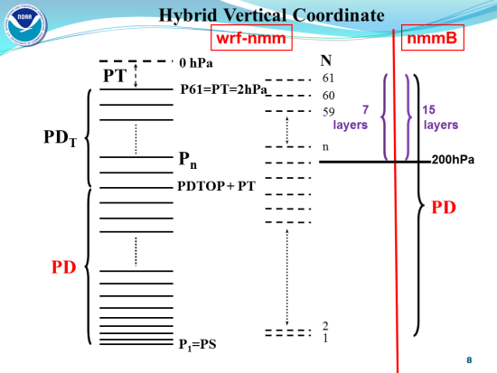
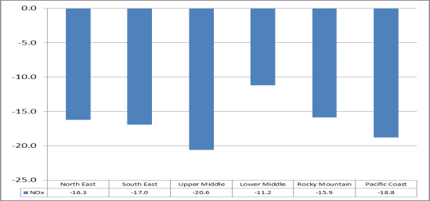
National Air Quality Forecast Capability
NAM(WRF-NMM)/CMAQ/SMOKE system
The Experimental NAQFC (CB05) has been used for this analysis
Routine updates
Point source emission update based on CEM + DoE Annual Energy Outlook (AEO)
Major updates
Model configuration
NMMB succeeded WRF-NMM as NAM at NCEP (Oct. 18, 2011)
Horizontal grid (E-grid → B-grid)
Hybrid vertical coordinate
Land Use Land Cover change (USGS→IGBP)
CMAQ update (Oct, 2011)
PBL adjustment, LBC, and dry deposition, IGBP
Major emission update (May 1, 2012)
Mobile: 2005 MOBILE6 with 05 to 12 projection
Area source (nonroad) : Cross-state Air Rule Projection (CSAPR)
Canadian EI : 2006 EI
NOx emission reduction (Pan et al., 2014)

Slide 4
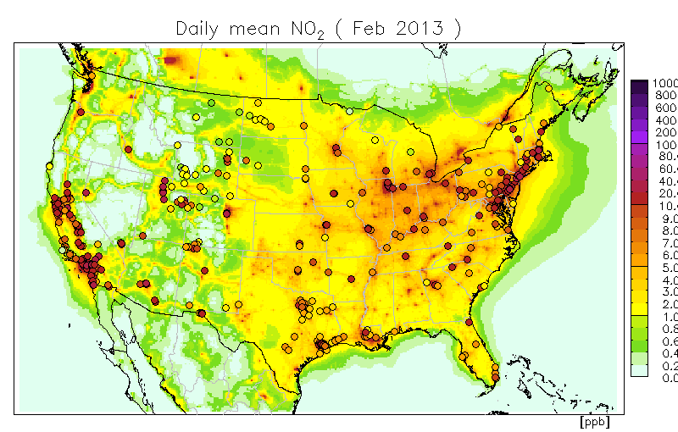
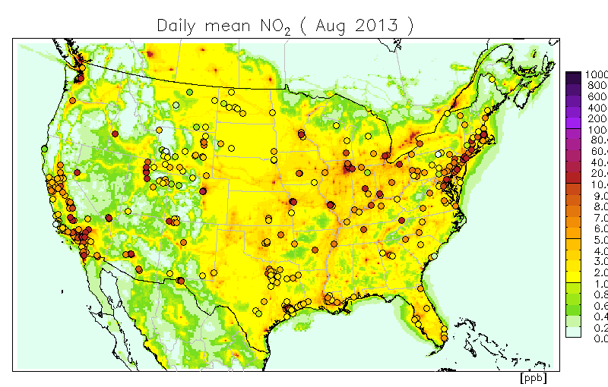
Surface NO₂ (AQS & NAQFC)
The Air Quality System (AQS) is EPA's repository of ambient air quality data.
~ 400 sites for surface NO₂ monitoring

Slide 5
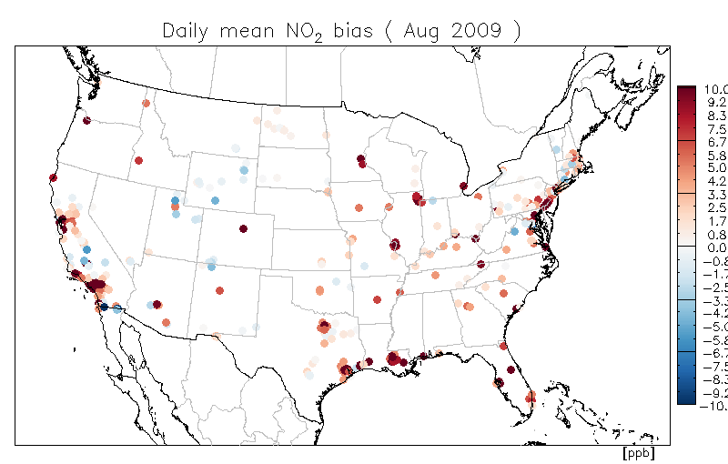
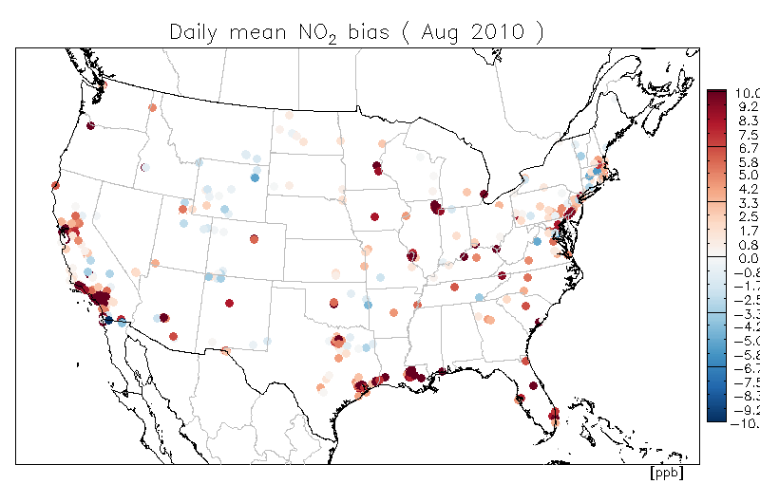
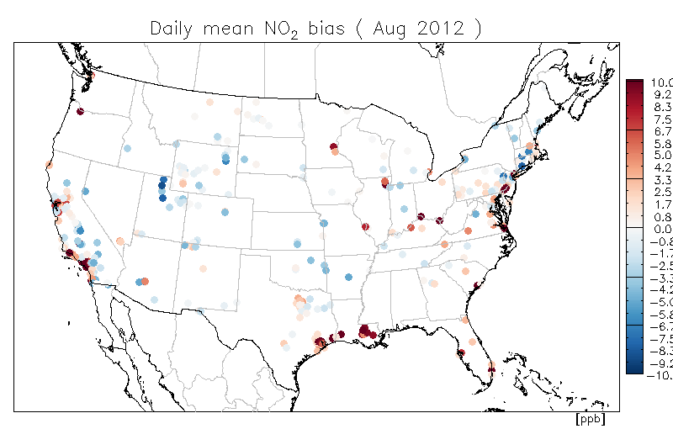
Surface NO₂ bias (NAQFC-AQS)
Aug. 2009
Aug. 2010
Reduced bias since 2012
Aug. 2012
Aug. 2013

Slide 6
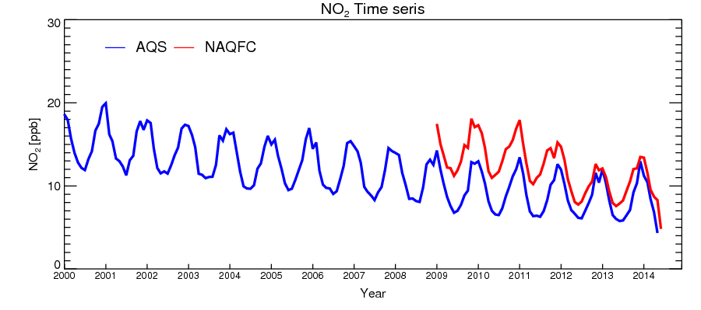
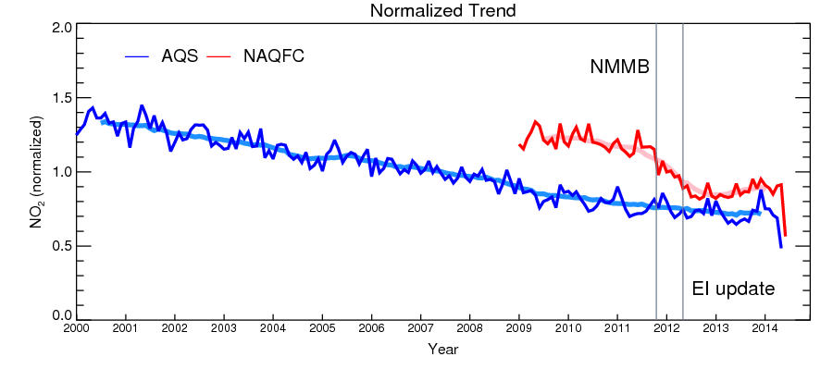

Slide 7
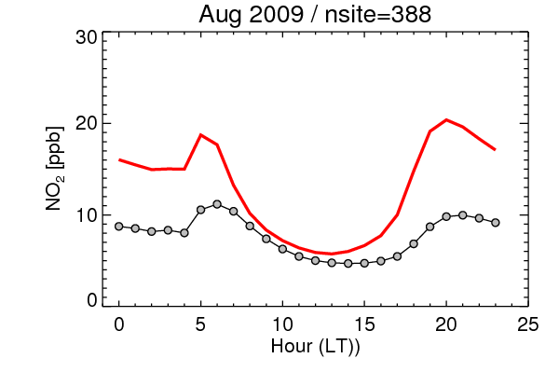
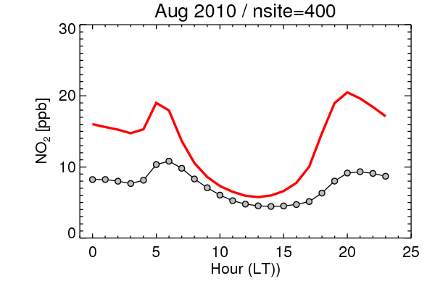
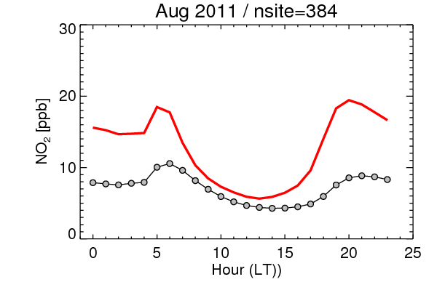
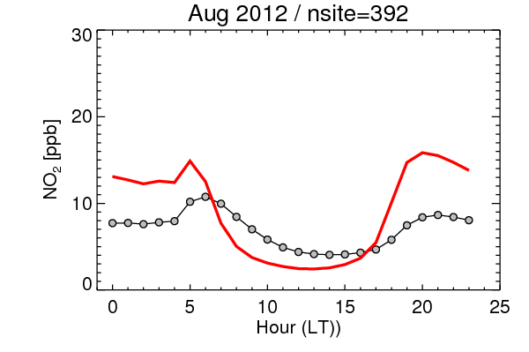
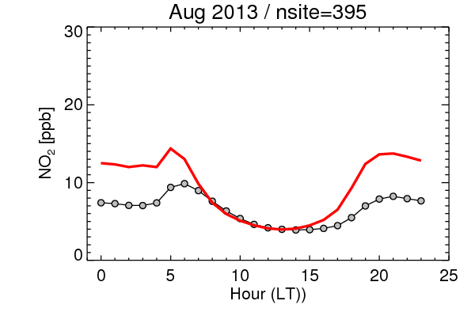
Diurnal variation (Aug.)
NAQFC AQS
Inconsistency in diurnal variation
Emission temporal allocation?
PBL?
Reduced in 2012

Slide 8
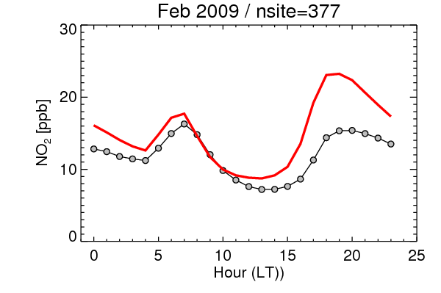
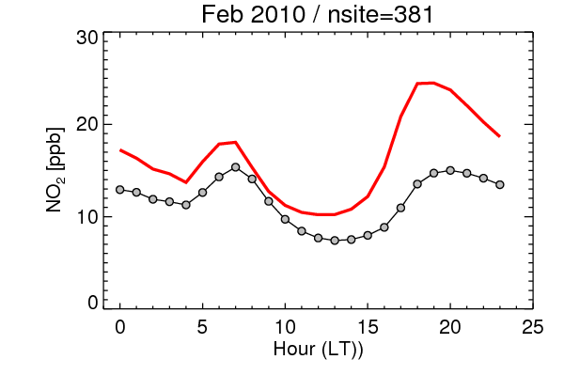
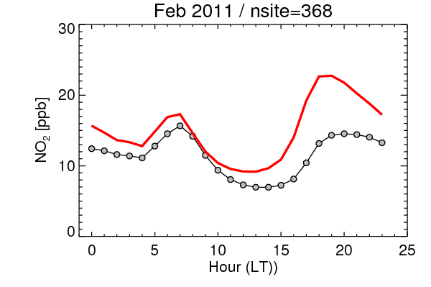
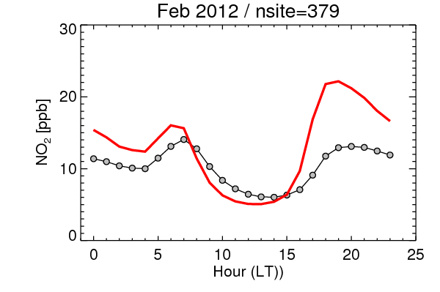
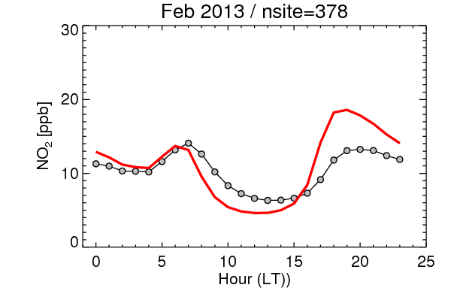
Diurnal variation (Feb)
NAQFC AQS
Reduced in 2012
Still overestimated in Afternoon

Slide 9
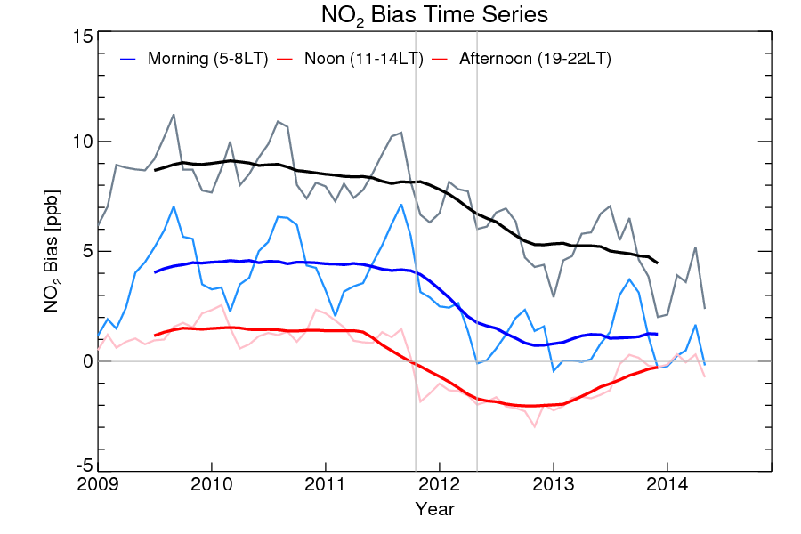
NO₂ Bias (NAQFC-AQS) by hour

Slide 10
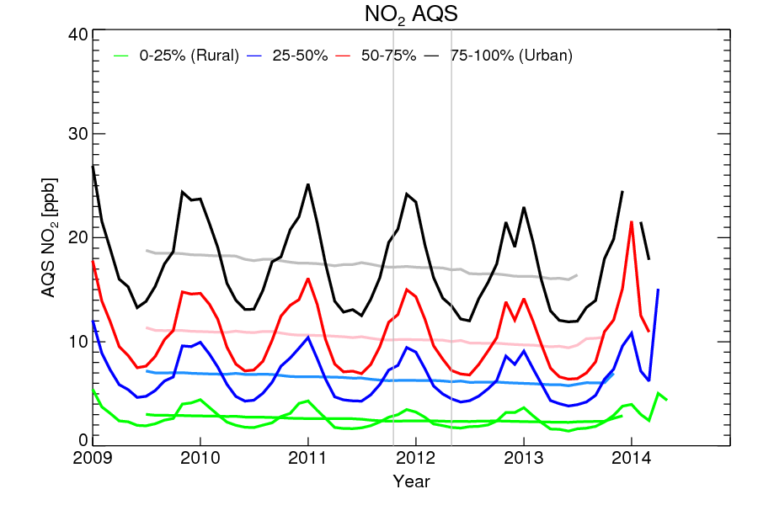
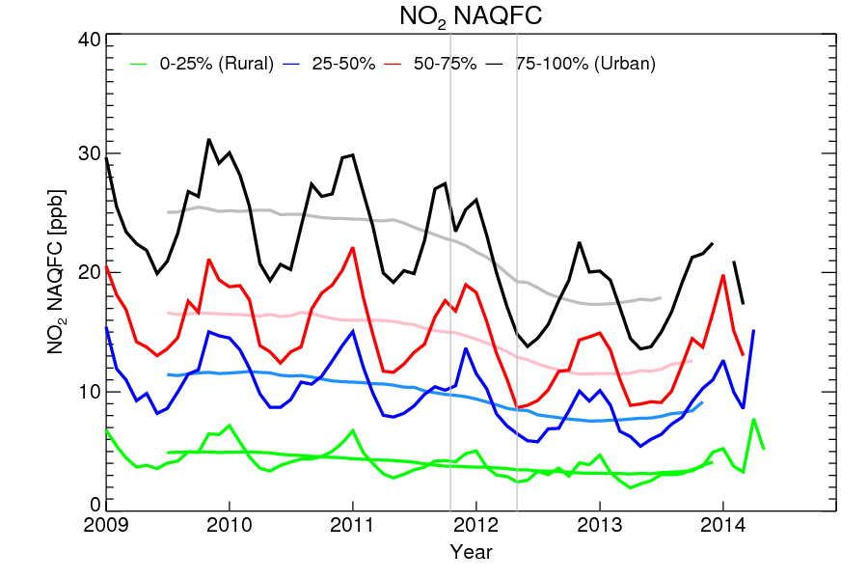
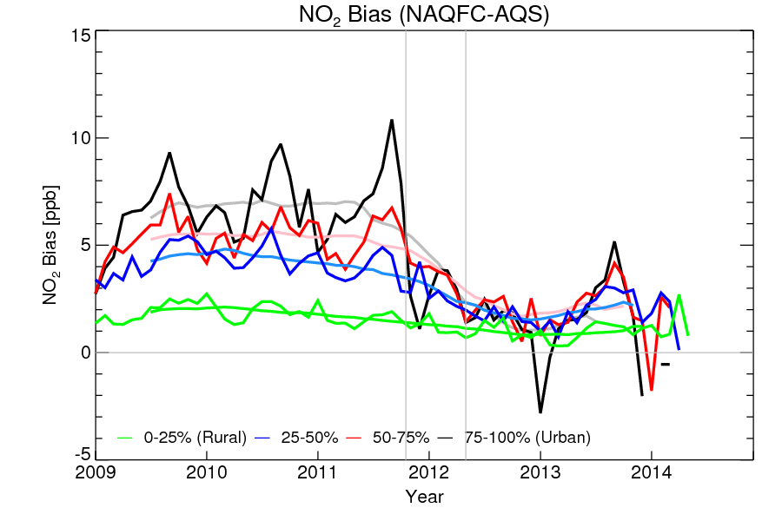
NO₂ time series (urban & rural)
Percentile sorted by mean concentrations for each site.

Slide 11
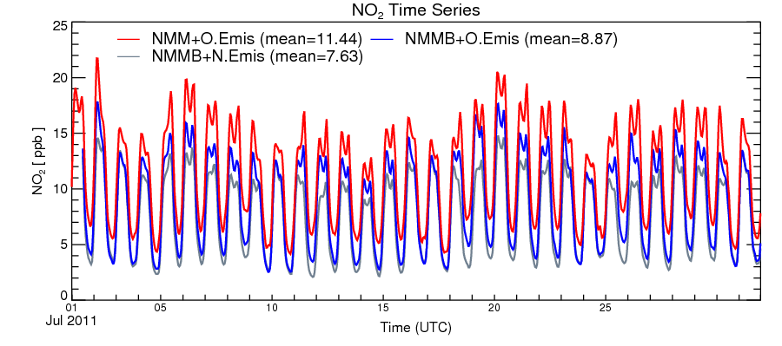
Sensitivity test (Jul. 2011)
Changes to the met driver (NMM to NMMB) and system configuration (LBCs, dry deposition, minimum PBL height) contribute ~67% of surface NO₂ change

Slide 12
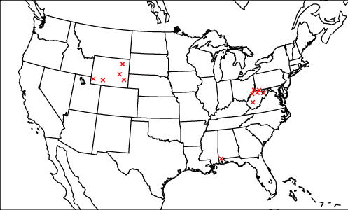
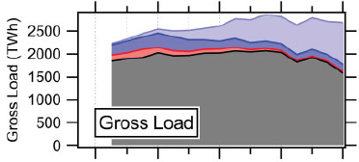
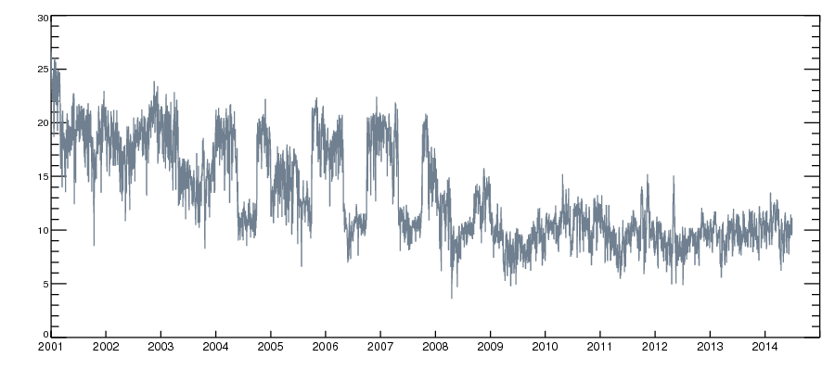
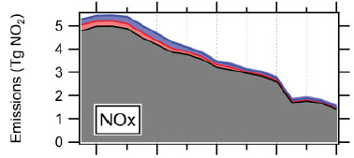
Decreasing NO_{x} emission trends (Continuous Emissions Monitoring system/CEMs)
Daily mean NOx emissions (tons) averaged over 12 selected power plants
(de Gouw et al., 2013)

Slide 13
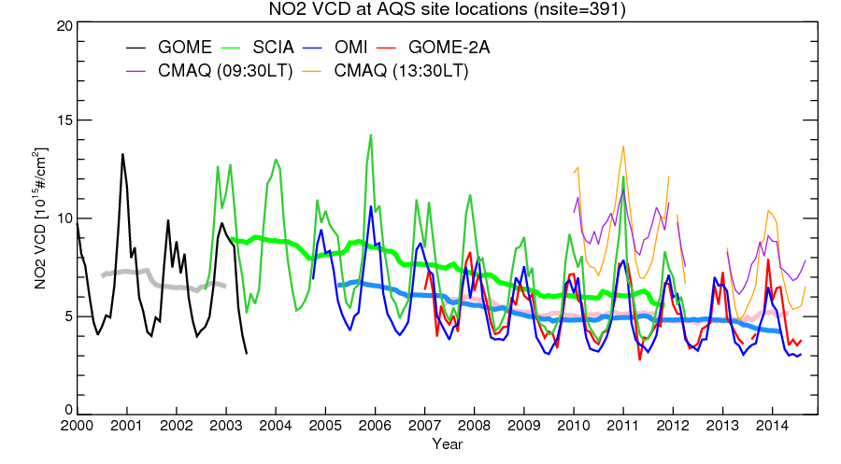
NO₂ Tropospheric VCD trend
Instrument | Satellite | Local pass | Resolution | Data
GOME | ERS | 10:30 LT | 320x40 km | 1996-2003
SCIAMACHY | ENVISAT | 10:00 LT | 30x60 km | 2002-2012
OMI | Aura | 13:30 LT | 13x24 km | 2004-
GOME-2 | MetOp-A MetOp-B | 09:30 LT | 40x80 km | 2007- 2013-
Decreasing trends from all satellites
Note: resolution differences are not resolved yet

Slide 14
NO₂ trends over CONUS (2000-2014)
Declining trends of surface and column NO₂ has been observed from surface AQS, satellites, and CEM NO_{x} emission monitoring
Model could not reproduce continuous changes, but was improved by emission update and model configuration change.
Change of met driver and system configuration (LBCs, dry deposition, minimum PBL height) had a large impact on simulated NO₂ concentrations

Slide 15
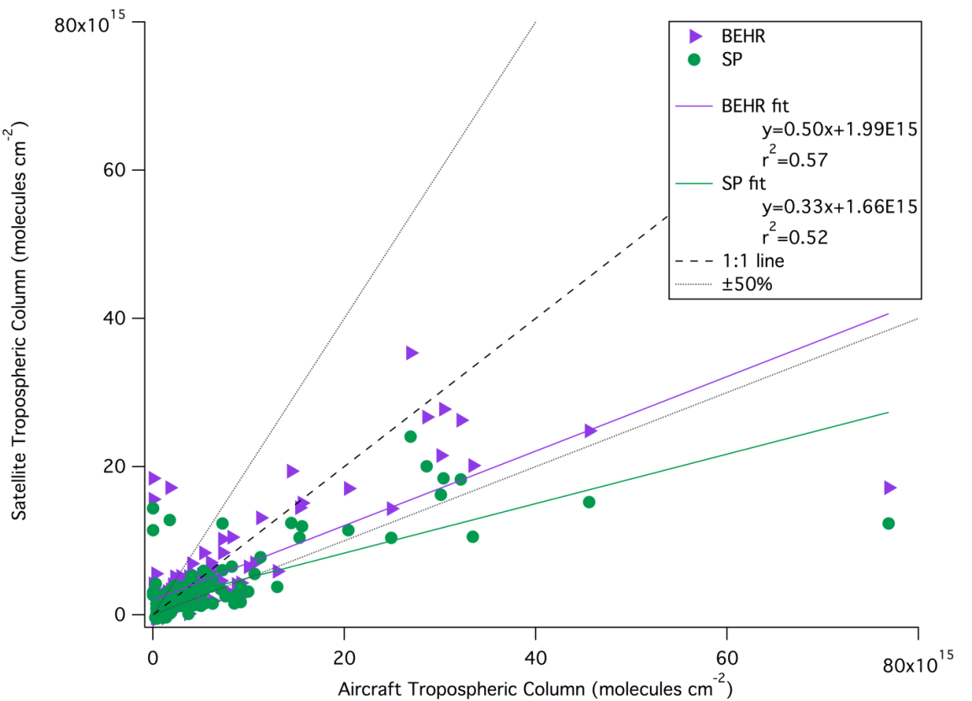
OMI & P3 flight NO₂ column comparison during 2010 CALNEX
Problem: Inhomogeneity of urban NO₂ plumes
Satellite tends to underestimate at urban area
OMI and P3 observations during then CALNEX campaign (Judd et al., in preparation)

Slide 16
Satellite + Model hybrid approach
Satellite provides near real-time observations, but has a limitation in spatial resolution.
Fine-resolution model provides better geospatial information based on Emission Inventory Database, but its emission input tends to be outdated.
Satellite magnitude + Model spatial distribution

Slide 17
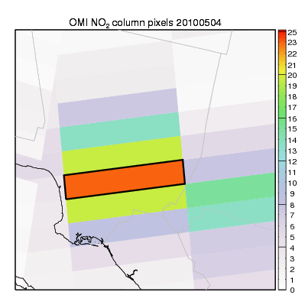
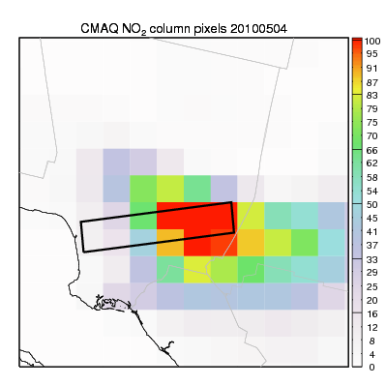
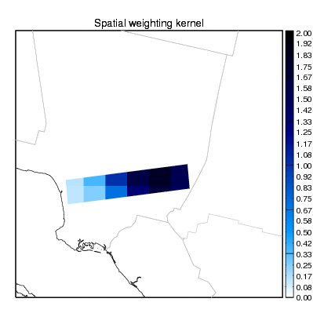
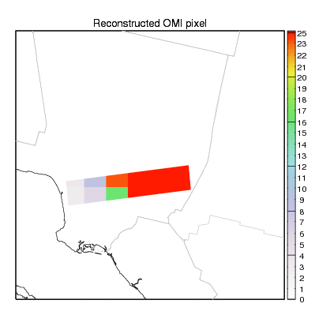
Original OMI NO2 VCD pixels
CMAQ
NO2 VCD
Spatial weighting Kernel
Adjusted OMI NO2 VCD pixel

Slide 18
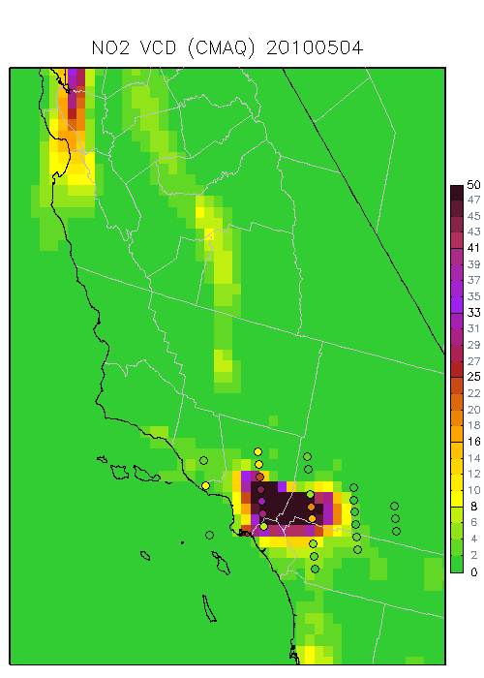
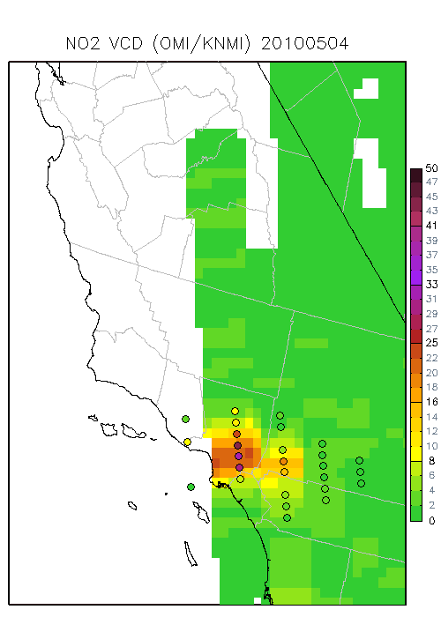
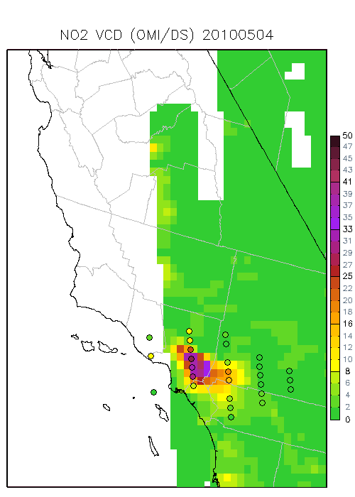
Improved NO₂ VCD distribution (May 4, 2010)
Model
Satellite
Adjusted

Slide 19
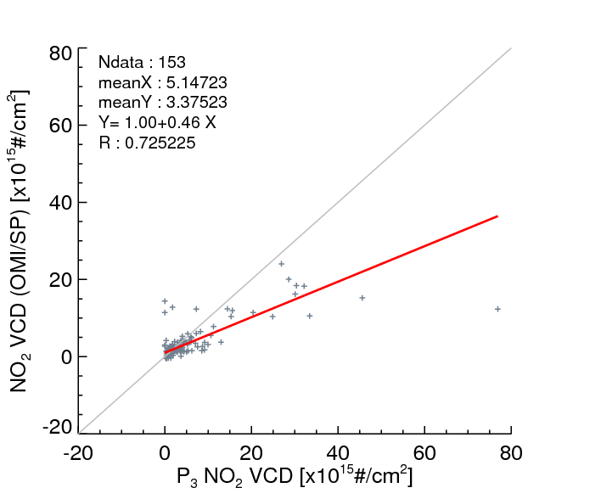
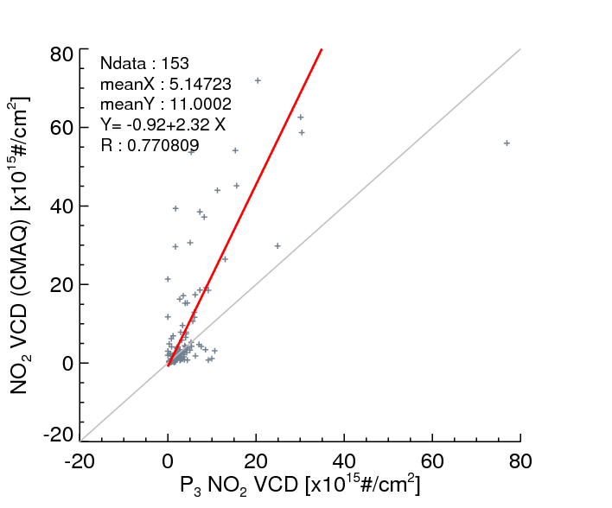
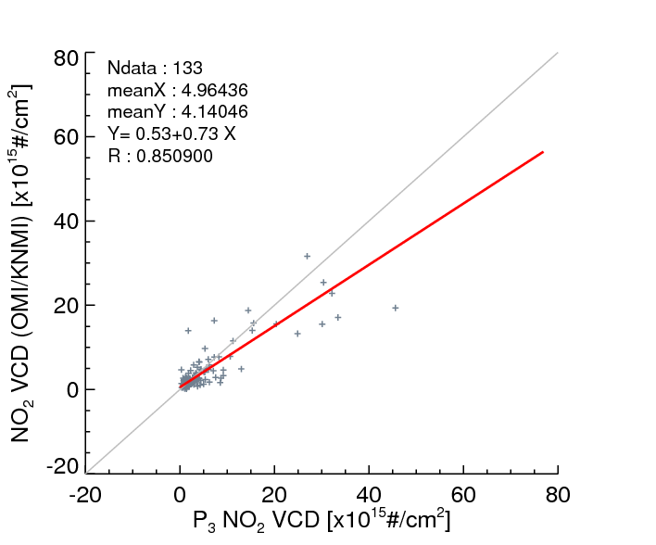
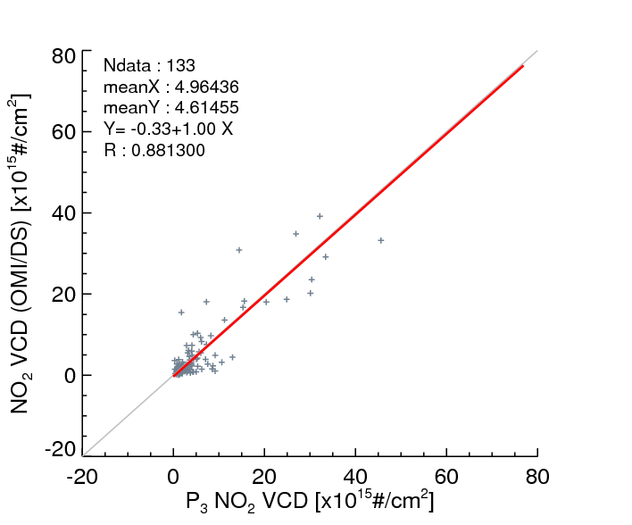
OMI/SP
CMAQ
OMI/KNMI
OMI/KNMI+CMAQ

Slide 20
Summary
Decreasing trends of CONUS NO₂ have been shown from multiple observations (AQS, Satellites, and CEM emission monitoring)
Model could not reproduce inter-annual trend without timely emission update.
Model configuration change (Met driver and CMAQ processes) can cause crucial impacts in NAQFC performance.
Hybrid approach (satellite + model) can be used to resolve fine-scale urban NO₂ plumes.

