Slide 1



Evaluating the Cross State Transport of Ozone using CAMx & DISCOVER-AQ Maryland Observations
Presentation by:
Dan Goldberg
Co-authors: Tim Vinciguerra, Linda Hembeck, Sam Carpenter, Tim Canty, Ross Salawitch & Russ Dickerson
13th Annual CMAS Conference
Tuesday October 28, 2014

Slide 2
Motivation for this study…
The state of Maryland owes a State Implementation Plan (SIP) in June 2015 to show future attainment of the Ozone NAAQS.
We are trying to verify that the regional air quality models are getting an accurate prediction of ozone for the right reasons in order to define the most effective attainment strategies.

Slide 3
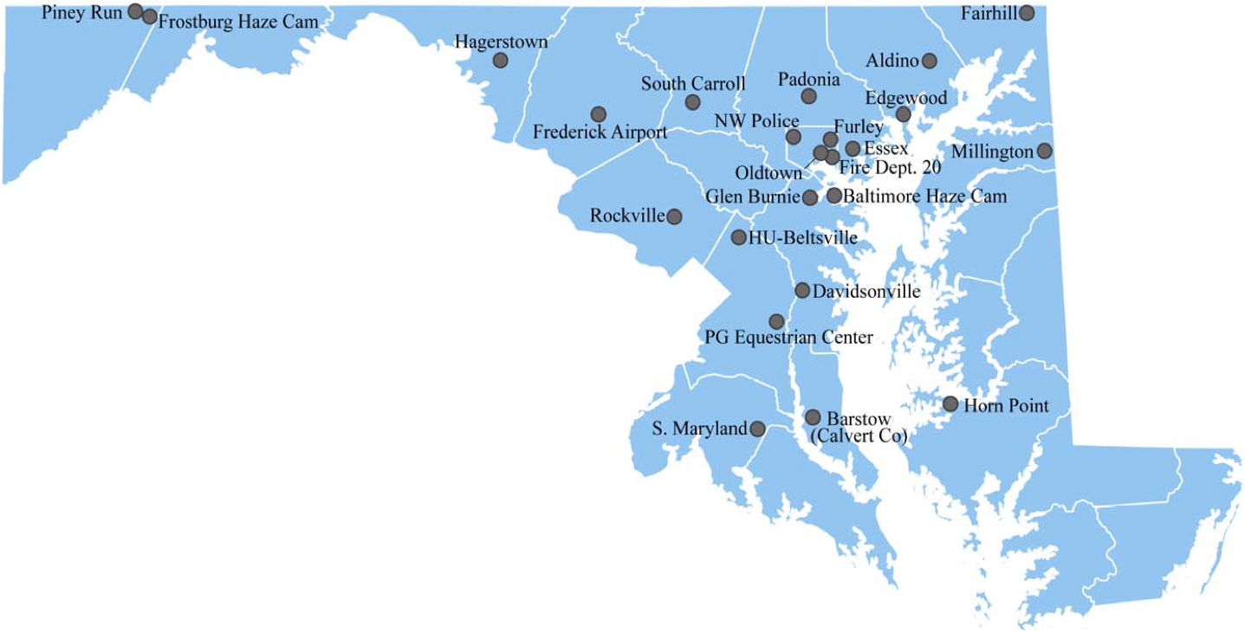
Motivation for this study…
The Ozone Design Values in Maryland have dropped dramatically in the past 3 years due to a combination of emissions reductions AND favorable meteorology
Maryland Ambient Air Quality Monitoring Network
EPA CASTNET Sites
Marginal
nonattainment (> 0.075 ppm)
nonattainment (> 0.085 ppm)
Moderate

Slide 4
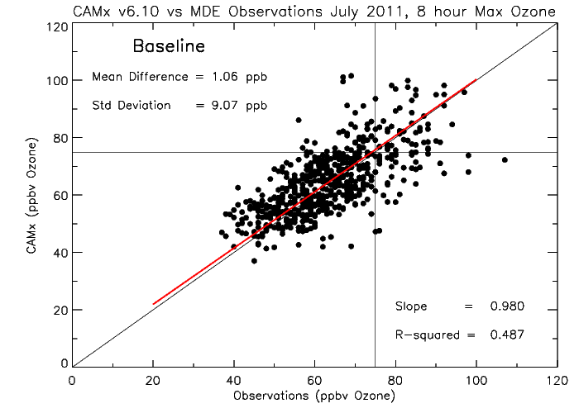
Comparison to Observations of Surface Ozone
There is excellent model agreement in predicting surface ozone when using the standard, “off-the-shelf” version of CAMx

Slide 5
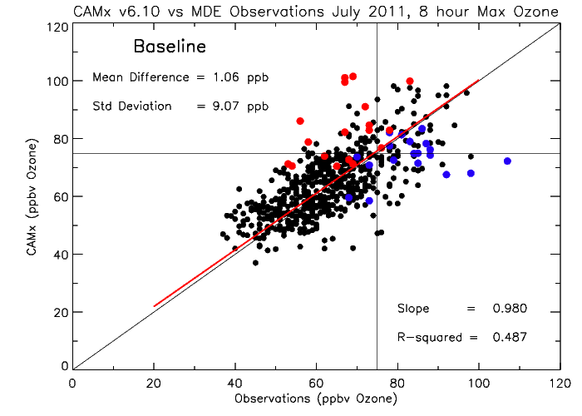
Comparison to Observations of Surface Ozone
July 21 – Over prediction due to bay breeze (He et al. 2014)
July 2 – Under prediction due to 4th of July travel & transport aloft
There is excellent model agreement in predicting surface ozone when using the standard, “off-the-shelf” version of CAMx

Slide 6

Comparison to Observations of Surface Ozone
Is the model getting ozone right for the right reasons?
Let’s take a look at the precursors to ozone: NO₂, VOCs, etc.
There is excellent model agreement in predicting surface ozone when using the standard, “off-the-shelf” version of CAMx

Slide 7

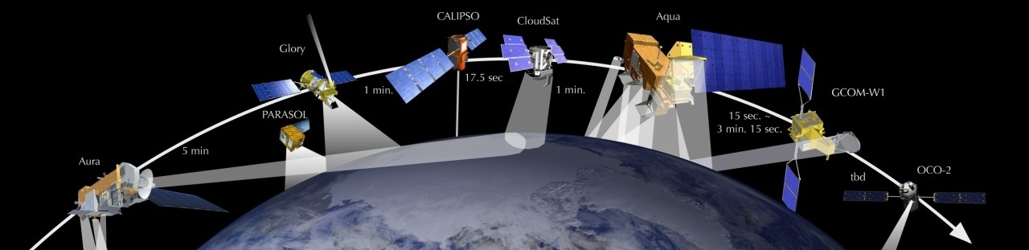
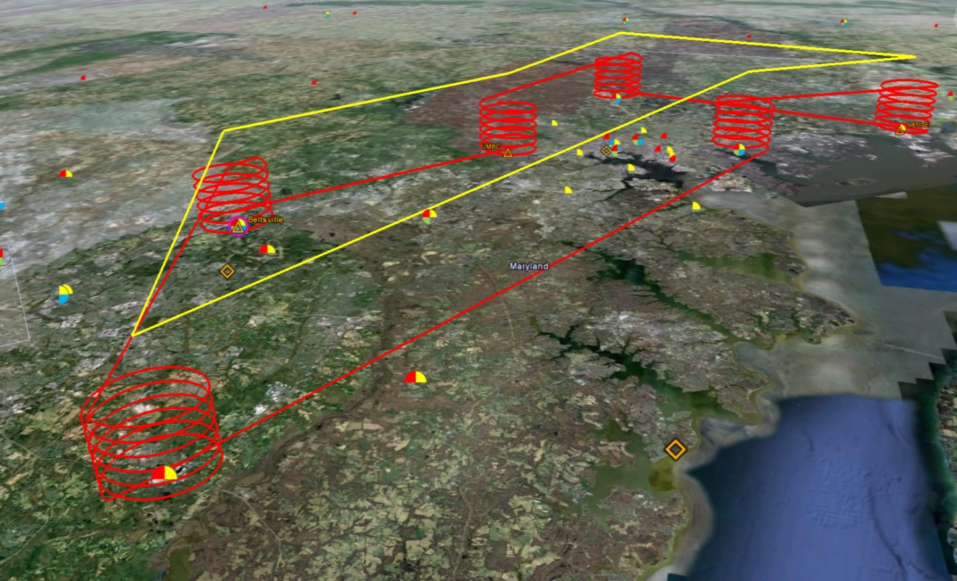
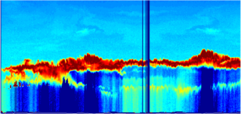

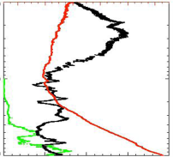
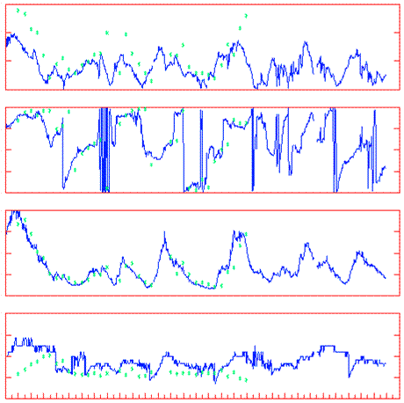
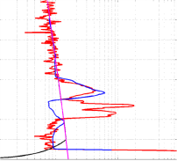
July 2011
DISCOVER-AQ: Deriving Information on Surface conditions from Column and Vertically Resolved Observations Relevant to Air Quality
Three major observational components:
NASA UC-12 (Remote sensing)
Continuous mapping of aerosols with HSRL and trace gas columns with ACAM
NASA P-3B (in situ meas.)
In situ profiling of aerosols and trace gases over surface measurement sites
Ground sites
In situ trace gases and aerosols
Remote sensing of trace gas and aerosol columns
Ozonesondes
Aerosol lidar observations

Slide 8
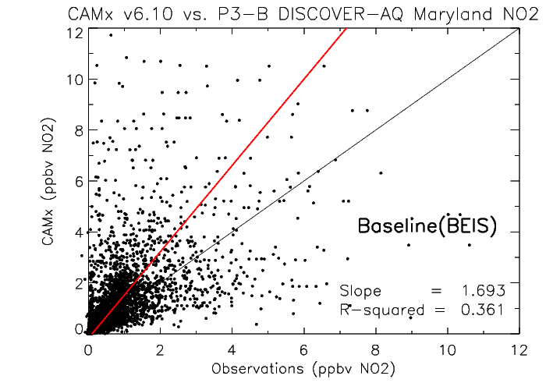
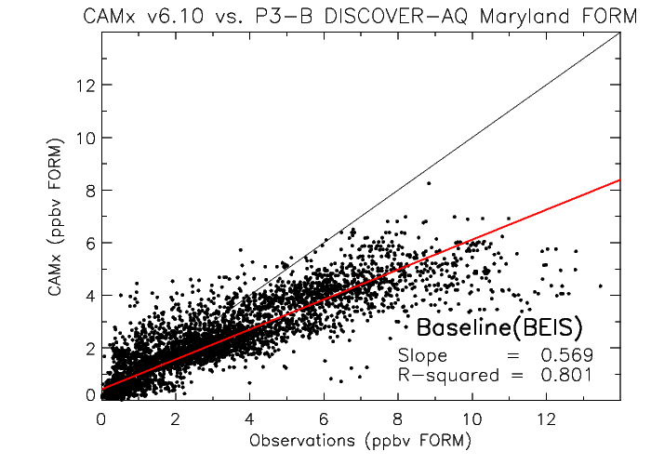
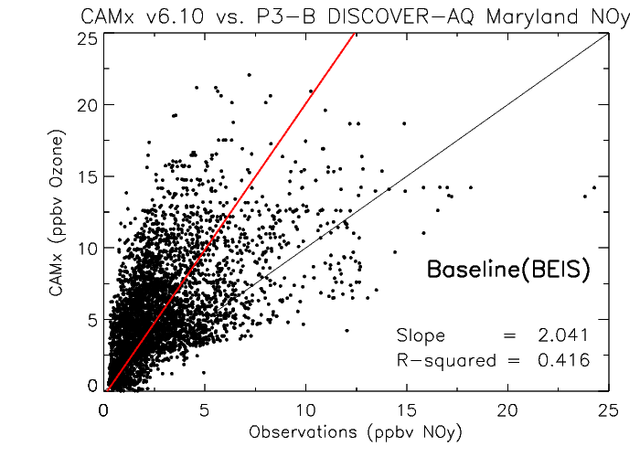
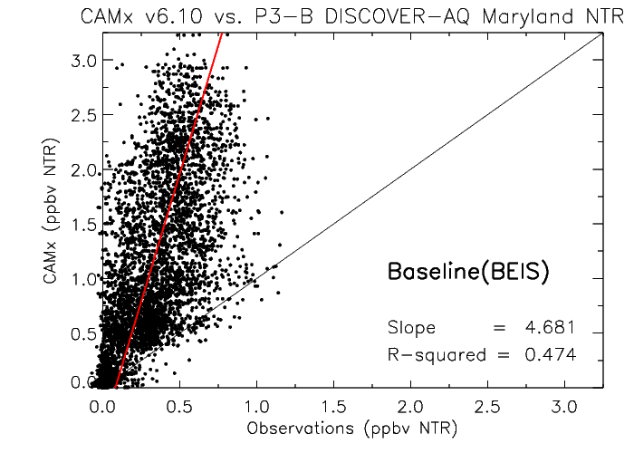
Ozone Precursors: CAMx v6.10 vs. Aircraft
NO₂
Formaldehyde (HCHO)
NOy
Alkyl nitrates (NTR)

Slide 9
Suggestions on how to reduce these biases
NO₂ & NO_{y} high biases:
  Reduce NO_{x} emissions from on-road vehicles by 50% (Anderson et al., 2014, Fujita et al. 2012, Brioude et al. 2013)
Formaldehyde low bias:
  Use a new model for estimating biogenic emissions (trees, soil, etc)
    MEGAN v2.10 from BEIS v3.14
NTR high bias:
  Reduce the photolytic lifetime from 10 days to 1 days (Perring et al. 2013, Farmer et al. 2011)

Slide 10
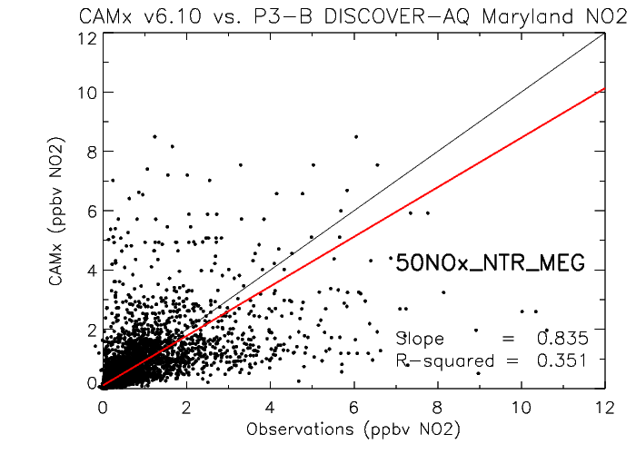
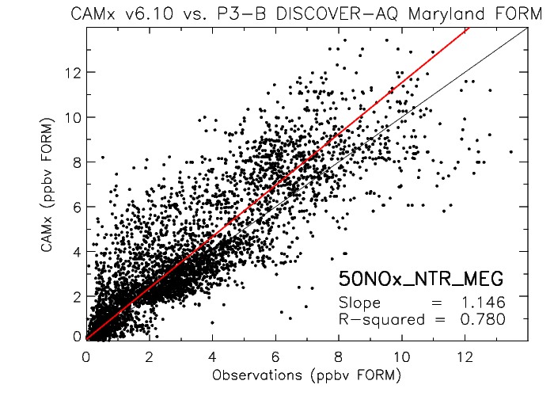
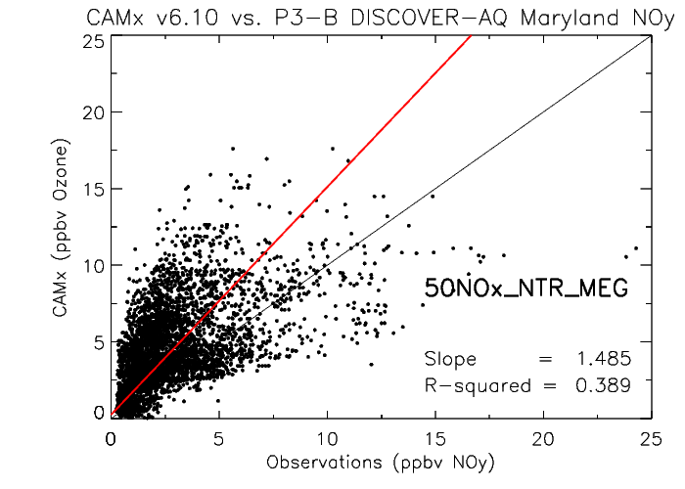
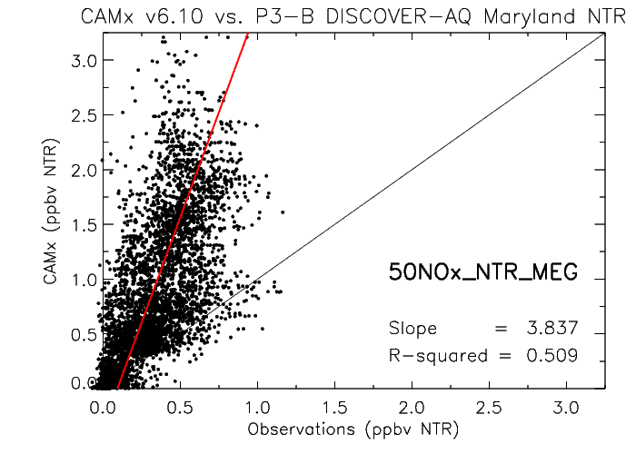
Making the aforementioned changes…
NO₂
Formaldehyde (HCHO)
NOy
Alkyl nitrates (NTR)

Slide 11
Baseline case
NO₂
Formaldehyde (HCHO)
NOy
Alkyl nitrates (NTR)

Slide 12
How about surface ozone agreement?
Reminder: The baseline case

Slide 13
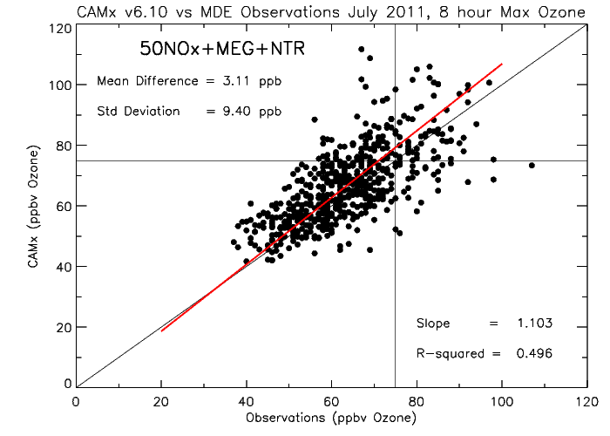
How about surface ozone agreement?
Updated chemistry & emissions
Didn’t change much! AND slightly better R-squared

Slide 14
How about surface ozone agreement?
Updated chemistry & emissions
Intermediate conclusion:
These changes have improved prediction of the precursors to ozone, while minimally impacting the prediction of surface ozone!
Didn’t change much! AND slightly better R-squared

Slide 15
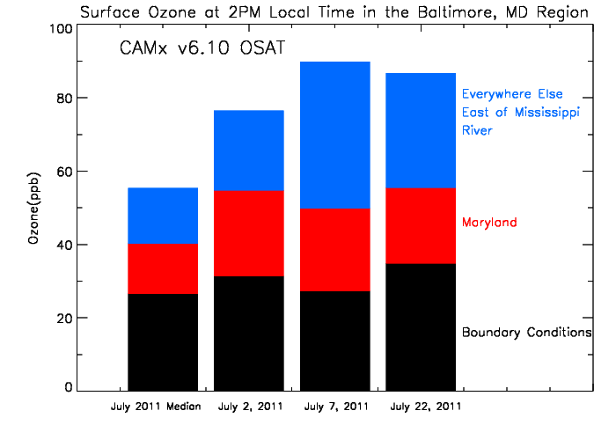
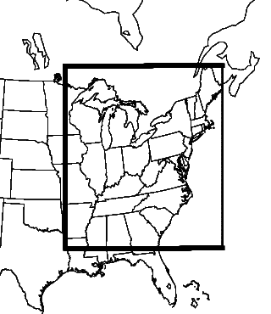
July 2011: Ozone Source Apportionment
Fraction of total surface ozone attributed to the boundary conditions, Maryland, and everywhere else in the modeling domain
Modeling domain
Baseline
Maryland accounts for only 30% of its air pollution!

Slide 16
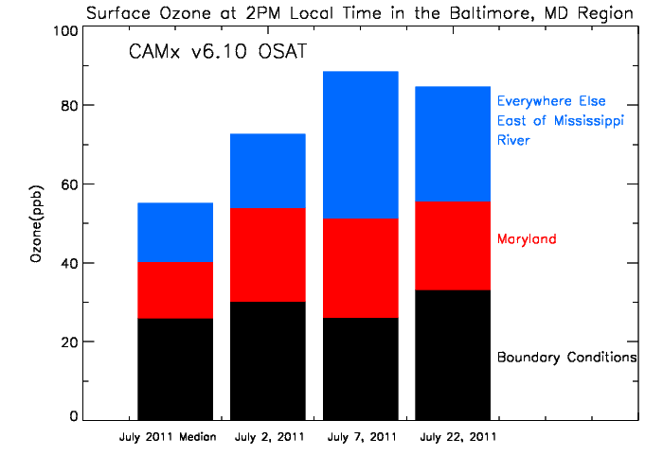
July 2011: Ozone Source Apportionment
Fraction of total surface ozone attributed to the boundary conditions, Maryland, and everywhere else in the modeling domain
Modeling domain
Updated chemistry & emissions
With the updated chemistry & emissions, Maryland accounts for a slightly larger percentage of its pollution*

Slide 17
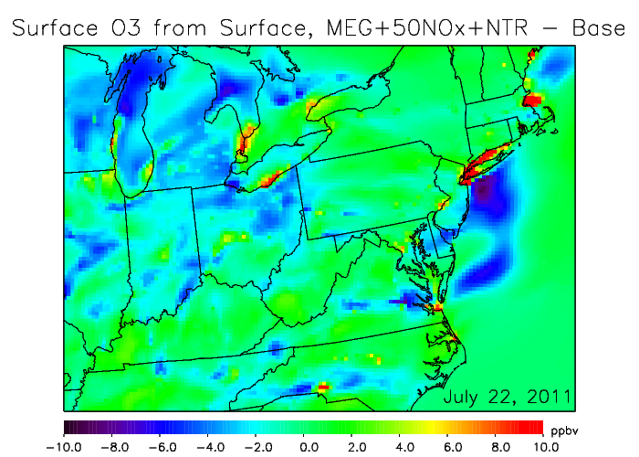
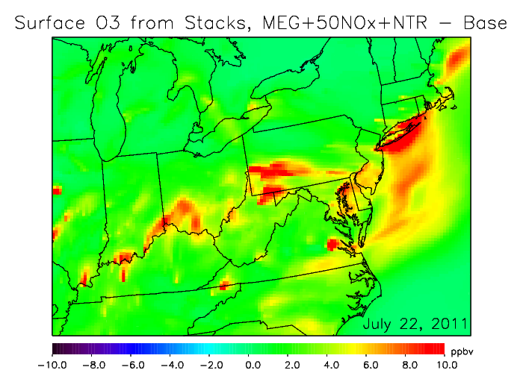
*Changes in model attribute more pollution to power plants!
Surface pollution sources
Above surface pollution sources
More ozone is attributed to sources that emit from smokestacks (mostly power plants, but also cement kilns, ships, etc.)

Slide 18
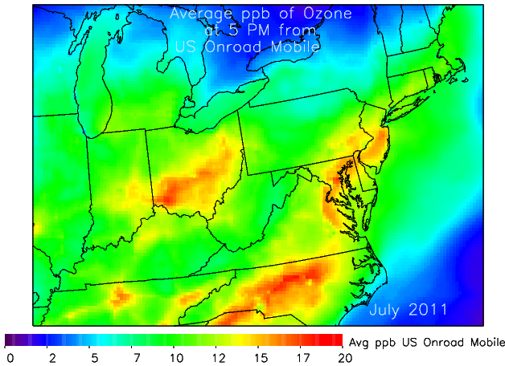
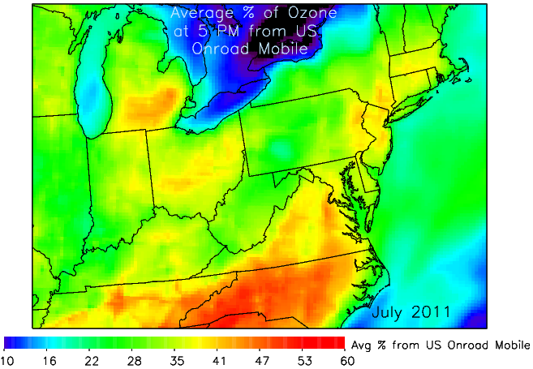
July 2011 Mobile Source Apportionment
Baseline case (On-road mobile emissions likely overestimated)
Ozone from On-road Mobile (ppb)
% of Ozone from On-road Mobile
Mobile emissions account for ~15 ppb of ozone at 5 PM in Baltimore, which is about 35% of total ozone as an average in July 2011

Slide 19
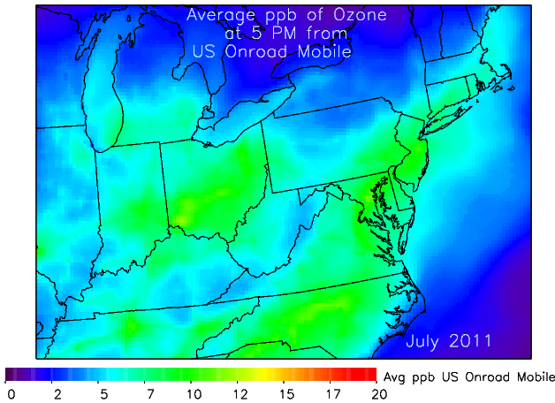
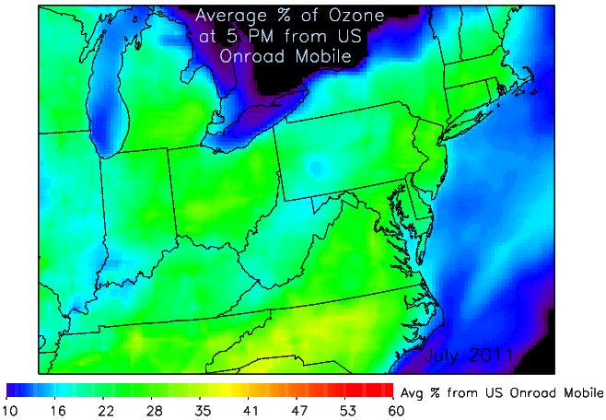
July 2011 Mobile Source Apportionment
50% Mobile NO_{x} case
Ozone from On-road Mobile (ppb)
% of Ozone from On-road Mobile
Mobile emissions account for ~10 ppb of ozone at 5 PM in Baltimore, which is about 20% of total ozone as an average in July 2011

Slide 20
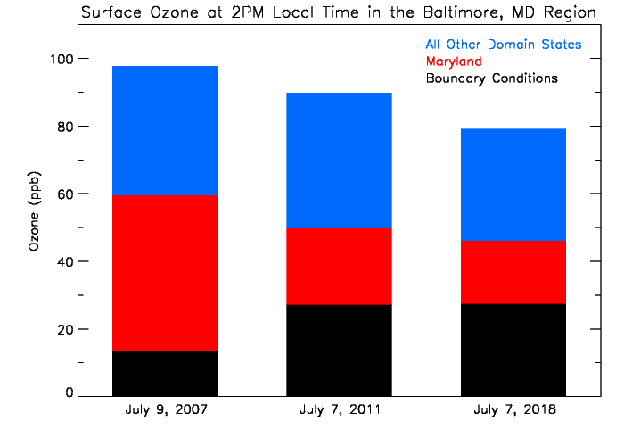
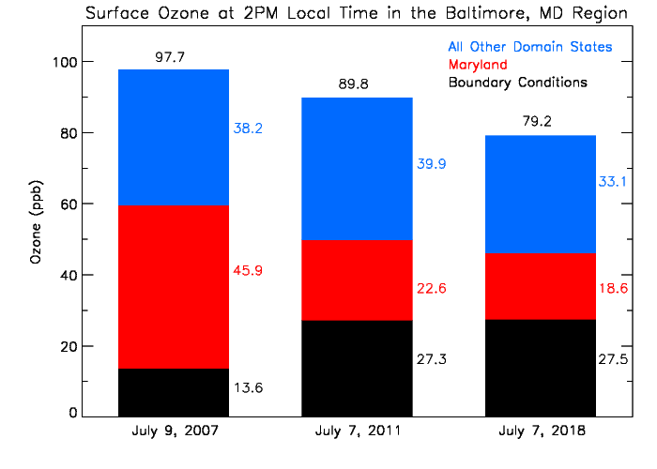
Importance of Boundary Conditions
Emissions outside of the state of Maryland, especially at the model domain boundaries, are becoming more important when trying to show future attainment
Synoptic set-up during July 9, 2007 & July 7, 2011 was very similar, see extra slides for more detail

Slide 21
Conclusions
CAMx v6.10 has excellent agreement with prediction of 8-hour maximum surface ozone
  Mean bias: 1.06 ppb
Changes to the model improve the biases of the precursors while only minimally affecting prediction of surface ozone
  NO_{y} high bias: from a factor of 2.0 to 1.5
  Formaldehyde low bias: from a factor of 0.57 to 1.15
Emissions from power plants account for a significantly larger percentage of ozone in the “improved” modeling scenario
  On-road mobile accounted for 35% of ozone, now only 20%
Ozone coming from the boundaries of the model domain has a non-trivial effect
  > 20 ppb surface ozone in Maryland

Slide 22
Next steps
Update model simulations to the CB6r2 gas-phase chemistry
Assimilate O₃ from TES and NO₂ from OMI into the boundary conditions
Adjust dry deposition rates of some reactive nitrogen species which are hypothesized to be underestimated

Slide 23
Conclusions
CAMx v6.10 has excellent agreement with prediction of 8-hour maximum surface ozone.
  Mean bias: 1.06 ppb
Changes to the model improve the biases of the precursors while only minimally affecting prediction of surface ozone.
  NO_{y} high bias: from a factor of 2.0 to 1.5
  Formaldehyde low bias from a factor of 0.57 to 1.15
Emissions from power plants account for a significantly larger percentage of ozone in the “improved” modeling scenario.
  On-road mobile accounted for 35% of ozone, now only 20%
Ozone coming from the boundaries of the model domain has a non-trivial effect.
  > 20 ppb surface ozone in Maryland

Slide 24
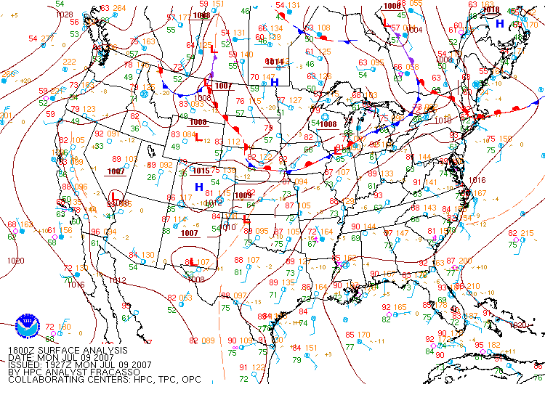
Synoptic Met: July 9, 2007

Slide 25
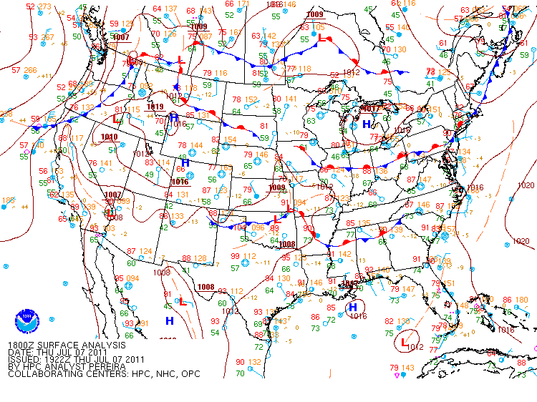
Synoptic Met: July 7, 2011

