Slide 1
Bay breeze enhanced air pollution event in Houston, Texas during the DISCOVER-AQ field campaign
Christopher P. Loughner (University of Maryland)
Melanie Follette-Cook (Morgan State University)
Kenneth E. Pickering (NASA Goddard Space Flight Center)
Mark Estes (Texas Commission on Environmental Quality)
Funded by: NASA DISCOVER-AQ and Texas AQRP

Slide 2
Introduction
Event: High air pollution event occurred September 25-26, 2013 in Houston, TX during the DISCOVER-AQ campaign. Northerly transport and sea and bay breezes were in place during this event.
Science Question: What were the roles of regional vs. local emissions, regional transport, and sea and bay breezes on this air pollution event?

Slide 3
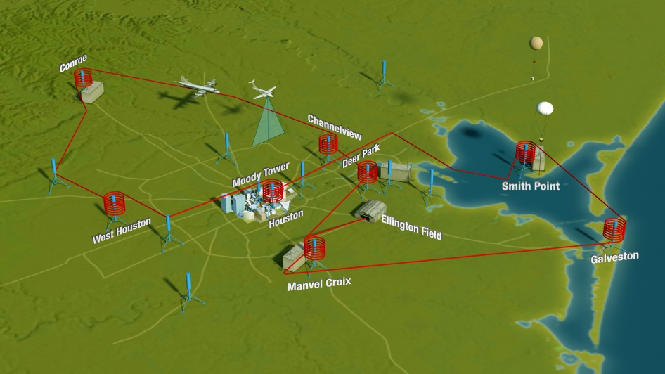
DISCOVER-AQ (Deriving Information on Surface conditions from Column and VERtically resolved observations relevant to Air Quality)
Houston deployment: September 2013
9 flight days conducting spirals and missed approaches throughout the Houston metropolitan area.
Numerous other ground-based measurements (Pandora UV/Vis spectrometers, AERONET sunphotometers, in-situ stationary and mobile platforms, ozonesondes, and tethersondes).

Slide 4
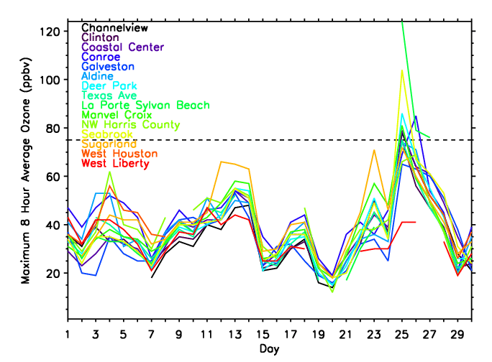
Maximum 8 hour average ozone during September 2013
Houston deployment: September 2013
Onshore flow during most of the campaign
September 25 was the exception
Northerly transport into Houston
Sea and bay breezes caused pollutants to recirculate

Slide 5
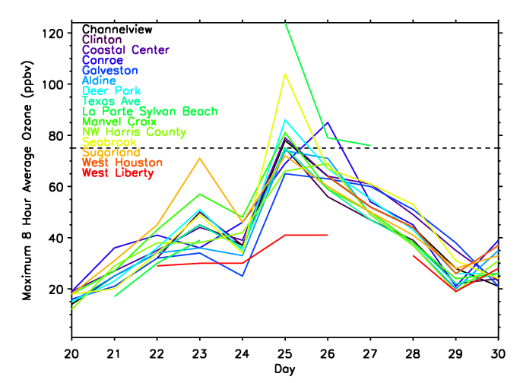
Maximum 8 hour average ozone during September 20-30, 2013
September 25: 6 of the 15 sites shown violated EPA’s maximum 8 hour average ozone standard
September 26: 2 of the 15 sites shows violated EPA’s maximum 8 hour average ozone standard

Slide 6
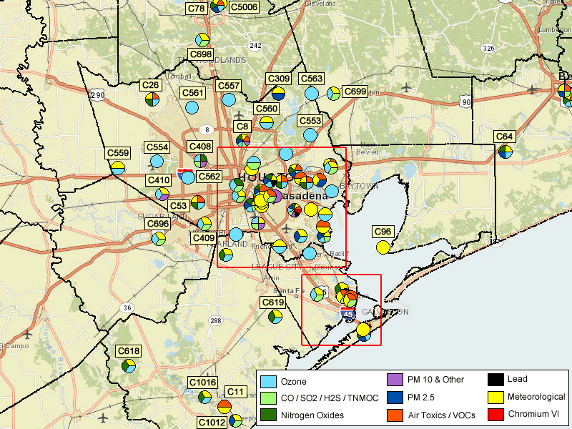
Air Monitoring Sites in Houston Region
Conroe 101 85
Sept. 26: peak ozone
NW of Houston
Jones Forest 94 90
Sept. 25: peak ozone near
western shore of
Galveston Bay
1-hr 8-hr Max (ppbv)
La Porte 151 124
Seabrook 132 104
Texas 119 89
City

Slide 7
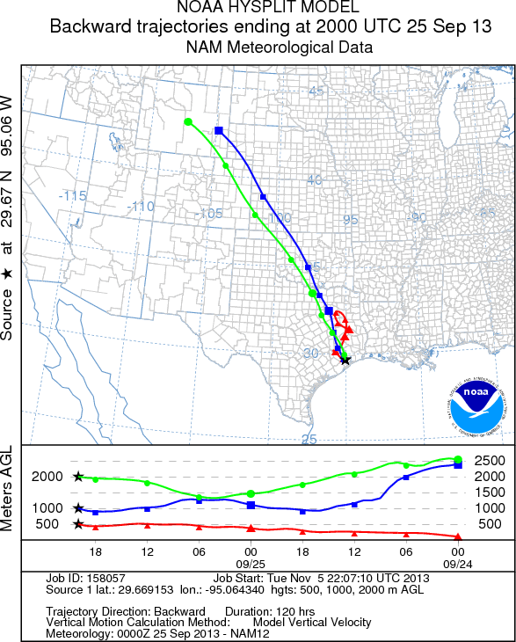
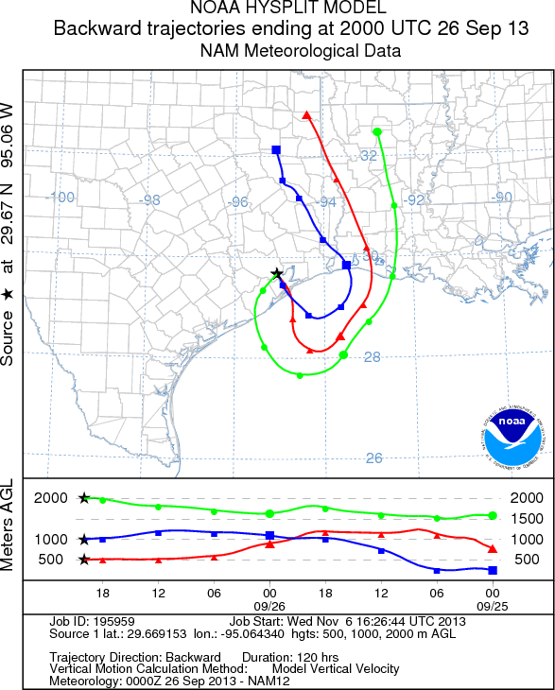
HYSPLIT Backtrajectories from NAM model output initialized at 2000 UTC over LaPorte Sylvan Beach
September 25: North-northwesterly wind transport into Houston
September 26: Continental air transported over the Gulf of Mexico and then back inland over Houston

Slide 8
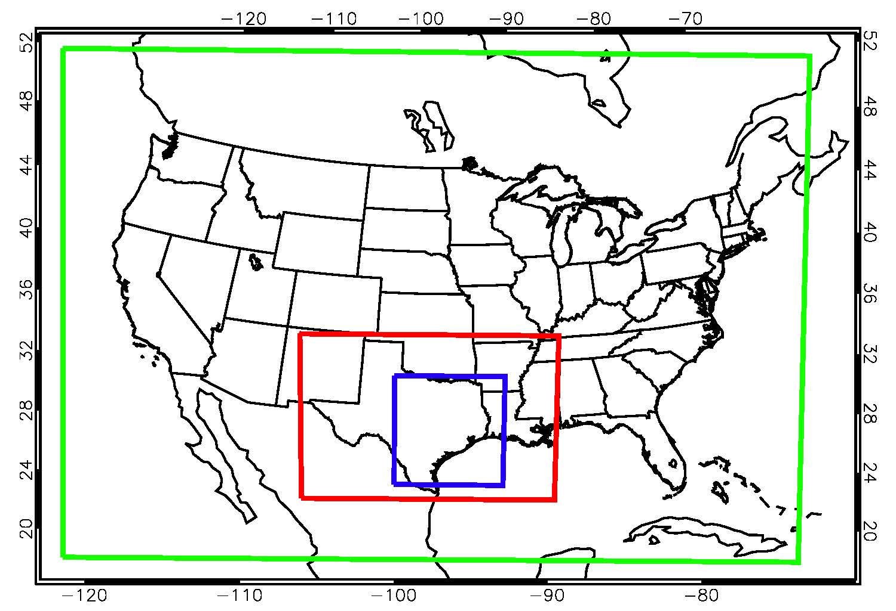
WRF-CMAQ Simulations
Time period: 28 August – 2 October, 2013
Re-initialize WRF every 3 days
Length of each WRF run: 3.5 days (first 12 hours of each run is discarded)
Initial and Boundary Conditions: North American Regional Reanalysis and MOZART Chemical Transport Model
CMAQ run offline
36 km
12 km
4 km

Slide 9
Weather Research and Forecasting (WRF) Version 3.6.1 Model Options
Radiation | LW: RRTM; SW: Goddard
Surface Layer | Pleim-Xiu
Land Surface Model | Pleim-Xiu
Boundary Layer | ACM2
Cumulus | Kain-Fritsch
Microphysics | WSM-6
Nudging | Observational and analysis nudging
Damping | Vertical velocity and gravity waves damped at top of modeling domain
SSTs | Multi-scale Ultra-high Resolution (MUR) sea surface temperature analysis (~1 km resolution)
CMAQ Version 5.0.2 Model Options
Chemical Mechanism | CB05
Aerosols | AE5
Dry deposition | M3DRY
Vertical diffusion | ACM2
Emissions | 2012 TCEQ anthropogenic emissions BEIS calculated within CMAQ

Slide 10
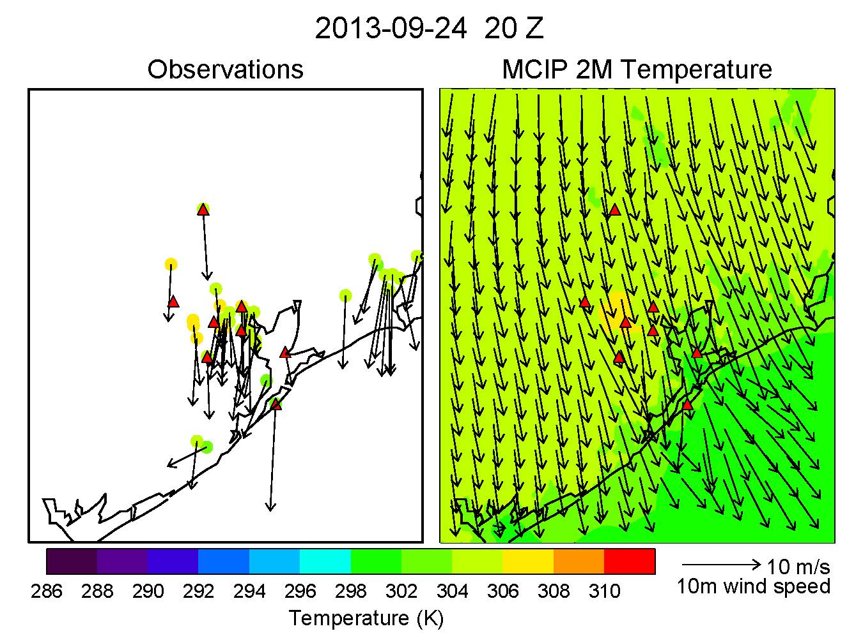
September 24
Northerly winds present day prior to air pollution episode.

Slide 11
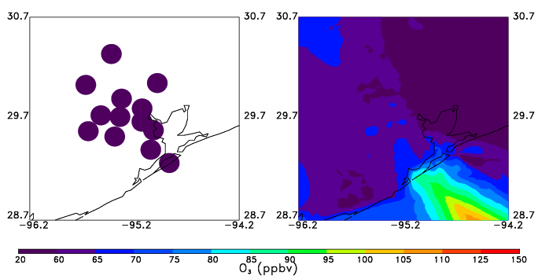
September 24
Northerly winds present day prior to air pollution episode.
Maximum 8 hour average ozone
CMAQ simulates high ozone offshore associated with northerly transport.

Slide 12
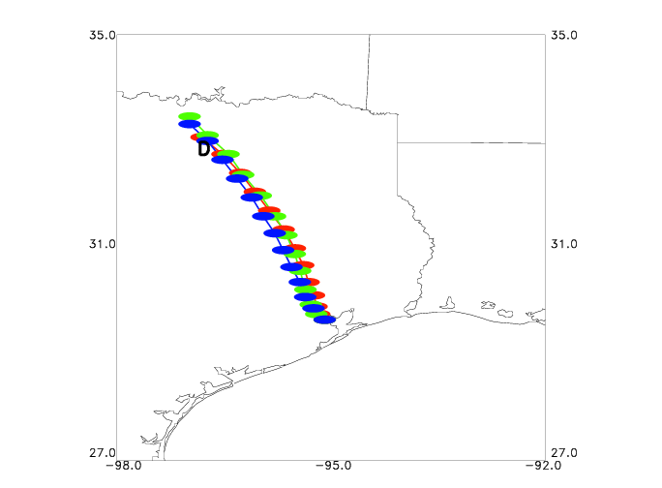
September 25 back trajectories from 4 km WRF output initialized at 2 pm CST over La Porte Sylvan Beach at 0.5 km AGL (red), 1.0 km AGL (green), and 2.0 km AGL (blue); D=Dallas Trajectories pass over Dallas

Slide 13
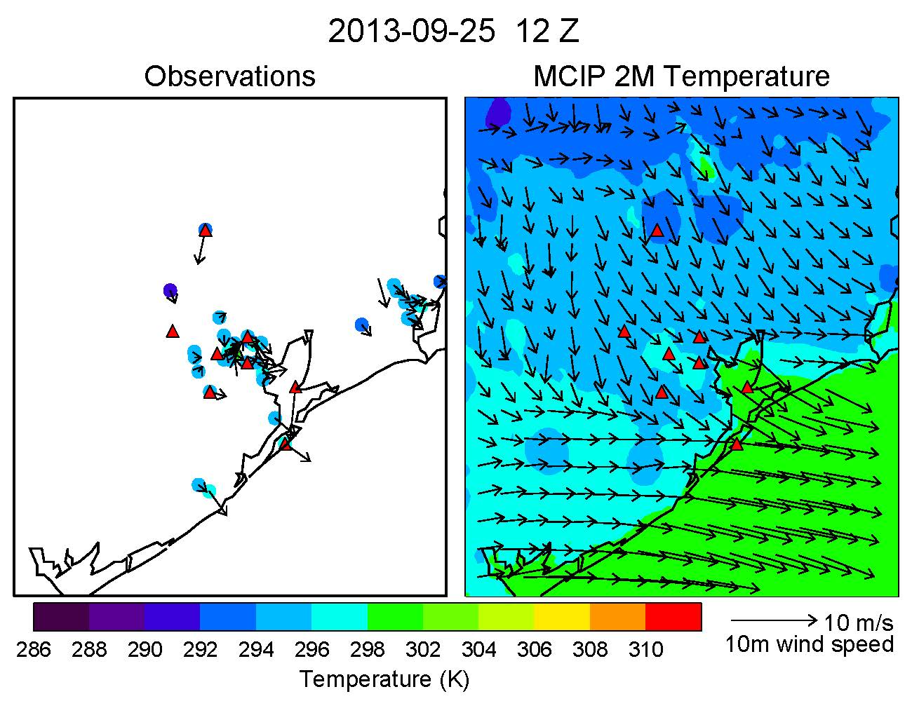
September 25
6 am CST:
Observations – calm winds
Model – northwesterly transport into Houston

Slide 14
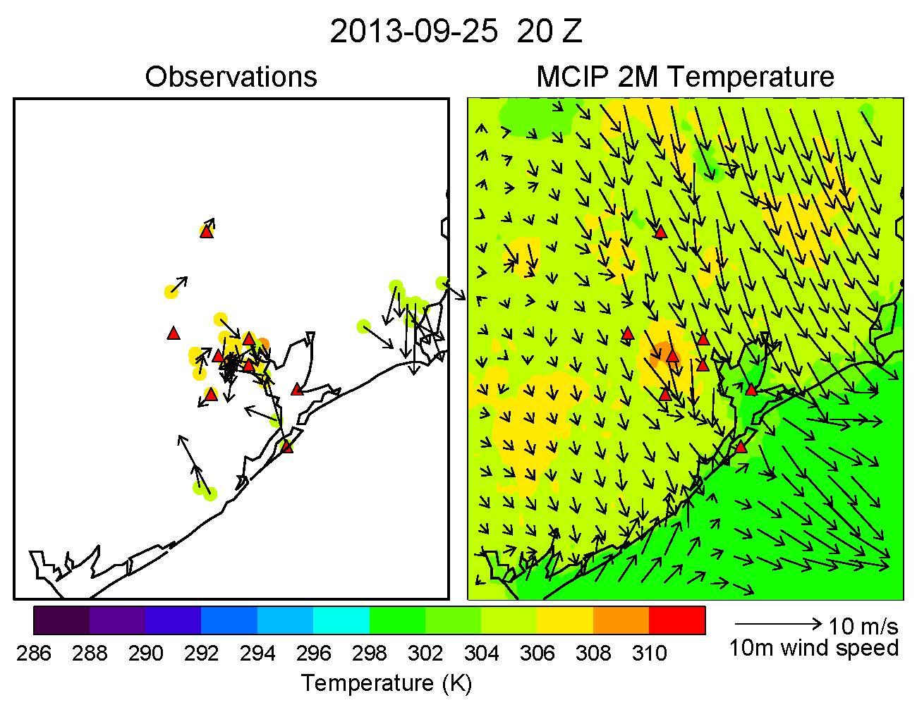
September 25
6 am CST:
Observations – calm winds
Model – northwesterly transport into Houston
2 pm CST:
Bay and sea breeze form. Model simulates weaker bay and sea breezes.

Slide 15
September 25
3 pm CST:
Observations reveal the bay breeze front located near the middle of Houston, while CMAQ shows it to the south.

Slide 16
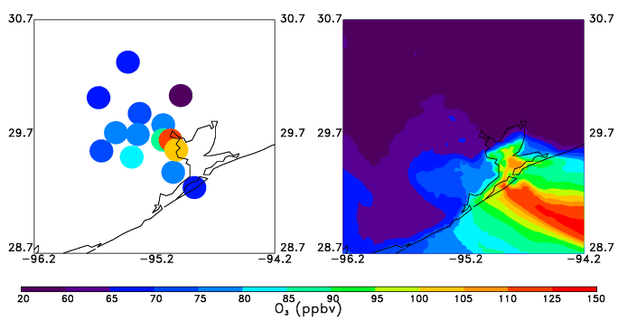
September 25
3 pm CST:
Observations reveal the bay breeze front located near the middle of Houston, while CMAQ shows it to the south.
Maximum 8 hour average ozone
Obs: peak ozone over Galveston and Galveston Bay.
CMAQ: peak ozone over Galveston

Slide 17
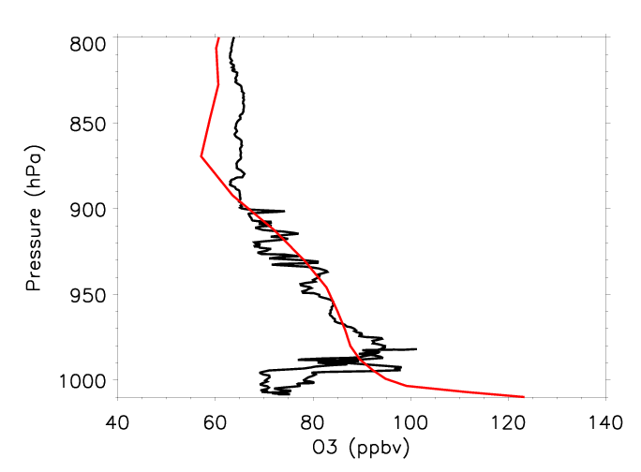
P-3B and CMAQ ozone profile over Galveston
Observations reveal high ozone around 975mb and low ozone at the surface.
Model does not capture the observed profile shape.
High model bias at surface due to weaker simulated sea and bay breezes.
P-3B (black)
CMAQ (red)

Slide 18
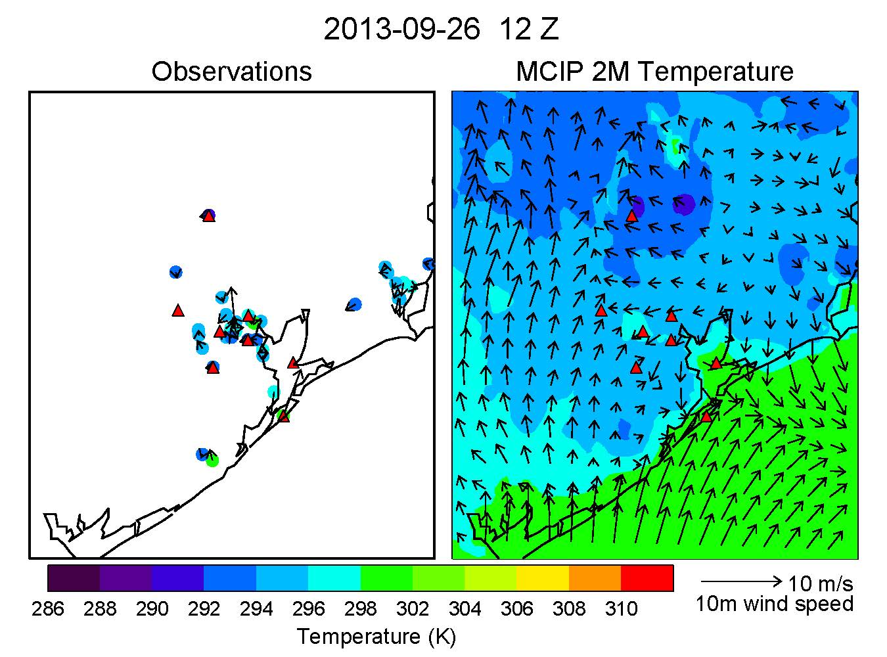
September 26
6 am CST:
Weak winds, stagnant conditions overnight.

Slide 19
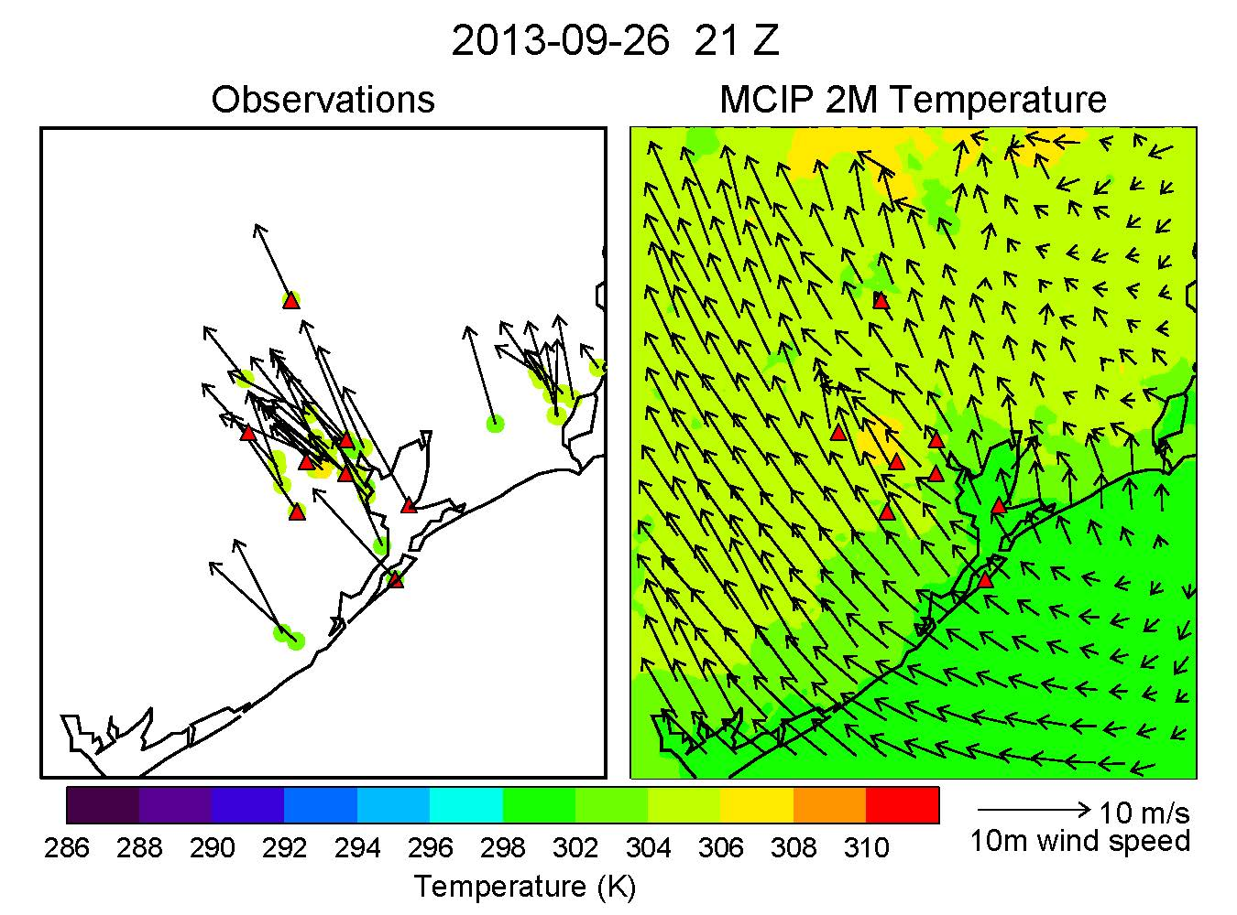
September 26
6 am CST:
Weak winds, stagnant conditions overnight.
3 pm CST:
Southeasterlies.

Slide 20
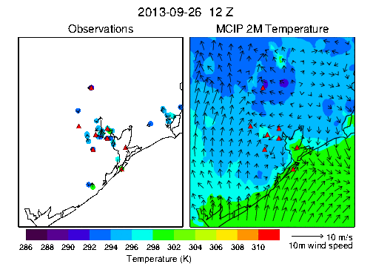
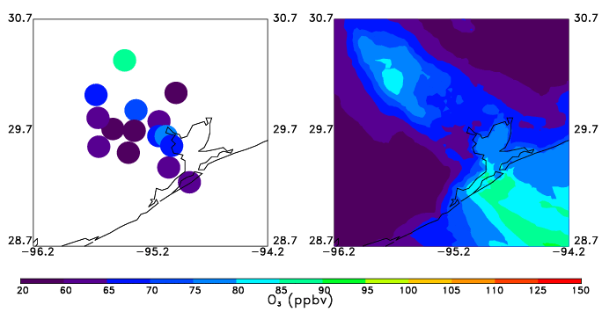
September 26
Maximum 8 hour average ozone
6 am CST:
Weak winds, stagnant conditions overnight.
Southeasterly transport results in peak ozone being located northwest of Houston.
3 pm CST:
Southwesterlies.

Slide 21
Conclusions and Future Work
WRF simulated weaker sea and bay breezes than observed, which resulted in low ozone biases inland and a high bias at Galveston. WRF and CMAQ also did not agree with the shape of the ozone profile over Galveston.
Future WRF sensitivity tests will be performed to try to improve the bay and sea breeze model representation (increase model resolution to 1 km; nudging finer domains?).
Investigate the role of local vs regional (Dallas) emissions on this air pollution episode.

