Slide 1

Using an Energy System Modeling Framework to Investigate Long-Term Emission Trends
Brian Keaveny
Climate and Energy Analyst 2014 CMAS Conference
NESCAUM October 29, 2014

Slide 2
Presentation Outline
NESCAUM
Example Project
Model Used
Scenarios and Results
Conclusions

Slide 3
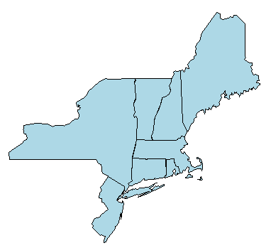
About NESCAUM
Northeast States for
Coordinated Air Use Management
Non-profit association of eight state air quality agencies

Slide 4
Project Overview
Georgia Institute of Technology
Objective
Defined Mitigation Scenarios
Mapped Technologies to SCC Codes & Developed Emissions Growth Factors
Processed in SMOKE
Develop Emissions Trajectories
CMAQ Modeling

Slide 5
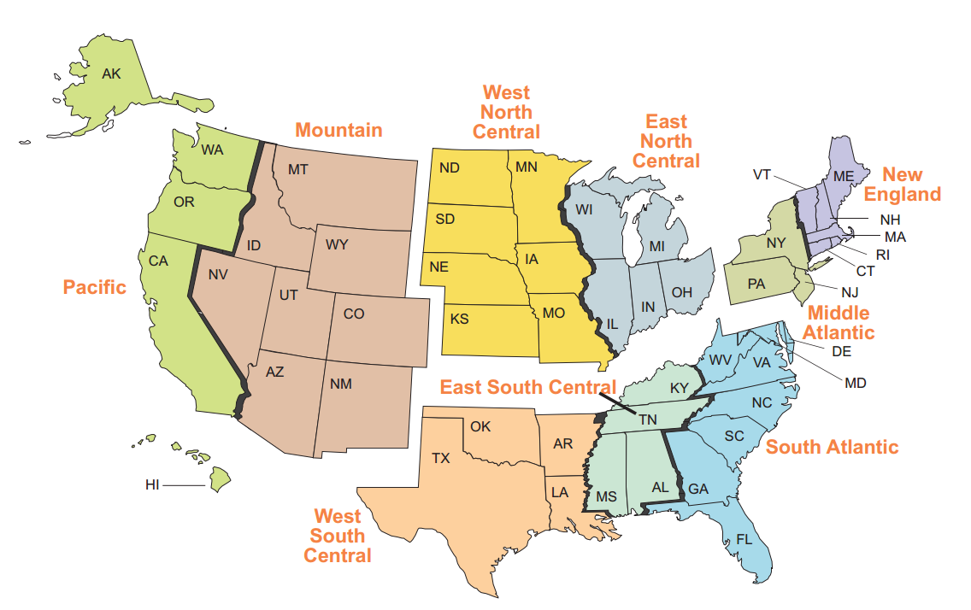

Model Overview
MARKAL
EPA U.S. Nine-Region Database (EPAUS9r)
Model Parameters
Outputs
Image Source: http://www.eia.gov/forecasts/aeo/pdf/f1.pdf

Slide 6
Mitigation Scenarios
Six mitigation scenarios
  Two low carbon transportation scenarios
  Two high biomass potential scenarios
  Two carbon tax scenarios
    Carbon Tax 1: $20/ton of CO2 in 2015, 4% annual growth
    Carbon Tax 2: $50/ton of CO2 in 2020, 10% annual growth

Slide 7
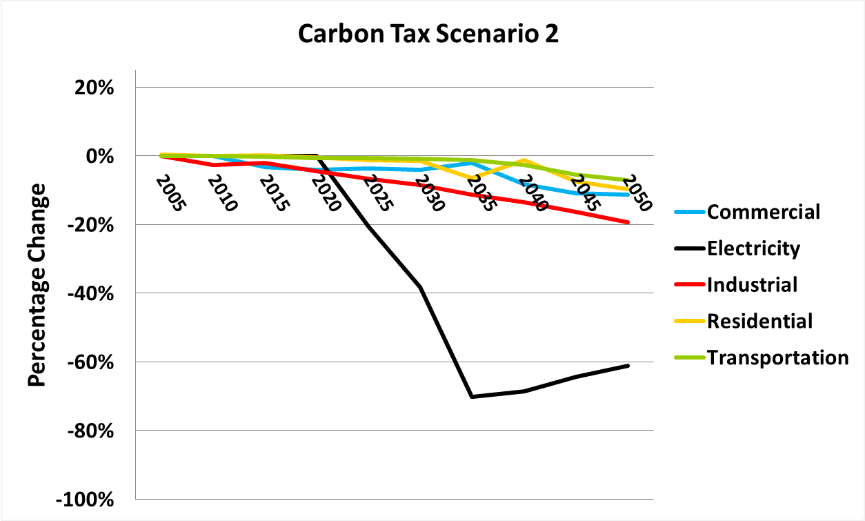
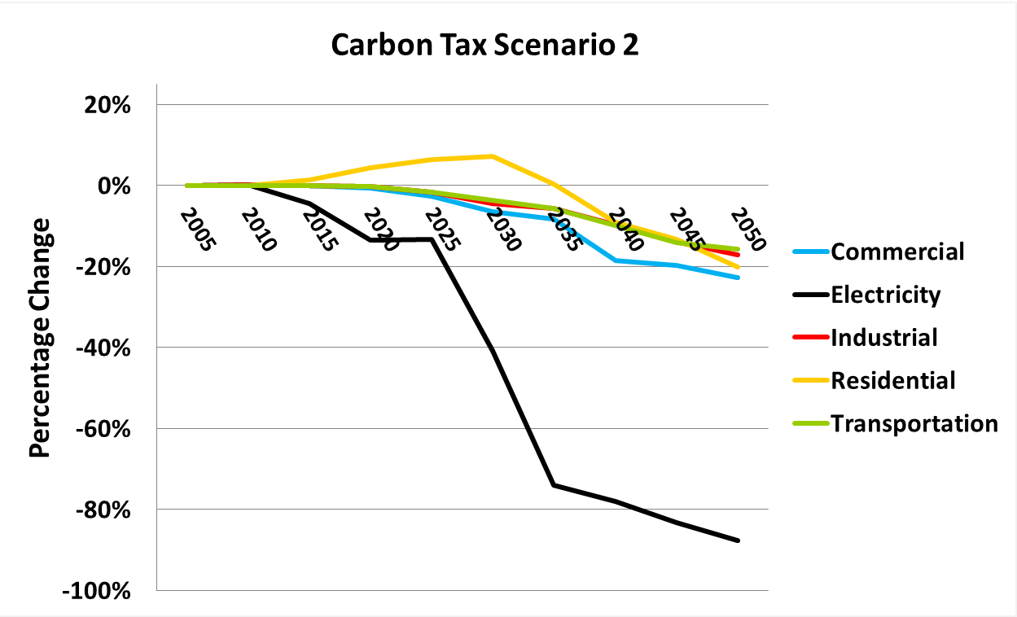
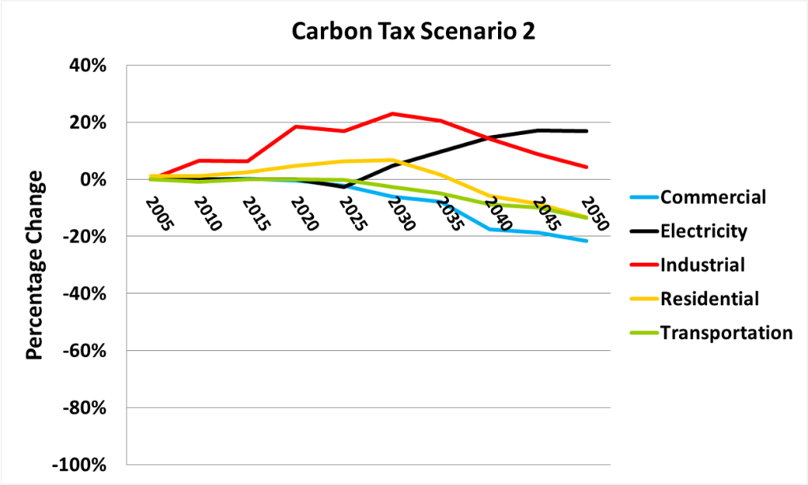
Results
CO2
SO2
NOx
Interesting trends:
  NOx increase from industrial sector
  NOx increase from power sector

Slide 8
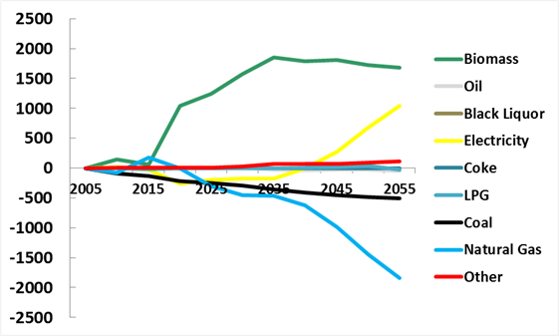
Results: Trends
NOx
NOx increase in industrial sector
  Biomass CHP
* Energy is in Petajoules

Slide 9
Results: Trends
NOx
NOx increase from power sector
  Changes in generation
  Widespread CCS retrofits of existing coal units
  Existing NOx controls used less

Slide 10
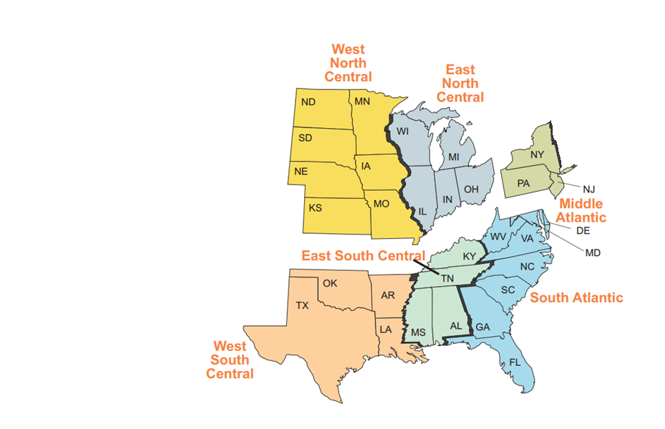
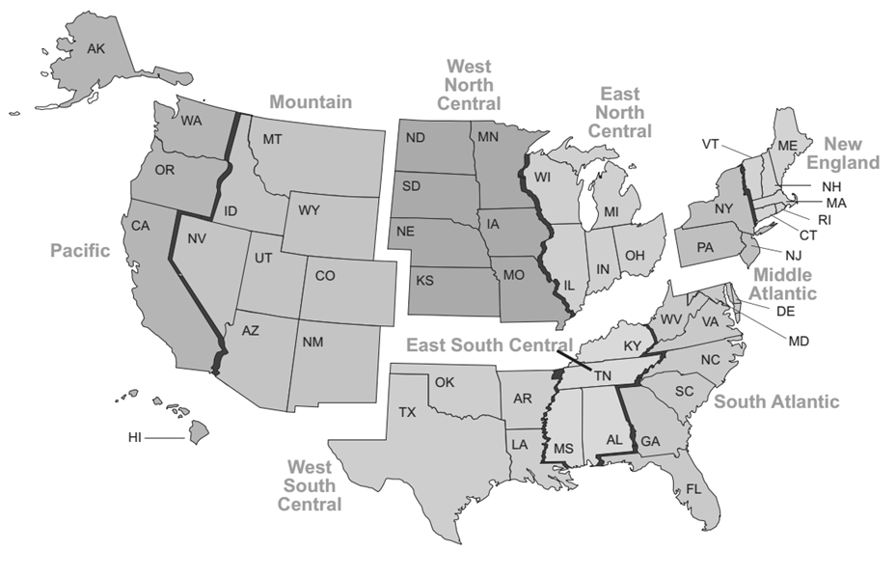
Results: Trends
Regional differences
    CAIR regions
    Non-CAIR regions

Slide 11
Conclusions
Takeaways:
  GHG mitigation measures may affected CAP emissions in surprising and undesirable ways.
  Such detailed emission trajectory modeling frameworks can be quite sensitive to modeling assumptions.
Next Steps:
  Emission trajectories for this and other scenarios were carried through SMOKE and CMAQ

Slide 12
Questions?
Brian Keaveny
bkeaveny@nescaum.org
617-259-2021

Slide 13
Supplemental Slides

Slide 14
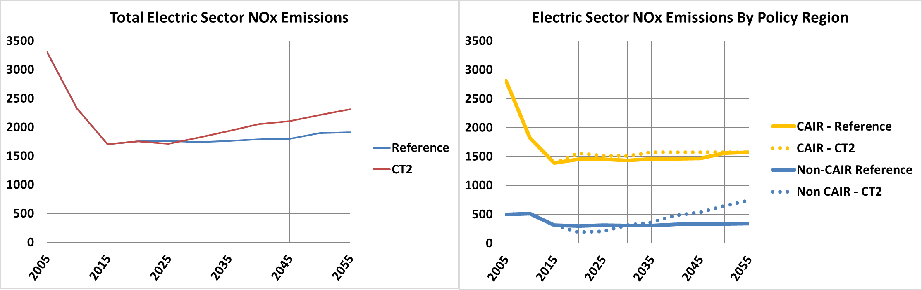
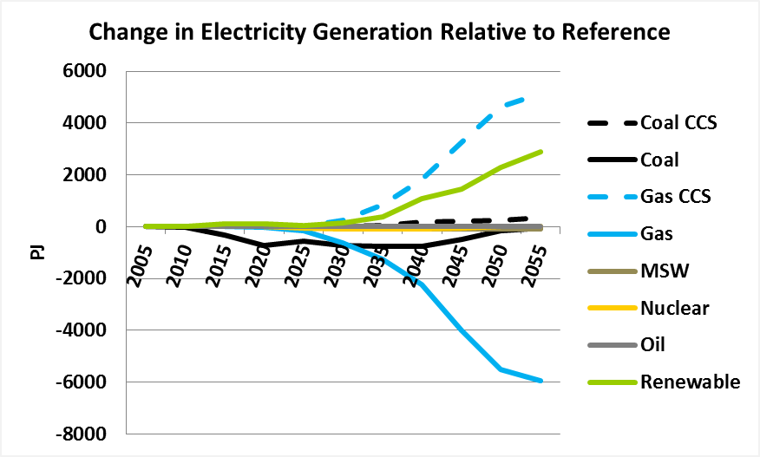
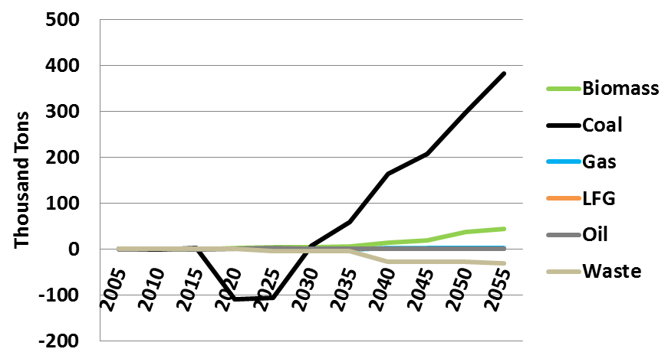
Change in NOx Emissions from Power Sector in Non-CAIR Regions, Relative to Reference

Slide 15
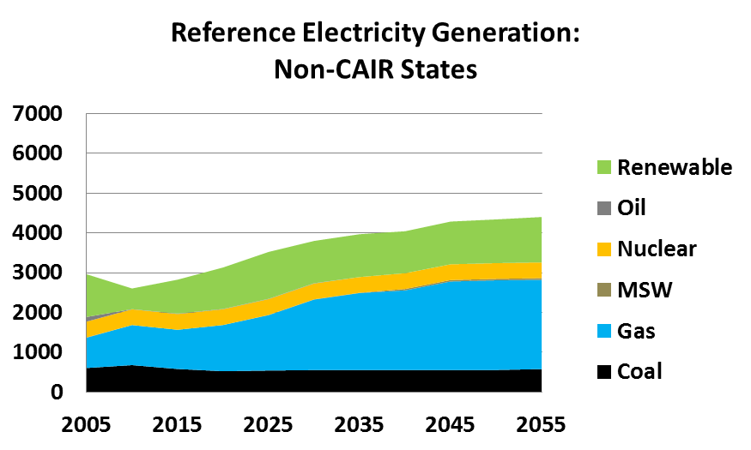
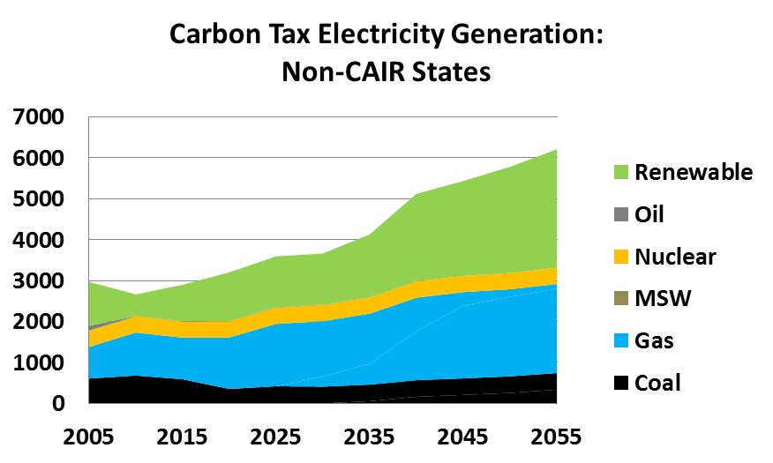
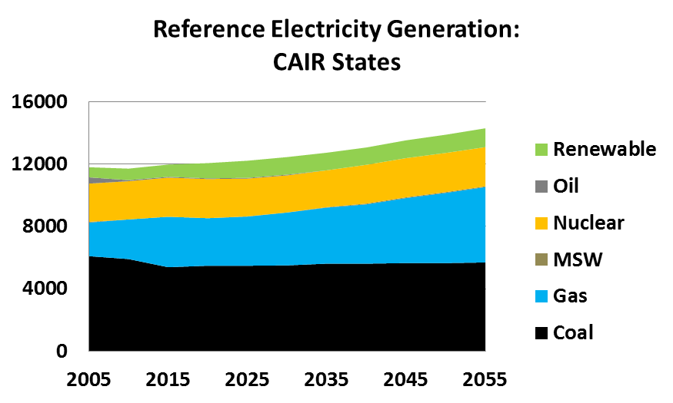
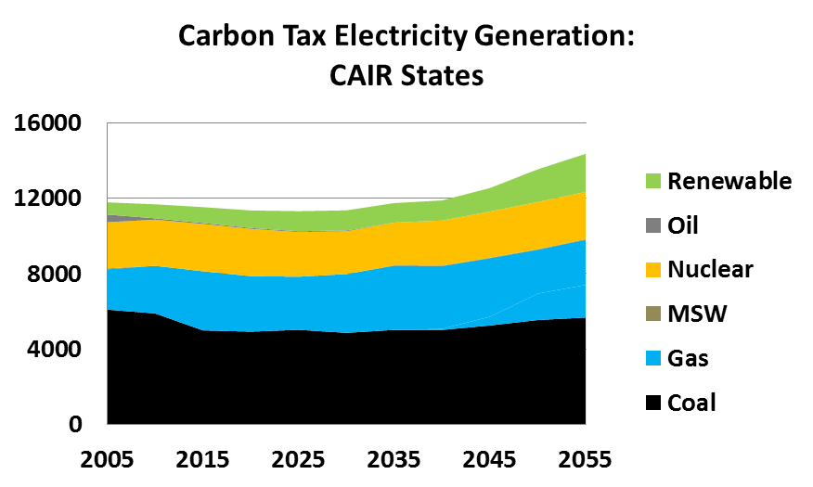

Slide 16
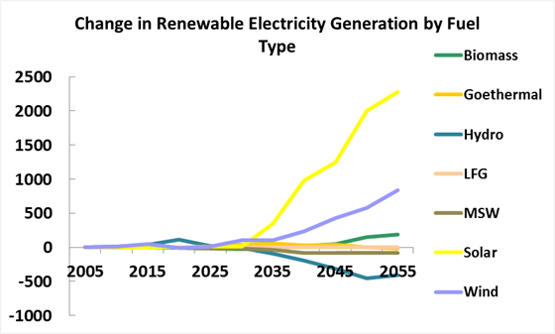
For CT-2
* Electricity Generation is in Petajoules

Slide 17
Reference Case Policy Assumptions
  Clean Air Act Title IV SO₂ and NO_{x} power sector limits
  EISA 2007
    Renewable Fuel Standard (RFS) Fuel Mandate (36 bgy by 2022, 21 bgy advanced biofuel / 15 bgy corn based)
  Clean Air Interstate Rule (CAIR)
  Mercury and Air Toxics Standards (MATS)
  Aggregated state Renewable Portfolio Standards (RPS) standards by region
  Federal Corporate Average Fuel Economy (CAFE) standards as modeled in the Annual Energy Outlook (AEO) 2012
  Tier 2 light duty vehicle emission standards
  Heavy duty fuel and engine rules
  No regional carbon policies at this time
  No efficiency or demand response programs

Slide 18
Mitigation Scenarios Modeled
Carbon Tax Scenarios:
  CT1 – carbon tax started in 2015 at ($20/ton) of CO2, and grew out to 2050 at an average annual growth rate of 4%.
  CT2 – carbon tax started in 2020 at ($50/ton) of CO2, and grew out to 2050 at an average annual growth rate of 10%.
Low Carbon Transportation Scenarios:
  TR1 – 70% reduction in transportation CO₂ emissions relative to 2005 by 2050.
  TR2 – 70% reduction in transportation CO₂ emissions relative to 2005 by 2050 + CO₂, SO₂, and NO_{X} emission rates from coal power plants set to natural gas combined cycle power plants.
High Biomass Potential Scenarios:
  BE1 – all available biomass in the U.S. put to full use, including agricultural residues, energy crops, mill residues, and urban wood waste.
  BE2 – full compliance with federal renewable fuel standard (RFS) requirements.

