Slide 1
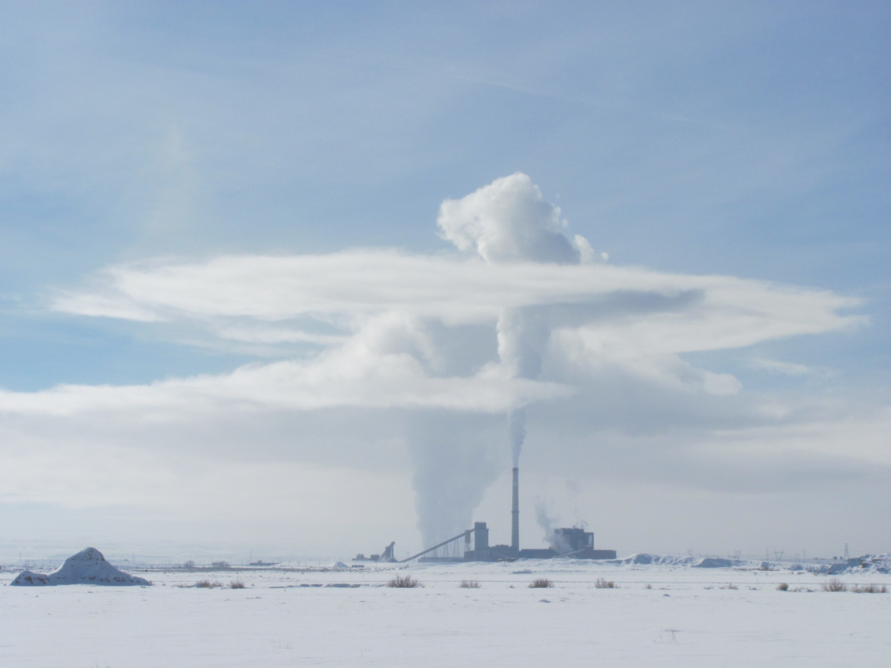
Winter Ozone Formation Sensitivity to Surface Albedo, Heterogeneous Chemistry and Precursor Emissions
Gail Tonnesen, Kirk Baker, Golam Sarwar, U.S. Environmental Protection Agency
Bernhard Rappenglueck, Department of Earth and Atmospheric Sciences, University of Houston
Photo Credit: Prof. Randy Martin, Utah State University

Slide 2
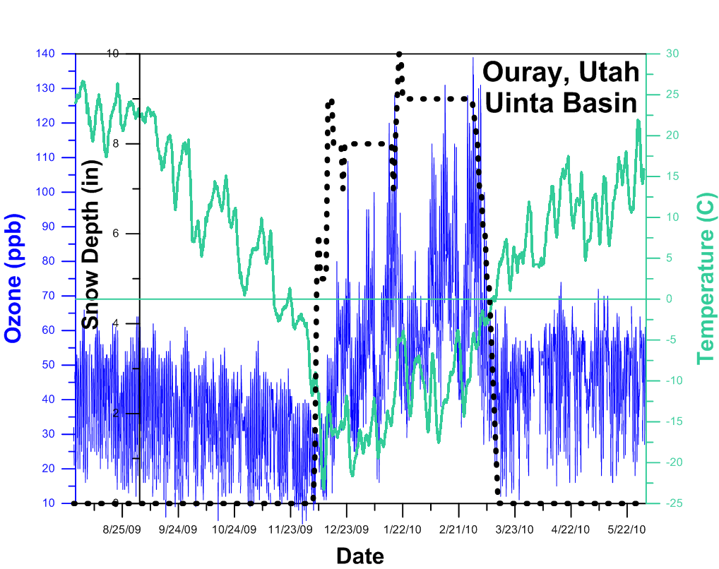
Winter Ozone Episodes
Observed in some oil and gas productions areas in WY, UT, CO.
Only occurs with snow cover:
Snow strengthens the inversion.
Snow enhances surface albedo and nearly doubles the rates of photolysis reactions.
Snow photochemistry might also act as a source of precursors and radicals.
Terrain features trapping air, and conducive meteorology (cold pools) also critically important.
Precursor emissions and high VOC/NOx ratio.
Plot from Russ Schnell, NOAA GMD, for 2009-2010 ozone data in the Uintah Basin.

Slide 3
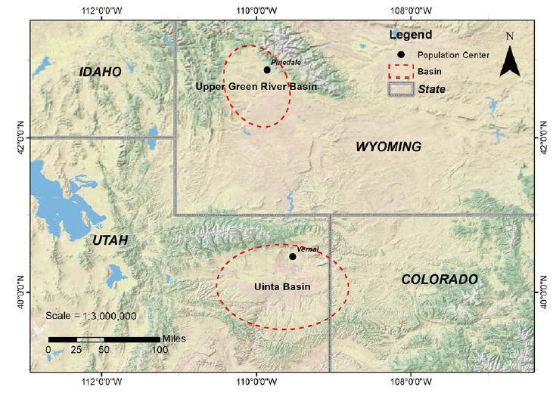
WY and UT Winter Ozone Basins

Slide 4
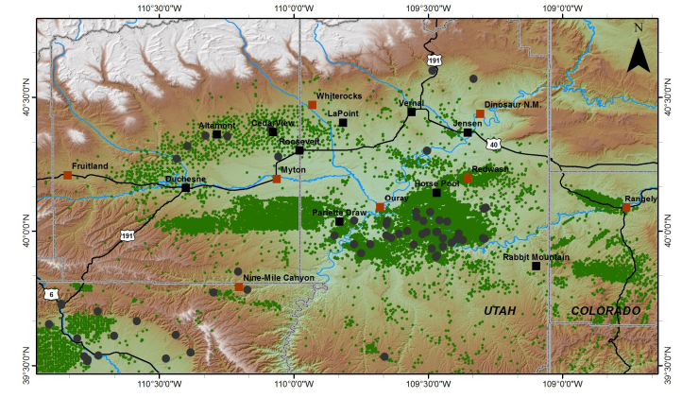
Locations of O&G emissions sources

Slide 5
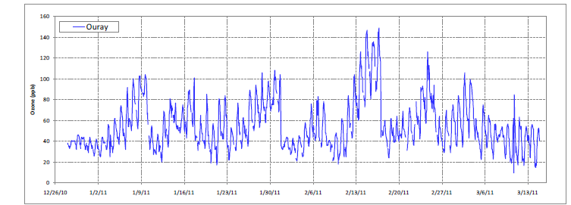
Uintah Basin Winter Ozone Study 2011
Elevated ozone first observed at 4 monitors in 2010.
Distributed ozone monitoring study in 2011 measures elevated ozone across the basin, Utah State Univ.
Several multiday inversion episodes with increasing nighttime lows and daytime highs.

Slide 6
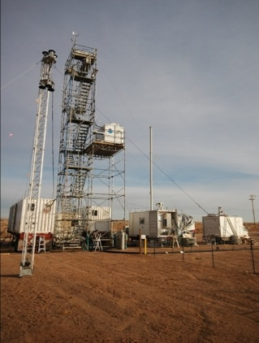
Uintah Basin Winter Ozone Study 2012
UBOS 2012: first intensive research study. No snow and no ozone, but rich data set for precursors and methane. NOAA, Universities, Utah DEQ, BLM, EPA, WEA.
Photo: Brian Lerner, NOAA, 2012, Horsepool research site.

Slide 7
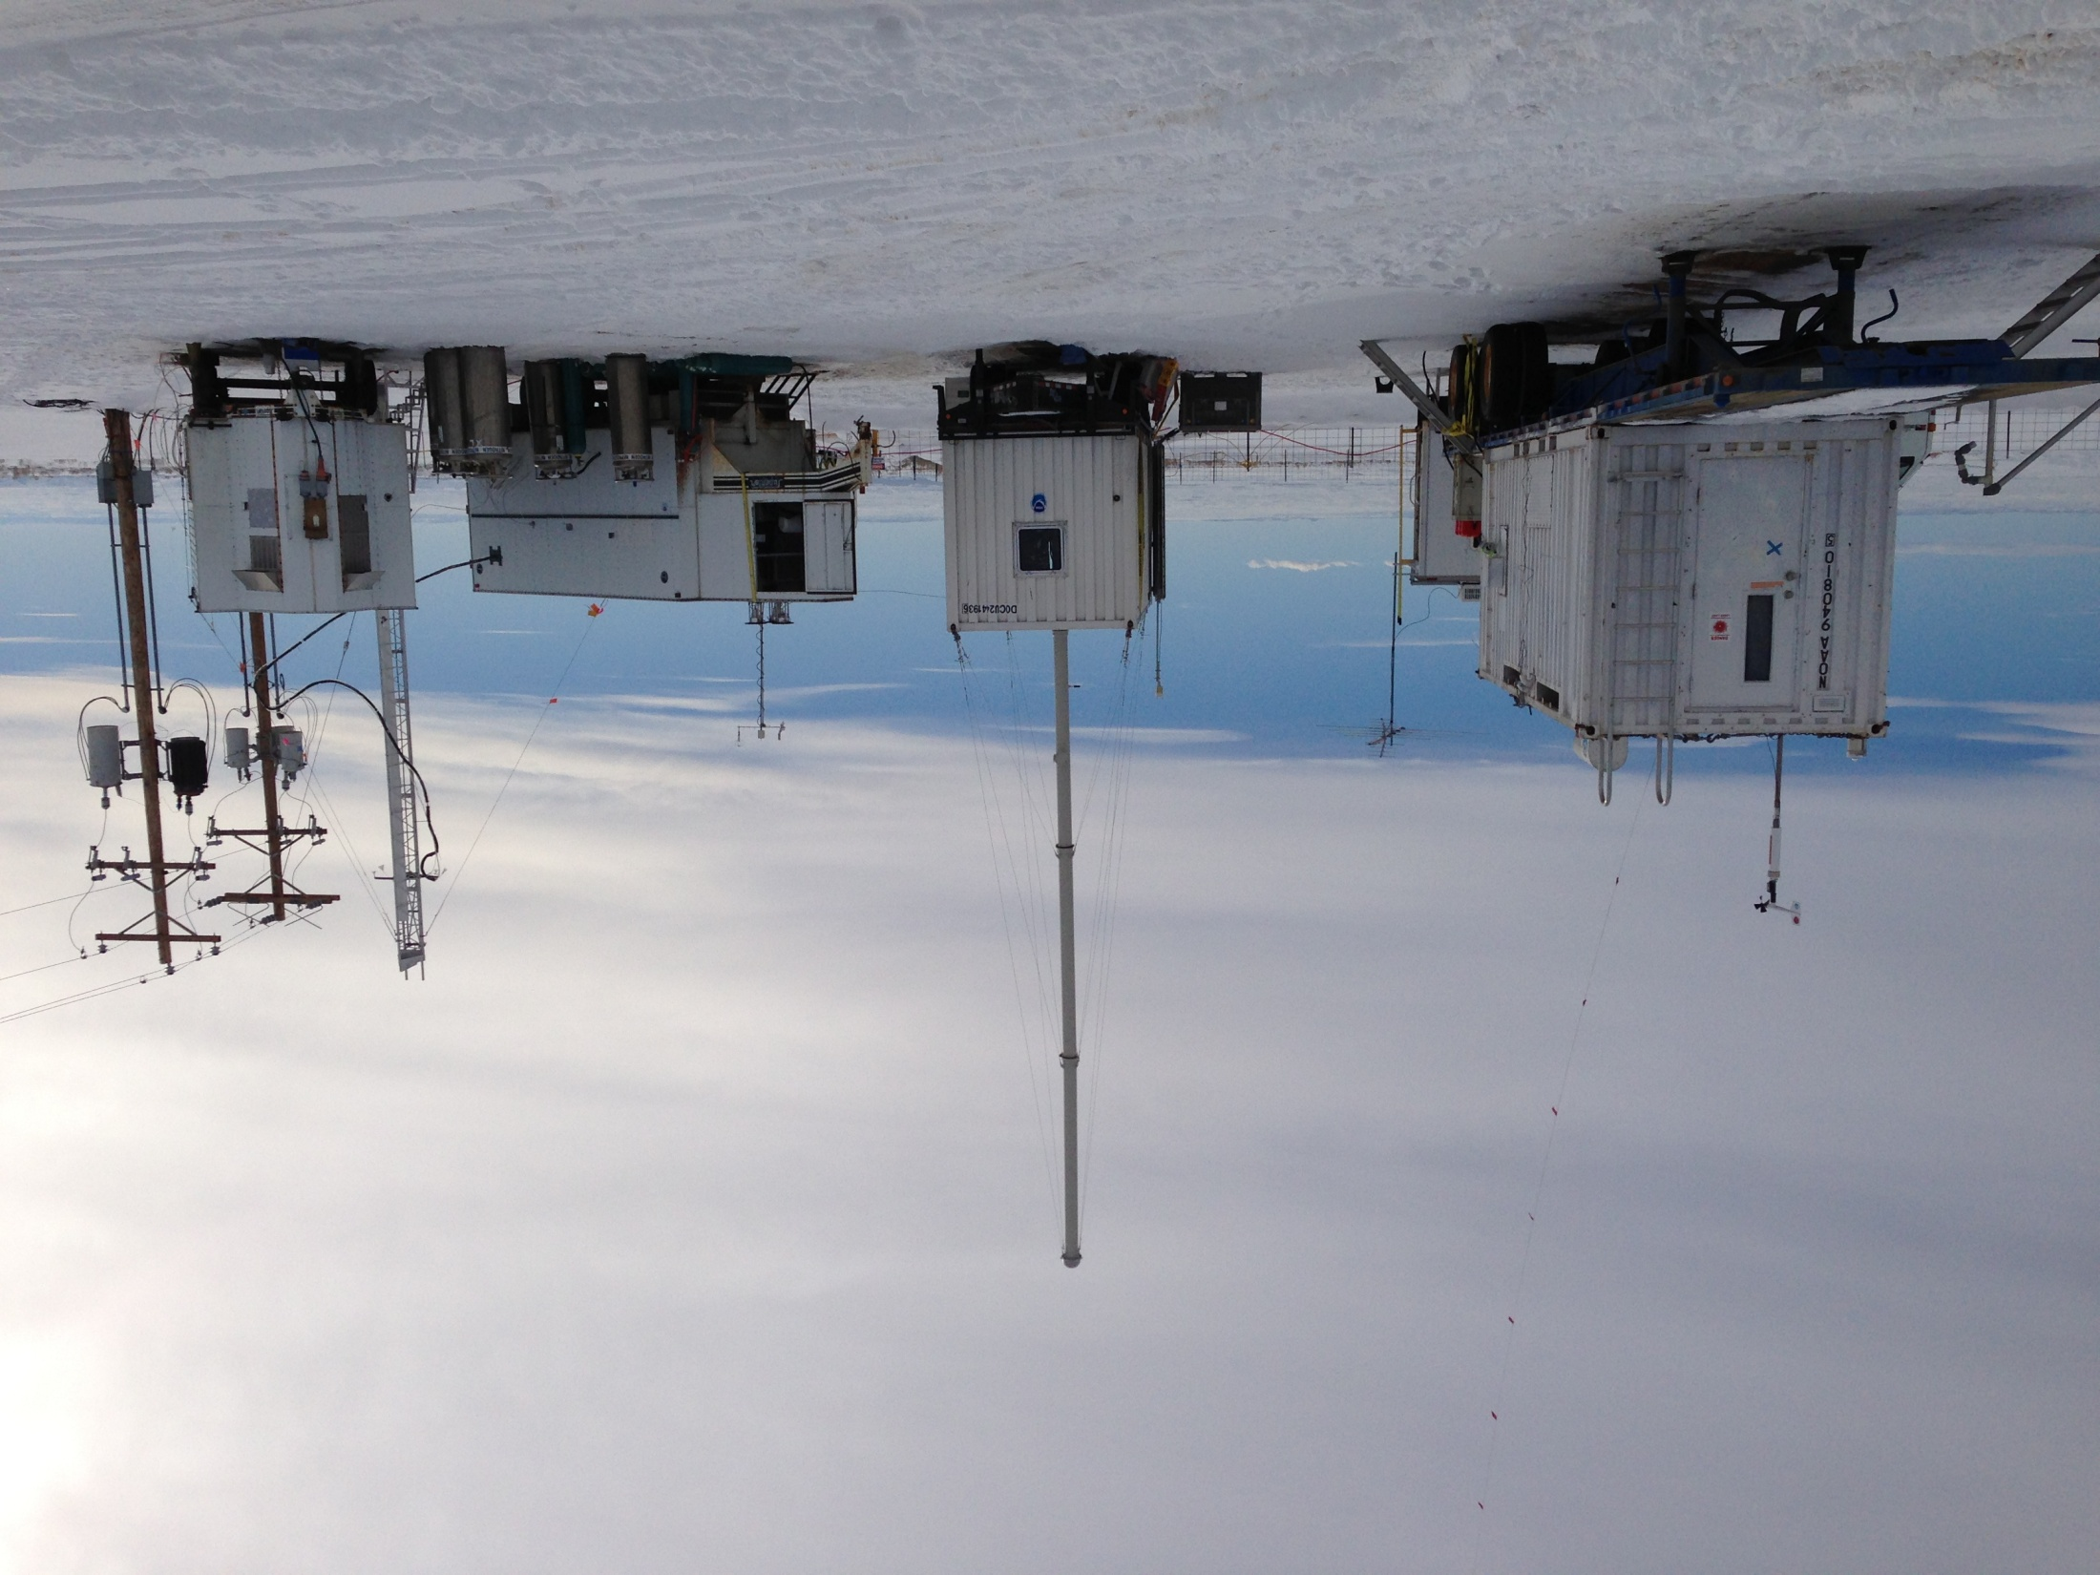
Uintah Basin Winter Ozone Study 2013
UBOS 2013: seven multiday inversion episodes varying from 3 to 17 days long.
Max 8-hour average ozone was 152 ppb.
Exceeded the NAAQS on a total of 22 days at Vernal and 29 days at Roosevelt
Photo: Jim Roberts, NOAA, 2013 UBOS, Horsepool research site.

Slide 8
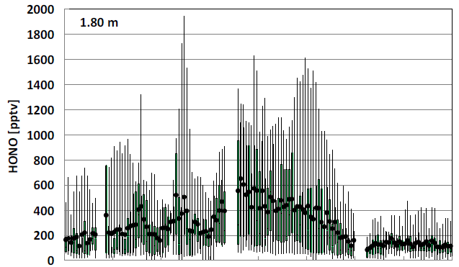
Winter high daytime HONO
Rappenglueck et al used LOPAP to measure high daytime HONO in WY in 2010 & 2011.
Typical daytime HONO levels observed in 2012 UBOS, DOAS, acid-CIMS
NOAA observed high daytime HONO in 2013 UBOS, acid-CIMS and Cavity-enhanced Absorption Spectrometer, however,
concerns remain in possible interference from HO₂NO₂.
Planning a UBOS 2014 study to focus on radical budgets, including HONO and HCHO. (DOAS, LOPAP, acid-CIMS, ACES)

Slide 9
2010-2011 Winter CMAQ Modeling
Use WRF and CMAQ version 5.01 model sensitivity studies to test uncertainty in key processes that affect:
winter ozone in Uintah Basin (Utah/Colorado)
winter ozone in Upper Green River Basin (Wyoming)
winter PM2.5 in Salt Lake City, UT (not the focus of this talk)
Key uncertainties include:
Effects of snow cover on albedo and photolysis rates
Effects of heterogeneous chemistry in snow on radicals
Uncertainty in emissions inventories

Slide 10
Model Inputs
METEOROLOGY
WRF v3.3
MYJ PBL, NOAH land surface model, Janjic Eta surface layer scheme
Thompson microphysics, Grell 3D cumulus
RRTM longwave, Goddard shortwave
USGS landuse data
Input analysis data from NARR
No nudging
MCIP v4.0
EMISSIONS
Anthropogenic 2011 NEI v2 based platform
WRAP phase III oil & gas emissions
Initial and Boundary conditions
2010/2011 GEOS-CHEM simulation downscaled with CMAQ to 36 km

Slide 11
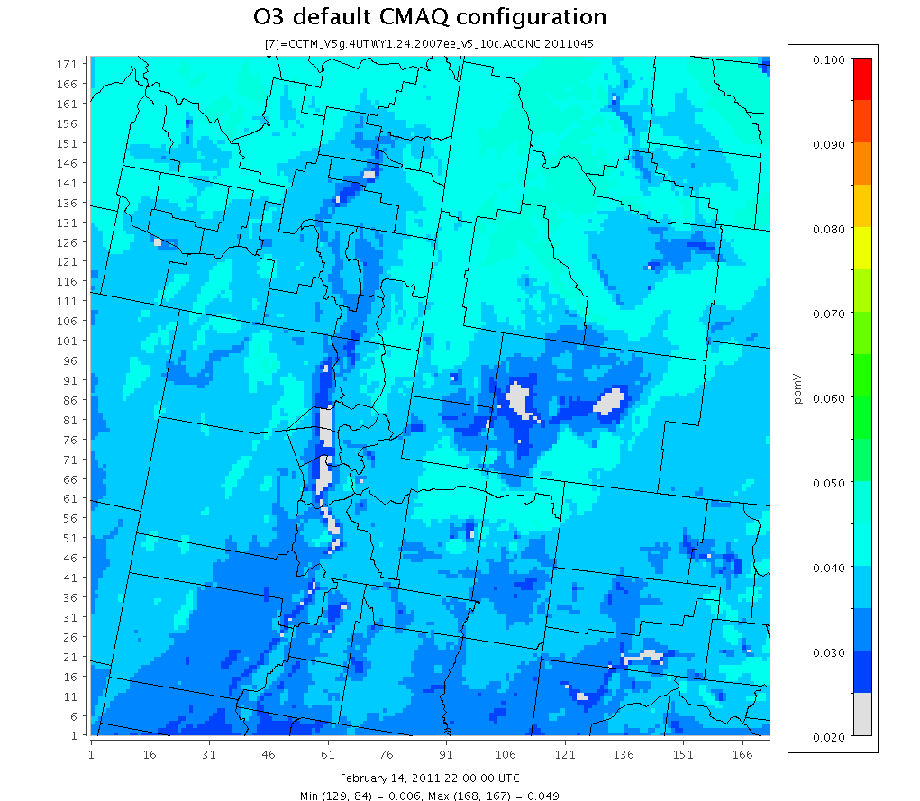
CMAQ Ozone Base Case
Base case max O3: 49 ppb; bias -120 ppb

Slide 12
Winter Ozone Sensitivity Tests
Albedo sensitivity using snow cover to enhance surface albedo, which increases photolysis:
CMAQ base case uses seasonal snow coefficients to modify surface albedo
As a sensitivity, changed surface albedo to match snow cover
HONO sensitivity – add HONO source in layer 1 proportional to HNO3 concentration and HNO3 photolysis rate.
VOC emissions from oil & gas sources are increased to determine impact on modeled ozone.

Slide 13
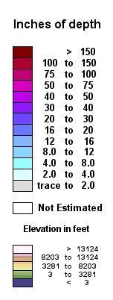
Modeled Snow Cover Feb 14, 2011
SNODAS Modeled Depth
WRF-CMAQ fractional snow cover

Slide 14
Snow Cover Effect on Photorates
CMAQ NO2 Photorate
WRF-CMAQ fractional snow cover
Plots from Photorate diagnostic output file

Slide 15
Albedo & Photolysis Rate Model Sensitivity
CMAQ 5.01 with seasonal snow coefficients, small increases in JNO2
CMAQ sensitivity with increased snow albedo, larger increase in JNO2
Albedo set to 90% of fractional snow cover (right plot)

Slide 16
CMAQ Ozone effect of Snow albedo Feb 14, 2011
CMAQ sensitivity with increased albedo
Base case with default albedo
Base case max O3: 49 pbb
Albedo case max O3: 72 ppb

Slide 17
CMAQ delta Ozone effect of Snow albedo
O3 increased up to 34 ppb, largest increases in Uintah Basin

Slide 18
CMAQ Ozone effect of HONO source
Increased Snow Albedo
HONO from HNO3 sensitivity
Albedo case max O3: 72 ppb
HONO case max O3: 92 ppb

Slide 19
CMAQ delta Ozone effect of HONO source
Largest increases, 29 ppb, in Uintah Basin, small effect in WY

Slide 20
VOC Emissions Sensitivity
Very large negative model bias for VOC in the Upper Green basin and large negative bias for VOC in the Uintah Basin.
CMAQ model sensitivity simulations with:
2x VOC emissions in UB and 5x VOC emissions in UGB
5x VOC emissions in UB and 10x VOC emissions in UGB

Slide 21
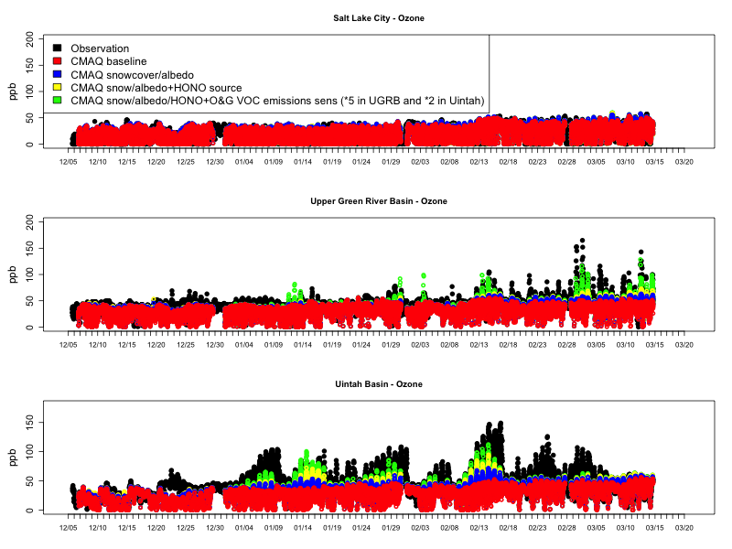
CMAQ Sensitivity with 2xUB and 5xUGB VOC

Slide 22
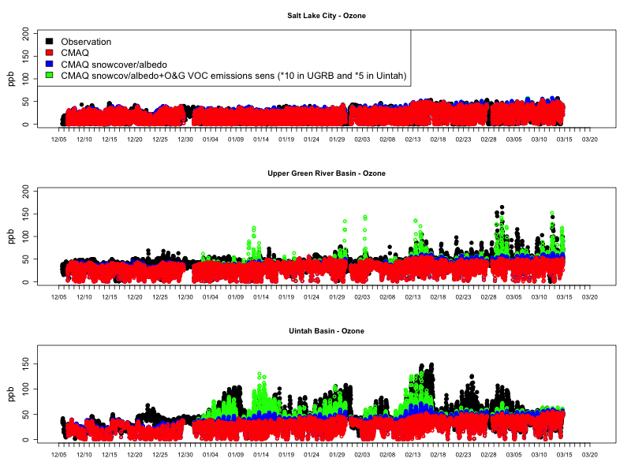
CMAQ Sensitivity with 5xUB and 10xUGB VOC

Slide 23
Wyoming Mesonet Surface Data

Slide 24
Conclusions
CMAQ can simulate elevated winter ozone in the Uintah and Upper Green River basins if adjustments are made to snow cover, albedo, emissions, and radical sources:
However, uncertainty remains in the correct setting for each of these parameters.
CMAQ inline albedo and photolysis approach has been revised to represent snow albedo adjustment for landuse types in the Uintah Basin.
Landuse type adjustments may need additional refinement.
Emissions, particularly VOC, need further examination.
Model ozone is highly sensitive to addition of a daytime surface radical (HONO) source.
additional measurement studies are needed to confirm and understand the cause of high daytime HONO.
UBOS 2014 study will measure radicals sources.

Slide 25
extra slides

Slide 27
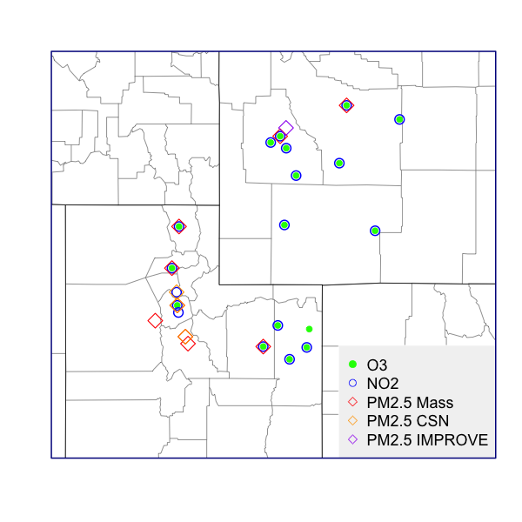
Routine Monitors

Slide 29
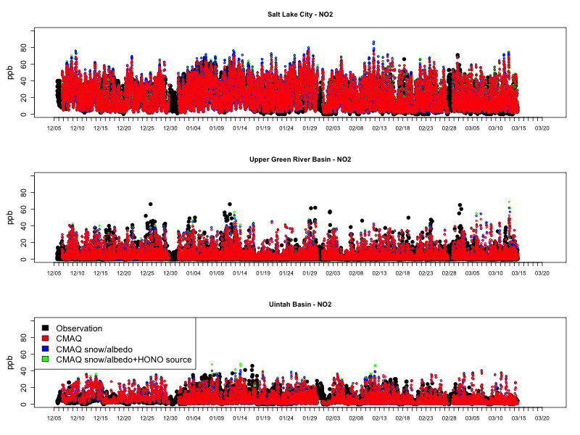

Slide 30
