Slide 1
Developing a High Spatial Resolution Aerosol Optical Depth Product Using MODIS Data to Evaluate Aerosol During Large Wildfire Events
Jennifer DeWinter, Sean Raffuse, Michael McCarthy, Kenneth Craig, Loayeh Jumbam, Fred Lurmann
Sonoma Technology, Inc., Petaluma, CA
Scott Fruin
University of Southern California, Los Angeles, CA
Presented at the
12th Annual CMAS Conference
Chapel Hill, NC
October 29, 2013
STI-5701

Slide 2
Outline
Background
Study objectives
Methods
  Data acquisition and preparation
  Surface reflectance ratios
  Aerosol optical properties
  Cloud filter
Results
Conclusions
Future applications

Slide 3
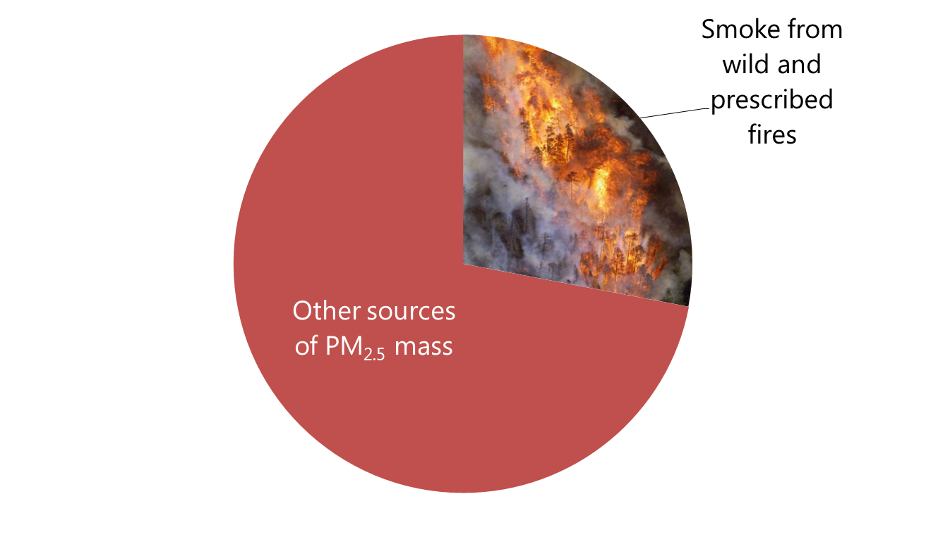
Smoke and Air Pollution
Background
Wildfires are a major source of air pollution, particularly in the western U.S. during summer/fall
Smoke from fires decreases visibility and exposes people to harmful air pollution such as PM_{2.5}
Accurate estimation of PM_{2.5} concentrations during wildfires is important to quantify air pollution exposure and visibility
2008 fire emissions inventory
sources of PM_{2.5}
29%

Slide 4
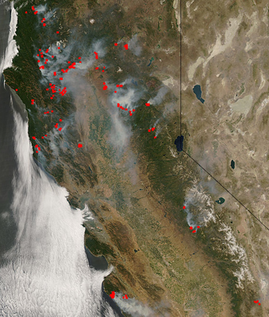
2008 Fires in Northern California
Background
Fire locations in Northern California on June 25, 2008, as detected by MODIS
  1.5 to 2 million acres burned
  600,000 to 800,000 tons of PM_{2.5} produced
  Stagnant meteorology and plumes mixed to the surface
  30-50 days of smoke impact
  Many days violated the National Ambient Air Quality Standards for PM_{2.5} and PM₁₀
Fire locations
Image courtesy of NASA

Slide 5
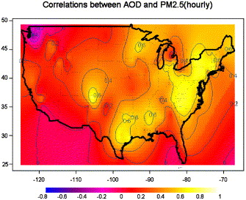
Estimating the Spatial Distribution of PM_{2.5}
Background
Measurements, models, satellites
Data from satellites can provide information on
the spatial distribution
of pollution
Aerosol optical depth (AOD) is a unitless measure of the total scattering and absorption of light by aerosols in an atmospheric column
Correlation between AOD and hourly PM_{2.5} across United States
R value
Engel-Cox J.A., Holloman C.H., Coutant B.W., Hoff R.M., 2004. Qualitative and quantitative evaluation of MODIS satellite sensor data for regional and urban scale air quality. Atmospheric Environment 38 (16), 2495-2509

Slide 6
Our Study Objectives
Objectives
  Develop a customized AOD product for wildfire conditions in the western U.S.
  High spatial resolution
  Localized aerosol and optical properties
  Improved cloud screening
  Estimate PM_{2.5} concentrations during wildfire events

Slide 7


Methods Overview
Methods
Obtain raw Level 1b MODIS radiance data and corresponding geolocation data
  http://ladsweb.nascom.nasa.gov/
  Raw data at 250 m, 500 m, 1-km
  spatial resolution
  Terra and Aqua satellites
  Time period: June 24 through July 31,
  2008 (and 2009)
Modifications to NASA algorithm to develop our AOD product
  Develop localized surface reflectance properties
  Better characterize smoke aerosol
  Relax cloud filter algorithm
Total signal measured by satellite =
light reflected by ground + light reflected by aerosol column
MODIS measures reflectance in 36 spectral channels
Daily satellite-detected reflectance at 2.13 and 0.66 µm

Slide 8
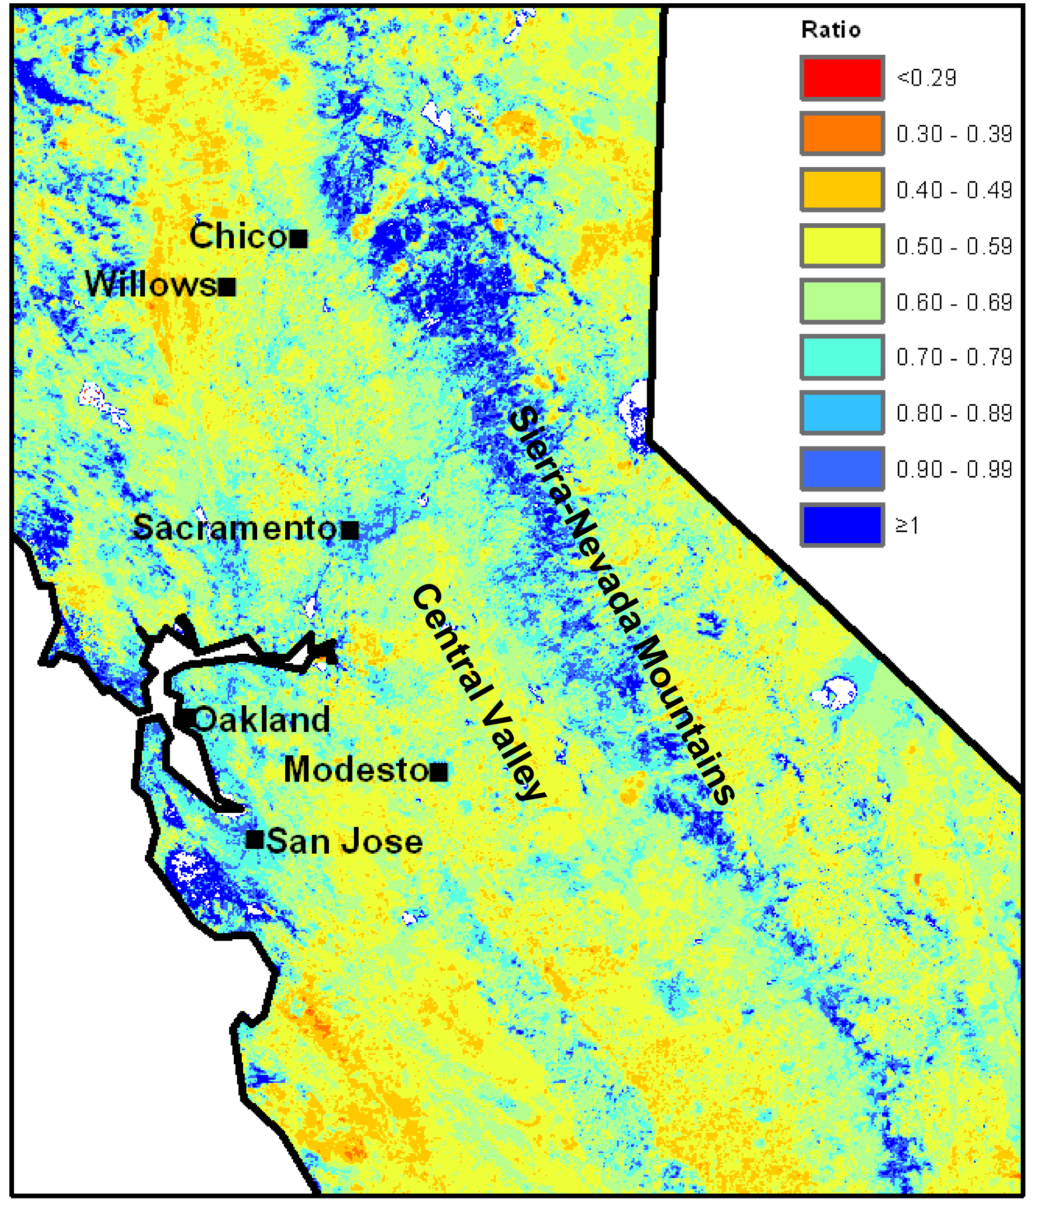
Local Surface Reflectance
Methods
Distinguish reflectance from aerosols in the atmospheric column vs. surface reflectance
Use MODIS top-of-atmosphere reflectance in two channels—0.66 and 2.13
Develop 0.66/2.13 surface reflectance ratio under clean conditions
Calculate the total column aerosol that would produce the observed 0.66 reflectance
Average surface reflectance ratio (0.66/2.13)

Slide 9
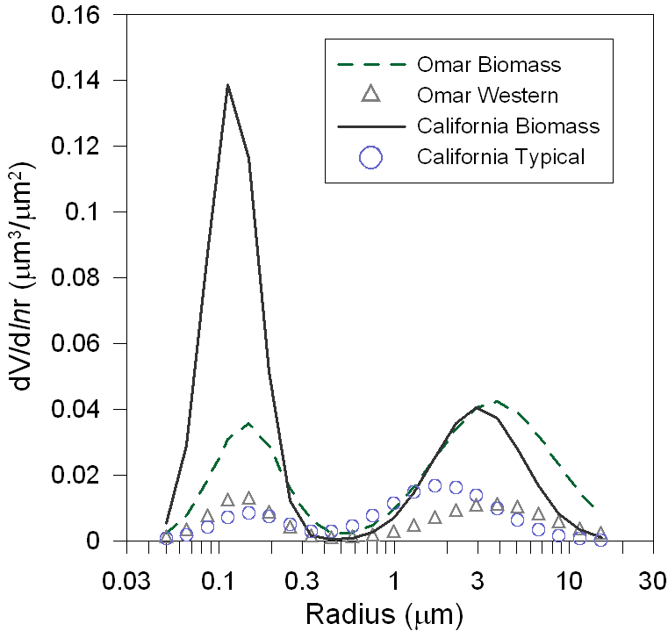
Local Aerosol Properties
Methods
Omar Western aerosol model for western U.S. used in standard NASA AOD product
California biomass model has aerosol optical properties specific to California and biomass burning conditions
      Biomass model better characterizes smoke aerosol
Aerosol size distributions for different aerosol optical models

Slide 10
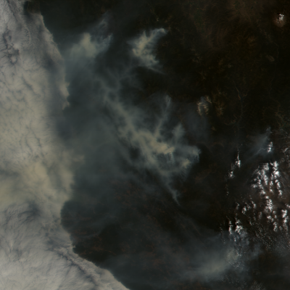
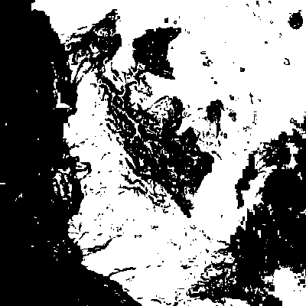
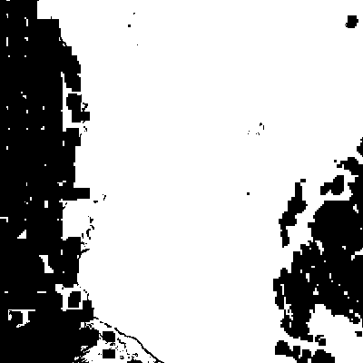
Improved Cloud Filter
Methods
Implement a relaxed cloud filtering algorithm
Use reflectance from three MODIS channels
  0.47 (bright thick clouds)
  1.38 (thin cirrus clouds)
  2.12 (clouds only)
  Spatial variability and absolute value
Original Cloud Mask
Relaxed Cloud Mask

Slide 11
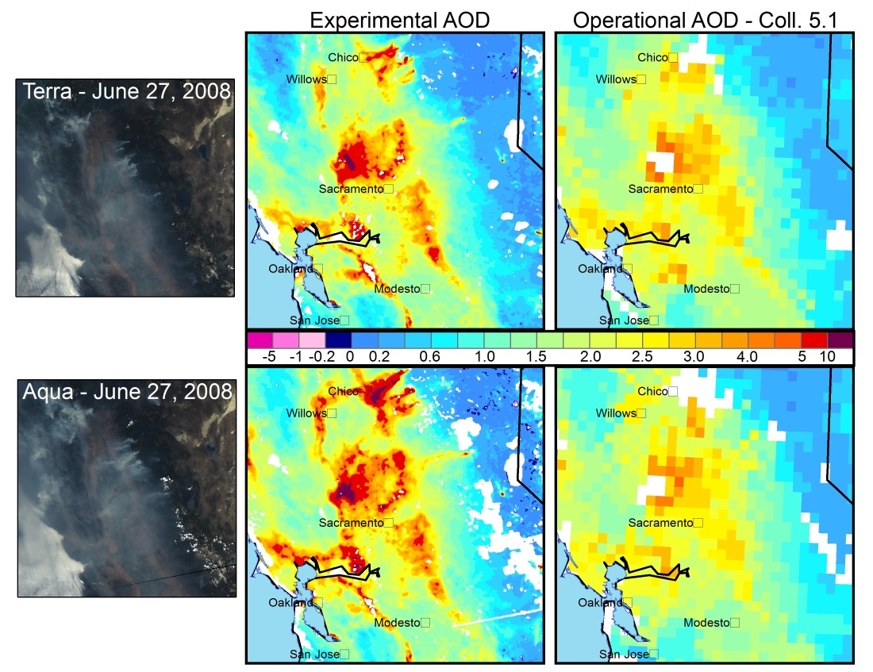
Comparison of AOD Products
Results
  Experimental AOD compared to the standard NASA product on June 27, 2008

Slide 12
Validating AOD with AOT
Results
Observed aerosol optical thickness (AOT) from three coastal Aerosol Robotic Network (AERONET) sites in central and northern California
High resolution AOD is much better at matching observed AOT
  High resolution: R² = 0.53
  Standard resolution: R² = 0.08

Slide 13
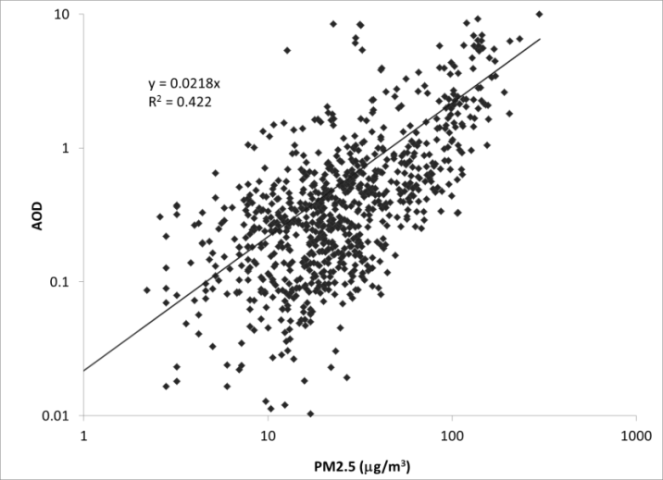
Validating AOD with PM_{2.5}
Results
Relationship between ground-based PM_{2.5} concentrations and high spatial resolution AOD that overlaps the ground monitors for June 24 to July 31, 2008.
  Identify AOD pixels at ground monitor locations
  Calculate mean PM_{2.5} using ground measurements from
  10 a.m. to 2 p.m.
  Calculate mean AOD using Terra and Aqua

Slide 14
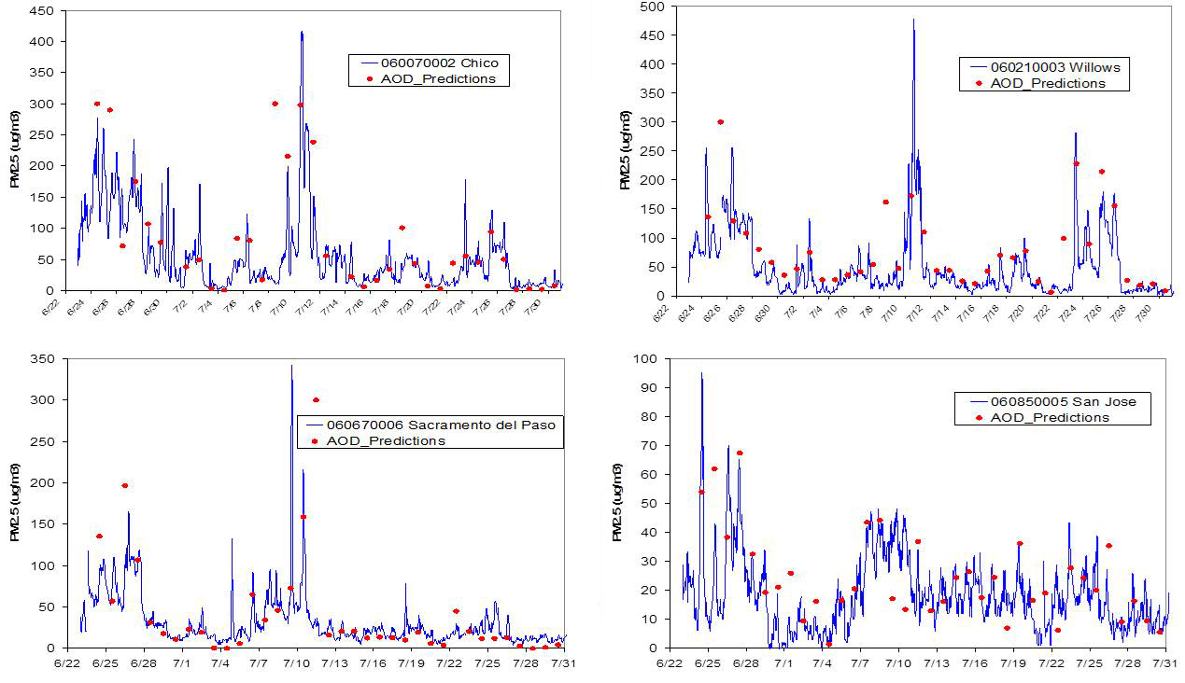
Time-Series at Select Sites: PM_{2.5} & AOD
Results
General shape of the pollution episodes is well captured

Slide 15
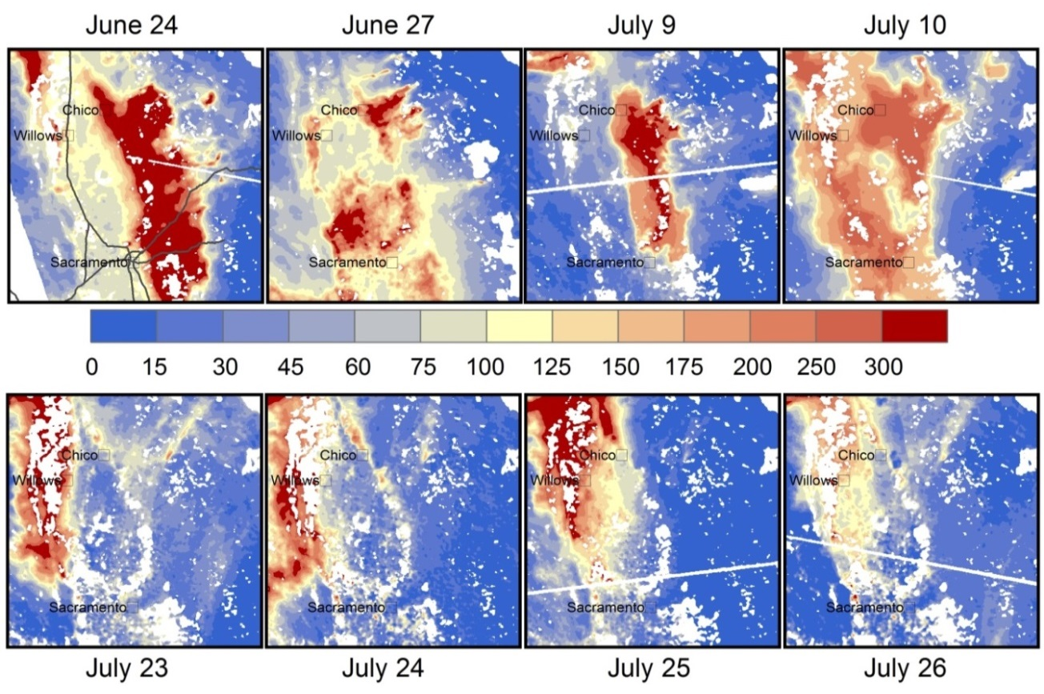
AOD-Estimated PM_{2.5}
Results
  Develop day-specific regression relationships (including all monitoring sites)
  Use the daily slope to predict PM_{2.5}
Units: µg/m³

Slide 16
Conclusions
Developed a high spatial resolution AOD product specific to smoke aerosol
  Local surface reflectance properties
  Aerosol optical properties typical of California biomass burning aerosol
  Relaxed cloud filter preserved smoke pixels typically classified as clouds
Predicted PM_{2.5,} particularly on days when smoke is well-mixed to the surface

Slide 17
Future Applications
High resolution AOD product will be useful for
  Others studying the 2008 fire event
  Evaluating modeled smoke predictions
  Assimilation into air quality models to improve PM_{2.5} forecasts
Method can also be used in other areas
  Requires data processing to develop local AOD product
  Requires further improvements to surface reflectance ratios and cloud screening

Slide 18

Contact
35
Stephen Reid
sreid@sonomatech.com
Jennifer DeWinter
jdewinter@sonomatech.com
707.665.9900
sonomatech.com
@sonoma_tech

