Slide 1
Changes in U.S. Regional-Scale Air Quality at 2030 Simulated Using RCP 6.0
Chris Nolte¹,Tanya Otte¹, Rob Pinder¹, Jared Bowden², Greg Faluvegi³, and Drew Shindell³
¹U.S. Environmental Protection Agency, Research Triangle Park, North Carolina
²Institute for the Environment, University of North Carolina
³NASA Goddard Institute for Space Studies
12th Annual CMAS Users’ Conference
30 October 2013

Slide 2
Motivation for Regional Climate Modeling
Leverage latest global modeling science/expertise/data to create regional climate simulations that are “driven” by global scenarios
Focus on U.S. interests in the light of global context
Provide higher spatial and temporal resolution climate data for climate change impact applications
Overall Objective:
To equip environmental managers and policy/decision makers with science, tools, and data to inform decisions related to adapting to and mitigating the potential impacts of regional climate change on air quality, ecosystems, and human health.

Slide 3
Downscaling NASA/GISS ModelE2 using WRF
ModelE2: AR5 runs at 2° x 2.5°
40 hybrid layers up to 0.1 hPa
ca. 2000 (“1995–2005”) and RCP 6.0 ca. 2030 (“2025–2035”)
Input data used at 6-h intervals; 3-h data used for evaluation
WRFv3.2.1
WRF Preprocessing System adapted to ingest raw ModelE2 fields
108-36-km, two-way-nested, domains (81x51 and 199x127)
34 layers up to 50 hPa
Continuous 11-year runs (no reinitialization)
Spectral nudging of wavelengths >1500 km toward ModelE2 fields, applied above PBL only

Slide 4
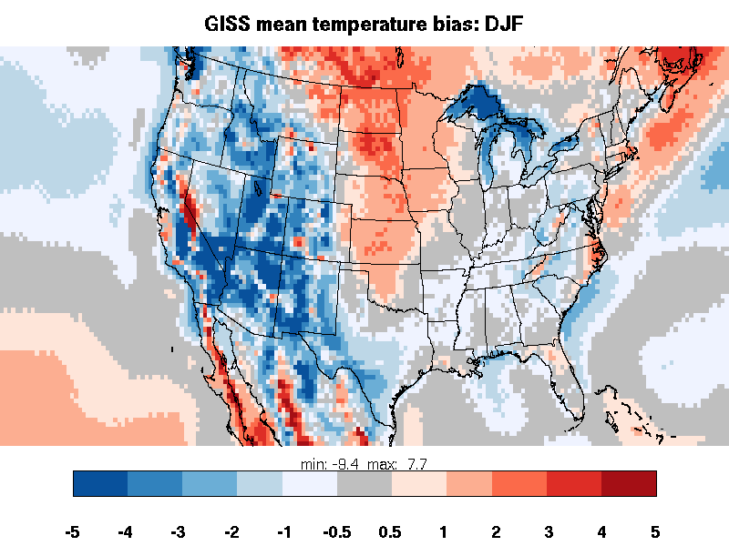
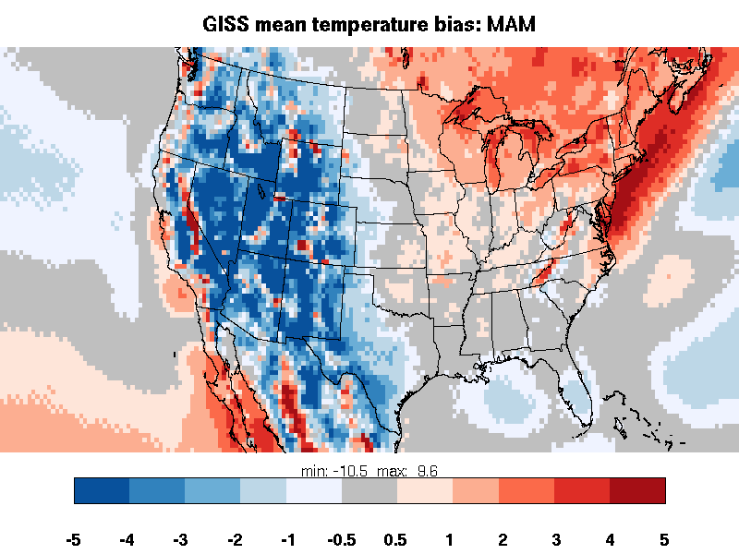
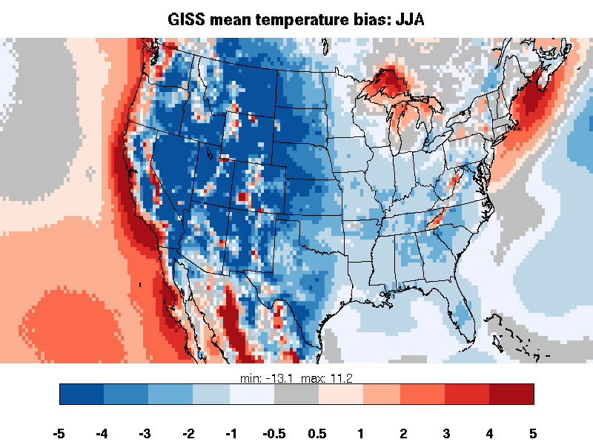
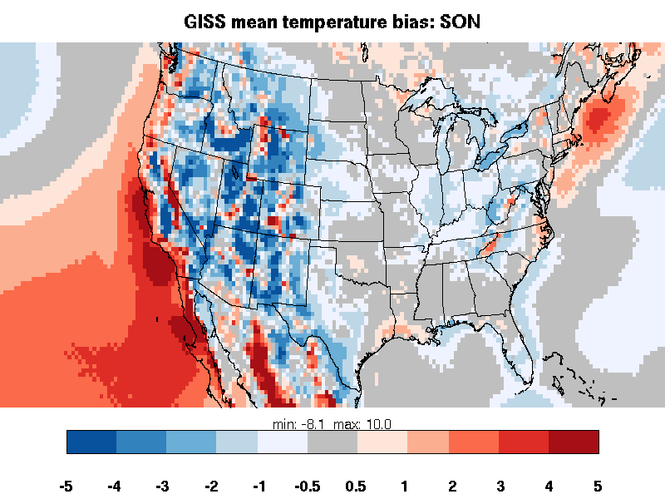
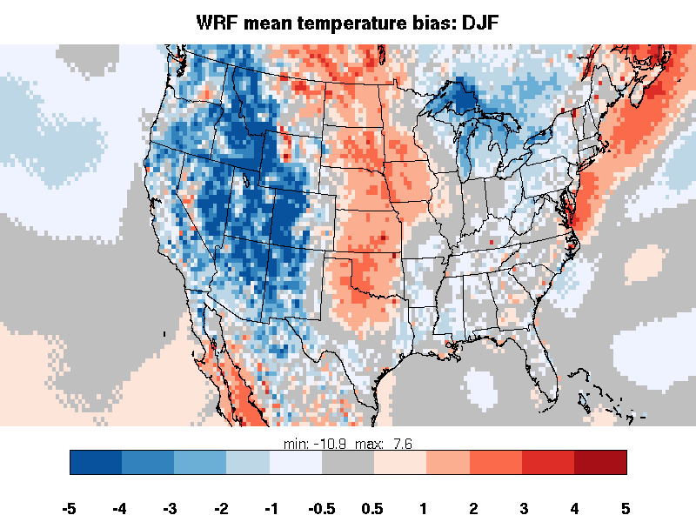
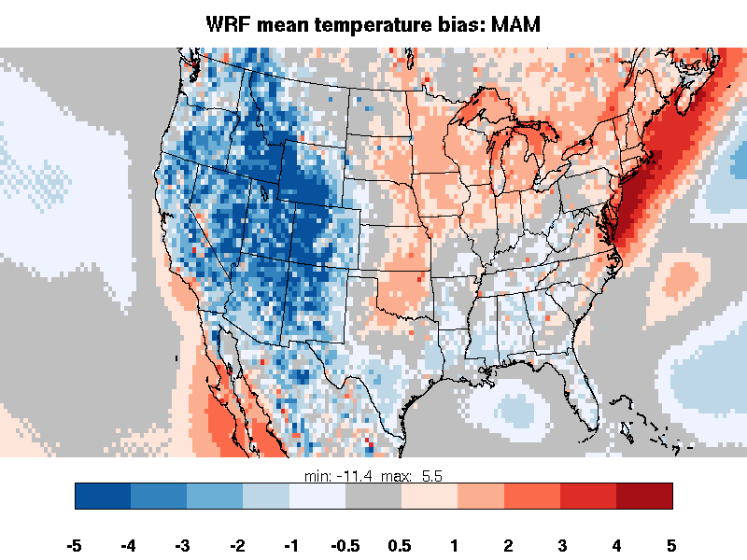
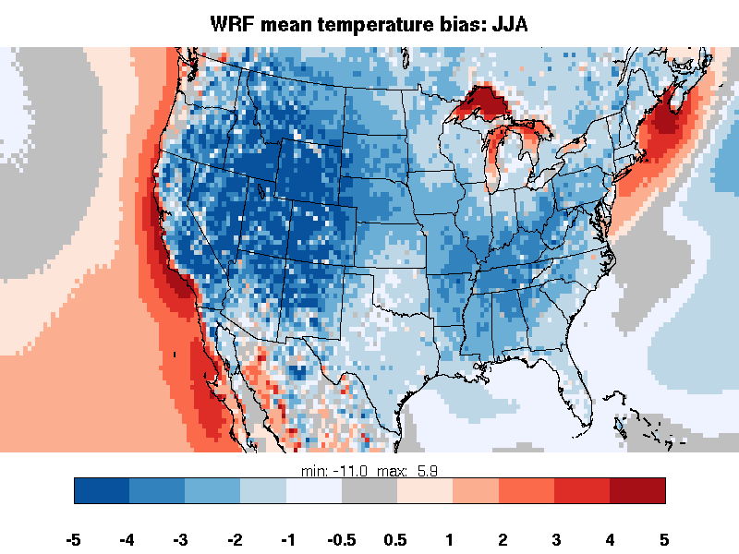
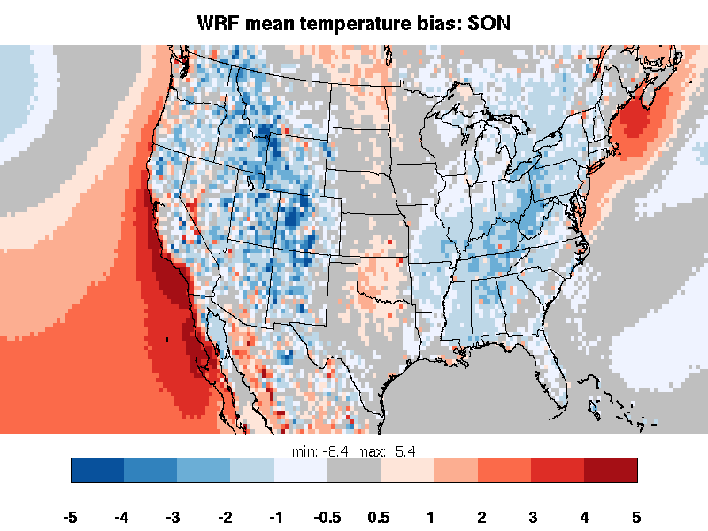
Seasonal Mean Temperature Bias relative to NARR
Winter (DJF)
Spring (MAM)
Summer (JJA)
Fall (SON)
Model E2
WRF
°C
Only long-term comparisons with observations are valid
WRF mostly consistent with Model E2
Cool bias > 1 K throughout summer

Slide 5
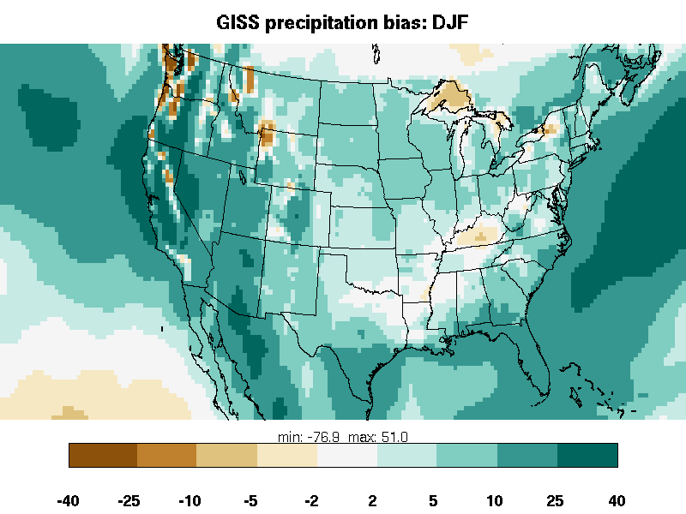
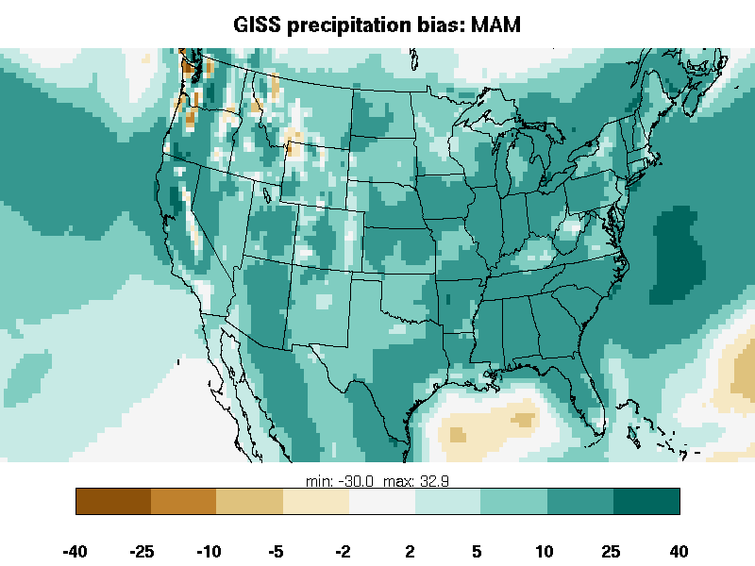
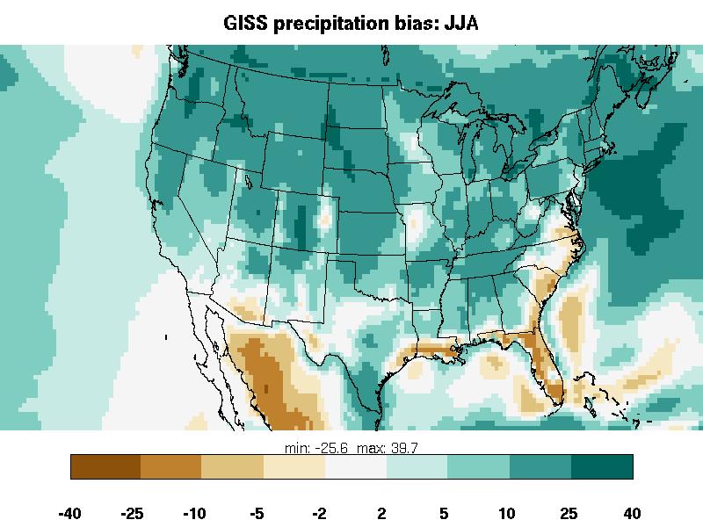
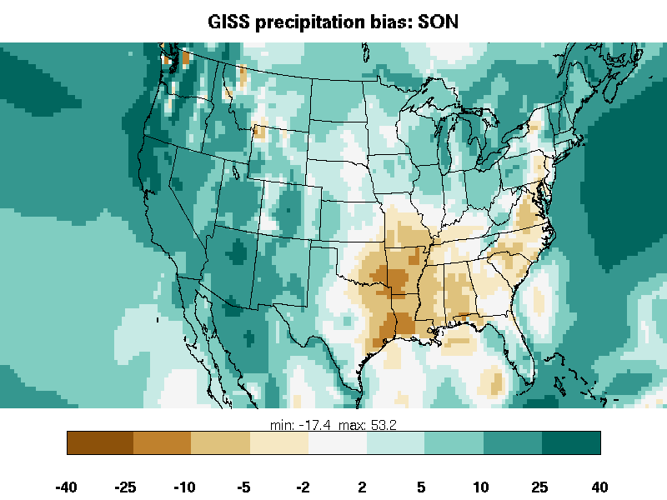
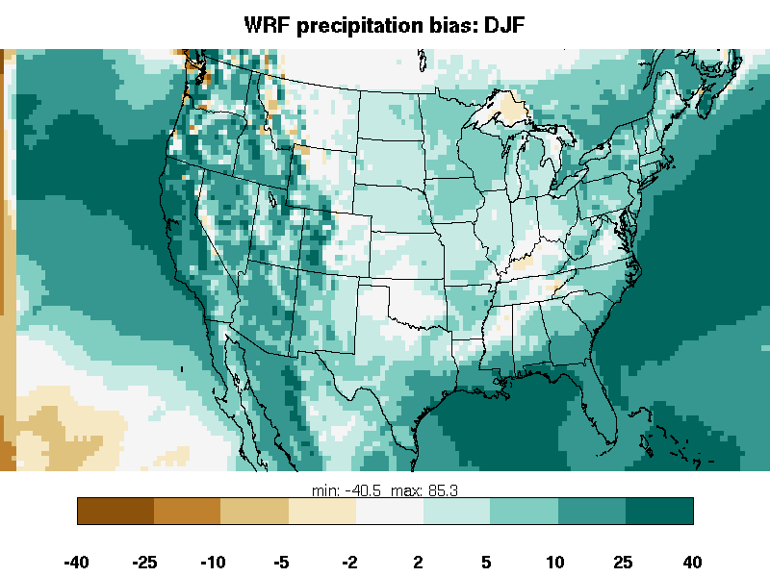
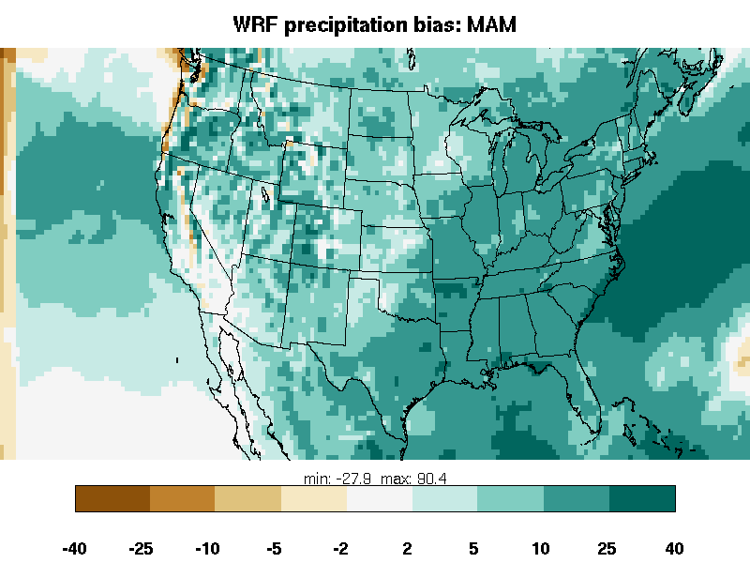
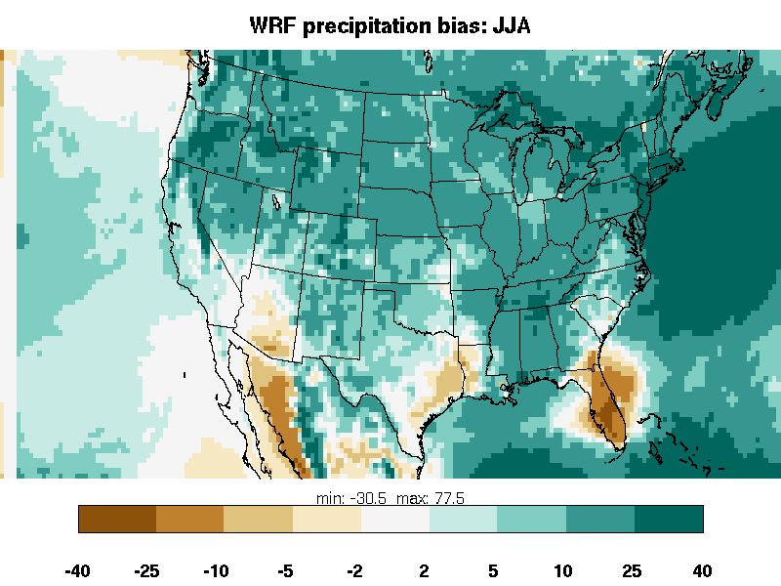
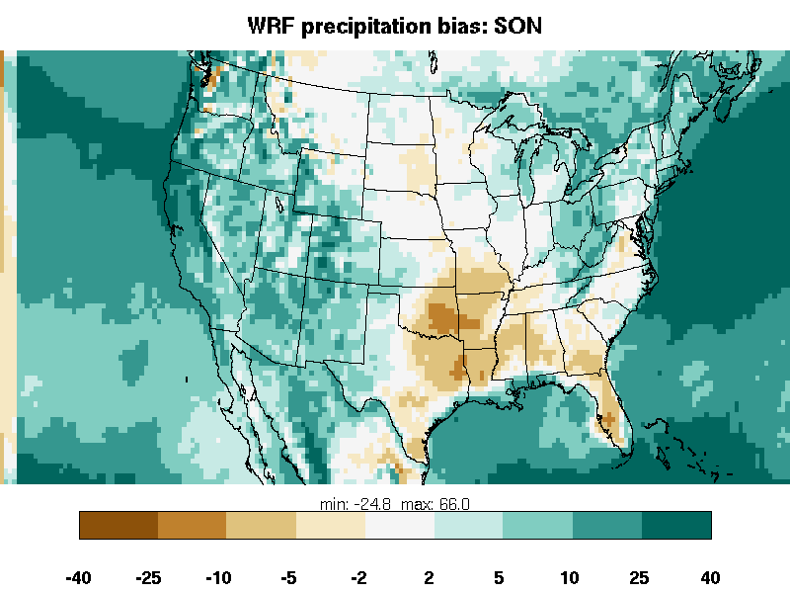
Seasonal Accumulated Precip Bias relative to NARR
Winter (DJF)
Spring (MAM)
Summer (JJA)
Fall (SON)
Model E2
WRF
cm
WRF precip largely consistent with Model E2
Pronounced wet bias in WRF, particularly spring and summer

Slide 6
Air Quality Model Configuration
CMAQ v5.0, SAPRC07
Using online photolysis and lightning NOx
Wind-blown dust option turned off
36-km North American domain (153 x 100)
Constant (for each year) anthropogenic emissions
2006 inventory
Biogenics simulated online using downscaled meteorology
Constant (clean, default) chemical boundary conditions
Purpose is to examine AQ averages and distribution obtained using meteorology downscaled from GCM

Slide 7
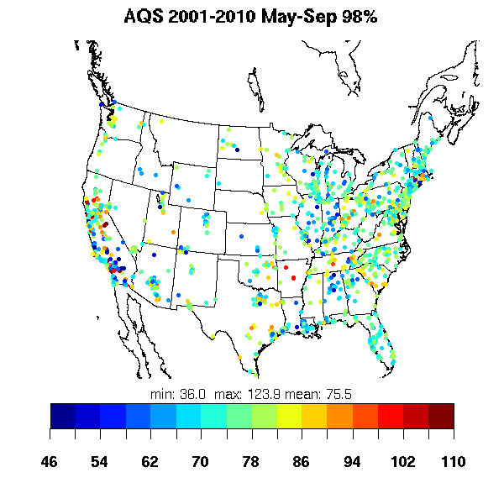
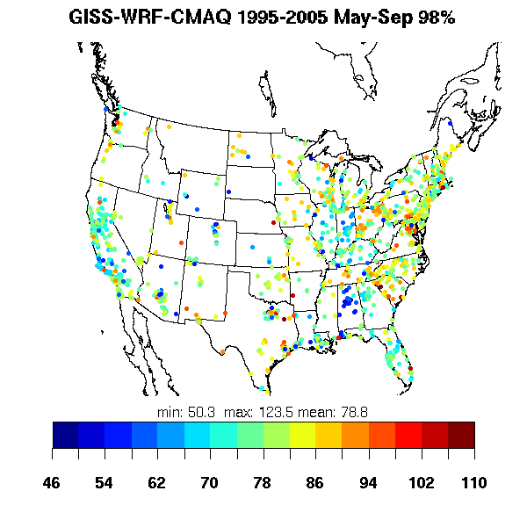
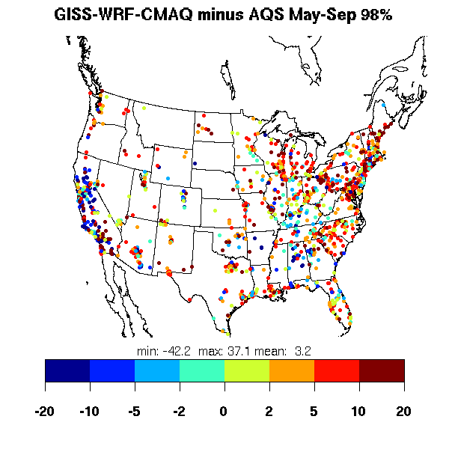
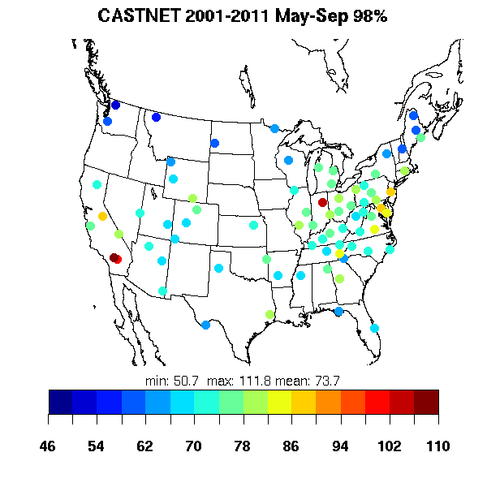
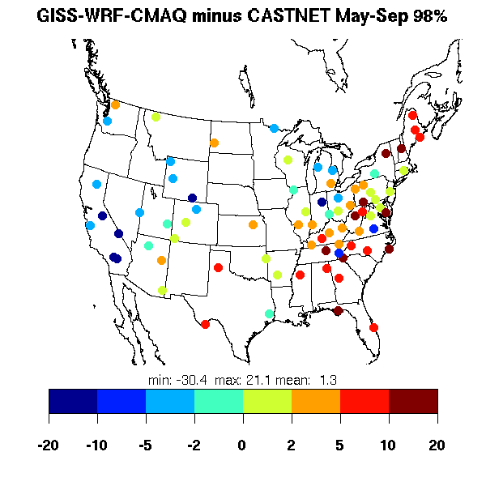
Daily Max 8-h Ozone: multiyear average 98th percentile (May – September)
Observations
Modeled
Model Bias
AQS 2001-2010
CASTNET 2001-2011

Slide 8
Average Ozone Distribution
percentile | obs | CMAQ | bias
mean | 48.6 | 57.7 | 9.1
10% | 32.6 | 45.7 | 13.0
25% | 39.4 | 50.6 | 11.2
50% | 47.8 | 57.0 | 9.3
75% | 57.0 | 64.1 | 7.1
90% | 65.4 | 70.7 | 5.3
95% | 70.3 | 74.6 | 4.3
98% | 75.5 | 78.8 | 3.2
percentile | obs | CMAQ | bias
mean | 49.8 | 57.0 | 7.1
10% | 35.5 | 46.5 | 11.0
25% | 41.9 | 50.9 | 9.0
50% | 49.4 | 56.4 | 7.1
75% | 57.3 | 62.6 | 5.4
90% | 64.4 | 68.2 | 3.8
95% | 69.0 | 71.5 | 2.6
98% | 73.7 | 75.0 | 1.3
AQS (~1150 sites)
Modeled O₃ positively biased throughout distribution
Peaks fairly well captured; larger bias for mean and lower end of distribution
Bias smaller for CASTNET than for AQS.
CASTNET (80 sites)
Notes:
revise so that AQS and CASTNET sections are side-by-side, and box on right is at bottom?

Slide 9
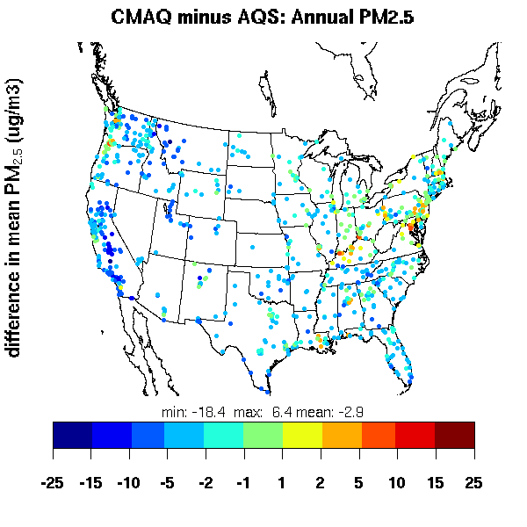
PM_{2.5} Bias at AQS Sites, 2006-2011
Seasonal PM_{2.5} Bias at AQS Sites
 | obs | model | median bias | NMdb
DJF | 10.4 | 8.4 | -1.3 | -0.13
MAM | 9.4 | 6.6 | -2.7 | -0.27
JJA | 11.5 | 6.9 | -4.7 | -0.42
SON | 9.8 | 7.7 | -1.8 | -0.19
annual | 10.3 | 7.4 | -2.6 | -0.25
NMdb = normalized median bias
PM_{2.5} biased low throughout year.
Largest negative bias during summer (-42%).

Slide 10
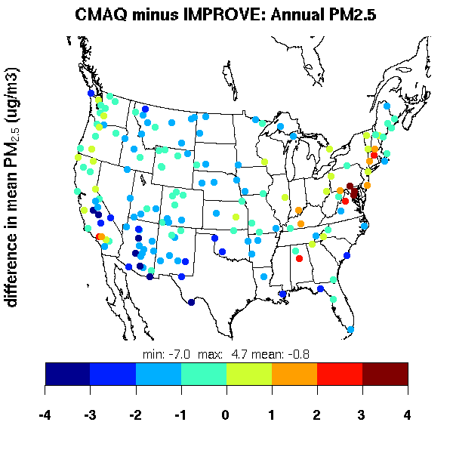
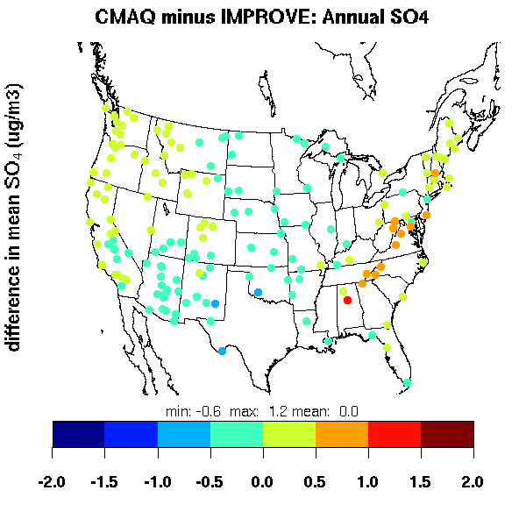
PM2.5 and SO4 Bias at IMPROVE sites
Seasonal PM2.5 Bias at IMPROVE Sites
 | obs | model | median bias | NMdB
DJF | 4.1 | 4.9 | 0.4 | 0.12
MAM | 5.1 | 4.0 | -1.3 | -0.30
JJA | 6.9 | 4.5 | -2.6 | -0.44
SON | 4.8 | 4.6 | -0.7 | -0.18
annual | 5.2 | 4.5 | -1.0 | -0.23
Seasonal SO4 Bias at IMPROVE Sites
 | obs | model | median bias | NMdB
DJF | 0.9 | 1.0 | 0.2 | 0.27
MAM | 1.3 | 1.3 | -0.1 | -0.09
JJA | 1.7 | 1.6 | -0.1 | -0.11
SON | 1.1 | 1.4 | 0.1 | 0.11
annual | 1.3 | 1.3 | 0.0 | 0.01
-4
-3
-2
-1
0
1
2
3
4
-4
SO4 concentrations unbiased on average.
-2.0
-1.5
-1.0
-0.5
0.0
0.5
1.0
1.5
2.0

Slide 11
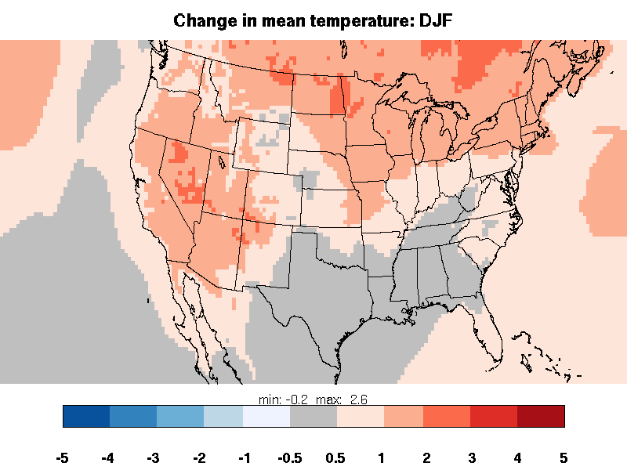
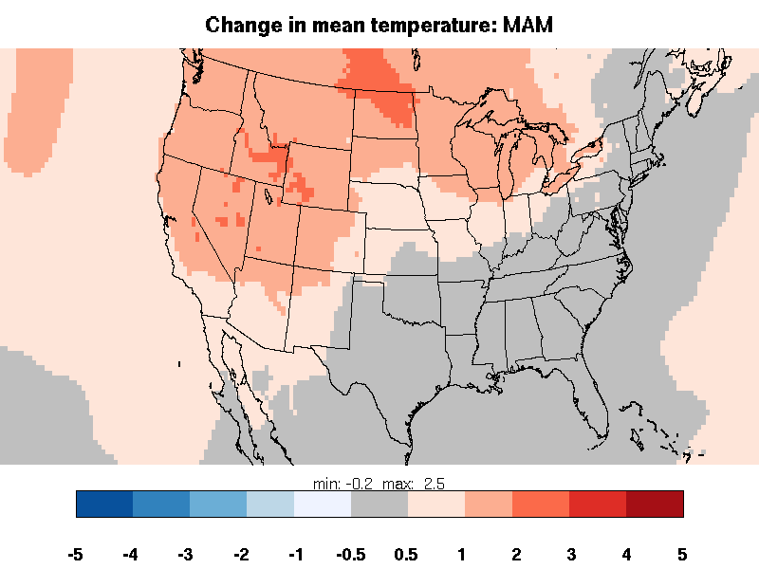
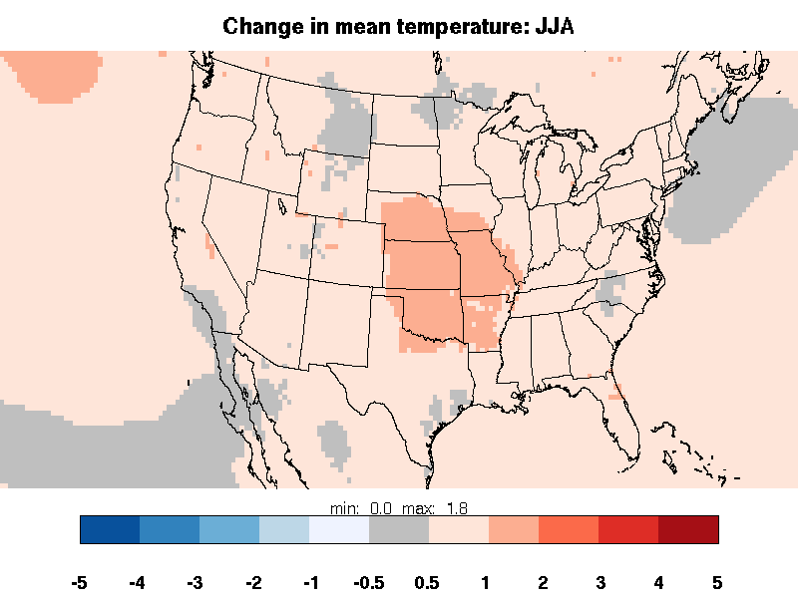
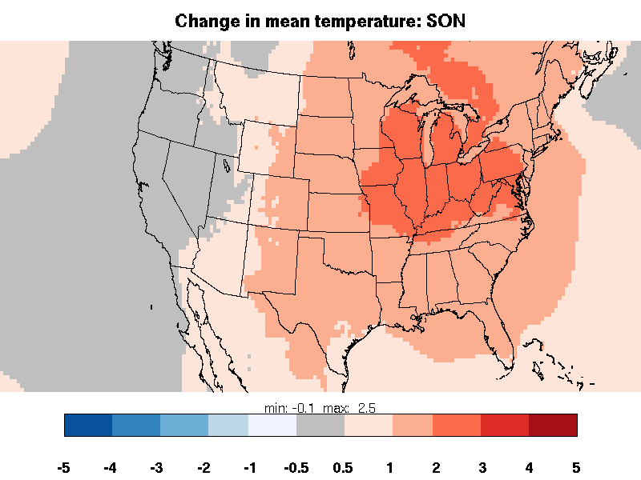
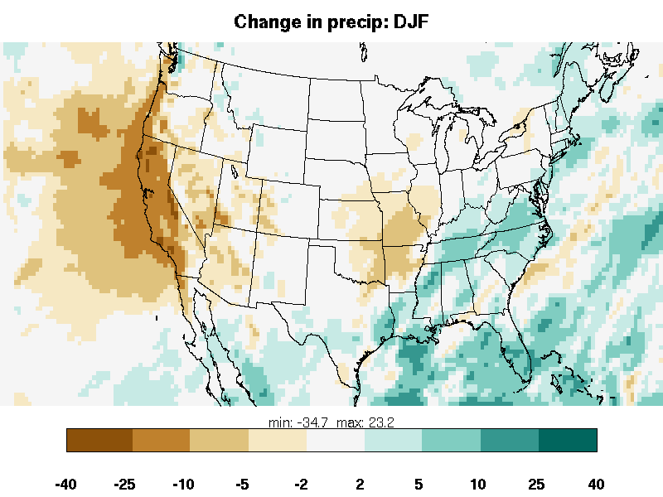
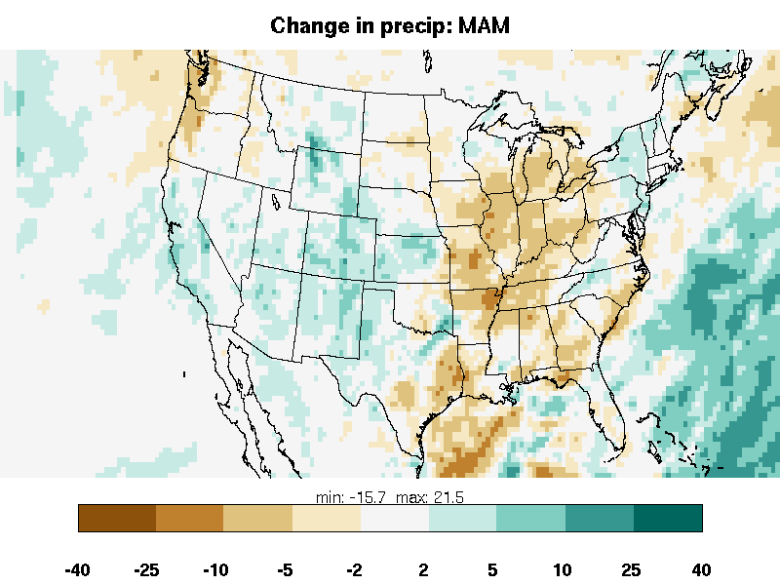
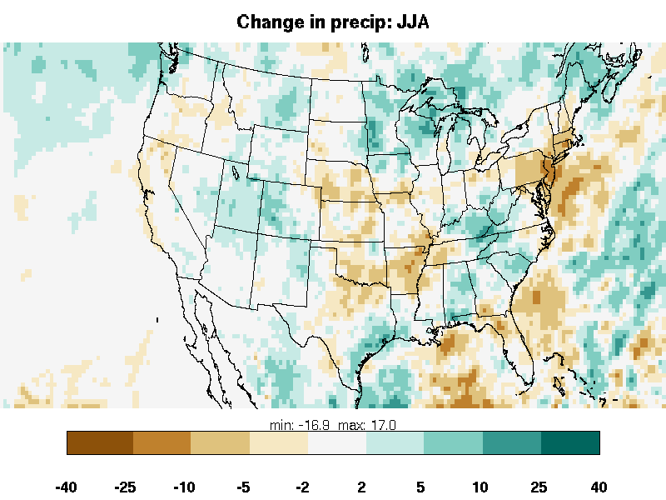
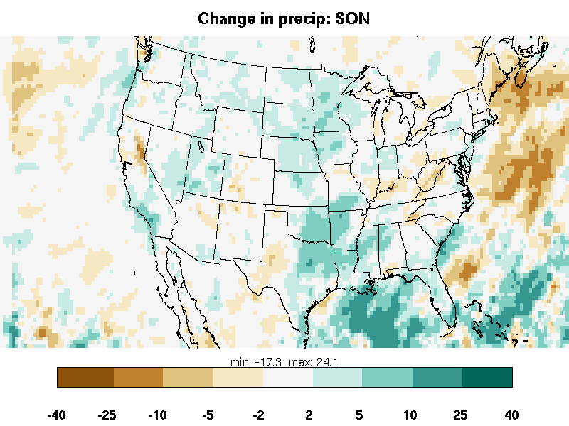
Changes in Seasonal Average Temperature and Accumulated Precip
Winter (DJF)
Spring (MAM)
Summer (JJA)
Fall (SON)
Summertime increase of 0.5 K throughout US, reaching 2 K in central US. Warming during fall up to 3 K.
Changes in average of daily maximum temperature are similar
Precip changes are small in comparison to current biases
Wintertime drying in California

Slide 12
Projected Change in Ozone Distribution from 2000 to 2030
AQS | obs | current | bias | future | change
mean | 48.6 | 57.7 | 9.1 | 58.2 | 0.4
10% | 32.6 | 45.7 | 13.0 | 46.0 | 0.3
25% | 39.4 | 50.6 | 11.2 | 51.0 | 0.4
50% | 47.8 | 57.0 | 9.3 | 57.5 | 0.4
75% | 57.0 | 64.1 | 7.1 | 64.6 | 0.4
90% | 65.4 | 70.7 | 5.3 | 71.1 | 0.4
95% | 70.3 | 74.6 | 4.3 | 75.0 | 0.4
98% | 75.5 | 78.8 | 3.2 | 79.3 | 0.5
CASTNET | obs | CMAQ | bias | future | change
mean | 49.8 | 57.0 | 7.1 | 57.4 | 0.4
10% | 35.5 | 46.5 | 11.0 | 47.0 | 0.4
25% | 41.9 | 50.9 | 9.0 | 51.4 | 0.5
50% | 49.4 | 56.4 | 7.1 | 57.0 | 0.5
75% | 57.3 | 62.6 | 5.4 | 63.0 | 0.4
90% | 64.4 | 68.2 | 3.8 | 68.6 | 0.4
95% | 69.0 | 71.5 | 2.6 | 71.8 | 0.3
98% | 73.7 | 75.0 | 1.3 | 75.2 | 0.2
AQS (~1150 sites)
Modeled O₃ increases by 0.4 ppb on average throughout distribution
Seasonal/annual average PM_{2.5} concentrations virtually unchanged (< 0.1 μg m⁻³; not shown)
CASTNET (80 sites)

Slide 13
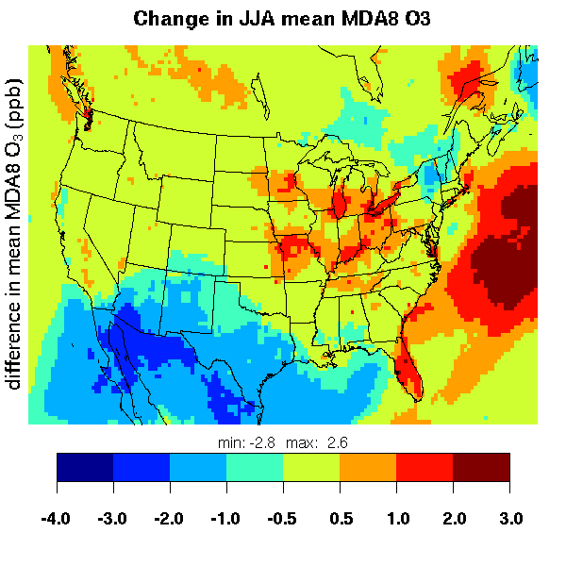
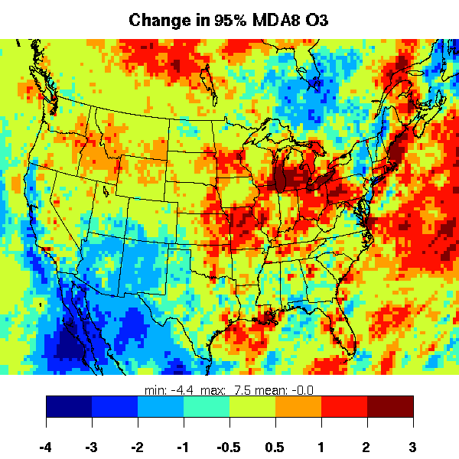
Changes in Air Quality under Future Climate with Constant Anthropogenic Emissions
Change in mean MDA8 O₃
Change in 95th Percentile MDA8 O₃
ppb
-4
-3
-2
-1
-0.5
0.5
1
2
3
-4
-3
-2
-1
-0.5
0.5
1
2
3
Mean MDA8 O3 increases 0.5-2 ppb, largely consistent with area of warming.
Larger increases for 95th percentile.

Slide 14
Summary: Downscaled Climate and Air Quality (ca. 2000)
WRF temperatures and precip consistent with Model E2 and representative of spatial patterns in NARR
Cool bias during summer of > 1 K
Wet bias throughout year, particularly spring/summer in eastern US
Biases in O₃ roughly comparable to those obtained in retrospective modeling applications
98th percentile MDA8 O₃ positively biased by 1-3 ppb
Mean MDA8 O₃ positively biased by 7-9 ppb
Bias higher in eastern US
Strong negative bias in California
Negative bias in PM_{2.5} (-25% annually, -40% in summer)
SO₄ unbiased

Slide 15
Summary: Projected Changes from 2000 to 2030 under RCP 6.0
Summertime warming of 0.5 K throughout US, reaching 2.0 K in central/eastern US
Increases of 0.4 ppb in average 8-h O3, reaching 2 ppb in some locations
Increases at upper end of distribution somewhat larger and more widespread
Small changes in average PM concentrations

