Slide 1
Marginal Health Damages of NO_{x} Emissions: An Application of the Adjoint of CMAQ
S. Morteza Mesbah, Amir Hakami, Stephan Schott
Carleton University, Ottawa, Canada

Slide 2
Outline
Marginal damage
Adjoint model for health damage
North American domain case study
Source-specific MD curves
Policy insight

Slide 3
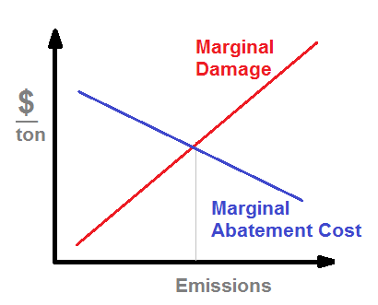
Marginal damage
Notes:
Take out social cost

Slide 4
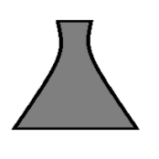
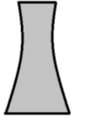
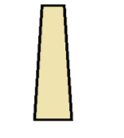
Adjoint Sensitivity Analysis
Source-specific damage information
Damage defined as the monetized nationwide (US) mortality due to short-term exposure to ozone (Pappin and Hakami, 2013).
US Mortality

Slide 5
Marginal Damage Estimation
Change in concentration
Concentration response factor
Baseline mortality
Population
Value of statistical life

Slide 6
Case Study
Domain: continental US, 36 km grid resolution, 34 vertical layers
Episode: May 1st to Sept. 30th of 2007
Adjoint runs for different emission reduction scenarios:
20%, 40%, 60%, 80%, 100 % reduction in:
Mobile sources
Point sources
Anthropogenic sources

Slide 7
MDs
MD of $20k indicates that 1 ton of emission causes $20k damage
Emission weighted average MDs
weighted by:
Mobile source emissions (MBL MDs)
Point source emissions (PNT MDs)
Notes:
Reduction is mis-spelled

Slide 8
PNT MDs for PNT Reduction
80% Reduction 40% Reduction Baseline
Notes:
Reduction is mis-spelled

Slide 9
MBL MDs for MBL Reduction
80% Reduction 40% Reduction Baseline
Notes:
Reduction is mis-spelled

Slide 10
MBL MDs for ANT Reduction
80% Reduction 40% Reduction Baseline
Notes:
Reduction is mis-spelled

Slide 11
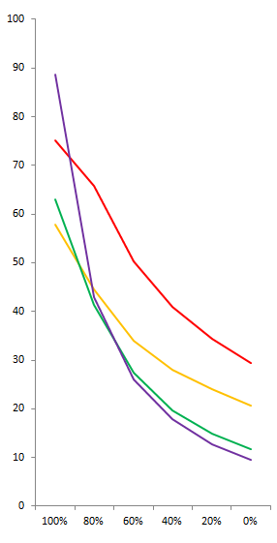
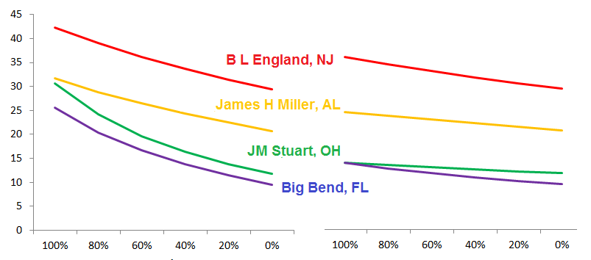
PNT MDs
PNT Reduction MBL Reduction
ANT Reduction
MDs ($1000/ton)

Slide 12
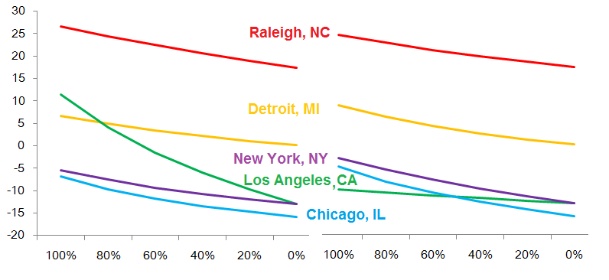
MBL MDs
PNT Reduction MBL Reduction
MDs ($1000/ton)

Slide 13
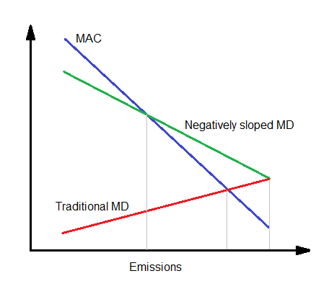
Emission Targets?

Slide 14
Conclusions
Adjoint is an efficient tool for source-specific MD estimation
MDs vary significantly by location
Ozone based NO_{x} MD curves are negatively slopped
MDs in large cities change sign with emission reductions
Further emission reduction is required

Slide 15
Questions?
Thank-you

