Slide 1
Recent Advances in High-Resolution Lagrangian Transport Modeling
Jennifer Hegarty, Thomas Nehrkorn,
Janusz Eluszkiewicz, John Henderson,
Mark Leidner and Marikate Mountain
Roland Draxler, Ariel Stein, Jerome Brioude,
Fong Ngan and Arlyn Andrews
Kathryn McKain and Steven Wofsy
Philip DeCola and Taylor Jones

Slide 2
Focus on Meteorology Driving Transport Models
Lagrangian Particle Dispersion Model (LPDM) Inter-comparision
Evaluate LPDMs with controlled tracer release experiments
Urban Greenhouse Gas (GHG) Simulations
Enable top-down monitoring of CO₂ and CH₄ emissions
Notes:
My presentation will focus on the impact of meteorological inputs to Lagrangian Particle Dispersion Models (LPDMs) in two contexts.
First an LPDM intercomparion study in which several LPDMs were evaluated (at regional to continental scale) using measurements of controlled tracer release experiments.
Second the use of LPDMs (with high resolution meteorological inputs) for greenhouse gas simulations in urban areas for the purpose of top-down monitoring of CO2 and CH4 emissions.
Approximately 17% of global GHG emissions are from urban areas.

Slide 3
Lagrangian Particle Dispersion Model Intercomparison
Evaluate widely-used LPDMs, HYSPLIT, STILT and FLEXPART using measurements from controlled tracer release experiments.
CAPTEX(1-5 and 7), Sept – Oct 1983, from Dayton, OH and Sudbury ON
ANATEX: January 1987 from Saint Cloud, MN (STC) and Glasgow, MT (GGW)
LPDMs driven by hourly 10 km WRF fields
Several WRF configurations tested
Use of 3-hourly 32 km NARR-only fields for HYSPLIT and STILT provides a benchmark to assess added value from WRF.
Hegarty et al., J. Appl. Meteor. Climatol., in press.
Notes:
The motivation for this study grew out of break-out discussions at the AGU Chapman Conference on Lagrangian modeling in Grindelwald Switzerland during October of 2011.
Two questions resulted from those discussions; 1) are there major differences in the accuracy of the various LPDMs presented and 2) what suggestions could we give to the various agencies that archive reanalysis data often used to drive Lagrangian models. For example what spatial or temporal resolution increases would be beneficial and are there any customized inputs that would also be helpful.
To start with we decided to evaluate 3 widely-used LPDMs …
The LPDM intercomparison study uses WRF data that isn’t considered high resolution spatially (10km grid spacing), but the hourly WRF data is of higher temporal resolution than the archived 3 and 6 hourly reanalysis data that is frequently used to drive regional and global LPDM simulations.
The study was motivated by break-out discussions at the AGU Chapman conference on LPDM in Grindewald, Switzerland during October 2011, that asked the questions a) are there any noteable differences in the abilities of the LPDMs presented b) what would be the benefit of storing reanalysis data at higher spatial (typically .3 – 1 degree) and temporal resolution ( 3 -6 hourly) for use in LPDMs.

Slide 4
Evaluation and Sensitivity to Meteorological Inputs
R - Correlation
FB - Fractional bias,
FMS - Figure of merit in space,
KSP - Kolomogorov-Smirnov Parameter.
Average Rank
 | NARR ONLY | WRF
 |  | avrg |  | inst
 |  | pbl = 1 | pbl = 0 | pbl = 1 | pbl = 0
HYSPLIT | 2.13 | 2.42 | 2.34 | 2.29 | 2.29
STILT | 2.12 | 2.39 | 2.26 | 2.26 | 2.27
FLEXPART |  | 2.33 | 2.12 | 2.32 | 2.11
Sensitivity to WRF inputs:
1. Nudging of winds in PBL turned on (pbl=1) or off (pbl=0)
2. Use time-averaged (avrg) or
instantaneous (inst) wind fields
Notes:
To evaluate the LPDMs performance we used a ranking metric comprised of 4 well-known statistical parameters ….
Each parameter was normalized to 1 so that the rank goes from 0 to 4, worst to best.
We performed sensitivity studies using different configurations of WRF and its output options.
These included optionally turning nudging ( to the NARR analysis on or off) and using either time averaged or instantaneous winds output from WRF to drive the LPDMs
The statistical results are summarized in the table on the right that shows the average ranks over all experiments for each type of meteorological input.
Several points are clear: 1. The WRF runs are noticeably better than the NARR-Only runs 2; The best LPDM runs used WRF runs with PBL wind nudging on and used the time-averaged wind fields and for this configuration there was very little differences between the LPDMs; 3. PBL wind nudging was beneficial to all LPDMs , but the use of time-averaged winds seemed to only benefit HYSPLIT and STILT.
Use of these and other statistical parameters discussed in Mosca et al. 1998. Draxler 1996 chose to combine the four parameters shown to make up overall rank.
Parameters normalized to 1 so that rank goes from 0 to 4 worst to best.

Slide 5
Impact of PBL Wind Nudging
HYSPLIT
24 h PTCH
ANATEX-GGW: 1400 UTC 13 January 1987, 69 and 9 hours post release
Plume transport too fast without nudging of PBL winds.
Notes:
Simulated plumes transported more too quickly away from source if pbl wind nudging turned off.
May be due to surface wind speed bias in WRF. Momentum sink added to WRF version 3.5

Slide 6
Findings from LPDM Intercomparison
The three LPDMs have comparable skill when driven by the same meteorological inputs
Higher resolution beneficial to LPDMs
Hourly 10 km WRF fields produce better HYPLIT and STILT simulations than 32-km 3-hourly NARR fields
Nudging of PBL winds beneficial to all 3 LPDMs, particularly for FLEXPART
Time averaged wind fields beneficial to HYSPLIT and STILT.

Slide 7
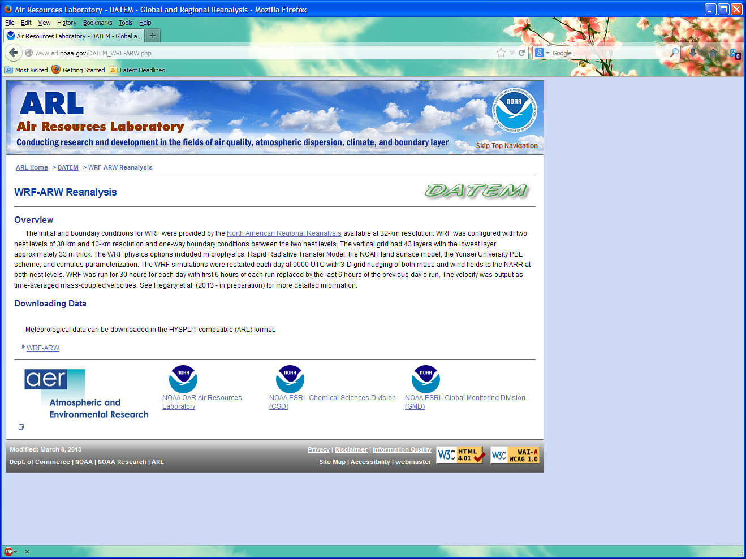
WRF Model Data Available at
http://www.arl.noaa.gov/DATEM_WRF-ARW.php
Follow DATEM link for observations, statistics, reports and HYSPLIT/STILT configuration files.

Slide 8
Urban Greenhouse Gas Emission Modeling
Monitoring of anthropogenic emissions from urban areas needed for international treaty verification /climate projections
Urban areas produce significant portion of global emissions
Top-down approach employs modeling with measured concentrations to detect trends using inverse techniques
Salt Lake City and Boston
CO₂ and CH₄

Slide 9
WRF-STILT Urban GHG Modeling Approach
WRF - nested domains down to 1.33 km grids
STILT modeling:
Compute backward trajectories and influence regions (“footprints”) for measurement sites
Couple with background concentration and surface flux estimates for comparison with observations
Footprints represent the adjoint of the transport model, enabling efficient inverse quantification of emissions.
Notes:
- Footprints (ppmv/umol/m^2 s^2)

Slide 10
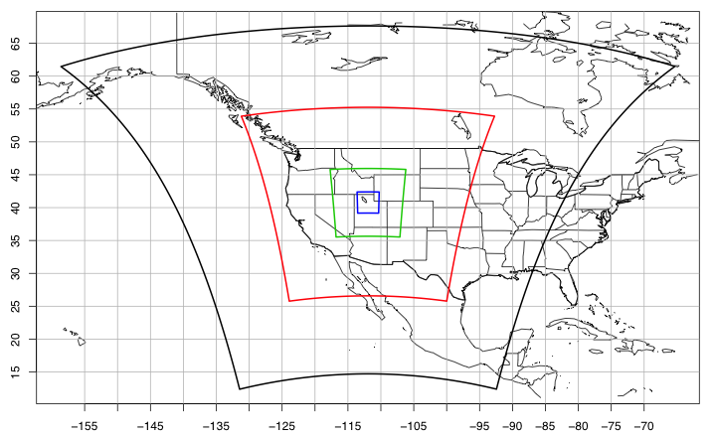
Salt Lake City WRF Domains
d01: 36km, d02: 12km, d03: 4km, d04: 1.33km (Enhanced WRF run option)
Notes:
CO2 measurements at 3 sites within Salt Lake City

Slide 11
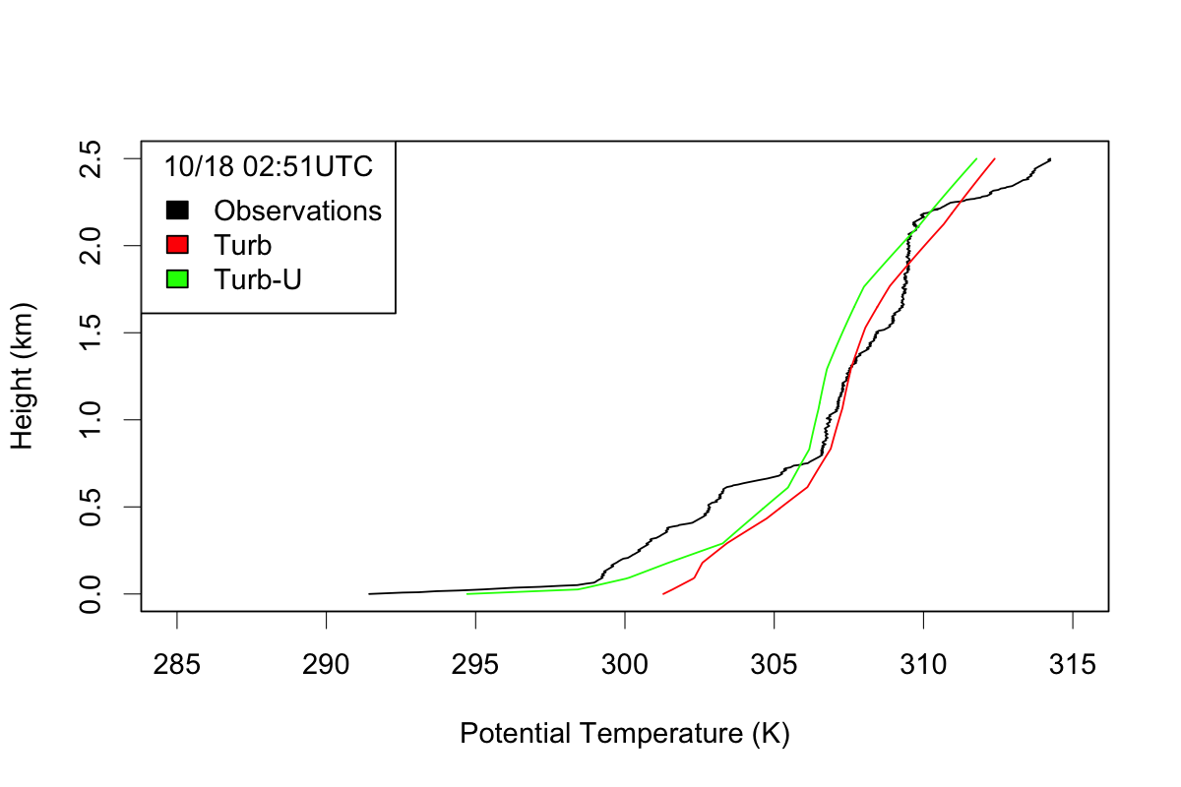
Enhanced WRF Improves CO₂ Simulations in Salt Lake City
WRF vs Observed Ѳ Profile
Mean Diurnal CO₂ Cycle
OBS
4 km, No UCM
1.33 km, UCM
No UCM
UCM
CO₂ (ppmv)
Hour (UTC)
High-resolution and Urban Canopy Model (UCM) improve diurnal cycle and enable more robust trend detection^{1,2}
¹McKain et al., 2012: Proc. Natl. Acad. Sci., 109, 8423–8428.
²Nehrkorn et al., 2013: J. Appl. Meteorol Climatol., 52, 323–340.
Notes:
- High res UCM runs a better match for the diurnal cycle, particularly in the early evening – concentrations increase more quickly due to better fidelity of WRF PBL simulation.

Slide 12
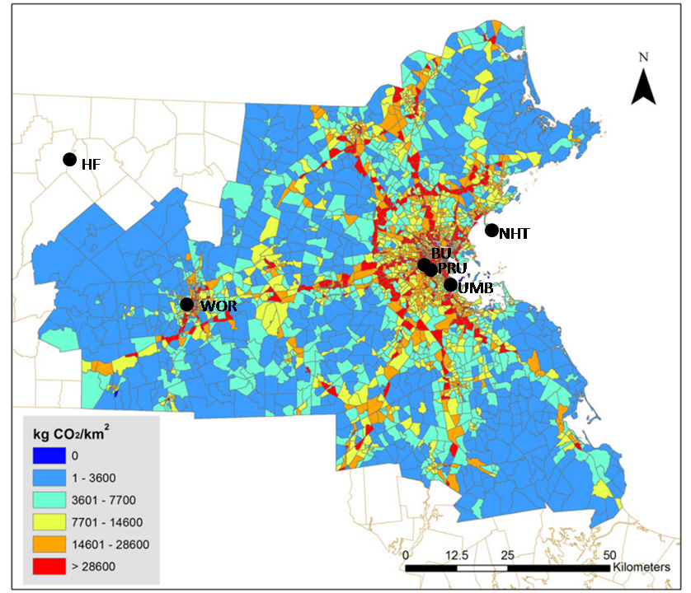
Boston Area Measurement Network
CO2 Emissions
Notes:
7 Tower sites
Total column measurements at 2 sites
MiniMPL aerosols at 1 – several sites around Boston
CO2 emissions database updated with high resolution mobile onroad Traffic Area Zone (TAZ) emissions.
TAZ emissions generated by a Harvard graduate student counting cars at major road junctions and scaling existing onroad mobile data base

Slide 13
Average CH₄ Diurnal Cycle for November 2012
Hour UTC
Hour UTC
Simulations have difficulty reproducing diurnal cycle, particularly during morning growth phase of PBL.
Notes:
Observed (black) and simulated (colored lines) average diurnal cycle of CH4 mixing ratio at the BU and PRU sites for the months of September, October and November 2012; the hours are listed in UTC. The colored lines are for different emission inventories including a customized inventory from BU (red), EDGAR (green), and a uniform land source (blue). The background mixing ratio is in grey (from the coastal Nahant, MA site and Harvard Forest site west of Boston).
- The emissions were scaled up using a simple regression fit line for modeled versus observed mixing ratios. This is an advantage of this approach since footprints are stored, don’t’ have to re-run transport model

Slide 14
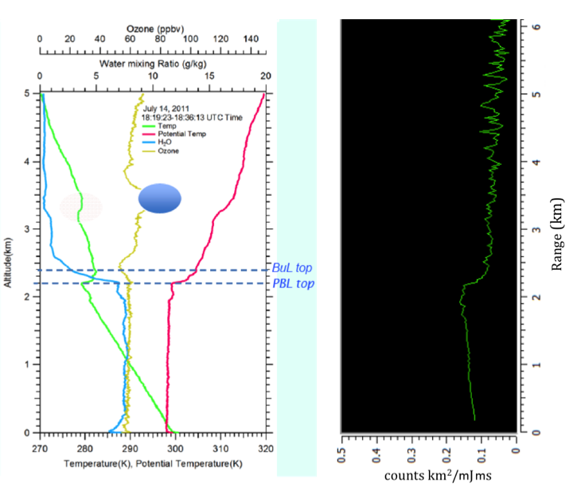
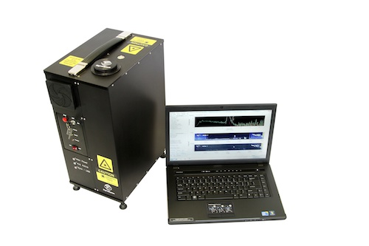
Quality Control WRF with Mini Micro-Pulse LiDAR
The Sigma Space Corporation Micro-Pulsed LiDAR provides continuous, automated measurements of aerosol backscatter to diagnose PBL structure.
MiniMPL yields high temporal and spatial resolution data, yet are affordable, portable, and meet eye safety standards.
Balloon Sondes Data
MiniMPL Aerosol Backscatter
Notes:
Important point to make: The MiniMPL backscatter plot agrees with the sounding, but has the advantage of generating these profiles continuously throughout the day. The integration time for the profile displayed is 30 s, but it can go down to as short as 1s.
Data from balloon sondes (left) and Sigma Space Mini MPL Normalized Relative Backscatter (NRB) profile (right) collected during the NASA DISCOVER-AQ mission on July 14th, 2011, 18:40 UTC in Edgewood, MD. The MiniMPL profile is a single 30-second integration time profile with 30-meter range bins. Both data sets show a PBL top at circa 2.2 km and the presence of a shallow buffer layer between the boundary layer and the free troposphere.
PBL top derived from MiniMPL matches that derived from radiosonde measurements of temp., H2O and O3.
MiniMPL even depicts buffer layer.

Slide 15
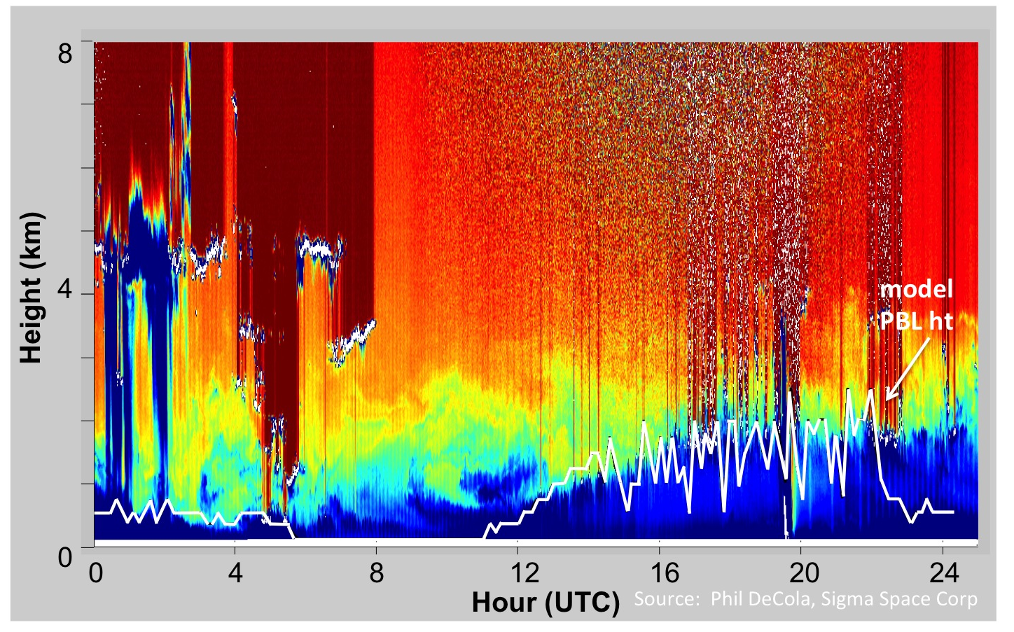
WRF Model PBL Height vs MiniMPL Backscatter Data
Boston July 16, 2012
MPL Data Guides Model Diagnostics and Improvements
Notes:
Important point to make: WRF output is every 10 min, LiDAR every 30s but can be as short as 1s.
WRF PBL height from Mellor-Yamada-Janic (MYJ) scheme and is determined from profiles of turbulence parameters.
Above figure shows a time series of Mini MPL backscatter profiles acquired with 30 second/30 meter integrations during deployment in Boston on July 16, 2012. These measurements are part of collaboration with Steve Wofsy for a GHG inversion project. The time series (UTC) shows scattered low and mid-level clouds (white) on the left above the residual boundary layer (yellows and greens) with embedded dynamical features in the PBL and at the PBL top followed by the growth of the daytime PBL (blue). The corresponding WRF simulation of PBL height using the MYJ scheme (solid black line) captures the daytime PBL growth. The model underestimates the PBL height during the early morning hours and the model PBL collapses too early on the evening of July 16th. Model comparisons with LiDAR data are diagnosing issues and guiding improvements in the WRF simulations. ( counts x km^2 / us x uJ). Is that supposed to be counts x km^-2?
Fig. 4. Time series of MiniMPL backscatter (color filled) during deployment on the BU rooftop on July 16, 2012. The time series shows scattered low and mid-level clouds (white) on the left above the residual boundary layer (yellows and greens) with embedded dynamical features in the PBL and at the PBL top followed by the growth of the daytime PBL (blue). The WRF simulated PBL height is shown as a solid white line.

Slide 16
Boston Modeling Objectives
Optimize WRF-STILT to enable accurate estimates of urban GHG emissions
Verification of bottom-up inventories
Quantify CH₄ gas leaks in Boston
Use MiniMPL to quality-control WRF PBL
Remove periods of suspect WRF simulations from inversion
Quantify impact on emissions estimates from WRF errors
Optimize WRF configuration

Slide 17
Summary
LPDMs highly sensitive to quality of meteorological inputs.
WRF enhanced with urban canopy model and high spatial resolution enables better top-down emissions estimates in urban areas.
Work ongoing to optimize WRF-STILT for monitoring GHG emissions utilizing advanced instrumentation and robust measurement networks.

Slide 18
Additional Slides

Slide 19
Enhanced WRF Improves CO₂ Simulations in Salt Lake City
Mean Diurnal CO₂ Cycle
OBS
4 km, No UCM
1.33 km, UCM
No UCM
UCM
CO₂ (ppmv)
WRF with Urban Canopy Model (UCM) captures evening collapse of convective boundary layer.
Hour (UTC)
Notes:
- High res UCM runs a better match for the diurnal cycle, particularly in the early evening – concentrations increase more quickly due to better fidelity of WRF PBL simulation.

Slide 20
Effect of High-resolution, UCM on Salt Lake City CO₂ simulation
Improved diurnal cycle of CO₂
improvement in late afternoon concentrations
still leaves issues with nighttime/early morning maximum
High-resolution and UCM enable more robust trend detection^{1,2}
¹McKain et al., 2012: Proc. Natl. Acad. Sci., 109, 8423–8428.
²Nehrkorn et al., 2013: J. Appl. Meteorol Climatol., 52, 323–340.

Slide 21
Boston Area WRF Domains
d04:1.33 km,used for verification
d03:4 km
d02:12 km
d01:36 km
Notes:
WRF domain with 4 nest levels centered on Boston
3D wind nudging on outer domain
Daily restart 30-hour runs

Slide 22
Enhanced WRF Improves CO₂ Simulations in Salt Lake City
Mean Diurnal CO₂ Cycle
OBS
1.33 km with UCM
4 km without UCM
Observed
Without UCM
CO₂ (ppmv)
WRF with Urban Canopy Model (UCM) captures evening collapse of convective boundary layer.
With UCM
Hour (UTC)
Notes:
- High res UCM runs a better match for the diurnal cycle, particularly in the early evening – concentrations increase more quickly due to better fidelity of WRF PBL simulation.

