Slide 1
Simulating the Impacts of Marine Organic Emissions on Global Atmospheric Chemistry and Climate using an Online-Coupled Meteorology and Chemistry Model
Brett Gantt*, Timothy Glotfelty, Nicholas Meskhidze, and Yang Zhang
Department of Marine, Earth, and Atmospheric Science,
North Carolina State University
*Now at National Exposure Research Laboratory, U.S. EPA
2013 CMAS Meeting
10-30-2013

Slide 2
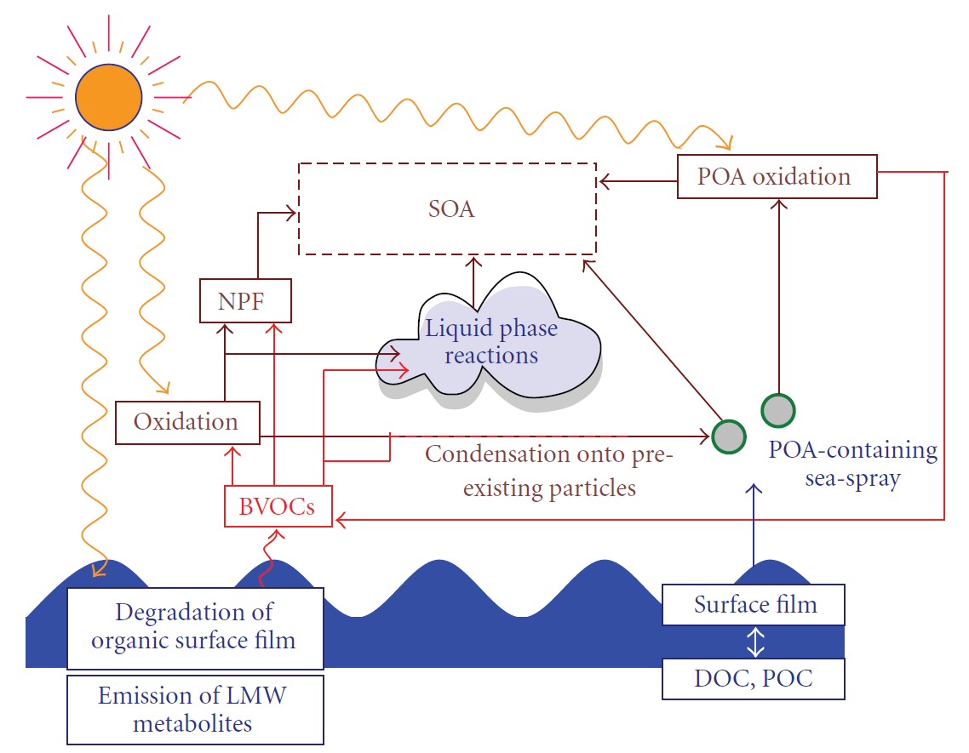
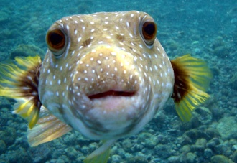
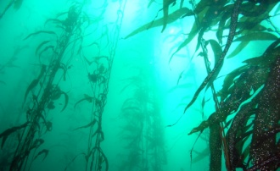
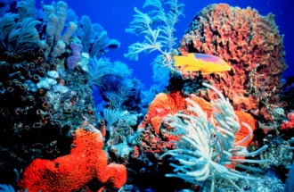
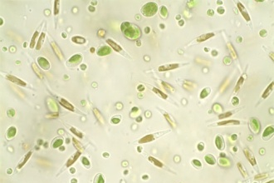
Marine Boundary Layer Organics
Rinaldi et al. (2010) Advances in Meteorology

Slide 3
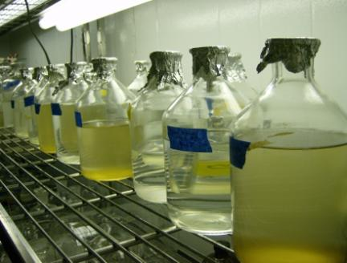
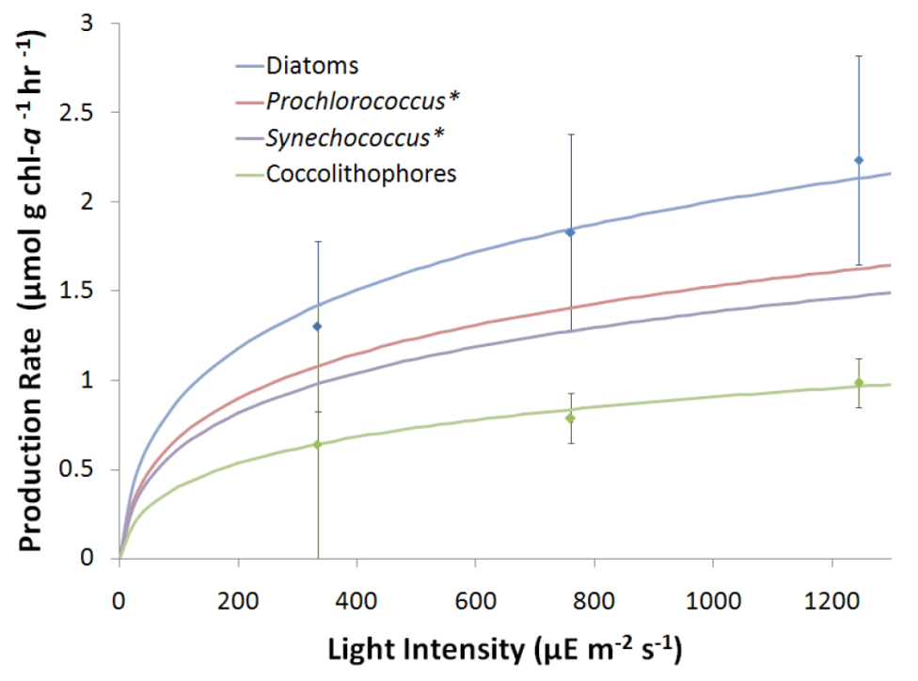
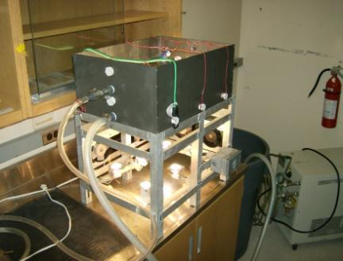
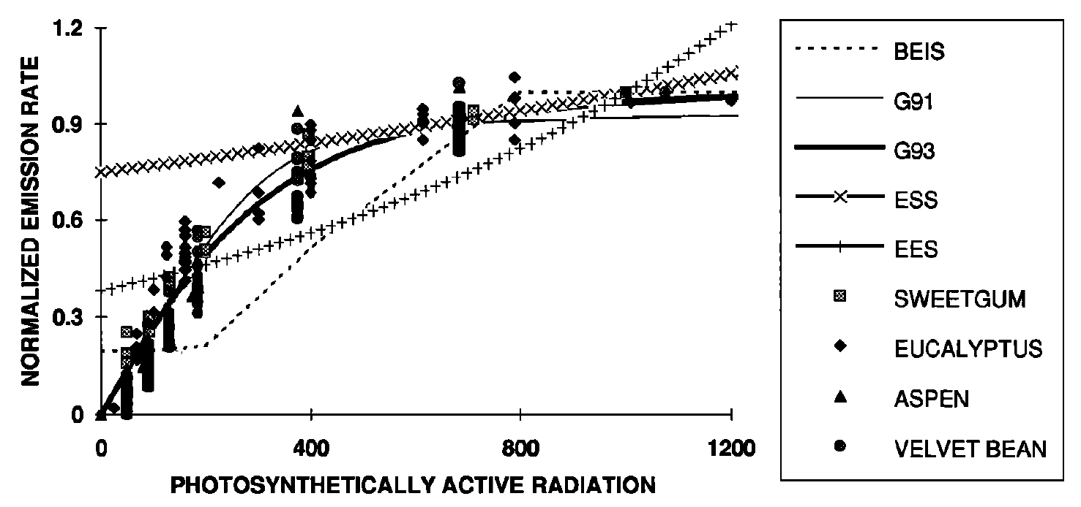
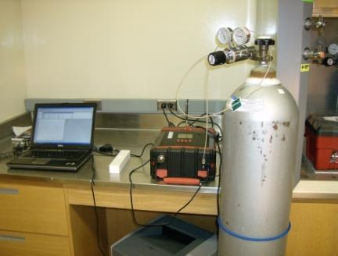
Marine Isoprene
Gantt et al. (2009) Atmos. Chem. Phys.
Emission rates are a function of chlorophyll-a concentration, phytoplankton speciation, and solar radiation similar to plants
Emission rates are a function of chlorophyll-a concentration, phytoplankton speciation, and solar radiation
Guenther et al. (1993) J. Geophys. Res.

Slide 4
Marine Boundary Layer Chemistry
Rinaldi et al. (2010) Advances in Meteorology

Slide 5
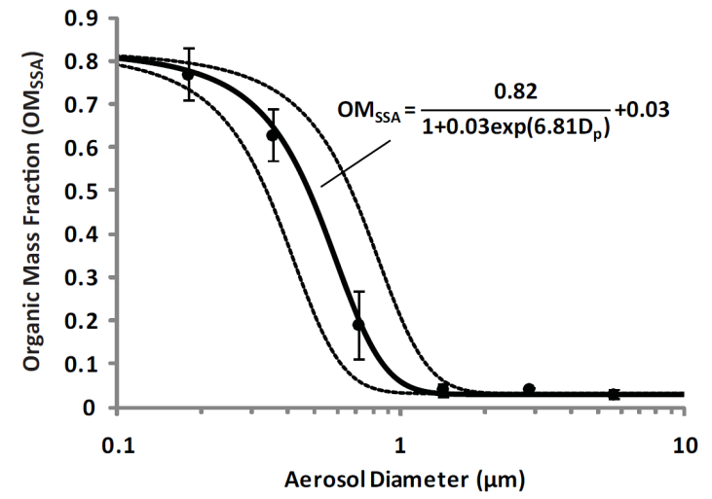
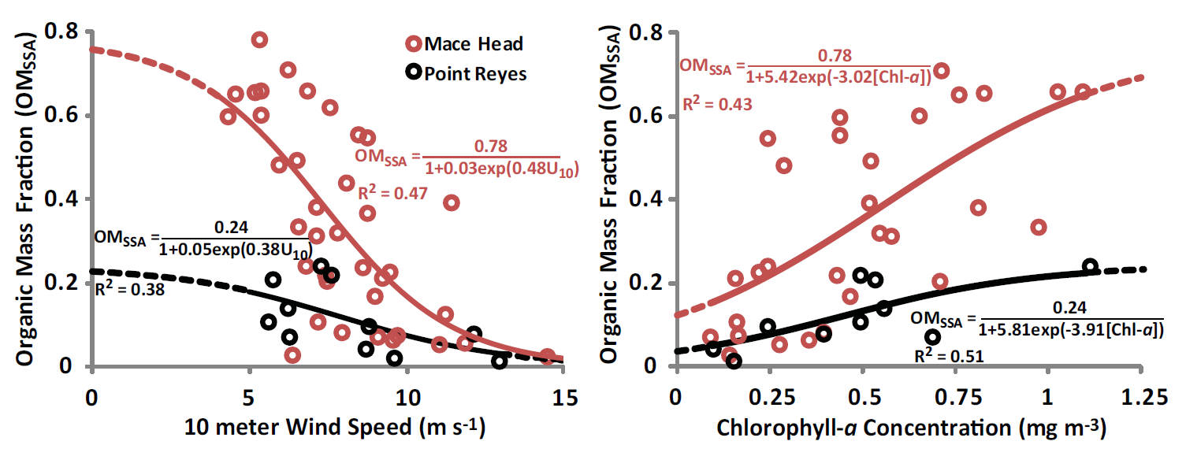
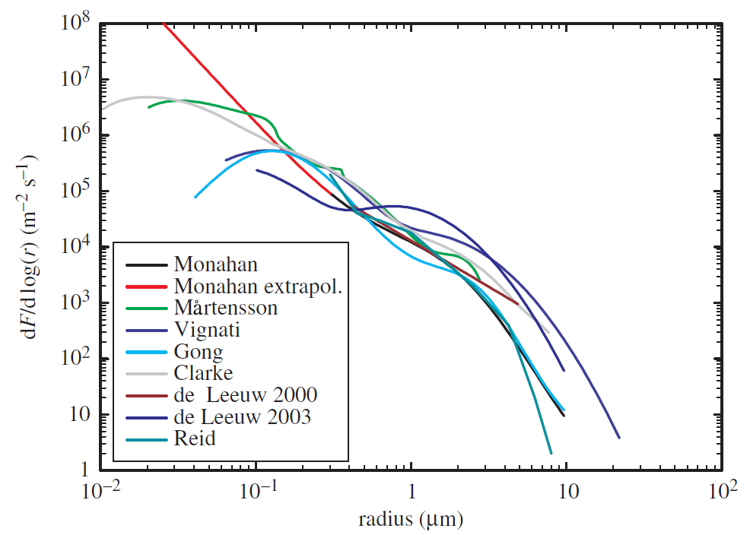
Marine Primary Organic Aerosol
Gantt et al. (2011) Atmos. Chem. Phys.
O’Dowd and de Leeuw (2007) Phil. Trans. R. Soc. A,
Emission rates are a function of aerosol size, chlorophyll-a concentration, and wind speed
To drive the emissions, we calculate an organic fraction of sea spray aerosol and multiply that by the sea spray aerosol number and mass emissions

Slide 6
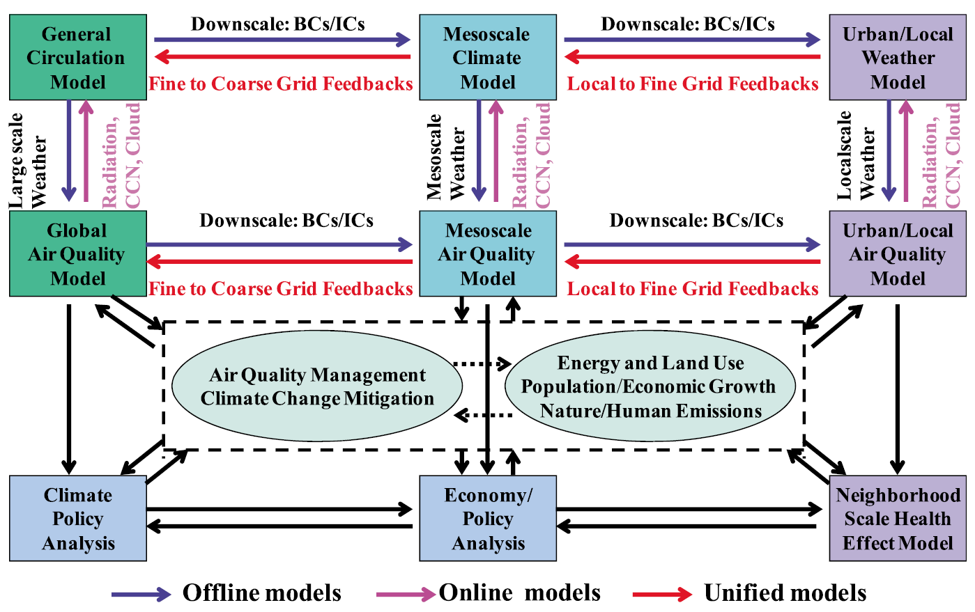
GU-WRF/Chem
Modeling and Set Up
Global-to-Urban WRF/Chem 3.0
Global (4º x 5º x 27 levels)
3-month simulations (Jun-Aug 2001, 2009) with 1-month spin-up
Gas Chemistry: CB05_GE
Aerosol Module: MADRID (8 sections)
Aerosol Activation: Abdul Razzak-Ghan (2000)
Online marine isoprene emissions: Gantt et al. (2009)
Online marine POA emissions: Gantt et al. (2011)
Simulation Design
Default: no marine organic emissions
MarOrg: with marine isoprene and POA emissions
A generalized modeling system for linking climate, air quality, human health effect, and policy studies
Zhang et al. (2012) JGR

Slide 7
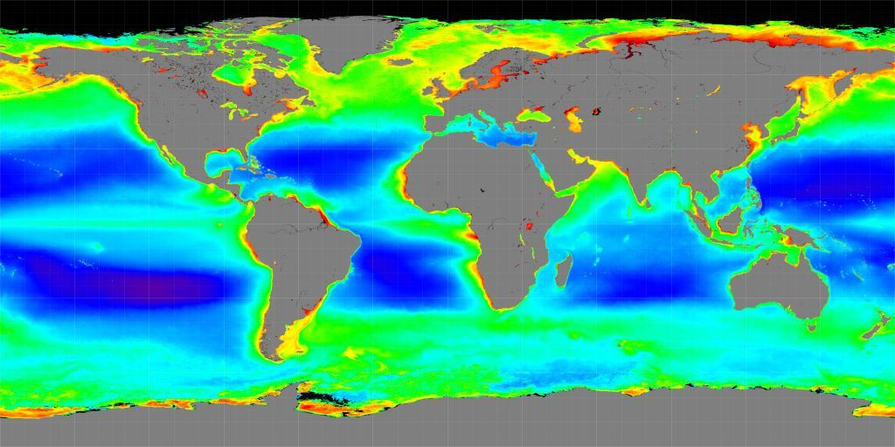
Marine Isoprene Evaluation
Emissions are overestimated by the model, but concentration predictions are still underestimated (may be due to chlorine chemistry)

Slide 8
Marine Organic Aerosol Evaluation
Both the organic aerosol concentrations and size distribution predictions are improved with the inclusion of marine organic emissions

Slide 9
Changes in Surface Isoprene
JJA, 2001
JJA, 2009
Highest emissions: N. Pacific and Atlantic with concentrations up to 10 ppt

Slide 10
Changes in Atmospheric Oxidants
JJA, 2001
JJA, 2009
O₃ increases or decreases by up to 1 ppb in remote marine regions

Slide 11
Changes in Atmospheric Aerosols
JJA, 2001
JJA, 2009
SOA increases by 0.2 µg m⁻³, total organic aerosol increases by 0.5 µg m⁻³

Slide 12
Changes in Cloud Condensation Nuclei
Change in CCN concentration
Change in aerosol number concentration
Change in average aerosol diameter

Slide 13
Climate Impact and Conclusions
Improvement in predictions of marine isoprene concentrations/emissions and aerosol concentrations/size distributions
Increase in concentrations of isoprene, SOA, and total organic aerosols in remote marine regions
Increase in aerosol number concentration and average aerosol diameter, which lead to increased CCN concentration, CDNC, and decreased surface solar radiation

Slide 14
Acknowledgements
This project was sponsored by the U.S. Department of Energy grant #DE-FG02-08ER64508, the EPA STAR grant R83337601, and the National Science Foundation EaSM program (AGS-1049200)
We also thank Jurgita Ovadnevaite, Darius Ceburnis, and Colin O’Dowd for providing the Mace Head data
Thanks for listening.
Any questions??

Slide 15
Evaluation of Isoprene and Organic Aerosol
Variable | Obs. Mean | Model Mean |  | NMB (%) |  | Correlation
 |  | Default | MarOrg | Default | MarOrg | Default | MarOrg
 | Isoprene emissions (nmol m⁻² day⁻¹) and surface concentrations (ppt) from the NW Pacific Ocean on 23-27 May 2001 [Matsunaga et al., 2002]
Emission | 130.8 | 0 | 795.0 | -100 | 508 | 0.00 | 0.09
Concentration | 45.4 | 0.8 | 14.0 | -98.3 | -69.2 | -0.15 | -0.47
 | Organic aerosol concentrations (µg m⁻³) at Mace Head, Ireland from June to Aug 2009 [Ovadnevaite et al., 2011a]
Concentration | 0.79 | 0.21 | 0.31 | -73.5 | -61.0 | 0.55 | 0.70

