Slide 1
Use of Photochemical Grid Modeling to Quantify Ozone Impacts from Fires in Support of Exceptional Event Demonstrations
Kenneth Craig, Daniel Alrick, Yuan Du,
Garnet Erdakos, Clinton MacDonald
Sonoma Technology, Inc., Petaluma, CA
Tom Gross, Doug Watson
Kansas Department of Health and Environment, Topeka, KS
Presented at the
12th Annual CMAS Conference
Chapel Hill, NC
October 30, 2013
STI-5704

Slide 2
Presentation Outline
Background
  Exceptional Events
  Flint Hills Fires
Methodology
  BlueSky Gateway
  Fire Emissions Processing
Results
Conclusions

Slide 3
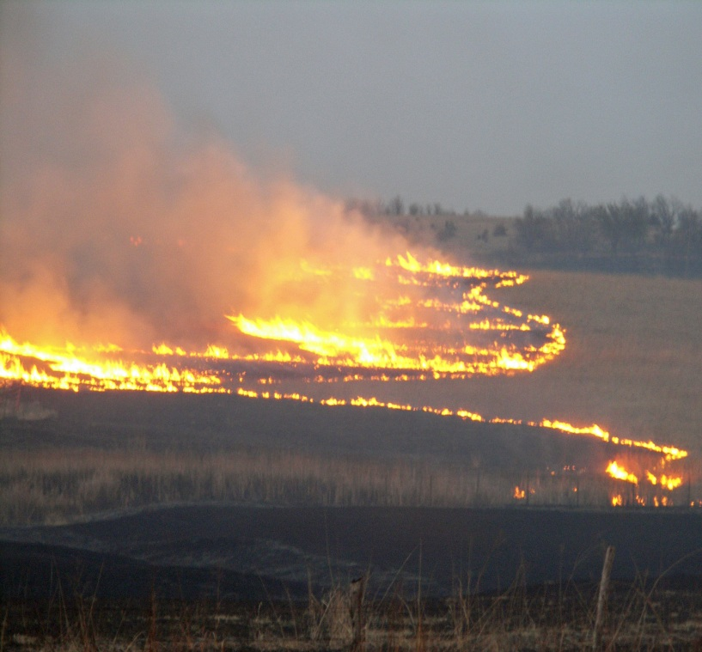
Smoke and Air Pollution
Background
Smoke from fires contains PM_{2.5}, NO_{x}, and VOCs, and other pollutants.
Smoke from fires is associated with negative health effects.
Fire events can trigger violations of the ozone and PM NAAQS.
Fire in Wabaunsee County, Kansas

Slide 4
Exceptional Events
Background
Unusual or naturally occurring events that affect air quality but are not reasonably controllable or preventable.
EPA has considered wildland and prescribed fires as exceptional events under some circumstances.
States can flag data to be excluded from regulatory determinations by demonstrating to EPA’s satisfaction that the measurements were influenced by an exceptional event.
Technical evidence of such influences must be submitted to EPA as a demonstration package.

Slide 5
Exceptional Event Demonstrations
Background
Must include analyses showing that no NAAQS exceedance would have occurred "but for" the exceptional event.
“But for” demonstrations typically must provide quantitative assessment of ozone levels with and without fire.
Because ozone is a secondary pollutant, meeting the "but for" requirement is particularly challenging.
This talk describes numerical modeling used to support an exceptional event demonstration for the
Kansas Department of Health and Environment (KDHE).

Slide 6
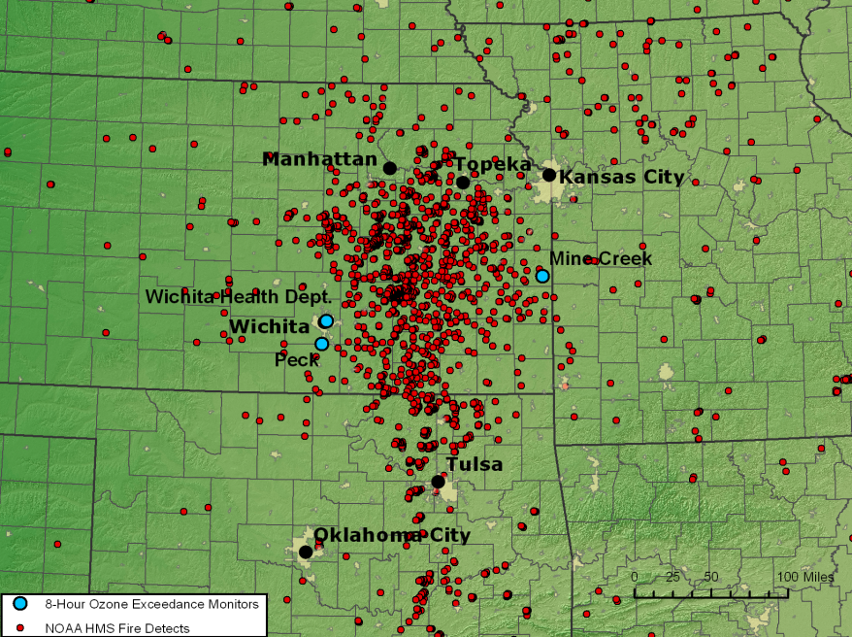
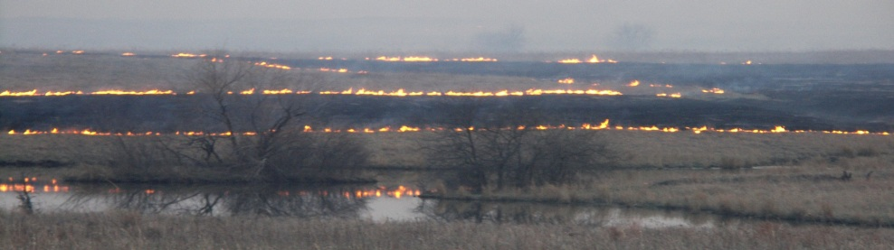
Flint Hills Prescribed Burning
Background
Land management practice in the Kansas Flint Hills region.
Approximately 2,000,000 acres of rangeland burned each spring (March and April).
Several NAAQS exceedances for ozone in April 2011.
Analysis focuses only on the scientific aspect of exceptional event demonstration.
HMS fire detections on April 6, 2011
Prescribed burn in the Kansas Flint Hills

Slide 7
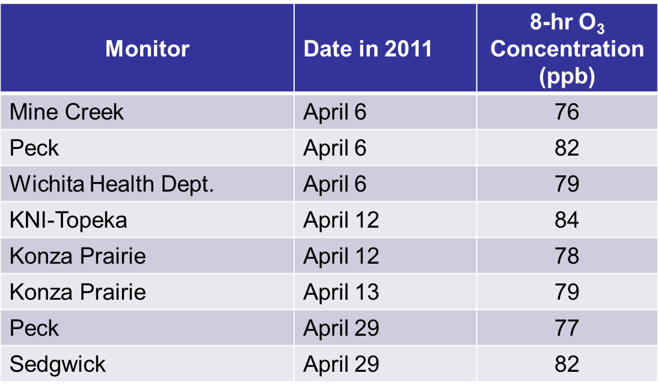
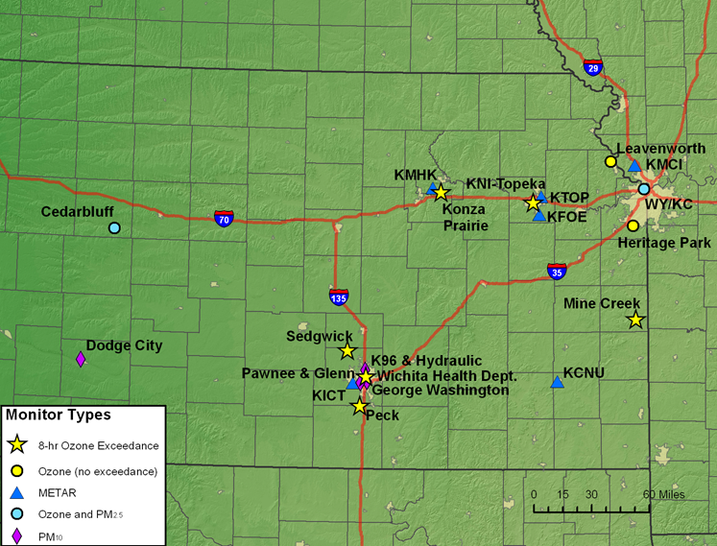
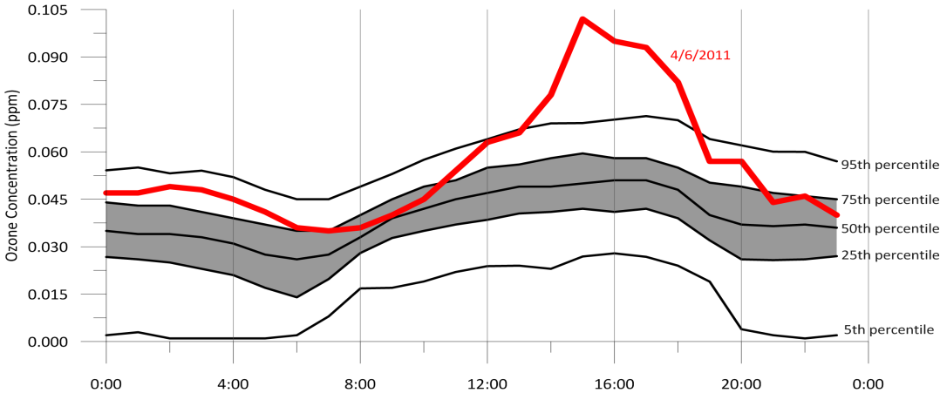
Ozone NAAQS Exceedances
Background
Ozone values are historically unusual for this region in April (above 95th percentile)

Slide 8
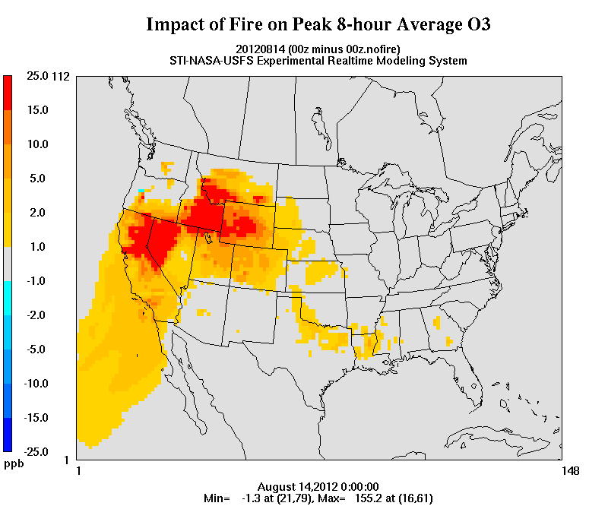
Modeling Methodology
Methodology
BlueSky Gateway
  36 km National RPO grid
  MM5 v3.7, CMAQ v4.5
  Daily runs initialized with prior results for carryover
  Simulations with and without Flint Hills fires during April, 2011
Fire Information and Emissions
  SMARTFIRE outside Flint Hills
  Special data for the Flint Hills
  USFS BlueSky Framework
Ozone Impacts from Fires predicted by BlueSky Gateway on August 14, 2013.

Slide 9
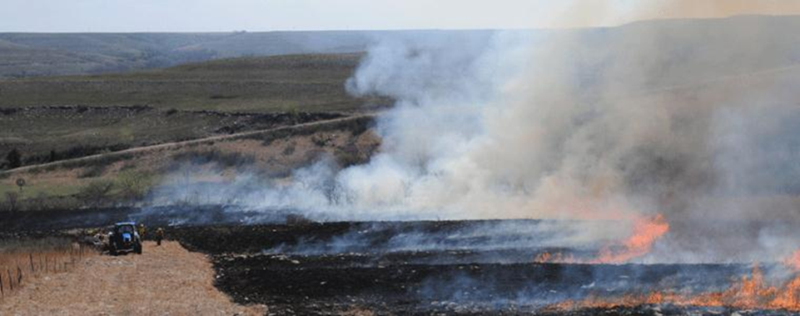
Modeling Methodology
Methodology
Daily, county-level burn acreages from Kansas State Univ. burn scar analyses, allocated to model grid cells based on typical burn practices.
Local fuel loading data provided by KDHE.
BlueSky Framework processing with standard pathway endorsed by USFS.
Default diurnal profile replaced by a top-hat profile that allocates fire emissions from 10 a.m. to 6 p.m.
2008 NEI used for non-fire sources.
Burn scar from a Flint Hills rangeland fire

Slide 10
Model Performance Analysis
Results
Gateway captured general ozone trends for April 2011.
Mean bias: -4.5 to 1.8 ppb
Normalized mean error: 9 to 18%
Observations
Predictions

Slide 11
April 6, 2011
Results
248,000 acres burned.
Complex flow pattern due to midday frontal passage.
Ozone would not have exceeded 75 ppb “but for” the smoke.
Monitor | Observed | CMAQ All Fires | CMAQ No Flint Hills Fires | Impact of Flint Hills Fires
Mine Creek | 76 | 70 | 60 | 10
Wichita | 79 | 74 | 54 | 20
Peck | 82 | 74 | 54 | 20
Modeled impact of Flint Hills fires on 8-hour average ozone (ppb)

Slide 12
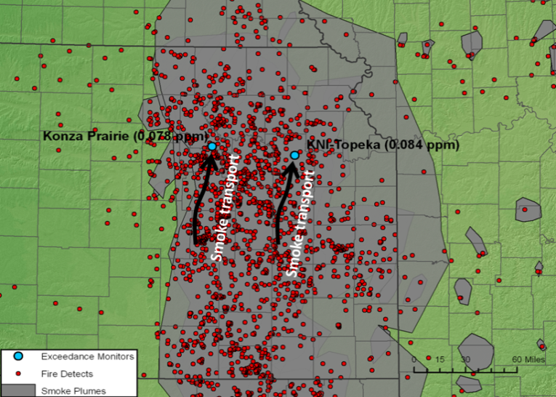
April 12, 2011
Results
298,000 acres burned.
Smoke transport by southerly winds.
Ozone would not have exceeded 75 ppb “but for” the smoke.
Monitor | Observed | CMAQ All Fires | CMAQ No Flint Hills Fires | Impact of Flint Hills Fires
KNI-Topeka | 84 | 82 | 54 | 28
Konza Prairie | 78 | 60 | 53 | 7
Modeled impact of Flint Hills fires on 8-hour average ozone (ppb)

Slide 13
April 13, 2011
Results
291,000 acres burned.
Southeast winds transported smoke to Konza Prairie. Smoke carryover from prior days also important.
Ozone would not have exceeded 75 ppb “but for” the smoke.
Monitor | Observed | CMAQ All Fires | CMAQ No Flint Hills Fires | Impact of Flint Hills Fires
Konza Prairie | 79 | 92 | 62 | 30
Modeled impact of Flint Hills fires on 8-hour average ozone (ppb)

Slide 14
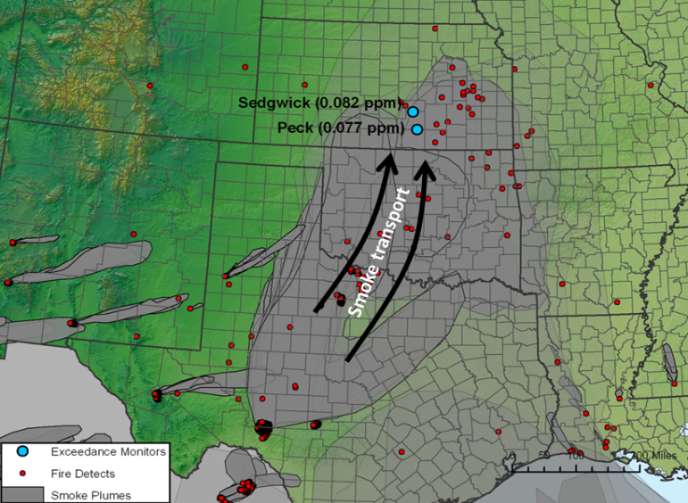
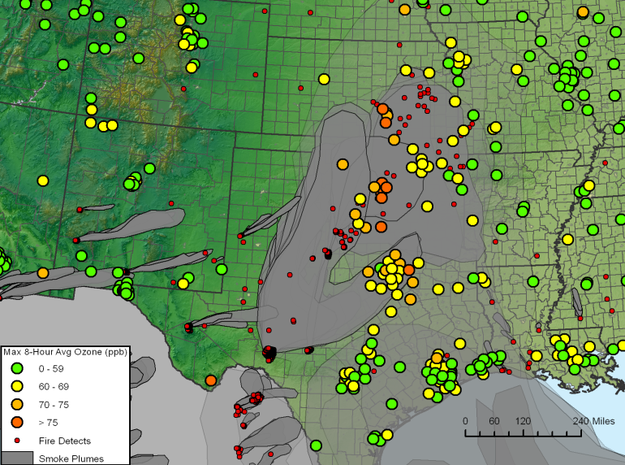
April 29, 2011
Results
Only 19,000 acres burned in the Flint Hills.
Numerous large fires in Texas and Mexico, with region-wide ozone enhancement.
Modeling showed no ozone impact due to Flint Hills fires. Ozone enhancement at the Kansas monitors was due to long range smoke transport
Ozone would not have exceeded 75 ppb “but for” the smoke, based on non-modeling analyses.

Slide 15
Conclusion
Conclusion
Photochemical modeling (BlueSky Gateway) was successfully applied to support an exceptional event analysis. EPA concurred that the analysis satisfied the exceptional event demonstration requirements.
For 3 of 4 NAAQS exceedance days in Kansas, modeling analysis helped demonstrate that NAAQS ozone exceedances would not have occurred “but for” the smoke from Flint Hills fires.
On April 29, additional analyses were used to satisfy the but-for requirement.
Modeled fire impacts on 8-hour ozone levels ranged from 5 to 30 ppb at Kansas monitors during April, 2011.

Slide 16
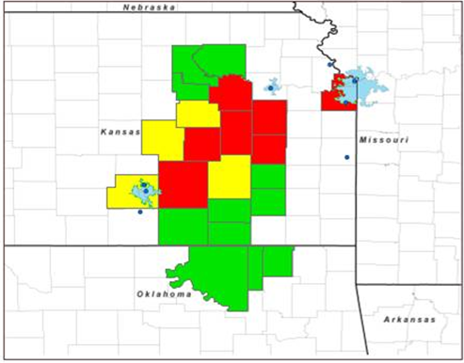
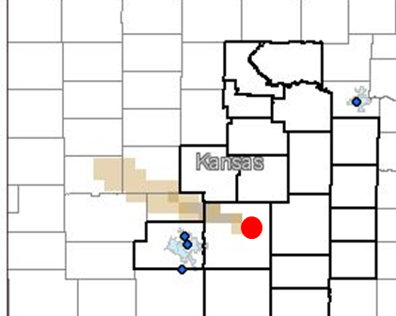
Conclusion
Conclusion
KDHE has developed a Smoke Management Plan to mitigate smoke impacts on urban areas.
STI has worked with KDHE to develop guidance tools to support burn/no-burn decisions.
Guidance tools and website will be operational during the 2014 Flint Hills fire season.

Slide 17

Contact
17
Ken Craig
kcraig@sonomatech.com
707.665.9900
sonomatech.com
@sonoma_tech

