Slide 1
Future prediction of tropospheric ozone over south and east Asia in 2030
Satoru Chatani*
Toyota Central R&D Labs., Inc.
Markus Amann and Zbigniew Klimont
International Institute for Applied Systems Analysis (IIASA)
Anju Goel, Atul Kumar, Arabinda Mishra and Sumit Sharma
The Energy and Resources Institute (TERI)
Jiming Hao, Shuxiao Wang, Yuxuan Wang and Bin Zhao
Tsinghua University
12th Annual CMAS Conference
Chapel Hill, NC, October 28-30, 2013
Notes:
豊田中央研究所の茶谷です。2013年1月中国北京高濃度大気汚染に対する領域モデル解析と題して、発表させて頂きます。
(20)

Slide 2
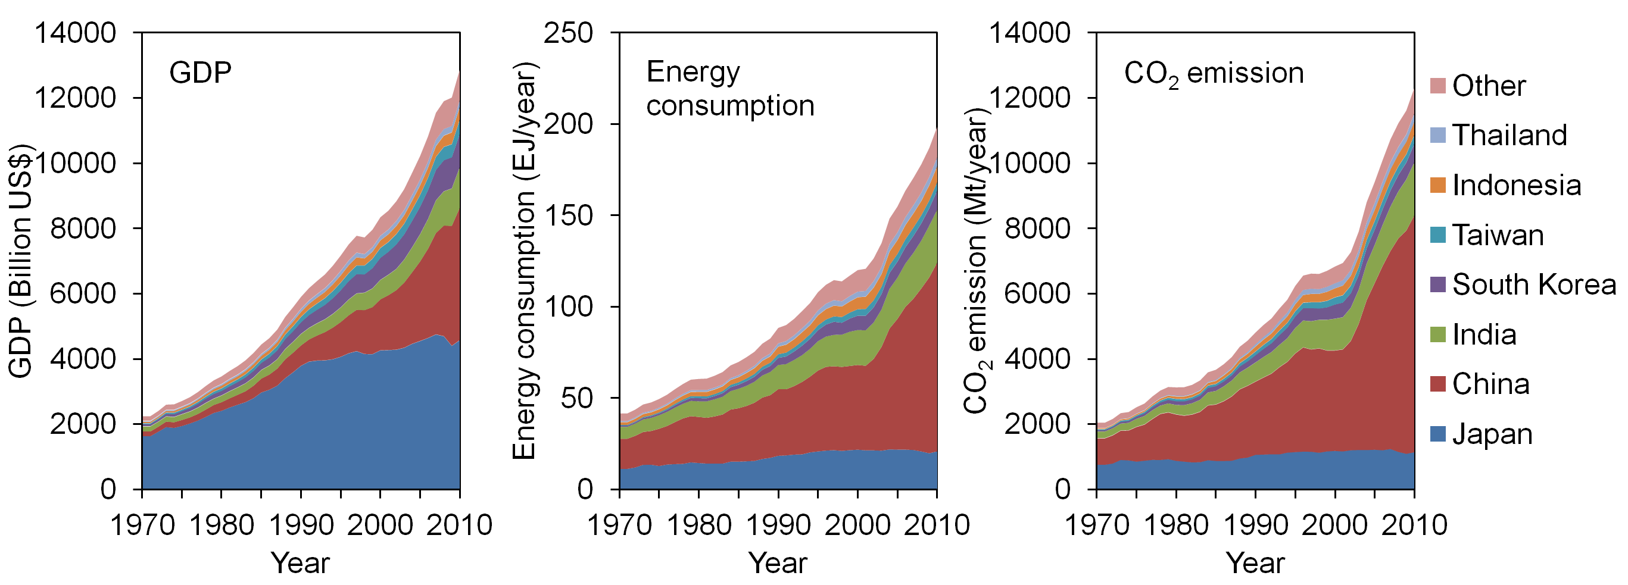
GDP, energy, and CO₂ in Asia
（IEA, 2012）
Significant increase of energy consumption and CO₂ emission due to rapid economic growth.
Predict effects of emission increases due to future economic growth on tropospheric ozone over south and east Asia.
Seek effective scenarios which suppress future energy consumption, CO₂ emission, and tropospheric ozone.

Slide 3
Flow of this study
Energy scenarios
Current energy consumption
Future energy prediction
for multiple scenarios
Emission
inventory
Current CO₂, NOx, and VOC emission
Future emission
Abatement costs
for multiple scenarios
Air quality simulation
Current ozone simulation
Future ozone simulation
for multiple scenarios
Validation of simulated ozone
Best future scenarios

Slide 4
Structure of the simulation
(Guenther et al., 2006)
(Skamarock et al., 2008)
Emission in China
Tsinghua University
Biogenic VOC
estimation model
MEGAN ver.2.0.4
Regional meteorological model
WRF-ARW ver.3.4.1
Emission in India
TERI
Regional chemical transport model
CMAQ ver.5.0.1
Emission in other Asia
IIASA
Spatial allocation
Speciation
Ship emission
EDGAR ver.4.1
(Byun and Schere, 2006)
(European Commission, 2010)
Global chemical transport model
MOZART-4
Biomass burning
GFED ver.3.1
(Van der Werf et al., 2010)
(Emmons et al., 2010)

Slide 5
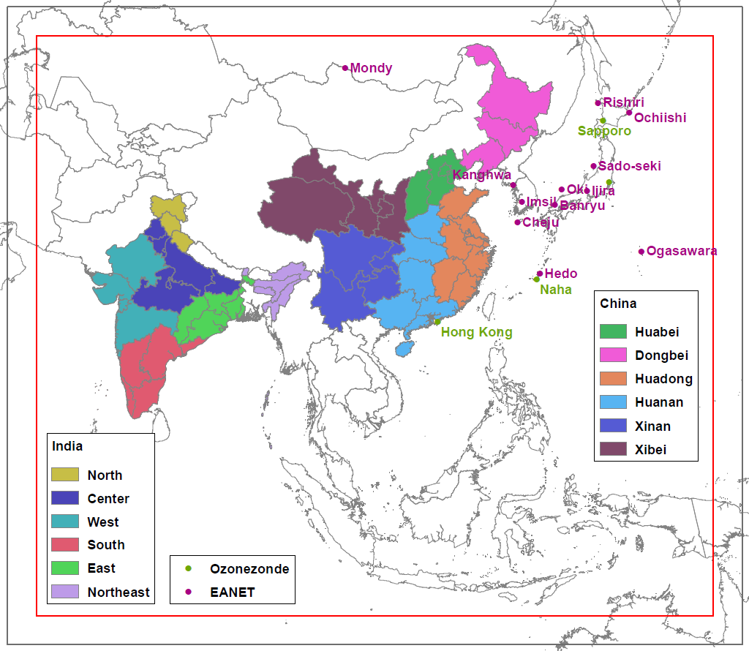
Target domain
Mesh size
60×60 km
Vertical layers
41 (WRF)
28 (CMAQ)
Model top
5639 Pa
(19.5 km)
Bottom layer height
34 m
Black : WRF
Red : CMAQ

Slide 6
Simulated surface ozone
Target period : November 2009 – December 2010
Horizontal distributions of simulated seasonal surface ozone
[8hr maximum within bottom 3 layers (134m)]
High concentration over mid-latitude from India to Japan in spring and autumn.
Shifted to north in summer. Maximum around northeastern China.
Shifted to south in winter. Decrease around northeastern China.
Low concentration around the equator for whole year.

Slide 7
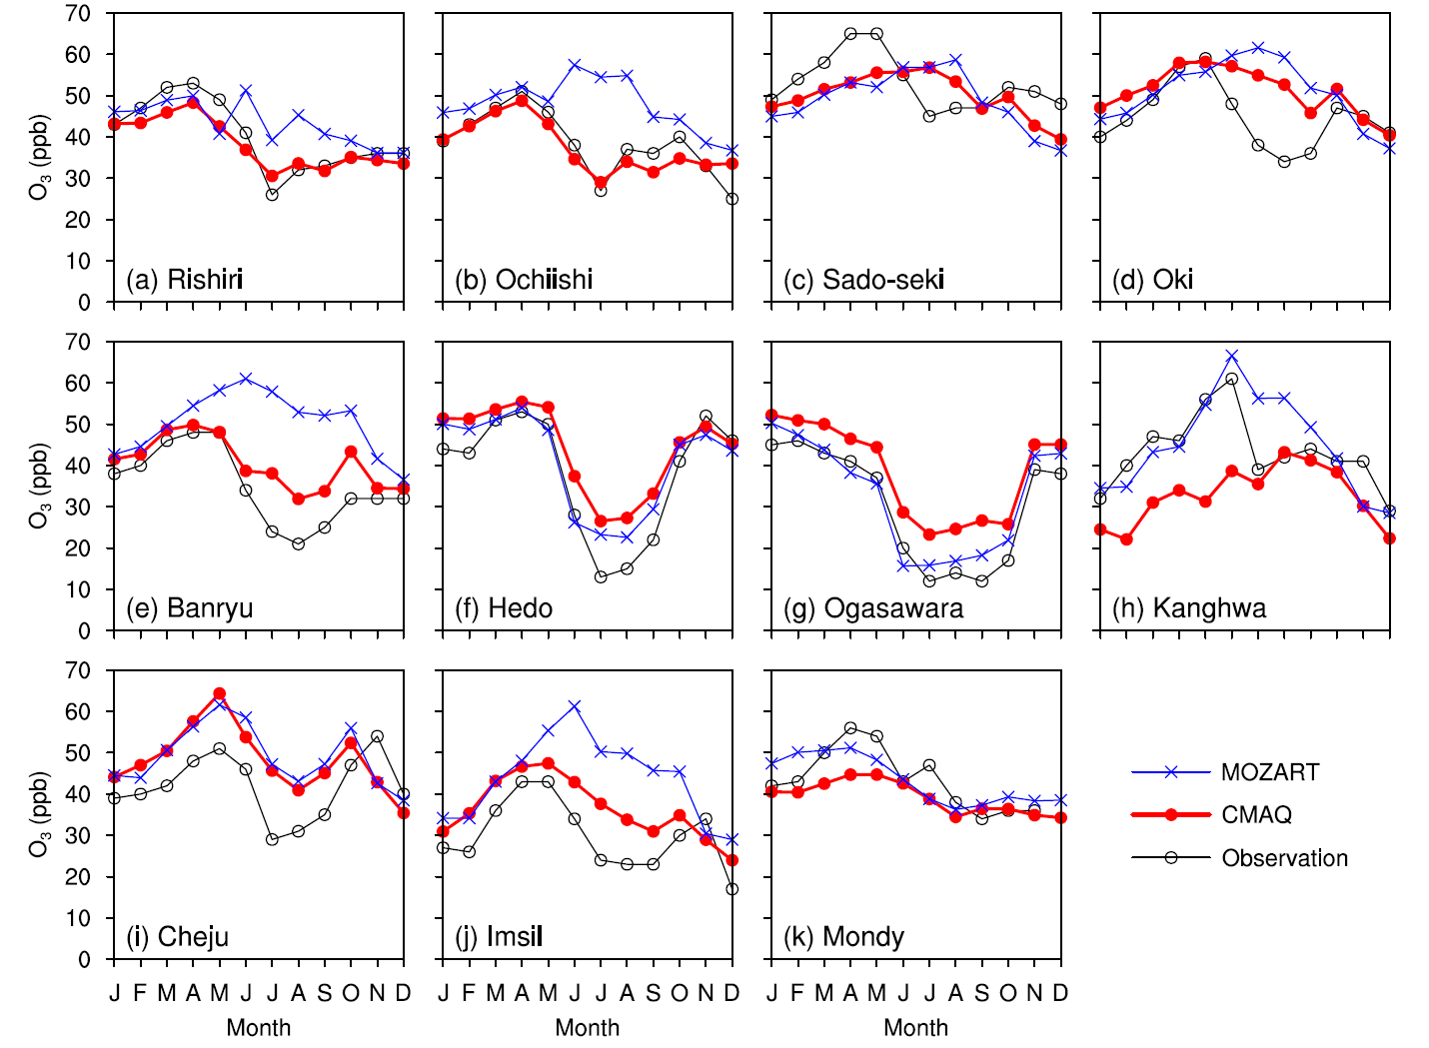
Performance of surface ozone
Comparison with EANET surface ozone data (Network Center for EANET, 2012)
Good except for overestimation in summer.

Slide 8
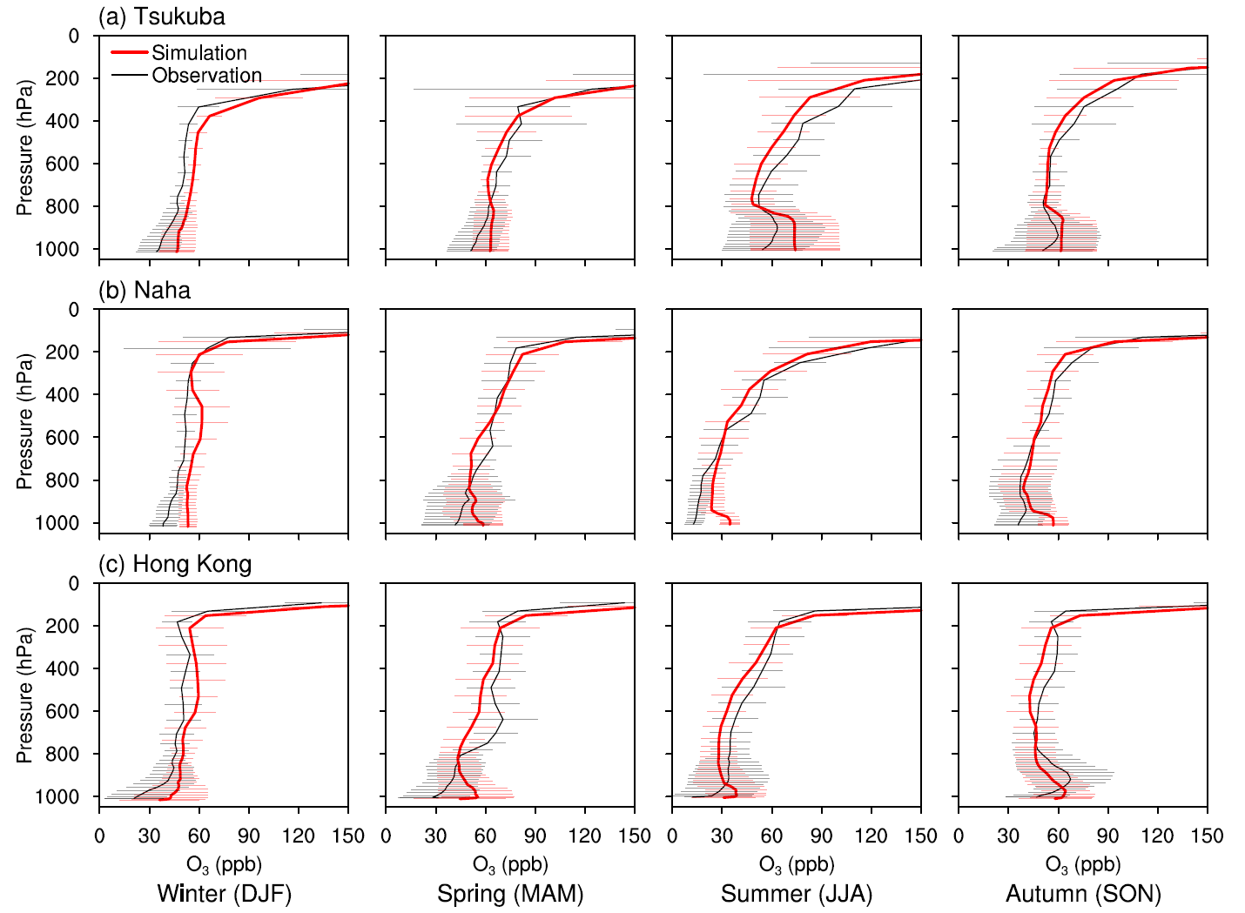
Performance of vertical ozone profile
Comparison with ozonezonde (WOUDC)
Good including upper troposphere.

Slide 9
Performance of tropospheric NO₂ column
Comparison with OMI tropospheric NO₂ column (OMNO2)
Good in absolute values, horizontal distribution, and seasonal variation.

Slide 10
Performance of tropospheric ozone column
Comparison with OMI/MLS tropospheric ozone column (Ziemke et al., 2006)
Similar features in horizontal distributions.

Slide 11
Future scenarios
Designed to separately evaluate effects of potential energy and environmental strategies.
Scenario | Year | Energy strategies | Environmental strategies
BASE | 2010
BAU0 | 2030 | Assume current policies and compliance. | Assume current policies and compliance.
PC0 | 2030 | Assume new energy-saving strategies, including; life style changes, structural adjustment, and energy efficiency improvement. (Only in China and India)
PC1 | 2030 |  | Assume new pollution control strategies, representing the “best guess” of future environmental policies. (Only in China and India)
Change NOx and VOC only.
Ship, biomass burning, and biogenic VOC emissions are unchanged.

Slide 12
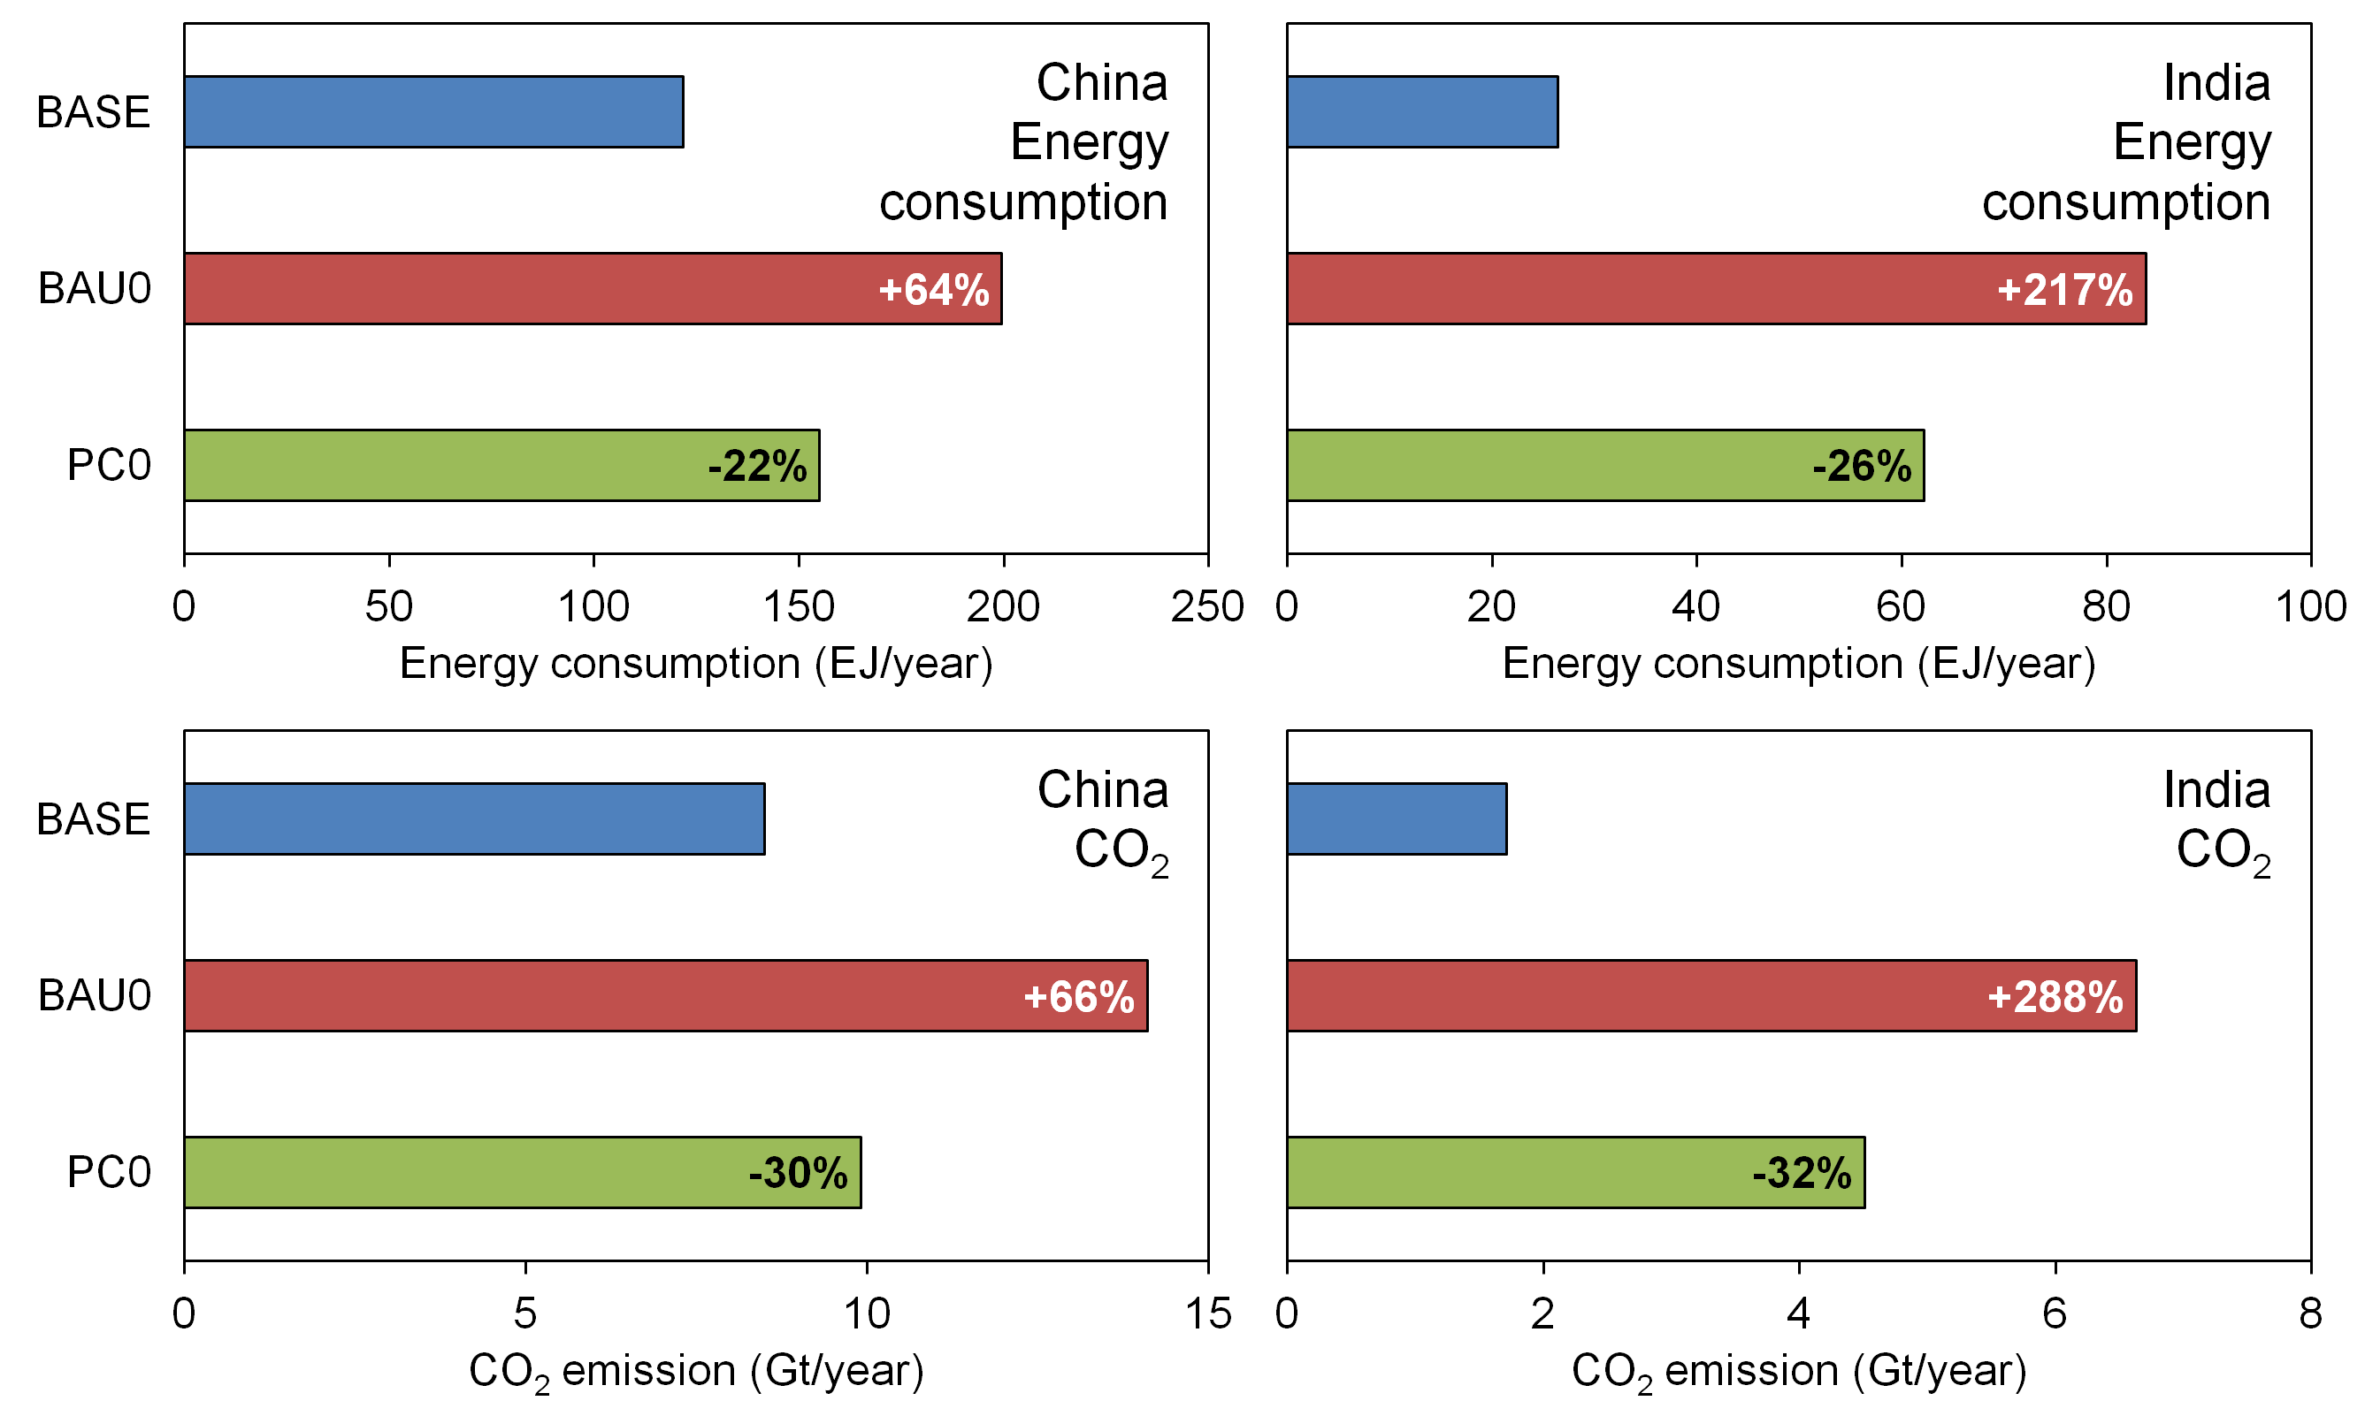
Predicted energy and CO₂
Significant increase of energy and CO₂ due to economic growth.
Potential energy strategies realize 30% decrease.

Slide 13
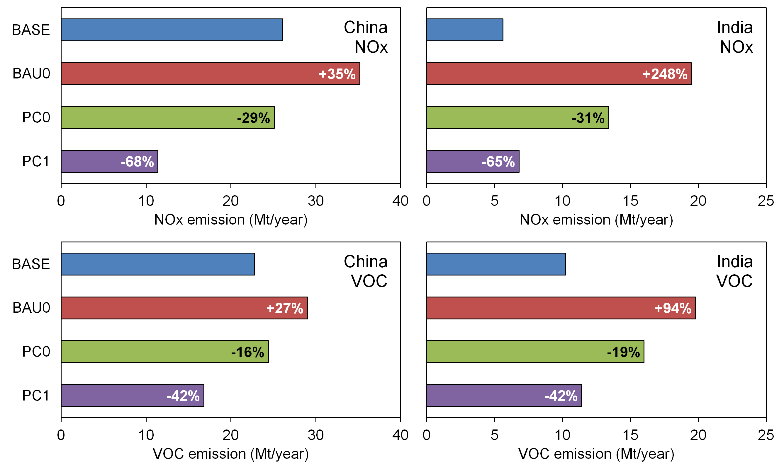
Predicted NOx and VOC emissions
Significant increase of NOx and VOC emissions due to economic growth.
Energy and environmental strategies realize comparable to (India) or lower (China) emissions than BASE.

Slide 14
Future simulation cases
Case | Emission | Other
BASE | BASE
BAU0nox | BAU0 (NOx only) + BASE
BAU0voc | BAU0 (VOC only) + BASE
BAU0 | BAU0
BAU0o3 | BAU0 | +5 ppb boundary O₃*
BAU0ch4 | BAU0 | +400 ppb background CH₄*
BAU0ta | BAU0 | -5 degC temperature
PC0 | PC0
PC1 | PC1
*Based on Dentener et al. (2006)
Meteorological fields are the same as 2010.
(Future climate change is not considered.)

Slide 15
Future changes of surface ozone
Significant increase for whole year in India and in summer in China.
Energy and environmental strategies could suppress increase.

Slide 16
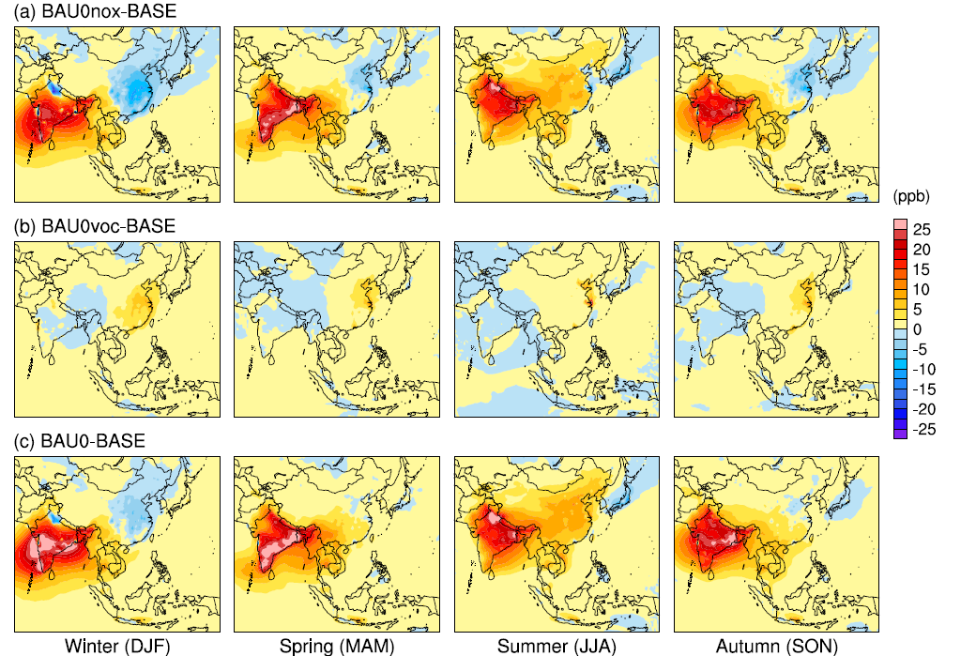
Effects of NOx and VOC
Significant increase is mainly caused by NOx.
Negative effects of NOx are observed in eastern China in winter.

Slide 17
Effects of external factors
Effects of background ozone and CH₄ are compensated.
Warmer weather around India contributes to significant increase.

Slide 18
Effects of potential strategies
Effectively suppressed for whole year in India and in summer in China.
Negative effects disappear following decreasing NOx.
-> Change regimes from VOC-limited to NOx-limited.

Slide 19
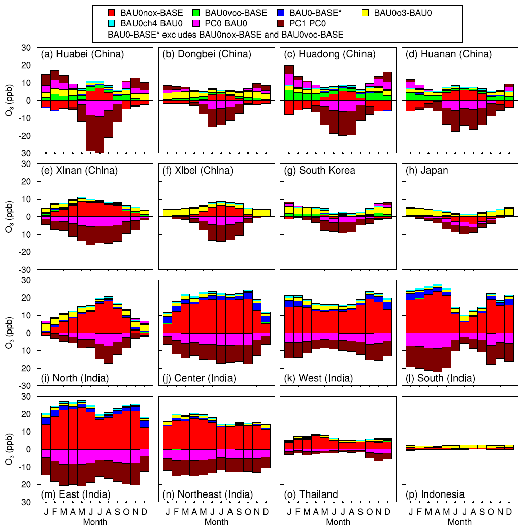
Overall effects on monthly ozone in regions
Increase in BAU0 and suppressed by strategies for whole year in India and western China.
Same in eastern China in summer, but opposite in winter.

Slide 20
Overall effects on annual ozone in regions
Negative and positive effects of NOx in eastern China are compensated. VOC and boundary O₃ are relatively important.
Effects of NOx are dominant in western China and India. Effects of VOC increase after significant NOx increase.
Potential strategies are effective to suppress ozone in surrounding countries as well as China and India.

Slide 21
Summary
A regional air quality simulation framework to simulate tropospheric ozone over South and East Asia has been constructed. Its performance was acceptable.
The simulations predicted significant increase of surface ozone for whole year around India and in summer around north eastern China in BAU0. It is mainly caused by increasing NOx. Warmer weather also contributes to it.
Potential energy and environmental strategies would effectively suppress significant increase of surface ozone.
Increasing VOC, background O₃ and CH₄ are relatively important on annual surface ozone around north eastern China.
It is desired that energy and environmental strategies assumed in this study are implemented to suppress tropospheric ozone as well as energy consumption and CO₂ over South and East Asia.

Slide 22
Thank you
for your attention!

Slide 24
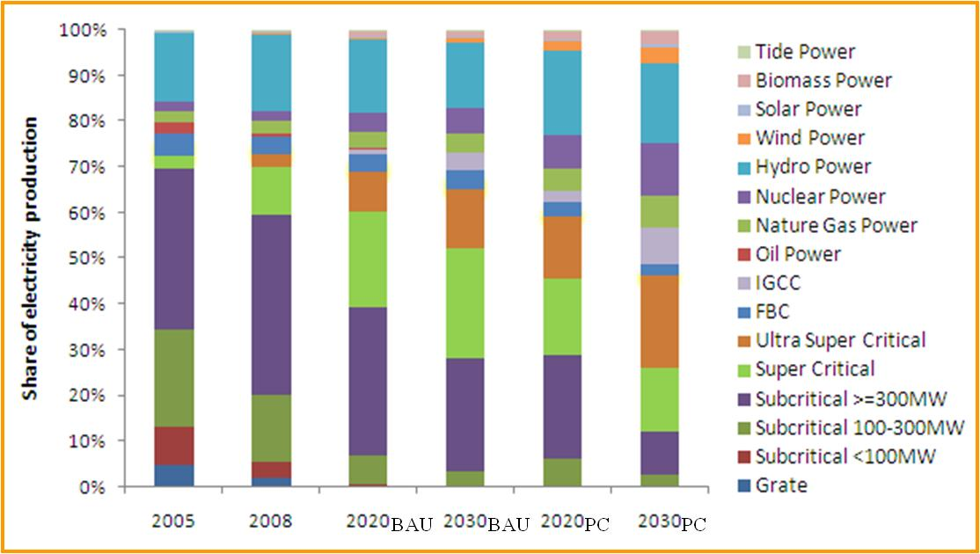
Structure adjustment of power plants
Share of various power generation technologies

Slide 25
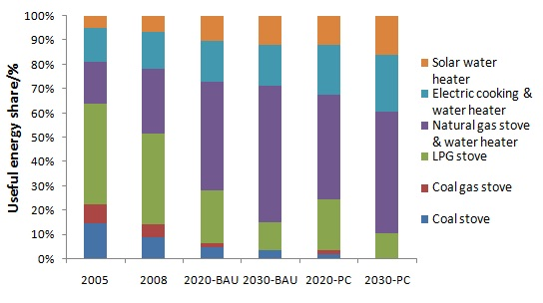
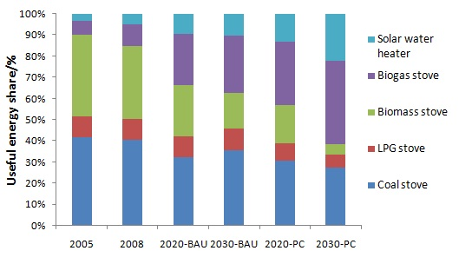
Domestic energy use
Urban Cooking & Hot water
Rural Cooking & Hot water

Slide 26
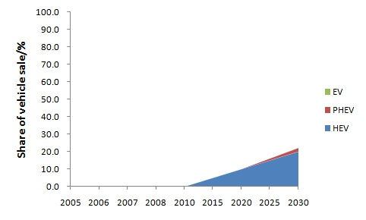
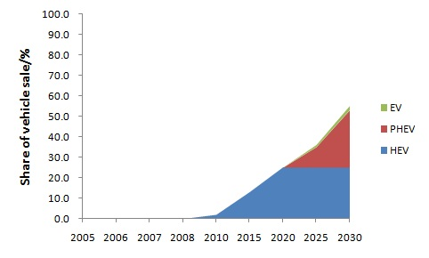
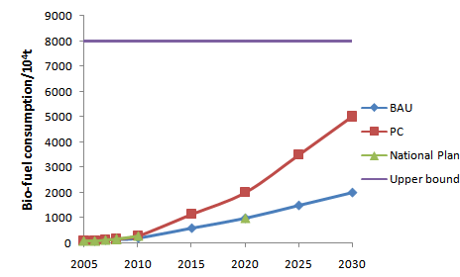
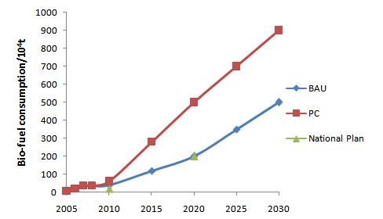
Increase of EV and bio-fuel vehicles
Electric vehicles -BAU
Electric vehicles -PC
Bio-gasoline development
Bio-diesel development

Slide 27
Emission control scenario for vehicles
[0]
[1]

Slide 28
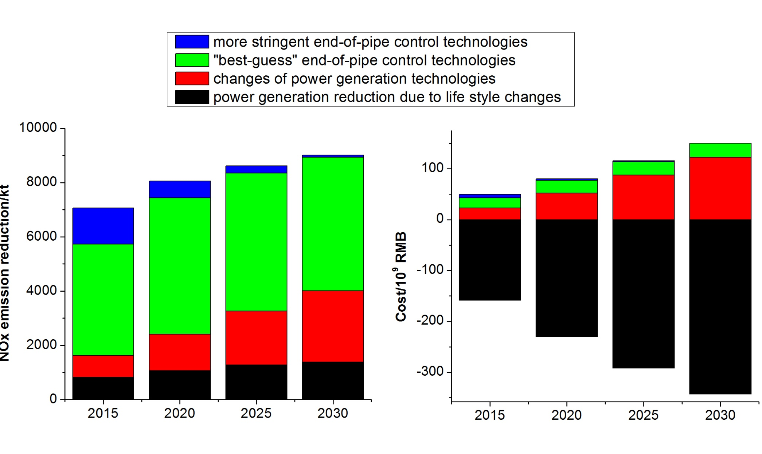
Cost effectiveness analysis (power plants)

