Slide 1
Characterizing single source contribution to urban-scale ozone and PM2.5
Kirk Baker
Kristen Foley
James Kelly
U.S. Environmental Protection Agency

Slide 2
Outline
Motivation
Understanding urban scale single source impacts
Variability across an urban area
Screening tools for single source secondary impacts
Approaches
RSM proof of concept
Summary

Slide 3
Motivation
New Source Review (NSR) and Prevention of Significant Deterioration (PSD) programs
Assess the air quality impacts of new or modified sources related to precursor emissions for ozone and PM2.5
EPA granted Sierra Club petition with commitment to update Appendix W to address Ozone and secondary PM2.5 impacts
Interpollutant trading (NSR offset) provisions for PM2.5
National Environmental Policy Act (NEPA)
Assess the environmental impacts of new or modified sources

Slide 4
What is different about PSD/NSR modeling?
Using maximum allowable emissions, not actual
Not looking at specific monitors, looking at entire domain
Looking for high impact over (ideally) at least one year or ozone season

Slide 5
Fundamental questions related to secondary impacts of single sources
How close to a source are maximum secondary impacts?
How variable are the impacts within an urban area? From one area to another? Urban vs. rural?
How do stack parameters influence peak impacts?
How to emission rates and co-emissions influence peak impacts?
Answering these questions will help determine whether an appropriate screening tool could be developed for assessing secondary impacts of single sources

Slide 6
Single Source Screening Level Tool
Existing approaches often lack a strong technical basis: “Scheffe tables” and Q/D (emissions/distance from source)
A screening tool would ideally provide a quick, reasonable, credible, and appropriately conservative assessment of single source secondary impacts before more complex modeling may be required
ENVIRON has presented a reduced form single source screening model that estimates ozone impacts from single source emissions of VOC and/or NOX based on CAMx-HDDM
http://www.epa.gov/ttn/scram/10thmodconf/presentations/2-21-Morris_Ozone_Screen_New_Srcs_EPA_10th_AQMC_Mar_2012.pdf
Offset ratios with AERMOD approach has been proposed by NACAA for secondary PM2.5 (would not provide any information for ozone)
Others

Slide 7
Understanding urban-scale single source impacts
Complimentary information provided by poster:
Kelly, J., Baker, K., 2013. Examining the impacts of emissions from single-sources on PM2.5 and ozone using a photochemical model, CMAS 2013 Conference, Chapel Hill, NC.

Slide 8
Intra-urban variability in single source impacts
Applications for 4 km Atlanta domain (45x45x25 cells)
July 2007
Same source placed in 25 unique locations in the model domain
25 different model runs (one for each unique stack location)
Relevant emissions species for ozone and PM2.5
Ozone: NO_{X} (~235 TPY), VOC (~235 TPY)
PM: SOX (~235 TPY), NO_{X}, VOC, primarily emitted PM (~4 TPY)
All precursors included in the same simulation
Generated average stack parameters based on non-EGU point sources in the 4 km Atlanta domain
stack height = 16.6 m, stack diameter = 1.4 m,
stack velocity = 13.8 m/s, stack exit temperature = 428 K
NO_{X} (NO=0.9 and NO₂=0.1) and VOC speciation based on average speciation for non-EGU point sources in the 4 km domain

Slide 9
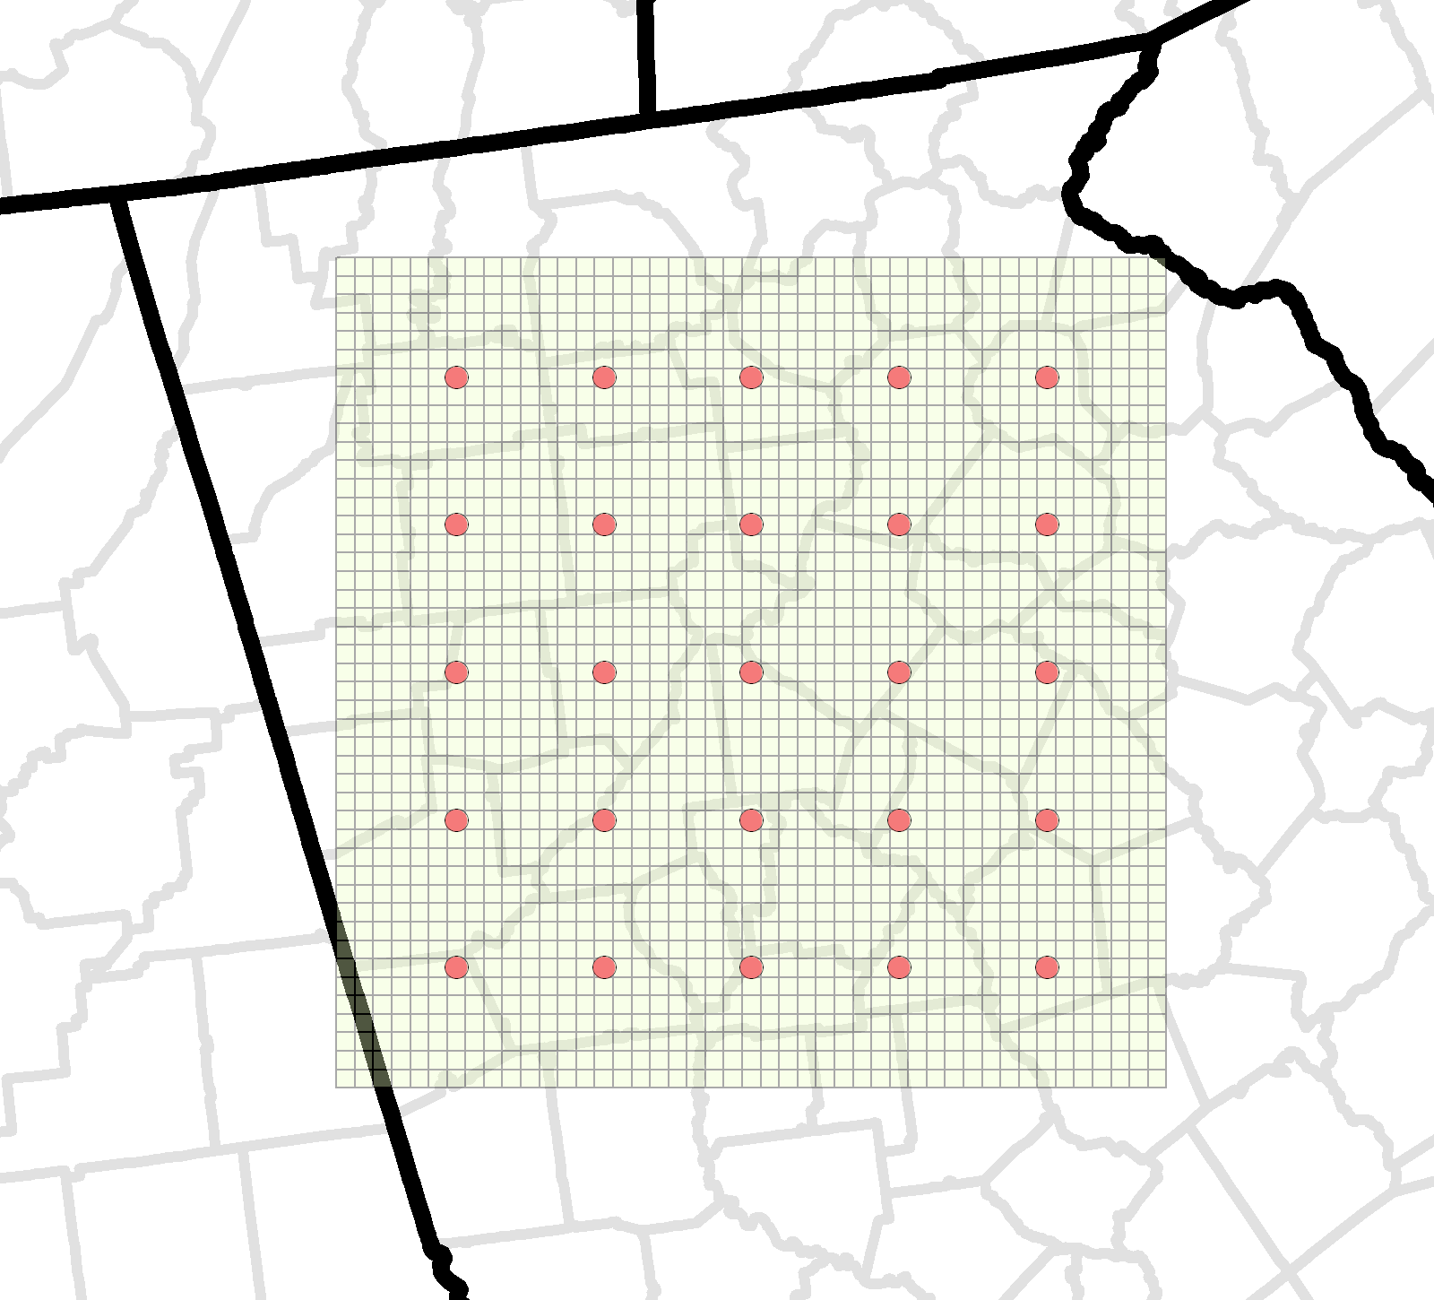

Slide 10
Maximum Impacts by Distance
July 2007 maximum 24-hr contribution shown by distance from the source
25 unique sources shown (same emissions and stack parameters but different locations)

Slide 11
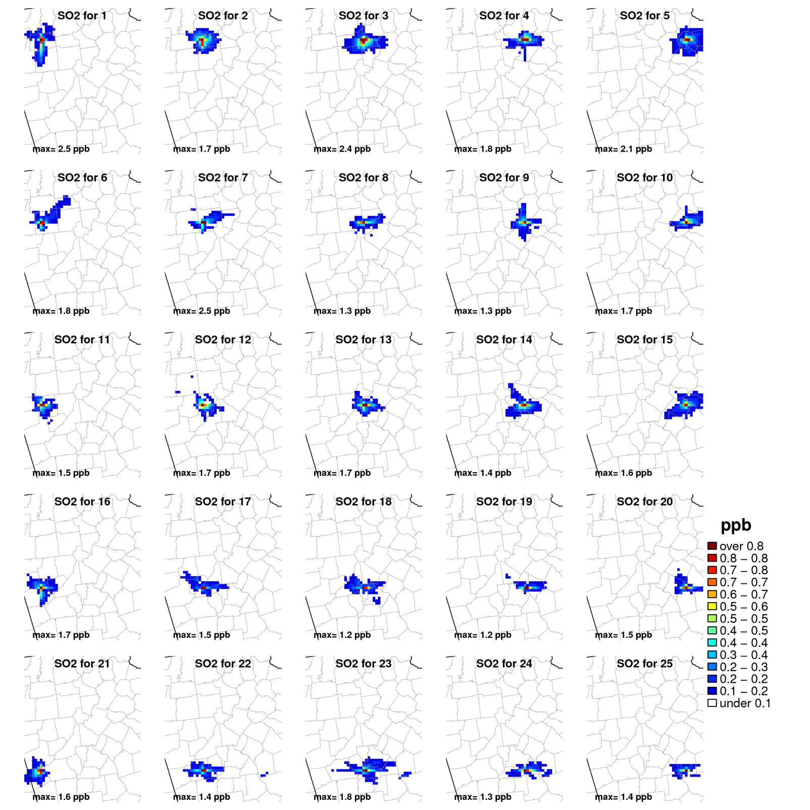
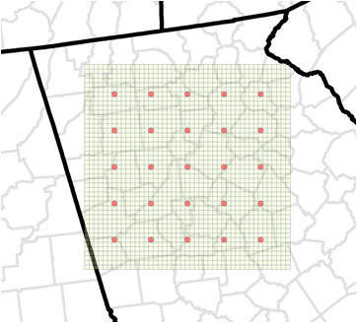
Sulfur Dioxide

Slide 12
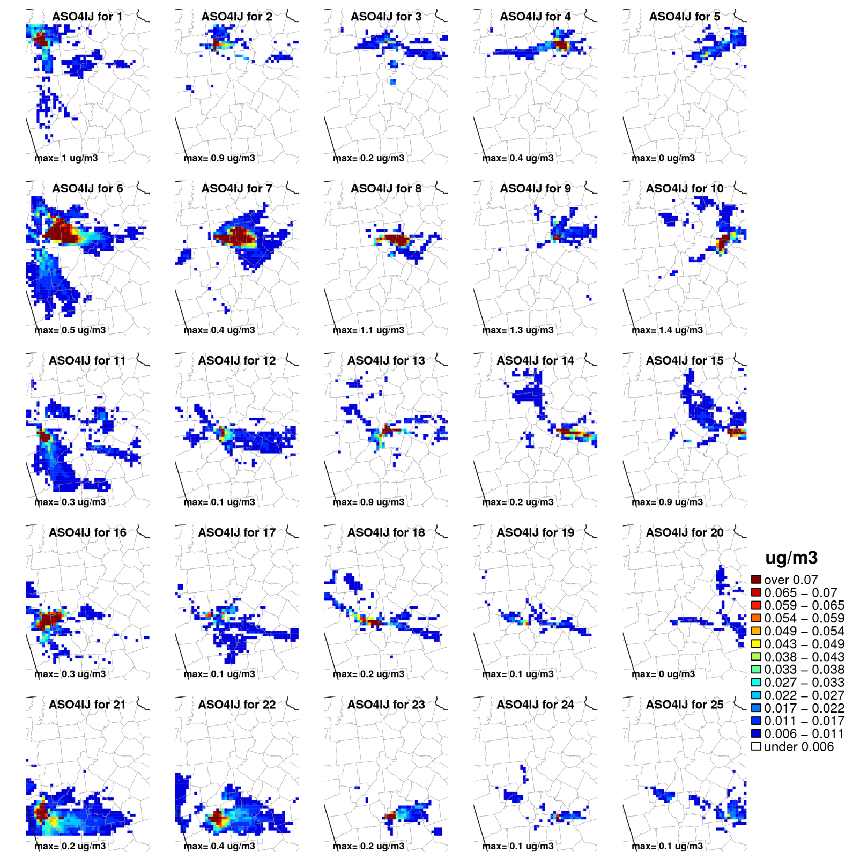
PM2.5 Sulfate Ion

Slide 13
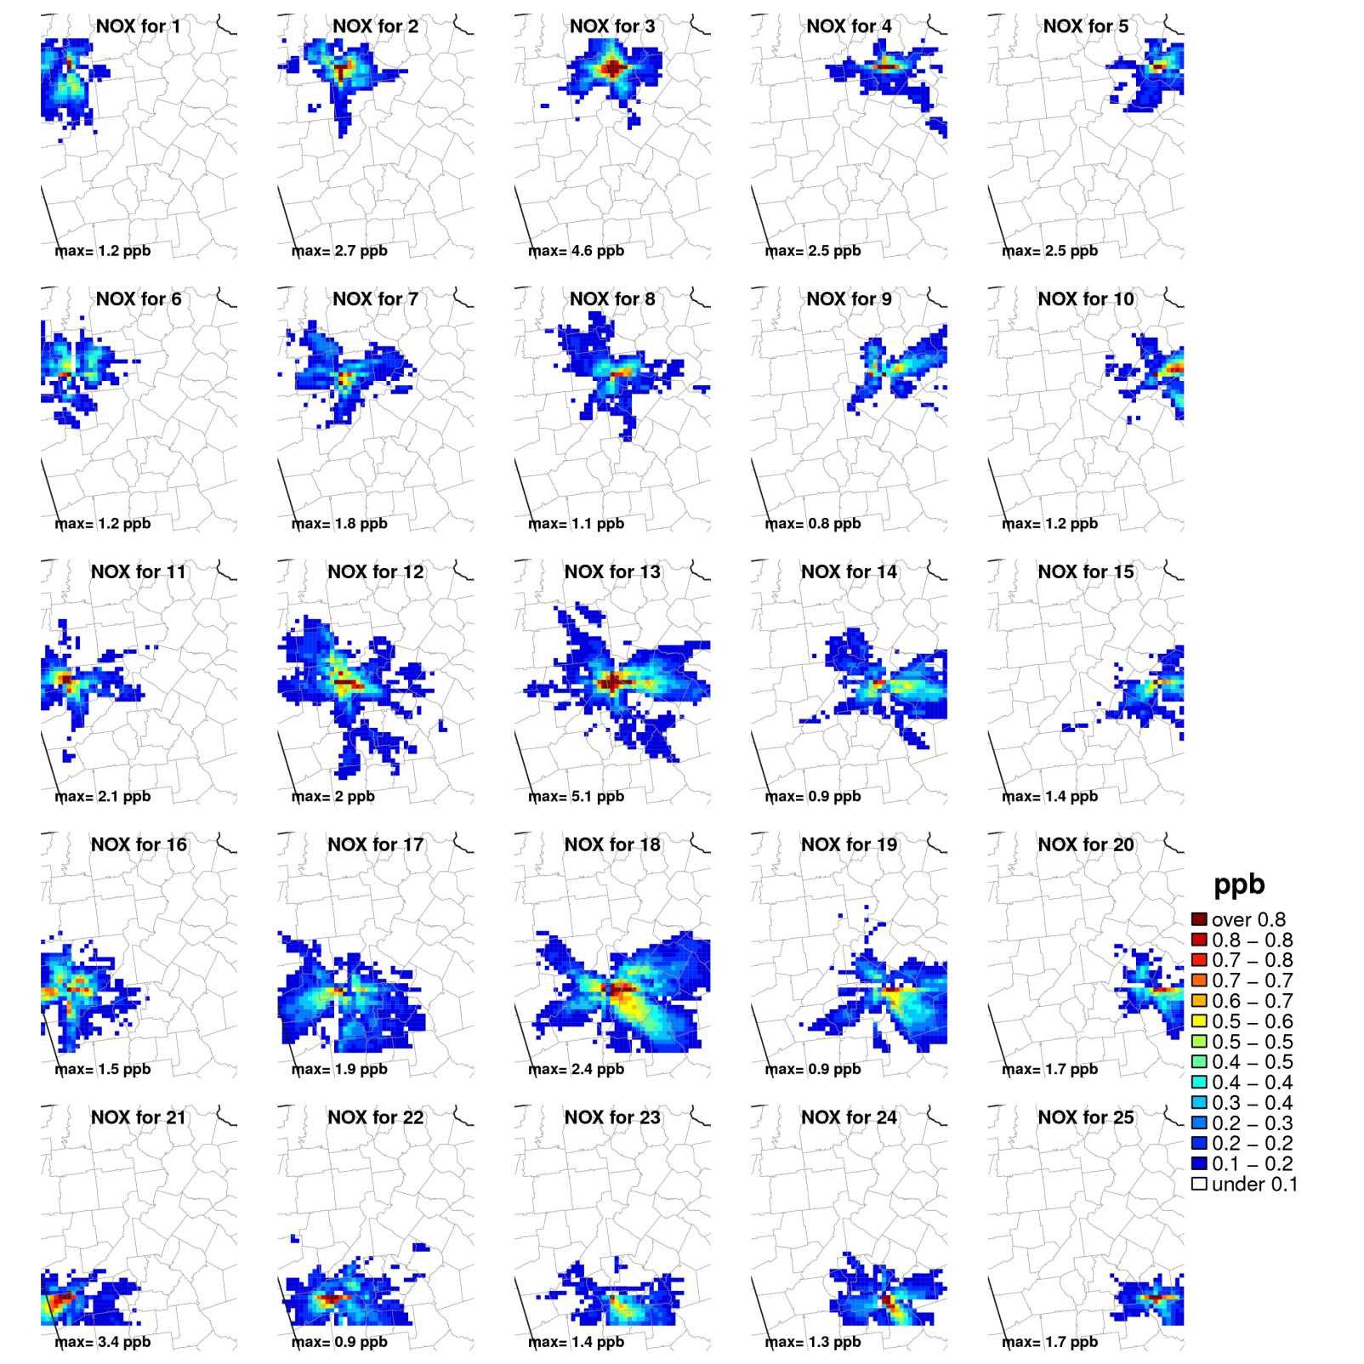
Nitrogen Oxides

Slide 14
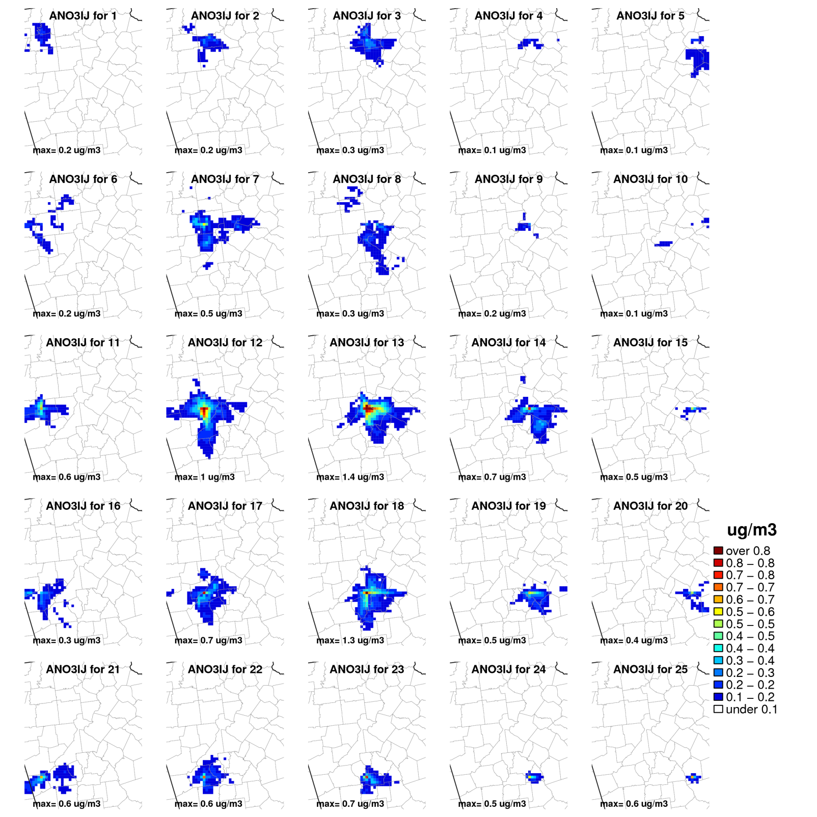
PM2.5 Nitrate Ion

Slide 15
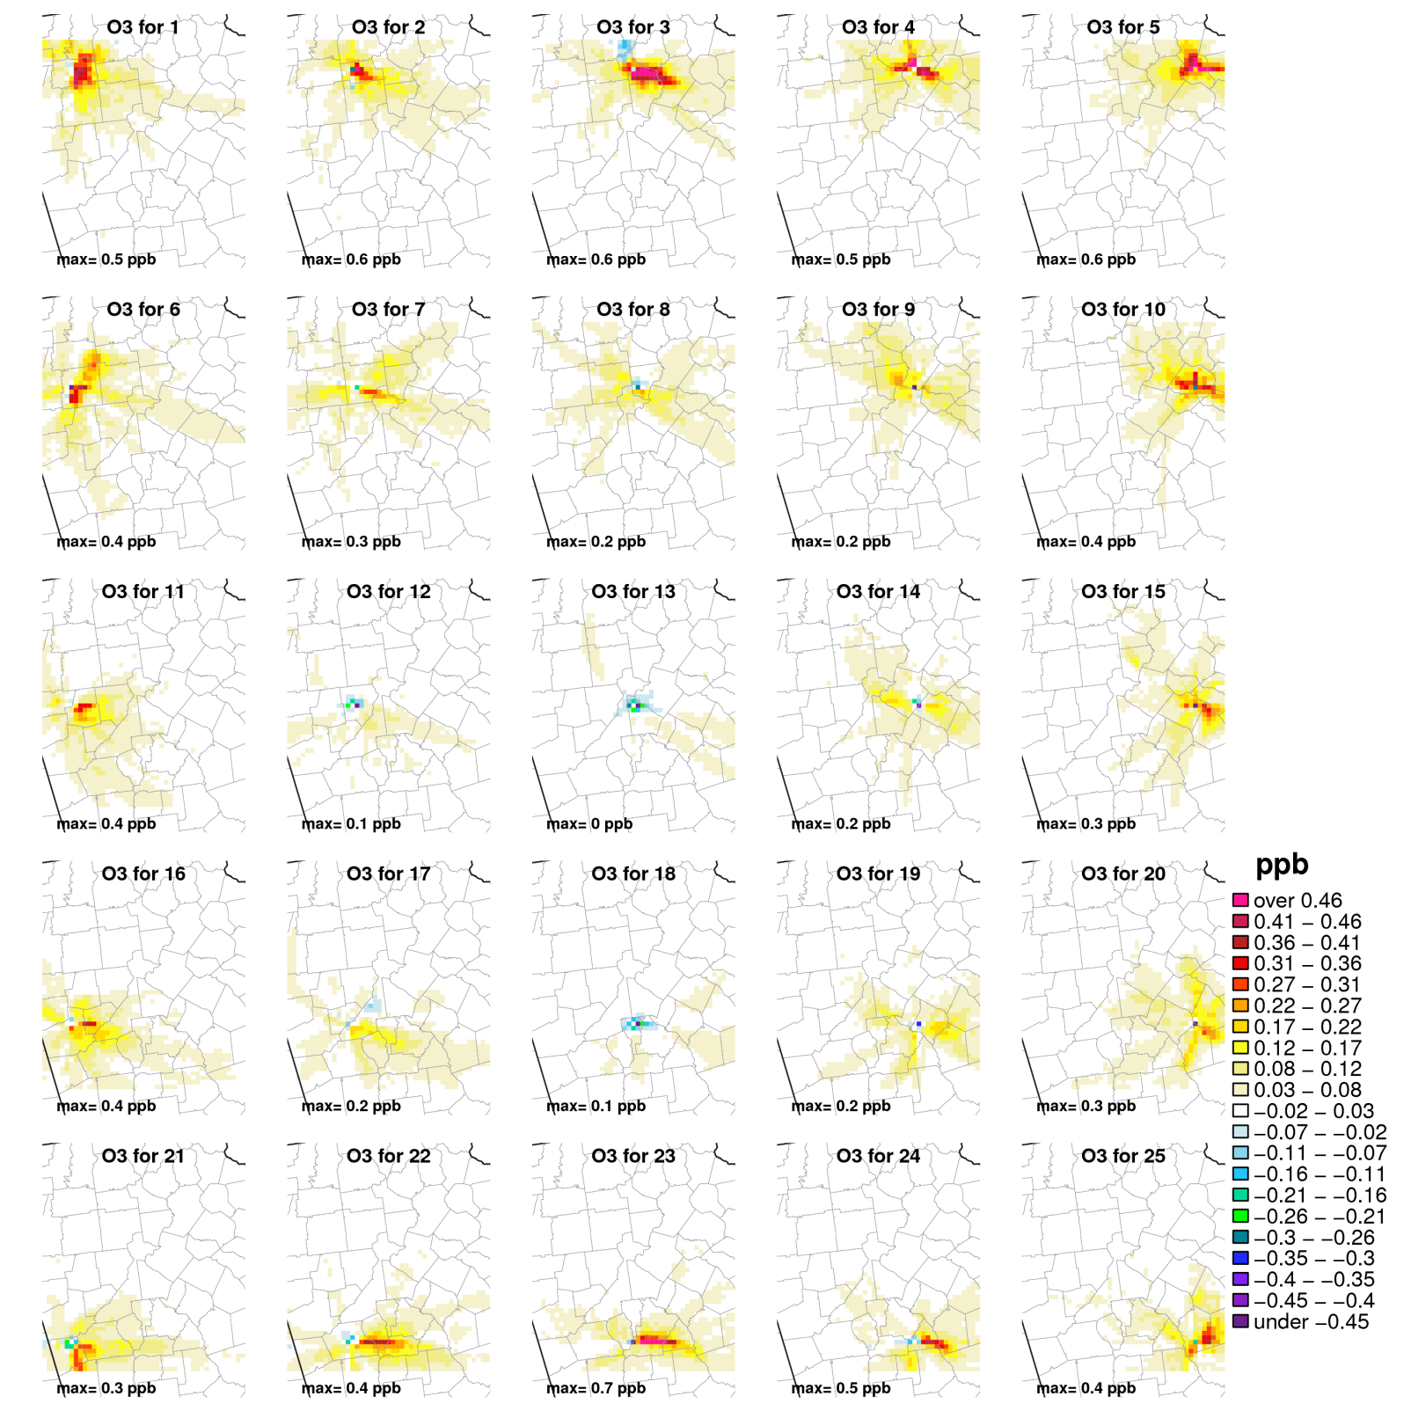
Ozone

Slide 16
Remarks
Need to perform similar analysis for other urban and rural areas
Analyze alternative emissions levels, stack parameters
Analyze emissions impacts without co-emission
Include more seasons and other years
Investigate potential influence of grid resolution

Slide 17
Screening tools for single source secondary impacts

Slide 18
Potential Application Methods
Preliminary work shows photochemical model brute force approach can capture single source plume
Kelly, J., 2012. Evaluation of Single-Source Plume Chemistry Simulations with the SCICHEM Reactive Plume Model CMAS 2012 Conference, Chapel Hill, NC.
Preliminary work shows similar single source impacts using brute force, DDM, and source apportionment
Baker, K., 2012. Estimating Secondary Pollutant Impacts from Single Sources, CMAS 2012 Conference, Chapel Hill, NC.
Ideally a reduced form model would be built from state of the science deterministic models
What approaches are available to differentiate the impacts from a single source in a complex air quality model?
Source apportionment
Decoupled direct method (DDM and HDDM)
Brute force emissions sensitivities
Sensitivity based response surface model (RSM)

Slide 19
Preliminary RSM Test Case
Applications for 4 km Atlanta domain (45x45x25 cells)
July 2007
January 2007
Source located in the center of the domain
Relevant emissions species for ozone and PM2.5
Ozone: NO_{X} (~235 TPY), VOC (~235 TPY)
PM: SOX (~235 TPY), NO_{X}, VOC, primarily emitted PM (~4 TPY)
All precursors included in the same simulation
Generated average stack parameters based on non-EGU point sources in the 4 km Atlanta domain
stack height = 16.6 m, stack diameter = 1.4 m,
stack velocity = 13.8 m/s, stack exit temperature = 428 K
NO_{X} (NO=0.9 and NO₂=0.1) and VOC speciation based on average speciation for non-EGU point sources in the 4 km domain

Slide 20
Experimental Design
5 factors (emissions species)
Latin-hypercube sampling between 0.0 and 2.0 (N=31)
31 unique CMAQ simulations
~10 days to finish 31 member ensemble running sequentially (32 processors)
Response surface generated using R “DiceKriging” package
Response theoretically useful for 0 to ~450 TPY for precursors and 0 to at least 8 TPY for primary PM2.5

Slide 21
PM2.5 Sulfate Ion Predicted Surface
Episode average PM2.5 sulfate ion response surface

Slide 22
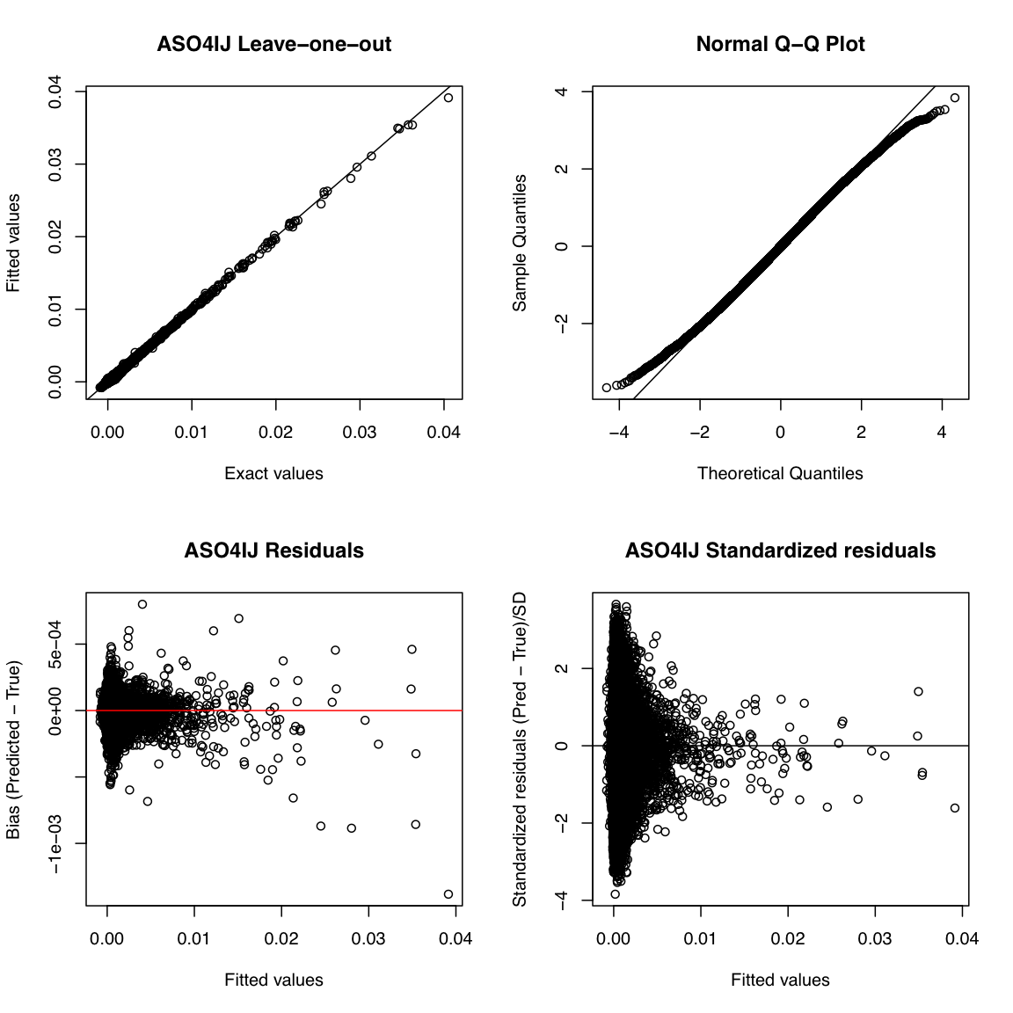
Leave-one-out cross validation

Slide 23
New PM2.5 Sulfate Ion Predicted Surface
Episode average PM2.5 sulfate ion response surface (75% reduction)

Slide 24
Out-of-sample validation
Episode average PM2.5 response for a 75% reduction to all precursors compared to RSM estimate of 75% reductions to precursors

Slide 25
Remarks
This work provides information about how varying emissions rates and co-emissions impact secondary formation of ozone and PM2.5 (for this location and time period)
Apply for other precursors, seasons, locations
Develop an approach for simple visualization
Develop an approach to port RSM to a more accessible program (such as Excel)

Slide 26
Acknowledgements
Charles Chang, Lara Reynolds, Allan Beidler, James Beidler, Chris Allen, Alison Eyth, Alexis Zubrow, Rich Mason, Charles Fulcher, Carey Jang, Marc Houyoux, Tyler Fox

