Slide 1
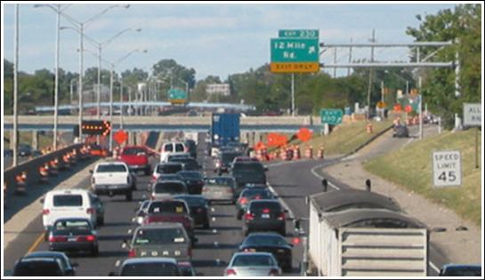
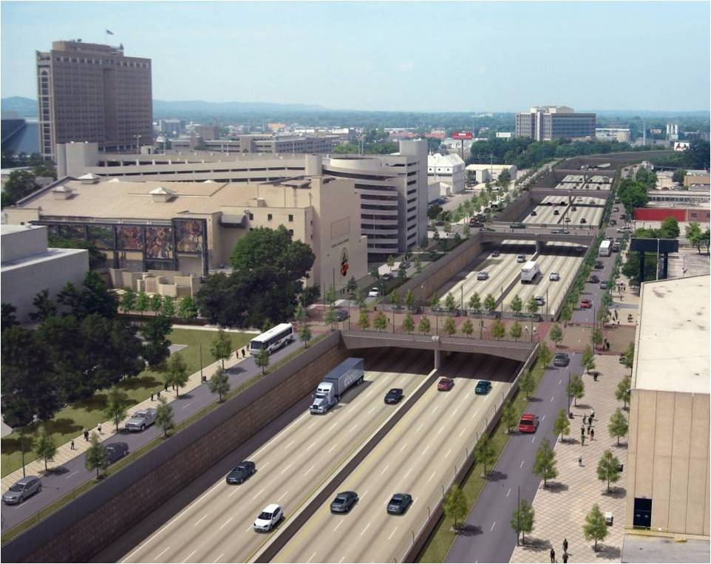
RLINE: A Line Source Dispersion Model for Near-Surface Releases
Saravanan Arunachalam¹, Michelle G. Snyder², Akula Venkatram³,
David K. Heist², Steven G. Perry², Vlad Isakov²
¹UNC/IE, ²U.S.EPA/NERL/AMAD, ³UCR
Presented at the 12th Annual CMAS Conference, Chapel Hill, NC
October 28 – 30, 2013

Slide 2
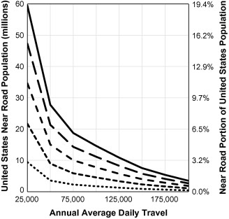
Background
59.5 million people live within 500m of roads with > 25,000 Annual Average Daily Traffic (AADT)
Source: Rowangould, Transport Research Part D, 2013

Slide 3
Illustrative AADT in Urban Area
Source: Michigan DOT

Slide 4
Why was RLINE Developed?
Based on Science Advisory Board and the National Research Council recommendations, EPA-ORD initiated research on near-road air quality and health effects
Field measurements indicated that exposures to traffic-emitted air pollutants near roads can be influenced by complexities of roadway configurations (noise walls, depressed sections, etc.)
To improve exposure metrics for future health studies, ORD initiated model development project to account for these important parameters

Slide 5
What is RLINE?
RLINE is EPA -ORD's research dispersion modeling tool for near roadway assessments
based on a steady-state Gaussian formulation
currently formulated for near-surface releases
contains new formulations for the vertical and lateral
dispersion rates
accounts for low wind meander
includes M-O similarity profiling of winds near the surface
uses the surface meteorology provided by AERMET
includes user-friendly input requirements for road network

Slide 6
EPA-ORD: Model Development Focus
  Account for near-road complexities and very near road concentrations (i.e., within a few meters of the road)
  Design and conduct wind tunnel and field studies for development and evaluation of improved line source algorithms
  RLINE is
    initial modeling product of this development program
    research tool designed primarily to support risk assessments and health studies related to near-road pollutants

Slide 7
What RLINE is NOT?
RLINE is not designed for regulatory applications (e.g., NAAQS enforcement, New Source Review, PM Hot Spot Conformity, SIP analyses, etc).
It is contained in a research platform and has not gone through the rigorous review and public comment required for inclusion in the list of recommended regulatory models

Slide 8
Model Algorithm
Steady-state, Gaussian based plume model
where
and
Concentration at a receptor is the integrated contributions from points along the line using a Romberg Iteration Scheme.
Plume
For each point source within the integration, a wind-direction following plume is simulated.
Meander
For each point source within the integration, meander is handled in the same way as
AERMOD point source meander.
Snyder et al, Atmos. Environ, 2013

Slide 9
Model Algorithm
Mean Plume Height
Concentration is a function of mean plume height (similar in nature to the effective parameter concept used in AERMOD).
Meteorological Inputs
Snyder et al, Atmos. Environ, 2013
RLINE uses the meteorological inputs from the AERMOD met. preprocessor (u*, w*, mixing height, L_{mo}, z₀, Wspd, Wdir, heat flux, T) then corrects u* for light wind conditions.
Other surface parameters are then recalculated to be internally consistent with M-O theory.
This method was developed and evaluated by Qian and Venkatram (BLM 2011).

Slide 10
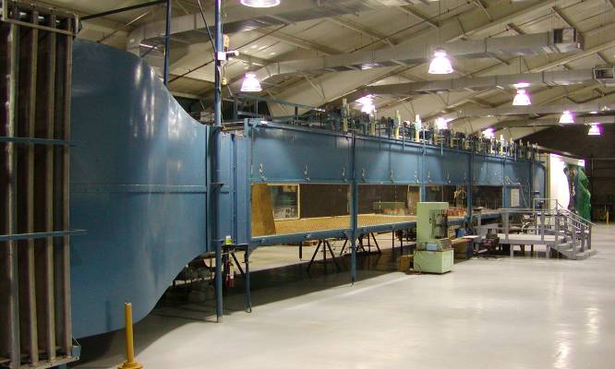
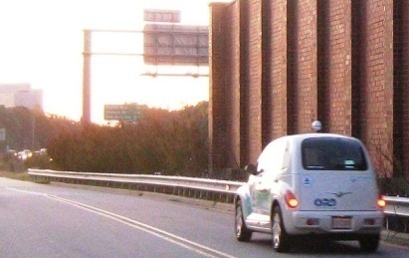
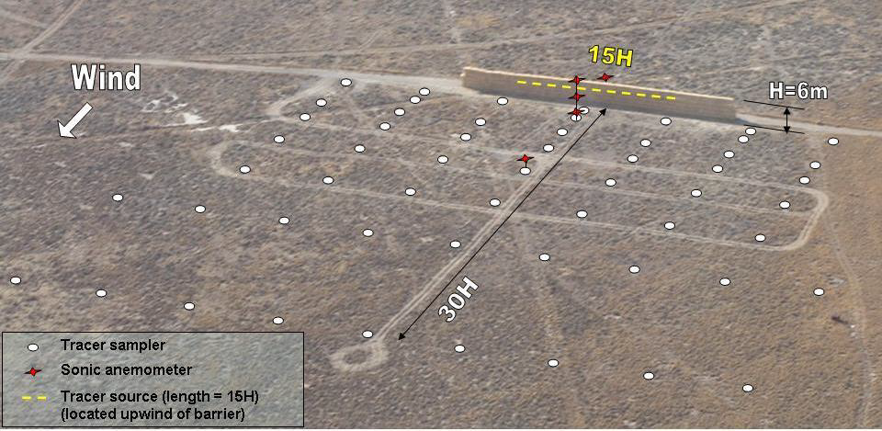
Model Development Databases
Tracer Studies
  Idaho Falls 2008
  Prairie Grass
Wind Tunnel Studies
Field Studies
  Raleigh, Detroit, Phoenix

Slide 11
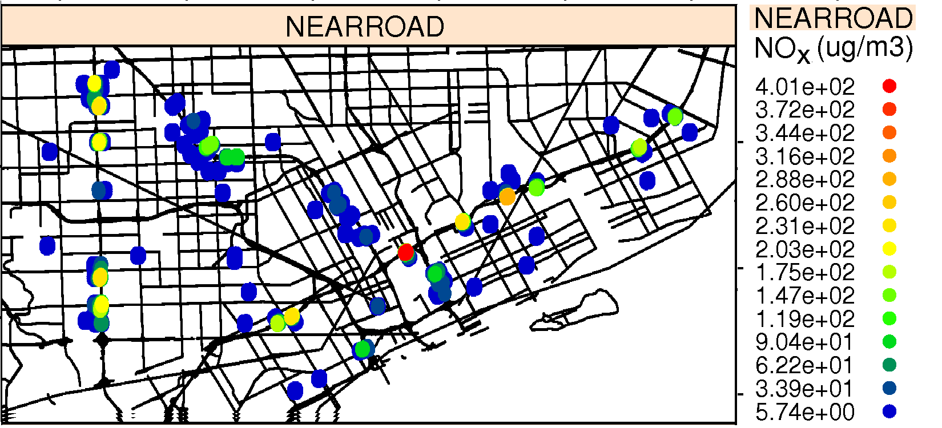
How is RLINE being used?
The model can support health and risk assessments, epidemiology studies, and community based tools.
RLINE is designed to handle urban situations with thousands of line sources and receptors.
RLINE is used in a) “Near-Road EXposures to Urban air pollutants Study” (NEXUS) in Detroit examining the role of near-road exposures on asthmatic children who live near major roadways; b) Portland, ME and c) North Carolina Piedmont
RLINE can be used to estimate spatial variability in urban areas with many roadways.
See Talks by Snyder et al, and Chang et al, and Poster by Isakov et al.

Slide 12
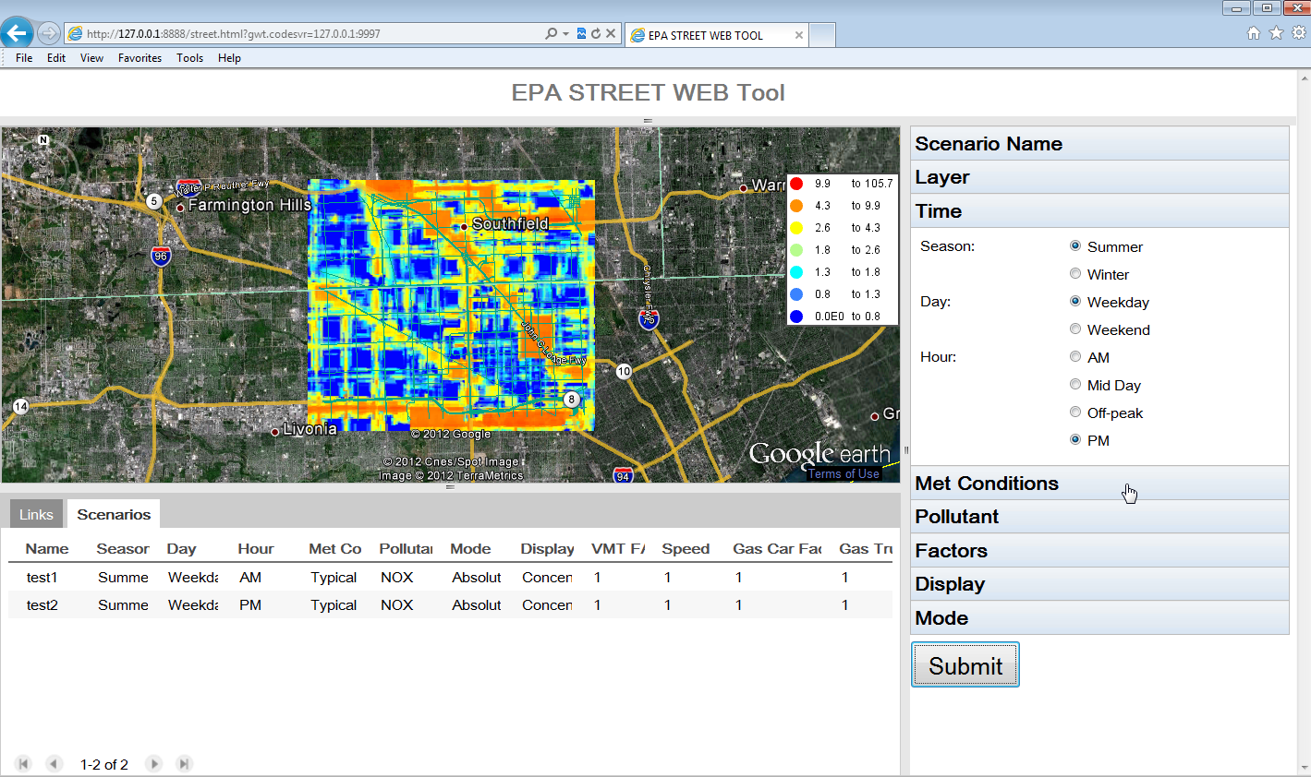
How does RLINE support community tools?
R-LINE algorithm is used in C-LINE, a decision support tool for evaluating effects of alternate transportation options on community health
EPA’s C-LINE Tool
See Poster by Barzyk et al

Slide 13
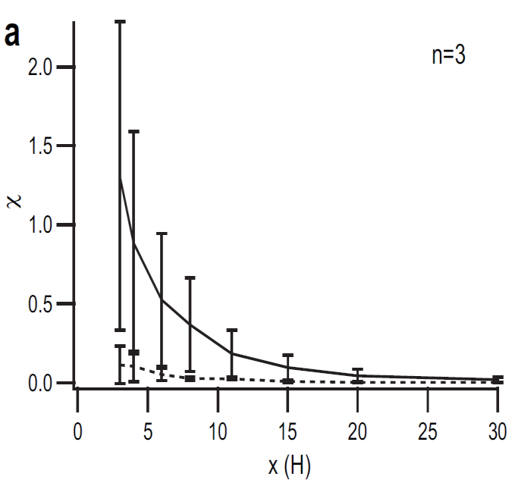
Ongoing Development Work
The model framework is designed to accommodate algorithms for simulating near-source effects of complex roadway configurations (noise barriers, depressed roadways, roadway vegetation, etc).
These configurations could be used in mitigation, to reduce exposure near high emission roadways.
Idaho Falls 2008 tracer study
_____ no barrier
------ barrier
Finn et al., Atmos. Environ., 2010

Slide 14
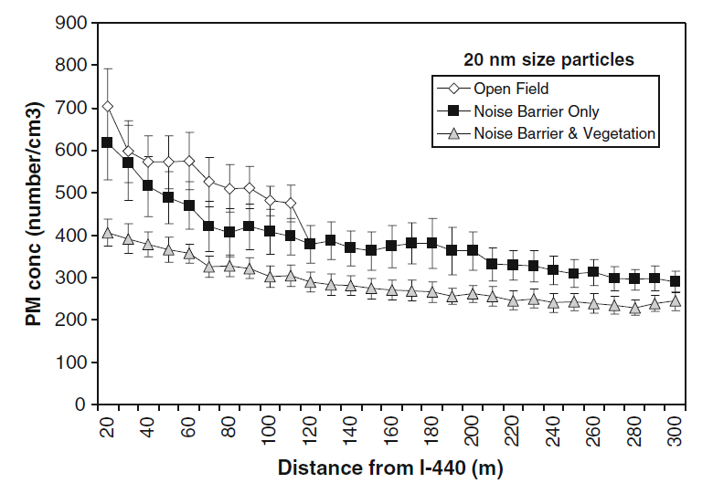
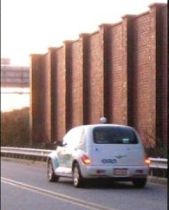
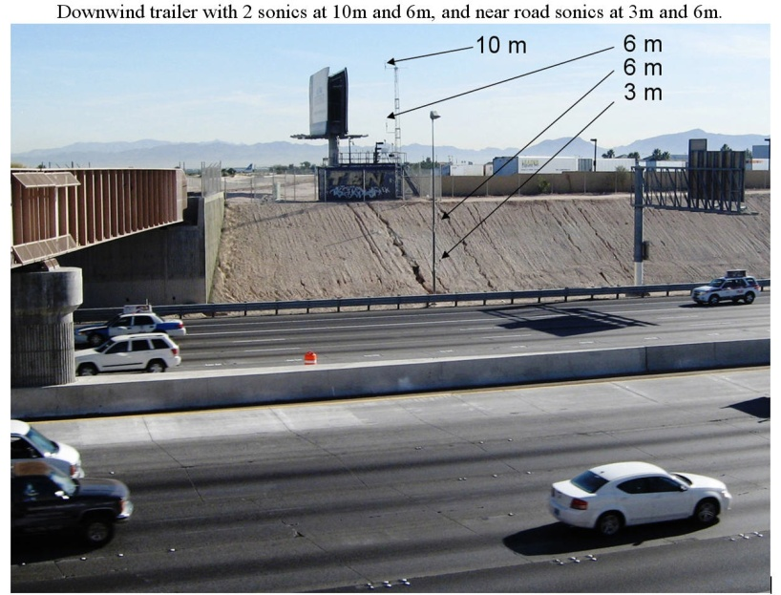
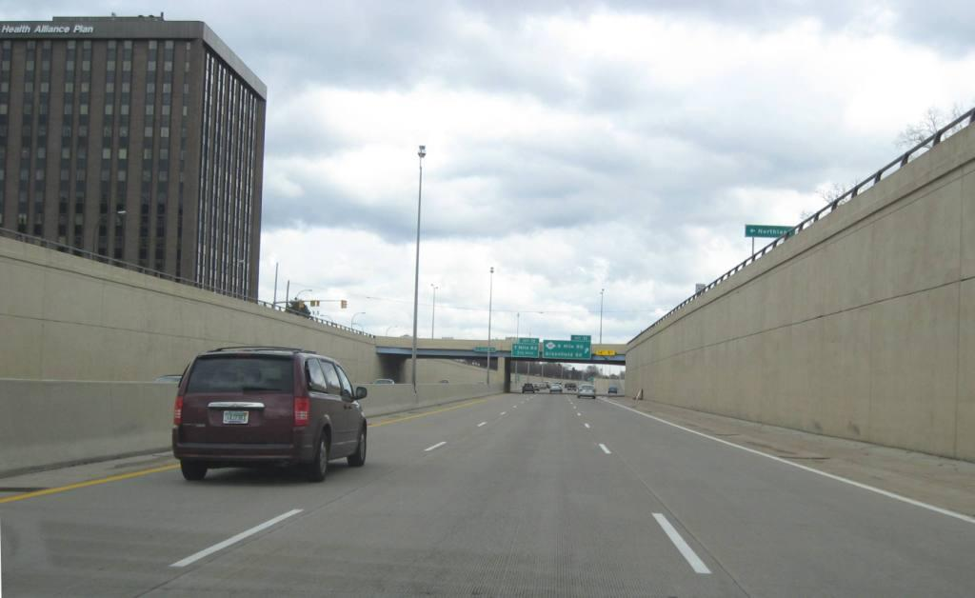
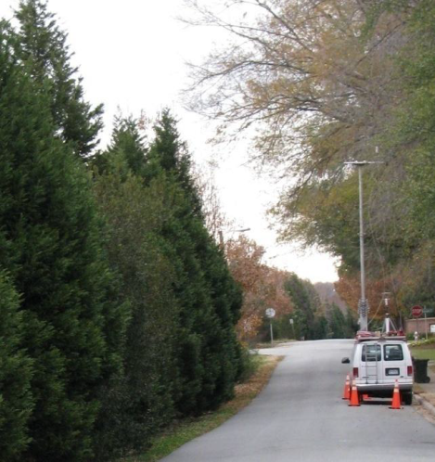
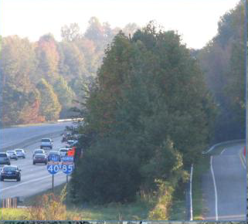
Ongoing Development Work
Field studies
Field and wind tunnel studies show noise barriers and depressions reduce downwind concentrations under multiple stability conditions. These features are being added to the flat terrain RLINE model.

Slide 15
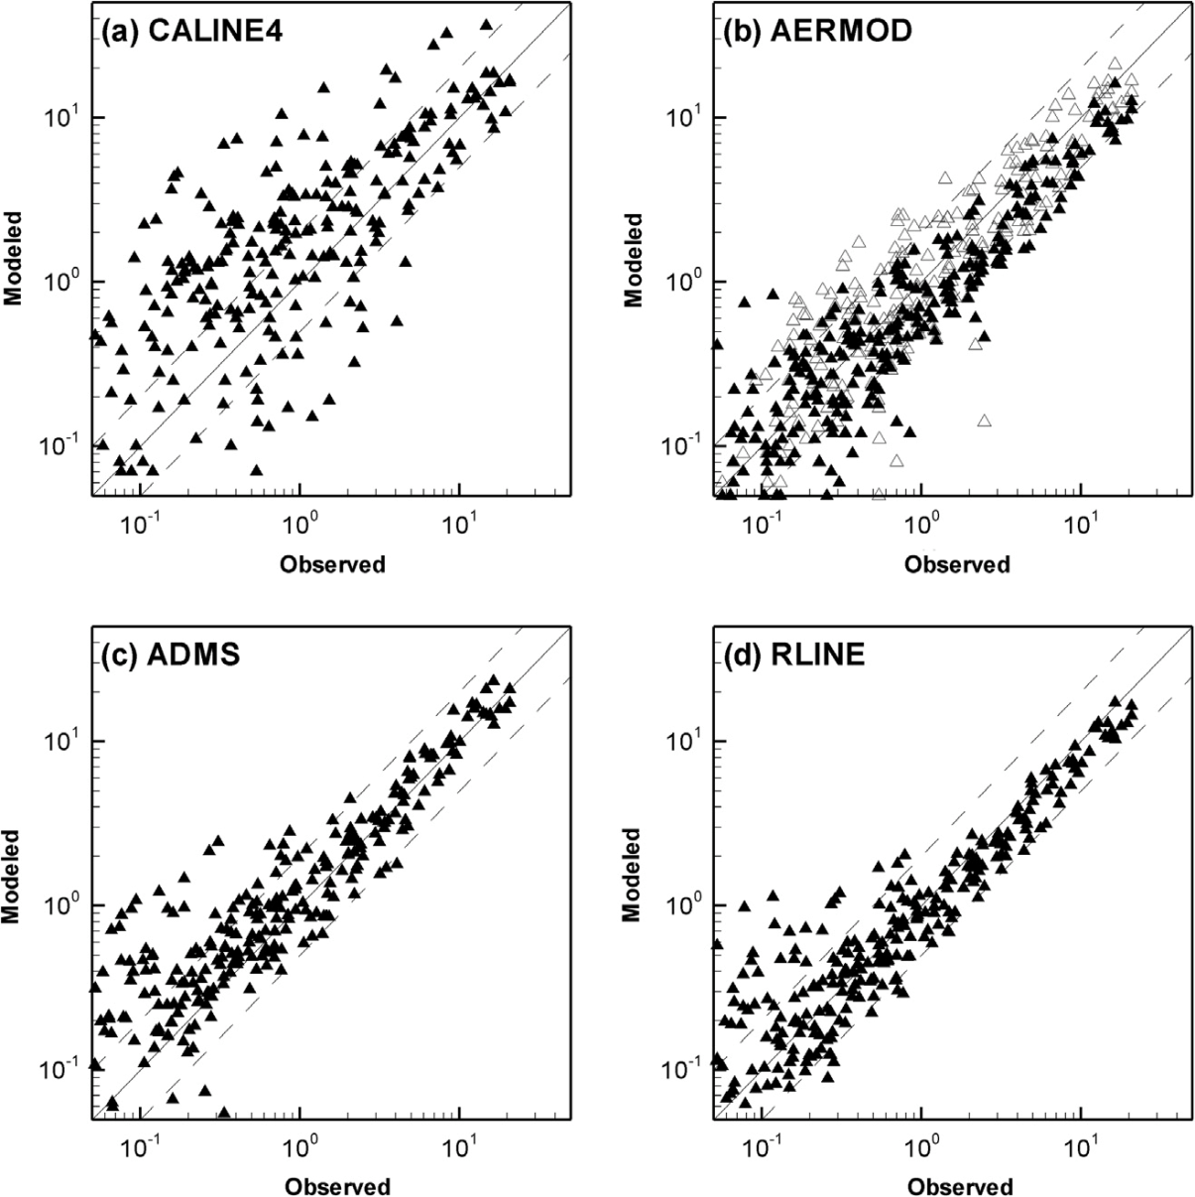
Inter-comparison against other models
  4 models applied for 2 Tracer Studies
    Idaho Falls 2008
    CalTrans Highway 99
  All models showed ability to estimate majority of observations within a factor of 2
  Models performed best for near-neutral conditions in both tracer studies
    Mixed results in convective and stable conditions
AERMOD-A
AERMOD-V
Heist et al, Trans. Res. D, 2013

Slide 16
Features in Release Version of RLINE
  Uses hourly meteorological data from AERMET v12345
    Similar to AERMOD applications
  Contains updated σ_{y} and σ_{z} formulations
    See Venkatram et al, 2013
  Can handle inputs in the form of activity (in AADT) or emissions (in g/m/s)
    AADT outputs can be post-processed with TAFs and species-specific emissions to obtain variable emissions
    Output in μg/m³
  Produces grouped source outputs
    Hourly (for entire simulation period or monthly)
    Daily average

Slide 17
Features Available as Beta Options
  Analytical solution for near-source receptors
    Speeds up computation
  Input # lanes per roadway
    Spreads emissions over the lanes of traffic
  Solid/noise barrier algorithm
  Depressed roadway algorithm

Slide 18
Where to get RLINE from?
  Summer 2013: Availability of pre-release version announced via Community Modeling & Analysis System (CMAS) website
  November 2013: Full public release expected via CMAS to include:
      Explanation of model code, use, and inputs required
      Documented evaluation and evaluation data
      Qualifications on appropriate use
  Spring/Summer 2014: Planned repository of tools and utilities for pre- and post-processing to support user community

Slide 19
Disclaimer: Although this work was reviewed by EPA and approved for publication, it may not necessarily reflect official Agency policy.

Slide 20
Backup Slides

Slide 21
Model Algorithm
New Dispersion Formulations
Vertical Dispersion
Venkatram et al, Atmos. Environ, 2013

Slide 22
Model Algorithm
New Dispersion Formulations
Lateral Dispersion
Prairie Grass
Venkatram et al, Atmos. Environ, 2013

Slide 23
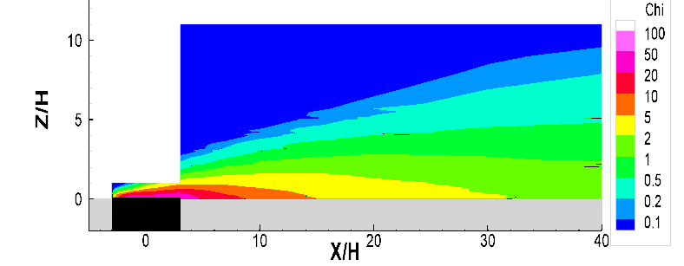
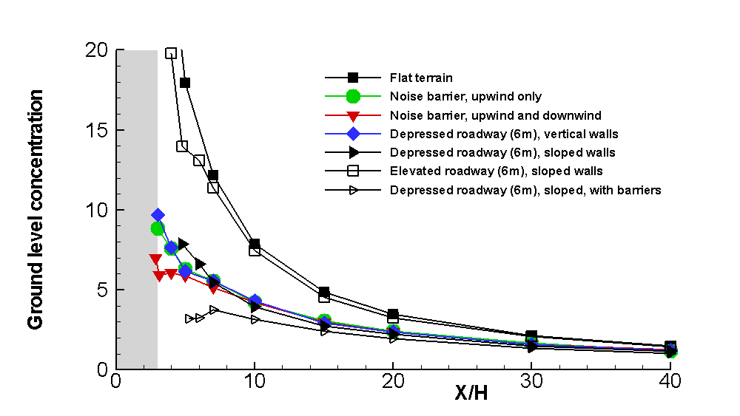
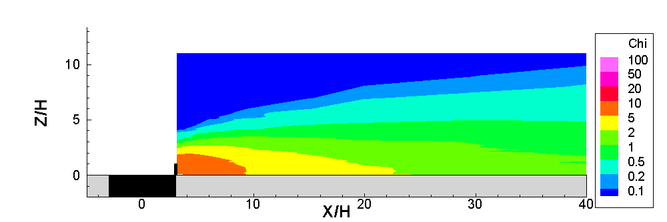
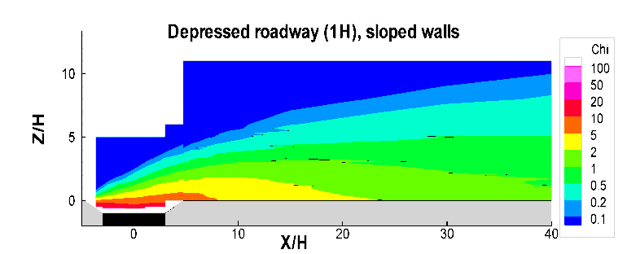
Ongoing Development Work
H = 6 m
Flat terrain
Wind tunnel studies
Downwind barrier
Depressed Roadway
Baldauf et al, 2009
Heist et al, Atmos. Environ, 2009

