Slide 1




CMAQ Validation of Optical Parameters and PM₁₀ Concentrations Based on LIDAR Experimental Campaign in the Metropolitan Area of Vitória - Brazil
12th CMAS Conference 2013, Chapel Hill - NC
Taciana T. de A. Albuquerque, Uma Shankar, Erick Nascimento, Fabio Lopes, Gregori Moreira, Renato Sartório, Nadir Salvador, Ayres Loriato, Alexandre Magalhães, Eduardo Landulfo, Gehard Held, Neyval C. Reis Jr., Davidson Moreira.
GROUPS INVOLVED:
Federal University of Espirito Santo (UFES), ES - Brazil.
UNC - Institute for the Environment, Chapel Hill - NC, USA.
Nuclear and Energy Research Institute (IPEN / USP), SP - Brazil.
Meteorological Research Institute (IPMet / UNESP), SP - Brazil.
IPEN/USP
Notes:
Good Afternoon everyone, My name is Taciana Albuquerque. I’m a Professor at the Federal University of Espirito Santo in Southeast Area of Brazil.
Today I am going to present

Slide 2
OUTLINE
Motivation
Area of Study
Experimental Campaing
Modelling Tools
Results
Summary

Slide 3
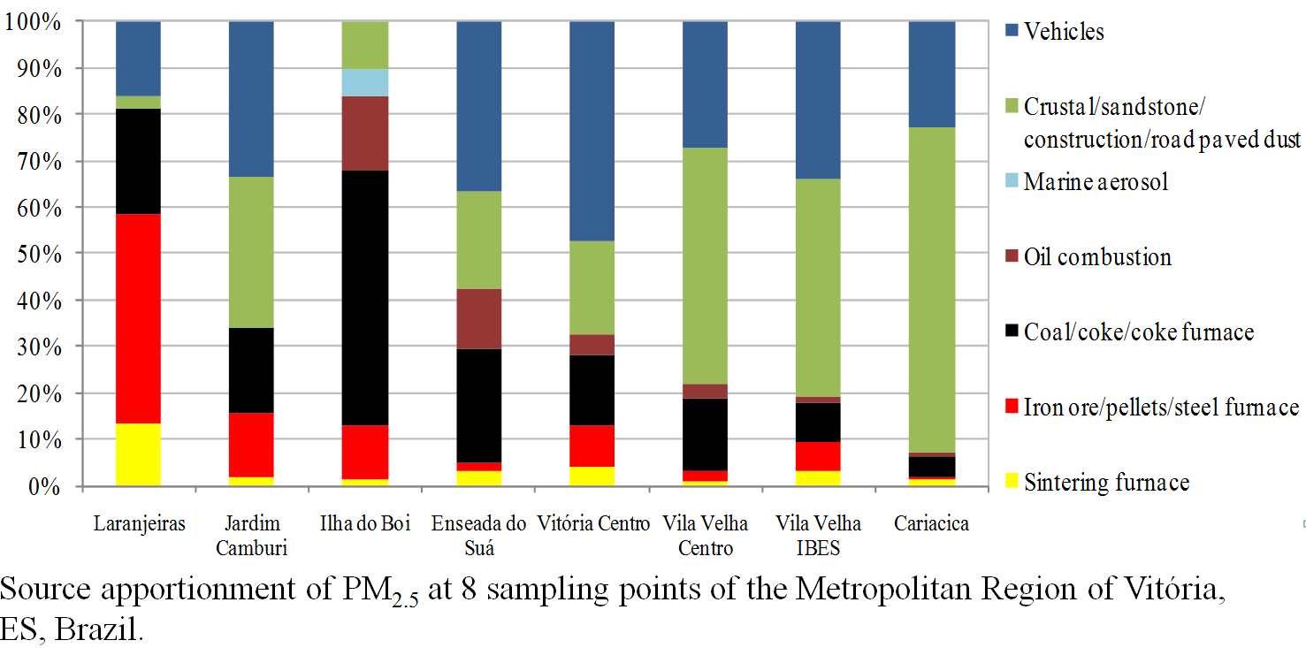
Motivation
The Metropolitan Area of Vitória has a complex diversity of air pollutants from different kind of sources

Slide 4
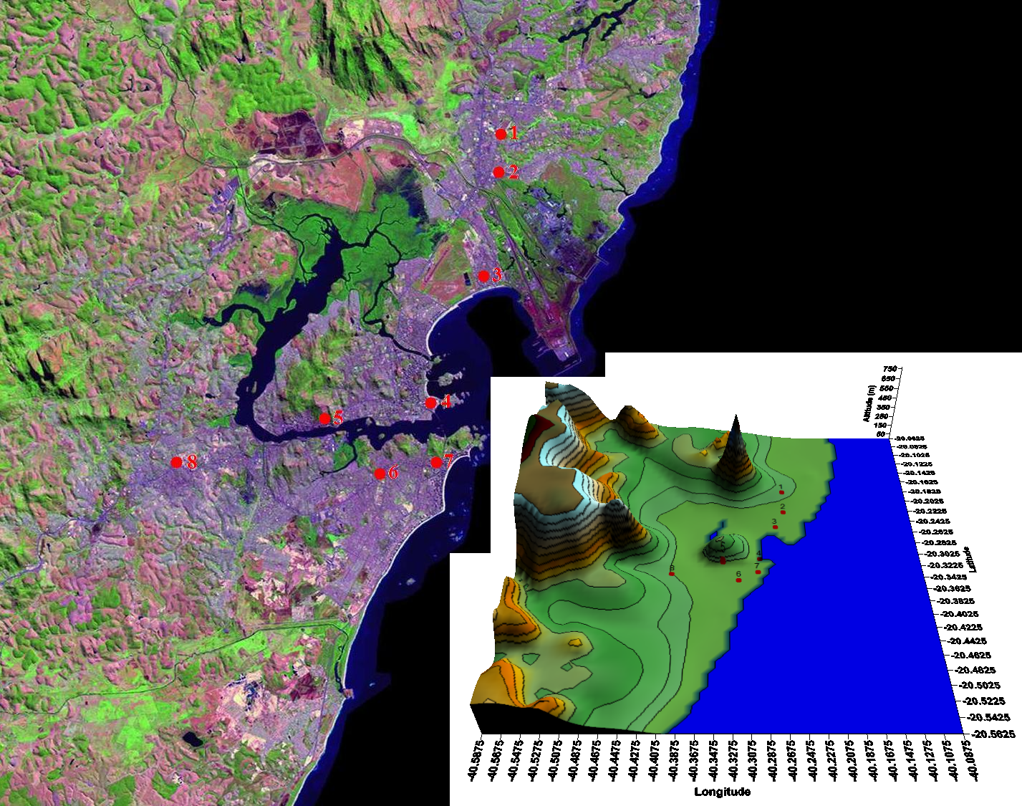
MOTIVATION
Complex topography and coastal interactions, the MAV provides a difficult test for Air Quality Models (AQMs).

Slide 5

Vitória Urban Area is influenced by a mix of Meteorological Conditions:
Local Circulations (Sea + Mountain Breeze) and
Synoptic Conditions (High Pressure and CF)
MOTIVATION

Slide 6
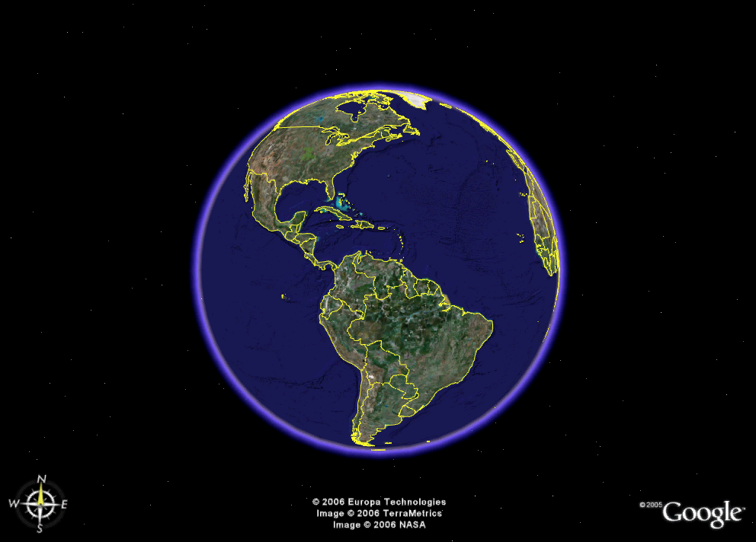
VITÓRIA

Slide 7
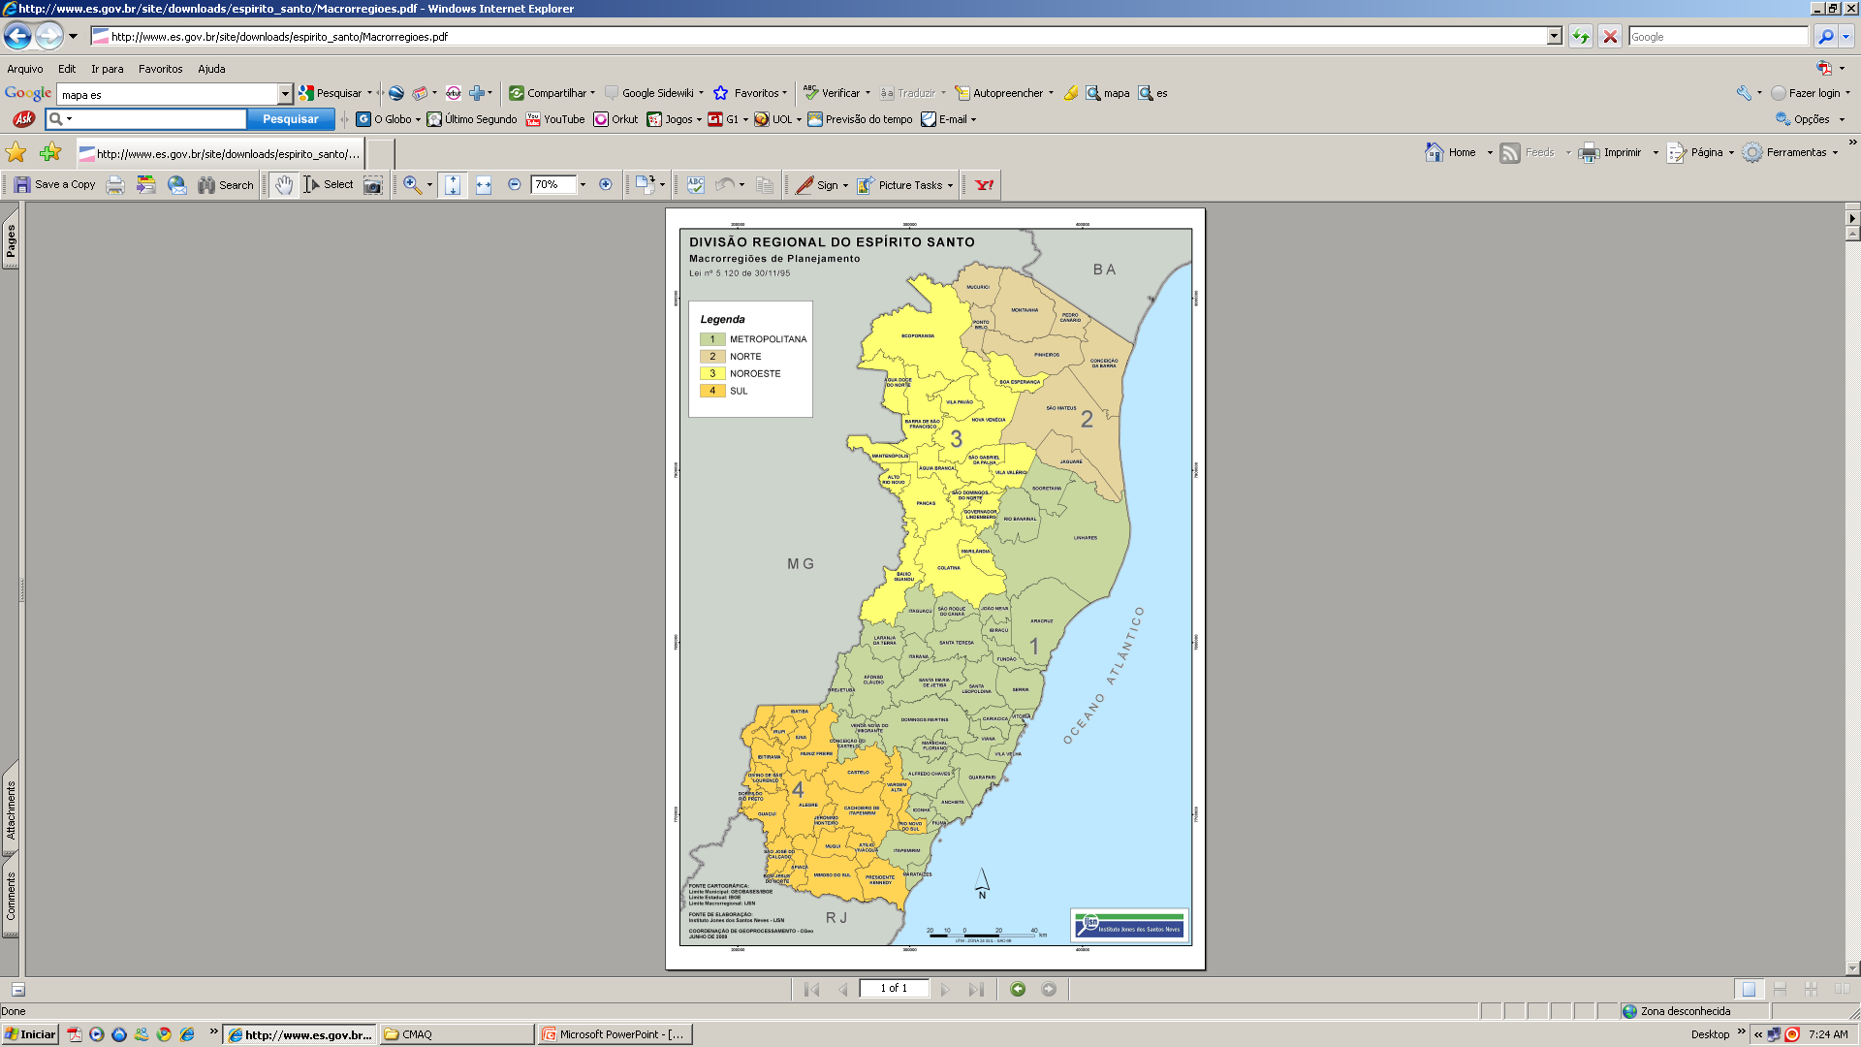
ESPIRITO SANTO STATE
Fonte : IJSN. (2012).

Slide 8
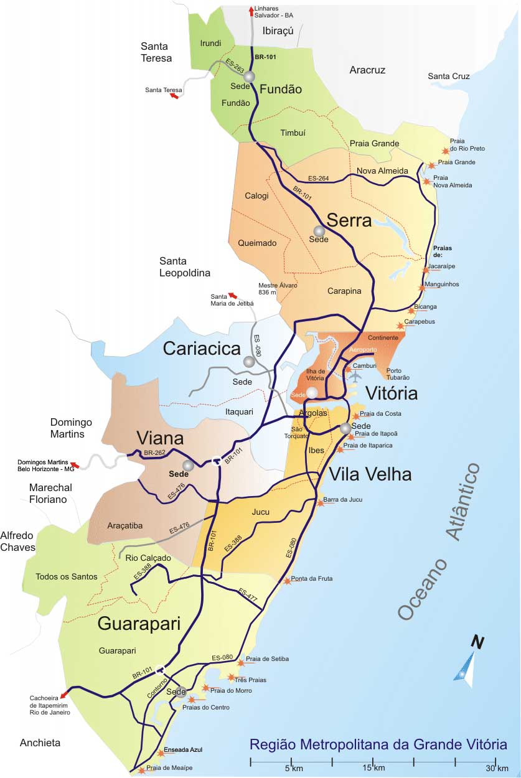
Area of Study
Municípios | área (km²) | Habitantes
Guarapari | 595 | 105.286
Serra | 554 | 409.267
Viana | 312 | 65.001
Fundão | 287 | 17.025
Cariacica | 274 | 348.738
Vila Velha | 212 | 414.586
Vitória | 99 | 327.801
RGV | 1451 | 1.565.393
RMGV | 2.333 | 1.687.704
Espírito Santo | 46.184,10 | 3.514.952
Industrial Sources in MAV - 50 to 65%
Around 50% of the population are in the MAV
Source: http://www.vitoria-es-brasil.com
Source: IEMA, 2008; IBGE, 2009; IJSN, 2012

Slide 9
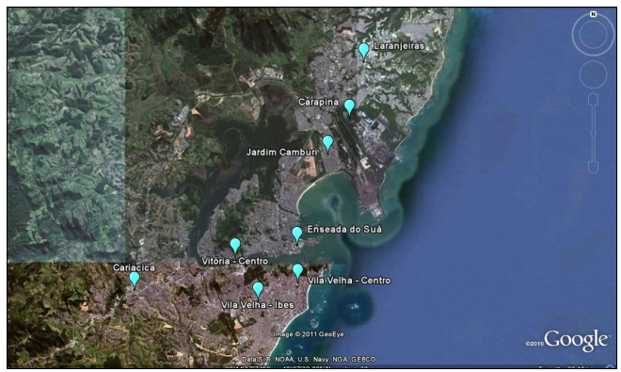
Metodologia
PTS PM₁₀ SO₂
CO
NO_{X} O₃
PTS, PM₁₀, SO₂, CO, NO_{X}, O₃, DD, VV, UR, PP, P, T e I
PTS, PM₁₀, SO₂, NO_{X} , DD e V V
PTS, PM₁₀, SO₂, CO, NO_{X}, HC, O₃ , DD e V V
PTS, PM₁₀, SO₂, CO, NO_{X}, HC
PM₁₀ e SO₂
PTS, PM₁₀, SO₂, CO, NO_{X}, HC, O₃, DV e V V
PTS, PM₁₀, SO₂, CO, NO_{X}, O₃ ,DD, V V e UR

Slide 10
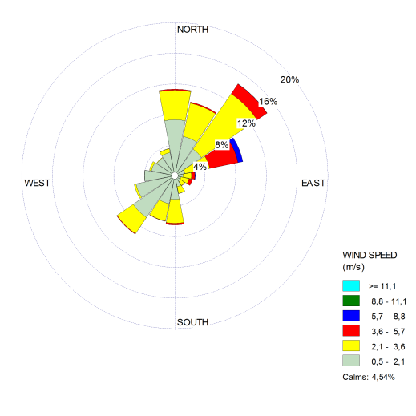
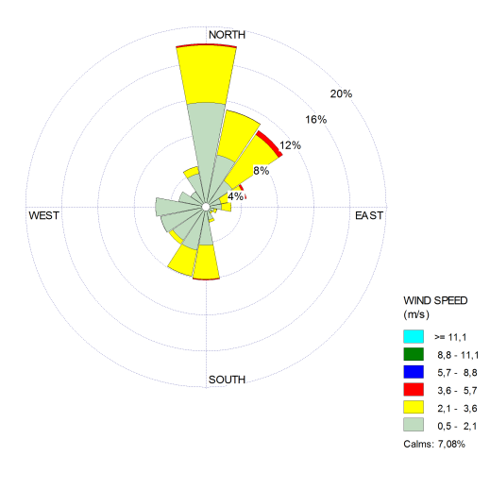
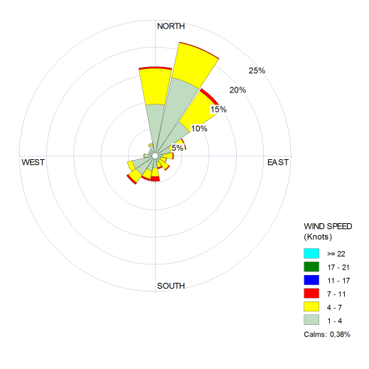
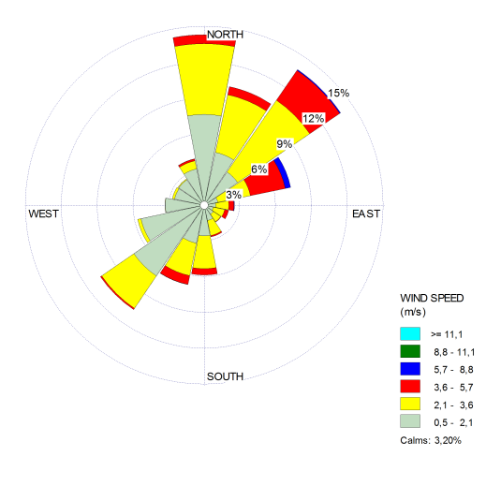

Slide 11
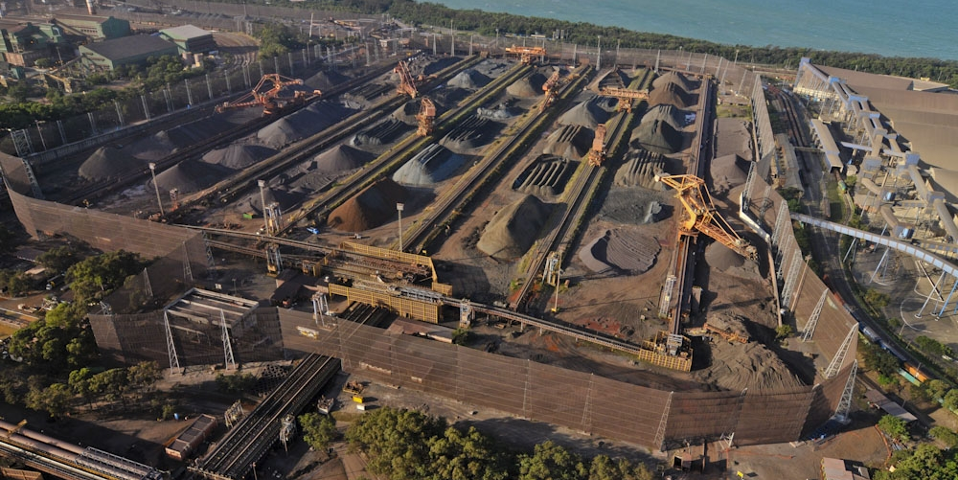
    Iron Pellets Stacks
Notes:
11

Slide 12
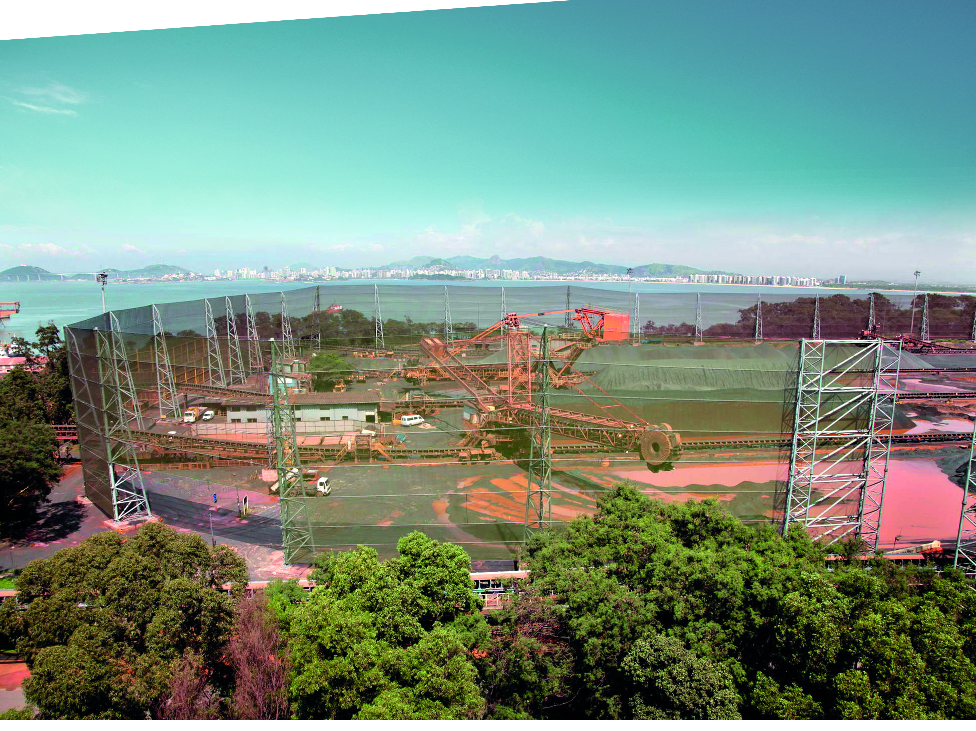
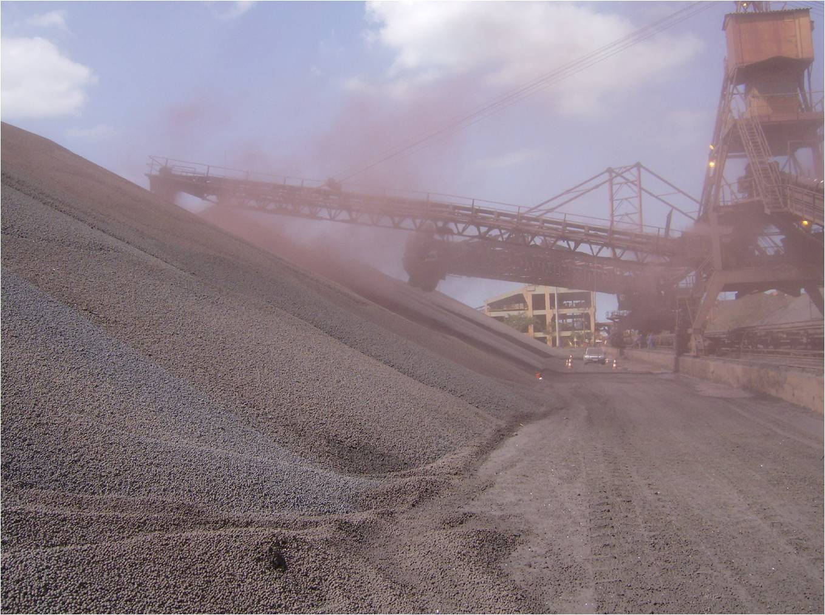
    Stokeyard
Notes:
12

Slide 13

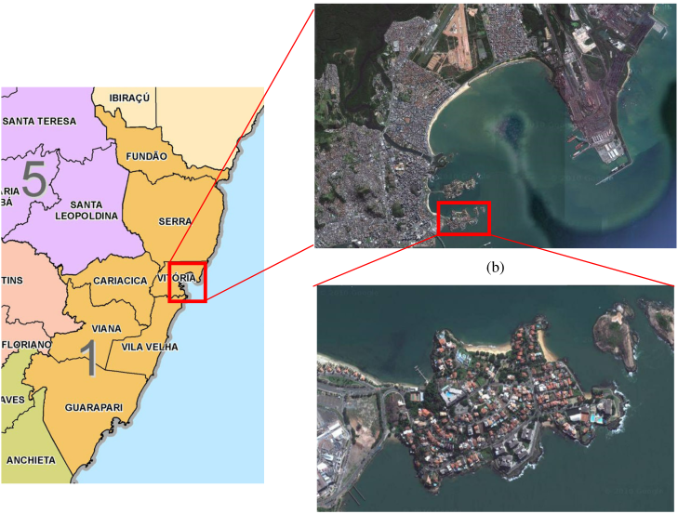
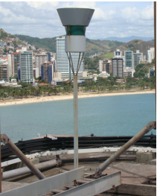
The dustfall problem
  Quantification and Qualification of Vitória’s Dustfall
  Ilha do Boi (Vitória)

Slide 14
Air Quality Monitoring Data
There is no Standard for PM2.5!!!

Slide 15
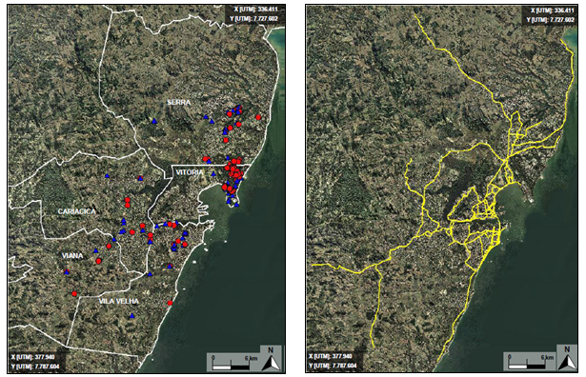
Official Inventory Emission Data
Source: IEMA (2011)

Slide 16
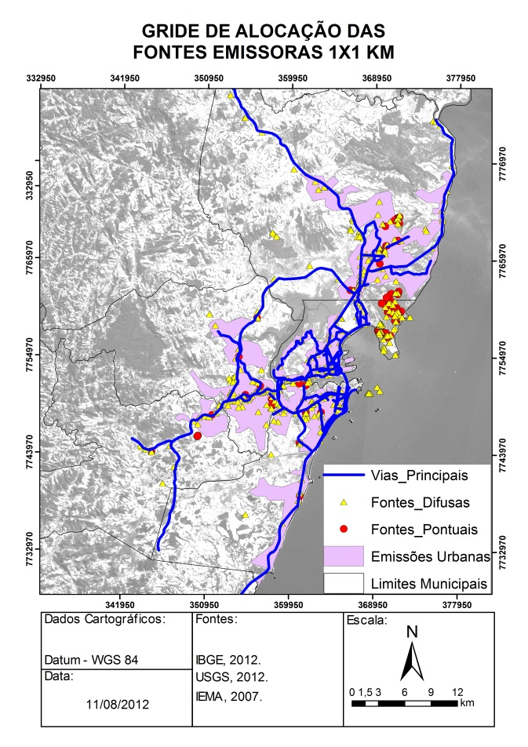
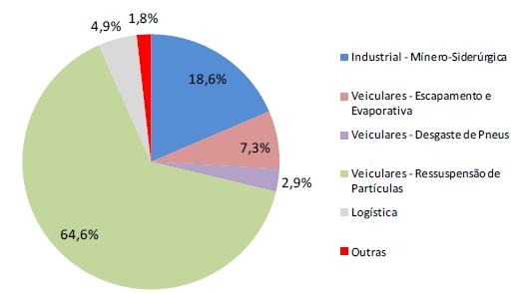
Official Inventory Emission Data
PERCENTUAL OF THE PM_{2.5} EMISSIONS
Source: IEMA (2011)

Slide 17
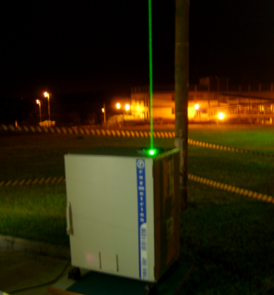
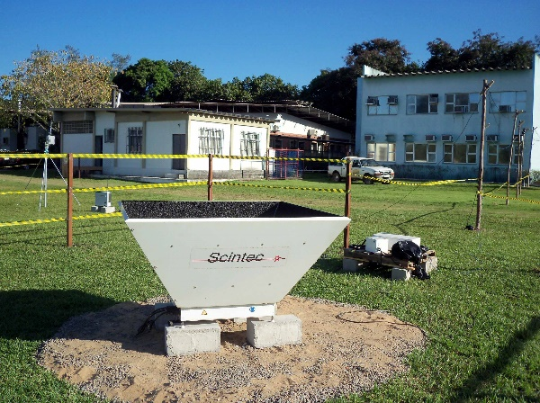
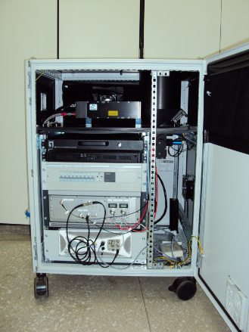
Lidar/Sodar Campaign Overview
The LIDAR: one week from 23-July until 30-July, 2012.
The SODAR: starting at 17:00 (local time) on 23-July continuously until 13:30 on 1-Aug except for an interruption on 24-July between 11:00-16:00.
LIDAR
SODAR

Slide 18
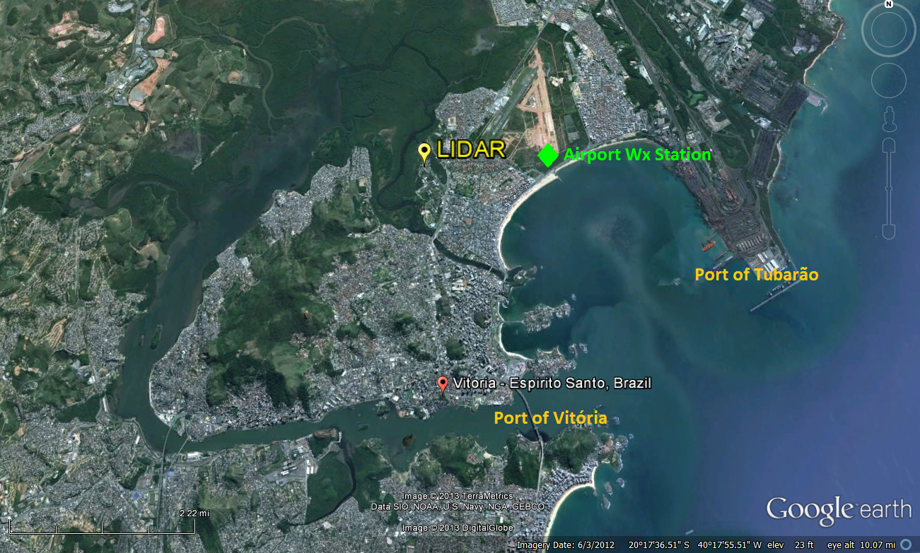
Lidar and Sodar Location
Vale do Rio Doce iron ore
Arcelor-Mittal Tubarão steel manufacturing plant
Notes:
The location of the SODAR and LIDAR are shown in Figure below on the Federal University of Espirito Santo (UFES) campus. Vitória, Brazil is the home of two of the largest shipping ports in Brazil: the Port of Vitória and the Port of Tubarão (also shown in Figure 1). The Port of Tubarão is owned by the company Vale and is most commonly used to export iron ore. Also located on the Port of Tubarão is the Arcelor-Mittal Tubarão steel manufacturing plant. The airport meteorological station location used for SODAR comparisons is directly east of the LIDAR and SODAR location.

Slide 19
Modelling Tools
Meteorological Model: Weather Research and Forecasting (WRF) version 3.2.1
- Input Data: GFS data (1˚× 1˚) and USGS – Global Land Cover
Air Quality Model: CMAQ version 4.6
Emissions: SMOKE version 2.7
WRF
CMAQ
Notes:
We used a couple modeling system for this modeling study.
WRF was used as meteorological model with GFS data.
CMAQ vr 4.6 was used as air quality model.
We made an Emission inventory for the MARJ as the emission input of our study.
These are the physical and chemical option that were used to run the WRF and CMAQ model respectively.

Slide 20
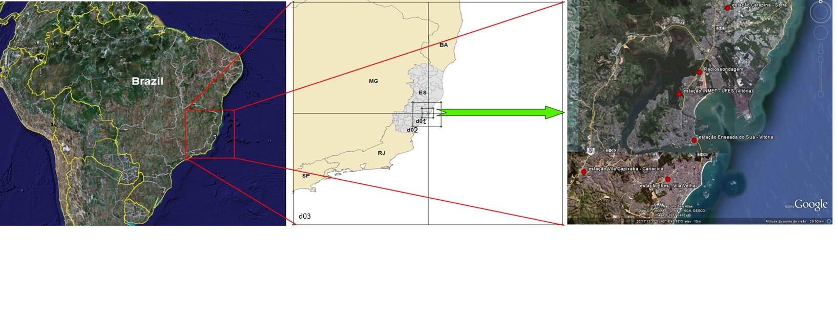
Simulations Descriptions
WRF Four nested domain: 27km (70 x 70 cells), 9km (100 x 100 cells), 3km (100 x 100 cells) and 1km (64 x 82 cells);
CMAQ: High Resolution 1-km
Simulated Period: 18 to 31 of July, 2012

Slide 21
RESULTS

Slide 22
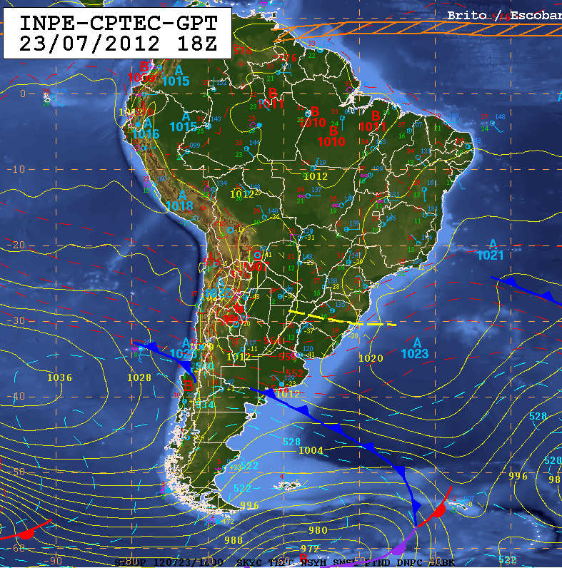
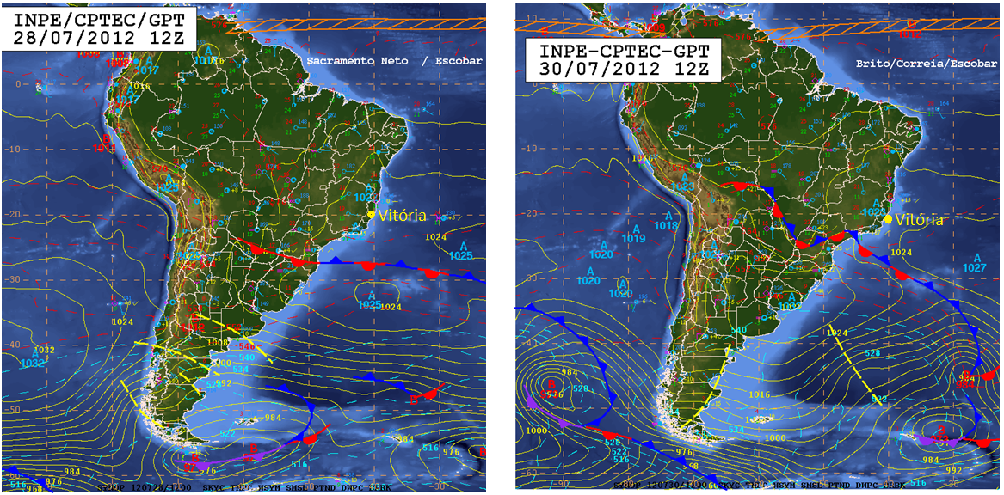
Synoptic Weather Conditions
Vitória
CF
HP
July 23, 2012
July 30, 2012
Notes:
Synoptic weather conditions throughout the campaign period were optimal for the development of the sea breeze circulation due to a persistent high pressure system

Slide 23
Monitoring Station: PM10 (μg/m³) x Wind Speed (m/s)
PM10
Cold Front
+ Rain
Wind Speed
Biomass Burning
Let’s focus on July 23, 2012.

Slide 24
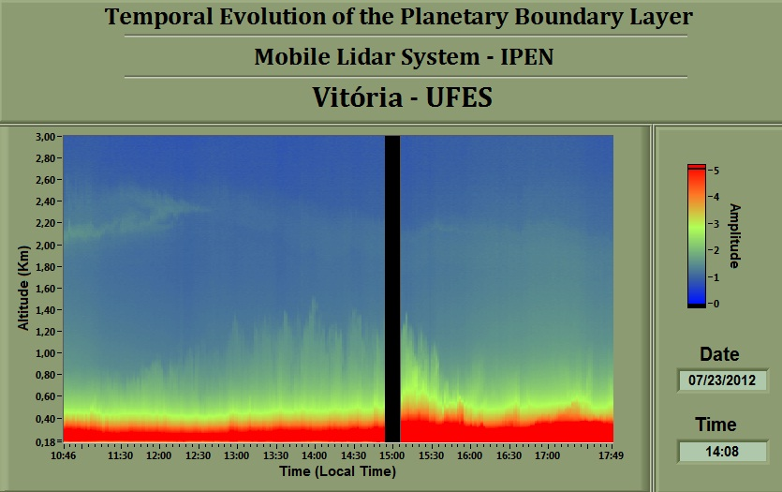
LIDAR RESULTS: day time

Slide 25
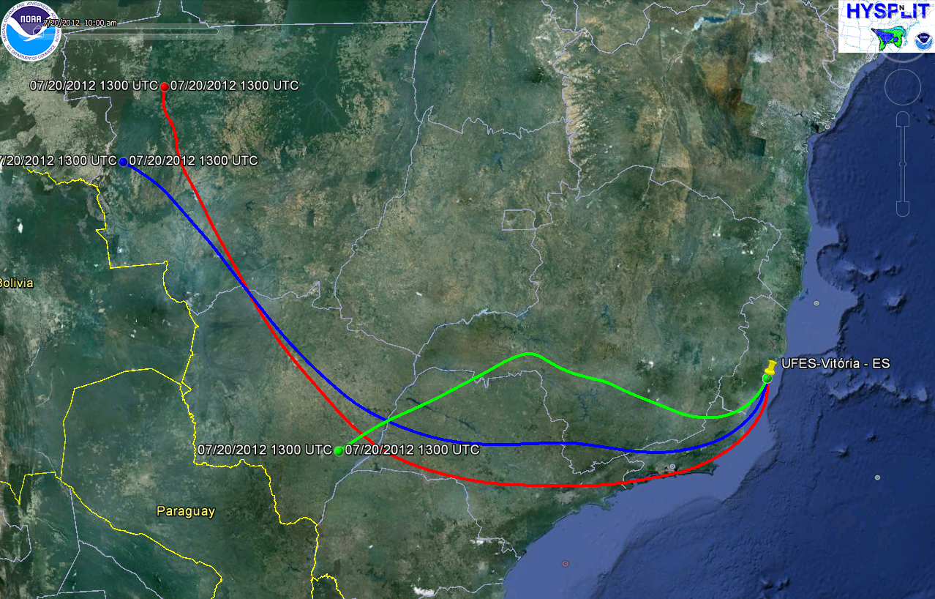
HYSPLIT backward trajectories – 72 hours Start: 23 July 2012 - 13 UTC
2000 m
2500 m
3000 m
Source ⇒ lat: -20.2715, long:-40.3056

Slide 26
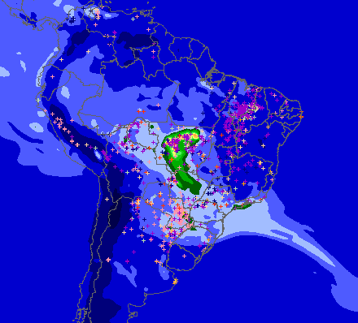
July 23, 2012 – SMOKE PLUME
Source: www.cptec.inpe.br/queimadas

Slide 27
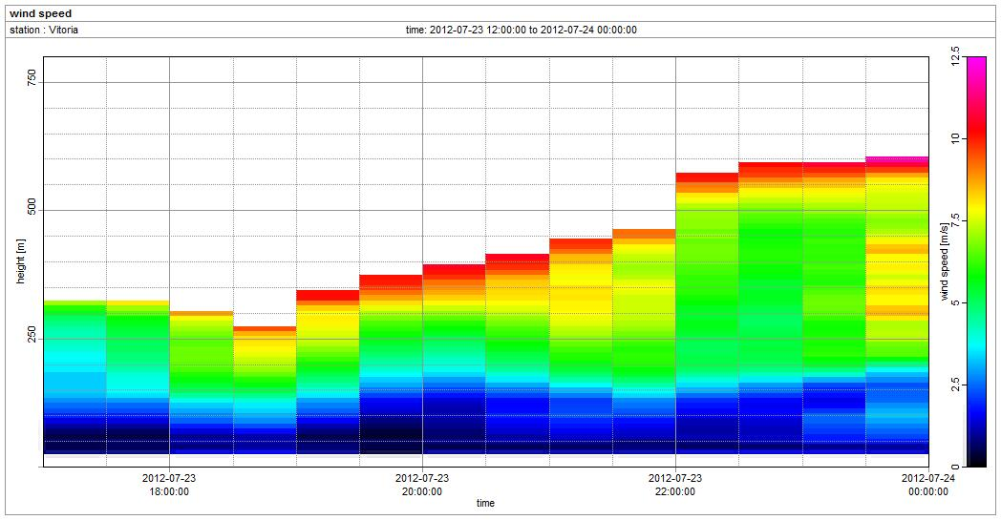
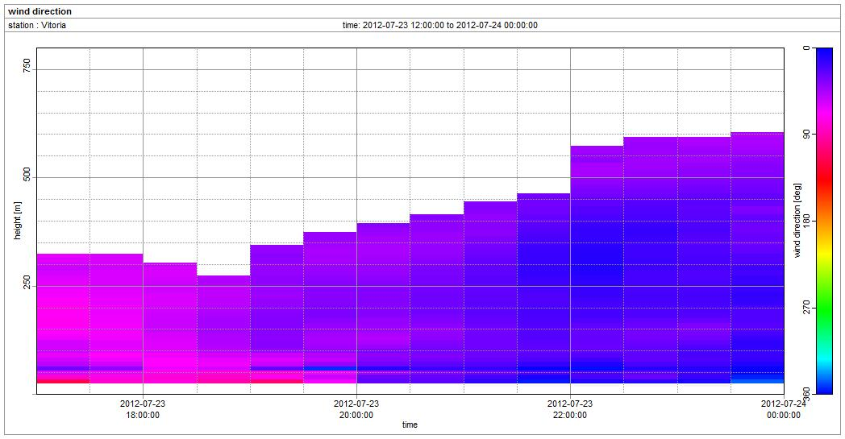
SODAR RESULTS
SODAR measured wind direction, wind speed, and w (vertical wind speed) beginning at 17:00.
Wind speed and w show very calm winds (<3 m/s) in the PBL (~200 m) - night time.
Sea Breeze

Slide 28
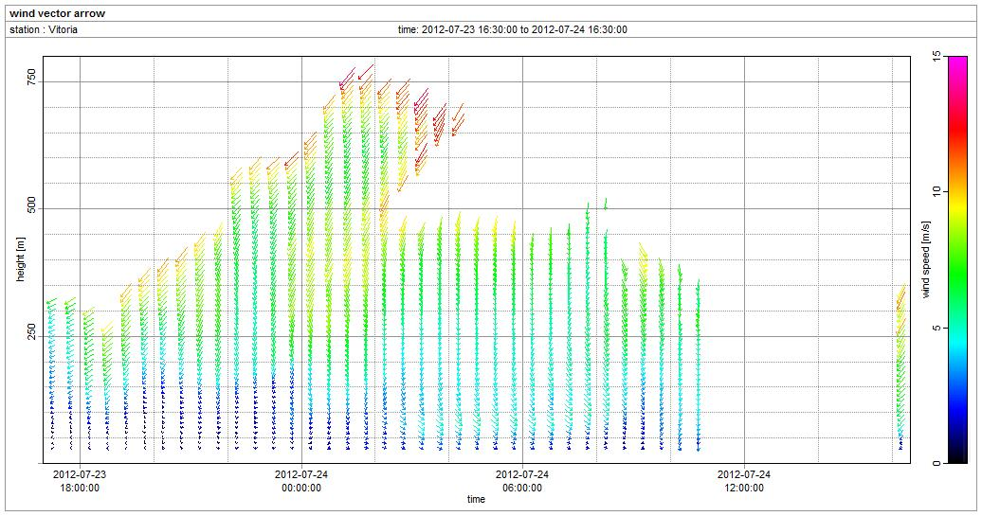
SODAR RESULTS
NW
N
NE

Slide 29
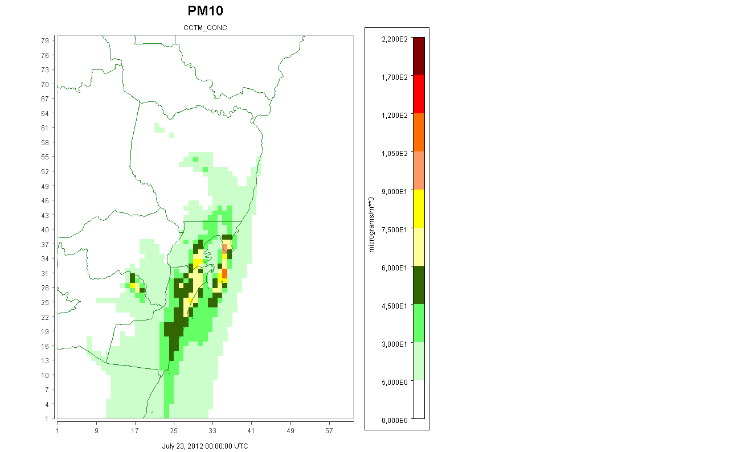
CMAQ PRELIMINARY RESULTS

Slide 30
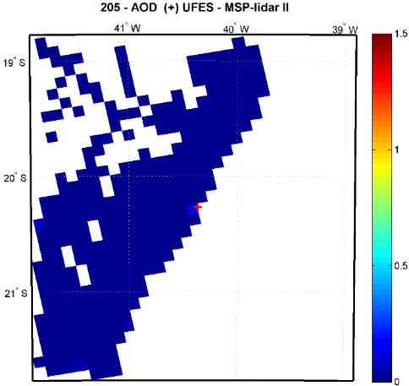
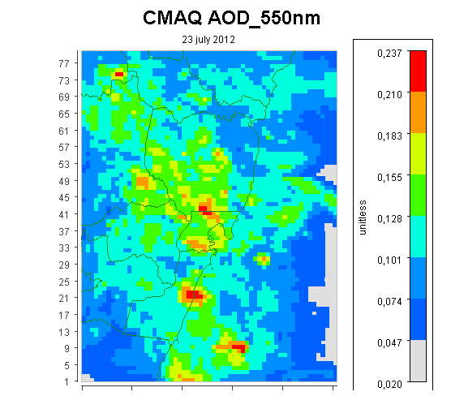
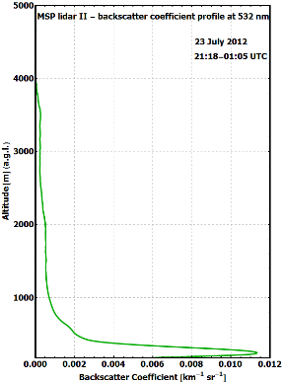
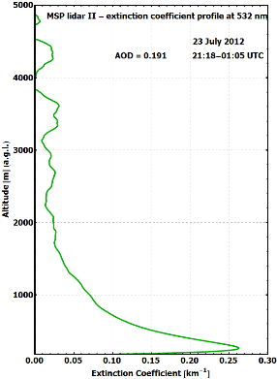
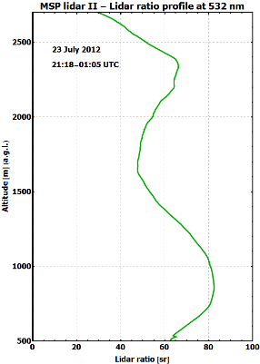
Validation of the CMAQ AOD
Preliminary Results (July 23, 2012)
TERRA satellite
Overpass time: 12:10 UTC
LIDAR Extinction, Backscatter and Lidar Ratio Profile Results
Development code from CMAS for AOD by Binkowski and Shankar (2012)
site coordinates:
Lat: -20.2715 Long: -40.3056
The AOD (integration of the extinction coefficient) = 0.191
AOD MODIS = 0.086
AOD CMAQ = 0.183
*These measurements was conducted using only the elastic channel (532 nm)
The AOD LIDAR was similar to CMAQ but it was much larger than the AOD measured by the MODIS radiometer
Notes:
The AOD value retrieved by MSP-lidar II system is much larger than the AOD measured by the MODIS radiometer
AOD modis = 0.086
AOD lidar = 0.191
The AOD retrieved by CALIPSO agreeds with AOD from MODIS radiometer, however, it is much lower than that measured by the MSP-Lidar II.
AOD CALIPSO = 0.081 ± 0.036
AOD modis = 0.086 ± 0.005
AOD lidar = 0.191 ± 0.009
AOD CMAQ = 0,18
Possible causes for the AOD differences:
1 – The MODIS radiometer couldn’t detected with accuracy all the aerosol layers detected by the MSP-lidar II system
2 – MSP-lidar II detected local aerosol layers that was not detected by MODIS radiometer

Slide 31
Summary
The results of the instrument campaign show a regular occurrence of the sea breeze circulation during high pressure synoptic conditions with light synoptic winds and clear skies;
High PM10 concentrations were found mainly in the first days of the campaign because of the weather conditions;
In July 23 was observed by LIDAR a plume over the MAV around 2km in altitude. The HYSPLIT model results show a backward trajectory from the central area of Brazil indicating that it is arriving in Vitória region.

Slide 32
Thank you for your attention!

