Slide 1
INFLUENCE OF MODEL GRID RESOLUTION ON NO₂ VERTICAL COLUMN DENSITIES OVER EAST ASIA
the 11th Annual CMAS Conference, Chapel Hill, NC, October 15-17, 2012
October 16, 2:40 PM, Grumman Auditorium (Model Evaluation and Analysis)
Kazuyo Yamaji
Japan Agency for Marine-Earth Science and Technology, Yokohama, Japan
(kazuyo@jamstec.go.jp)
Hitoshi Irie (satellite)
Chiba University, Chiba, Japan
Jun-ichi Kurokawa (emission)
Asia Center for Air Pollution Research, Niigata, Japan
Toshimasa Ohara (emission)
National Institute for Environmental Studies, Tsukuba, Japan
ACKNOWLEDGEMENTS the global environment research fund (S-7) of the ministry of the environment
the support program for young and women researchers of University of Tokyo

Slide 2
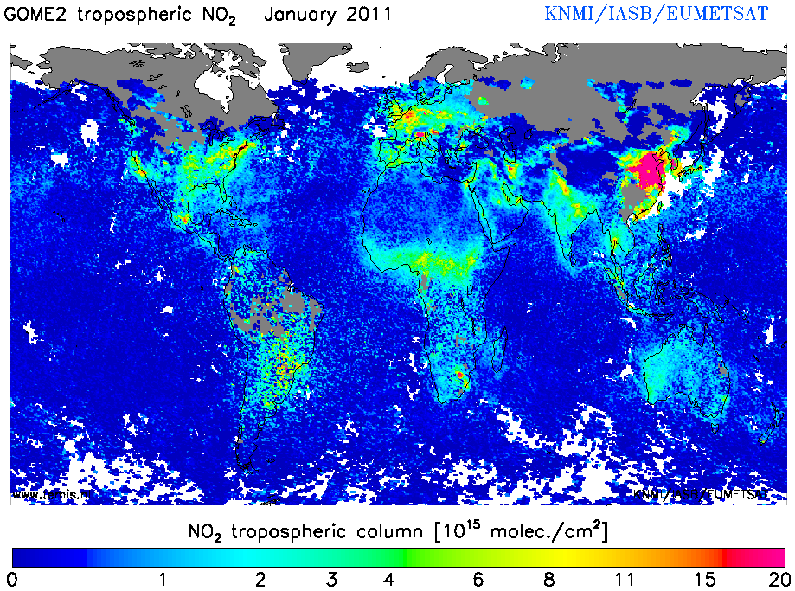
motivation
CEC
East Asia, especially central eastern China(CEC), has largest emissions.
Simulated NO₂ VCDs
(vertical column densities) were underestimated over CEC.
e.g. by RAMS/CMAQv4.4 +REASv1.0 (Uno et al., 2007), multi-model ensemble simulations (van Noiji et al., 2006)
These problems were caused by emissions?, retrievals?, or both? BUT the reasons have been still unclear
CTM’s horizontal grid resolutions may affect on simulated NO₂ VCDs.
Finer resolutions made larger NO₂ VCDs over large source regions (e.g. Wild et al., 2006; Valin et al., 2011) .
In this study, we investigated influence of horizontal grid resolutions in the model system using, WRF-CMAQv4.7.1-updated REAS*, on NO₂ VCDs over East Asia
*REAS: Regional emission inventory in Asia developed at Japan (Ohara et al., 2007)

Slide 3
model system (WRF-CMAQ-updated REAS)
Meteorology
WRF ver.3.3.1 with NCEP ds083.2 for the year 2007
[setup]Thompson(microphysics),ACM2(PBL physics),RRTM(longwave), Dudhia(shortwave)
Chemistry
CMAQ ver.4.7.1
[setup] PPM (advection),ACM2_inline(vertical diffusion), SAPRC99 (gas), AERO5 (aerosol )
Emissions
updated REAS (monthly) with 0.25° horizontal resolution for 2007 (anthropogenic),
RETRO (biomass burning), MEGANv2 (biogenic emissions)
Boundary conditions
outputs from global model (CHASER) for the outer domain
outputs from the outer domains (nested) for the inner domains
Vertical resolution
37 layers, top=50hPa, the first mid-layer height=20 m

Slide 4
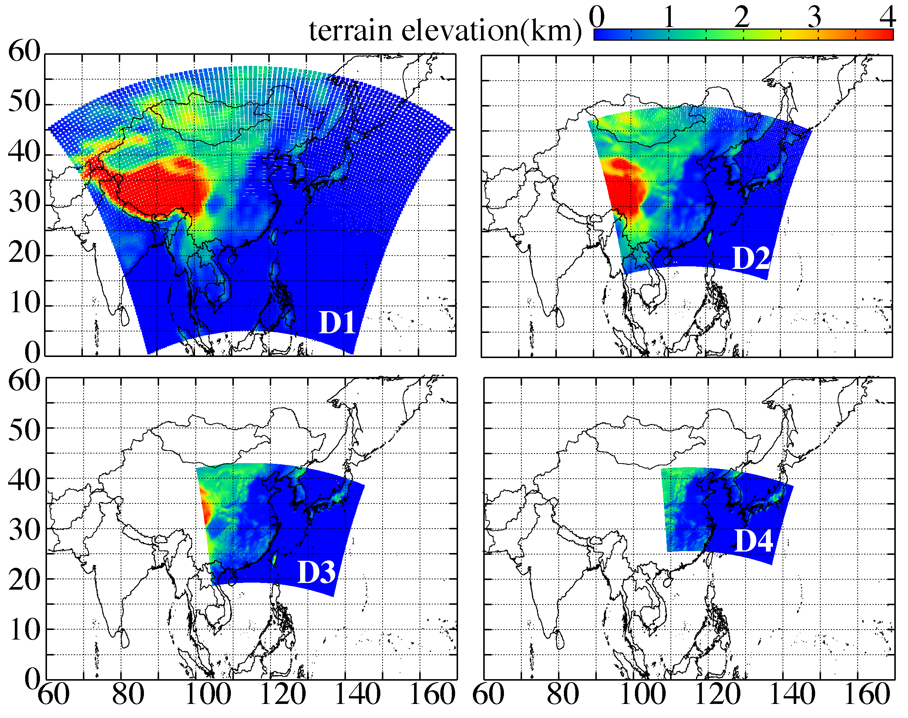
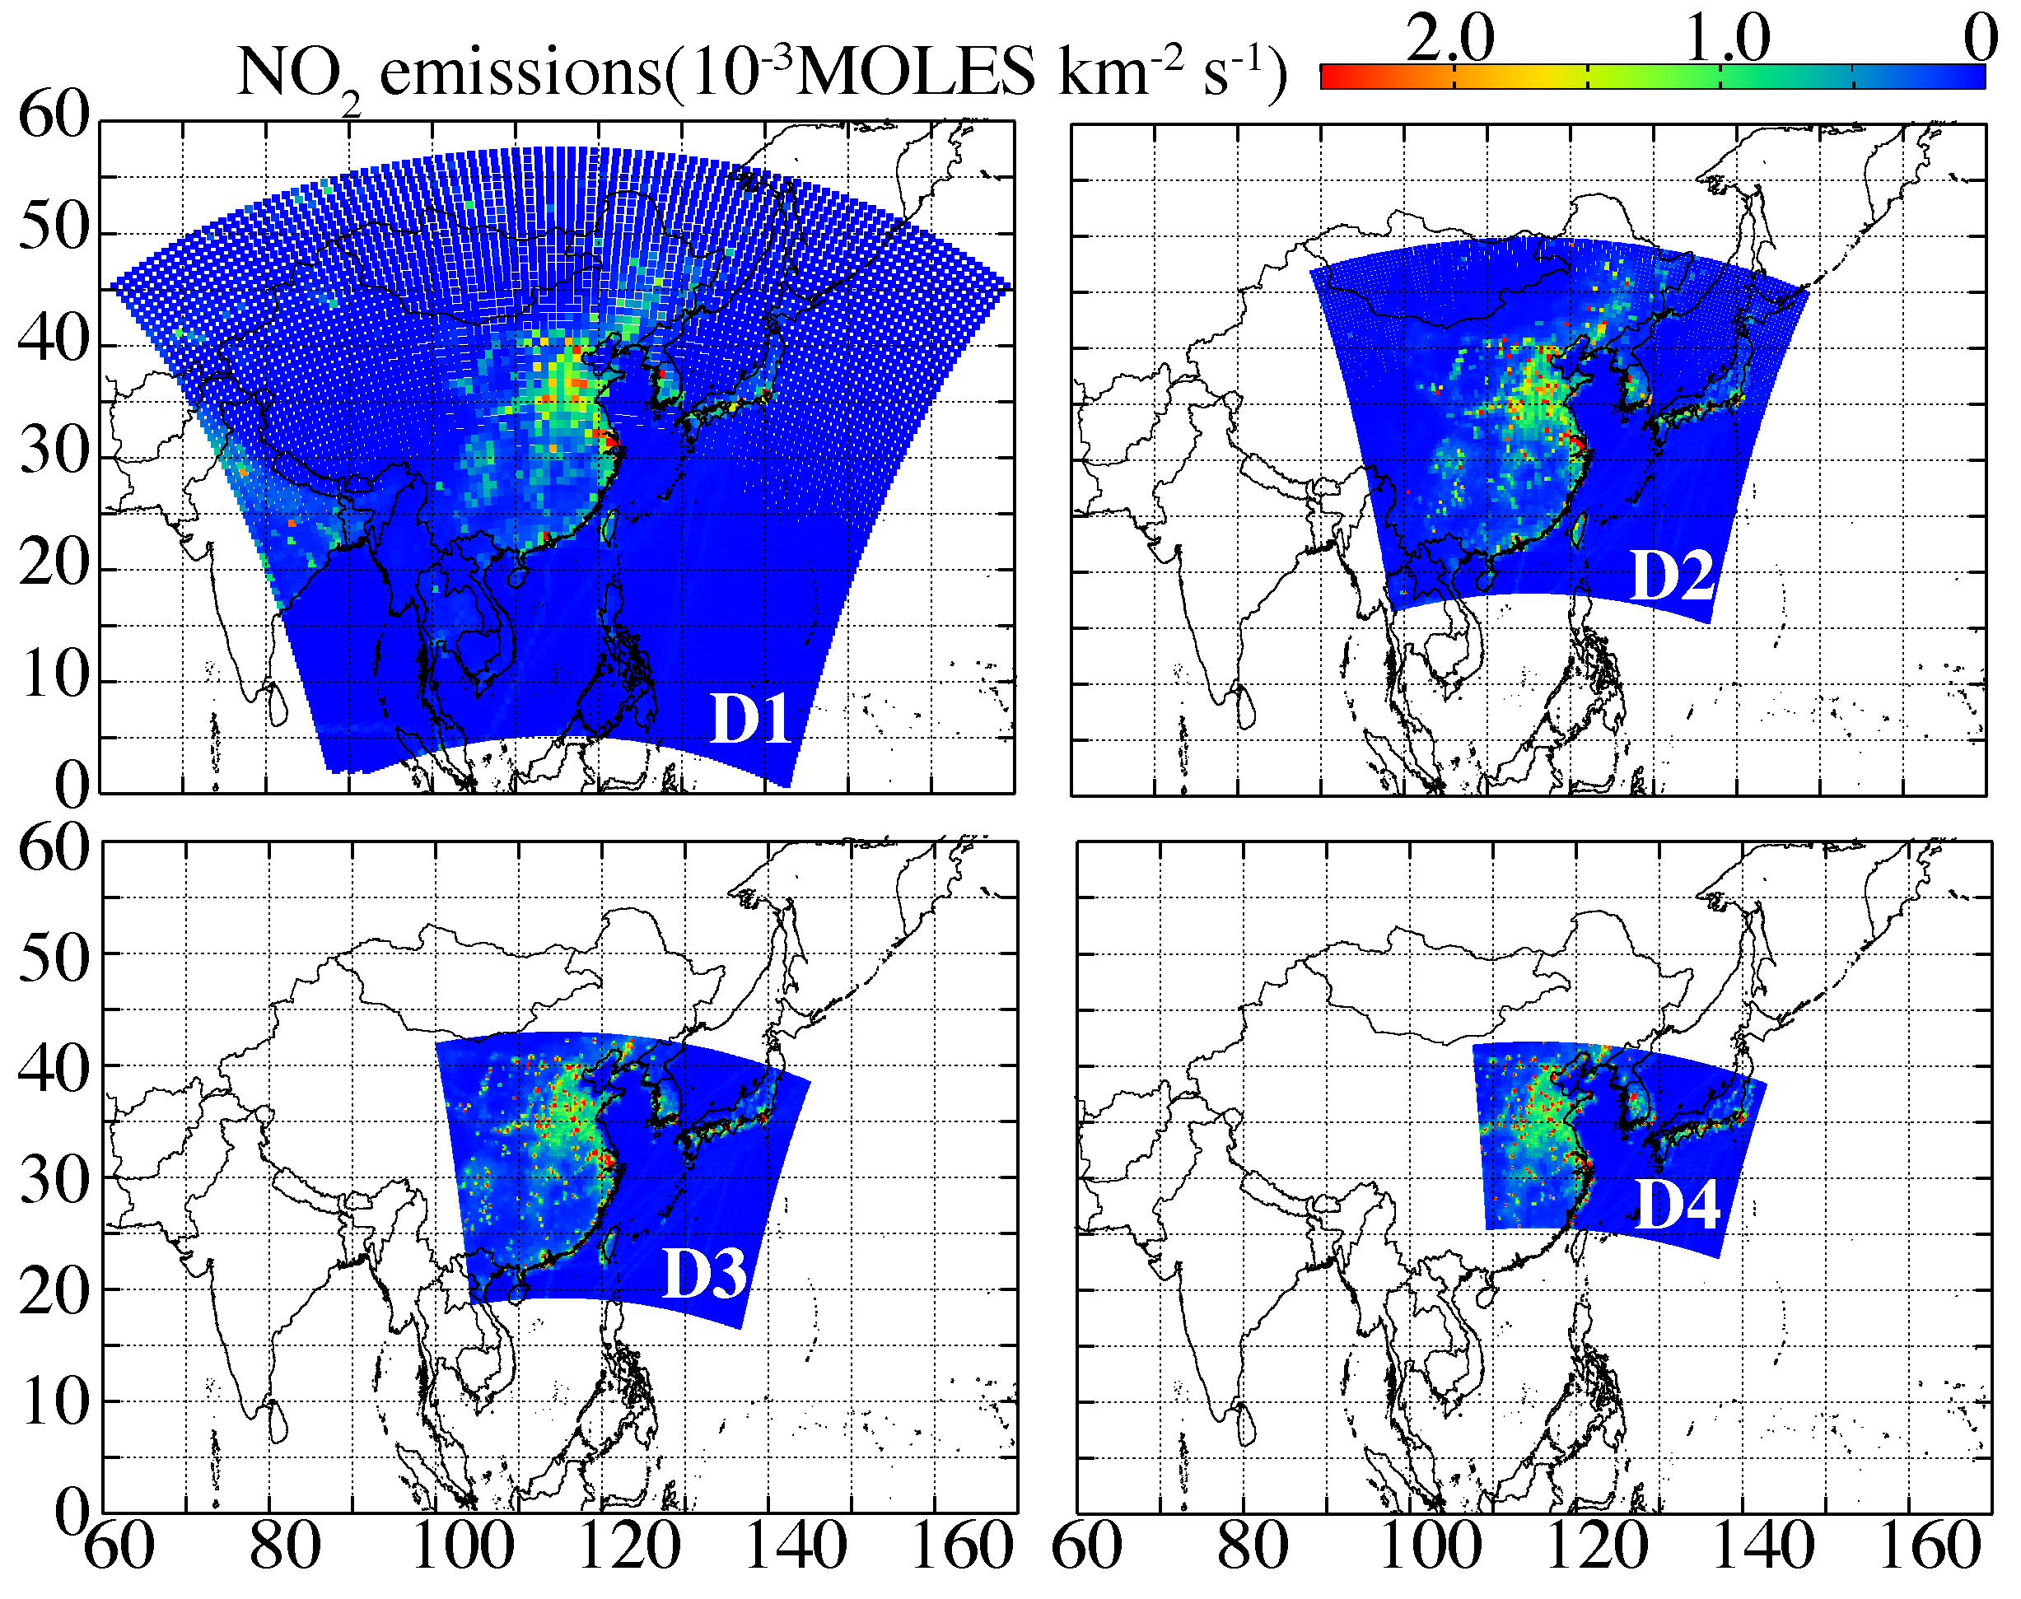
model system (emissions and grids information)
terrain elevations
NO₂ emissions in June 2007
 | Domain 1, D1 | Domain 2, D2 | Domain 3, D3 | Domain 4, D4
horizontal resolutions | 80km | 40km | 20km | 10km
grid numbers | 95 × 75 | 110 × 88 | 184 × 132 | 292 × 182
NO₂ emissions over CEC | 1.1 kmoles s⁻¹ | 1.1 kmoles s⁻¹ | 1.1 kmoles s⁻¹ | 1.1 kmoles s⁻¹

Slide 5
for comparisons with satellite NO₂ VCDs
GOME-2 passing over the equator at 9:30 LT
SCIAMACHY at 10:00 LT
OMI at 13:45 LT
*These retrievals using with the same basic algorithm (DOMINO products for OMI and TM4NO2A products for SCIAMACHY and GOME-2) (Irie et al., 2012)
in this study, CMAQ NO₂ VCDs
at 9:00 CST (Chinese Standard Time)
at 10:00 CST
at 14:00 CST
was used, respectively.

Slide 6
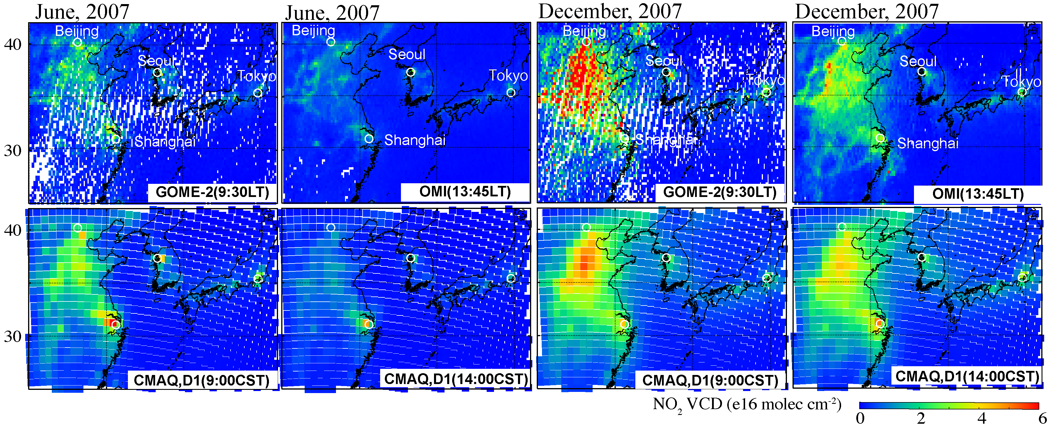
Results CMAQ (D1,80km) vs. GOME-2 and OMI
JUN, morning
JUN, afternoon
DEC, morning
DEC, afternoon
These maps compare monthly averaged NO₂ VCDs from CMAQ(D1) and satellites.
CMAQv4.7.1 with updated REAS can capture well satellite NO₂ VCDs even at D1
CMAQ overestimates over Shanghai area
In December, CMAQ underestimates over large emission areas
On the other hand, CMAQ NO₂ VCDs are higher over clear area, e.g. over sea

Slide 7
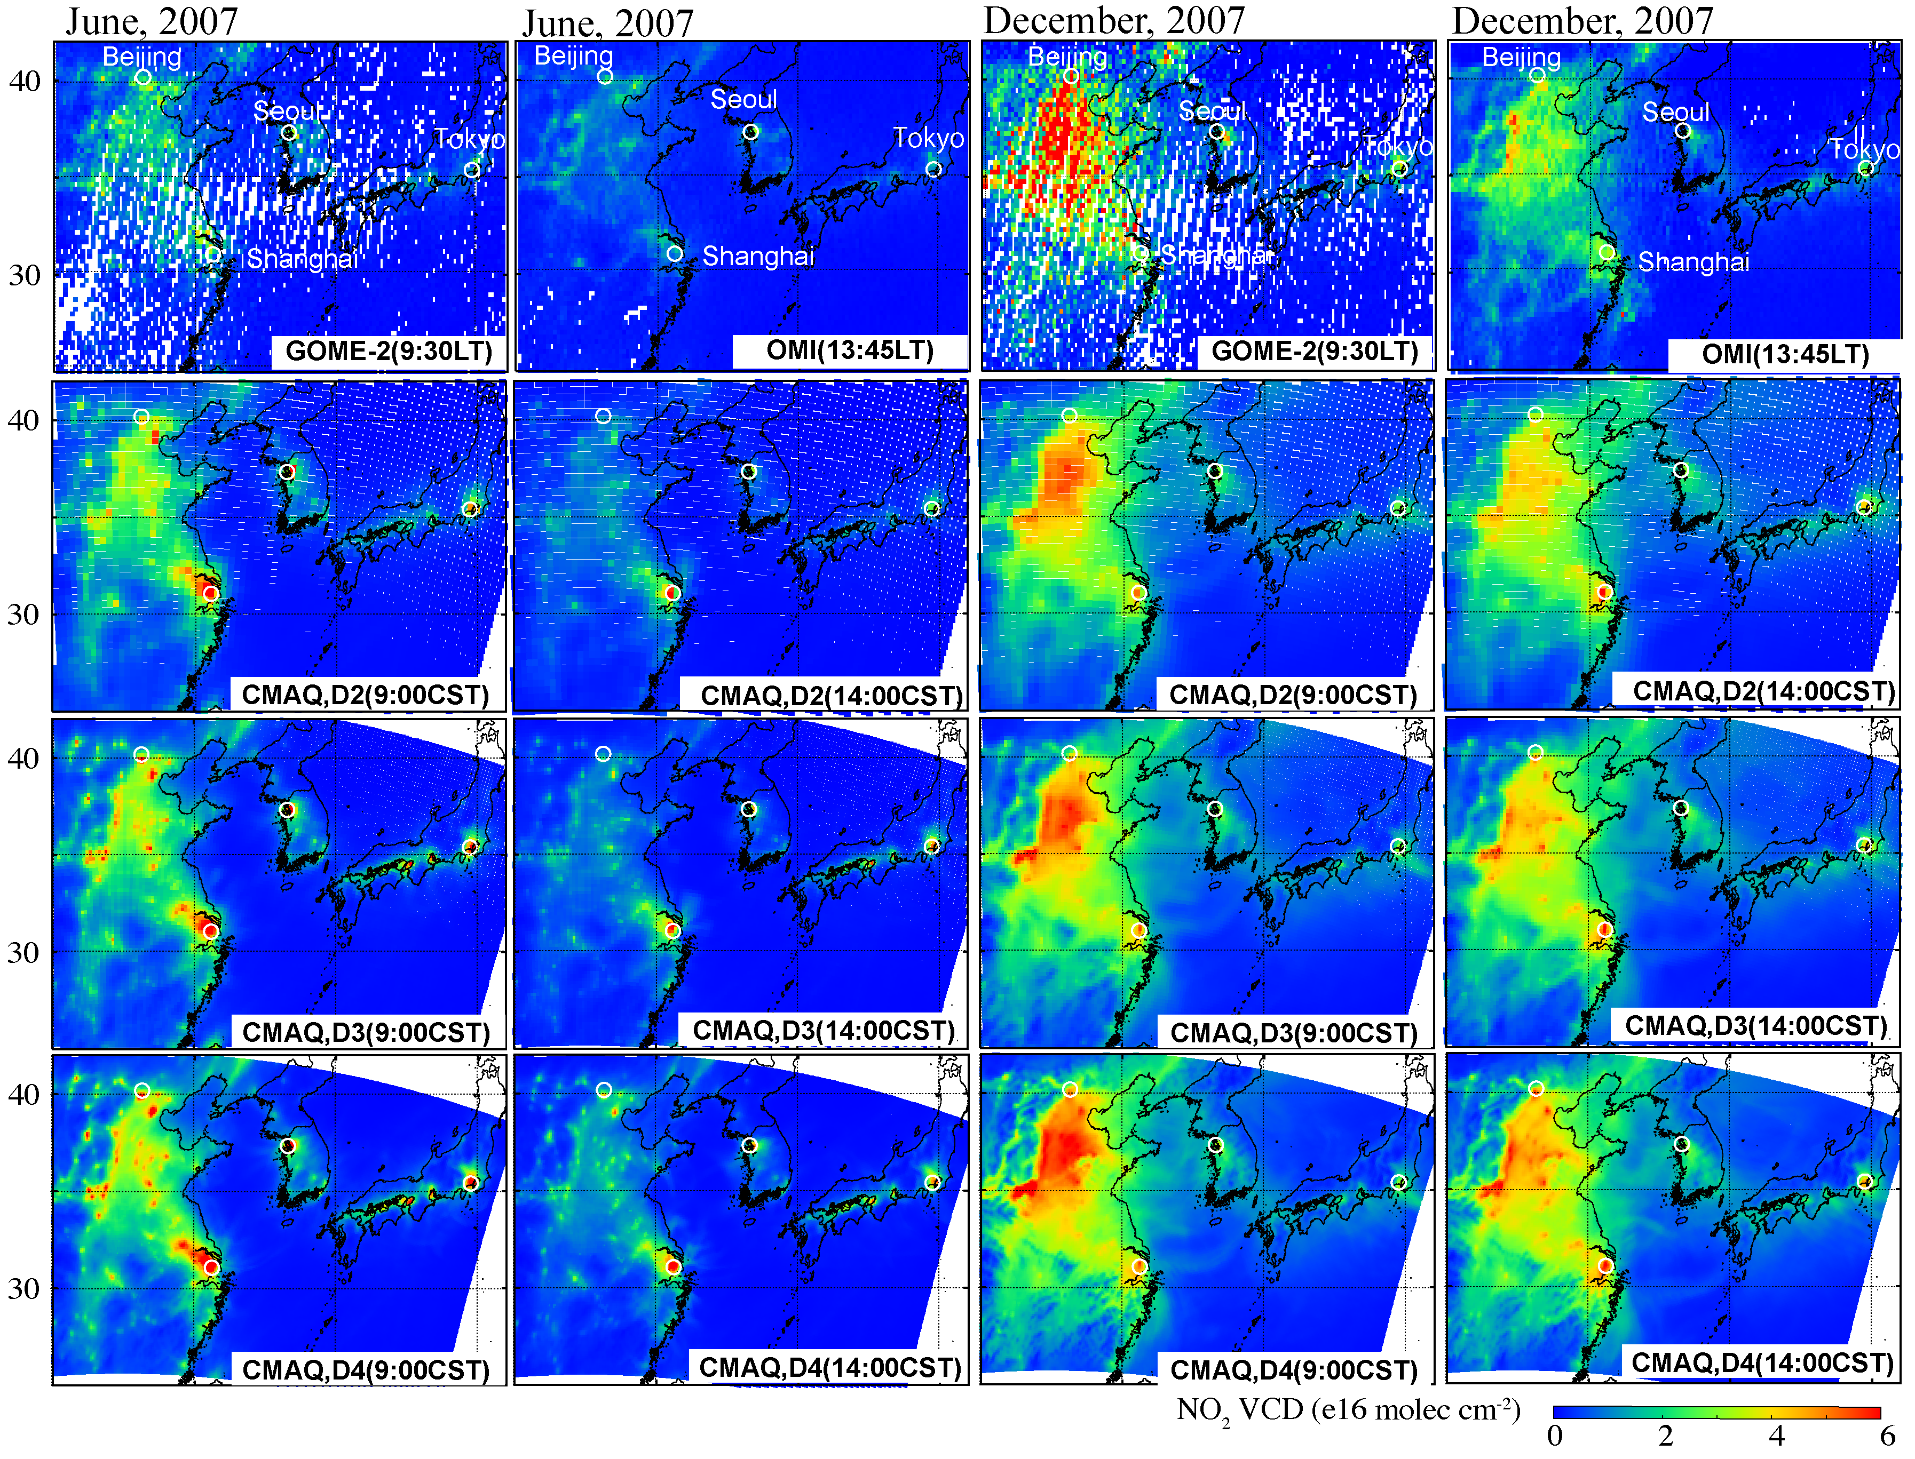
CMAQ(D2-40km, D3-20km, and D4-10km) vs. GOME-2 and OMI
JUN, morning
JUN, afternoon
DEC, morning
DEC, afternoon
These maps compare monthly averaged NO₂ VCDs from CMAQ at D2, D3, and D4 and satellites
CMAQ NO₂ VCDs are increased due to the horizontal resolution change
Finer resolutions can produce in detail NO₂ VCDs distribution
Meanwhile, the finer resolutions results overestimation at some grids.

Slide 8
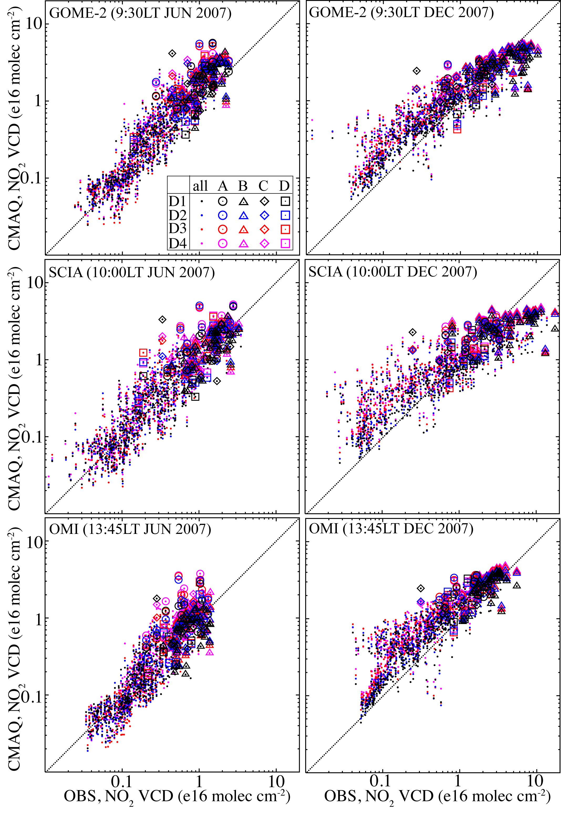
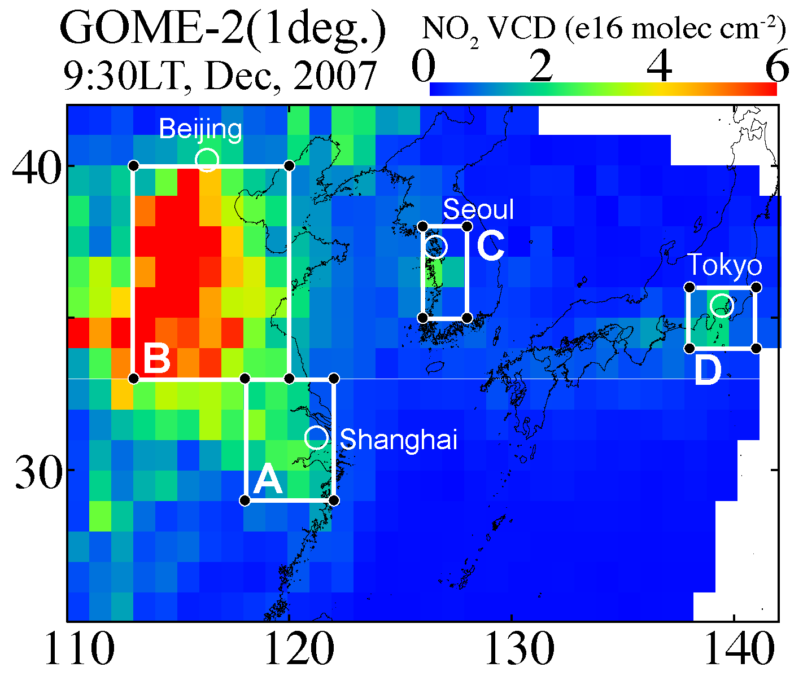
CMAQ vs. satellites
using monthly averaged NO₂ VCDs in a 1 degree grid of all and diagnostic regions (A, B, C, and D) shown in this map.
Generally, correlations between CMAQ and satellites are reasonable
Finer resolutions produce larger NO₂ VCDs at most grid
In December, CMAQ tends to overestimate over the cleaner area
In the morning in December, CMAQ tends to underestimate over the large emission areas

Slide 9
Biases between satellite retrievals and CMAQ NO₂ VCDs
diagnostic regions
region | all |  |  |  |  | A |  |  |  |  | B |  |  |  |  | C |  |  |  |  | D
resolution | D1 | D2 | D3 | D4 |  | D1 | D2 | D3 | D4 |  | D1 | D2 | D3 | D4 |  | D1 | D2 | D3 | D4 |  | D1 | D2 | D3 | D4
JUN 2007
GOME-2 | 47 | 63 | 69 | 78 |  | 77 | 121 | 119 | 130 |  | 47 | 65 | 73 | 80 |  | 94 | 80 | 103 | 121 |  | 54 | 60 | 117 | 99
SCIA | -47 | -40 | -37 | -32 |  | 27 | 60 | 65 | 70 |  | -2 | 12 | 19 | 30 |  | -4 | -9 | 5 | 20 |  | 3 | 15 | 56 | 46
OMI | 2 | 12 | 18 | 38 |  | 53 | 102 | 121 | 136 |  | -9 | 1 | 4 | 38 |  | 18 | 18 | 38 | 76 |  | 1 | 20 | 64 | 66
DEC 2007
GOME-2 | -6 | 5 | 12 | 17 |  | 26 | 39 | 51 | 58 |  | -32 | -23 | -21 | -18 |  | 34 | 36 | 44 | 46 |  | 0 | -1 | 1 | 2
SCIA | -36 | -29 | -23 | -20 |  | 0 | 10 | 19 | 24 |  | -53 | -48 | -46 | -43 |  | 8 | 10 | 17 | 18 |  | -3 | -4 | -2 | -1
OMI | 39 | 55 | 67 | 76 |  | 49 | 66 | 78 | 87 |  | 9 | 21 | 26 | 32 |  | 84 | 90 | 102 | 107 |  | 58 | 57 | 63 | 66
*Biase(%)=(CMAQ NO₂ VCDs - satellite NO₂ VCDs) / satellite NO₂ VCDs *100, using monthly and regional averages
The horizontal resolution change, from D1 to D2, D3, and D4 was not necessarily make improvements the biases between CMAQ NO₂ VCDs and satellite retrievals
The negative biases at D1 are decreased or changed to positive biases due to the resolution change
The positive biases are increased due to the resolution change, esp. comparing with GOME-2 in the morning in JUN and OMI in the afternoon in DEC

Slide 10
Ratios of CMAQ NOx, NOy, and NOz VCDs in D2, D3, and D4 to those of D1
region |  | A |  |  |  | B |  |  |  |  | C |  |  |  | D
resolution |  | D2 | D3 | D4 |  | D2 | D3 | D4 |  |  | D2 | D3 | D4 |  | D2 | D3 | D4
JUN 2007 (9:00 CST)
NOx | 1.2 |  | 1.2 | 1.3 |  | 1.1 | 1.2 | 1.2 |  |  | 1.1 | 1.2 | 1.3 |  | 1.1 | 1.6 | 1.5
NOy | 1.1 |  | 1.1 | 1.1 |  | 1.0 | 1.1 | 1.0 |  |  | 1.0 | 1.1 | 1.0 |  | 1.0 | 1.4 | 1.0
NOz | 1.0 |  | 1.1 | 0.9 |  | 1.0 | 1.0 | 0.8 |  |  | 1.0 | 1.0 | 0.7 |  | 0.9 | 1.0 | 0.4
JUN 2007 (13:00 CST)
NOx | 1.1 |  | 1.2 | 1.3 |  | 1.1 | 1.1 | 1.2 |  |  | 1.1 | 1.2 | 1.2 |  | 1.1 | 1.1 | 1.1
NOy | 1.1 |  | 1.2 | 1.2 |  | 1.1 | 1.1 | 1.1 |  |  | 1.0 | 1.1 | 1.0 |  | 1.0 | 1.1 | 0.9
NOz | 1.0 |  | 1.1 | 1.0 |  | 1.0 | 1.1 | 0.9 |  |  | 0.9 | 1.0 | 0.7 |  | 1.0 | 1.0 | 1.0
DEC 2007 (9:00 CST)
NOx | 1.1 |  | 1.3 | 1.3 |  | 1.1 | 1.2 | 1.3 |  |  | 1.1 | 1.2 | 1.3 |  | 1.1 | 1.2 | 1.2
NOy | 1.1 |  | 1.2 | 1.2 |  | 1.0 | 1.0 | 1.1 |  |  | 1.1 | 1.1 | 1.1 |  | 1.1 | 1.1 | 1.2
NOz | 1.0 |  | 1.1 | 1.2 |  | 1.0 | 0.9 | 1.0 |  |  | 1.0 | 1.0 | 1.0 |  | 1.0 | 1.0 | 1.1
DEC 2007 (13:00 CST)
NOx | 1.1 |  | 1.3 | 1.3 |  | 1.1 | 1.2 | 1.3 |  |  | 1.1 | 1.3 | 1.3 |  | 1.1 | 1.2 | 1.3
NOy | 1.1 |  | 1.2 | 1.2 |  | 1.0 | 1.0 | 1.1 |  |  | 1.0 | 1.1 | 1.1 |  | 1.1 | 1.2 | 1.2
NOz | 1.0 |  | 1.1 | 1.1 |  | 1.0 | 0.9 | 1.0 |  |  | 1.0 | 0.9 | 0.9 |  | 1.0 | 1.1 | 1.1
*increasing from D1
*decreasing from D1
NOx VCDs are increased with the resolution change from D1 to D2, D3, and D4 without linear chases in the sequence, D1-D2-D3-D4
The largest increments in the change from D_{n} to D_{n+1} appeared in the morning were 18% at A (from D1 to D2), 12% at B (from D1 to D2), and 13% at C (from D2 to D3) and 42% at D (from D2 to D3)
On the other hand, NOz VCDs did not have monotonic changes
These seemed to be affected by both of in-situ non-linear chemistry and transport.

Slide 11
SUMMARY
Multi-scale nested simulations (horizontal resolutions, 80, 40, 20, and 10 km) has been done to investigate influence on NO₂VCDs
This model, even at the coarsest resolution, can capture well satellite NO₂ VCDs
NO₂ (NOx) VCDs are increased with the resolution change from D1 to D2, D3, and D4
However, the increased NO₂ VCDs due to the resolution change did not necessarily show better agreement with the satellite retrievals in this study
The largest increment in the change from D2 to D3 appears in the morning in June was 42% at region D (near Tokyo)
NOz VCDs changes due to the resolution change are more complex because of in-situ non-linear chemistry and transport

Slide 13
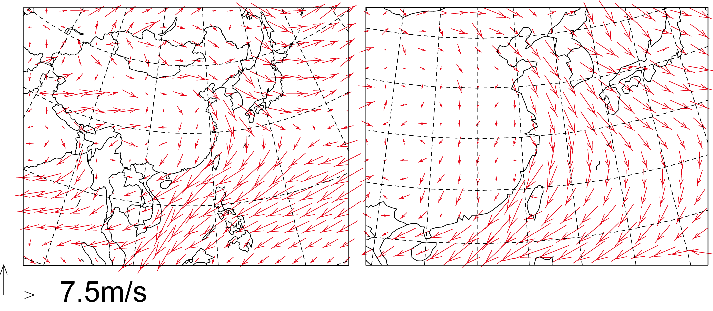
Monthly wind pattern in the first layer in Dec. 2007
D1(80km)
D3(40km)

