Slide 1
Comparison of the CAM and RRTMG Radiation Schemes in WRF and coupled WRF-CMAQ models Aijun Xiu, Zac Adelman, Frank Binkowski, Adel Hanna, Limei Ran Center for Environmental Modeling for Policy Development (CEMPD) Institute for the Environment University of North Carolina at Chapel Hill Rohit Mathur, Jon Pleim, David Wong U.S. EPA

Slide 2
Radiation Schemes in the WRF model and their impacts on air quality
Radiation is the main force that regulates the surface energy budget
Surface temperature and PBL height in met models depend on accurate calculation of both shortwave and longwave radiations
Radiation, surface temperature, and PBL height are important met inputs to air quality models
There are several radiation schemes available in the Weather Research and Forecasting (WRF) model that is used as a met driver for CMAQ
All the radiation schemes in WRF are in the form of column (one-dimensional in vertical) model with the assumption of the vertical model layer thickness is much less than the horizontal grid resolution
For regional climate applications CAM and RRTMG are the two most used radiation schemes
The coupled WRF-CMAQ model offers both CAM and RRTMG as options

Slide 3
The NCAR Community Atmospheric Model (CAM) Radiation Scheme
Delta-Eddington approximation to calculate solar absorption and scattering
Shortwave radiation spectrum divided into 19 discrete intervals and longwave radiation spectrum into 2
Absorption of tracer gases: O₃, CO₂, O₂, H₂O, CH₄, N₂O, CFC-11, and CFC-12
Scattering and absorption of cloud water droplet
Default aerosol profile included
Calculate cloud cover fractions and use overlapping assumption in unsaturated regions
Applied to many climate scenarios (IPCC) and evaluated extensively

Slide 4
The Rapid Radiative Transfer Model for GCMs (RRTMG)
Use the correlated-k method for radiative transfer
A line-by-line radiative transfer model provides the absorption coefficients and is used for evaluations
16 spectral bands to emphasize important molecular absorption features
Gaseous absorption of H₂O, CO₂, O₃, CH₄, N₂O, O₂, N₂, CFC-11, CFC-12, CFC-22, and CCL4
Utilize the Mote Carlo Independent Column Approximation for sub-grid clouds
Extensive evaluations against measurements from the ARM program
Implemented in the ECMWF and CCSM models

Slide 5
The CAM radiation scheme vs the RRTMG radiation scheme in the WRF model
Episodic study of the radiation schemes
The California fire case during June 20 to June 25, 2008
Compare to SURFRAD measurements

Slide 6
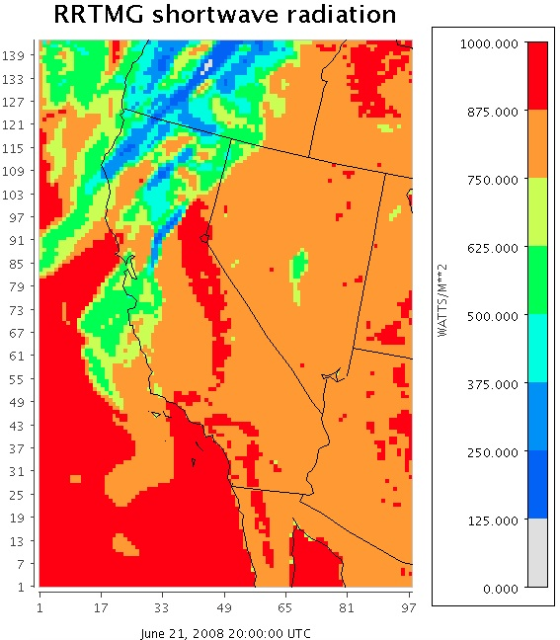
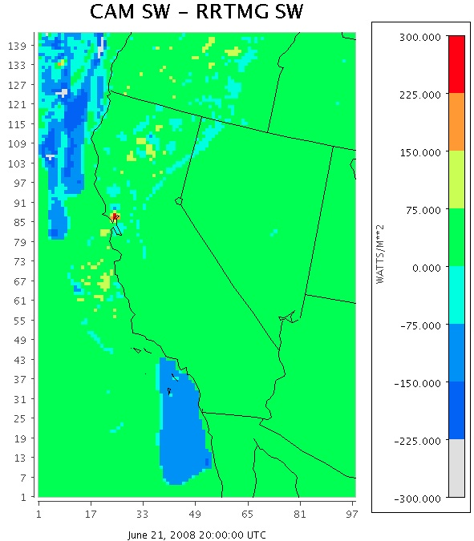
Shortwave Radiation from the WRF model

Slide 7
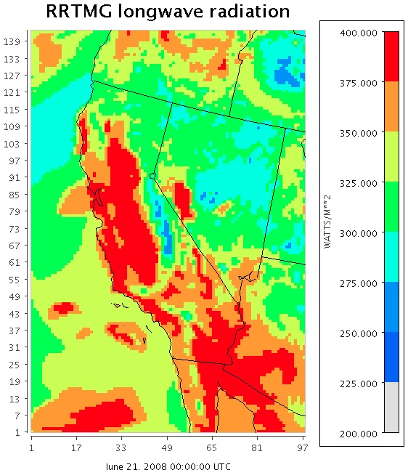
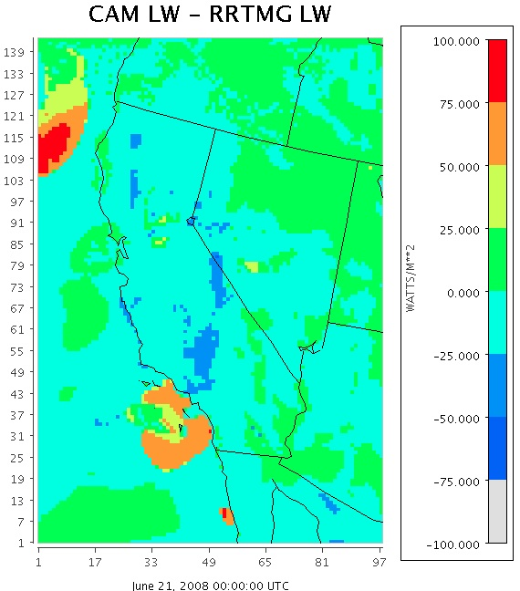
Longwave Radiation from the WRF model

Slide 8
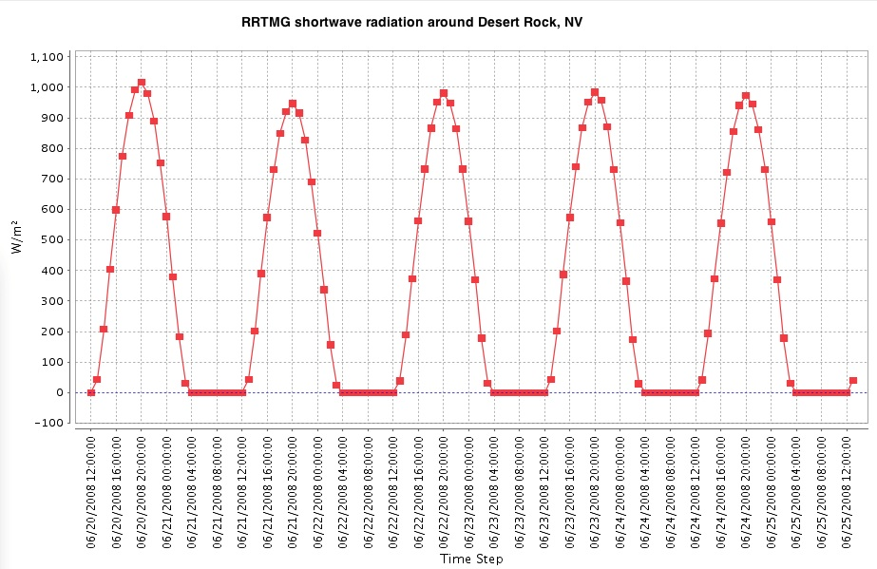
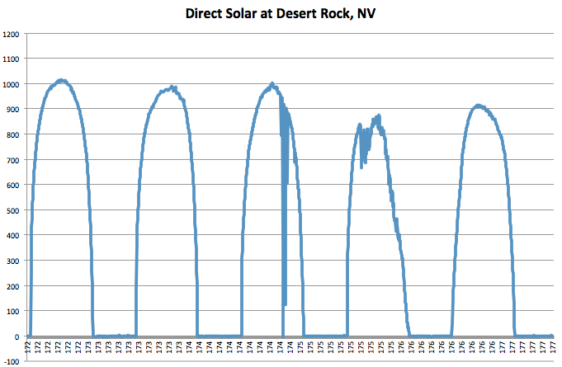
Shortwave Radiation from the WRF model and SURFRAD at Desert Rock, NV
CAM: overprediction
RRTMG: very good first
three days not the last two

Slide 9
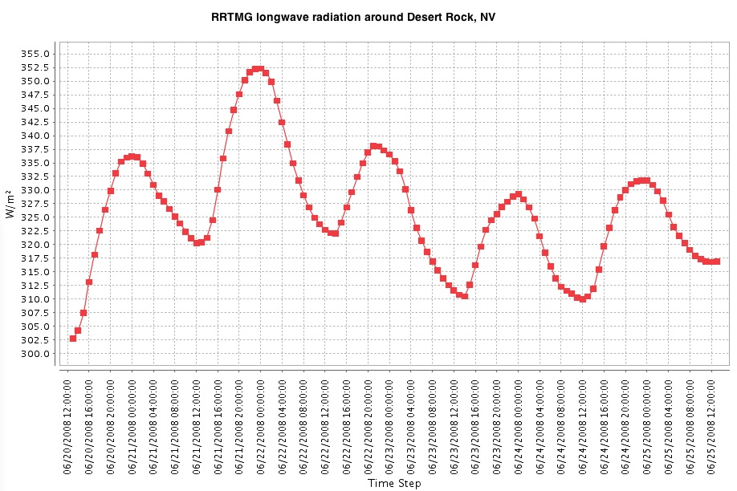
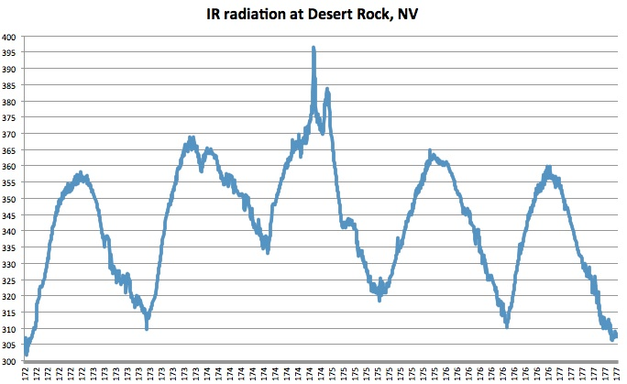
Longwave Radiation from the WRF model and SURFRAD at Desert Rock, NV
CAM: good and catch the
trend
RRTMG: underprediction

Slide 10
WRF3.2 Configuration
Operation
5.5 day simulation periods
108 and 36 km CONUS grids
34 vertical layers
Inputs: NNRP 2.5° and RTG SST analysis
Physics
Microphysics: Morrison Double Moment
LWR: RRTMG or CAM
SWR: RRTMG or CAM
Land Surface and Surface Layer: P-X
PBL: ACM2
Cumulus: Kain-Fritsch
Heat/moisture surface fluxes, snow cover, and cloud effects included
Dynamics
Non-hydrostatic mode
Horizontal Smagorinsky 1st order closure
6th order numerical diffusion but prohibit up-gradient diffusion
Rayleigh damping
Monotonic advection of moisture, scalars, and TKE
FDDA
Grid and analysis nudging continuously in d1, sensitivity to also nudge in d2
CAM FDDA-2 Configuration
IPX for soil moisture, UV wind nudging below the PBL, relaxed nudging coefficients in the 36km domain
CAM OBSGRID
IPX for soil moisture, nudging with actual observations using OBSGRID rather than reanalysis data using MG2SFDDA

Slide 11
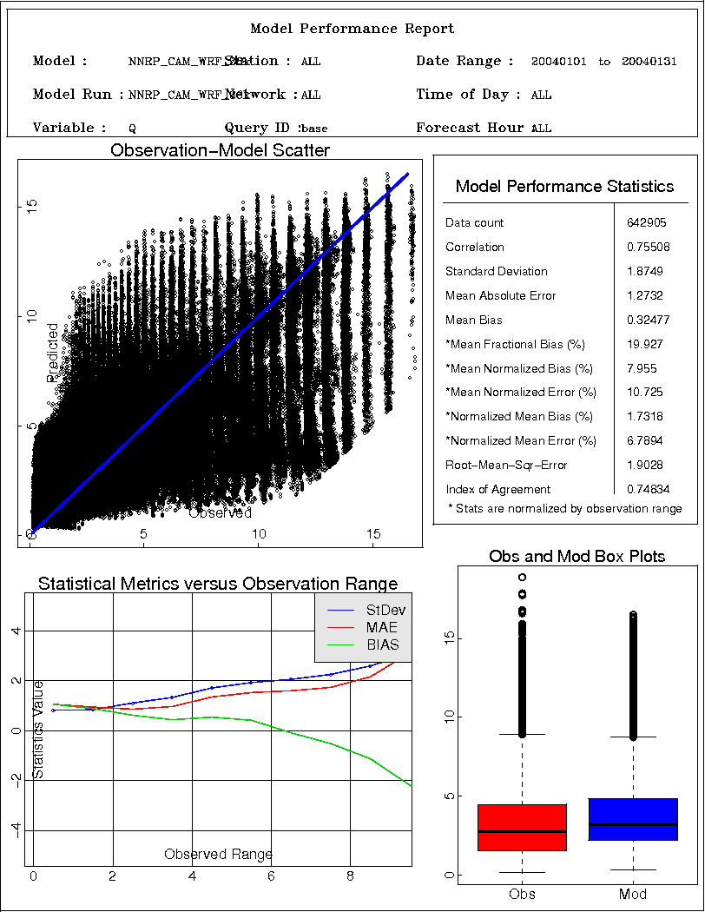
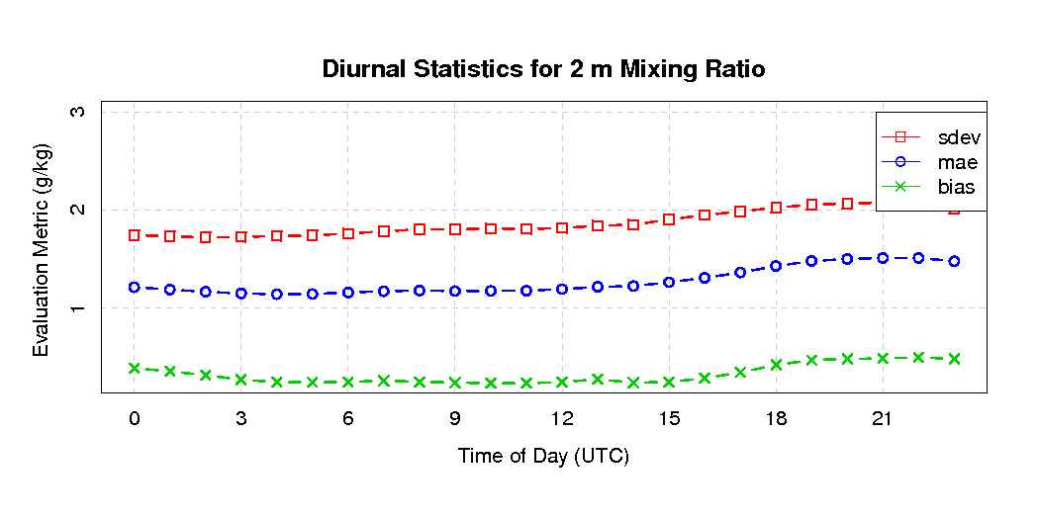
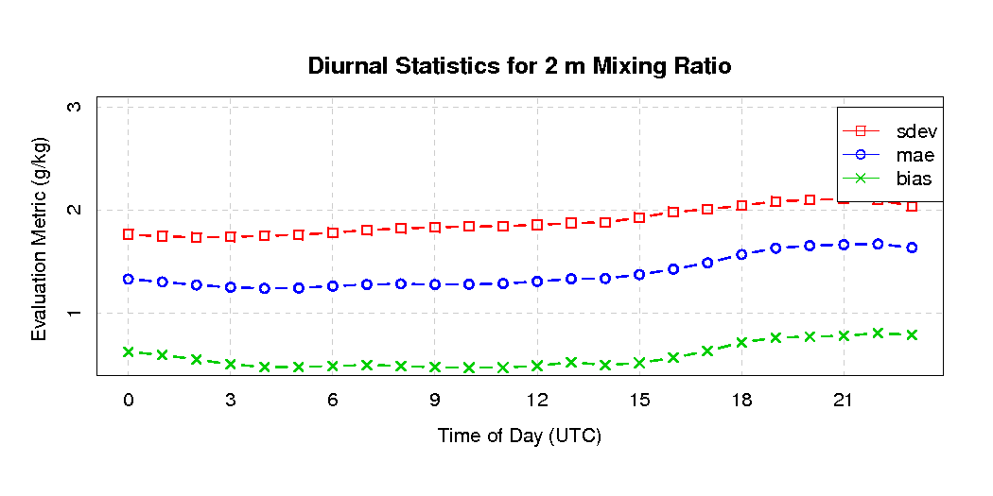
January Humidity
CAM
RRTMG

Slide 12
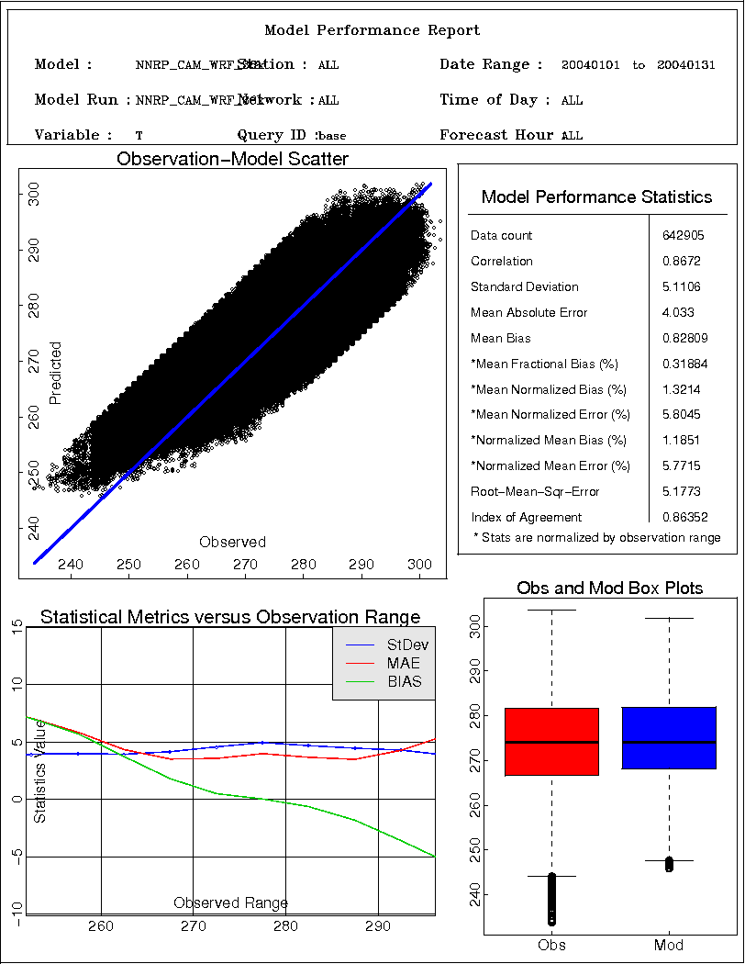
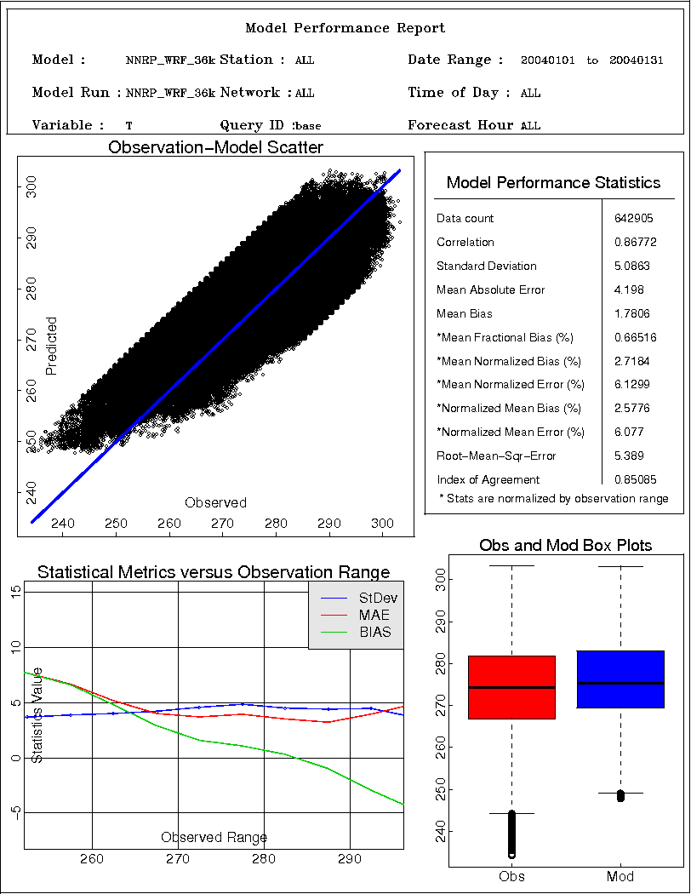
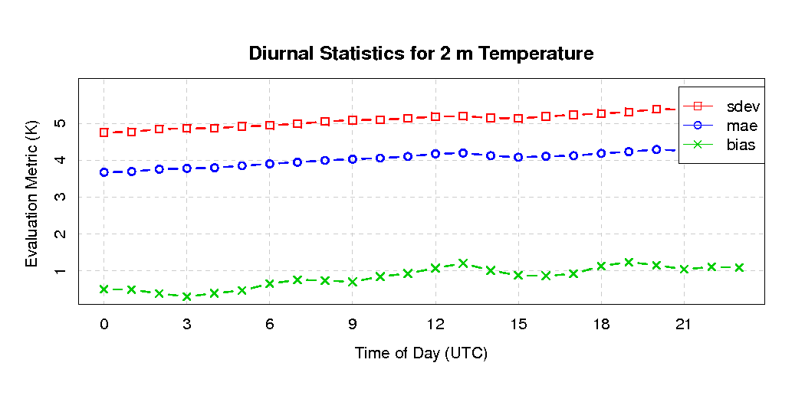
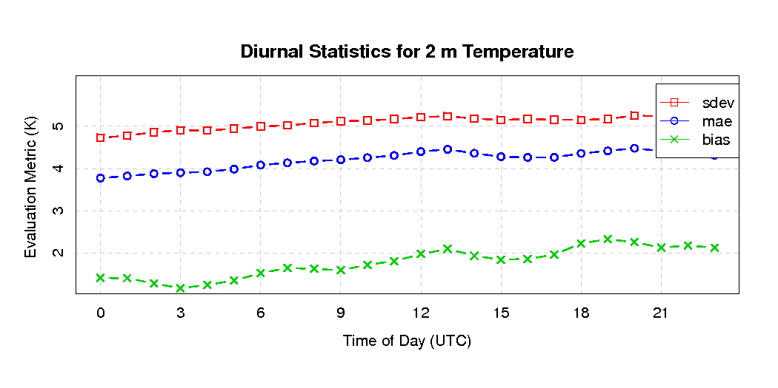
January Temperature
CAM
RRTMG

Slide 13
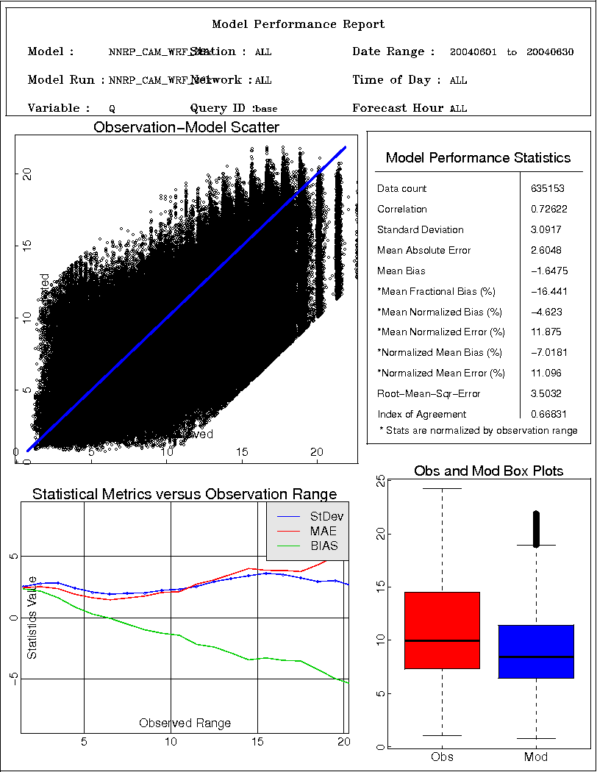
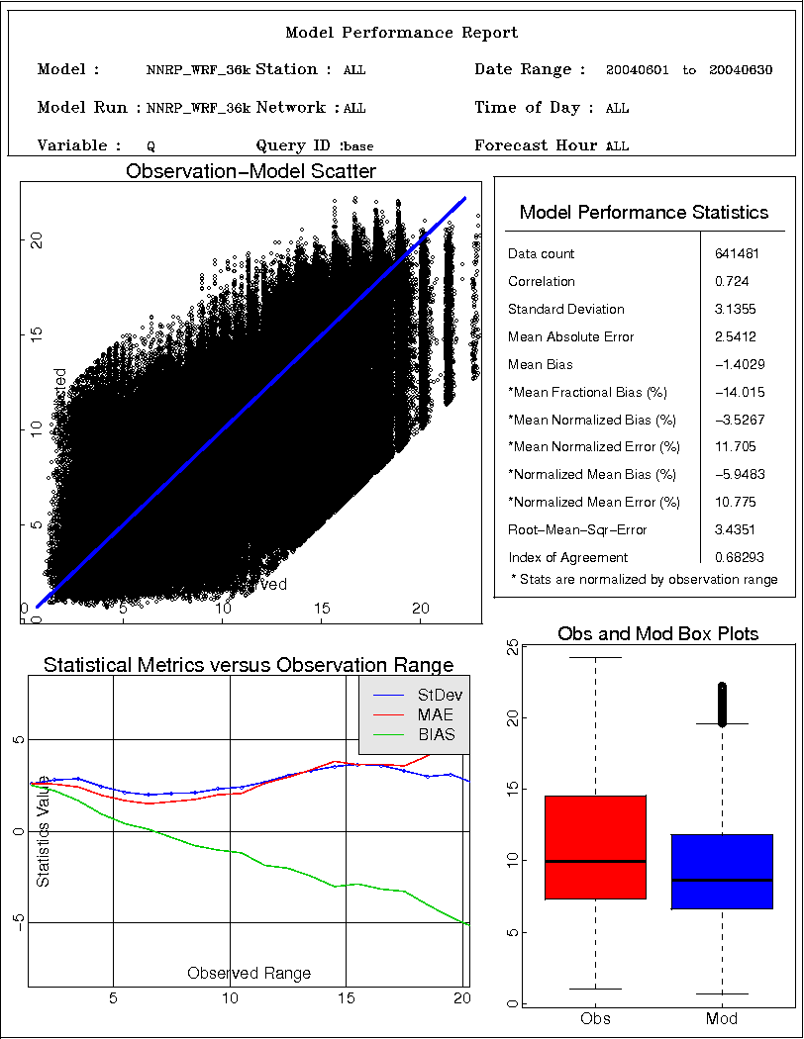
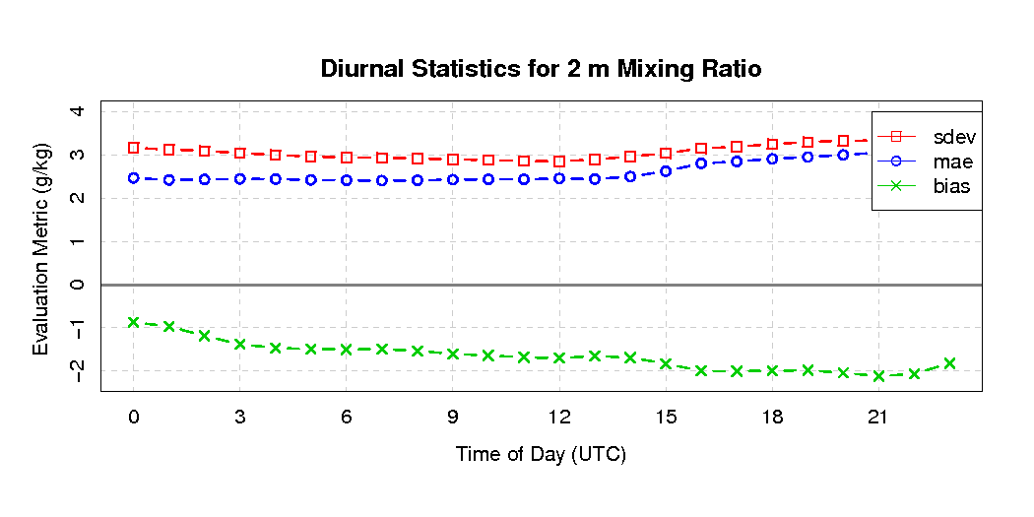
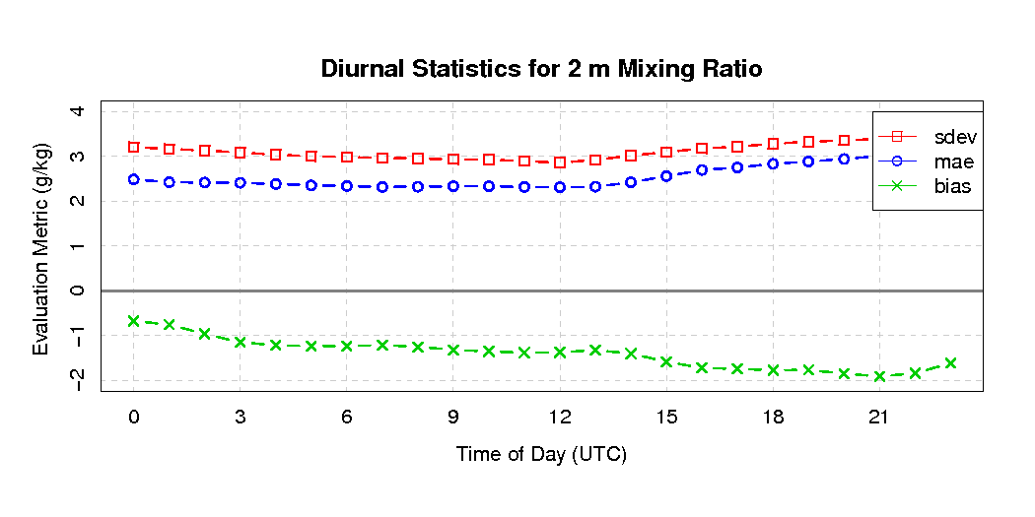
June Humidity
CAM
RRTMG

Slide 14
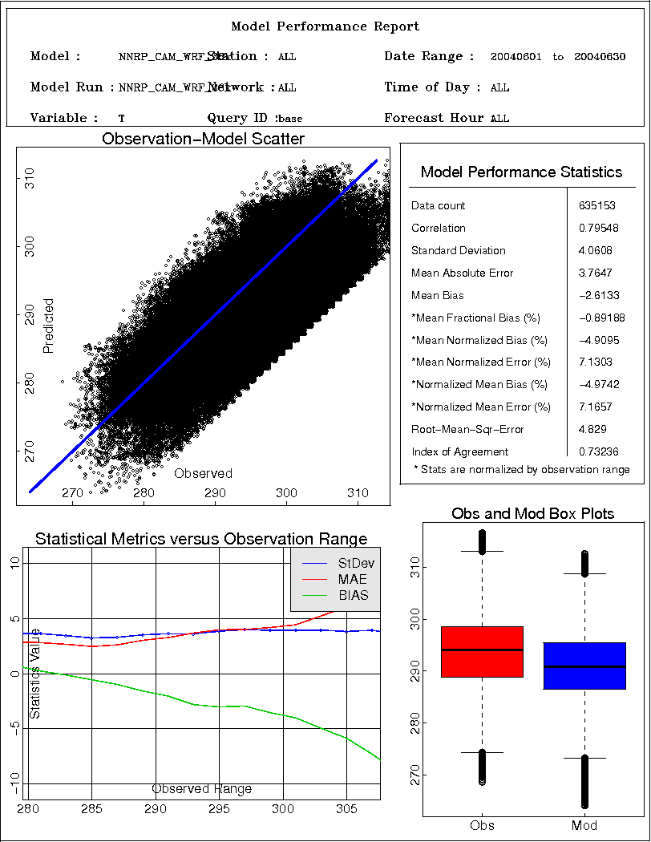
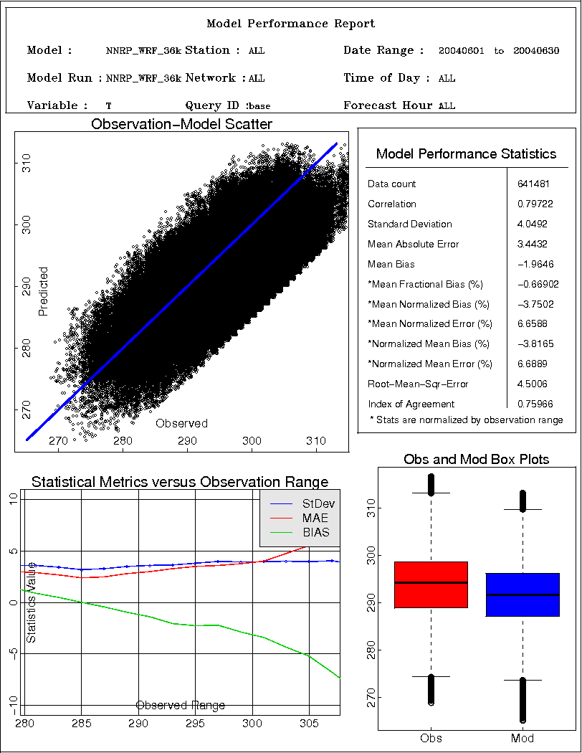
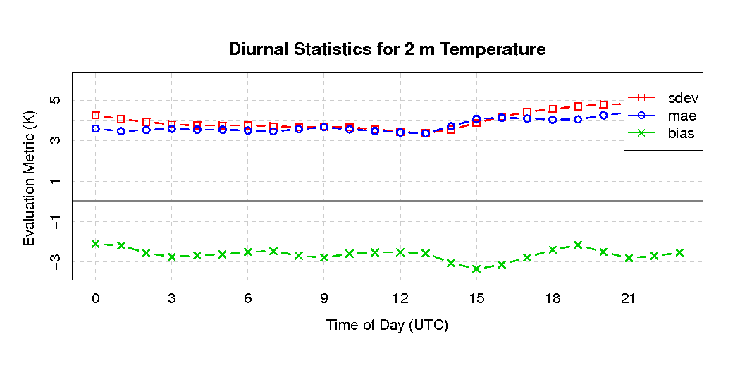
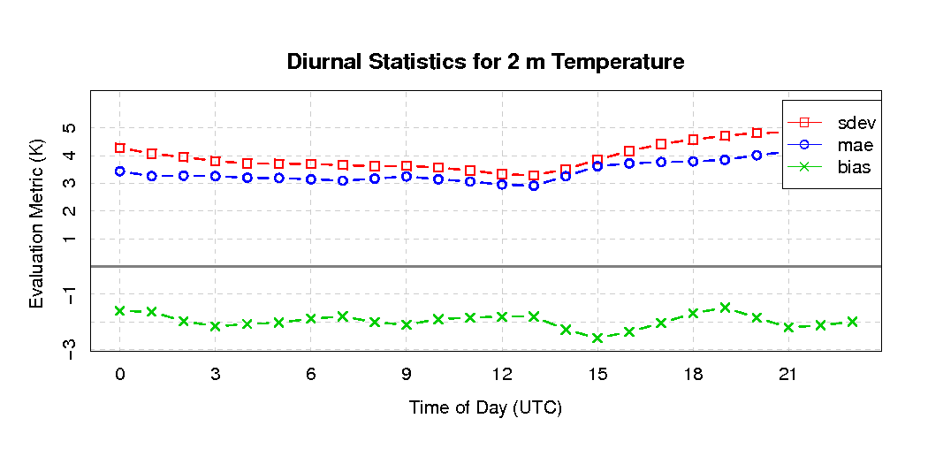
June Temperature
CAM
RRTMG

Slide 15
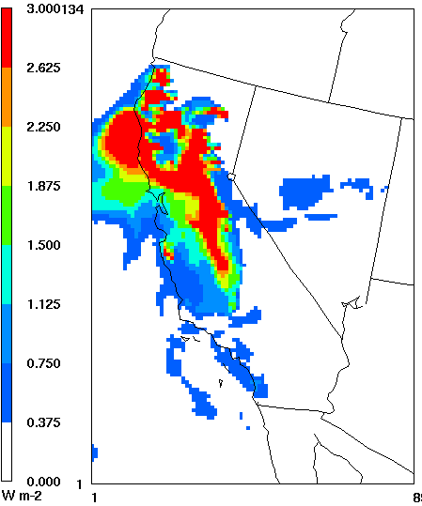
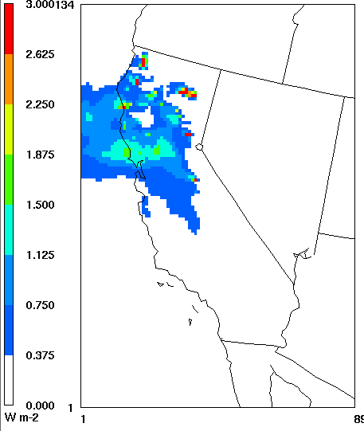
CAM vs RRTMG in the WRF-CMAQ coupled model AOD
MODIS 550nm
CAM 495nm
RRTMG 533nm
19UT, June 27, 2008

Slide 16
Background Aerosol profile in CAM and RRTMG
CAM radiation scheme in WRF model has a background aerosol profile so it accounts for the direct radiative feedback of aerosols
but the background aerosol profile does not vary with time or location
RRTMG radiation scheme in WRF model actually does not account for aerosol effect (it may be corrected in the future)
Even though there is a control variable, IAER, in WRF that user can set as:
IAER=10 user defined aerosol profile
IAER=6 using ECMWF aerosol profile
IAER=0 no aerosol effect

Slide 17
Define a common aerosol profile for both CAM and RRTMG
The mathematical formulae for the extinction coefficient, the aerosol optical depth, the single scattering albedo, and the asymmetry factor are:
where λ is the wavelength in nm.; H is the altitude; and H_{S} is the scale height = 1km
The contribution to the aerosol optical depth at any altitude is where δH is the layer thickness.
The single scattering albedo, ϖ=0.99 ; the asymmetry factor g=0.61 .

Slide 18
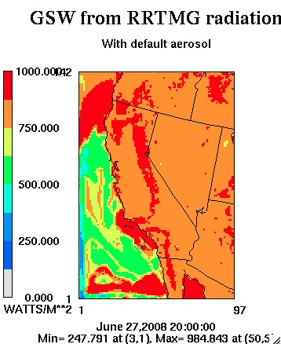
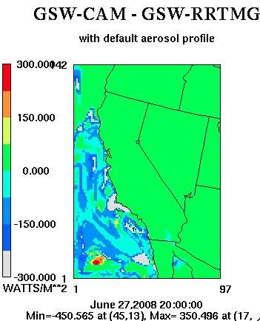
Shortwave Radiation from the WRF model with the common aerosol profile

Slide 19
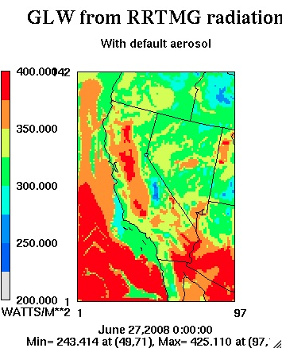
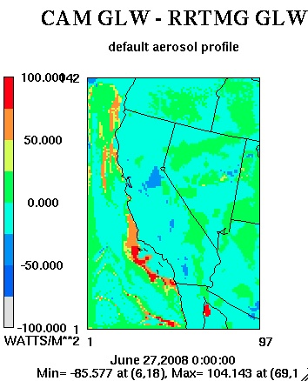
Longwave Radiation from the WRF model with the common aerosol profile

Slide 20
Conclusions
Comparable shortwave radiation from CAM and RRTMG under clear sky but different with clouds
Clear and cloudy sky longwave radiation from CAM and RRTMG can be different due to the treatment of water vapor continuum
Seasonal effects on the performance of surface temperature and humidity from the CAM and RRTMG radiation schemes in WRF
In both WRF and WRF-CMAQ models RRTMG scheme is slower than CAM scheme
No background aerosol profile in current RRTMG implementation in WRF
With a common aerosol background profile shortwave radiation from CAM and RRTMF in WRF are more comparable
AOD from RRTMG in WRF-CMAQ shows better comparison to MODIS data

Slide 21
Future Work
Extensive evaluations needed for the coupled WRF-CMAQ modeling system
Compare to regional climate simulations such as North American Regional Climate Change Assessment (NARCCAP)
Evaluate against observations (SURFRAD, MODIS) and field campaign (ARM)
Longer simulations and systematic analysis for regional climate applications
Speed up the RRTMG scheme with aerosol feedback in the coupled WRF-CMAQ model
Future climate applications downscaled from a variety of climate models (CESM, MOZART, GISS) under different IPCC climate scenarios (RCPs)

