Slide 1
An Enhanced Sub-grid Scale Approach to Characterize Air Quality Impacts of Aircraft Emissions at the Hartsfield-Jackson Atlanta International Airport
Matthew Woody, Jeffrey Rissman, Frank Binkowski,
J. Jason West, Saravanan Arunachalam
University of North Carolina at Chapel Hill
October 24-26, 2011
10th Annual CMAS User’s Conference, Chapel Hill, NC

Slide 2
Motivation
Aviation activities have emissions of CO, NO_{x}, VOC, SO_{x}, PM_{2.5} and numerous hazardous air pollutants
Traditional modeling simplifies representation of aircraft emissions (e.g. point sources)
Uncertainty in estimating organic PM aircraft emissions
First Order Approximation 3 (FOA3 or FOA3a) typically used to estimate aircraft PM emissions
Goals
Enhance model predictions of aircraft contributions to PM_{2.5} using CMAQ with sub-grid scale treatment
Grid vs. sub-grid variability when using plume-in-grid (PinG)
Enhance ability to model aircraft organic PM contributions, particularly SOA

Slide 3
CMAQ-AMSTERDAM Modeling Overview
Advanced Modeling System for Transport, Emissions, Reactions, and Deposition of Atmospheric Matter (AMSTERDAM)
CMAQ with Advanced PinG Treatment, based on Second-Order Closure Integrated puff model with CHEMistry (SCICHEM)
SCICHEM simulates plume transport and dispersion
3-D puffs advected and dispersed based on local micro-meteorology
Effects of buoyancy on plume rise and initial dispersion simulated
Puff and grid chemical mechanisms identical
Focus on aircraft emissions at the Atlanta Hartsfield-Jackson International Airport in Summer 2002
4-km urban domain
June and July

Slide 4
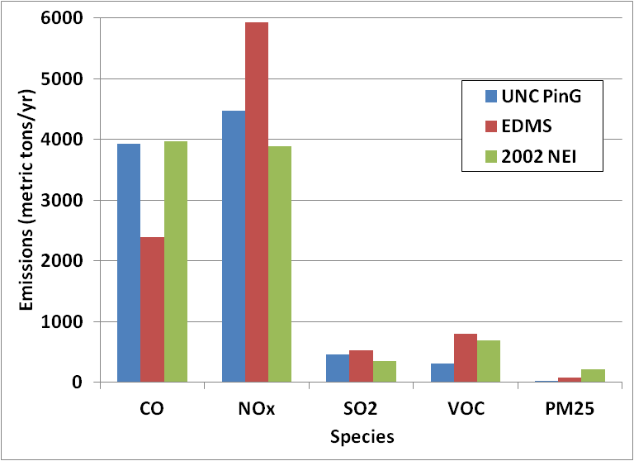
Emissions
Estimates based on flight activity and Landing and Takeoff (LTO) cycles up to 1 km (~3,000 ft) above field elevation (AFE)
Cruise level emissions not considered
Calculated using International Civil Aviation Organization (ICAO) engine specific data and the First Order Approximation (FOA3) (Wayson et al., 2009) for PM species
Modeled aircraft emissions include: CO, NO_{x}, HONO, H₂SO₄, SO₂, PEC, POA, and VOCs
Calculated estimates (UNC PinG) comparable to those estimated by the Emissions and Dispersion Modeling System (EDMS) and the EPA’s 2002 NEI

Slide 5
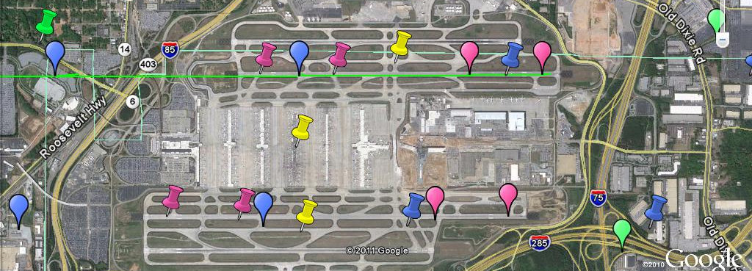
Aircraft Emissions Represented as Fixed Point Sources
51 representative emitters
8 take off, 20 climbout, 20 approach, 3 taxi
Mapped onto 4 runways – 2 takeoff, 2 for landing (5th runway opened after 2002 and was excluded here)
(Not all emitters shown)

Slide 6
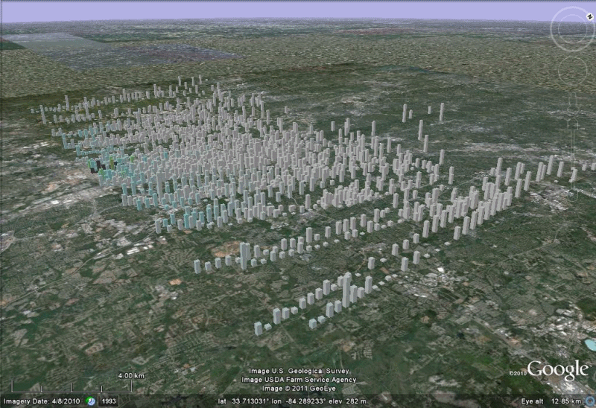
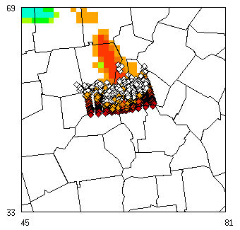
Hourly Contributions from Aircraft to PM_{2.5} Puff and Grid Concentrations on June 6, 2002
Notes:
animation

Slide 7
CMAQ-AMSTERDAM Test Cases
4 Test Cases (TC) performed for June and July 2002 centered on ATL
ADSC - 1-d model to predict sulfate PM in near field of aircraft plumes (~30 m), recently enhanced for organic species (Wong et al., J. Propulsion & Power, 2008)
Sensitivity Analysis for June 6 and 7, 2002
Test impacts of number of emitters used to represent aircraft
Test Case | Aviation Emissions
TC1 | PinG
TC2 | None
TC3 | Traditional Representation (No PinG)
TC4 | PinG with Aerosol Dynamics Simulation Code (ADSC) inputs
Notes:
Indicate motivation for last bullet point on number of emitters

Slide 8
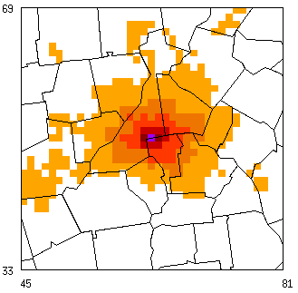
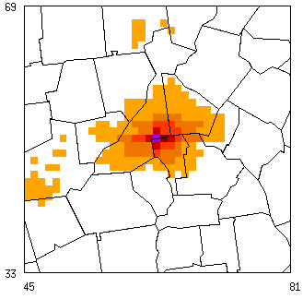
Jun and Jul Average Aircraft Contributions to PM_{2.5} Concentrations – PinG (TC1-TC2) and No PinG (TC3-TC2)
Aircraft increase PM_{2.5} throughout Atlanta metro area
Increase of 0.236 µg/m³ at grid cell containing airport
PinG aircraft contributions higher further downwind from airport than simulation without PinG
PinG
(TC1-TC2)
Rings indicate distances of 50-km, 75-km, and
100-km from airport
No PinG
(TC3-TC2)

Slide 9
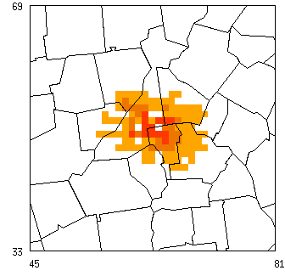
PinG Compared to Traditional Representation (TC1-TC3)
PinG predicts higher impacts to PM_{2.5} in the ATL area from aircraft emissions
Increases using PinG > 2 ng typically within 50-km of airport but extend as far as 75-km
In general, PinG predicts higher contributions from inorganic PM species and lower contributions from primary PM species
June-July 2002 Average

Slide 10
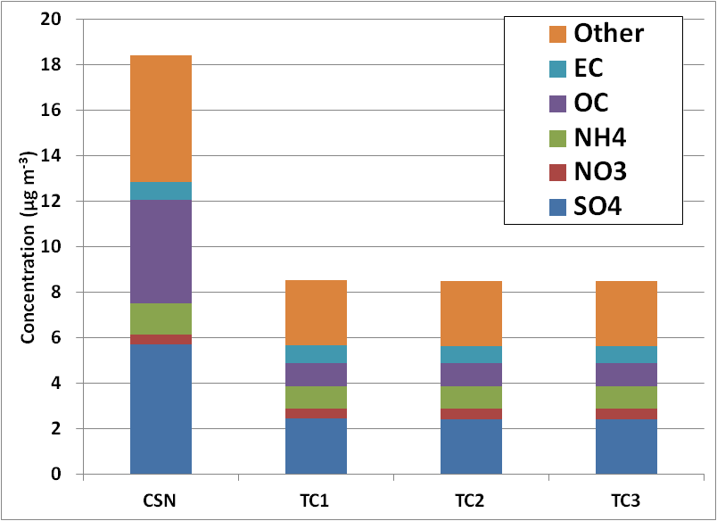
Model Evaluation
Comparison of June and July, 2002 results at the Decatur CSN monitor (~10 km from the airport)
Model NME
Species | TC1 | TC2 | TC3
EC | 42.2% | 42.1% | 42.2%
OC | 77.5% | 77.5% | 77.5%
NH4 | 40.6% | 40.7% | 40.6%
NO3 | 72.3% | 71.9% | 72.0%
SO4 | 58.8% | 59.0% | 58.9%
PM25 | 53.8% | 53.9% | 53.9%
Comparable model performance across all test cases as aircraft emissions comprise only a fraction of the total emission budget.

Slide 11
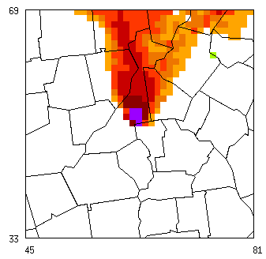
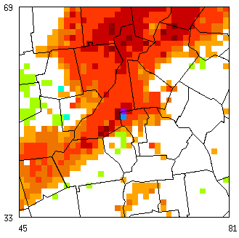
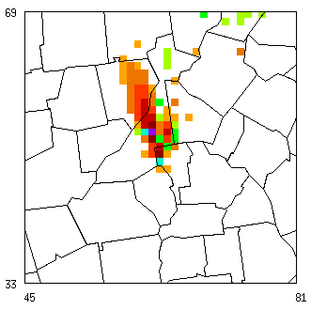
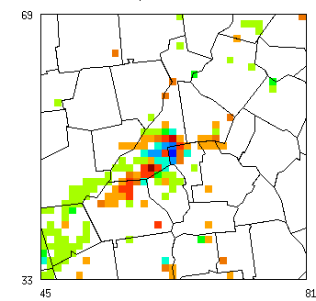
Daily Average PM_{2.5} contributions from PinG and Non-PinG aircraft emissions
PinG
(TC1-TC2)
June 6
June 7
PinG – No PinG
(TC1-TC3)
Mixed results when considering daily average PinG vs. non-PinG due primarily to differences in inorganic species and associated with differences in meteorology.

Slide 12
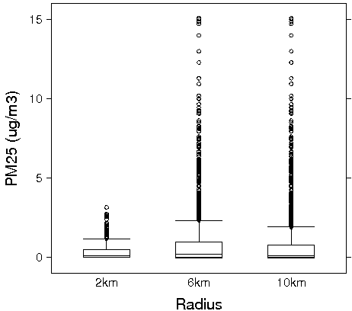
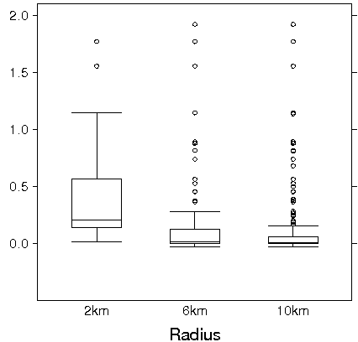
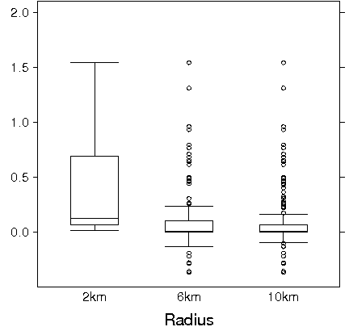
Comparison of June 6, 2002 Hourly Grid Averaged vs Puff Averaged PM_{2.5} Concentrations at the Surface
SubGrid
TC1
Grid w/PinG
(TC1-TC2)
Grid w/o PinG
(TC3-TC2)
Max subgrid scale concentrations in puffs order of magnitude higher than grid-averages. Puffs typically have high concentrations further downwind than grid-averages
Without PinG, hourly averaged aircraft contributions are lower at and downwind of the airport.

Slide 13
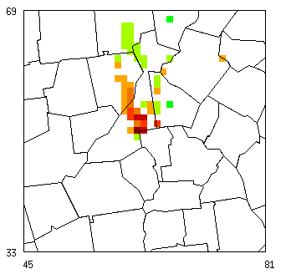
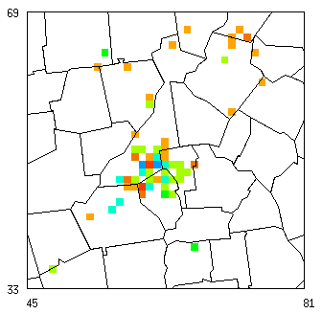
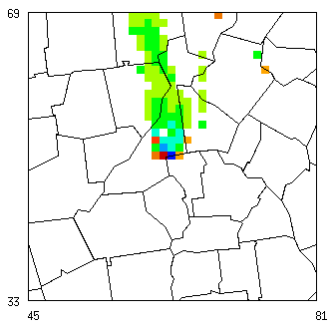
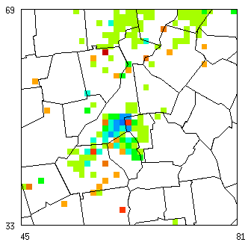
Difference in Daily Average PM_{2.5} when number of emitters increased by 2x and 4x
(2x – 1x)
June 6
June 7
(4x – 1x)
Doubling (and tripling, not shown) emitters increase/decrease aircraft contributions to PM_{2.5} similar to PinG vs. Non-PinG. Quadrupling emitters lowers contributions possibly due to diluted plumes merging into grid sooner and reducing PinG effects.
Notes:
Reiterate motivation for emitter sensitivity runs

Slide 14
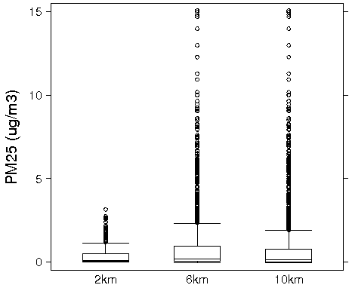
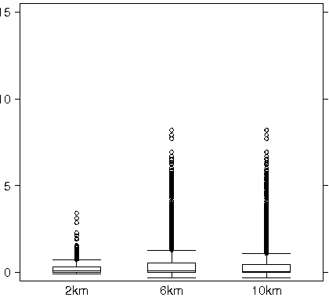
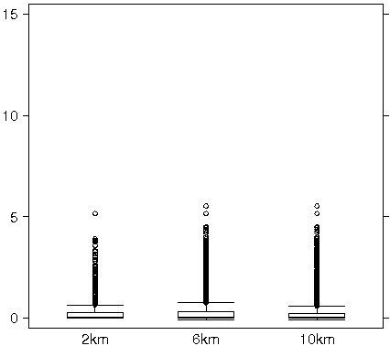
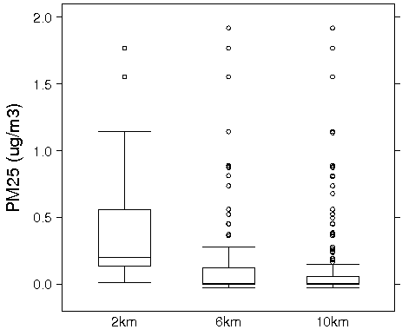
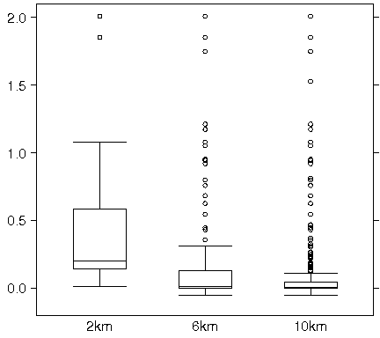
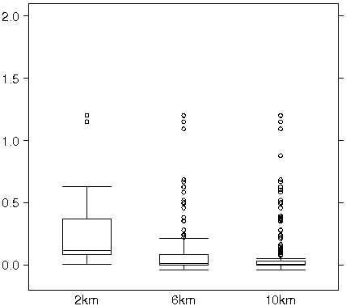
Comparison of Grid Averaged vs Puff PM_{2.5} Contributions at the Surface for 1x, 2x, and emitters
1x
2x
4x
Puff
Grid
Increasing emitters creates more puffs but with lower average concentrations. Increasing emitters to 4x lowers grid-averaged contributions at and downwind of airport due to reduced PinG effects

Slide 15
Next Steps – Using the Volatility Basis Set (VBS) to predict SOA
SOA Predictions in AQMs
Odum two product approach (traditional)
Explicit SOA precursors
VBS
Includes Intermediate Volatile Organic Carbon (IVOC) and Semi-Volatile Organic Carbon (SVOC), non-traditional SOA (NTSOA) precursors
Significant formation of SOA shown from NTSOA precursors for aircraft emissions (Miracolo et al., 2011)
Collaboration with Carnegie Mellon University (CMU)
CMU provided VBS box model to estimate SOA formation from aircraft emissions
SVOC and IVOC emission factors and VBS yields specific for aircraft emissions based on smog chamber data
Implementation of aircraft specific VBS within CMAQ to be used concurrently with a generalized VBS for emissions from other sources
Notes:
Mention CMAQ 5.0

Slide 16
ADSC, VBS spatiotemporal scales
Boeing 757
50m
ADSC
30 meters/
seconds
VBS/AMSTERDAM
Few hundred meters/minutes

Slide 17
Conclusions
Framework in place to model aircraft as PinG sources
Use of PinG to represent aircraft increase contributions to PM_{2.5} concentrations
Max subgrid scale concentrations > 10x higher than grid-averages
Mixed results on grid-based daily averaged contributions when the number of emitters are increased
Increasing emitters (1x to 2x, 2x to 3x, etc.) increases run time by ~15%
Max emitters in AMSTERDAM = 202
Ongoing work to use ADSC, AMSTERDAM, and VBS with CMAQ to enhance predictions of organic PM contributions from aircraft, and understand subgrid scale variability

Slide 18
Acknowledgements
Hsi-Wu Wong, Aerodyne Research
Richard Miake-Lye, Aerodyne Research
Shantanu Jathar, Carnegie Mellon University
Allen Robinson, Carnegie Mellon University
Prakash Karamchandani, Environ and EPRI
Georgia Department of Natural Resources
The Partnership for Air Transportation Noise and Emissions Reduction is an FAA/NASA/Transport Canada/US DOD/EPA-sponsored Center of Excellence.
This work was funded by FAA and Transport Canada under 07-C-NE-UNC Amendment Nos. 001 to 004, and 09-CE-NE-UNC Amendment Nos. 001-003.
The Investigation of Aviation Emissions Air Quality Impacts project is managed by Christopher Sequeira.
Any opinions, findings, and conclusions or recommendations expressed in this material are those of the author(s) and do not necessarily reflect the views of the sponsors.

Slide 19
References
Wayson, R.L., G.G. Fleming, and R. Iovinelli, 2009. Methodology to estimate particulate matter emissions from certified commercial aircraft engines. Journal of the Air & Waste Management Association, 59, pp. 91–100.
Wong, H.W., P.E. Yelvington, M.T. Timko, T.B. Onasch, R.C. Miake-Lye, J. Zhang, and I.A. Waitz, 2008. Microphysical modeling of ground-level aircraft-emitted aerosol formation: roles of sulfur-containing species. Journal of Propulsion and Power, 24 (3), pp. 590–602.
Miracolo, M.A., C.J. Hennigan, M. Ranjan, N.T. Nguyen, T.D. Gordon, E.M. Lipsky, A.A. Presto, N.M. Donahue, and A.L. Robinson, 2011. Secondary aerosol formation from photochemical aging of aircraft exhaust in a smog chamber. Atmospheric Chemistry and Physics, 11, pp: 5135-4147.
Notes:
Slides after references are extra which were moved to the end.

