Slide 1
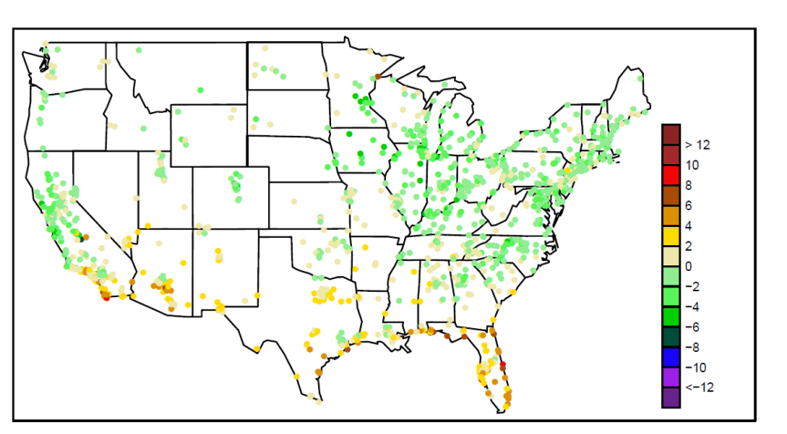
Policy-driven priorities for improvements to the CMAQ photochemical modeling system
Heather Simon, Kristen Foley, Sharon Phillips, Norm Possiel, Shawn Roselle, Prakash Bhave

Slide 2
Model development and evaluation cycle
Model Evaluation
Model Updates
New Scientific Understanding
More Realistic Parameterizations
Improved Model Inputs

Slide 3
Model evaluation is driven by intended application
Evaluation Components
Model Applications
Pollutant of interest
Season/region of interest
Pollutant averaging period
Metric (performance at average versus maximum concentration)
Operational, diagnostic, dynamic, probabilistic
Development of national air pollution rules (EPA)
Human and ecosystem exposure
Visibility in Class I areas
Deposition to sensitive ecosystems
Development of air pollution control strategies (EPA, state and local governments)
Air pollution forecasting (state governments)
Research on atmospheric chemistry and physics (many groups)
Human exposure research (many groups)

Slide 4
CMAQ outputs relevant to ongoing/future air pollution regulation
Ozone
Sulfate
Nitrate
Sulfate, Nitrate, and Mercury Deposition
Air Toxics
Organic Aerosols
Crustal/Unspeciated PM
Ammonia
Focus of this presentation

Slide 5
Ozone: Relevant rules/regulatory activities
Ozone NAAQS
Implementation of the 2008 ozone NAAQS
2013 ozone NAAQS evaluation/standard setting
Cross-State Air Pollution Rule (CSAPR)
Eliminated significant interstate transport of ozone and PM_{2.5} precursors (NO_{x} and SO₂) from utilities
Office of Transportation and Air Quality (OTAQ) Rules:
Heavy-Duty and Light-Duty Greenhouse Gas Rules
Tier 3 Rule
Focuses on NO_{x}/primary PM controls and changes in fuel type

Slide 6
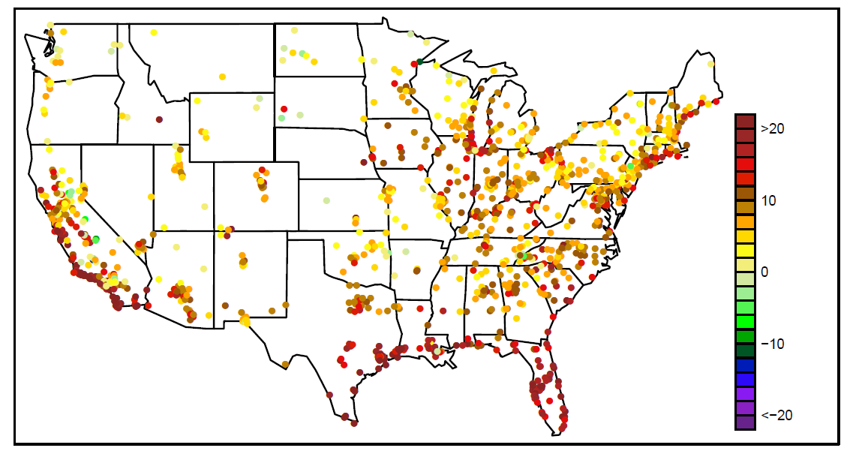
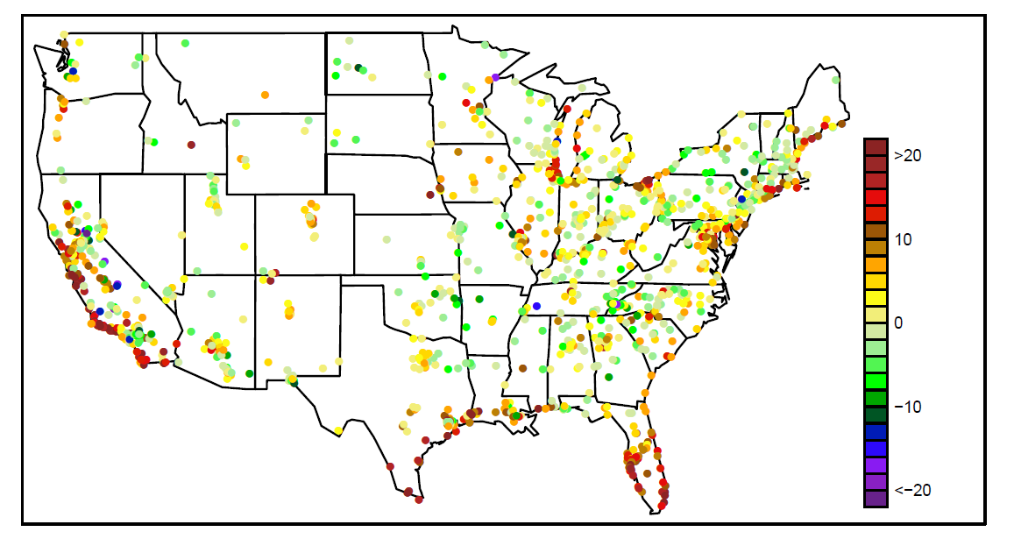
Ozone: CMAQv4.7.1 bias in max 8hr average O₃
CMAQv4.7.1 average bias in daily max 8hr ozone in July/August 2006
CMAQv4.7.1 average bias in highest 10% of max 8hr ozone days in July/August 2006

Slide 7
Ozone: Model inputs play a key role
Improved model inputs:
improved data assimilation of wind speeds (particularly improved simulation of nocturnal jet in NE)
lightning generated NO emissions
new stable boundary layer scheme in WRF and CMAQ
higher vertical resolution near the surface in WRF and CMAQ (20m 1st layer)
Chemistry improvements:
Updated CB05 chemistry
Updated in-line photolysis (includes aerosol loading effects)

Slide 8
Ozone: Change in max 8hr O₃ bias |CMAQv5.0 bias| - |CMAQv4.7.1 bias|
Average change in bias in daily max 8hr ozone in July/August 2006
Average change in bias in highest 10% of max 8hr ozone days in July/August 2006

Slide 9
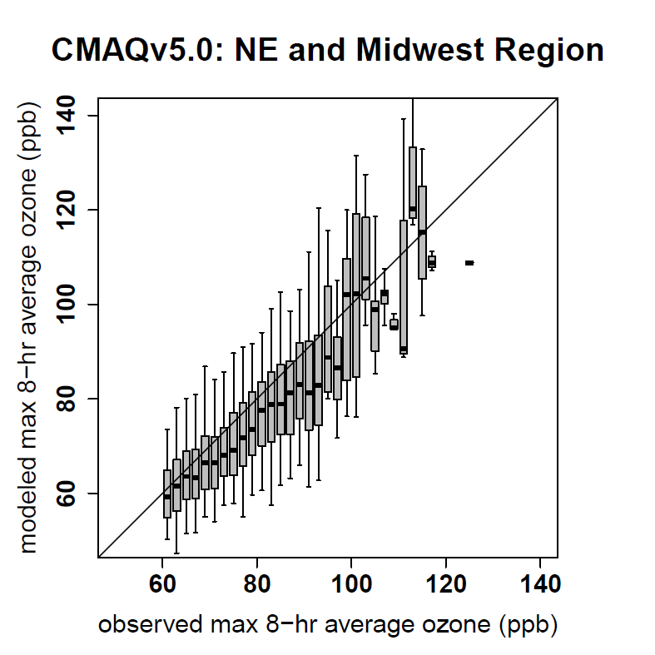
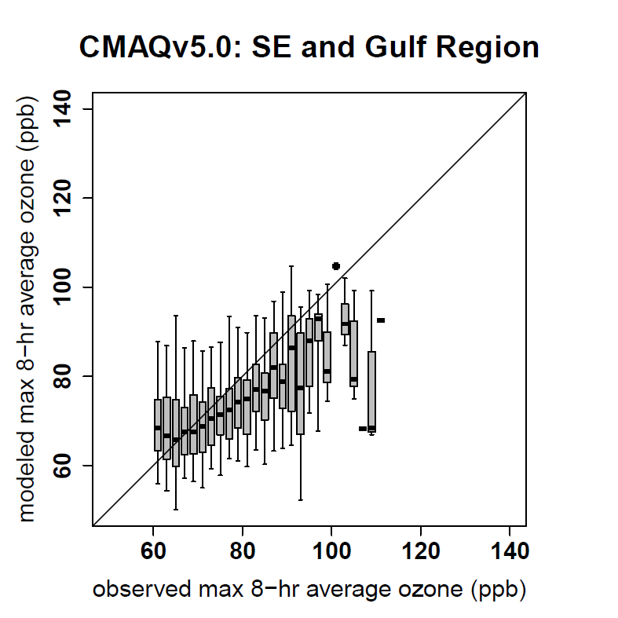
Ozone: Policy relevant performance issues
Observed vs modeled ozone for top 10% of max 8hr ozone days in July/August 2006
In Southeastern and Gulf states, overestimation at low end of the ozone distribution and underestimation at the high end is more pronounced than in other regions of the East.

Slide 10
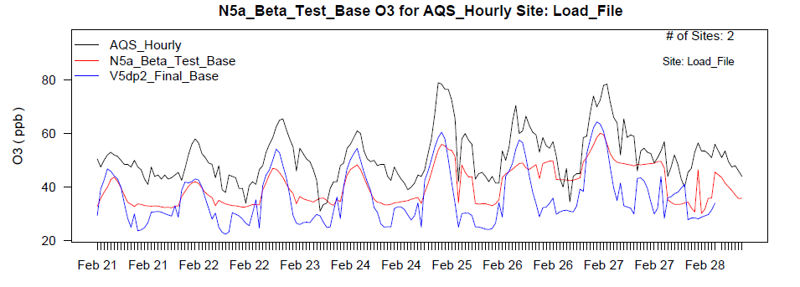
Ozone: High wintertime ozone event
High ozone episode in Feb 2006 in Sublet County WY associated with emissions from oil and gas drilling.
Improved predictions of peak ozone: albedo effects from snow + new stable boundary layer scheme
Hourly O₃ data for Feb. 2006 at two AQS sites in WY
Observed
CMAQv4.7.1
CMAQv5.0

Slide 11
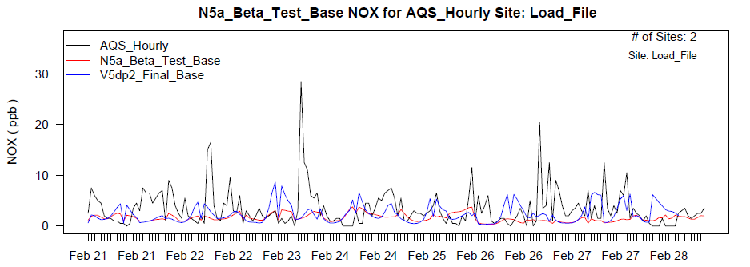
Ozone: High wintertime ozone event
Hourly NO_{x} data for Feb. 2006 at two AQS sites in WY
Observed
CMAQv4.7.1
CMAQv5.0
Correct NOx concentrations are needed before these types of wintertime ozone events can be adequately modeled. Focus future efforts on:
-Characterizing emissions in oil and gas drilling regions
-Evaluation of CMAQ’s ability to predict stable wintertime meteorology during these episodes

Slide 12
Particulate Matter: Relevant rules/regulatory activities
Regulatory Activity | PM Constituent
 | Primary | Sulfate | Nitrate | SOA
2012 PM NAAQS evaluation/standard setting | X | X | X
Implementation of the current and future PM NAAQS standards | X | X | X
Cross-State Air Pollution Rule (CSAPR) |  | X | X
OTAQ: Heavy-Duty and Light-Duty Greenhouse Gas Rules | X | X | X | X
OTAQ: Tier 3 Rule | X | X | X | X
Mercury and Air Toxics Rule (MATS) | X | X
National Air Pollution Assessment (NAPA)* | X | X | X | X
*Designed as multi-pollutant version of the National Air Toxics Assessment (NATA). Includes ozone and HAPs.

Slide 13
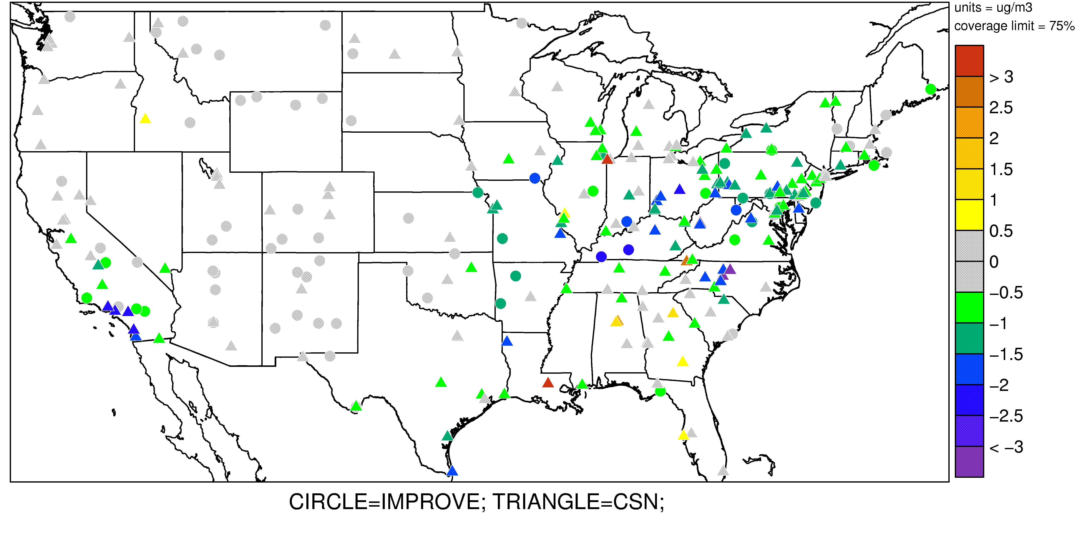
Sulfate : Summertime underestimation
CMAQv5.0 July/August Average Modeled – Observed SO₄ (µg/m³)
Cloud module improvements in CMAQv4.7.1 led to increased summertime sulfate (due to increased convective cloud activity) but underestimation still persists in CMAQv5.0.

Slide 14
Sulfate : Future needs and data gaps
Better representation of convective clouds clouds:
Luo et al (2009) report MM5/CMAQv4.6
Underpredicts cloud cover events (especially for broken cloud conditions)
Overpredicts cloud water content
Overpredicts precipitating cloud fraction → too much sulfate wet deposition
Review and further analysis of these findings is necessary
Comprehensive review of gas- and aqueous-phase sulfate formation pathways
Chao Luo, Yuhang Wang, Stephen Mueller, and Eladio Knipping, Evaluation of sulfate simulations using CMAQ version 4.6: The role of cloud, CMAS, 2009

Slide 15
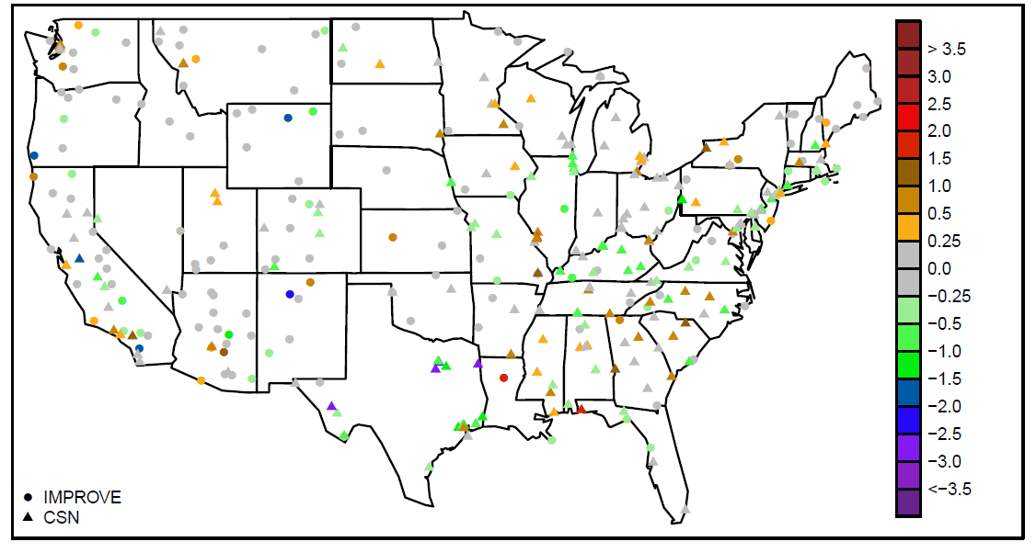
Nitrate: Spring overestimation improved with new bi-directional flux system for NH3
CMAQv4.7.1 Spring NO₃ bias (µg/m³)
CMAQv5.0bi-di Spring NO₃ bias (µg/m³)

Slide 16
Nitrate: Impact of new bi-directional flux system for NH₃

Slide 17
Nitrate: Unresolved performance issue
Salt Lake City, UT: 2005
Poor representation of cold pool meteorology contributes to model under-estimates for high wintertime PM episodes in the inter-mountain west (Baker et al, 2011)
Baker, K.R., Simon, H., Kelly, J.T. (2011), Challenges to Modeling “Cold Pool” Meteorology Associated with High Pollution Episodes, ES&T, 44(17), 7118-7119.

Slide 18
Summary: Recent CMAQ improvements and potential areas for community contributions
Pollutant | Performance Improvements | Remaining Needs
Ozone | Bias decreased in average summertime max 8hr ozone | Underestimation still an issue for higher observed ozone levels, especially in the SE and Gulf regions
 | Predictions of peak ozone during wintertime episodes improved | Need more accurate emissions from oil and gas drilling operations to capture peak wintertime events in Western states
Sulfate | Cloud improvements increase summertime SO₄ in v4.7.1 | Underestimation persists and more cloud model development is needed in met and air quality models
Nitrate | Bidirectional flux model for NH₃ greatly improved spring and autumn overestimation of NO₃ | High wintertime nitrate events are still not captured due to poor performance of meteorological models during stagnant cold pool conditions

Slide 20
