Slide 1
Evaluation of CMAQ NOx Performance using Onroad Emissions Inputs from Two Mobile Source Emissions Models
Heather Simon, Sharon Phillips, Norm Possiel, George Pouliot, John Koupal, Alexis Zubrow, Alison Eyth, Rich Mason

Slide 2
Purpose
Evaluate effects of MOVES and MOBILE6 emissions on CMAQ NOx estimates
Focus initial analysis on Northeastern US
Strong seasonal temperature variations may show how MOVES and MOBILE6 respond differently to summer versus winter temperature regimes
Large concentration of urban areas should give strong urban signal for mobile NO_{x} emissions

Slide 3
CMAQ Model Runs
2005 Model Runs*
(January and July)
2006 Model Runs**
(January and July)
MOBILE6 (2005af)
CMAQv4.7
12 km EUS domain
24 vertical layers
MM5 meteorology
2005 point and area sources
MOVES (2005cr)
CMAQv4.7.1
12 km EUS domain
14 vertical layers
MM5 meteorology
2005 point and area sources
MOBILE6 and SMOKE-MOVES
CMAQ v5beta
Lightning NOx
Inline photolysis
Continental US – 12km domain
34 vertical layers
WRF meteorology
2005 area sources, 2006 point sources
**Emissions from all other sectors are identical for both runs
*Two runs include some other small changes to emissions values and temporalization

Slide 4
Mobile Source Emissions
2005 Scenarios
2006 Scenarios
MOBILE6 county/month
NMIM version: November 28, 2006
County-level input data version: January 23, 2007
Meteorological data: 2005 county-level monthly averaged diurnal temperature profiles
MOVES state/month
MOVES2010
May 2010 MOVES database
National default vehicle fleet characteristics
Meteorological data: 2005 state-level monthly averaged diurnal temperature profiles
allocated to counties based on MOBILE6 inventory
Common Features
Activity data (2005)
Temporalization: Monthly totals allocated to hours based on the same day-of-week and hourly temporal profiles
NOx speciation used a 90/10 split
MOBILE6 county/month
NMIM version: October 9, 2007
County-level input data version: September 12, 2007
Meteorological data: 2005 county-level monthly averaged diurnal temperature profiles
NOx speciation used a 90/10 split
SMOKE-MOVES
MOVES April 14, 2011 version*
May 12 2011 MOVES database*
County-level vehicle fleet characteristics
Meteorological data: 2006 gridded hourly temperatures
NO, NO₂ predicted directly by MOVES
Common Features
Activity data (2005)
Temporalization: Monthly totals allocated to hours based on the same day-of-week and hourly temporal profiles
*Draft updates to MOVES 2010a

Slide 5
Monthly Onroad Mobile NOx Emissions for Northeast States
January
July
tons/month
2005
2006
2005
2006
Percent Increase from MOBILE6 to MOVES
37%
8%
60%
23%

Slide 6
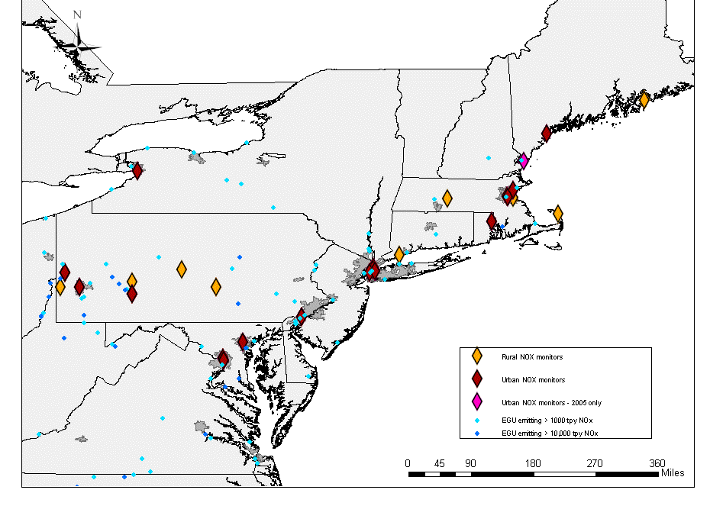
NOx Monitoring Sites Selected for Analysis

Slide 7
Northeast Urban Sites: January Hourly NOx Concentrations
2005
2006
Mean Increase in NOx Conc with MOVES Emissions
7am: 17%
Noon: 16%
6pm: 21%
Mean Increase in NOx Conc with MOVES Emissions
7am: 8%
Noon: 6%
6pm: 6%

Slide 8
Northeast Urban Sites: July Hourly NOx Concentrations
2005
2006
Mean Increase in NOx Conc with MOVES Emissions
7am: 29%
Noon: 21%
6pm: 26%
Mean Increase in NOx Conc with MOVES Emissions
7am: 15%
Noon: 13%
6pm: 14%

Slide 9
Model Performance Evaluation
Looked at spatial and temporal bias trends:
Spatial: Urban vs. Rural
Temporal:
Diurnal
Monthly average (January versus July)
Morning rush-hour in urban areas is often used to look for mobile emissions signal
AQS monitoring locations
Urban and rural monitors evaluated separately
Monitors very near to point sources or airports were eliminated from urban and rural subsets
Challenges
CMAQ model performance is commonly evaluated for ozone and PM, but not for NOx
NOx measurement uncertainty
Uncertainties in modeled meteorological fields
Evaluating model-predicted concentrations is not equivalent to evaluating emissions

Slide 10
NOx Measurement Uncertainty
NOz species may interfere with NOx measurements
Model species can be defined in several ways to compare to measured NOx:
NOx = NO + NO2
Assumes that NOx monitors do not measure any NOz species
Lower bound on model bias
Standard practice
NOxeq = NOy – HNO3
Assumes that NOx monitors measure all NOz species other than HNO3
Upper bound on model bias.
NOy = NO + NO2 + 2*N2O5 + HONO + HNO3 + PAN + PANX + PNA + NTR + NO3
 | Urban | Rural
January | Fresh (NOx≈NOxeq) | Intermediate
July | Intermediate | Aged (NOxeq > NOx)

Slide 11
Northeast Urban Sites: January NOx Bias by Hour
January 2005
January 2006
NOx
MB_{MOBILE6} = -7.8 ppb ; NMB_{MOBILE6} = -21%
MB_{MOVES} = -1.0 ppb ; NMB_{MOVES} = -3%
NOx
MB_{MOBILE6} = -2.4ppb ; NMB_{MOBILE6} = -5%
MB_{MOVES} = 0.7 ppb ; NMB_{MOVES} = 2%

Slide 12
Spatial Heterogeneity of NOx Bias 6am-9am January 2006
MOBILE6 run
MOVES run
Boston area shows some overestimates and some underestimates
Boston area shows some overestimates and some underestimates
NY area shows some overestimates and some underestimates
NY area shows some overestimates and some underestimates
Baltimore area is underestimated
Baltimore area is underestimated
Spatial patterns of NOx mean bias look very similar in MOBILE6 and MOVES runs
Difference in bias between runs is much less than site-to-site variability of bias within a single run

Slide 13
Northeast Urban Sites: July NOx Bias by Hour
July 2005
July 2006
NOx
MB_{MOBILE6} = -6.5 ppb ; NMB_{MOBILE6} = -18%
MB_{MOVES} = -1.1ppb ; NMB_{MOVES} = -3%
NOx
MB_{MOBILE6} = 5.0ppb ; NMB_{MOBILE6} = 24%
MB_{MOVES} = 8.5 ppb ; NMB_{MOVES} = 41%

Slide 14
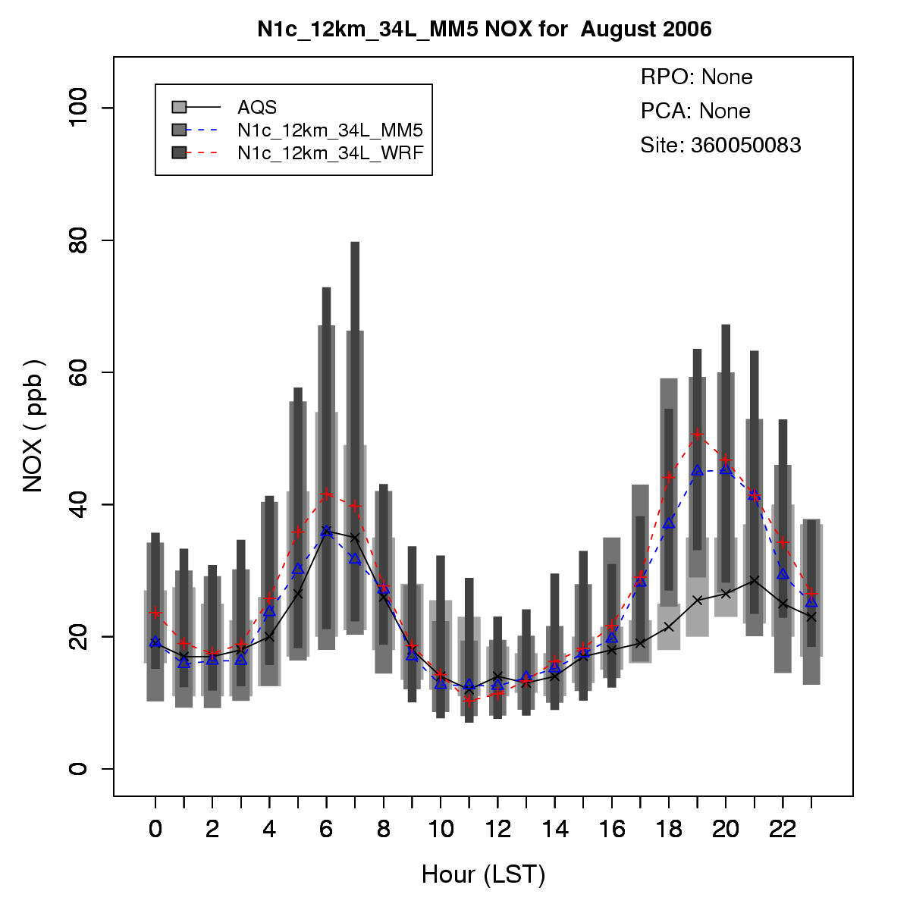
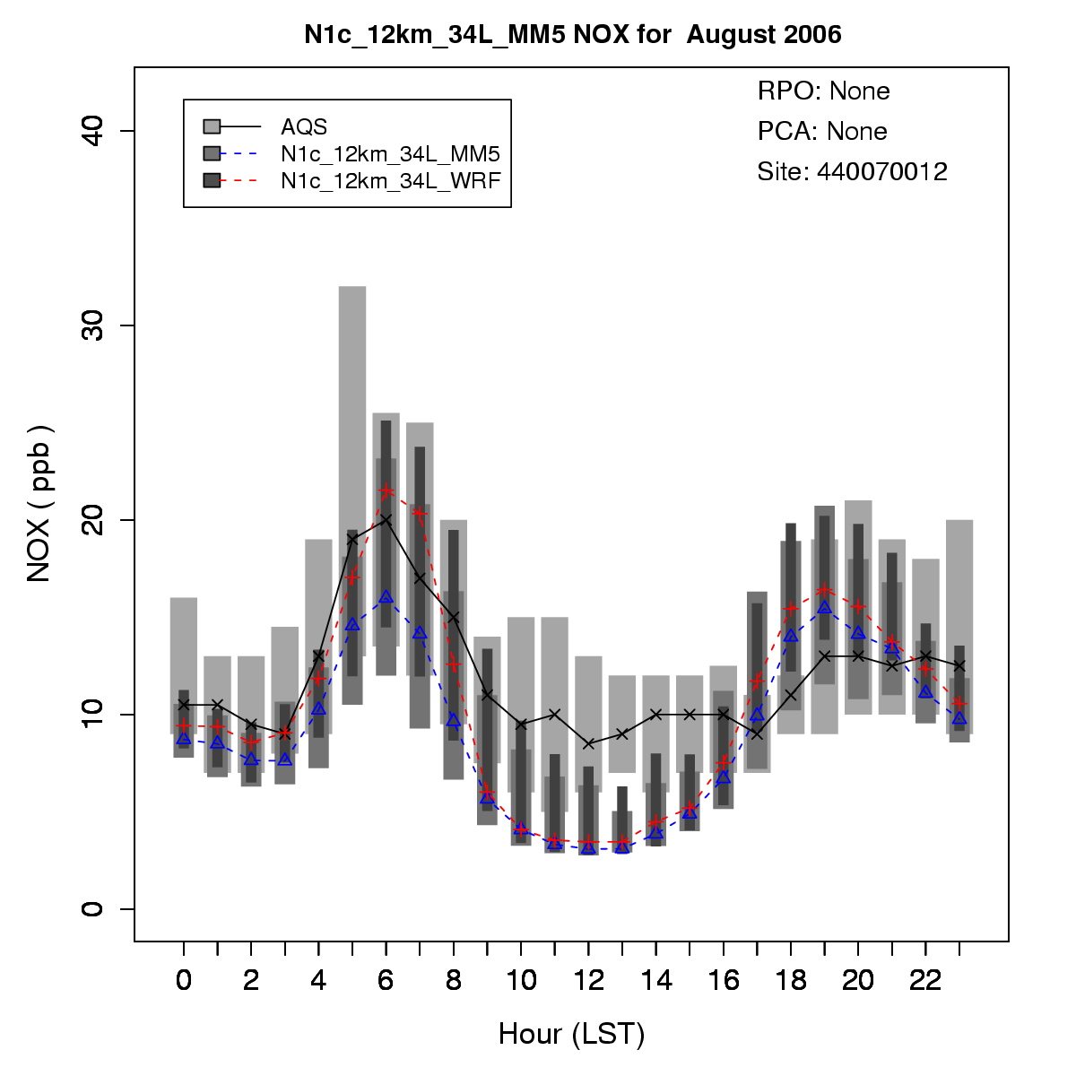
Uncertainties in Modeled Meteorological Fields
Two common meteorological models used to create inputs for CMAQ: MM5 and WRF
CMAQ simulations with inputs from MM5 vs WRF estimate different NOx concentrations
May be a result of different degrees of dilution/mixing of ground level emissions
WRF + CMAQ leads to higher predicted NOx concs than MM5 + CMAQ
The difference is most pronounced:
Summer
Urban areas
Transition periods (morning and evening)
New York City NOx Conc in model runs using MM5 and WRF
Providence NOx Conc in model runs using MM5 and WRF

Slide 15
Urban NOx Median Bias in the Northeast using Different Model Setups (All with MOBILE6 Emissions)
January 2005/2006
July 2005/2006
*
*
Met model has especially large effect on predicted urban bias in the summer
*2006 MM5 and WRF model simulations use slightly different model setups (CMAQv4.7 vs CMAQv5.0 beta; 24 vs 34 vertical layers)

Slide 16
Rural NOx Median Bias in the Northeast using Different Model Setups (All with MOBILE6 Emissions)
January 2005/2006
July 2005/2006
*
*
Difference in met models has less impact on rural bias estimates
*2006 MM5 and WRF model simulations use slightly different model setups (CMAQv4.7 vs CMAQv5.0 beta; 24 vs 34 vertical layers)

Slide 17
Summary
MOVES estimates higher NOx emissions than MOBILE6 in the Northeastern US
State/month: 37% / 60% in January / July
SMOKE-MOVES: 8% / 23% in January / July
Urban NOx concs in CMAQ increase by 5-20% with MOVES vs MOBILE6 emissions
Rural NOx concs in CMAQ increase by 10-40% with MOVES vs MOBILE6 emissions
We expect a strong signal for comparing the two mobile models:
In urban areas
During the morning rush-hour
There is the least measurement uncertainty in urban areas during the winter/morning hours
CMAQ run with MOBILE6 emissions underestimated NOx concentrations at these times/locations
CMAQ run with MOVES emissions had a smaller NOx bias at these times/locations
Meteorological inputs have a large affect on estimated nighttime/morning concentrations in urban areas during the summer
CMAQ run with MM5 inputs underestimated NOx concentrations at these times/locations (underestimate with MOBILE6 emissions was more notable)
CMAQ run with WRF inputs overestimated NOx concentration at these times/locations (overestimate with MOBILE6 emissions was less notable)

Slide 18
Acknowledgements
Wyat Appel
Kirk Baker
Jim Kelly
Harvey Michaels
Brian Timin
Alfreida Torian

Slide 20
Northeast Rural Sites: July Hourly NOx Concentrations
2005
2006
Similar absolute difference between MOBILE6 and MOVES
Higher baseline concentrations
Mean Increase in NOx Conc with MOVES Emissions
7am: 34%
Noon: 40%
6pm: 37%
Mean Increase in NOx Conc with MOVES Emissions
7am: 21%
Noon: 22%
6pm: 20%

Slide 21
Northeast Urban Sites: January 2006 Hourly Bias NOx vs NOxeq
(Fresh)
NOx
NOxeq
-These two metrics bound the actual NOx bias because we do not know what fraction of ambient NOz species are being measured by NOx monitors
-In fresh air masses, NOxeq normalized bias is similar to NOx normalized bias

Slide 22
Northeast Rural Sites: July 2006 Hourly Bias NOx vs Noxeq
(Aged)
NOx
NOxeq
-These two metrics bound the actual NOx bias because we do not know what fraction of ambient NOz species are being measured by NOx monitors
-In aged air masses, NOxeq normalized bias is substantially higher than NOx normalized bias

