Slide 1
Monitoring Air Quality Changes in Regions Influenced by Major Point Sources over the Eastern and Central United States Using Aura/OMI NO₂
Ken Pickering NASA Goddard Space Flight Center, Greenbelt, MD
Ana Prados UMBC/JCET Goddard Space Flight Center, Greenbelt, MD
Sergey Napelenok US EPA, Research Triangle Park, NC

Slide 2
Introduction
Tropospheric NO₂ observations from space :
GOME 8/95-6/03 40 x 320 km* 10:30 AM LT
SCIAMACHY 8/03 → 60 x 30 km** 10:00 AM LT
OMI 11/04 → 13 X 24 km*** 1:30 PM LT GOME-2 3/07 → 40 X 80 km 9:30 AM LT
* Global coverage in 3 days; **complete coverage at Equator in 6 days; ***nadir resolution, increasing to 40 X 160 km at edges
Trend analyses – examples:
Richter et al. (2005): GOME and SCIAMACHY data used to show NO₂ increases over China and decreases in US and Europe
Kim et al. (2006): SCIAMACHY data used to demonstrate initial NO₂ decrease due to SIP Call power plant emission reduction

Slide 3
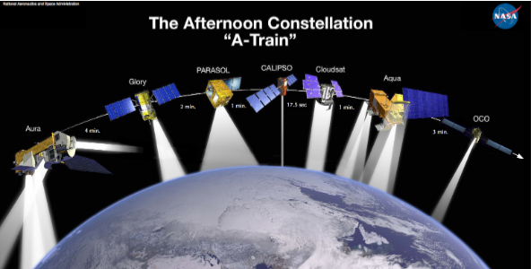
Aura/OMI
Ozone Monitoring
Instrument
Aura
2-dimensional CCD
Wavelength range: 270 – 500 nm
Sun-synchronous polar orbit;
Equator crossing at 1:30 PM LT
2600-km wide swath; horiz. res.
13 x 24 km at nadir
Global coverage every day
O₃, NO₂, SO₂, HCHO, aerosol,
BrO, OClO
wavelength
~ 580 pixels
~ 780 pixels
viewing angle
± 57 deg
flight direction
» 7 km/sec
13 km
(~2 sec flight))
2600 km
13 km x 24 km (binned & co-added)

Slide 4
What has happened to Eastern US NO_{x} emissions since 2002?
US EPA mandated power plant NO_{x} emission reductions under the 1998 NO_{x} State Implementation Plan Call. Nearly 40% reductions between 2002 and 2005 were documented by Kim et al. (2006) using SCIAMACHY NO₂ data.
Program evolved into the “NO_{x} Budget Trading Program”. Resulted in further summertime power plant emission reductions over the regulated region (19 eastern states), but trading program allows flexibility concerning the magnitude of reduction at specific facilities.
Clean Air Interstate Rule (CAIR) – resulted in further reductions (28 states), but rule thrown out by courts; then reinstated. Some companies reduced emissions in response to more stringent state rules and court orders.
Cross-State Air Pollution Rule (CSAPR) – announced July 2011; replaces CAIR; ozone season NO_{x} reductions of 54% from 2005 required over 20 states by 2012.

Slide 5
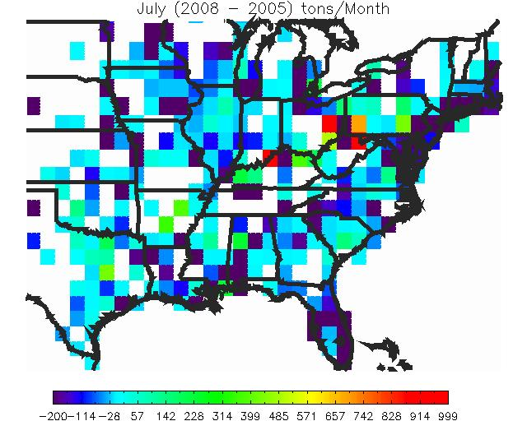
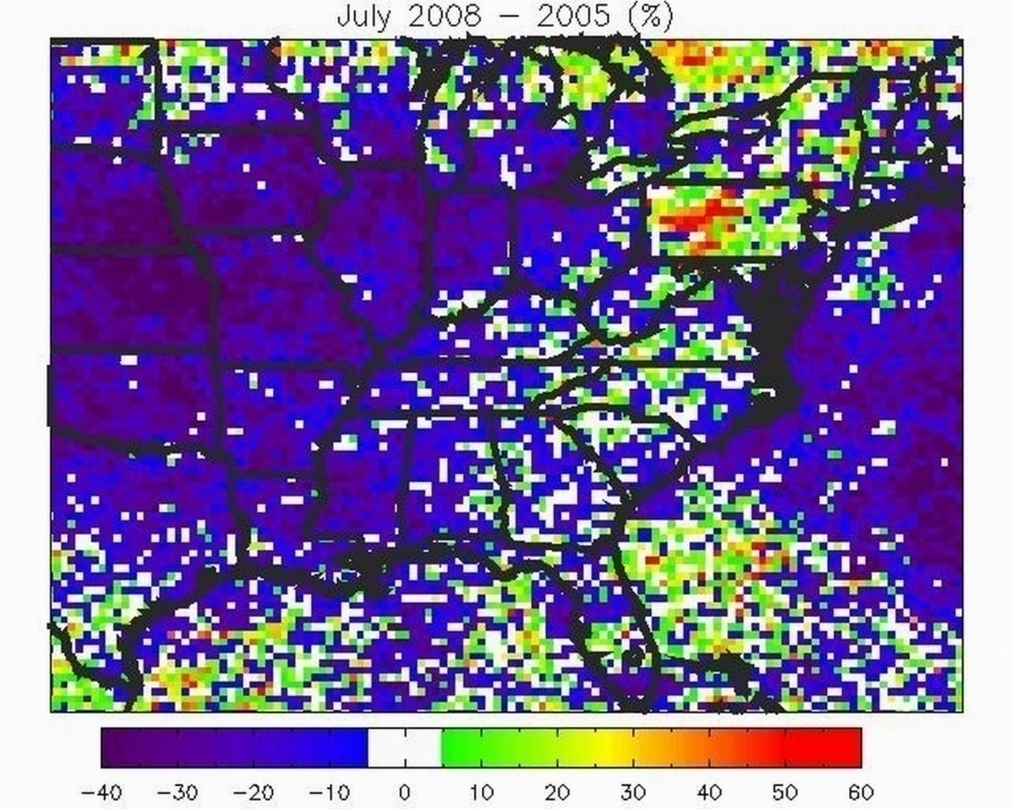
July 2008 vs. July 2005
OMI Trop. NO2 -- % change
Continuous Emission Monitoring
System (CEMS) -- Absolute Changes

Slide 6
OMI NO₂ Trend Calculation
Total NO₂ and the NO₂ sensitivity to NO_{x} emissions from major point sources in selected regions at each model layer computed by CMAQ-DDM-3D
CMAQ tropospheric columns of total NO₂ and the NO₂ contribution from major point sources were calculated daily for OMI overpass time
The monthly mean fraction of the total CMAQ NO₂ column contributed by these point sources was calculated for each model column
OMI tropospheric NO₂ (0.05 degree Level 3 product) was regridded onto the CMAQ 12 km grid
The CMAQ columns corresponding to three fraction thresholds, 0.3, 0.4, and 0.6 were selected
For each month and year, the corresponding OMI NO₂ regridded values were averaged into monthly means
OMI NO₂ trends were calculated as the differences between the monthly means for each year (2006, 07, 08) and the 2005 means

Slide 7
CEMS Trend Calculation
CEMS point source NO_{x} emissions were mapped onto the OMI NO₂ grid, and monthly values (in tons/month) were calculated for the 2005-2008 time period
The trends were calculated as the difference between monthly NO_{x} emissions from all grid cells contained within each selected region and the 2005 monthly emissions.

Slide 8
Decoupled Direct Method in 3D (DDM-3D) in CMAQ (Napelenok et al., 2008, Environ. Modeling and Software)
Provides a measure of the change in pollutant concentrations due to changes in some parameter of interest (in this case emissions).
Change in concentrations of specie i due to changes in emissions of j.
DDM-3D provides sensitivity of gaseous pollutants (NO, NO₂, O₃, etc.) due to EGU emissions of NO_{x} in 8 predefined geographical areas.
MN
WPAEOH
LOHV
MDSPA
WMOEKS
NEOK
NGANAL
NETXWLA

Slide 9
Application of CMAQ-DDM-3D in Trend Analysis
Ideally, one would want to run CMAQ-DDM-3D for the beginning year and end year of the trend period, and compute the OMI NO₂ trend only for CMAQ grid cells with similar sensitivities in both years.
In this preliminary work we have a 2005 CMAQ-DDM-3D run and examine the monthly mean analyzed winds to determine similarities in transport between 2005 and 2008.

Slide 10
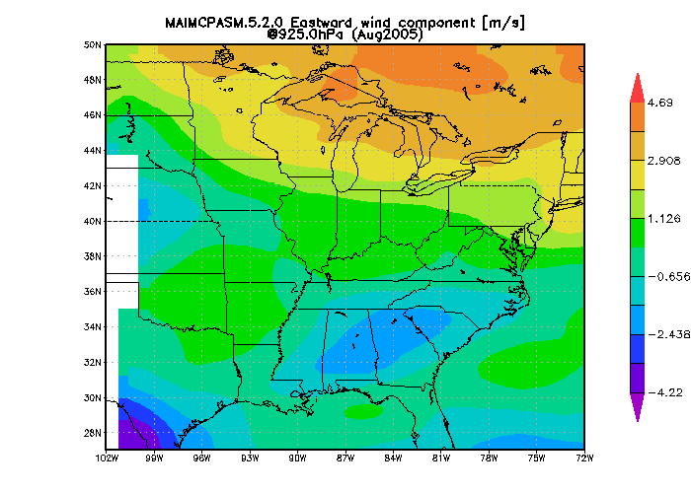
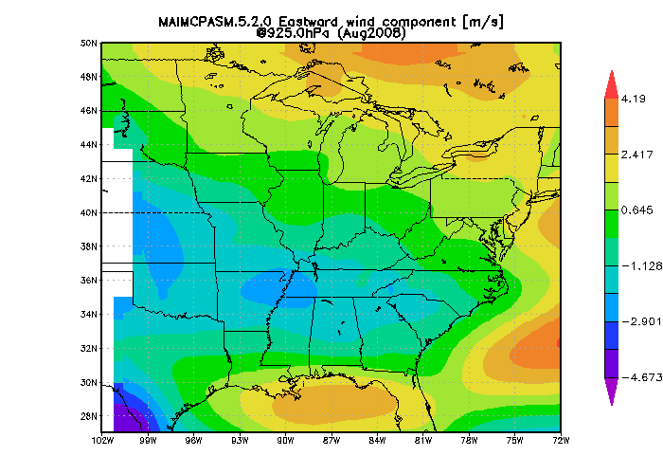
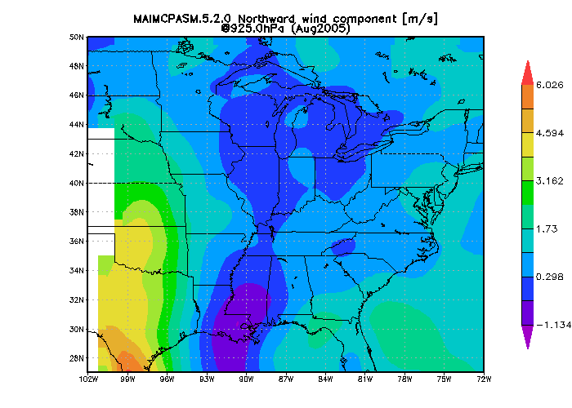
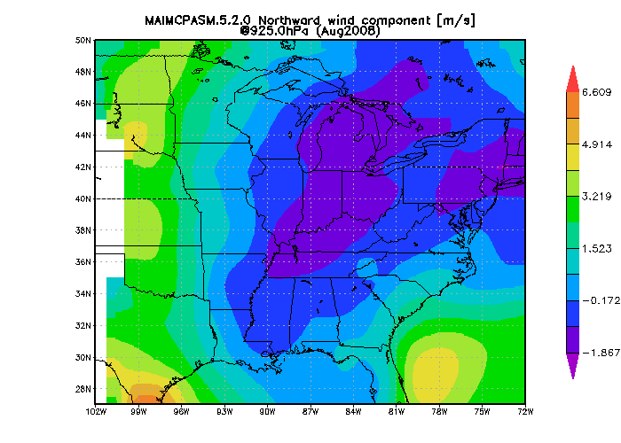
Example: August 2005 vs. 2008 GSFC/GMAO MERRA Winds
U August 2005
U August 2008
V August 2005
V August 2008

Slide 11
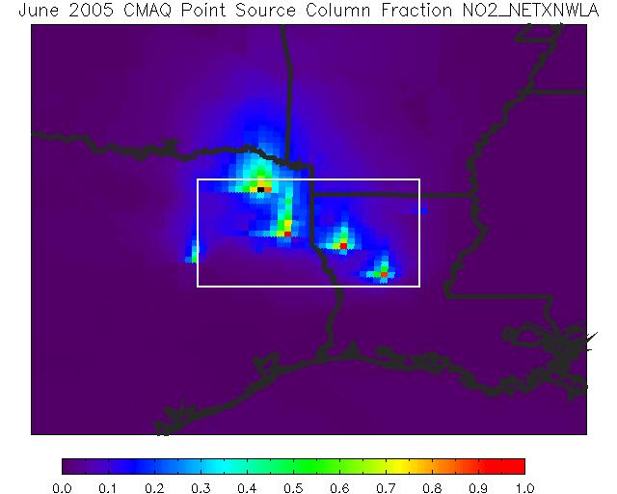
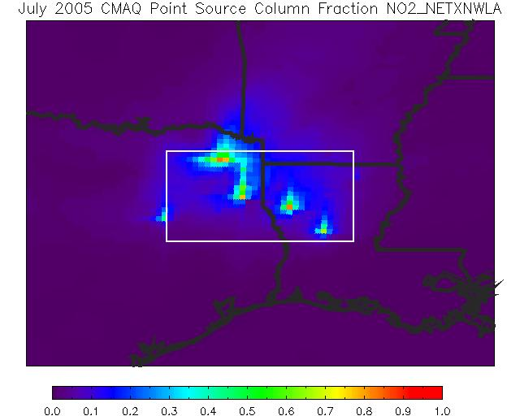
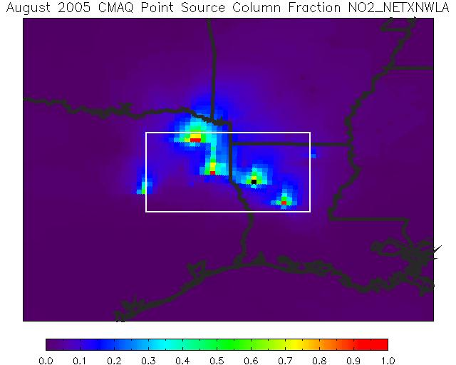

Slide 12
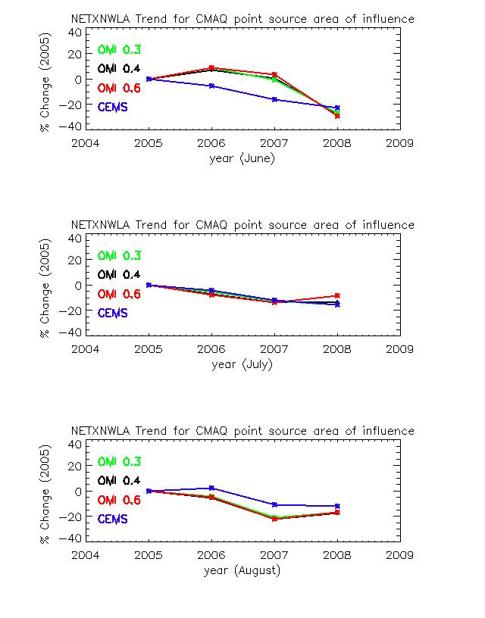

Slide 13
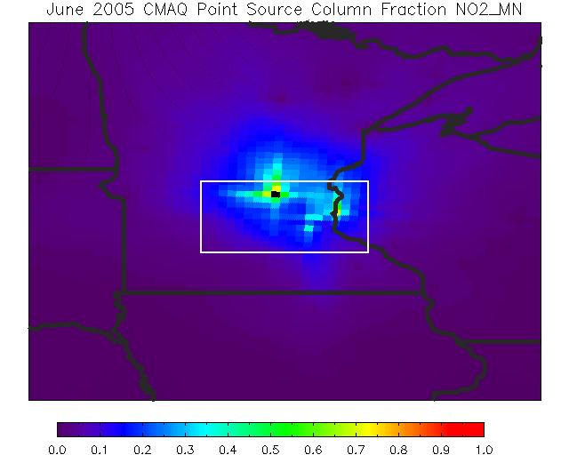
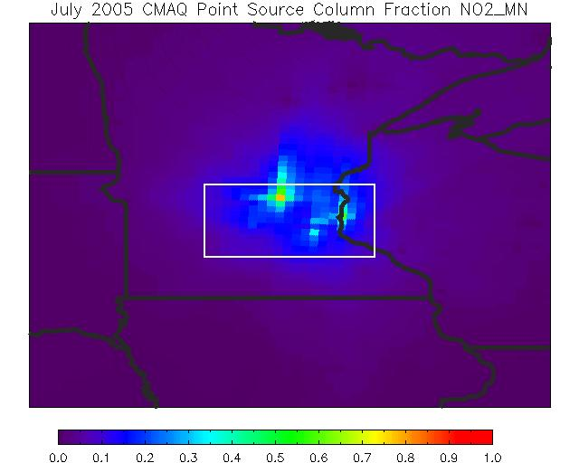
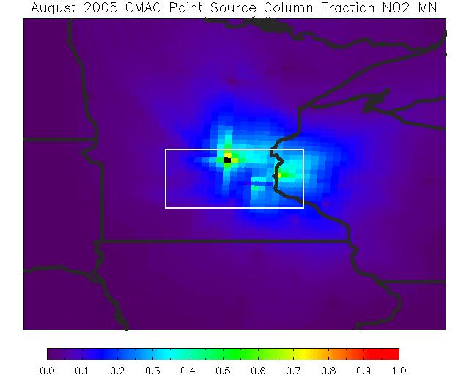

Slide 14
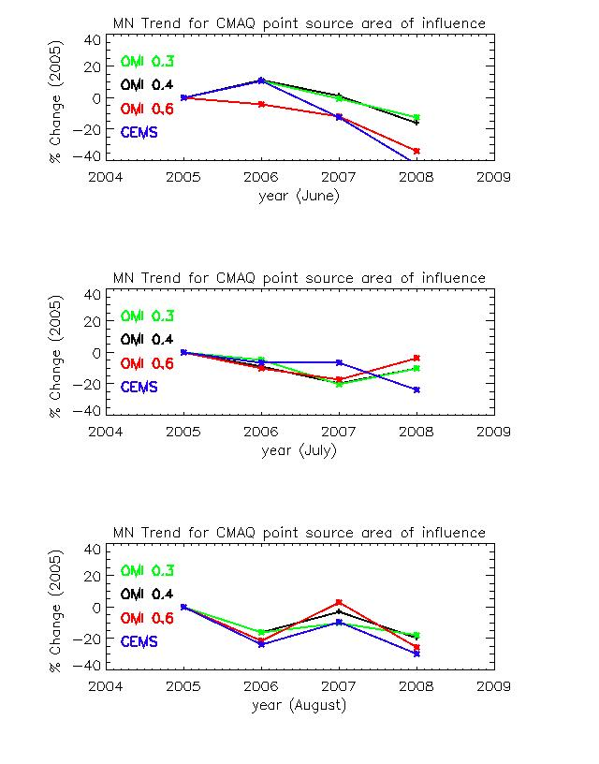

Slide 15
Percentage Changes 2005 to 2008
NE TX – W LA June July Aug
OMI trend in grid -29.2 -8.4 -16.6
cells with sensitivity
ratio >0.6
CEMS trend -22.7 -15.6 -12.1
---------------------------------------------------------------------------------------------------------------
MN
OMI trend in grid -34.3 -4.0 -25.5
cells with sensitivity
ratio >0.6
CEMS trend -42.5 -23.8 -29.7
---------------------------------------------------------------------------------------------------------------
Moderate emission reductions in all
three months; OMI trends similar
Large emission reductions in all
three months; OMI trends nearly
as large except for July

Slide 16
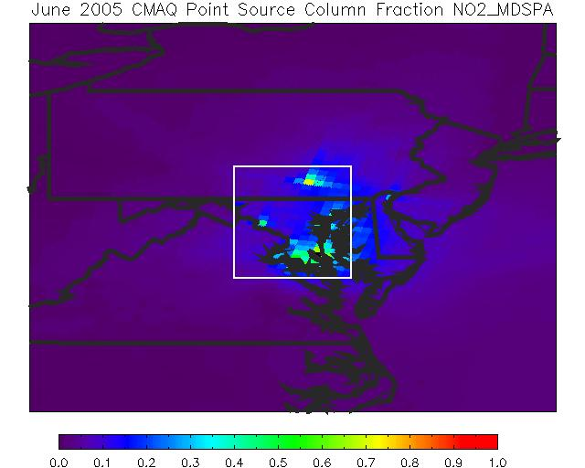
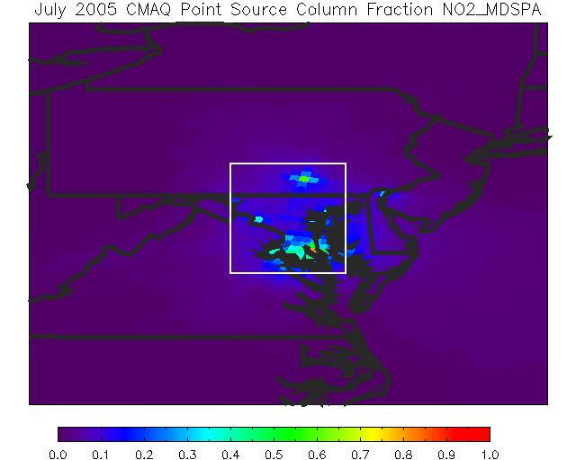
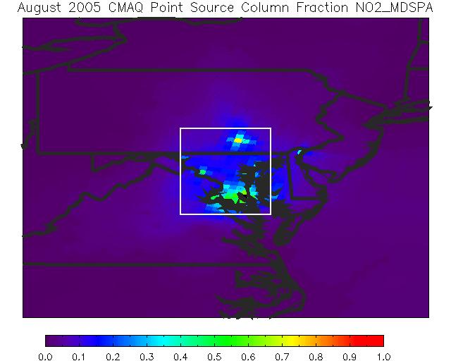

Slide 17
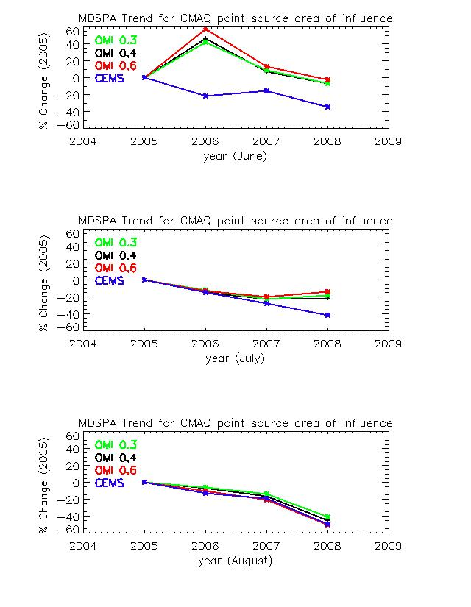

Slide 18
Percentage Change 2005 to 2008
MD – S PA June July Aug
OMI trend in grid -2.4 -13.5 -50.1
cells with sensitivity
ratio >0.6
CEMS trend -34.6 -41.4 -49.6
-------------------------------------------------------------------------------------------------------------------
W MO – E KS
OMI trend in grid -37.6 -31.3 -17.4
cells with sensitivity
ratio >0.6
CEMS trend -41.6 -39.7 -35.1
-------------------------------------------------------------------------------------------------------------------
Large emission reductions in all three
months; OMI shows small decrease in
June, moderate in July, and decrease
equal to CEMS in August. Other
sources must have increased. Will
need to compare 2005 and 2008 NEI.
Large emission reductions in all three
months; OMI shows nearly similar
reductions except in August.

Slide 19
Percentage Change 2005 to 2008
Lower OH Valley June July Aug
OMI trend in grid -25.4 -4.5 -23.7
cells with sensitivity
ratio >0.6
CEMS trend +2.4 +6.2 +2.6
---------------------------------------------------------------------------------------------------------------
NE OK
OMI trend in grid -29.2 -12.9 -18.4
cells with sensitivity
ratio >0.6
CEMS trend +9.5 +1.5 -4.4
---------------------------------------------------------------------------------------------------------------
Small increases in emissions in all
three months; OMI has substantial
opposite trend.
Same as above.
Other source emission reductions
must be dominating!
Possible candidates:
Mobile sources ?
Lightning ?
Two additional regions (N GA – N AL, W PA – E OH) show similar pattern for
two months out of three;

Slide 20
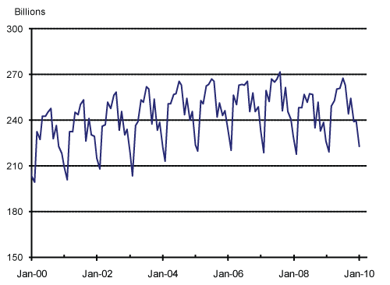
Tier II Tailpipe NO_{x} Emission Standards – 5% reduction in emissions
per year for new vehicles over 2002 to 2010. This combined with dip in
Vehicle Miles Traveled could have led to ~10% reductions from
2005 to 2008.
US Monthly Vehicle Miles Traveled
~5% decr.
Federal Highway Administration

Slide 21
SUMMARY
CMAQ-DDM-3D output and OMI tropospheric NO₂ data together form a system for monitoring NO₂ air quality response in regions influenced by sector emission reductions, demonstrated here for major point sources.
In three regions (NE TX – W LA; MN; W MO – E KS) OMI NO₂ summertime trends from 2005 – 2008 nearly match those of CEMS NO_{x} (moderately to strongly negative).
MD – S PA region has large decrease in CEMS emissions, but this is only matched by OMI in August. OMI is only weakly negative in June and July, suggesting some other sources increased.
In four regions (LOHV; NE OK; N GA – N AL, W PA – E OH) CEMS shows primarily small increases, but OMI trends are mostly moderately to strongly negative. Mobile sources? Lightning?
OMI trends can be extended to present, but sampling is greatly reduced due to blockage of part of the field of view.

Slide 22
Acknowledgements
This work was supported by a Decision Support System project funded by the NASA Applied Sciences Air Quality Program.
Thanks to Uma Shankar of CMAS for providing software for regridding OMI NO2 data to the CMAQ grid.

