Slide 1
Analysis of CMAQ Performance and Grid-to-grid Variability Over 12-km and 4-km Spacing Domains within the Houston airshed
Daiwen Kang
Computer Science Corporation, Research Triangle Park, NC, USA
Golam Sarwar, Rohit Mathur
AMAD/NERL, U.S. Environmental Protection Agency, Research Triangle Park, NC, USA

Slide 2
CMAQ modeling details
Nested model runs using CMAQv4.7.1 with CB-05 chemistry
Modeling domain
Large eastern US domain: 12-km grids
Nested Houston domain: 4-km grids
Layer structure
35 vertical layers with 20-m surface layer
WRF generated for meteorological fields
Initial and Boundary conditions
Large domain uses data from AQME II continental domain results
Small domain (4 km) uses results from the large domain (12 km)

Slide 3
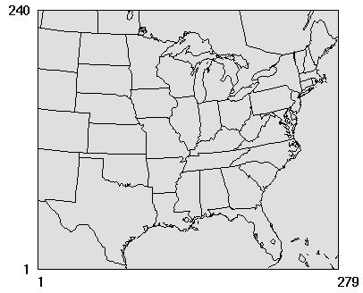
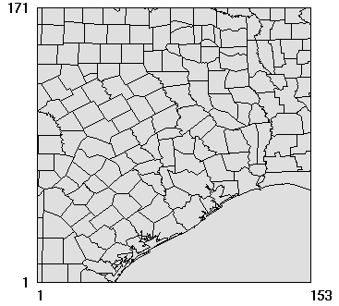
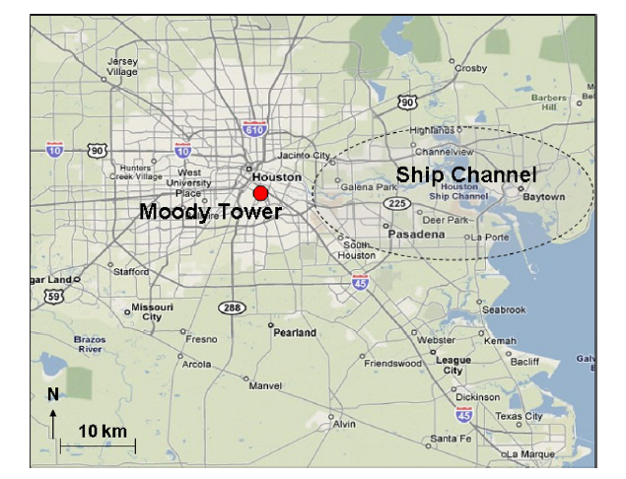
Modeling domains
Smaller domain
with 4-km grid-cells
Large domain with 12-km grid-cells

Slide 4
Emissions
Point sources in Texas for VOC, NO_{X}, CO - specialized inventory
Point sources in Texas for other pollutants - NEI 2005
Other sources in Texas for all pollutants - NEI 2005
Sources outside Texas for all pollutants – NEI 2005
Mobile sources were estimated using MOBILE6
Biogenic sources were estimated using BEISv3.14 (off-line)
Plume rise calculations for point sources are done in CMAQ

Slide 5
Illustration of grid structure for analysis
12 km grid cell
3 | 6 | 9
2 | 5 | 8
1 | 4 | 7
Each 12-km grid cell contains 9 4-km grid cells. The neighboring grid cells mentioned in this presentation include all the 9 grid cells surrounding an observation site.
For traditional evaluation:
OBS MOD (12-km)
or
OBS MOD (4-km)
In this analysis:
OBS All neighboring cells
Observation site
4 km grid cell

Slide 6
Stats for Daily Maximum 8-hr O₃ at All AQS Sites within 4km Domain
Metrics | Paired (4km) | Paired (12km) | Best-Matching (4km Neighboring Cells)
RMSE (ppb) | 15.65 | 14.94 | 11.62
NME (%) | 25.36 | 24.29 | 17.63
MB (ppb) | 1.86 | 2.43 | 1.32
NMB (%) | 3.92 | 5.13 | 2.79
R | 0.55 | 0.61 | 0.76

Slide 7
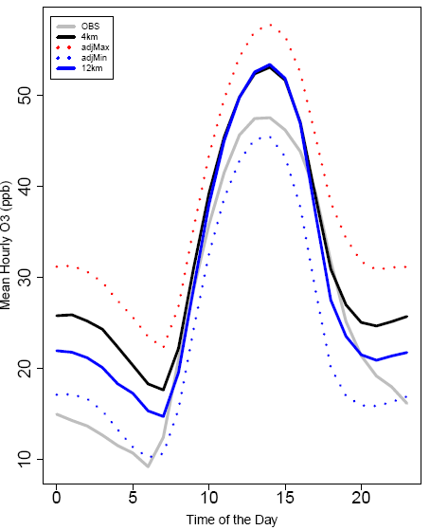
Average Diurnal Profile for AQS Houston Sites
Majority of the observed values are within the range of mixing ratios simulated by the 4km grid cells (within a 12km grid cell).
The simulated values over the 4km and 12km resolutions differ mostly during nighttime. Daytime values are very similar and both overestimated

Slide 8
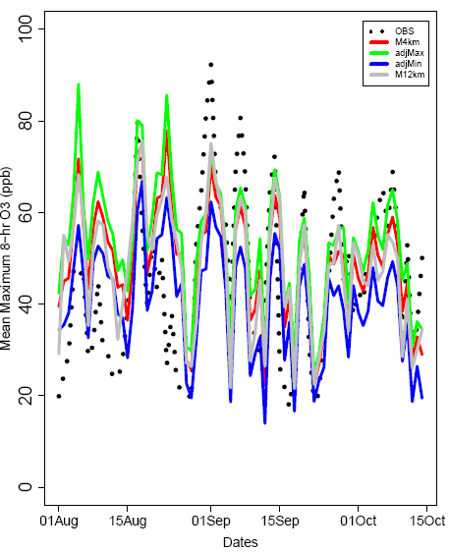
Time-series of Daily Max. 8-hr O₃ for AQS Houston sites
The simulated variability within a 12km grid can be as wide as 30 ppb with a mean value of 13 ppb.
About 1/3 of the observed daily max. 8-hr values are within the range simulated with finer resolution.

Slide 9
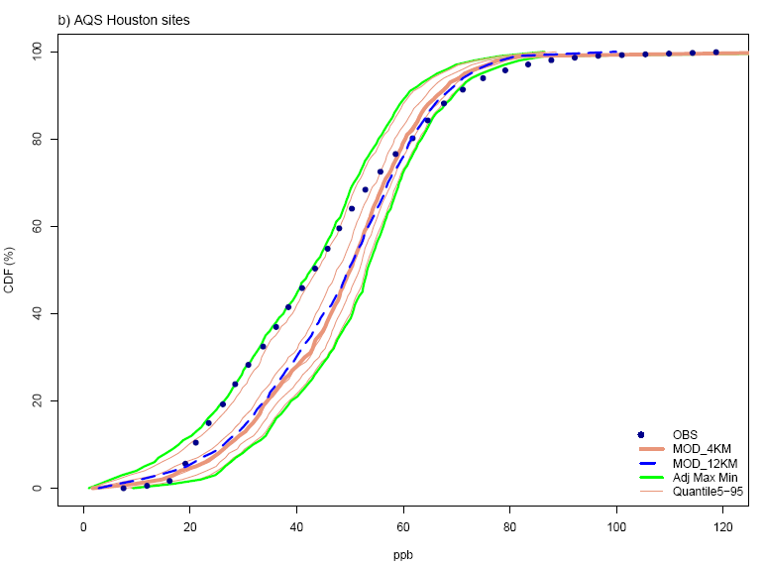
ECDF of Daily Max. 8-hr O₃ for AQS Houston Sites
The observed daily maximum 8-hr O₃ concentrations are within the distribution range constituted by the values from the neighboring cells.
At lower levels (20 to 50 ppb), the observed values are close to the low value edge, while at higher levels (>60 ppb), the observed values closer to or just beyond the high value edge of the band.

Slide 10
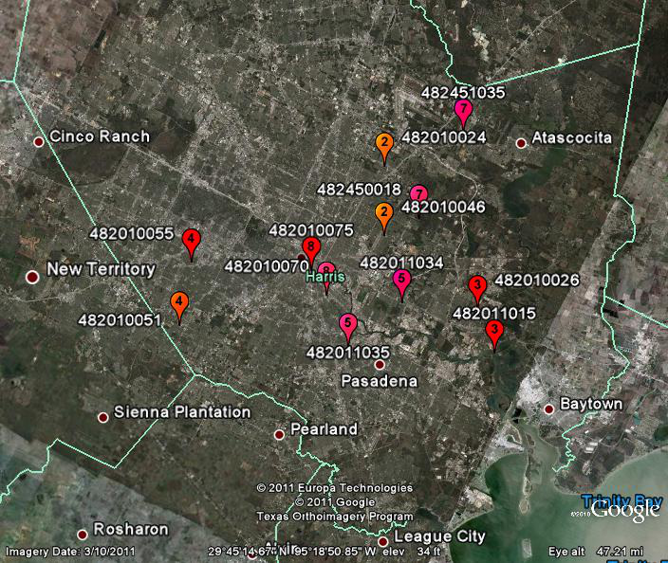
Sites located in the same 12km grid cell in Houston area
The sites with the same numbers are located within the same 12km grid cell, while the pair of sites 8 is also located in the same 4km grid cell. Sites numbered 1 and 6 are out of this view.

Slide 11
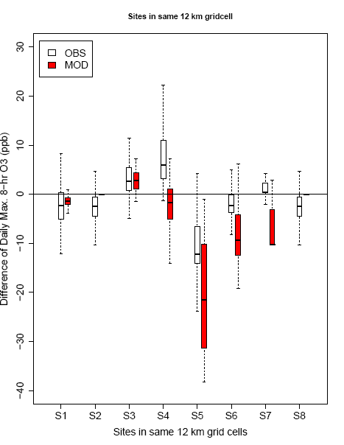
The difference between observations and model simulations for sites located at the same 12 km grid cell
Significant differences exist between the two sites which are located in the same 12km grid cell while in different 4km grid cells for both the observations and model simulations. At some site-pairs, the observed and modeled differences are opposite (s4 and s7)

Slide 12
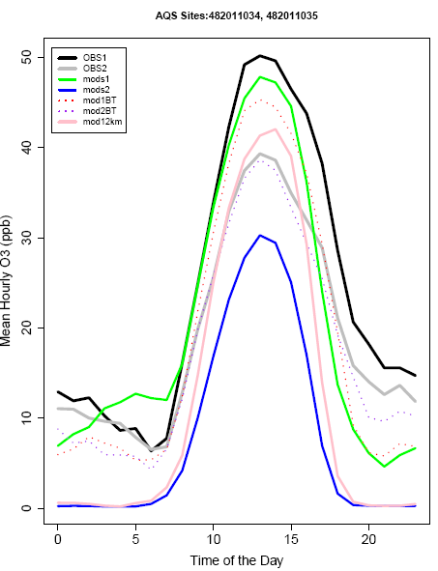
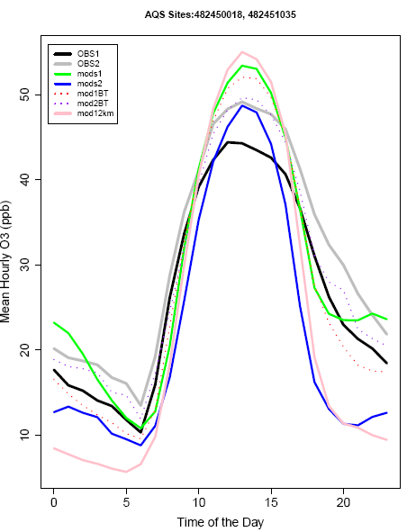
The diurnal O₃ variation at two sites which are located in the same 12km grid cell but different 4km grid cells
MOD1
MOD1
OBS1
OBS2
OBS2
OBS1
MOD2
MOD2

Slide 13
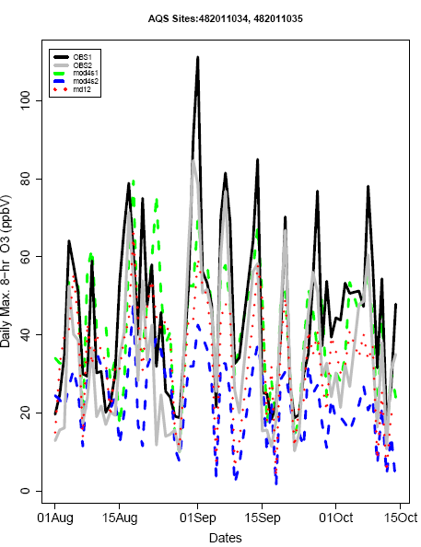
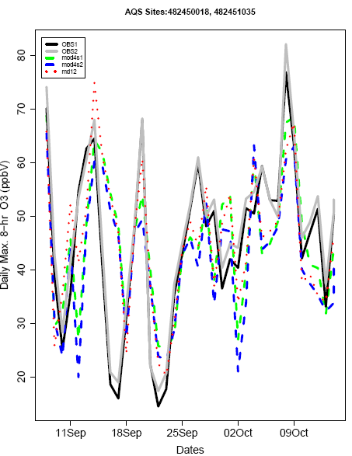
Time series of daily Max. 8-hr O₃ at two sites which are located in the same 12km grid cell but different 4km grid cells

Slide 14
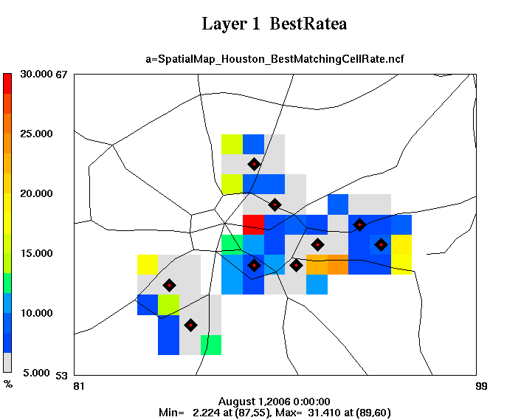
The best-matching rate in the neighboring grid cells (hourly O₃)
The best-match is one of the simulated values that is closest to an observation at a site from the neighboring grid cells surrounding the site; the best-matching rate (BMR) at one grid cell is the total best-matching points located at this grid cell divided by the total number of observed data points at the site.
Mathematically:
where BMR(i), the best-matching rate at cell (i), i=1,9; NP_{i}, best-matched points located at cell (i); O(j), an observation (j); M(i, j), the corresponding simulated value (j) at cell (i); N, the total number of observations

Slide 15
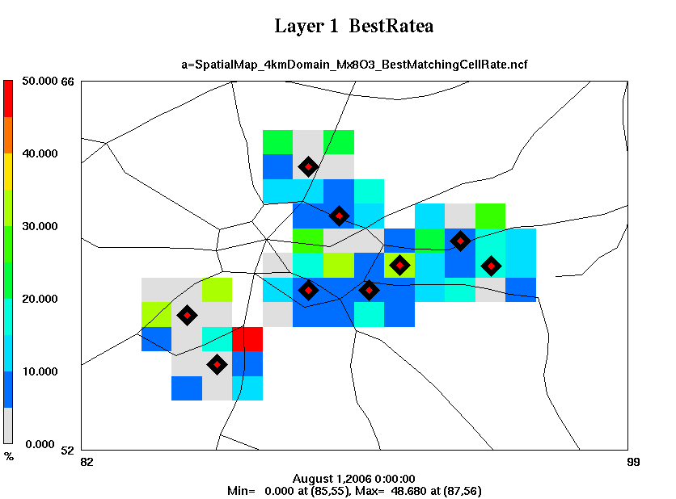
The best-matching rate in the neighboring grid cells (Daily Max. 8-hr O₃)
At some sites, the best-matching rate is dominantly higher at one grid cell than at other neighboring grid cells, that may suggest some subtle spatial configuration issues about emissions/meteorology inputs.

Slide 16
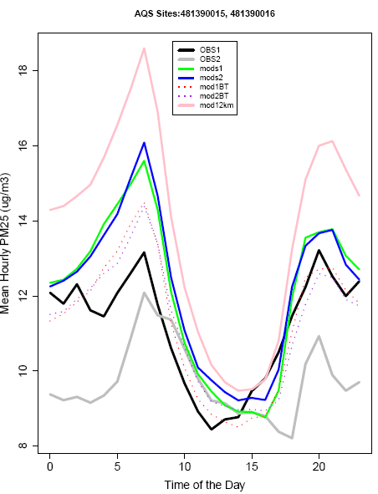
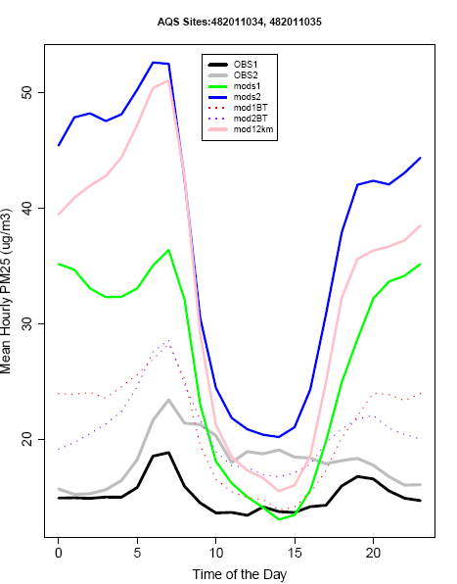
The diurnal variation at two sites which are located in the same 12km grid cell but different 4km grid cells for PM_{2.5}
MOD2
MOD2
MOD1
MOD1
OBS1
OBS2
OBS1
OBS2

Slide 17
Conclusions
Significant differences between the observations at sites which are located in the same 12 km grid cell indicate that it is necessary to perform model simulations using finer (4 km) resolutions over Houston airshed
The performance measures over the 4 km resolution may not be necessarily better than over the coarser (12 km) resolution; it may be even worse if it is evaluated using the traditional evaluation metrics based on paired obs-mod data
The distributional analysis of species concentrations among the neighboring grid cells may shed light on the subtle configuring problems associated with meteorological and/or emissions inputs which can help improve future model simulations

Slide 18
Conclusions
The finer resolution provides additional information which enables distribution and probability evaluations which are more suitable measures to gauge a model’s performance
To properly evaluate a 12km simulation, we need to perform the 4km simulation, and use the subsequent information to assess the 12km model performance

Slide 19
Acknowledgements
David Wong, Sergey Napelenok, Shawn Roselle, James Godowitch, ST Rao
Disclaimer
The United States Environmental Protection Agency through its Office of Research and Development funded and managed the research described here. It has been subjected to Agency’s administrative review and approved for presentation.

