Slide 1

Analysis of Vertical Fire Emissions Distribution in CMAQ
Fernando Garcia-Menendez
Deniz Genc Tokgoz, Talat Odman
10th Annual CMAS Conference
October 25, 2011

Slide 2
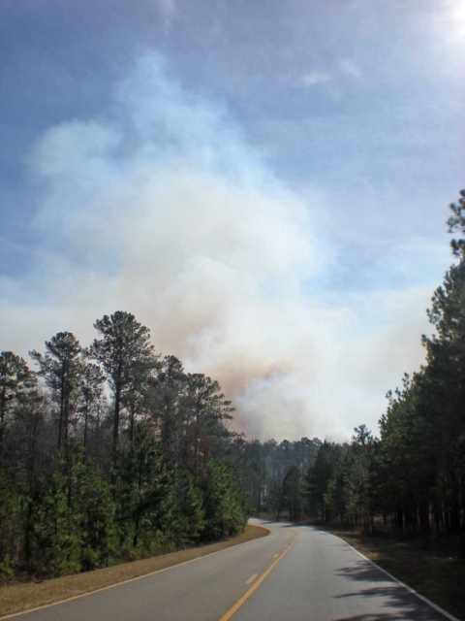
Objective:
Evaluate the uncertainties related to fire air quality modeling with 3D photochemical models
Sensitivity analyses:
  Emissions
  Resolution
  Meteorology
  Plume rise

Slide 3
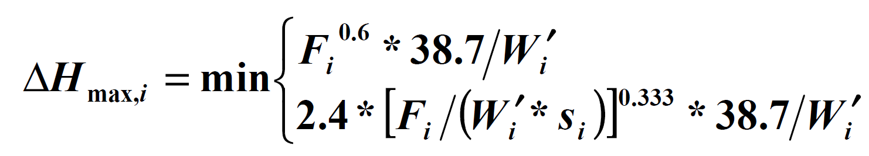
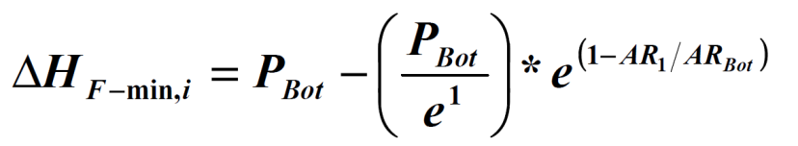
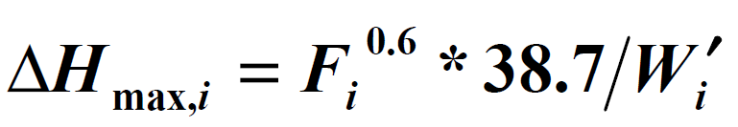
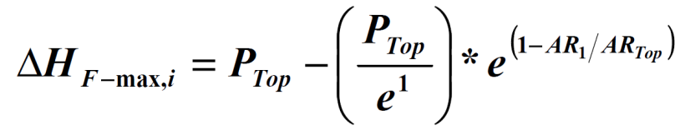
Typical Approaches for Estimating Plume Rise
Theoretical Maximum:
Empirical Maximum and Minimum:

Slide 4
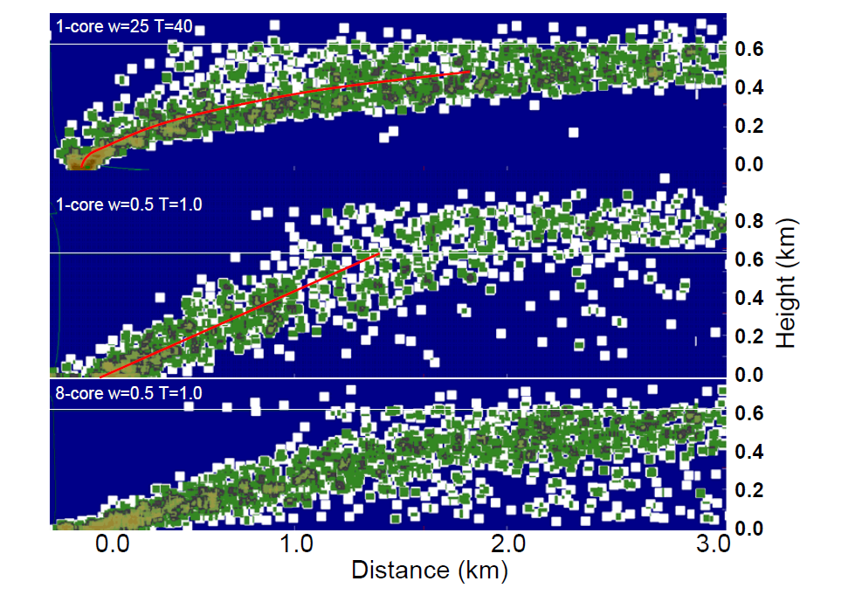
DAYSMOKE
Empirical-statistical plume rise and dispersion model
Provides a vertical emissions profile for smoke injection into regional scale air quality models

Slide 5
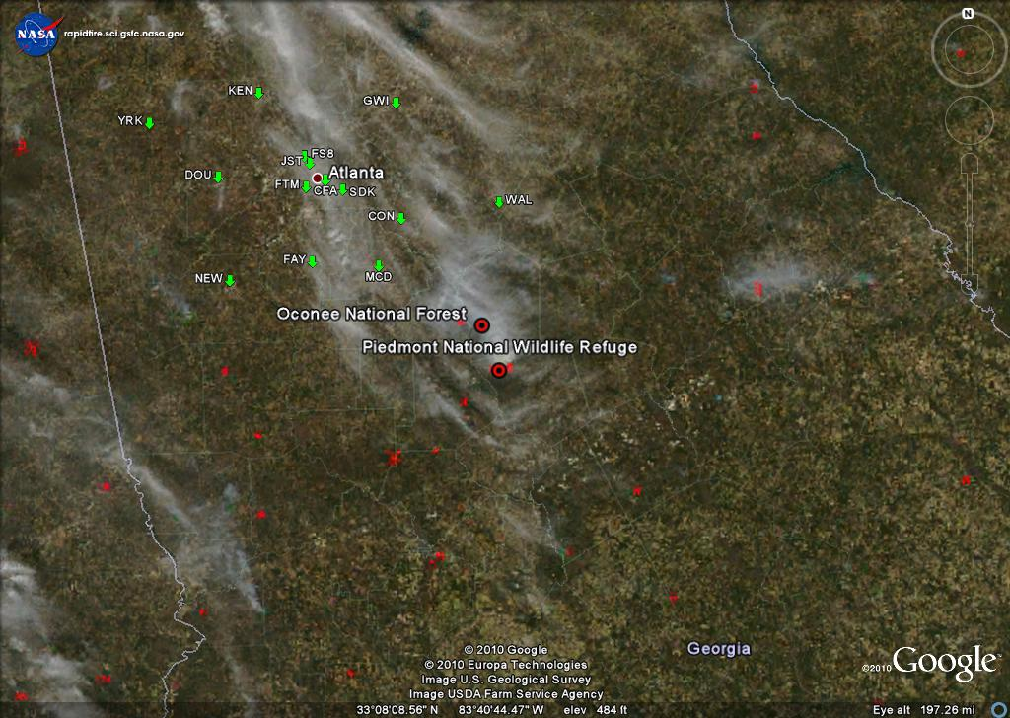
2/28/2007

Slide 6
Vertical Plume Profiles

Slide 7
Vertical Plume Profiles
DAYSMOKE
Briggs Estimate
Empirical Estimate

Slide 8
Benchmark CMAQ Simulation with DAYSMOKE Vertical Profile
Fire Emissions:
Fire emissions Production Simulator (FEPS)
Background Emissions: SMOKE with projected 2002 “typical year” inventory
Meteorology:
Weather Research & Forecasting model (WRF)

Slide 9
Receptor Impacts

Slide 10
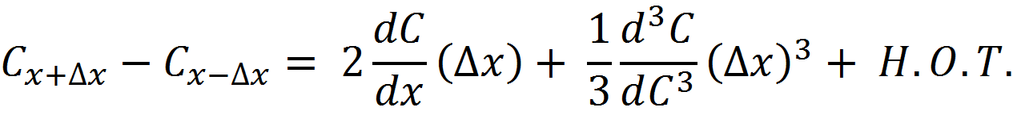
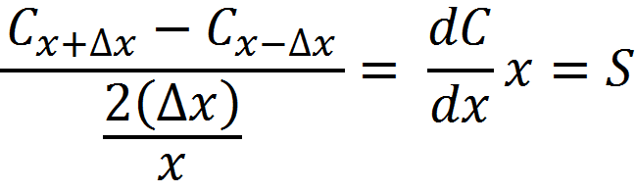
1st Order Sensitivity Analysis

Slide 11
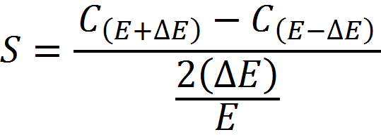
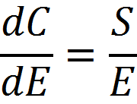
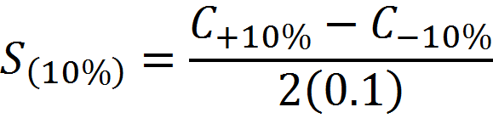
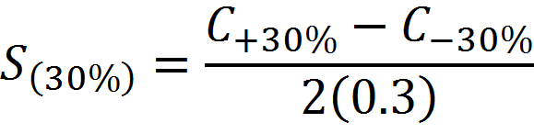
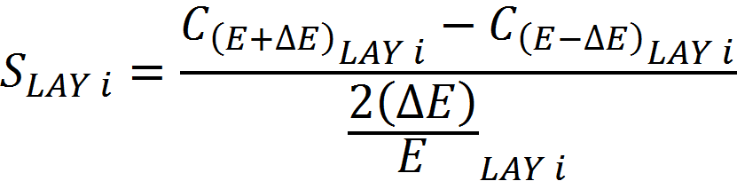
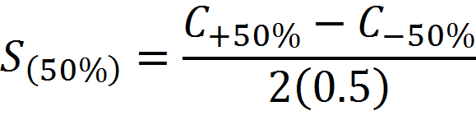
Brute Force Analysis of Concentration Sensitivity to Fire Emissions

Slide 12
Brute Force Sensitivity to Fire Emissions by Vertical Layer (S10%)

Slide 13
Impact Estimated from ΣS_{10%}

Slide 14
S_{30%}:
S_{50%}:

Slide 15
S_{10%} at McDonough, GA

Slide 16
S_{10%} at Jefferson St.

Slide 17
S_{10%} at Walton, GA

Slide 18
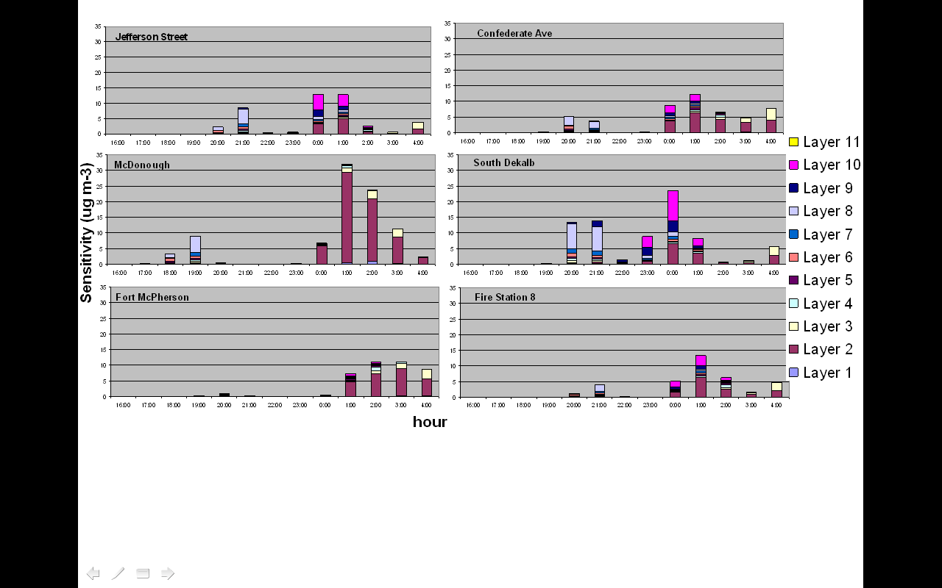
S from Direct Decoupled Method (CMAQ-DDM-3D )

Slide 19
Conclusions
Vertical fire emissions distribution can play an important role in fire air quality modeling.
Sufficient vertical model resolution could be important for successful fire modeling.
Sensitivity analyses of vertical emissions layering can provide useful insight into fire simulations.
1st order sensitivities provide accurate results for small (~10%) perturbations in layered fire emissions of primary pollutants.
Brute force estimates agree with DDM results.
The sensitivities could be applied to improve model performance by optimizing vertical emissions profiles.

Slide 20




THANK YOU!
Questions?
Strategic Environmental Research and Development Program
Joint Fire Science Program
Georgia Department of Natural Resources, Environmental Protection Division
US Forest Service, Southern Research Station

