Slide 1
Integrating Cropland Management into Bidirectional CMAQ
Ellen J. Cooter and Jesse Bash
Atmospheric Modeling and Analysis Division
NERL, EPA
Verel Benson
Benson Consulting, Columbia, MO
Li Mei Ran
UNC Institute for the Environment,
Chapel Hill, NC

Slide 2
CMAQ 5.0 Implementation
Bidirectional pilot and CMAQ 5.0 Beta studies show nitrogen deposition estimates improve when soil ammonia emissions are estimated using a compensation point flux approach coupled with more temporally and spatially detailed agricultural land management information.
A full implementation of this approach has been completed for CMAQ 5.0 (see Jesse Bash, October 24 presentation).
This presentation focuses on the agricultural fertilizer management inputs required for the CMAQ5.0 bidirectional science option.

Slide 3
What inputs are required for CMAQ 5.0?
-Daily Fertilizer (kg-N/ha) application amount
-Daily fertilizer depth
-Initial managed soil pH
For each crop within each CMAQ domain grid cell
Sample data sets containing this information have been prepared for the 12km CONUS domain and are available on request
Technical questions regarding the content of these files should be submitted to Ellen Cooter, cooter.ellen@epa.gov
Submit requests to receive copies of these files to Jesse Bash,
bash.jesse@epa.gov

Slide 4
Fertilizer Management Implementation for CMAQ 5.0
Fertilizer application rates and management practices are simulated by a biogeochemical model
Simulation of a mix of organic (manure) and inorganic N-fertilizer forms applied at form-specific depth
42 commercial crops (irrigated and rainfed)
10 USDA Production areas
Crop-area distributions use 2002 USDA Census of Agriculture and 2001 NLCD and MODIS landcover data.

Slide 5
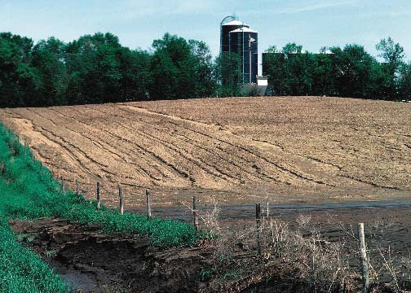
The Environmental Policy Integrated Climate (EPIC) model
Developed in early 1980’s to assess the effect of wind and water erosion on productivity
Water Erosion
Wind Erosion
Leaving Field
- sediment
- water
Deposition
- within field
- base of slope
Unsheltered tilled Cropland
Shelterbelt
Sheltered tilled cropland
Conservation cover
Notes:
Saltation means to jump
EPIC was originally designed for field-scale applications, but a field can extend to 10km^2.

Slide 6
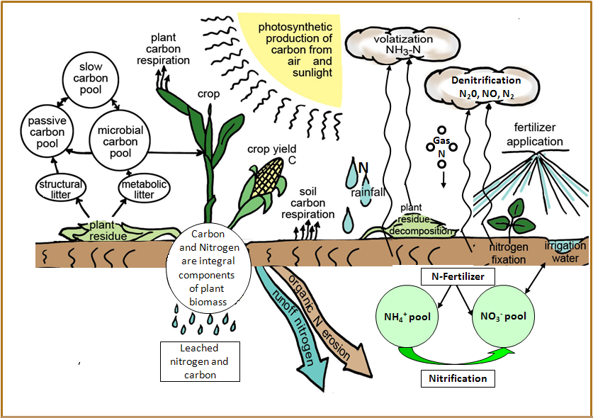
EPIC carbon and nitrogen processes have been recently enhanced
Parton et al., 1994 (CENTURY) modified and added to EPIC as described in Izauralde, et al., 2006

Slide 7
Crops Modeled (irrigated and rainfed)
Grass Hay
Alfalfa Hay
Other grasses
Barley
Canola
Edible Beans
Edible Peas
Grain Corn
Corn for Silage
Cotton
Oats
Peanuts
Potatoes
Rice
Rye (winter and spring)
Grain Sorghum
Sorghum for Silage
Soybeans
Winter Wheat
Spring Wheat
Other Crops

Slide 8
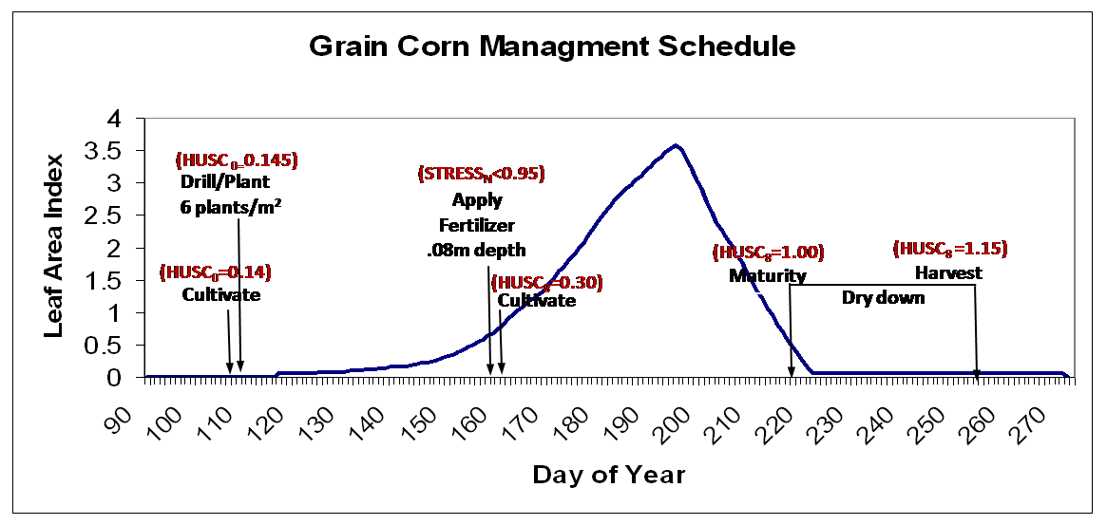
Fertilize

Slide 9
U.S. Farm Production Regions

Slide 10
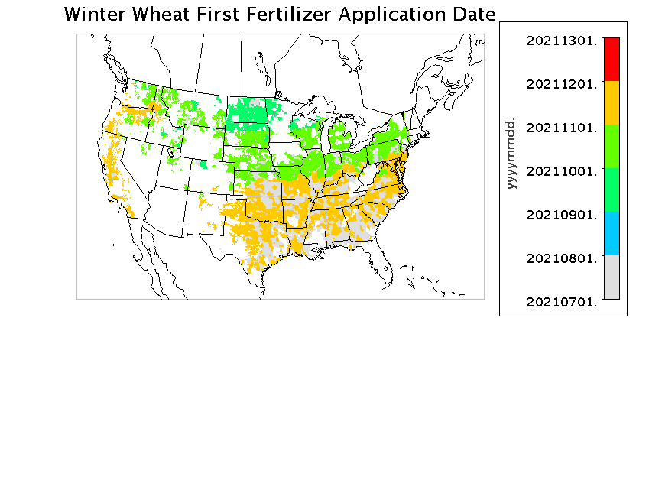
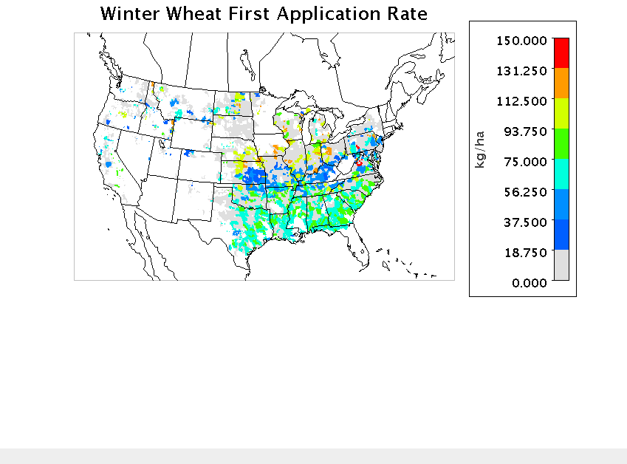
Fertilizer Application Amount and Timing
DEC
NOV
OCT
SEPT
AUG

Slide 11
So how good are these estimates?

Slide 12
Preliminary Evaluation Plant and Harvest Dates

Slide 13
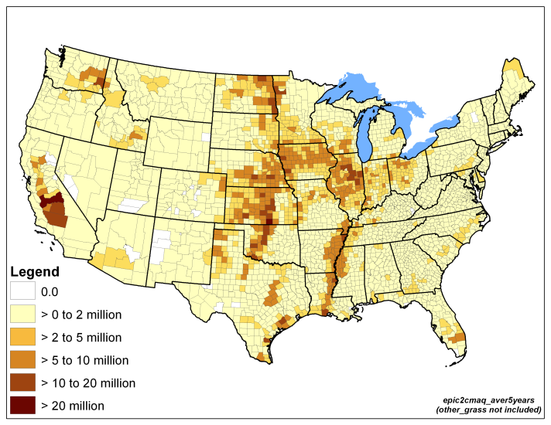
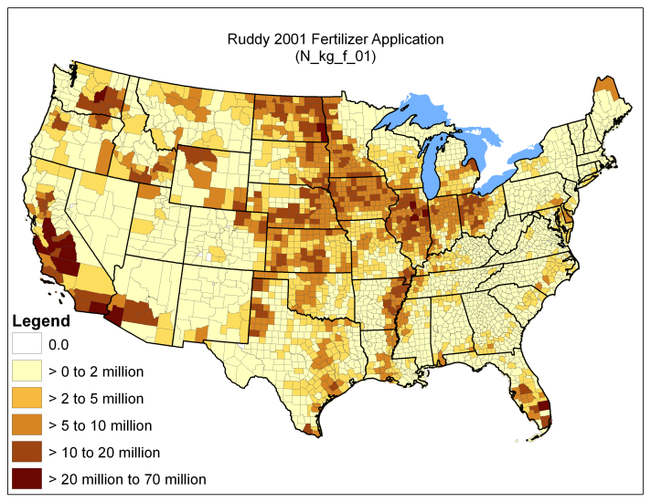
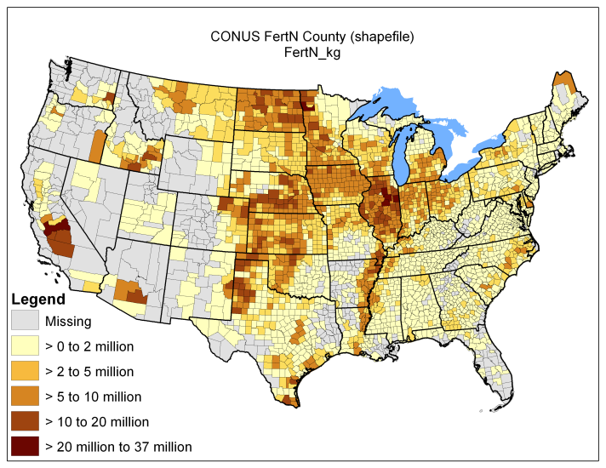
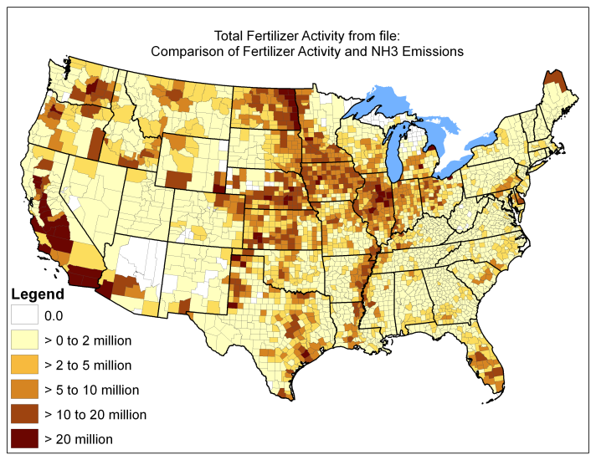
Preliminary Evaluation Annual Fertilizer Application
EPIC
Plant-Demand Based
USGS 2001
Sales-based
Ruddy et al., 2006
USDA 1997
Survey-based
USDA 1997
Survey-based
NEI 2002 (via CMU)
Sales-based

Slide 14
Summary
The bi-directional flux science option of CMAQ 5.0 yields improved nitrogen deposition estimates, but requires detailed information regarding fertilizer management.
Fertilizer management and biogeochemical scenarios have been developed for the continental U.S.
Preliminary evaluation indicates these scenarios reflect reasonable temporal and spatial distributions of fertilizer management.
A file of fertilizer-related inputs based on these scenarios is available on request for the CMAQ 5.0 CMAQ 12km CONUS domain to support the bi-directional flux science option.

Slide 15
Future Improvements
Year Specific estimates
Support for other CMAQ resolutions and domains
Refined farm management
Update BELD to 2006 NLCD and Agricultural Census
Add detailed Mexico and Canada treatment

