Slide 1
Ambient Air Monitoring Networks
- networks
- observations and models
- unique challenges associate with fine scale, multiple pollutant applications
2010 CMAS Conference
Chapel Hill, NC
October 13, 2010
Rich Scheffe, Sharon Phillips, Wyatt Appel, Lew Weinstock, Tim Hanley, Nealson Watkins, Mike Jones, Kevin Cavender, Karen Wesson, Kirk Baker

Slide 2
The Basic Networks

Slide 3
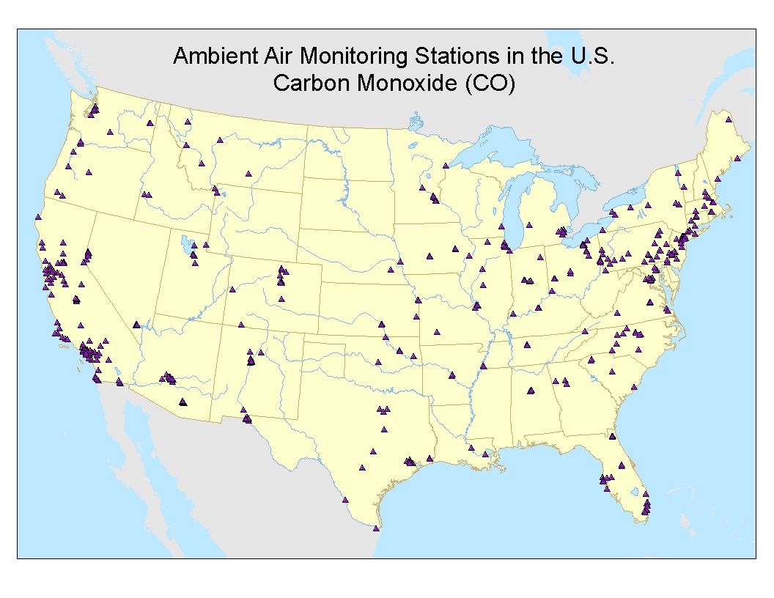

Slide 4
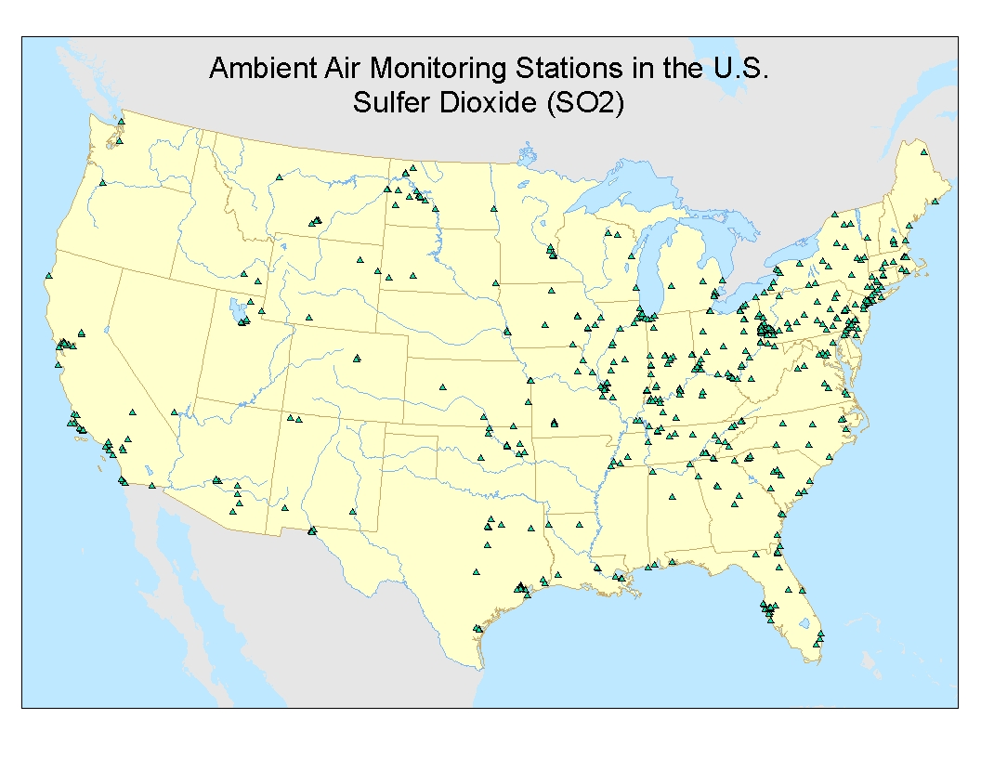

Slide 5
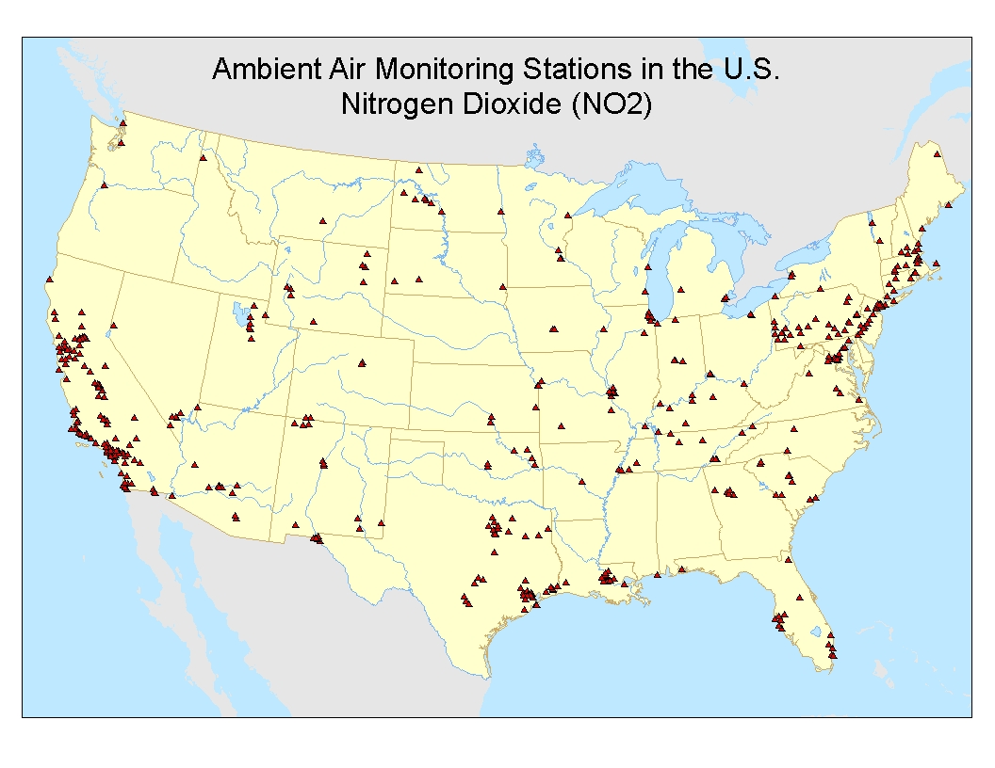

Slide 6
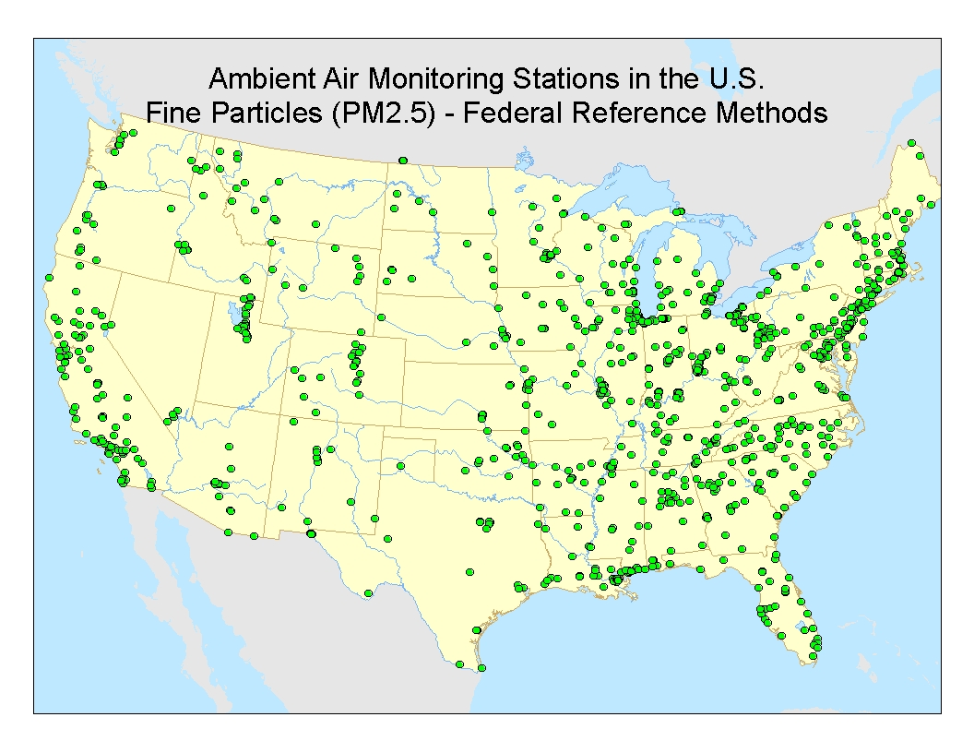

Slide 7
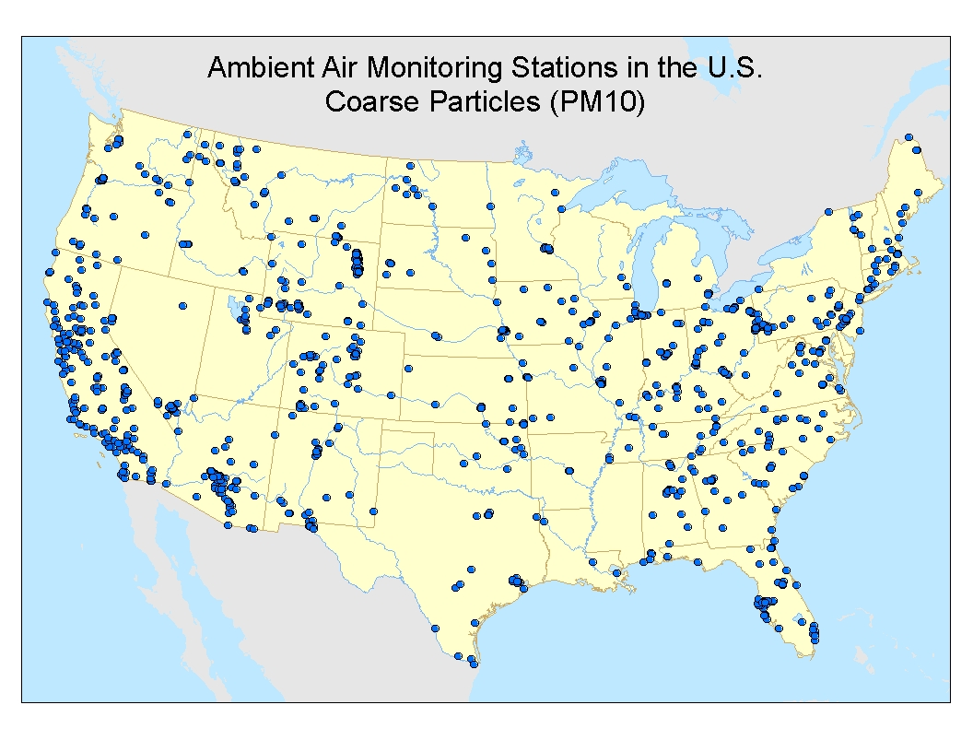

Slide 8
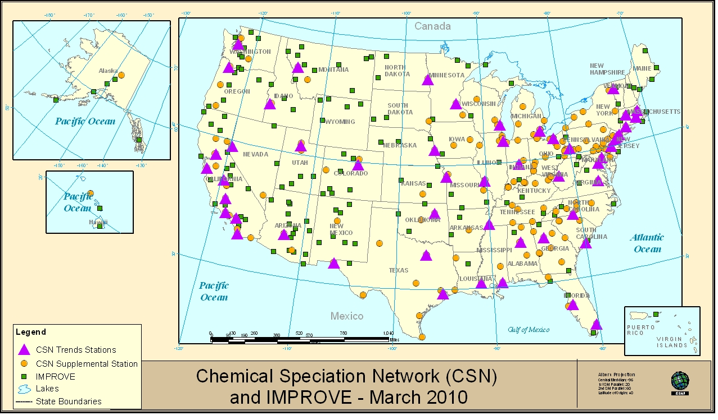
PM_{2.5} Chemical Speciation Network (CSN) and IMPROVE

Slide 9
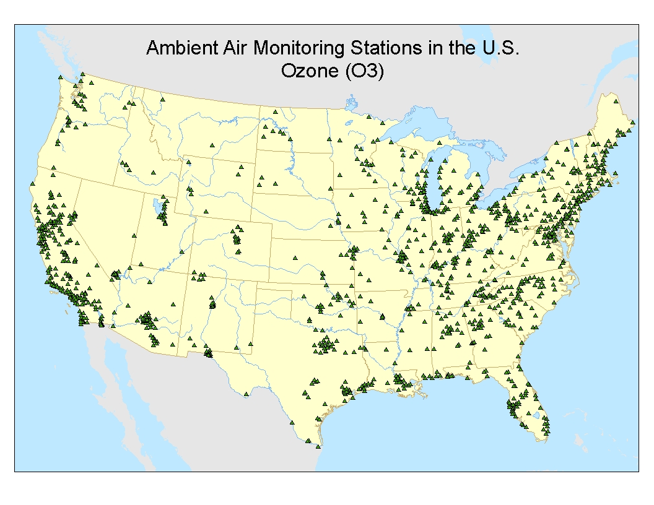

Slide 10
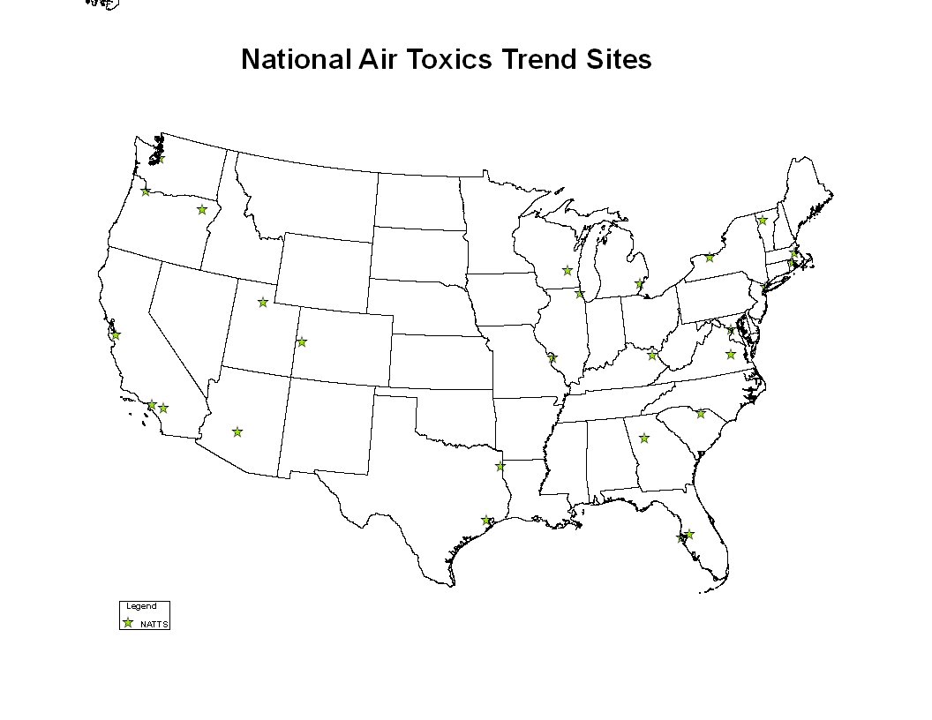

Slide 11
Current areas of focus
Implementing NCore
New NO₂ , lead and ozone requirements
School air toxics

Slide 12
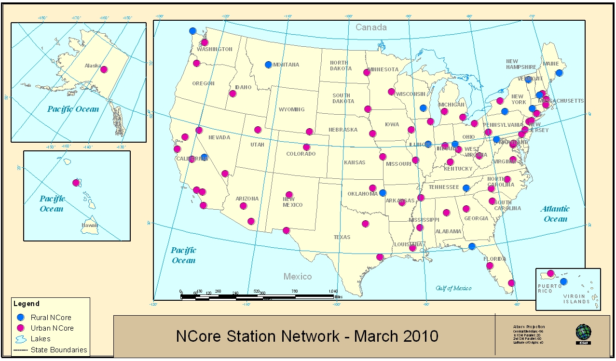
National Core (NCore) Network
  urban (about 63 sites)
  rural (about 17 sites)
  May achieve additional rural coverage with National Parks and CASTNET
Pollutants Measured - NAAQS multi-pollutant
  Particles
    PM_{2.5} - continuous mass, filter mass, speciation
    PM_{10-2.5} - mass
  Gases – O₃ and high sensitivity measurements of CO, SO₂, NO and NO_{y.}
  Meteorology - basic meteorological parameters
    Temperature, Wind Speed, Wind Direction, Relative Humidity

Slide 13

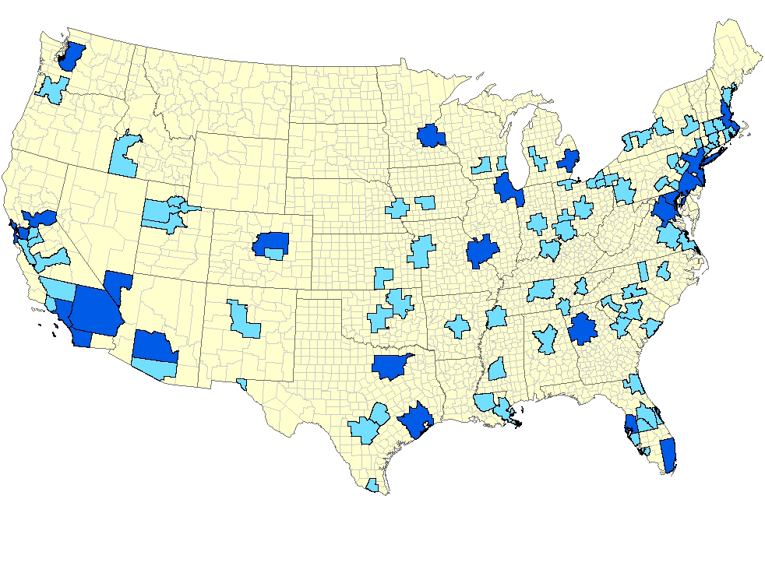
Near Road NO₂ Monitors Are Required
in 102 Urban Areas
Not shown on map
Anchorage, Alaska
Honolulu, Hawaii
San Juan, Puerto Rico
Minimum Near-Road NO₂ Monitoring Requirements
78 areas would require 1 monitor (> 500,000 population)
24 areas would require 2 monitors (> 2.5 million population or road segments with annual average daily traffic counts > 250,000 vehicles)
126 total monitors
Monitors required no later then January 1, 2013
Approximately 40 additional monitors will be placed in locations to help protect communities that are susceptible and vulnerable to NO2-related health effects

Slide 14
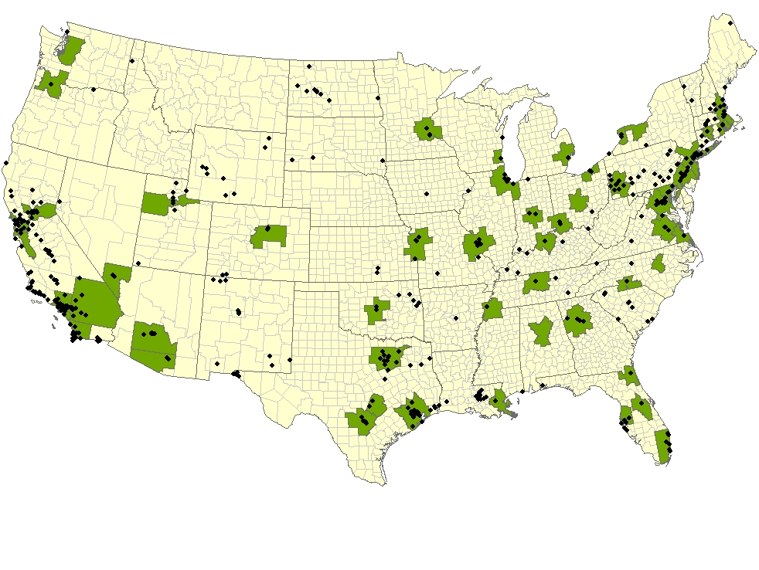
Community-Wide NO₂ Monitors Are Required
in 53 Urban Areas
Not shown on map
San Juan, Puerto Rico
Honolulu, Hawaii
Minimum Community-wide NO₂ Monitoring Requirements
Monitors required no later then January 1, 2013
53 areas would require 1 monitor (> 1 million population)
418 existing NO₂ monitoring sites in 2008 Many of these sites would satisfy the proposed community-wide monitoring requirements.

Slide 15
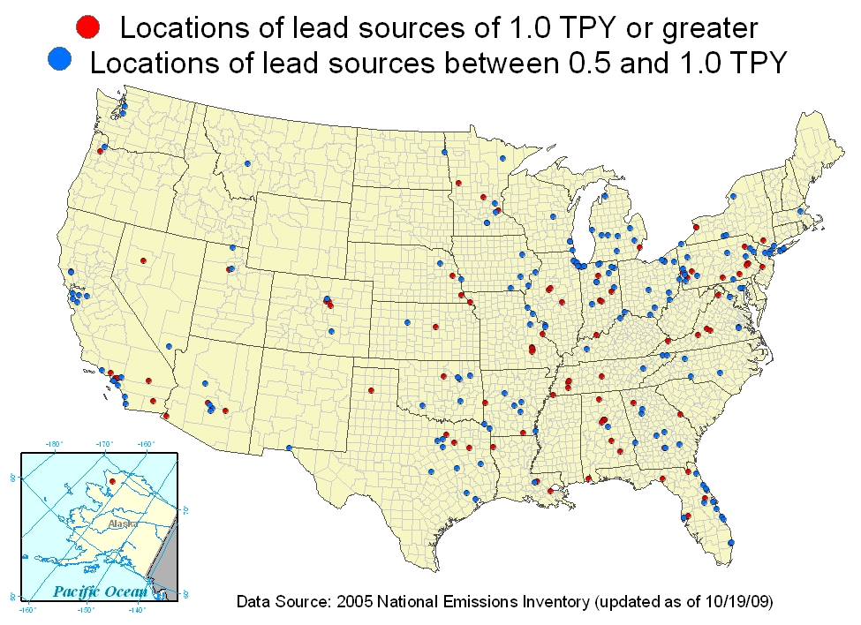
*
* Proposed requirement

Slide 16
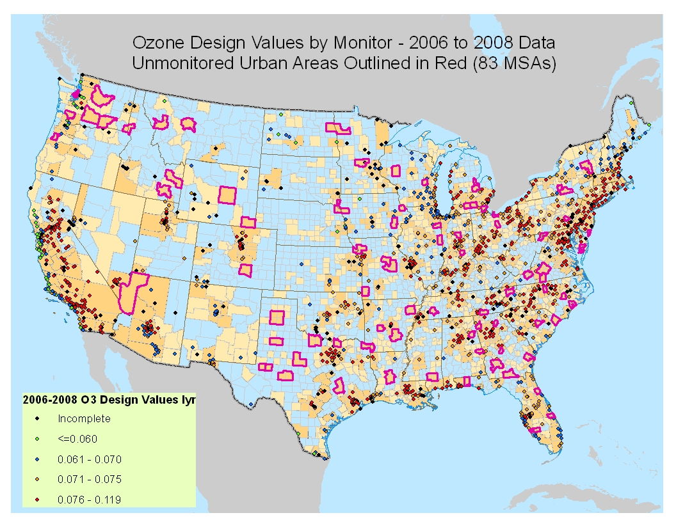
MSAs highlighted in magenta may need to add ozone monitors based on proposed requirements

Slide 17
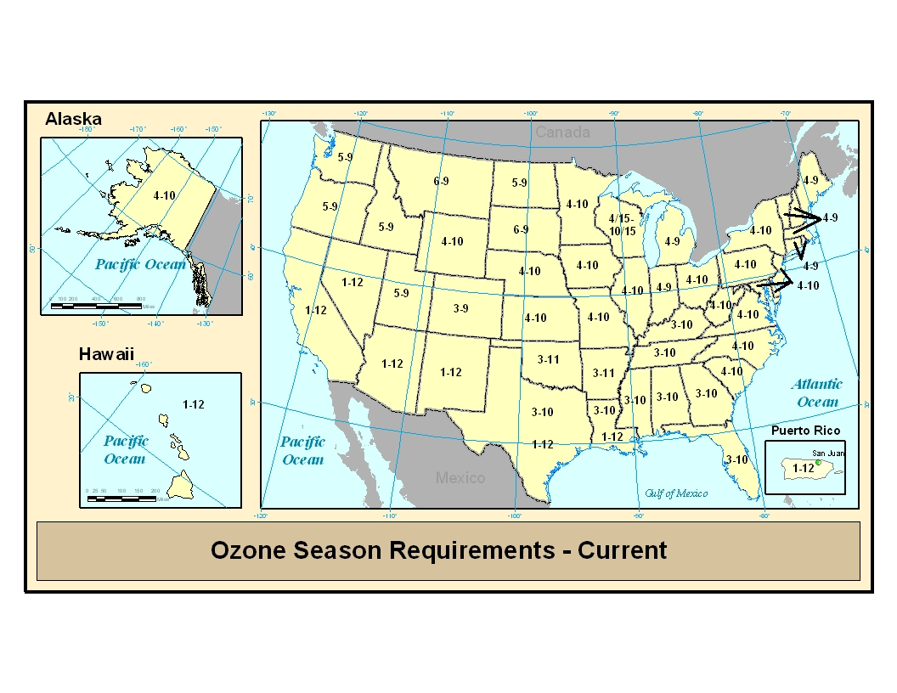
Revising the Ozone Monitoring Seasons

Slide 18
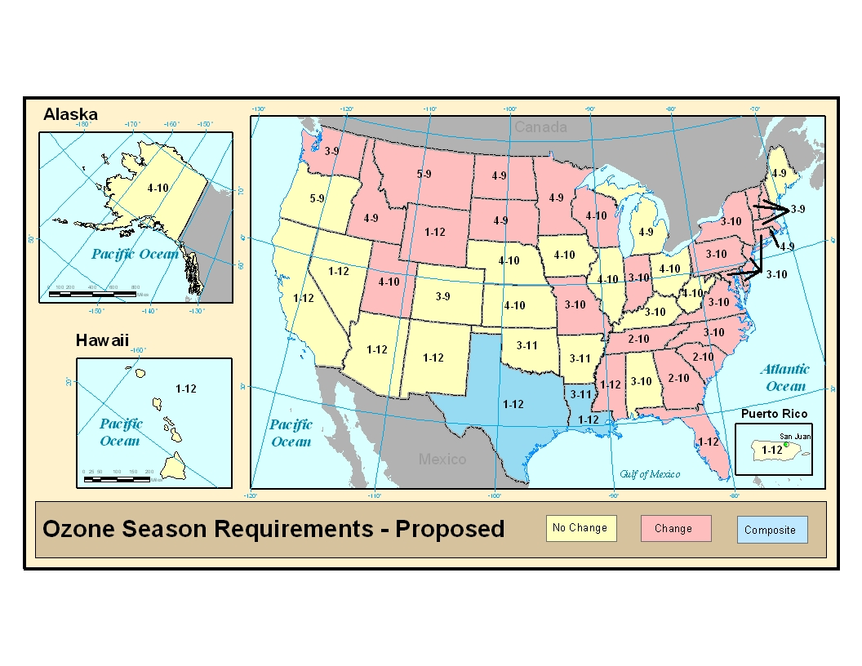
Revising the Ozone Monitoring Seasons

Slide 19
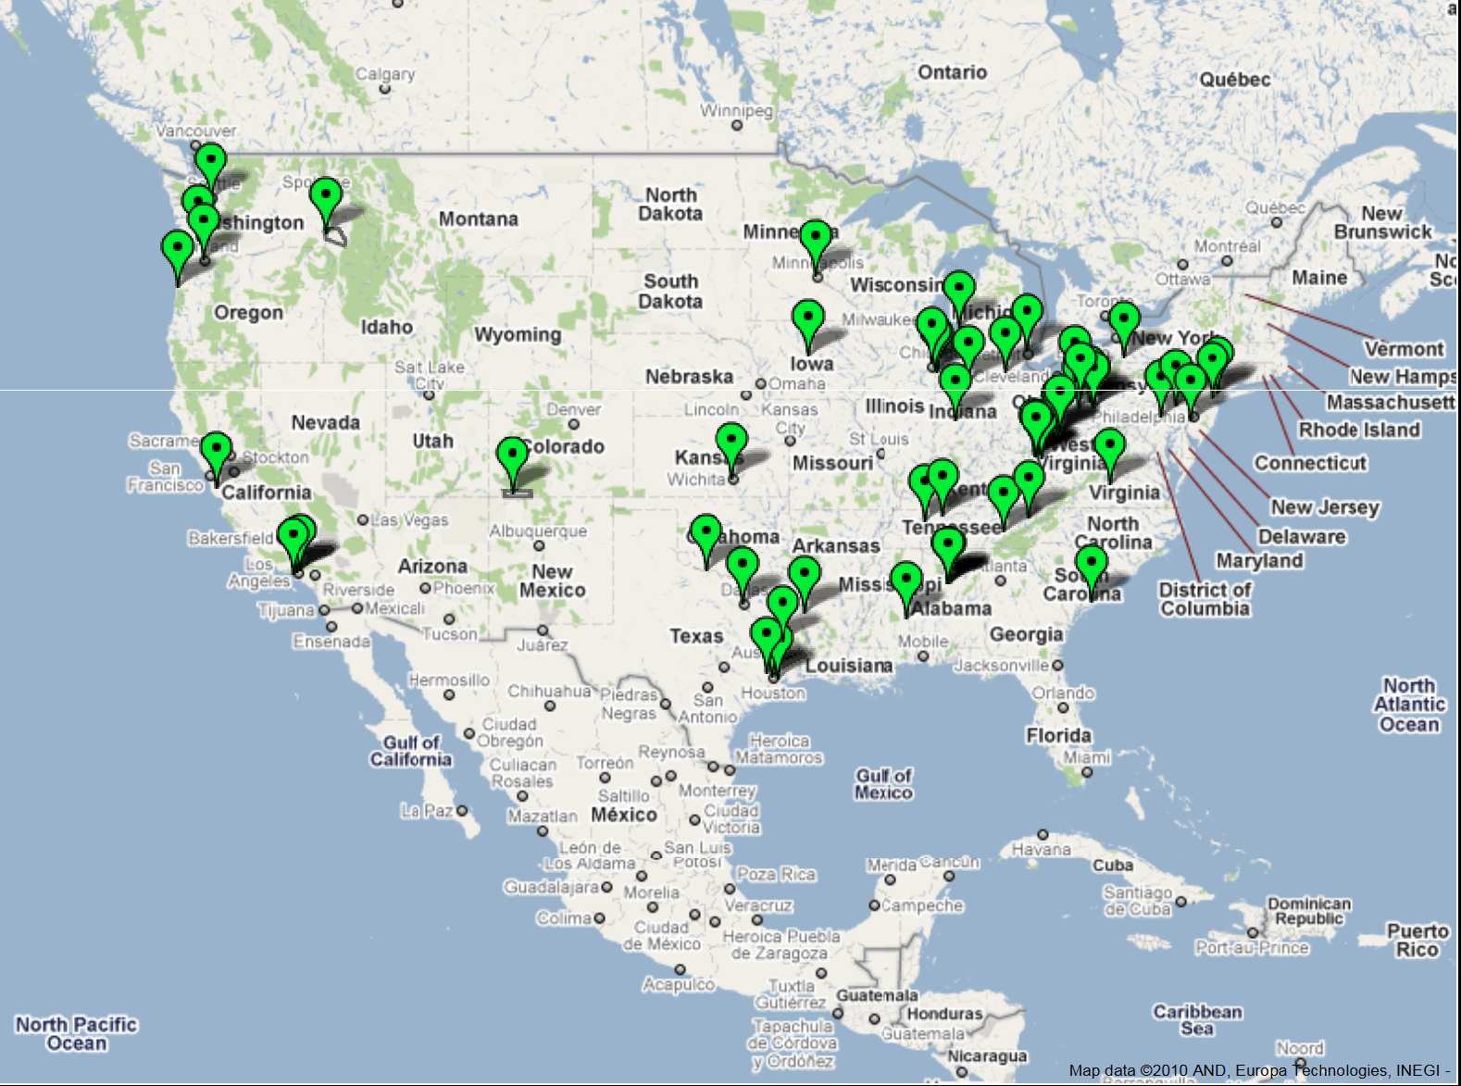
School Air Toxics (short term, in response to USA Today)

Slide 20
Why do we measure the air? Role of Observations and Models
Remember, traditional regulatory use drives network design
Models have been an untapped (or at least underutilized) resource for exposure/health assessments
  Solid linkage from regional to global scale characterization partly due to similar disciplines across EPA, NASA, NOAA, NCAR, Academia
  The link to fine scales is in an exploratory mode
Characterization of air quality over time, ambient space and composition is inherently a responsibility of the atmospheric science/modeling community
  What happens when that community does not prioritize for support of health assessments

Slide 21
Acknowledge
Basic incommensurabilities between measurements and modeled estimates
  Point vs volume representation
  Instrument artifacts
    Yield a method defined estimate
  Modeled constraints
    Emissions limits
    Chemical/physical formulations

Slide 22
Multiple Pollutant Considerations
Additional Pollutant Groups, particularly HAPs place greater emphasis on fine scale exposures
Challenge in availability of data bases for fine scale model evaluations and ability of models to match observations in time, space

Slide 23
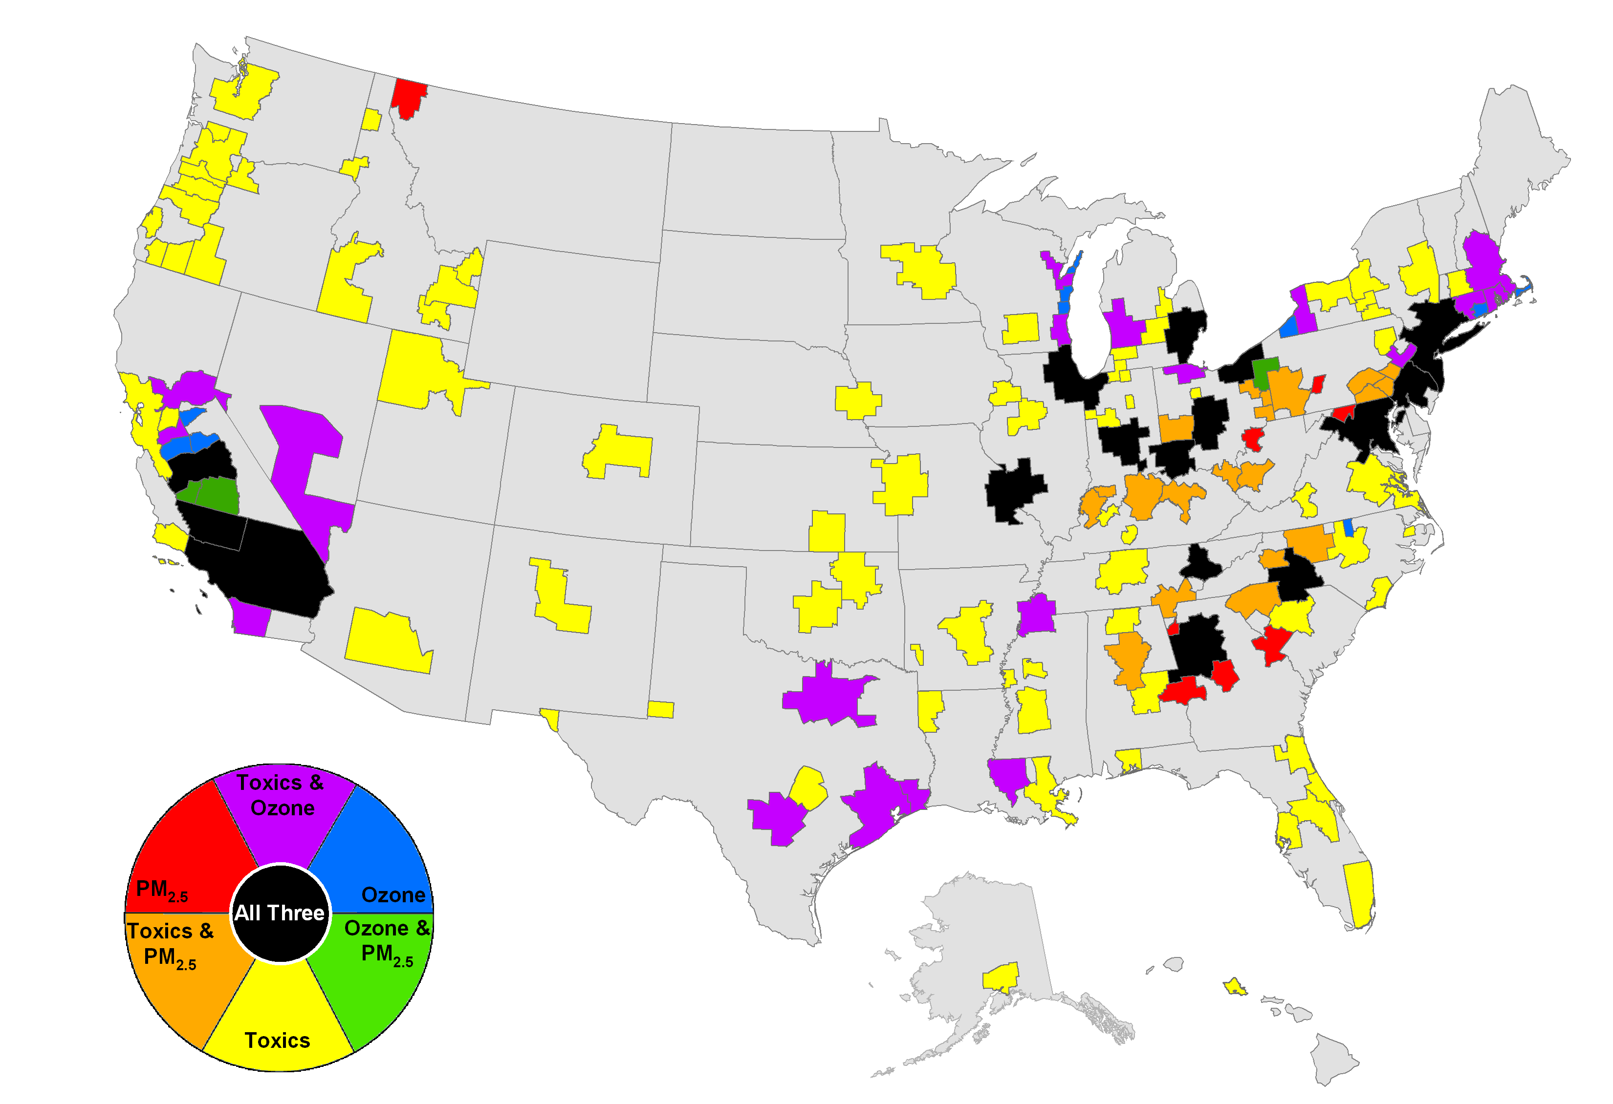
Nexus of ozone, PM_{2.5} (2003-5) and air toxics (NATA 1999)
High Risk Counties often Coincide with Locations where
Criteria Pollutant Issues are Significant -
.
Draft

Slide 24
Multiple space and time scales
when addressing MPs
Source, K. Demerjian

Slide 26
Detroit PM: 1km STN sites

Slide 27
Near field Process considerations

Slide 28
Local (near source) scale processes
Source, K. Demerjian

Slide 29
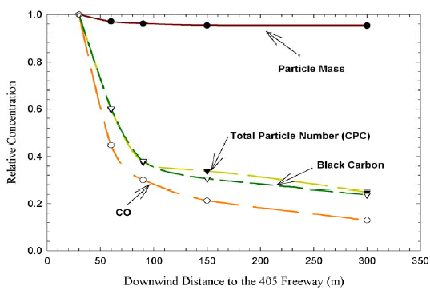
Roadway Pollution Gradients
Source: S. Cal PM Center, 2004

Slide 30
Model evaluation and human exposure applications
Terminology
  Operational
    Focuses on the statistical and qualitative relationship between observations and terminal model species
  Diagnostic
    Do the model processes work as intended,
    are we getting the right answers for the right reasons?
  Dynamic
    Does the model response to perturbations in inputs (emission, meteorology) reflect observed response to same changes?
  Probabilistic
    Bound model estimates
Model evaluation of regulatory models has focused on urban/regional scale applications
  NOAA, NASA field programs
    Regional to hemispherical scale
  Relatively close alignment between process based field campaigns and model evaluation
Analog with observation design for human exposure studies may(or may not) be as closely aligned

Slide 31
How do we develop fine scale model evaluation data bases?

