Slide 1
Investigating Differences in O₃ Production from CB05 and CBMIV Versions of the NAQFC
Rick Saylor, Hsin-Mu Lin, Pius Lee, Binyu Wang, Tianfeng Chai,
Ariel Stein, Daniel Tong, Hyun-Cheol Kim, Yunsoo Choi,
Fantine Ngan, Daewon Byun
9th Annual CMAS Conference, Chapel Hill, NC, October 11-13, 2010

Slide 2
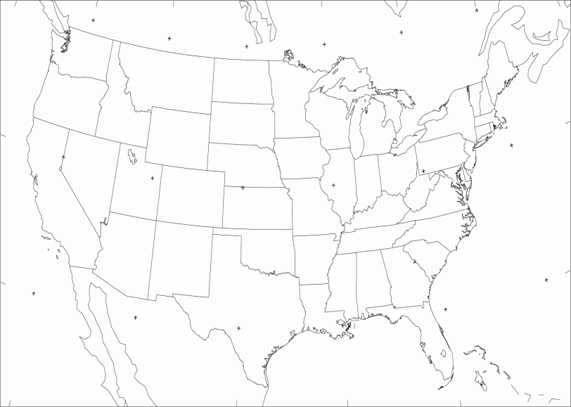
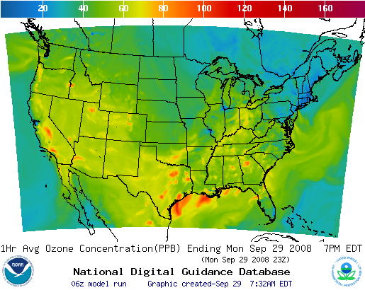
National Air Quality Forecast Capability
Emissions:
EPA CEM anthropogenic inventories
2005 base year projected to current year w/ EGU
BEIS V3 Biogenic Emissions
Met Model:
North American Model (NAM)
Non-hydrostatic Multi-scale Model (NMM)
12 km x 60 Levels
AQ Model:
USEPA Community Multiscale Air Quality (CMAQ)
  CMAQ v4.6: 12 km/L22 CONUS Domain
  Operational: CBMIV gas-phase
  Experimental/Developmental: CB05/ AERO-4 PM
Output available on National Weather Service Air Quality Forecast Guidance website (http://www.weather.gov/aq)
  48 hour O₃ forecasts from 06/12 UTC Cycles
  PM_{2.5} forecasts to be operational in FY2015
CONUS “5x” Domain
268 grid cells
442 grid cells

Slide 3
CB05 Ozone > CBM4 Ozone
Mechanism differences
Reactions responsible for ozone production?
Differences in speciation?
CBM4
CB05
Systemic differences
Precursor emissions?
Meteorological parameters?
Some process common to both CB05 and CBM4
2009

Slide 4
Updates to the Carbon Bond Mechanism: CB05 vs CBMIV
G. Yarwood, S. Rao, M. Yocke, and G. Whitten, Updates to the Carbon Bond Chemical Mechanism: CB05, Final Report to U.S. EPA, December 8, 2005.
Incorporates current (as of 2005) kinetic and photolysis data.
Extends the CB mechanism to better support PM modeling needs such as SOA formation.
Adds extra species and reactions to treat additional VOCs for air toxics study.
Includes effect of reactive chlorine emissions in VOC degradation and oxidant chemistry.
• Explicit methylperoxy radical, methyl hydroperoxide and formic acid.
• Lumped higher organic peroxides, organic acids and peracids.
• Higher aldehyde species ALDX making ALD2 explicitly acetaldehyde.
• Recycling of NO_{y} from organic nitrates.
Additional NO_{x} recycling from HNO₃, N₂O₅ and HO₂NO₂.
• Higher peroxyacyl nitrate species from ALDX called PANX.
• Explicit terpene gas phase chemistry.

Slide 5
Box Model Equations
= concentration of species i in the box (µg/m³)
= time dependent mixed layer height (m)
= emission of species i into the box (µg/m²-s)
= chemical production rate of species i within the box (µg/m³-s)
= dry deposition velocity of species i (m/s)
= background concentration of species i (µg/m³)
= concentration of species i above the mixed layer (µg/m³)
= mixing rate of background air (s⁻¹)

Slide 6
Simulation Conditions
Fixed mixing layer height = 1000 m,
No dry deposition,
No mixing with background air,
Fixed initial conditions: T = 298 K
p = 1 atm
RH = 50%
O₃ = 10 ppbv
CO = 100 ppbv
CH₄ = 1600 ppbv
NO_{x} = all VOCs = 0
Zaveri and Peters (1999) JGR,
104, 30387-30415.

Slide 7
Simulation Suite
Scenario | NO_{x} (μmol m⁻² h⁻¹) | ISOP (μmol m⁻² h⁻¹) | R_{NMHC} (mol NMHC/mol NO_{x}) | CO (μmol m⁻² h⁻¹)
u001 | 5 | 0 | 10 | 800
u002 | 20 | 0 | 10 | 800
u003 | 40 | 0 | 10 | 800
u004 | 5 | 0 | 1 | 800
u005 | 20 | 0 | 1 | 800
u006 | 40 | 0 | 1 | 800
u007 | 5 | 0 | 100 | 800
u008 | 20 | 0 | 100 | 800
u009 | 40 | 0 | 100 | 800
r001 | 1 | 50 | 1 | 80
r002 | 5 | 50 | 1 | 80
r003 | 10 | 50 | 1 | 80
r004 | 1 | 50 | 0.1 | 80
r005 | 5 | 50 | 0.1 | 80
r006 | 10 | 50 | 0.1 | 80
r007 | 1 | 50 | 10 | 80
r008 | 5 | 50 | 10 | 80
r009 | 10 | 50 | 10 | 80
Hourly emission = E₀ * cos(zenith angle)

Slide 8
NMHC Species Apportionment
CBM4 | mol i/mol NMHC |  | CB05 | mol i/mol NMHC
PAR | 0.860 |  | PAR | 0.845
 |  |  | ETHA | 0.0075
ETH | 0.050 |  | ETH | 0.050
OLE | 0.010 |  | OLE | 0.005
 |  |  | IOLE | 0.005
TOL | 0.030 |  | TOL | 0.030
XYL | 0.020 |  | XYL | 0.020
HCHO | 0.010 |  | HCHO | 0.010
ALD2 | 0.020 |  | ALD2 | 0.015
 |  |  | ALDX | 0.005

Slide 9
Sensitivity Tests
Name | Description (changes made to CB05 from base mechanism)
xNTRrecycle | NTR recycling reactions removed
xiNOxrecycle | inorganic NO_{x} recycling reactions removed
xallNOxrecycle | both NTR and inorganic NO_{x} recycling reactions
xPANX | all PANX reactions removed (no ALDX emissions)
xPANXrecycle | PANX recycling reactions removed
xPANrecycle | PAN recycling reactions removed
PANcbm4 | PAN chemistry as in CBM4 (xPANX + CBM4 PAN rate constants)
PANjpl06 | PAN and PANX rate constants from JPL 2006
xNTR-PANcbm4 | xNTRrecycle + PANcbm4 (no NTR recycle and CBM4 PAN chem.)
xNTR-PANcbm4-xPANX | xNTRrecycle + PANcbm4 + xPANX (no NTR recycle, CBM4 PAN chemistry, and no PANX chemistry)
xPANX-xNTR | xPANX + xNTRrecycle (no PANX chem. and no NTR recycle)
noALDXemis | no ALDX emissions and ALD2 emissions as in base CBM4

Slide 10
Sensitivity Tests
Name | Description (changes made to CB05 from base mechanism)
xNTRrecycle | NTR recycling reactions removed
xiNOxrecycle | inorganic NO_{x} recycling reactions removed
xallNOxrecycle | both NTR and inorganic NO_{x} recycling reactions
xPANX | all PANX reactions removed (no ALDX emissions)
xPANXrecycle | PANX recycling reactions removed
xPANrecycle | PAN recycling reactions removed
PANcbm4 | PAN chemistry as in CBM4 (xPANX + CBM4 PAN rate constants)
PANjpl06 | PAN and PANX rate constants from JPL 2006
xNTR-PANcbm4 | xNTRrecycle + PANcbm4 (no NTR recycle and CBM4 PAN chem.)
xNTR-PANcbm4-xPANX | xNTRrecycle + PANcbm4 + xPANX (no NTR recycle, CBM4 PAN chemistry, and no PANX chemistry)
xPANX-xNTR | xPANX + xNTRrecycle (no PANX chem. and no NTR recycle)
noALDXemis | no ALDX emissions and ALD2 emissions as in base CBM4

Slide 11
Organic Nitrate (NTR) Chemistry in CBM4
Production –
R55. ROR + NO₂ → NTR
R64. TO2 + NO → NTR
R68. CRO + NO₂ → NTR
R78. ISOP + NO₃ → … + 0.8 NTR + …
R81. XO2N + NO → NTR
R92. ISPD + NO₃ → … + 0.85 NTR + …
R94. ISOP + NO₂ → … + 0.8 NTR + …
No chemical destruction of NTR in CBM4,
thus NTR is an irreversible sink for reactive nitrogen in CBM4.

Slide 12
Organic Nitrate (NTR) Chemistry in CB05
Production –
R115. ROR + NO₂ → NTR
R129. TO2 + NO → … + 0.1 NTR + …
R133. CRO + NO₂ → NTR
R144. ISOP + NO₃ → … + 0.8 NTR + …
R55. XO2N + NO → NTR
R147. ISPD + NO₃ → … + 0.85 NTR + …
R156. ISOP + NO₂ → … + 0.8 NTR + …
R152. TERP + NO₃ → … + 0.53 NTR + …
Destruction –
R61. NTR + OH → HNO₃ + …
R62. NTR + hν → NO₂ + HO₂ + …
Reactive N is recycled back into the gas phase via R61 & R62. NTR is an irreversible N sink in CBM4, but is a reversible temporary reservoir of N in CB05.
xNTRrecycle

Slide 13
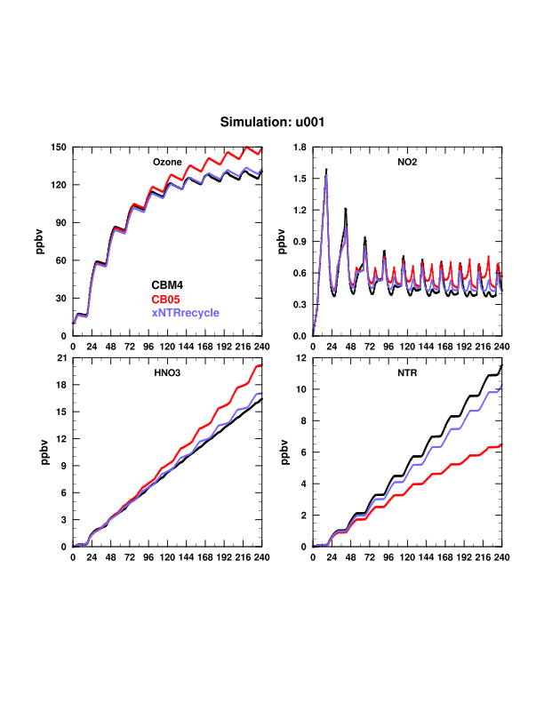

Slide 14
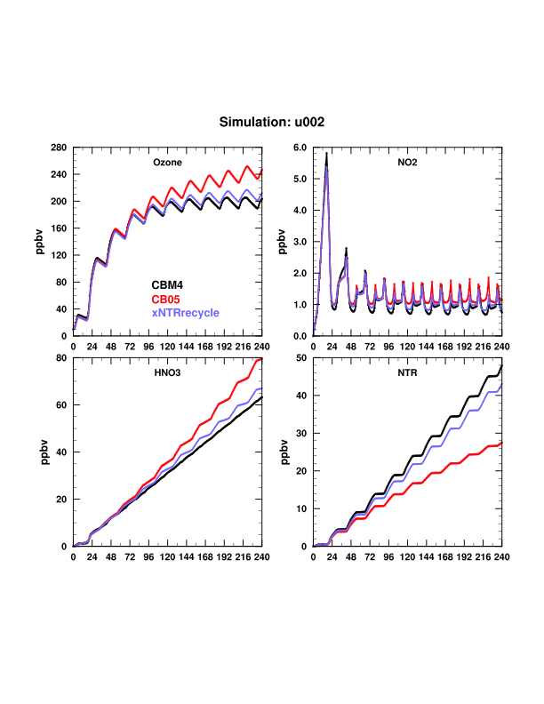

Slide 15
Inorganic NO_{x} Recycling Reactions in CB05
R51. HO₂NO₂ + hν → 0.61 HO₂ + 0.61 NO₂ + 0.39 OH + 0.39 NO₃
R52. HNO₃ + hν → OH + NO₂
R53. N₂O₅ + hν → NO₂ + NO₃
CBM4 does not include these recycling pathways for NO_{x}.
NOTE: Removing these in the box model sensitivity test will likely overestimate the effect it will have on ozone in the full 3-D model because some HO₂NO₂, HNO₃ and N₂O₅ will be removed via other processes (e.g., deposition and heterogeneous reactions).
xiNOxrecycle

Slide 16
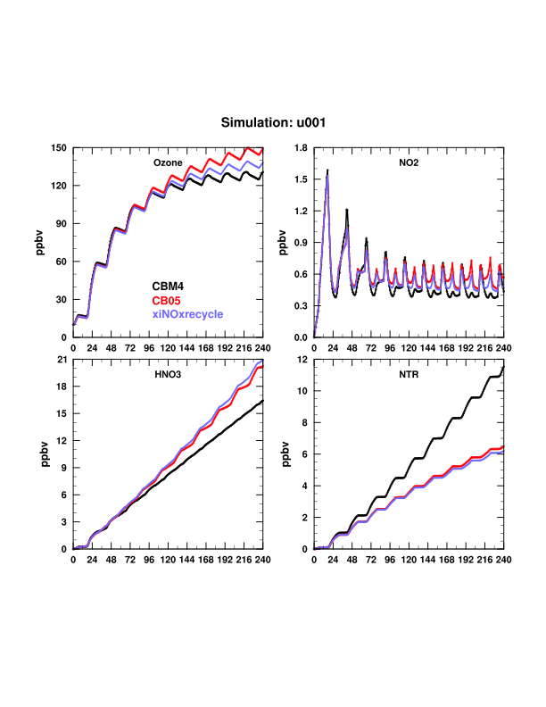

Slide 17
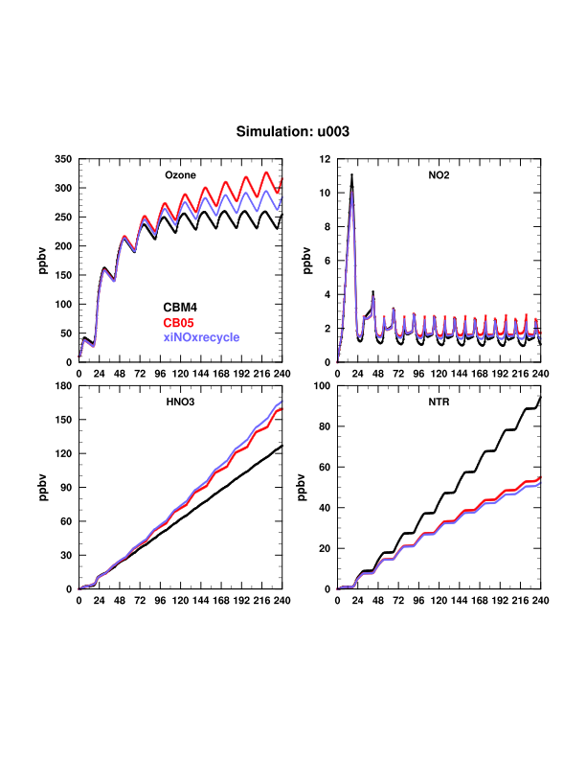

Slide 18
NTR and Inorganic NO_{x} Recycling Reactions in CB05
R51. HO₂NO₂ + hν → 0.61 HO₂ + 0.61 NO₂ + 0.39 OH + 0.39 NO₃
R52. HNO₃ + hν → OH + NO₂
R53. N₂O₅ + hν → NO₂ + NO₃
R61. NTR + OH → HNO₃ + …
R62. NTR + hν → NO₂ + HO₂ + …
xallNOxrecycle

Slide 19
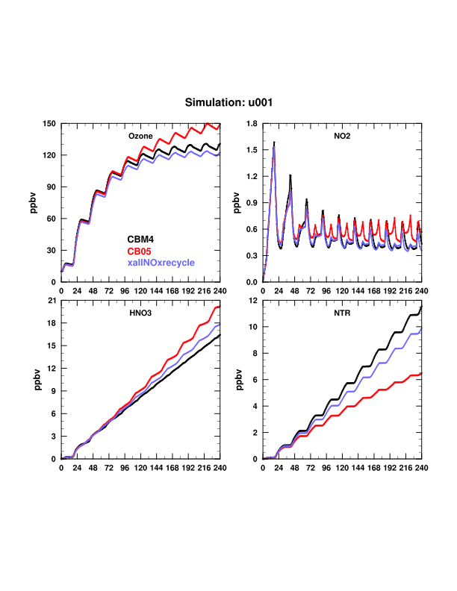

Slide 20
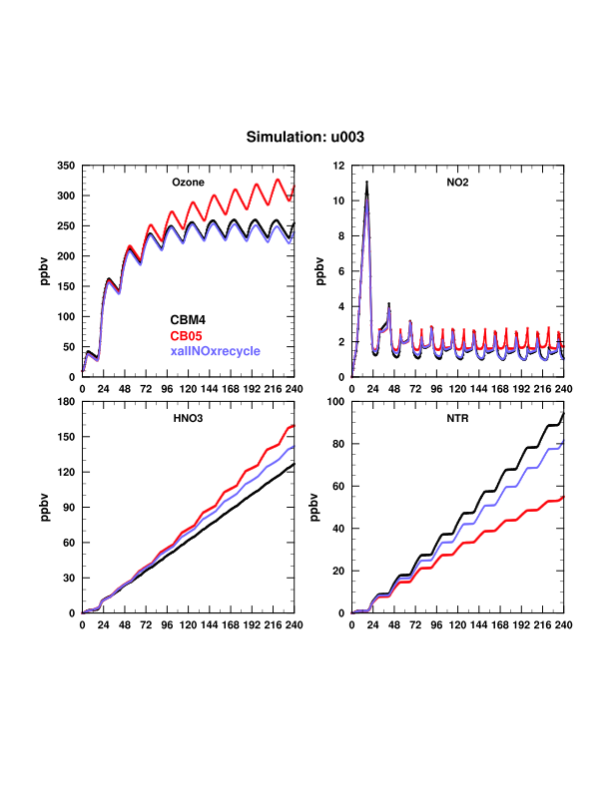

Slide 21
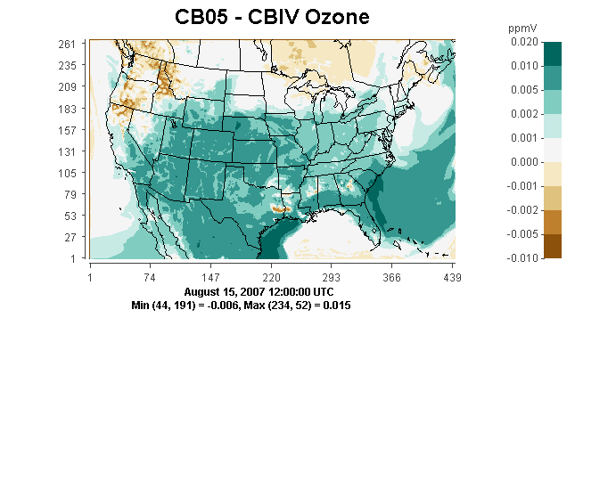
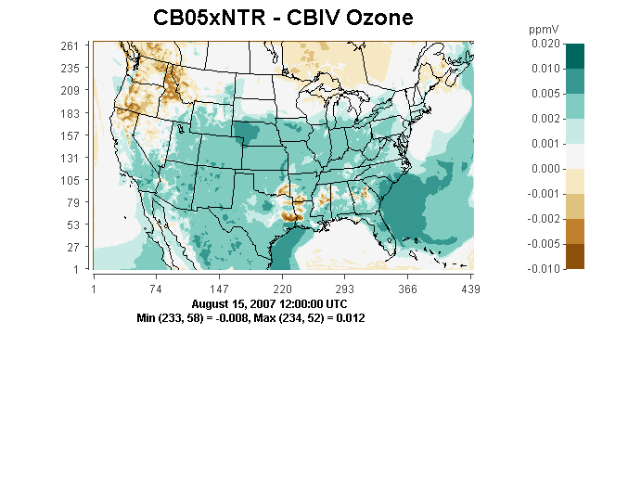
CB05 – CBM4 Ozone
With NTR recycling reactions removed from CB05, differences in O₃ between CB05 and CBM4 are substantially reduced (accounting for 40-50% of ∆O₃).
CB05-xNTR – CBM4 Ozone

Slide 22
Conclusion
Box model sensitivity tests indicate that the primary causes of higher ozone biases from CB05 simulations are the additional NO_{x} recycling pathways that were added to better represent the fate of NO_{x} over multi-day timescales. This has resulted in a larger “effective” NO_{x} level in the model (even with the same NO_{x} emissions), which results in more O₃ production.
Next Steps
Full-model sensitivity tests are underway to confirm the results of the box model simulations (results so far do confirm).
Future work will investigate individual chemical formation pathways of organic nitrates, compare predicted organic nitrate concentrations with available measurements, review all reactive N deposition parameters, and systematically re-evaluate NO_{x} emission sources.

